Slide 1
NJ 50 x 30 Building Electrification (BE) Team Recommendations
Meeting with NJ Any Dept
Any Name, Any Title
Any Date, 2022

Slide 2
NJ 50x30 Building Electrification Team
MISSION
The NJ 50 x 30 Building Electrification (BE) Team will work with all willing partners to establish and implement firm goals and timeframes for BE as part of the statewide strategies to meet the state’s 50% reduction in 2006 GHG emissions by 2030.

Slide 3
NJDEP GWRA Report 80 x 50 https://www.nj.gov/dep/climatechange/docs/nj-gwra-80x50-report-2020.pdf

Slide 4
Clean Electrification to Reduce GHG
In NJ plans are underway to reduce transportation emissions by electrification of vehicles.
Plans are underway to increase clean electricity via wind, solar programs.
We cannot reach 50% reduction by 2030 without building electrification.

Slide 5
Building Electrification (BE) Administrative Recommendations
May 2 and May 11, 2022, Letters to Governor Murphy
From NJ 50 x 30 Building Electrification Team

Slide 6
6 Recommendations for BE
Governor announce goal of 100K residential units electrified by 2025, 800K by 2030.
New and Retrofit/Rehab BE Roadmap, including codes, proper design of incentives, outreach and education, and a technical resource center, by 2022.
Much stronger incentives for BE: esp. electric heat pumps for heating/cooling; building energy efficiency. More aggressive marketing of BE programs.
Adopt building energy codes from International Code Council (ICC) for 2021, 2024, 2027 with No weakening amendments.
Electrify government buildings (state, local, county) and provide funding.
3300 affordable housing units in Murphy budget ($305M) electrified and high-efficiency with heat pump heating/cooling, with rooftop solar where feasible.

Slide 7
Building Electrification (BE) Legislative Recommendations
Sorted according to ACEEE Key Recommendations for State Legislators
American Council for an Energy-Efficient Economy
“Building Electrification: Programs and Best Practices,” Feb 2022 (page ix)
From NJ 50 x 30 Building Electrification Team
Any Date, 2022

Slide 8
ACEEE Key Recommendations for State Legislators
American Council for an Energy-Efficient Economy
Include explicit building electrification targets within larger climate plans, and prioritize access to resources and support for marginalized communities when setting goals
Provide consistent funding streams for building electrification programs, particularly whole-building retrofits for underserved communities
Capture electrification opportunities in new buildings through building codes and standards, such as requiring new buildings to be all-electric or “ready to electrify”
Utilize carbon market revenues to create sustainable funding streams for building electrification programs

Slide 9
Building Electrification Meetings with Key NJ Policy Makers
Meetings held
Rutgers Center for Green Building – Jennifer Senick, Executive Director
NJBPU Division of Clean Energy – Stacy Richardson, Deputy Director
Assemblyman James J. Kennedy (A1440)
NJDCA – Robert Long, Deputy Commissioner, Edward Smith, Director, Div Codes & Standards
Governor’s Office of Climate Action – Jane Cohen, Executive Director
Meetings planned
Senator Andrew Zwicker
Senator Bob Smith
NJBPU Chief Counsel Abe Silverman, Chief Economist Ben Witherell
NEEP (Northeast Energy Efficiency Partnerships) – Andrea Krim, Building Policy Manager

Slide 10
BILL | STATUS | AREA OF LAW | RESPONSIBLE NJ AGENCY
1.AMENDMENT TO A1440 | This Amendment to A1440 has significantly tightened A1440 by removing loopholes. The Amendment removed “Zero Energy Ready” building classification, and created the requirement to be “Zero Energy Building”. This amended bill may benefit from features of a “Zero Energy Roadmap” being developed 2021-2022. “Zero Energy Roadmap” was a BPU contract with Rutgers Center for Green Building, using NEEP (a consultant), and is likely to produce new terms, definitions, and effective dates, within the early Sept 2022 release of the 2022-2025 NJ Uniform Construction Code (UCC). | NJ Administrative Code Uniform Construction Code, Chapter 23 of Title 5 P.L. 1975,c.217 and P.L. 2009, c.106 | To be implemented by NJ Dept of Community Affairs (DCA): Division of Codes and Standards This amendment requires building codes and enforcement of zero energy new construction in Oct 2025 and zero energy rehabs in Oct 2026.

Slide 11
BILL | STATUS | AREA OF LAW | RESPONSIBLE NJ AGENCY
2. Building Electrification Act (new) | Proposed for sponsorship by NJ Senator Zwicker Awaiting informal review with NJ BPU. This proposed bill establishes a “Class III thermal energy program” with methodology similar to the NJ SREC program, and consistent with the competitive retail market established by the ”Energy Discount and Energy Competition Act” | P.L.2018, c.17 (C.48:3-87.8 et al.) Supported by: NJSA 48:3-87.14e P.L. 1991, c.164 (C.52:14-19.1) P.L.1968,C.410 (C.52:14B-1) P.L.2007, c.340 (C.48:3-98.1) (section 13) P.L.1999, c.23 (C.48:3-49 et al.) ”Energy Discount and Energy Competition Act”. (Section 38 is the law which apportions costs of SRECs and other renewable energy certificates) | NJ Board of Public Utilities (BPU) is requested to create a BE Roadmap, establish 2030 targets for building Electrification, and proposes amendments to Public utility laws to reduce use of electricity and natural gas in each territory; a new Class III clean thermal energy program, efficiency portfolio standard, and associated issuance of certificates

Slide 12
Following two slides show end user price of various fuels for space heating/cooling.
Each slide is based upon one specific bill of one JCPL and one PSEG customer.
1. JCPL electric and NJNG gas
2. PSEG electric and PSEG gas
(Following two slides are for background)

Slide 13
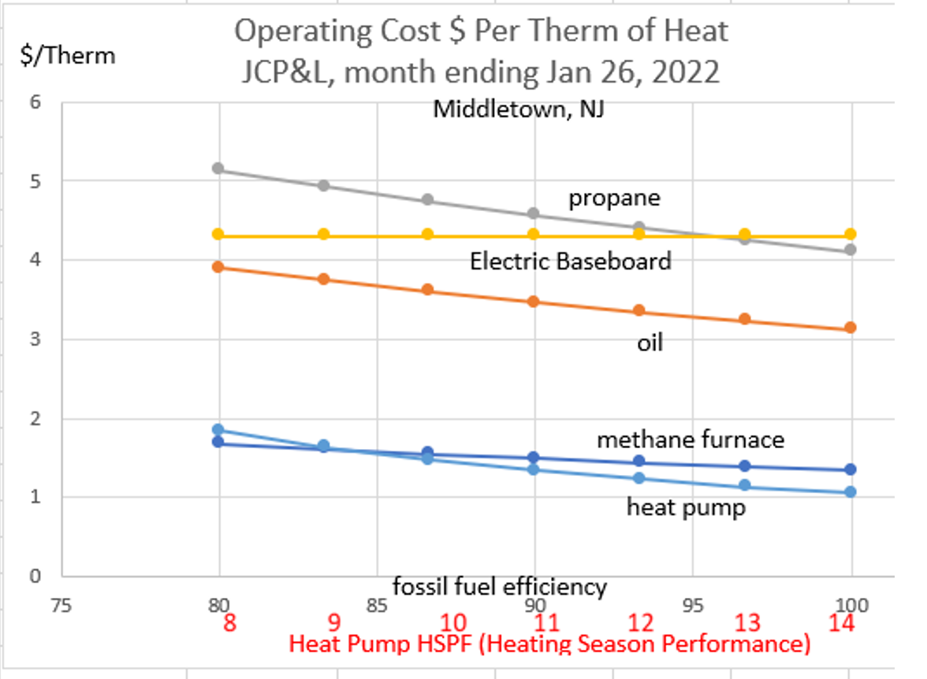

Slide 14
