Slide 1

Pat and Steve Miller
May 18, 2023
ELECTRIFY EVERYTHING WITH INFLATION REDUCTION ACT (IRA)
Source: NASA
Notes:
J:\s\Documents\BE\2022-11-6-Trinity-Episcopal\2022-11-06-Moorestown-Slides.pptx
ID #3 - Can be used in noncommercial online and TV broadcasts of your presentation.
And then on the last of the Apollo missions, this image known as the Blue Marble, became the most reproduced photograph in all of human history. The climate crisis is now the biggest and most serious challenge that humanity has ever faced.
DESCRIPTION: Photo of Earth from Apollo 17, taken as the crew was traveling toward the moon, December 7, 1972
ADDITIONAL TALKING POINTS: This picture is called the “Blue Marble,” taken during the last Apollo mission.
What makes the photograph so unique and powerful is that it captures the complete circle of the earth, helping us see the big picture of our planet – and our lives on it.[1*] It was the first time the Apollo mission made it possible to capture almost the entire southern polar ice cap.[2*]
REFERENCES:
[1*] Ben Cosgrove, “Home, Sweet Home: In Praise of Apollo 17’s ‘Blue Marble’,” Time, April 11, 2014. http://time.com/3879555/blue-marble-apollo-17-photo-of-earth-from-space/
[2*] NASA Visible Earth, “The Blue Marble from Apollo 17," December 7, 1972. http://visibleearth.nasa.gov/view.php?id=55418

Slide 2
NJDEP GWRA Report 80 x 50 https://www.nj.gov/dep/climatechange/docs/nj-gwra-80x50-report-2020.pdf

Slide 3
Top 3 Greenhouse Gas (GHG) Emissions Sources in NJ: 87% of All Emissions
  Electricity generation (19%)
  Transportation (42%)
  Residential and commercial buildings (26%)
RedUCE All 3

Slide 4

COMMUNITY SOLAR
Clean Energy
Lower Energy Costs
No Panels on Your Property
BPU/Sustainable Jersey Community Solar www.sustainablejersey.com/communitysolar

Slide 5
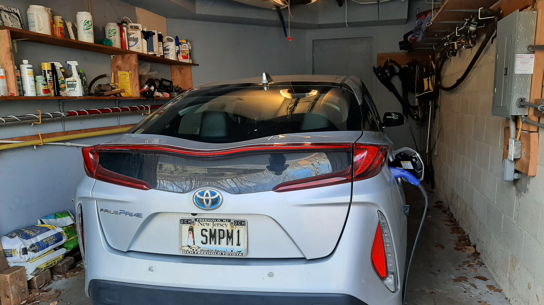
OUR EV – PRIUS PRIME PLUG-IN
Notes:
READ

Slide 6
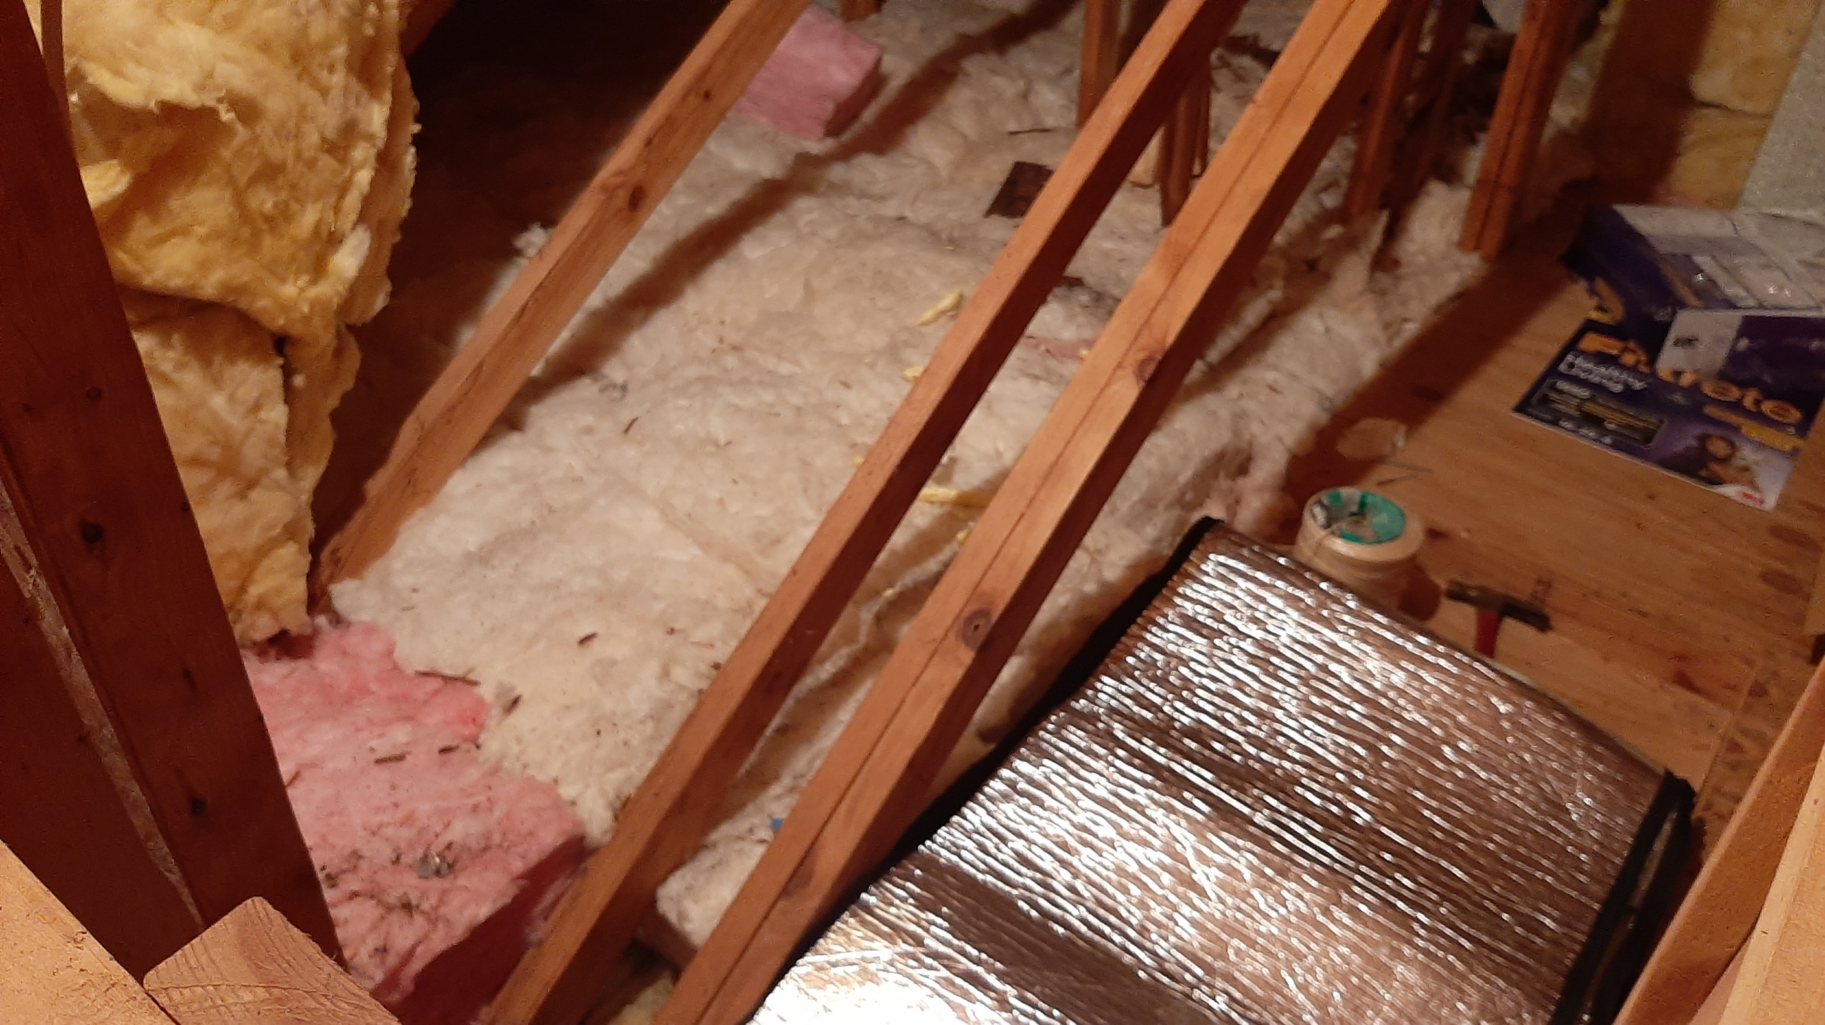
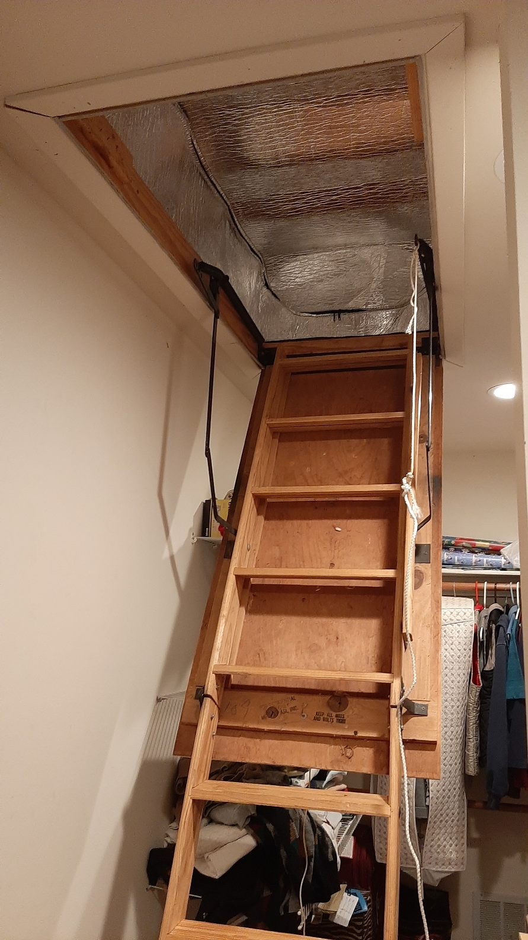
Energy Efficiency – Use Less Energy
Notes:
READ

Slide 7
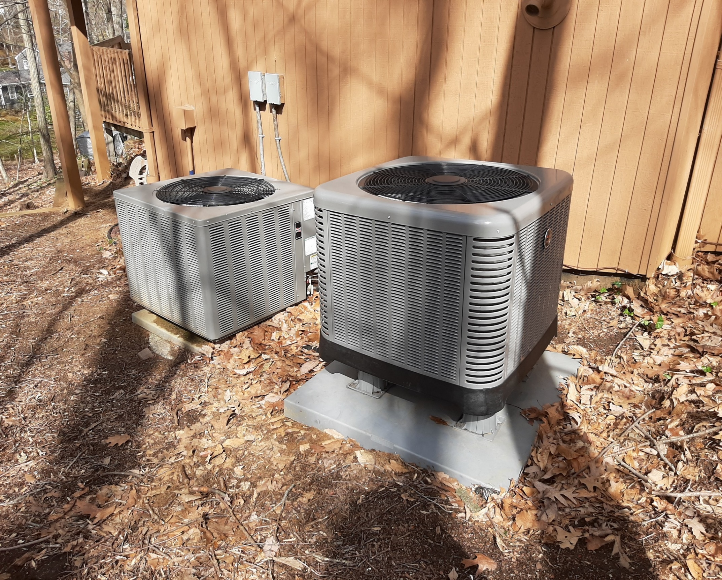
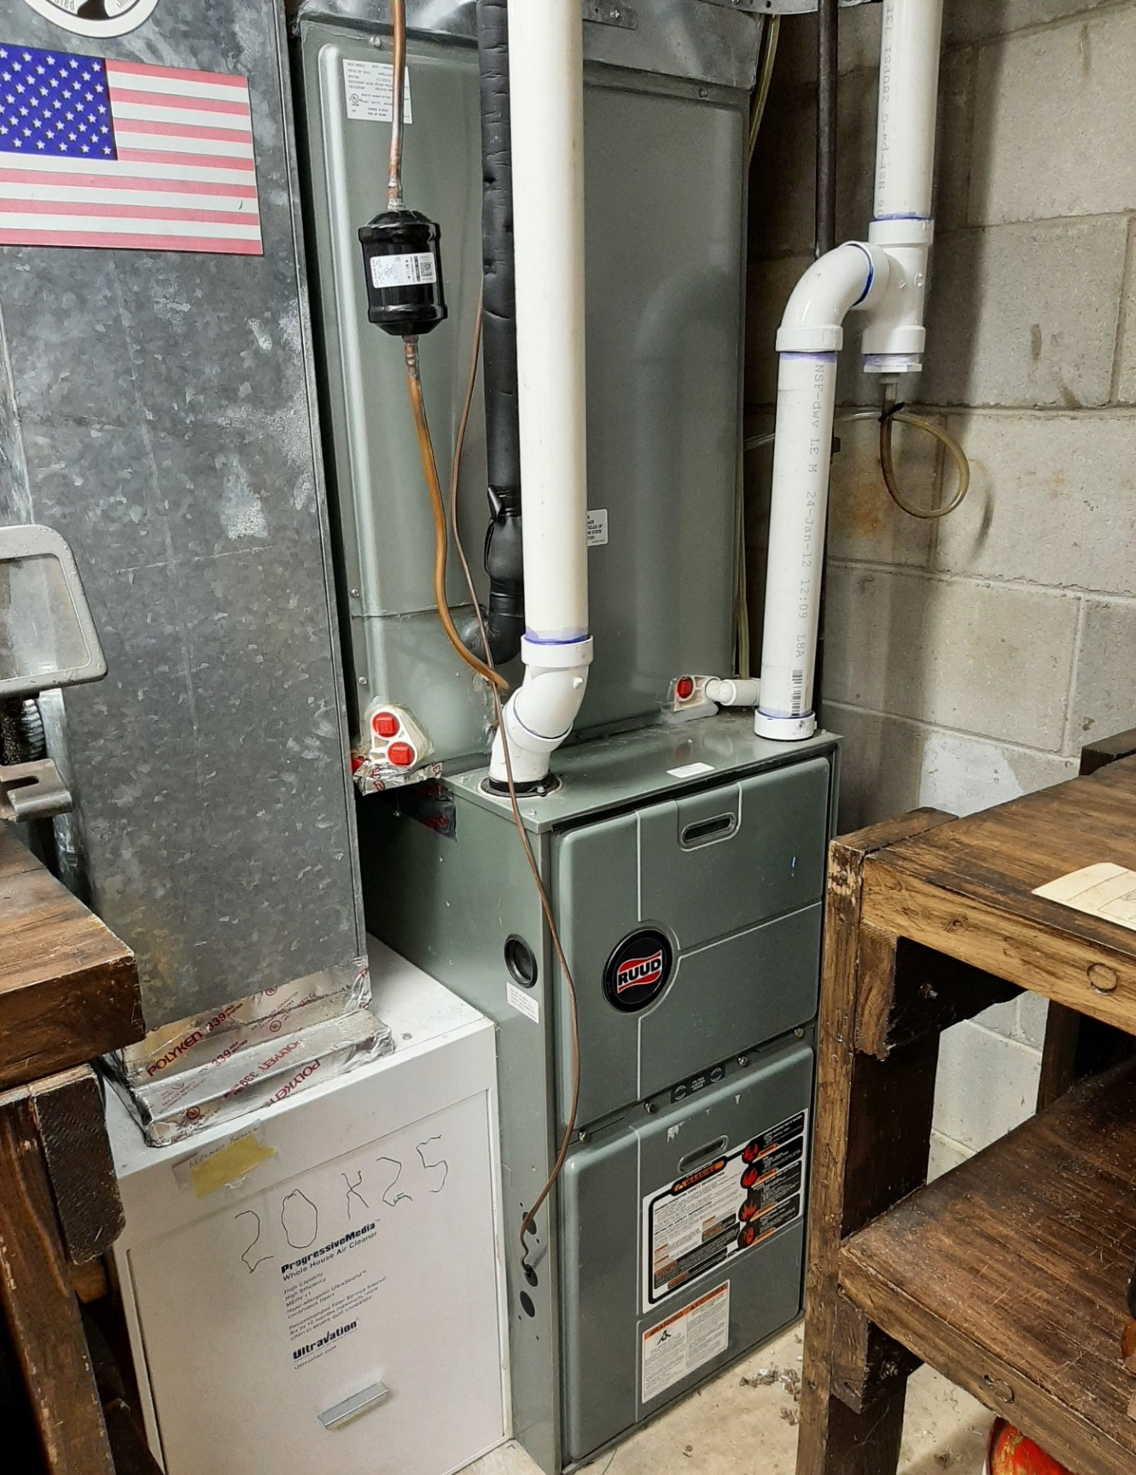
SPACE HEATING & COOLING WITH ELECTRIC HEAT PUMP
Gas Furnace Backup on Right
Notes:
READ

Slide 8
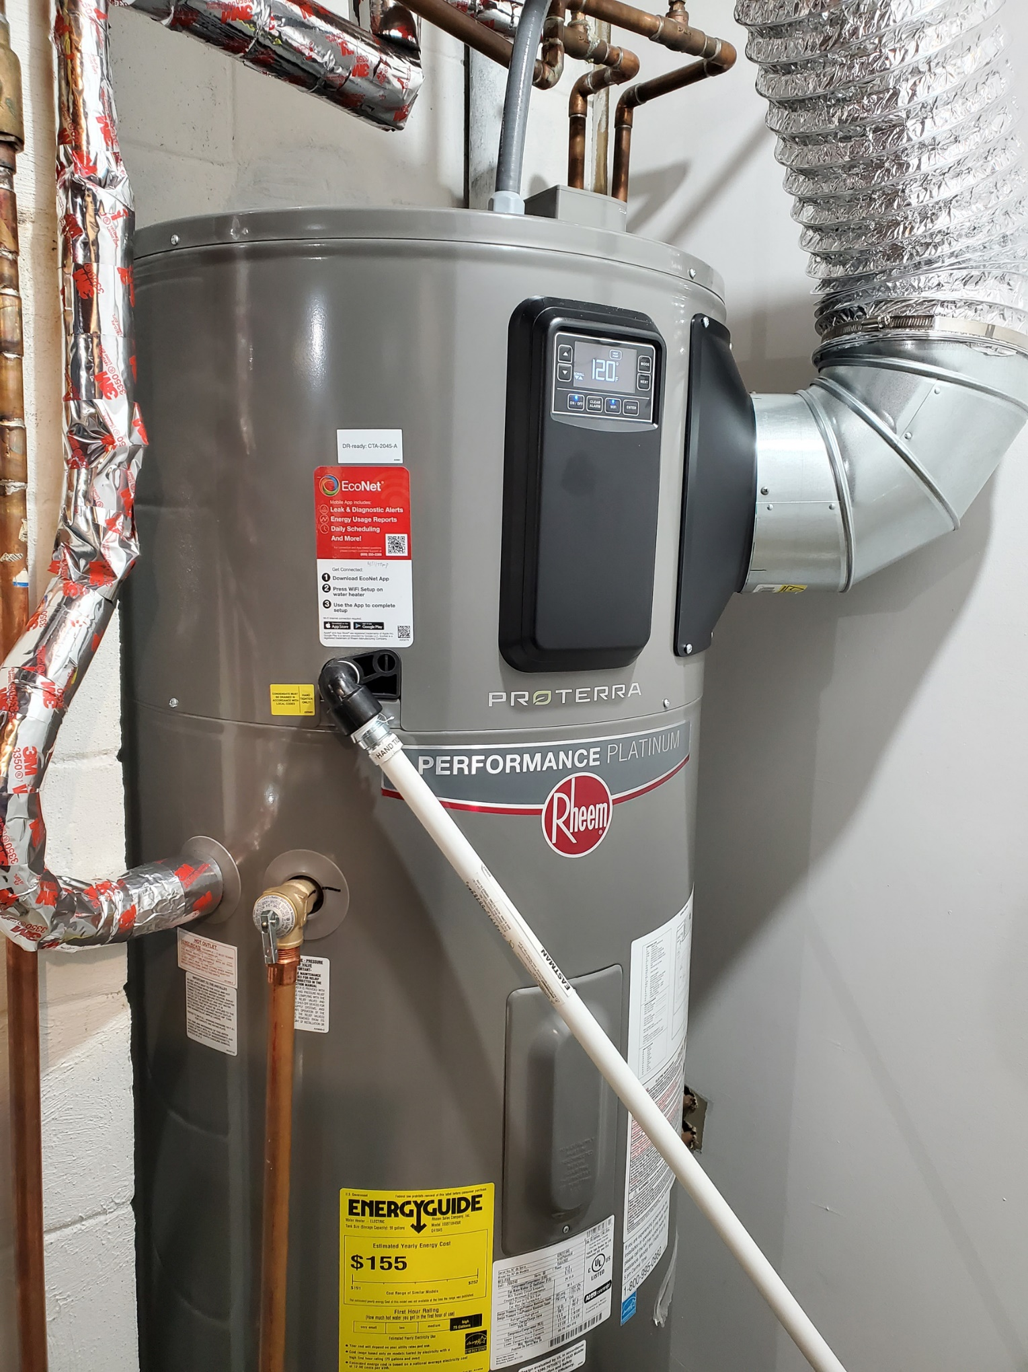
ELECTRIC HEAT PUMP WATER HEATER

Slide 9
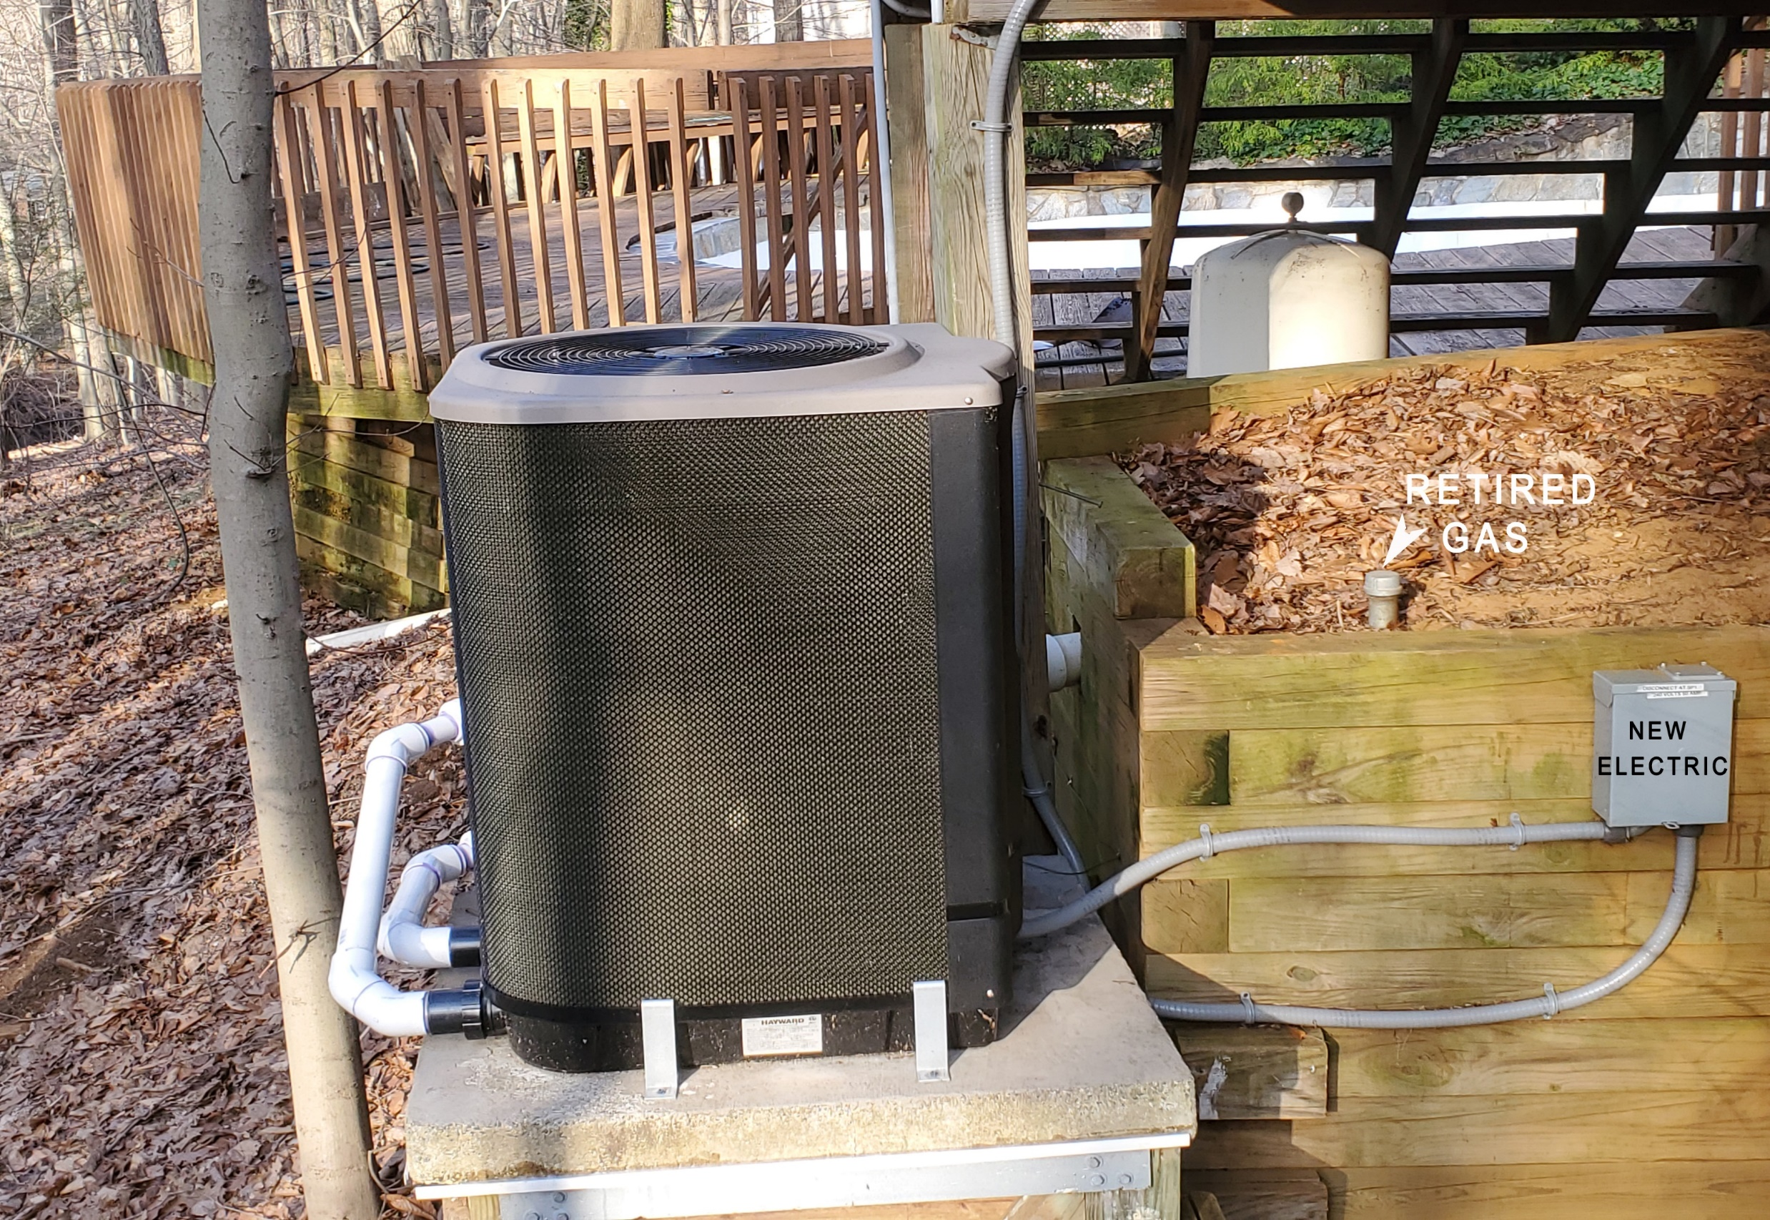
Pool Heater – Electric Heat Pump
Notes:
READ

Slide 10
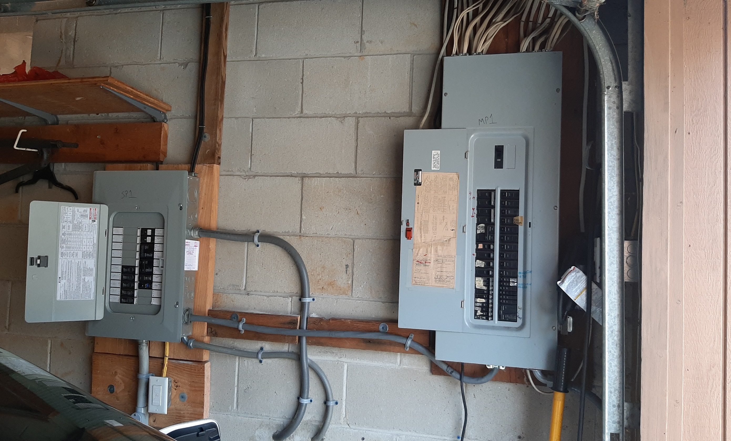
Spare Circuits for Future Electric Appliances
New Box on Left for New/Future
2nd Heat Pump Space Heater/AC
Heat Pump Water Heater
Stove
Dryer
2nd EV
Notes:
READ

Slide 11
Electric Heat Costs Less, Pollutes Less
2022 ENERGY COSTS
 | ACTUAL with heat pump | CALCULATED (no heat pump) | % CHANGE with heat pump | With Heat Pump
TOTAL Gas + Electric* | $2441 | $3153 | (23%) | Savings
GAS Cost | $394 | $1681 | (77%) | Reduction
ELECTRIC Cost | $2047 | $1472 | 39% | Increase
THERMS Gas Burned | 201 | 1163 | (83%) | Savings
TONS CO₂ Emitted** | 1.2 | 6.8 | (83%) | Savings
* Gas and electric costs include ALL uses for Miller household during year 2022 2202
**2023 electricity is 100% clean AND 21% cheaper, supplied by the Community Solar Tinton Falls 2, on a warehouse next to GSP exit 105

Slide 12
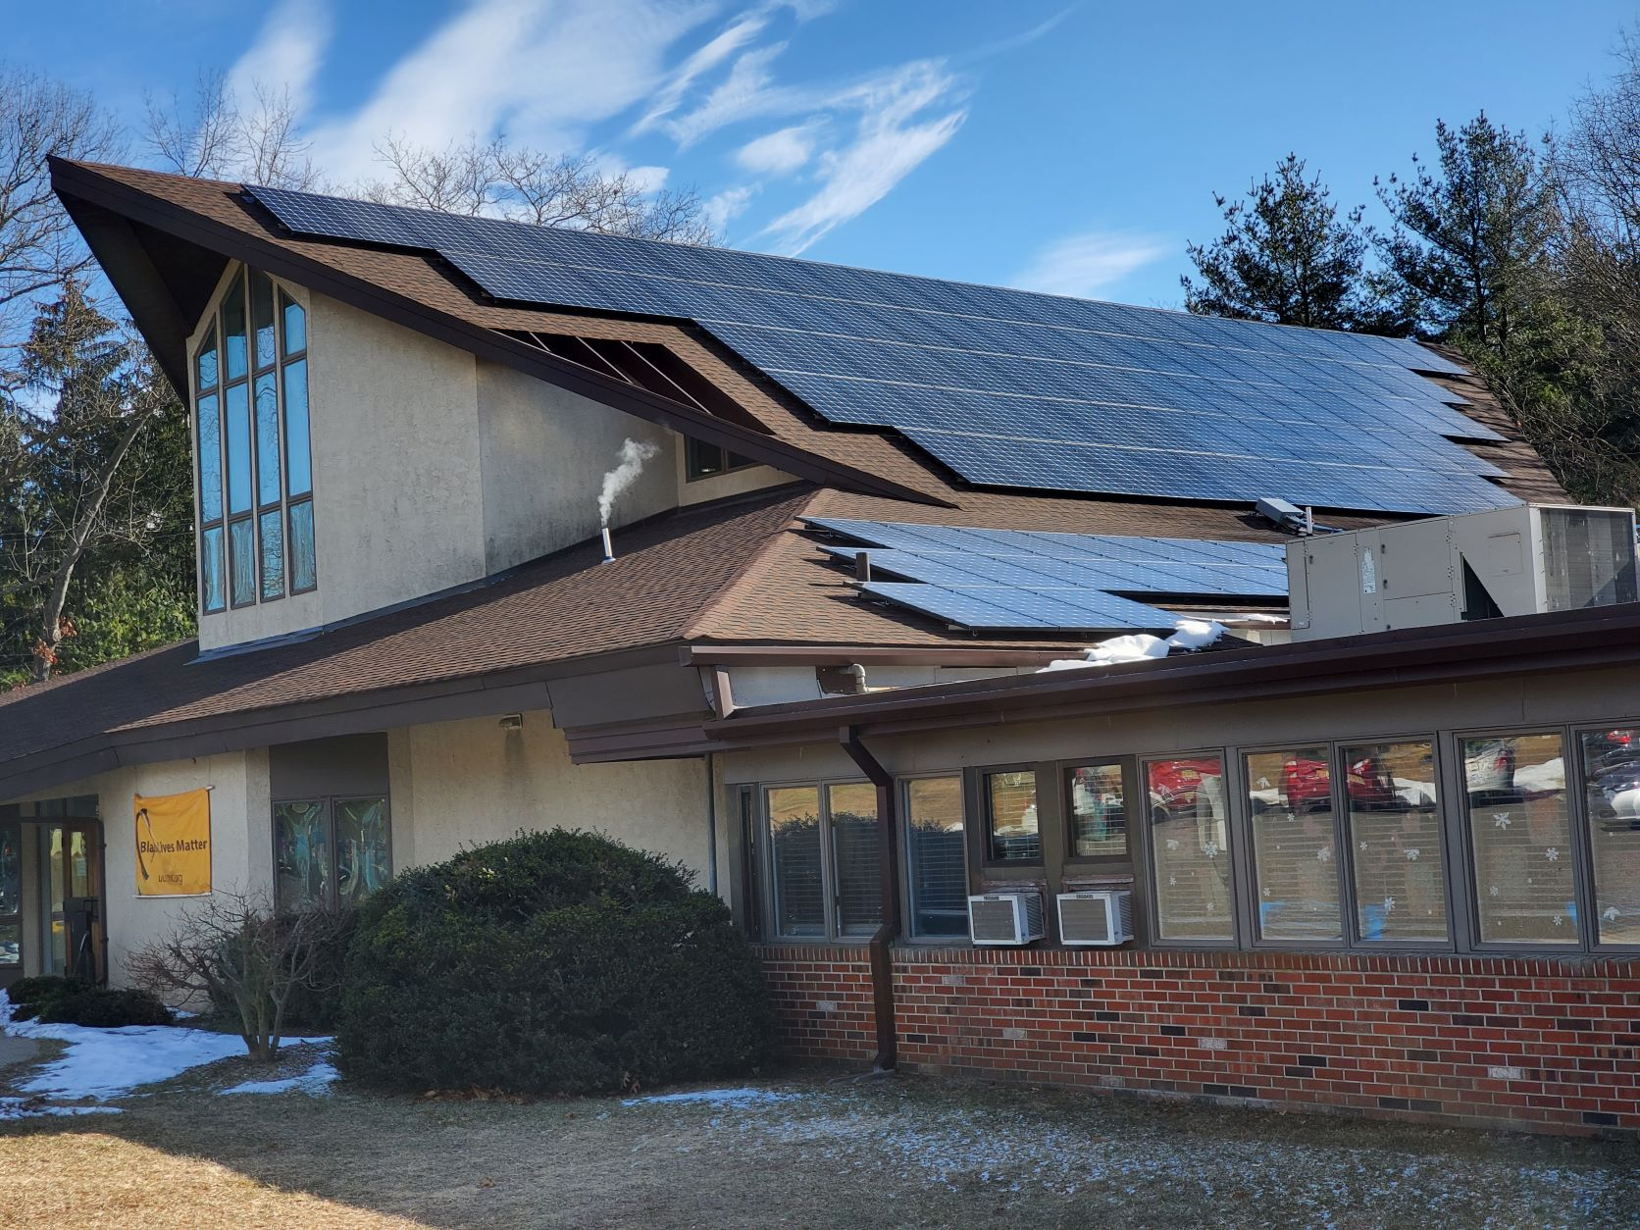

Slide 13
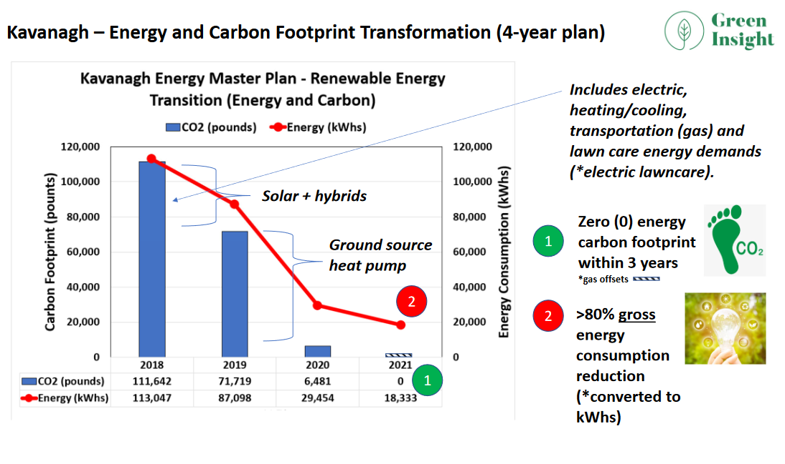
Webinar 12/15/2022

Slide 14
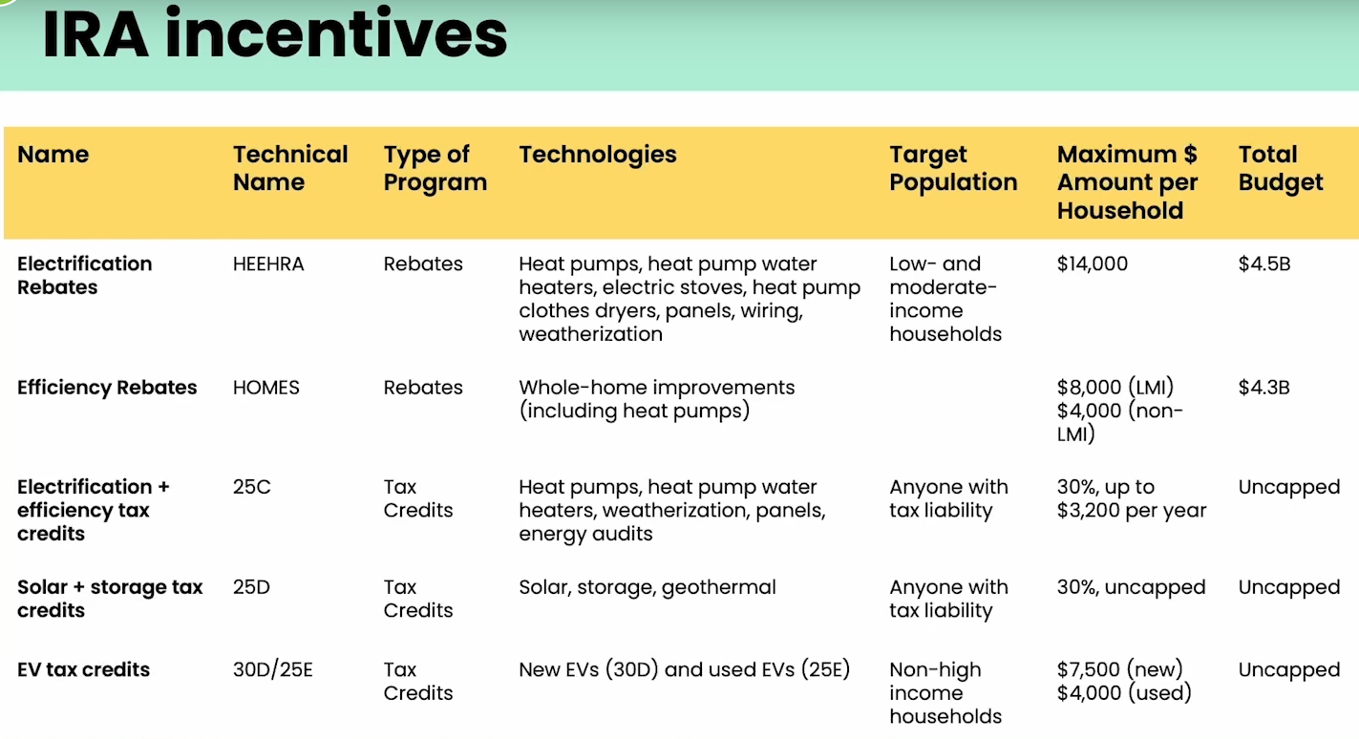
Navigating Individual incentives, by Dr. Leah Stokes
https://www.climaterealityproject.org/electrification-journey
Notes:
We know there are still many, many questions we all have about how the IRA rebates and tax credits will work. Pat showed some of the individual amounts that are available for some building electrification and efficiency measures, Evs and solar. This chart is a different view of the rebates and tax credits, by different programs they fall into. This is from a talk by Dr. Leah Stokes, who is affiliated with Rewiring America. She is showing the different provisions among the programs. For example, the top 2 lines are rebate programs covering electrification and efficiency, respectively. The electrification program, called HEEHRA, includes mostly electric appliances and basic weatherization for space heating. It is available only to low or moderate income, and has a cap for household and an overall budget cap. When the money allocated to each state runs out, it is done with.
The HOMES program is for whole-home efficiency measures. It is available to all, but in different amounts. The bottom 3 lines are tax credits. They each have different limitations such as annual caps by household, but the total budget is uncapped, meaning anyone can use them any year, and they never run out. The program names 25C, 25D,etc are IRS codes. You can google them to find details, but they are already in existence and change in 2023 so make sure you google 2023 details.

Slide 15
HOME PERFORMANCE WITH ENERGY STAR
South Brunswick, NJ | May 11, 2023
Install 50 Gallon Heat Pump Water Heater w. UEF of 3.88 | $5,460
Shell Test & Seal Incl. Applicable Air Seal Top-Plates & Penetrations | $2,960
Attic Hatch Insulated to R-13 | $275
Attic Stair Cover Insulated to R-13 | $475
4” of Dense-Packed Cellulose in Exterior Walls R-13, 564 Sq Ft | $3,412
4” of Dense-Packed Cellulose in Garage Buffered Walls R-13, 267 Sq Ft | $1,775
Audit Refund ($99) | ($99)
Total Project Cost | $14,258
Rebate to Ciel Power, LLC | $5,000
Balance Due Upon Completion of Project | $9,258
* Can be paid with PSE&G 0% On-Bill Repayment
Project qualifies for a $5,000 rebate to contractor through NJ HPwES Program
Notes:
This is an example of a NJ rebate home efficiency program called Home Performance with Energy Star, that will probably be incorporated into the HOMES IRA program. The above work proposal is how it works now on a home belonging to our daughter. This customized solution includes all the above energy efficiency improvements and provides a $5,000 rebate, paid to the contractor, since the calculated energy efficiency improvement is more than 25%

Slide 16
NEXT STEPS TO PLAN YOUR FUTURE
Arrange energy audit with your electric utility
      JCP&L “Quick Home Energy Check-ups” OR follow the JCPL “self-check”
      PSEG “Quick Home Energy checkup” or online “MyEnergy Program”
Start Your Electrification Journey Today
https://www.climaterealityproject.org/electrification-journey
      Watch Dr. Leah Stokes review the IRA, 41 minutes (Excellent!)
      https://youtu.be/j2Fio5kbMvs
      Determine your household benefits from the ira
      https://www.rewiringamerica.org/app/ira-calculator
Lookup your area median income (lookup by address)
https://ami-lookup-tool.fanniemae.com/amilookuptool/
Use existing references to building electrification topics
https://climate.smiller.org/REF/ (find best heat pumps, water heaters, locate HVAC vendors…)
https://climate.smiller.org/50x30/building-electrification/All-heat-pump-webinars.html (approaching 2 years of webinars)
Notes:
I highly recommend the link at the top right, to a video by Dr. Leah Stokes, which is about 40 minutes of REALLY GREAT description of the Inflation Reduction Act. ALSO there is a link the rewiring America IRA CALCULATOR- whicis the best we know of. AND if you want even more references, please look at my site with 300 current references to IRA, and all other BE topics.
https://climate.smiller.org/REF/- add to “CHAT” This has evaluations- the highest rated heat pumps (Daikin; Fujitsu; Mitsubishi); highest rated heat pump water heaters (Rheem, AO Smith), how to locate HVAC dealers for specific highest rated

Slide 17
QUESTIONS?

Slide 18
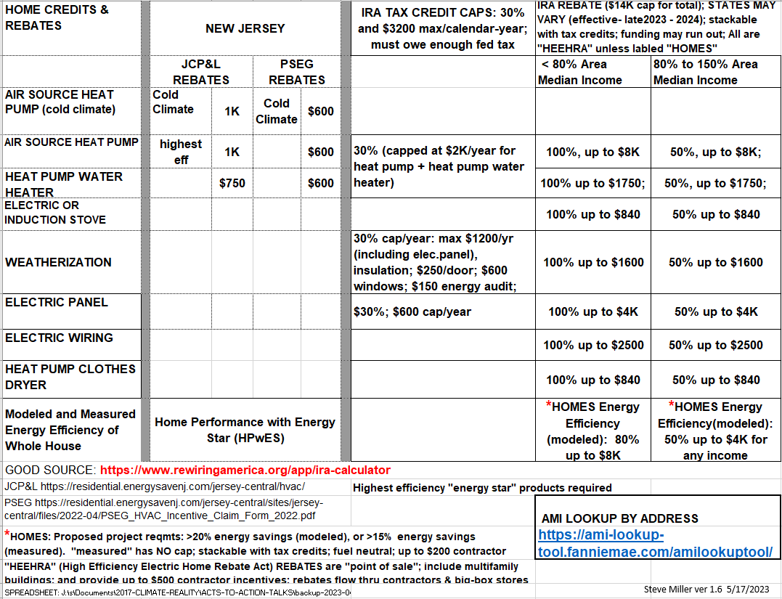
Steve Miller ver 1.5 5/17/2023

Slide 19
Have A Plan For Electrification
Home energy audit is a great starting point
Then weatherize (insulate, seal air leaks)
Have a plan so you’re prepared when your hot water heater or furnace dies
  Which one will you purchase?
  Will your electrical panel support it?

Slide 20

INDEX TO ALL BUILDING ELECTRIFICATION
WEBINARS.
The dates/names in GREEN were featured in the March 27 webinar

Slide 21
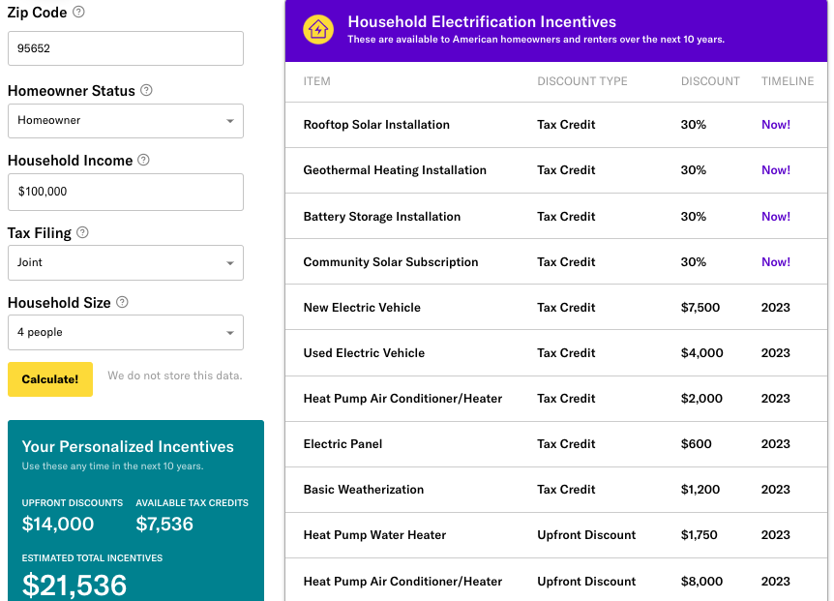
Rewiring America Savings Calculator https://www.rewiringamerica.org/app/ira-calculator
Rebates available up to $14,000 per household, plus tax credits
100% cost coverage for low-income households
  Up to $83,000 per year
50% cost coverage for mid-income households
  $83,000 to $155,000
Notes:
The home electrification and efficiency rebates in the bill include:
heat pumps for heating/air conditioning, water heaters, and clothes dryers
electric stoves;
electric cars;
home weatherization like improved insulation and windows;
rooftop solar and battery storage;
and wiring and breaker box upgrades.
• For low-income: will cover 100% of the costs of these upgrades up to $14,000
- low-income = 80% of median: Monmouth County: $83,000
• For middle-income: will cover 50% of the costs
- $83,000 — $155.000
• See URL above for Rewiring America to calculate your possible rebates and tax credits and when they go into effect

