Slide 1
MIDDLETOWN FOR CLEAN ENERGY
March 28, 2019
Briefing for
Rick Hibell & Patricia Snell
By Pat & Steve Miller
Notes:
TOWNS ACROSS THE COUNTRY ARE ESTABLISHING BOLD COMMITMENTS: move away from dirty fuels and repower their communities with 100% clean, renewable energy to address the threat of climate change.
More that 50 towns have committed, and are taking steps to 100% renewable energy
More than 200 mayors have pledged, typically 100% clean electrical energy by 2035, and
100% clean energy for transportation and heating by 2050.
We want YOU, in this room, to JOIN a team in your town to MAKE YOUR TOWN using 100% clean, renewable energy!!

Slide 2
MAYORS CLIMATE CONFERENCE
Notes:
This 3 minute inspiration video from the SUSTAINABLE JERSEY 2018 Mayors Climate SUMMIT has NJ mayors describing their towns’ efforts.

Slide 3
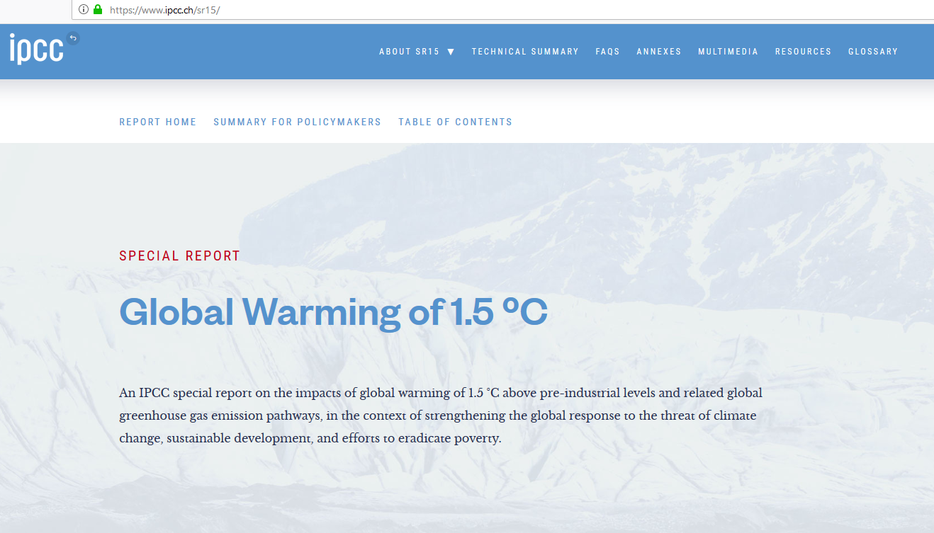
https://www.ipcc.ch/sr15
Source: http://climatecommunication.yale.edu/visualizations-data/ycom-us-2018/?est=discuss&type=value&geo=county:
Notes:
YOUR FRIENDS AND NEIGHBORS ARE THINKING ABOUT CLIMATE CHANGE,
BUT – this shows they talk about it rarely!!!
It is now up to YOU: GET ON BOARD WITH THE DATA, & TALK ABOUT CLIMATE CHANGE!!!

Slide 4
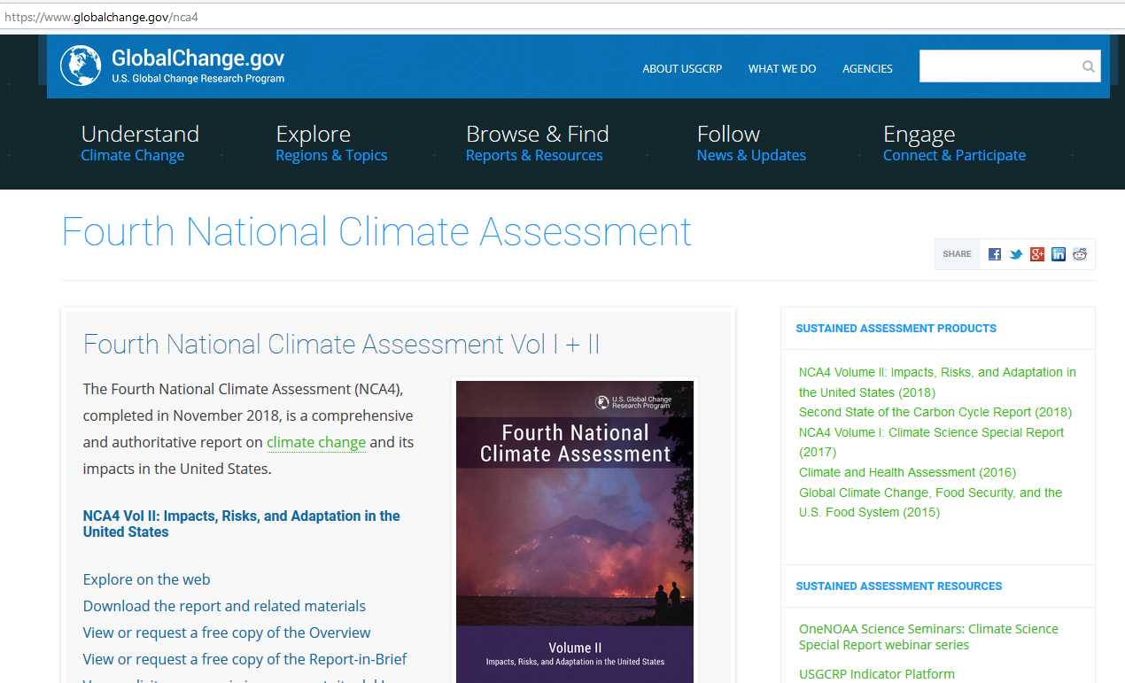
https://www.globalchange.gov/nca4
Source: http://climatecommunication.yale.edu/visualizations-data/ycom-us-2018/?est=discuss&type=value&geo=county:
Notes:
YOUR FRIENDS AND NEIGHBORS ARE THINKING ABOUT CLIMATE CHANGE,
BUT – this shows they talk about it rarely!!!
It is now up to YOU: GET ON BOARD WITH THE DATA, & TALK ABOUT CLIMATE CHANGE!!!

Slide 5
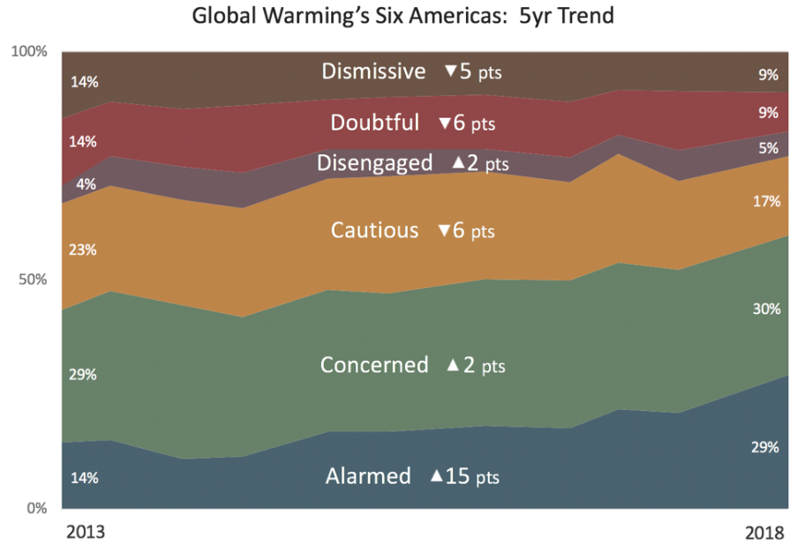
Source: http://climatecommunication.yale.edu/visualizations-data/ycom-us-2018/?est=discuss&type=value&geo=county:
Source: http://climatecommunication.yale.edu/visualizations-data/ycom-us-2018/?est=discuss&type=value&geo=county:
http://climatecommunication.yale.edu/publications/americans-are-increasingly-alarmed-about-global-warming/
Source: Yale Climate Survey – 12/2018
Notes:
Dec, 2018 survey data – a dramatic difference between 2013 and 2018
At the end of 2018, “Alarmed or Concerned” now outnumber “Dismissive or Doubtful” more than 3 to 1
(In 2013 – Alarmed and Dismissive were equal at 14% of US adults)

Slide 6
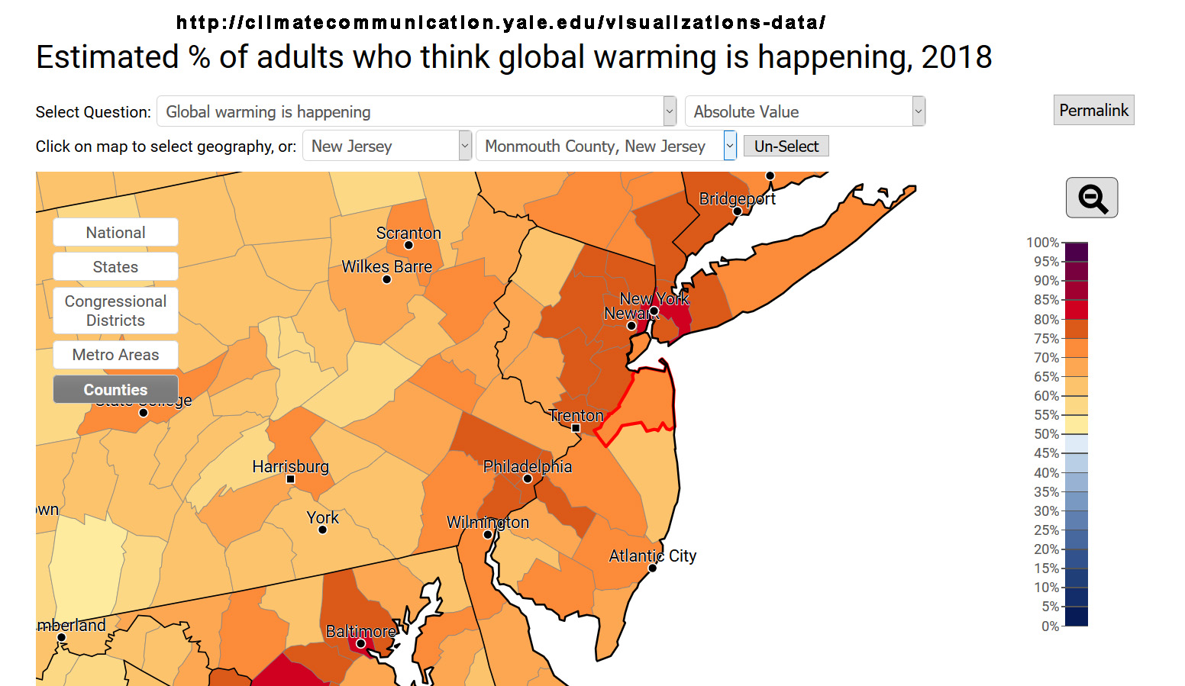
Source: http://climatecommunication.yale.edu/visualizations-data/ycom-us-2018/?est=discuss&type=value&geo=county:
Notes:
YOUR FRIENDS AND NEIGHBORS ARE THINKING ABOUT CLIMATE CHANGE,
BUT – this shows they talk about it rarely!!!
It is now up to YOU: GET ON BOARD WITH THE DATA, & TALK ABOUT CLIMATE CHANGE!!!

Slide 7
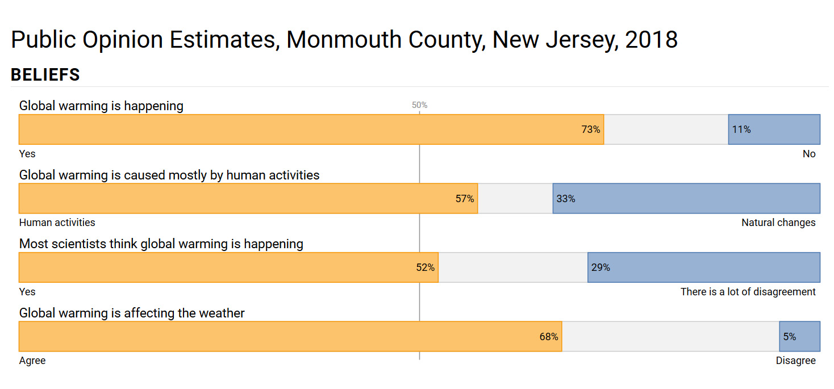
Source: http://climatecommunication.yale.edu/visualizations-data/ycom-us-2018/?est=discuss&type=value&geo=county
Source: http://climatecommunication.yale.edu/visualizations-data/ycom-us-2018/?est=discuss&type=value&geo=county:
Notes:
WHAT YOUR NEIGHBORS AND FRIENDS ARE THINKING-1!!

Slide 8
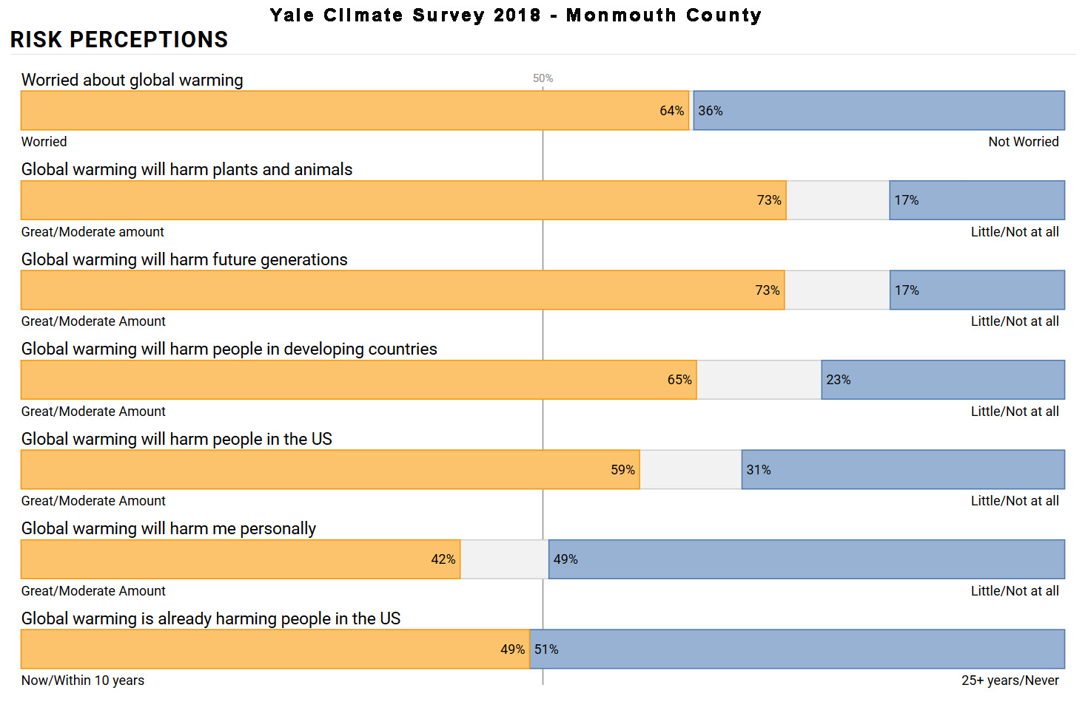
Source: http://climatecommunication.yale.edu/visualizations-data/ycom-us-2018/?est=discuss&type=value&geo=county:
Source: http://climatecommunication.yale.edu/visualizations-data/ycom-us-2018/?est=discuss&type=value&geo=county:
Notes:
YOUR NEIGHBORS AND FRIENDS ARE THINKING-2

Slide 9
Princeton Plasma Physics Lab
Science Saturday
March 2, 2019
Source: ice core records
SOURCE: CLIMATE SCIENCE SPECIAL REPORT (2017)
Harig et all (2015, 2016); WCRP (2018): Rignet et al (2019)
Notes:
Earlier this month, I attended Dr. Kopp’s lecture on sea level rise. He and his team at Rutgers Univ have created a Framework – a bottom up analysis of all the underpinning contributions to sea level rise. NOW USED by many coastal states on both East and WestCoast

Slide 10
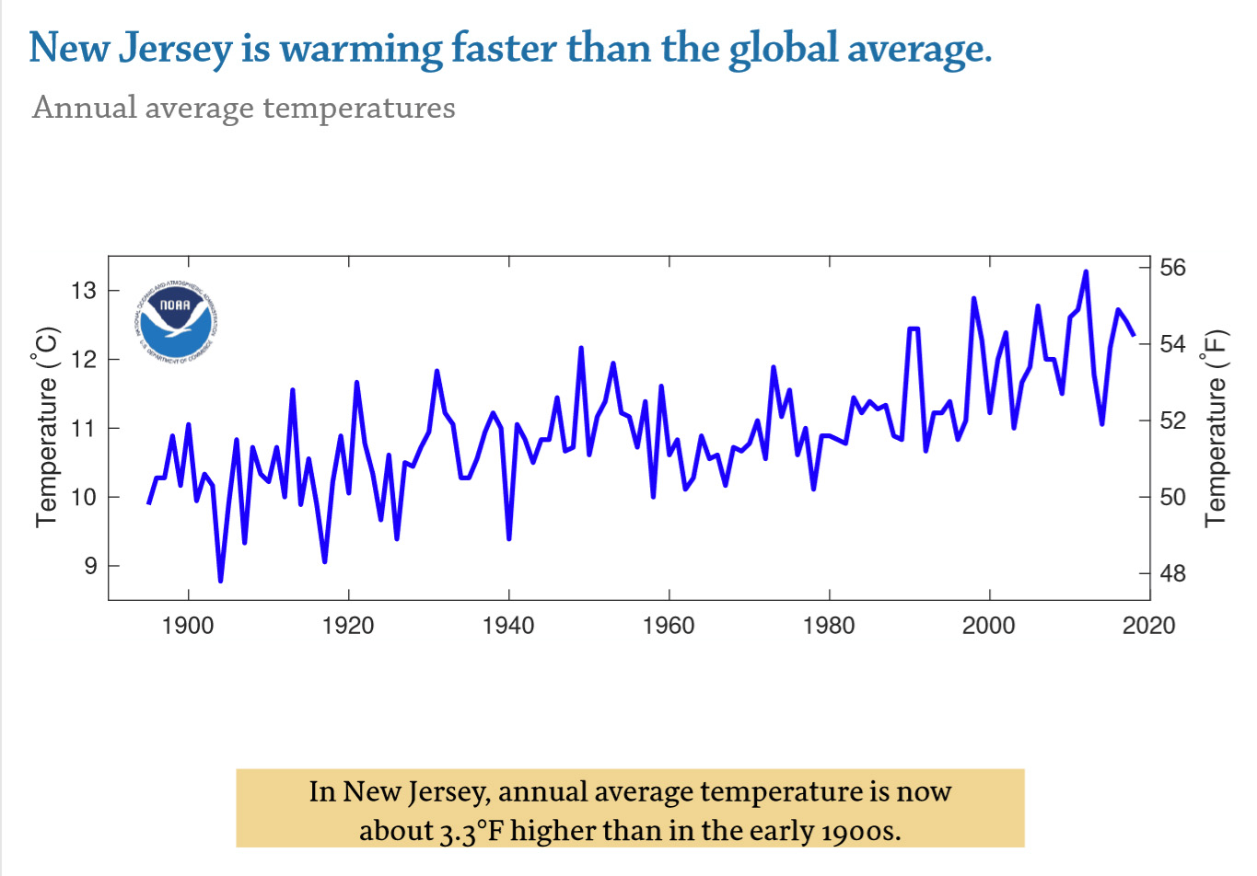
Princeton Plasma Lab
Science Saturday
March 2, 2019
Source: ice core records
SOURCE: CLIMATE SCIENCE SPECIAL REPORT (2017)
Harig et all (2015, 2016); WCRP (2018): Rignet et al (2019)
Notes:
NJ is now 3.3 degrees F higher than 100 years ago. NJ Is rising faster than the global average – One reason: the land temperature rise is MUCH faster than the ocean - HOWEVER, the ocean is absorbing 93% of all of earth’s added heat, warming down thru 1000s of feet depth, and is but is warming, indeed, and the fish are moving northward, much to the chagrin of the NJ fishing fleets.
The further north, (and toward the SOUTH POLE, by the way) the faster the temp rise- the arctic rate of rise is now 3 X faster than average.

Slide 11
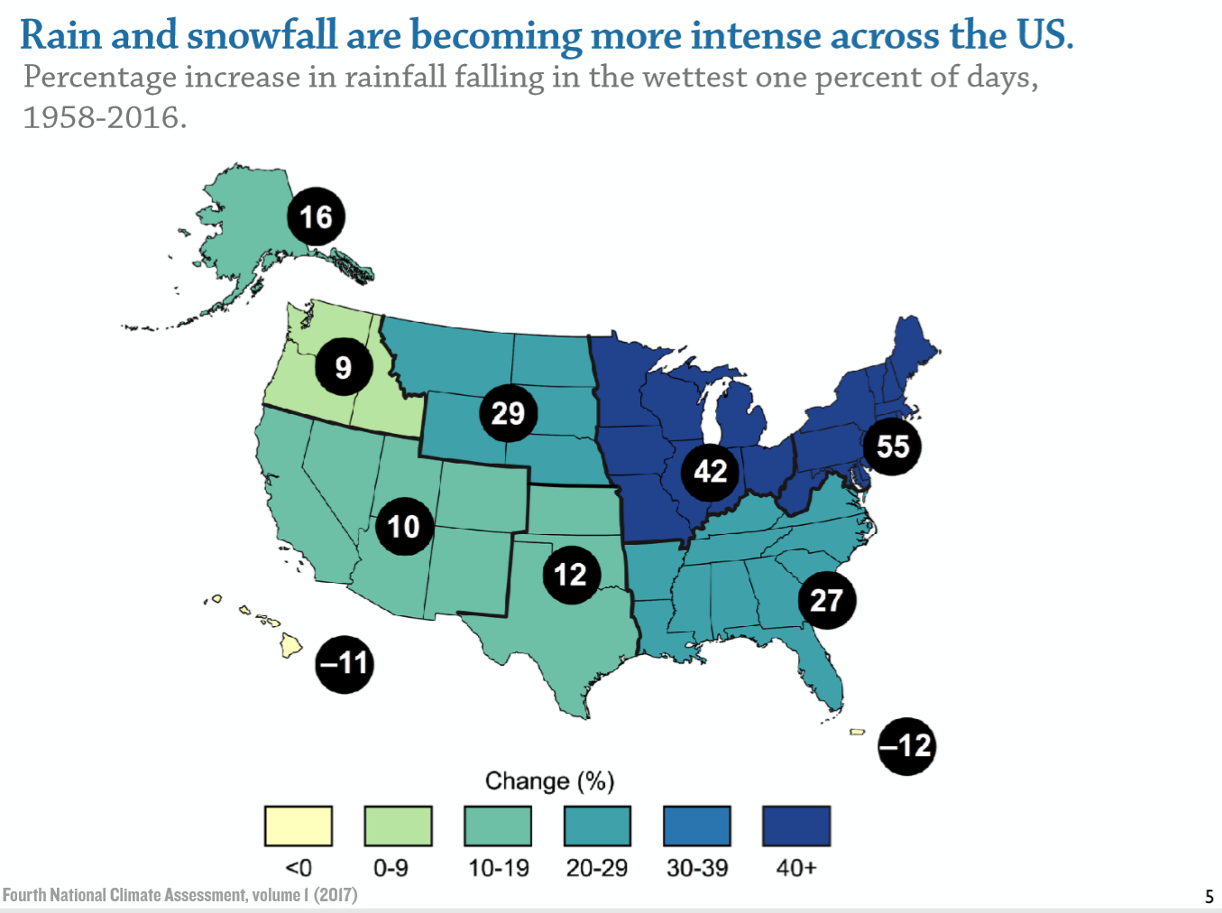
Princeton Plasma Lab
Science Saturday
March 2, 2019
Source: ice core records
SOURCE: CLIMATE SCIENCE SPECIAL REPORT (2017)
Harig et all (2015, 2016); WCRP (2018): Rignet et al (2019)
Notes:
Rain and Snow becoming more intense. Very clear signal 55% increase since mid-20th century

Slide 12
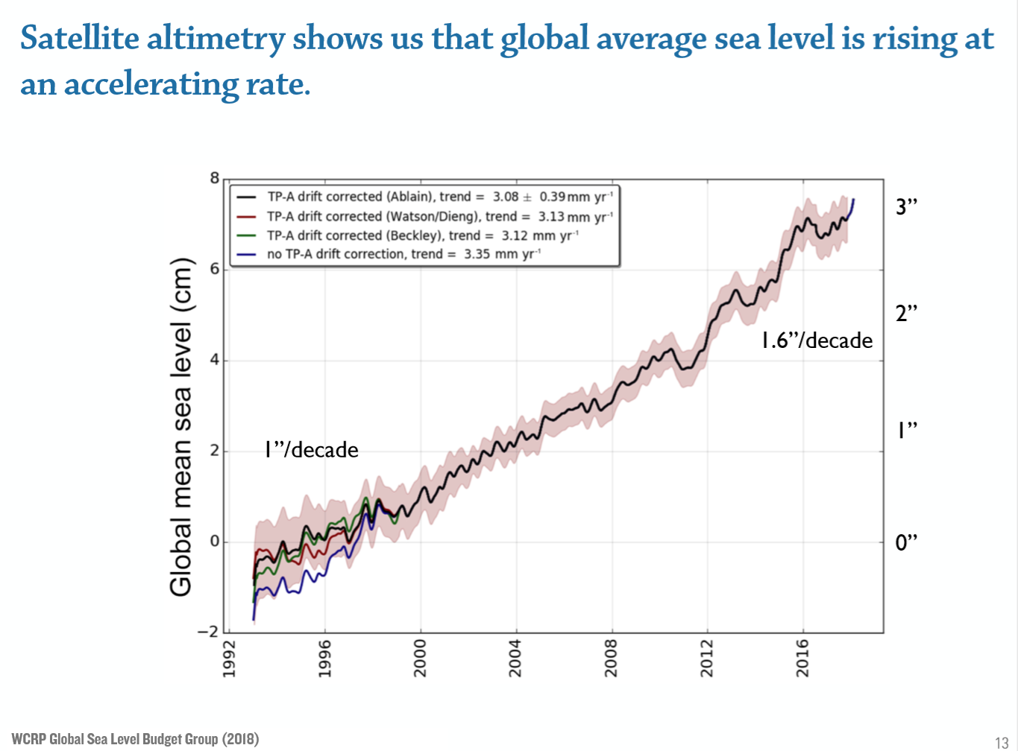
Princeton Plasma Lab
Science Saturday
March 2, 2019
Source: ice core records
SOURCE: CLIMATE SCIENCE SPECIAL REPORT (2017)
Harig et all (2015, 2016); WCRP (2018): Rignet et al (2019)
Notes:
We have accurate sea level measurements via satellite.
Global average sea level is rising at an accelerating rate.
Currently 1.6 inch rise /decade

Slide 13
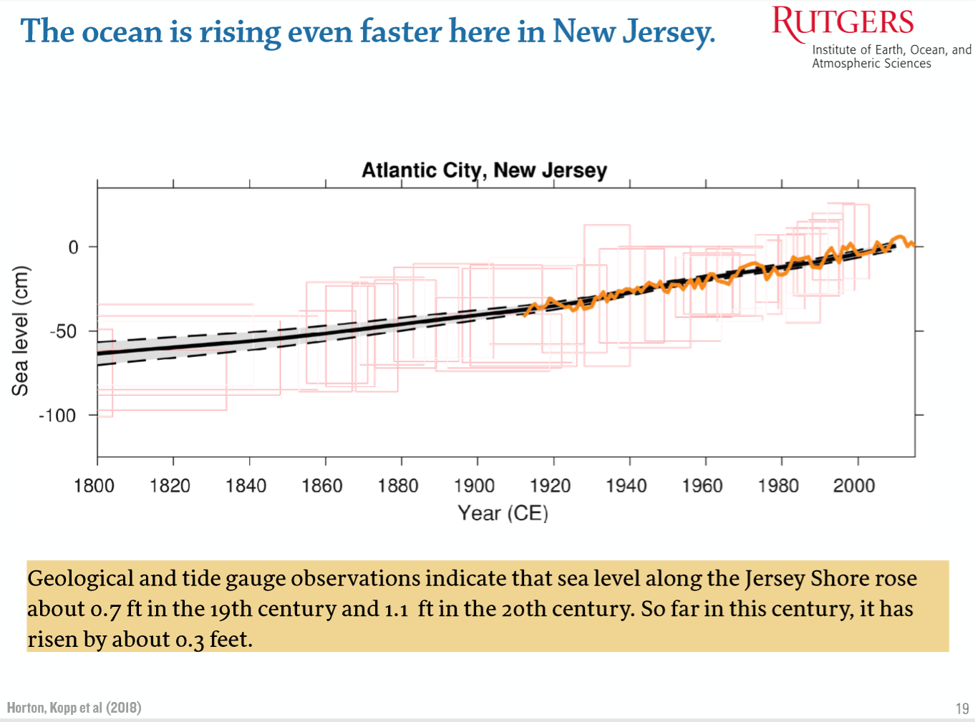
Princeton Plasma Lab
Science Saturday
March 2, 2019
Source: ice core records
SOURCE: CLIMATE SCIENCE SPECIAL REPORT (2017)
Harig et all (2015, 2016); WCRP (2018): Rignet et al (2019)
Notes:
But sea level rise is accelerating even faster on the NJ Shore
0.7 feet in 19th century
1.1 feet n the 20th century
0.3 feet so far this century

Slide 14
Princeton Plasma Lab
Science Saturday
March 2, 2019
Source: ice core records
SOURCE: CLIMATE SCIENCE SPECIAL REPORT (2017)
Harig et all (2015, 2016); WCRP (2018): Rignet et al (2019)

Slide 15
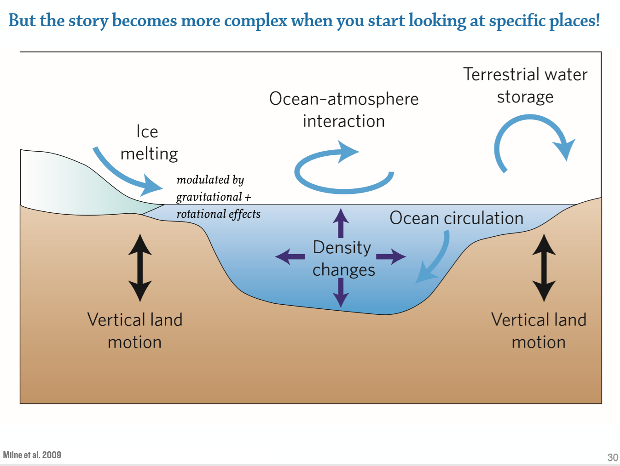
Princeton Plasma Lab
Science Saturday
March 2, 2019
Source: ice core records
SOURCE: CLIMATE SCIENCE SPECIAL REPORT (2017)
Harig et all (2015, 2016); WCRP (2018): Rignet et al (2019)
Notes:
IN ADDITION: vertical land motion –
withdraw water,
ice age effects (NJ was higher during ice ae, now receding)
Ocean currents; wind direction/speed
Gravitation- esp Greenland ice mass

Slide 16
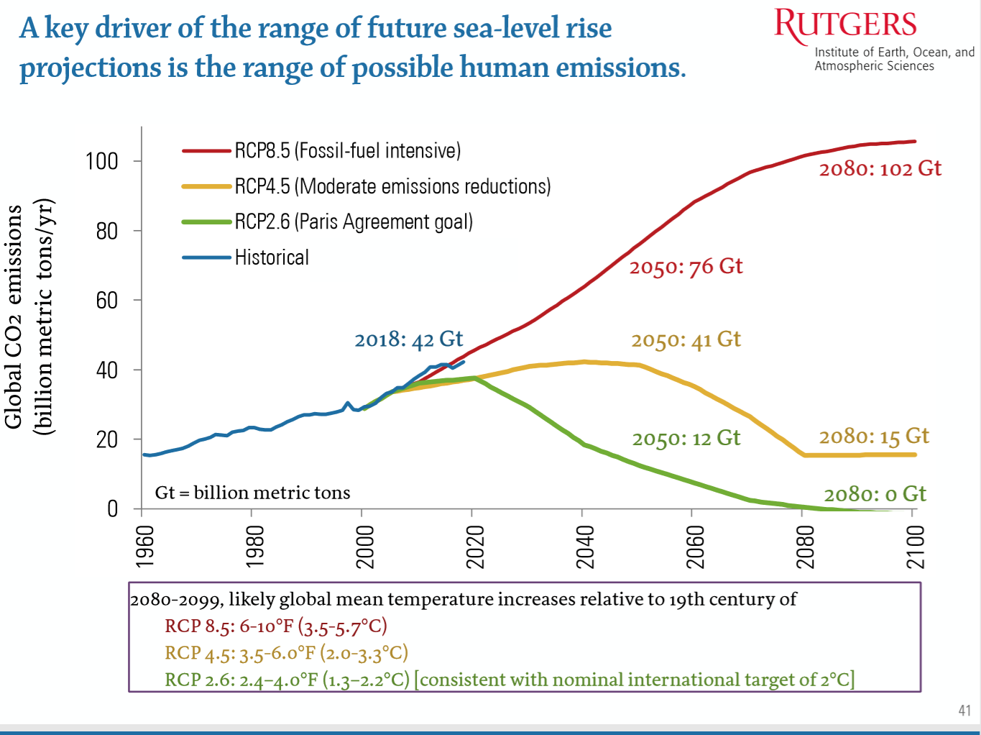
Princeton Plasma Lab
Science Saturday
March 2, 2019
Source: ice core records
SOURCE: CLIMATE SCIENCE SPECIAL REPORT (2017)
Harig et all (2015, 2016); WCRP (2018): Rignet et al (2019)
Notes:
Red curve- high growth in emissions- the curve we are on - doubling by the end of the century – 6 to 10 degrees ruse
Yellow/ - intermediate: 3.5 to 6 degrees rise
Green: low emissions – brought down dramatically- every ton of CO2 is actively removed – sequestered. 2.4 to 4 degrees (the Paris Agreement)
Why regardless: the ocean is very slow to rsespond.
By 2100: likel 2 to 5 feet high emissions; 2 to 3 ft low emisisons (likely menas 2 changes in 3 – 14% chance may be higher

Slide 17
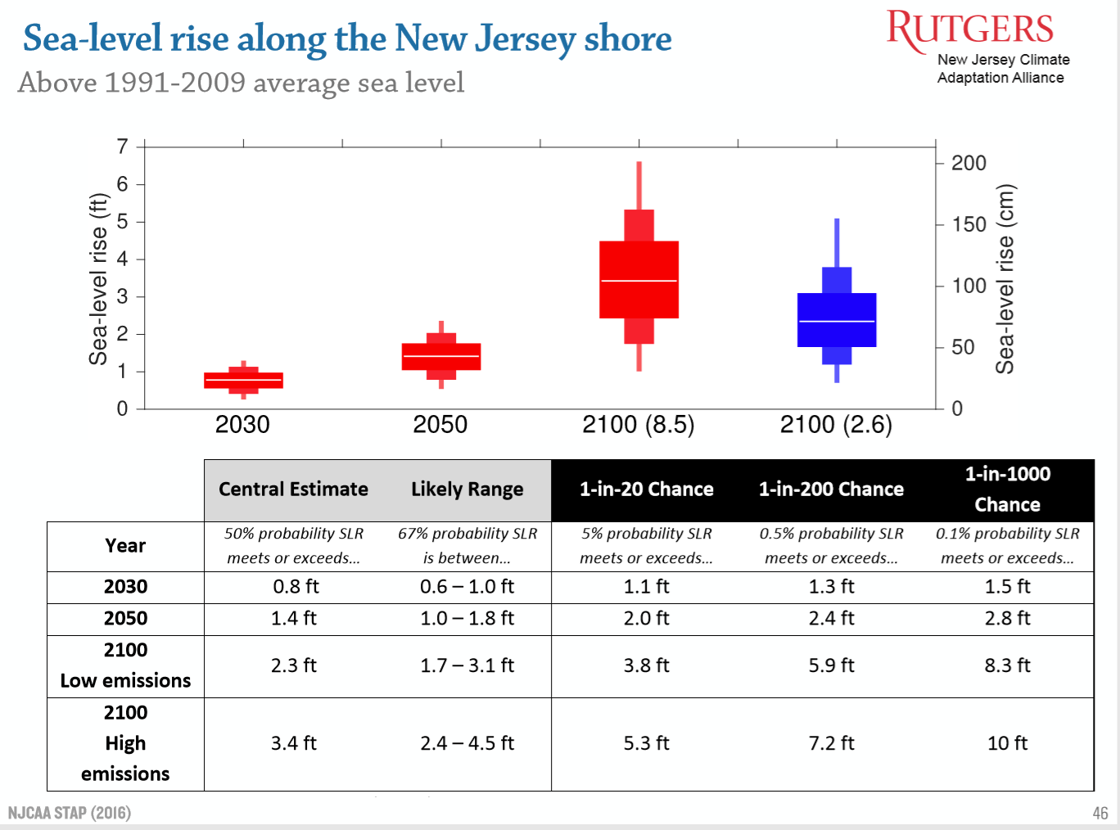
Princeton Plasma Lab
Science Saturday
March 2, 2019
Source: ice core records
SOURCE: CLIMATE SCIENCE SPECIAL REPORT (2017)
Harig et all (2015, 2016); WCRP (2018): Rignet et al (2019)
https://njadapt.rutgers.edu/docman-lister/conference-materials/167-njcaa-stap-final-october-2016/file
Notes:
the sea level is very slow to show differences in the near term.
By 2050, there is still little or no difference between high and low emissions.
BUT BY CENTURY END, SEA LEVEL CHANGE differences are notable between high emissions – the previous skyrocketing red curve, and rapidly reducing emissions- the previous quickly dropping green curve.
However, by 2100: up to 5 feet IN THE RED WHISKER DIAGRAM high emissions;
But only likely up to 3 feet if the world can manage to reduce its emisisons (likely means 2 chances in 3 of being in that “likely range”
Look at 1 in 20 chance (5% chance: have a 5% risk of exceeding 5 feet sea level rise.

Slide 18
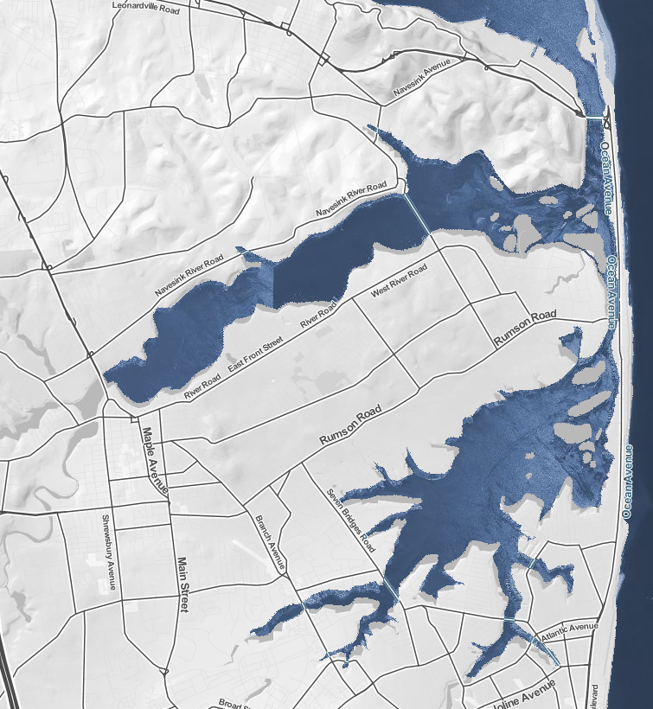
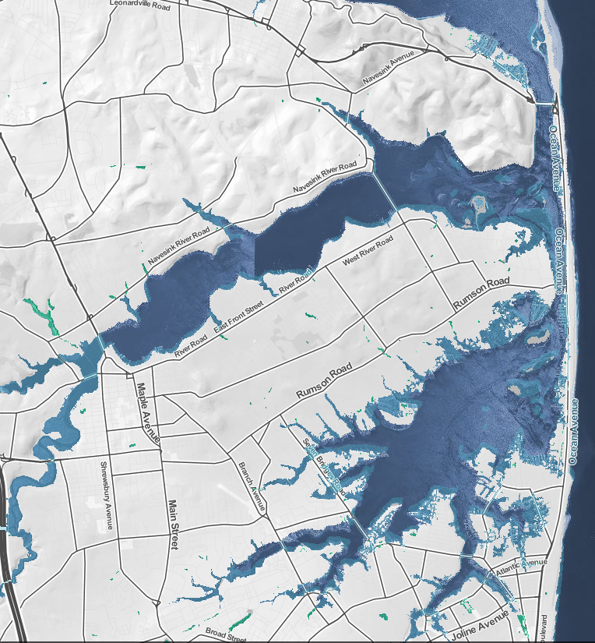
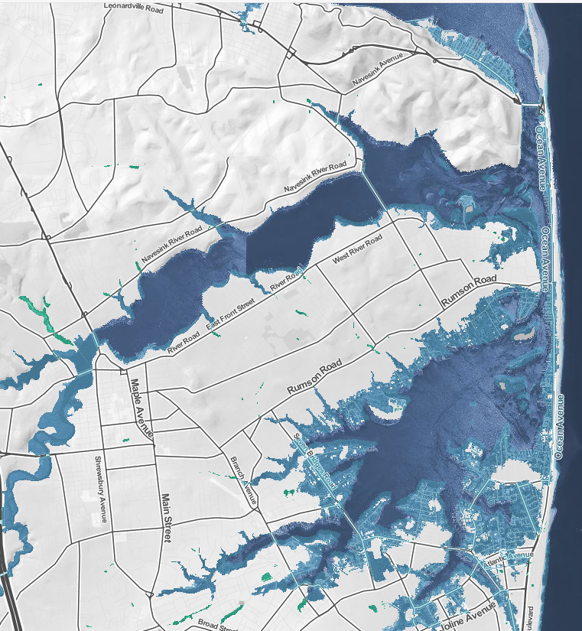
present
3 feet
(likely by 2090s
6 feet
(~5% chance by 2100)
Navesink and Shrewsbury Rivers
(note Highlands at 3 feet rise!)
On 3/27/2019, Army Corp of Engineers suggested raising houses or buy-back
https://ss2.climatecentral.org
Notes:
These photos show the base sea level on that date in the future.
Storms will be on TOP of this, and increasingly severe. SANDY SURGE WAS UP TO 13 FEET!!
(my portrayal was inspired by February’s lecture by, Dr. David Robinson, the OFFICIALLY APPOINTED NJ State Climatologist, Rutgers Univ. Lecture to “Science on Saturday” at Princeton Plasma Lab
https://goo.gl/322EBZ

Slide 19
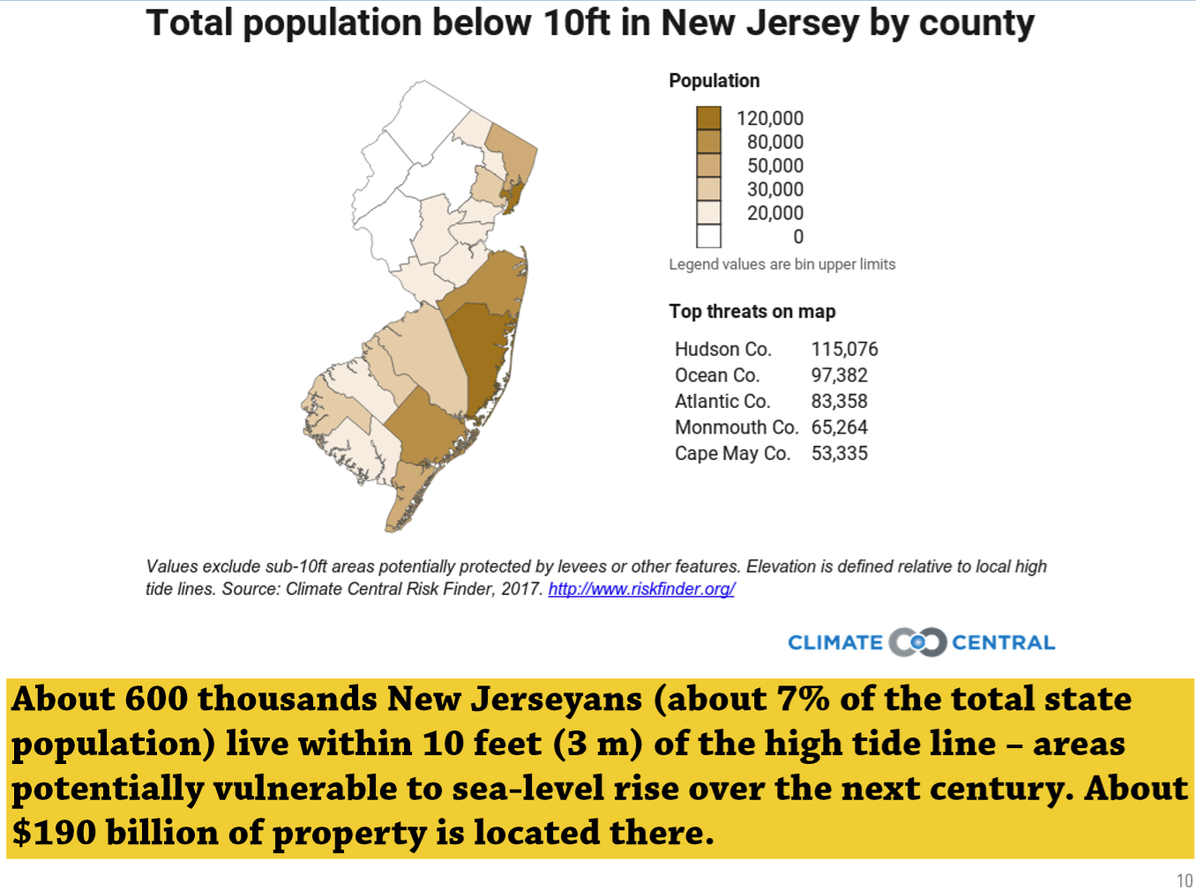
Princeton Plasma Lab
Science Saturday
March 2, 2019
Interactive map with current data https://ss2.climatecentral.org
Source: ice core records
SOURCE: CLIMATE SCIENCE SPECIAL REPORT (2017)
Harig et all (2015, 2016); WCRP (2018): Rignet et al (2019)
Notes:
700K NJ residents reside within 10 feet of high tide

Slide 21
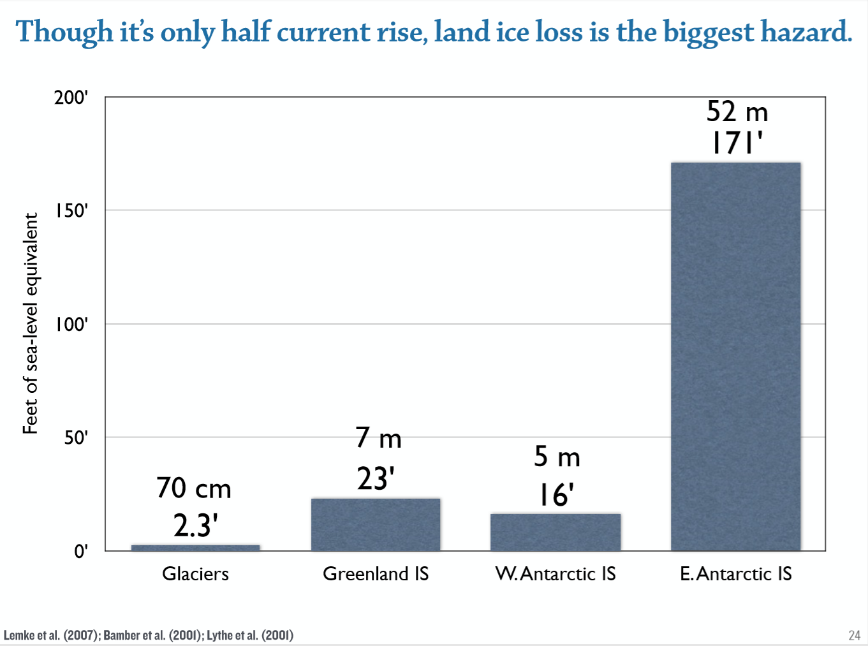
Princeton Plasma Lab
Science Saturday
March 2, 2019
Source: ice core records
SOURCE: CLIMATE SCIENCE SPECIAL REPORT (2017)
Harig et all (2015, 2016); WCRP (2018): Rignet et al (2019)

Slide 22
Princeton Plasma Lab
Science Saturday
March 2, 2019
Source: ice core records
SOURCE: CLIMATE SCIENCE SPECIAL REPORT (2017)
Harig et all (2015, 2016); WCRP (2018): Rignet et al (2019)
Notes:
If we look at an alternative less stable Antarctic.
Doesn’t matter under low emissions
BUT, an alternative, less stable Antarctic, under high emissions, likely 4.4 to 83 feet.

Slide 23
Princeton Plasma Lab
Science Saturday
March 2, 2019
Source: ice core records
SOURCE: CLIMATE SCIENCE SPECIAL REPORT (2017)
Harig et all (2015, 2016); WCRP (2018): Rignet et al (2019)
Notes:
If we look at an alternative less stable Antarctic.
Doesn’t matter under low emissions
BUT, an alternative, less stable Antarctic, under high emissions, likely 4.4 to 8.3 feet.

Slide 24
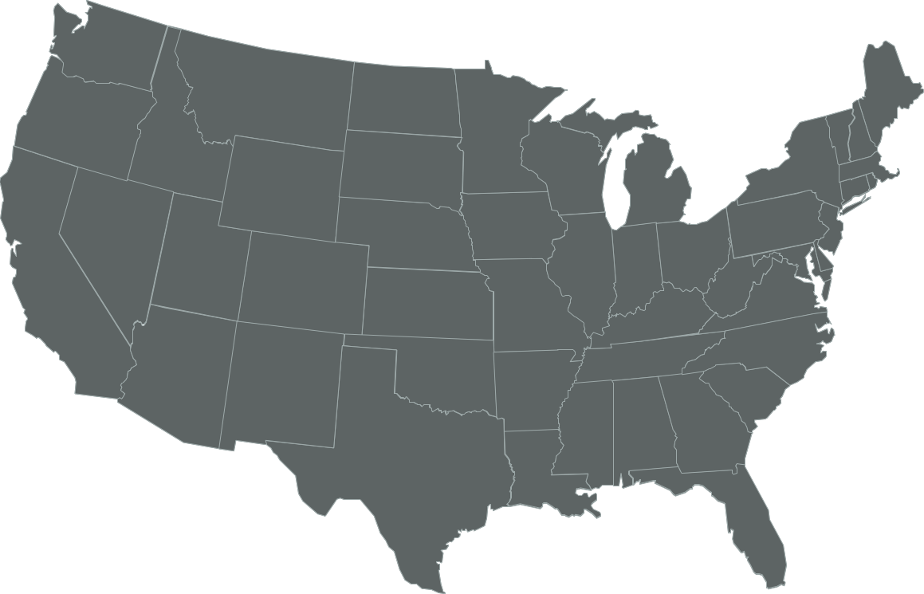
U.S. Commitments to 100% Renewable Electricity
Whatcom County
Edmonds
Spokane
Portland
Multnomah County
Burlington, VT
Milwaukie
Hanover
Plainfield
Cornish
St. Louis Park
Concord
Minneapolis
Eau Claire
Amherst
Cambridge
Eureka
St. Paul
Windsor
Lowell
Northampton
Middleton
Southampton
East Hampton
Nevada City
Truckee
Salt Lake City
Summit County
Madison
E. Bradford
New Brunswick
Breckenridge
Evanston
Cleveland
Downingtown
Haverford
San Fran.
S. Lake Tahoe
Park City
Nederland
Ft. Collins
Kennett Township
Phoenixville
Menlo Park
Berkeley
Aspen, CO
Longmont
Rock Port, MO
Washington, DC
West Chester
Palo Alto
Lafayette
Columbia, MD
Portola Valley
San Jose
Moab
Boulder
Denver
Kansas City
Cincinatti
Monterey
Summit County
Pueblo
St. Louis
San Luis Obispo
Pueblo County
Greensburg, KS
Blacksburg
Floyd County
Goleta
Santa Barbara
Questa
Hillsborough
Orange County
Ventura
Oxnard
Taos Ski Valley
Red River
Ojai
Culver City
Eagle Nest
Wake County
Santa Monica
Rolling Hills
Taos
Angel Fire
Norman
Fayetteville
Buncombe County
Encinitas
La Mesa
Taos County
Solana Beach
San Diego
Clarkston
Columbia
Committed
Del Mar
Chula Vista
Atlanta
Denton
Augusta
Already There
Georgetown, TX
Abita Springs
Gainesville
Dunedin
Orlando
Kodiak Island, AK
St. Petersburg
Sarasota
Largo
Data: The Sierra Club
Notes:
“COMMITMENTS” means “RESOLUTIONS to switch to 100% clean energy, by all of these cities. We have it so easy in NJ.
As allowed by NJ Legislation, we are free to choose 3rd party renewable suppliers of electricity.
Pat and I power our house from 3rd party 100% clean electricity! Save ~10% on the electric supply portation of our electric bill. And we also charge our large battery hybrid car into our house electricity!
AND Middletown can do the same-power m;unicipal buildings, and all residences, and all businesses, if they wish – from increasingly cheaper, renewable wind and solar electricity.
DESCRIPTION: Map of the US showing the cities that have committed to 100% renewable energy or are already there
Sierra Club’s ‘Ready For 100’ campaign Tthis slide was updated in January 2019, over 100 cities had adopted

Slide 25
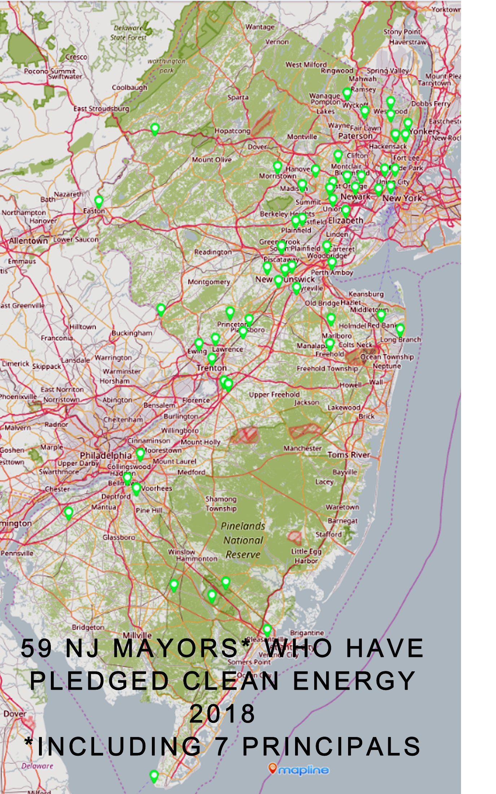
Atlantic | Franklin Township | Marlboro | Secaucus
Bloomingdale Borough | Freehold Borough | Millstone Borough | Shrewsbury Borough
Bordentown Township | Glen Rock | Morristown | South Orange Village
Buena Vista Township | Gloucester Township Hamilton Twp | Newark New Brunswick | Swedesboro
Cape May Point | Highland Park | Oradell Borough | Teaneck
Chatham Borough * | Hoboken | Perth Amoby | Tenafly, NJ
Cherry Hill | Hope | Phillipsburg | Trenton
East Brunswick | Jersey City | Piscataway | Union City
East Orange | Kearny | Plainfield | Verona
Elizabeth | Lambertville | Plainsboro | Wallington Borough
Englewood | Lawrence Township* | Pleasantville | West New York
Ewing Township, NJ | Long Branch | Princeton | Westwood
Fanwood | Livingston North Brunswick | Phillipsburg Red Bank Borough | Woodbridge Township*
Franklin Lakes, NJ | Maplewood | Runnemede Boro Princeton | West Windsor Tnsp
Oradell Borough
Notes:
59 cities in NJ have a mayor or 7 principals (mayor emeritus, President of council, etc) who pledged
in 1 or more of seven 100% clean energy campaigns
in 2017 through 2018

Slide 27
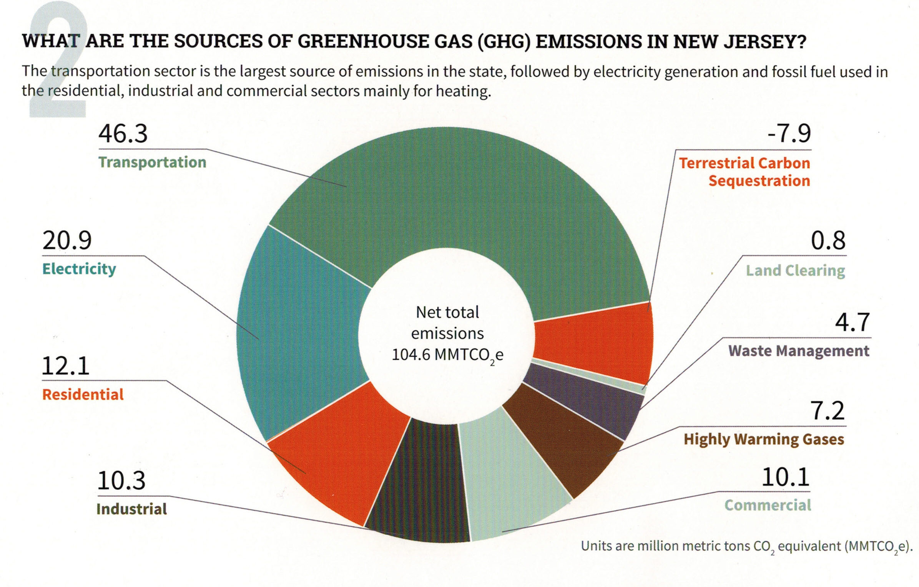
YOUR GHG EMISSIONS
“Reducing NJ Greenhouse Gas Emissions”, Rutgers, Jan, 2018
Notes:
Middletown has yet determined its OWN GHG footprint, then u current NJ emissions.

Slide 29
IMPROVE YOUR TOWN’s MASTER PLAN
ADD A “GREEN BUILDING” ELEMENT
“Green Building and Environmental Sustainability” Element of the Master Plan
is a Green Team “Action” which Provides:
Efficient Use of Natural Resources
Renewable Energy Systems in new and retrofitted buildings
Impact of Buildings on environment
Allow Ecosystems to function naturally
Conserve and Reuse Water
Treat Storm Water On-site
Optimize site orientation and design for the Climate
http://www.sustainablejersey.com/actions-certification/actions/#open/action/484
Notes:
Up at the top of your list, after Mayor’s proclamation, and Committee/Council Resolution, is that Your Town implement the “Green Building and Environmental Sustainability Element”. This is a permitted Master Plan Element, per the “Municipal land Use Law”. It provides vision and goals for towns to implement sustainability concepts including Green House Gas emissions, use of renewable energy, implement Green Building and Design, land-use decisions, smart growth strategies, and water conservation and protection.
Many NJ towns have implemented this Master Plan Element, and can be used as examples. See the Sustainable Jersey link (at bottom of the slide)

