Slide 1
What You Can Do
Steve & Pat Miller
Climate Reality Leaders
Aug 17, 2017
Notes:
ID #1 - Can be used in noncommercial online and TV broadcasts of your presentation.

Slide 2
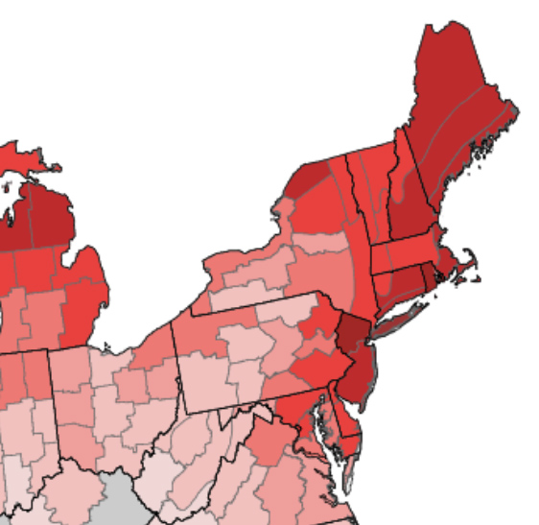
New York Times, Aug 8, 2017
“9 Takeaways From the National Climate Report”
1.2 F Avg US Temp increase; Warming fastest in North Great Plains, Alaska, SWest, NWest, NEast
Rising sea levels (esp in NE and Gulf of Mexico)
Heavier rain; flooding;
Wetter hurricanes – potentially more destructive
“Expect surprises in this unprecedented experiment”
Notes:
Map of temperature rises (NJ is 3.5degrees above last century): EPA, Aug, 2016 EPA 430-F-16-032 https://www.epa.gov/sites/production/files/2016-09/documents/climate-change-nj.pdf
Quotes from National Climate Report (5th draft 6/28/2017)https://www.nytimes.com/interactive/2017/08/07/climate/document-Draft-of-the-Climate-Science-Special-Report.html It is required to be periodically updated & was sent to Trump administration for approval.

Slide 3
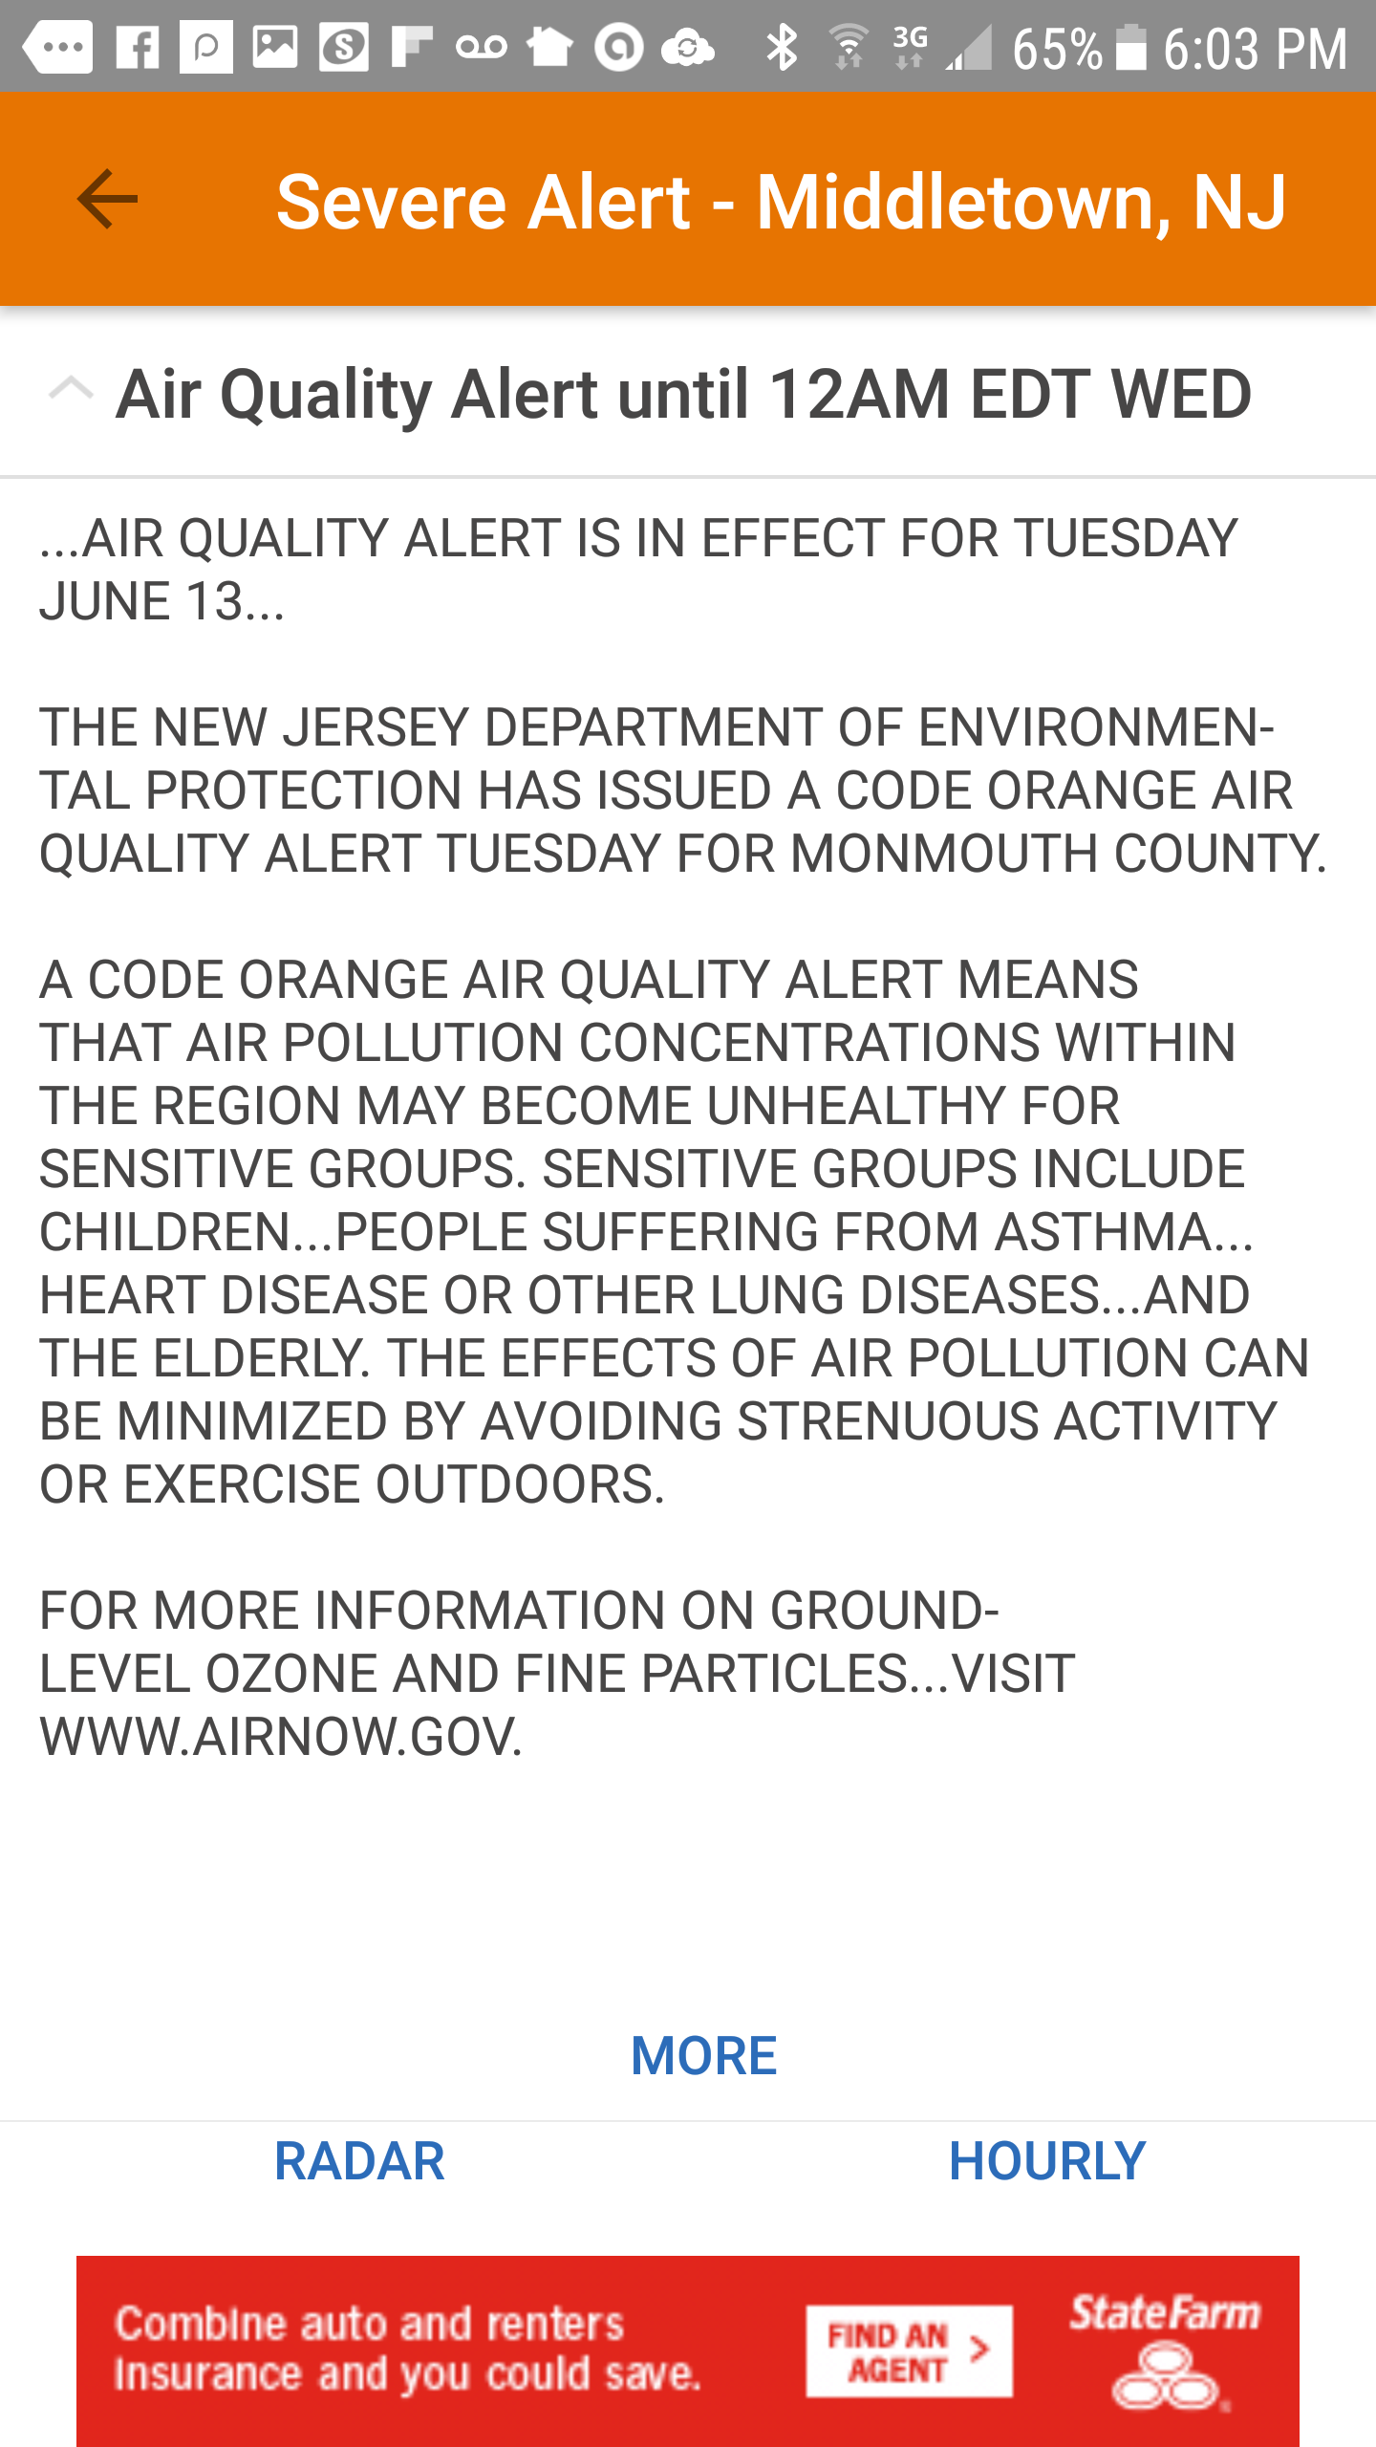
OZONE “SEVERE ALERT” IN MIDDLETOWN
multiple days around 5/17/2017 + 6/12/2017
EPA: “Federal rules, including the Cross-State Air Pollution Rule, the Tier 3 Vehicle Emissions and Fuels Standard, and the Clean Power Plan will significantly reduce ozone-forming pollution in the years ahead”
OZONE ACTION DAYS
EPA: “Unhealthy for Sensitive Groups….
Active children and adults should reduce prolonged or heavy exertion outdoors.”
Notes:
Source 5/16/1017 ”The Weather Channel” Android App.
(Snapshot of Steve Miller’s Android Smartphone)
Source: National Weather Service
EPA website as of 5/16/17
CROSS-STATE AIR POLLUTION RULE: requires 22 states to reduce NOx during May-Sept, to decrease ozone in down-wind states. A recent petition by east coast states (not NJ) to add power plants in 9 additional states was denied earlier in 2017.
The Fuel Standard and Clean Power Plan are also challenged/threatened.
Source: https://www.epa.gov/sites/production/files/2017-06/documents/final_finalcsaprur_keychangesfactsheet.pdf
Source 5/16/2017 + 5/19/2017 ”The Weather Channel” Android App.
(Snapshot of Steve Miller’s Android Smartphone)
Source: National Weather Service
EPA website as of 5/16/17

Slide 4
Air Quality Index Forecast 2017-6-12
ORANGE: unhealthy for sensitive groups
RED: Unhealthy. Everyone may begin to experience health effects
Notes:
Source: US EPA site: https://www.airnow.gov/index.cfm?action=airnow.local_state

Slide 5
CLIMATE SCIENCE BASICS
It’s Warming
It’s Us
We”re Sure
It’s Bad
We Can Fix It
Source: 350.org 6/8/2017

Slide 6
GOALS
1. Move Middletown (largest city in Monmouth County) to reduce emissions under their current Sustainable Jersey program.
2. Extend success to all other towns in Monmouth County via volunteers from MCCC and Sierra Club)
– Top down via Mayor VISION
- Bottom up by offering to motivate the Green Teams and encourage/support each green team create an emission reduction plan.
3. Extend success to all NJ towns: Top down and Bottom up as above
Notes:
Monmouth Community Climate Coalition: representatives of faith-based organizations, all local & regional environmental orgs

Slide 7
THE PATH TO PROGRESS IN ONE CITY
TOP DOWN:
Publicly requested action from Township Committee
Discussions & Brief presentations with Mayor
Letter writing campaign to mayor (& meeting with letter writers)
Asked Mayor for a green vision. Quoted from & gifted “Climate of Hope” (4/2017 book by Michael Bloomberg & Carl Pope) BOTTOM UP:
Provided Green Team with presentation/proposals/discussion
Volunteered to help Green Team as needed
STATUS:
An EDF intern started several energy actions
Movement toward significantly reduced emissions
On hold until Sept 5 Committee review
Notes:
Pat Miller and I are both volunteer leaders in Climate Reality Leadership Corps.
We are trained to give Climate Reality talks to various organizations, large and small.
Our Goal: dramatically reduce Green House gas emissions to “netzero” (forests/land/manmade sequestration of CO2)
We more intensively focused on Middletown, our residence. (the largest town in Middetown- other smaller cities tend to follow the lead)
RESULT: Green Team beginning emission inventory & emission reduction on greatest areas
GOAL: extend to all other Monmouth County towns, and to towns throughout NJ.

Slide 8
OPPORTUNITIES FOR MAYORS TO COMMIT TO CLEAN ENERGY
SIERRA MAYORS FOR CLEAN ENERGY sierraclub.org/ready-for-100/mayors-for-clean-energy
Climatemayors.org
WeAreStillIn.com
FoodandWaterWatch.org
(proposed) Oct, 2017 Mayors Climate Conference (sponsored by League of Conservation Voters). Sustainable Jersey will ask mayors to sign a pledge for Gold Star in Energy

Slide 9
REQUESTED FROM SIERRA CLUB
NJ DISTRICT CONSERVATION COMMITTEE + EXEC COMMITTEE
Provide the Mayoral Clean Energy VISION
Sustainable Jersey provides the “How to Do It”
Identify 1 or more Sierra members within each NJ town:
Encourage mayor & council/committee to further their clean energy vision
Encourage Green Teams to pursue clean energy projects (help round up volunteers, if needed)
RESULTS
Unofficial cooperation between Sierra Club – Sustainable Jersey
I wrote articles, to be published in next 2 editions of “NJ Sierran” – circ 21,000 NJ Sierra Club Members (1000 previously indicated interest)

Slide 10
MUNICIPAL GREEN TEAMS ARE THE FOUNDATION OF SUSTAINABLE JERSEY
444 city green teams (of 565 total towns)
Teams select from ~150 Actions to earn points
~half achieved significant accomplishments: 153 achieved bronze; 45 achieved silver
As of 6/21 Summit, the cities are encouraged to work toward Energy Gold Star in line with Paris Agreement.
The Green Teams descend from Sierra Club’s training Cool Cities Green Teams 10 years ago.
http://www.sustainablejersey.com/
Notes:
Green teams appointed by Council/Committee to implement sustainable town improvements
Green teams look for “low-hanging fruit”
Emission reductions and 100% renewable need higher priority (only 3 adopted “Climate Action Plan”

Slide 11
Want to Adopt Policies in Line with the Paris Climate Agreement?
Sustainable Jersey Municipalities Can Lead on Climate Action Now
And We Have a Road Map
New Jersey municipalities are on the cutting edge of making real-world decisions that are required to achieve the climate goals at a local level. To take meaningful action, your municipality can work on the Sustainable Jersey Gold Star in Energy and/or to do specific actions…. These actions guide your municipality on the steps you should take to reduce emissions. Sustainable Jersey towns and cities are setting the pace and scale of action that is needed to put the world on a climate safe pathway. LEARN MORE AT THE 6/21/2017 SUSTAINABLE JERSEY SUMMIT
Weekly email blast, 6/7/2017
Notes:
Big drive on “energy Gold Star” –select from 6 actions (2 critical would gain the star)

Slide 12
GREENHOUSE GAS EMISSION SAVINGS
Sustainable Jersey data, Gold Star in Energy Webinar data
COMMUNITY WIDE ACTIONS | % GHG SAVINGS
ELECTRICAL AGGREGATION | 5- 15%
SOLAR INITIATIVES | 2 – 4 %
VEHICLES | 10 – 18 %
BUILDING ENERGY | 3 – 4 %
TOTAL | 20 – 41 %
MUNICIPAL ACTIONS | % GHG SAVINGS
ON-SITE SOLAR | 1 – 35 %
GREENING THE MUNICIPAL FLEET | 15 – 18%
BUILDING & STREET LIGHT EFFICIENCY | 12 – 19 %
TOTAL | 28 – 72 %

Slide 13
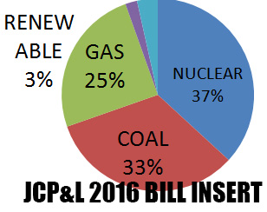
SWITCH YOUR ELECTRIC SUPPLY
TO GREEN RENEWABLE ENERGY
BEST INVESTMENT: BECOME YOUR OWN ELECTRICITY SUPPLIER - INSTALL SOLAR CELLS ON YOUR ROOF
FAR EASIER: ASK YOUR CITY TO CREATE AN “AGGREGATION” AND SUPPLY 100% RENEWABLE TO EVERYONE OR
PERSONALLY SWITCH TO A LOWER COST "GREEN" ELECTRICITY SUPPLIER
HOW?
Review and choose from the
REDUCE electric bill, and help move the world toward sustainable energy |  | SWITCH
www.electric.smiller.org

Slide 14
Levelized Cost of Energy in the U.S.
High
Mean
Low
Levelized Cost ($/MWh)
Renewable
Conventional
Wind – Onshore
Solar – Utility Scale
Gas Combined Cycle
Coal
Nuclear
Data: 2016 Lazard Lazard's Levelized Cost of Energy Analysis v.10.0; Energy Innovation Policy & Technology, LLC
Notes:
ID #4697 - Can be used in noncommercial online and TV broadcasts of your presentation, but not modified.
DESCRIPTION: Graph comparing the levelized cost of renewables and conventional energy sources in the US in dollars per megawatt-hour $50 on vertical axis is equivalent to 5cents/kwh
ADDITIONAL TALKING POINTS: Renewable energy generation technologies are fast becoming cost-competitive with conventional generation technologies. Since the turn of the decade, wind and solar PV in particular have become increasingly economically competitive with conventional power sources, partly due to declines in the cost of equipment and installations.*
According to the financial advisory and asset management firm Lazard, wind costs have dropped 66 percent between 2009-2016. The cost of solar showed an even more substantial decline, dropping 85 percent during the same time period.**
REFERENCES:
* Lazard, “”Lazard’s Levelized Cost of Energy Analysis- Version 10.0,” December 2016. https://www.lazard.com/media/438038/levelized-cost-of-energy-v100.pdf (data is on pages 2 and 4)
** Mike O’Boyle, “Wind and Solar are Our Cheapest Electricity Sources- Now What Do We Do?” Medium, America’s Power Plan, December 21, 2016. https://medium.com/americas-power-plan/wind-and-solar-are-our-cheapest-electricity-sources-now-what-do-we-do-b323082239de#.9emz48c96

Slide 15
The Way Forward
“We can stop global warming. Not by slowing down economies but by speeding them up.
Not by depending on national governments but by empowering cities, businesses, and citizens.
Not by scaring people about the future but by showing them the immediate benefits of taking action. If we accomplish this, we will be healthier and wealthier. We’ll live longer and better lives. We’ll have less poverty and political instability. And, while we’re at it, we’ll pass on to our children and theirs a brighter future.”
Source: “Climate of Hope”, Bloomberg & Pope, April, 2017, page 245
Notes:
The future is up to Middletown (read quote from Climate of Hope” by Bloomberg (former NYC mayor) and Pope (CEO of Sierra Club

Slide 17
BACKUP SLIDES

Slide 18
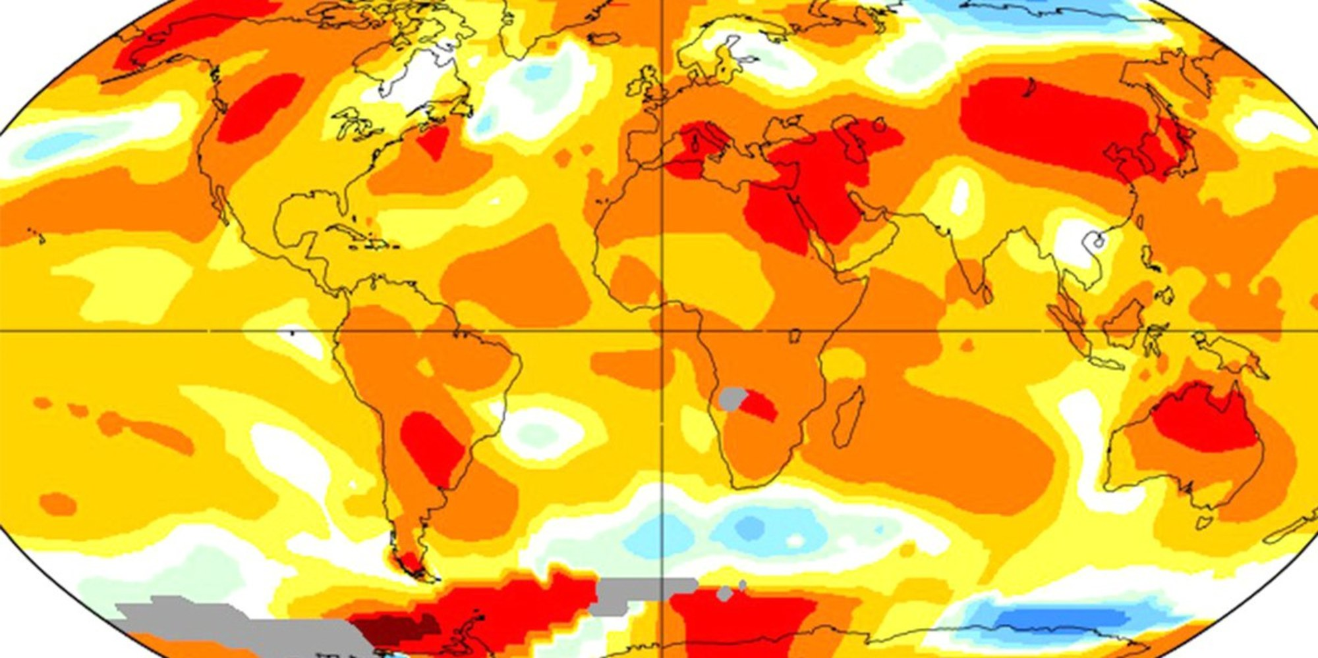
Global average temperature anomalies during July, 2017. NASA GISS
Notes:
SOURCE: CLIMATE NEXUS, 8/16/2017. https://www.ecowatch.com/july-hottest-month-2473630256.html
July, 2017 Ties for Hottest Month on Record
Last month tied July 2016 as the hottest July in recorded history, according to a preliminary analysis by NASA.
And as a result, it also statistically tied with August 2016 and July 2016 as the hottest months ever recorded. Mashable's Andrew Freedman noted that this record is even more noteworthy because it occurred in the absence of an El Niño, which combined with long-term planetary warming makes 2016 the hottest year ever.
Last month was about 0.83°C, or 1.49°F warmer than the monthly 1951-1980 July average. Eyes now are on NOAA's monthly report expected in a few days to see if it corroborates the analysis.

Slide 19
OTHER MAJOR CANDIDATES FOR EMISSION REDUCTION
WASTE
D28 Waste to Energy
D26 Methane Digesters
D42 Reduced Food Waste
D100 Landfill Methane
D158 Household Recycling
D160 Industrial Recycling
D160 Recycled Paper
D168 BioPlastic
D170 Water Saving- Home
SJ-GOLD STAR IN WASTE (8 Actions): http://www.sustainablejersey.com/actions-certification/gold-star-standards/
FOOD
D38 Plant-Rich Diet
D54 Regenerative Agriculture
D56 Nutrient Management
D60 Conservation Agriculture
D62 Composting
WOMEN & GIRLS
D78 Family Planning
D80 Educating Girls
Dpage# = “Drawdown”, edited by Paul Hawken ( possible “innovative” Actions)

Slide 20
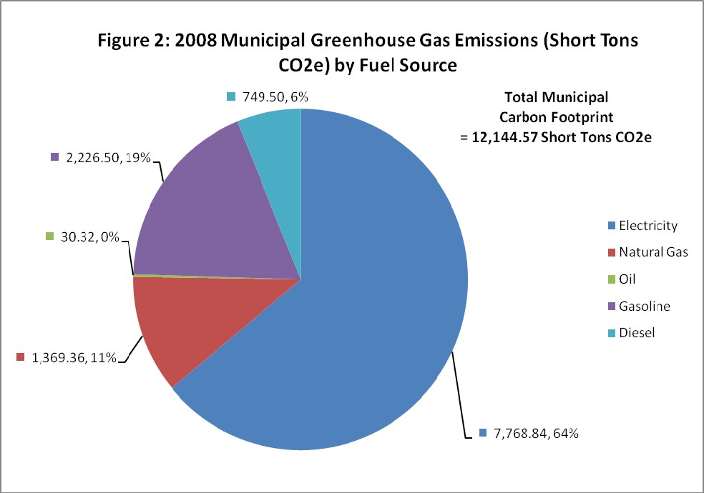
EXAMPLE MUNICIPAL (gov) CARBON FOOTPRINT (by fuel source)
64%% of total is Electrical
25% of total is Transportation (gas/diesel)
11% of total is Natural Gas (heating)
Source: 2010 Middletown Energy Plan (draft)
Notes:
Now we have established BOTH Municipal and Community Carbon Footprints
NEXT: develop a Climate Action Plan

Slide 21
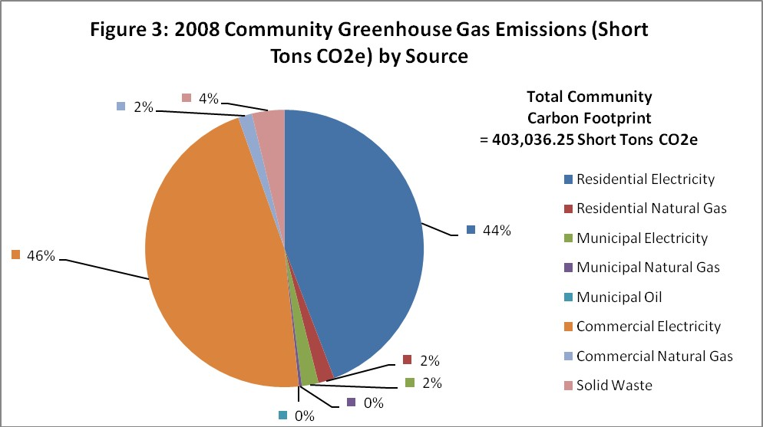
EXAMPLE COMMUNITY CARBON FOOTPRINT (by source)
92% of total is Electrical (commercial + residential + 2% municipal)
Transportation (gas/diesel) is not shown
4%Nat Gas is low (heating- commercial+res)
Source: 2010 Middletown Energy Plan (draft)
Notes:
Now we have established BOTH Municipal and Community Carbon Footprints
NEXT: develop a Climate Action Plan

Slide 22
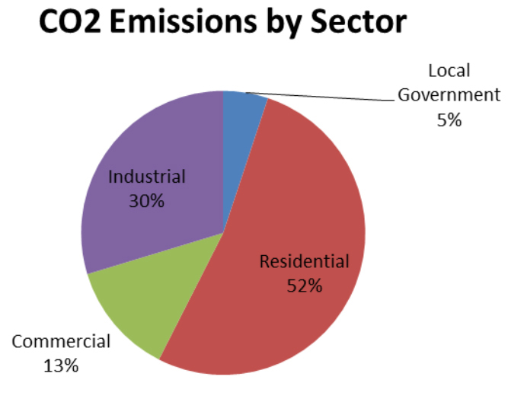
EXAMPLE COMMUNITY CARBON FOOTPRINT
“Local Government” (Municipal) is ONLY 5%
(“Industrial” is high in Woodbridge)
Source: Woodbridge Climate Action Plan
Notes:
Now we have established BOTH Municipal and Community Carbon Footprints

Slide 23
Increasing # of extremely heavy rain storms
Rising seas & stronger seacoast storms; flooding
Infectious diseases spreading northward
Increasing # of hot, unhealthy days (ozone)
Increasing temps & rain: increased pollen, worsening allergies & asthma
In last century, NJ has warmed more than twice as most of US
Notes:
Sources: https://www.epa.gov/sites/production/files/2016-09/documents/climate-change-nj.pdf, which relies on:
US Global Change Research Program; US Climate Change Science Program; Intergovernmental Panel on Climate Change; EPA Climate Change Indicators in the US
Extremely heavy rain storms increasing – erosion of brooks & flooding of low areas
Rising seas & stronger storms to increase flooding of Bayshore & Navesink River & tributaries
Infectious diseases are spreading northward (Zika & West Nile ) & increase opportunities for Lyme disease
Hot days increase ozone & unhealthy days;
increasing temps & rain increase pollen – worsening allergies & asthma

Slide 24
ELECTRIC TRUCKS
USE ARIAL BOLD FONT.
Notes:
Anton Kole, 4/8/2017 Presenters Forum

Slide 25
NATIONS ARE COMMITTING TO ELECTRIC
CARS AND TRUCKS
NORWAY - in Jan, 2017, > 50% new car registrations were electric or hybrid; By 2025 no new fossil fuel vehicles
NETHERLANDS - 2025: Internal Combustion (IC) Engines BANNED
GERMANY: - 2030: IC Engines BANNED
INDIA - 2030: 100% electric vehicles
CHINA: 650K existing electric vehicles – leads the world

Slide 26
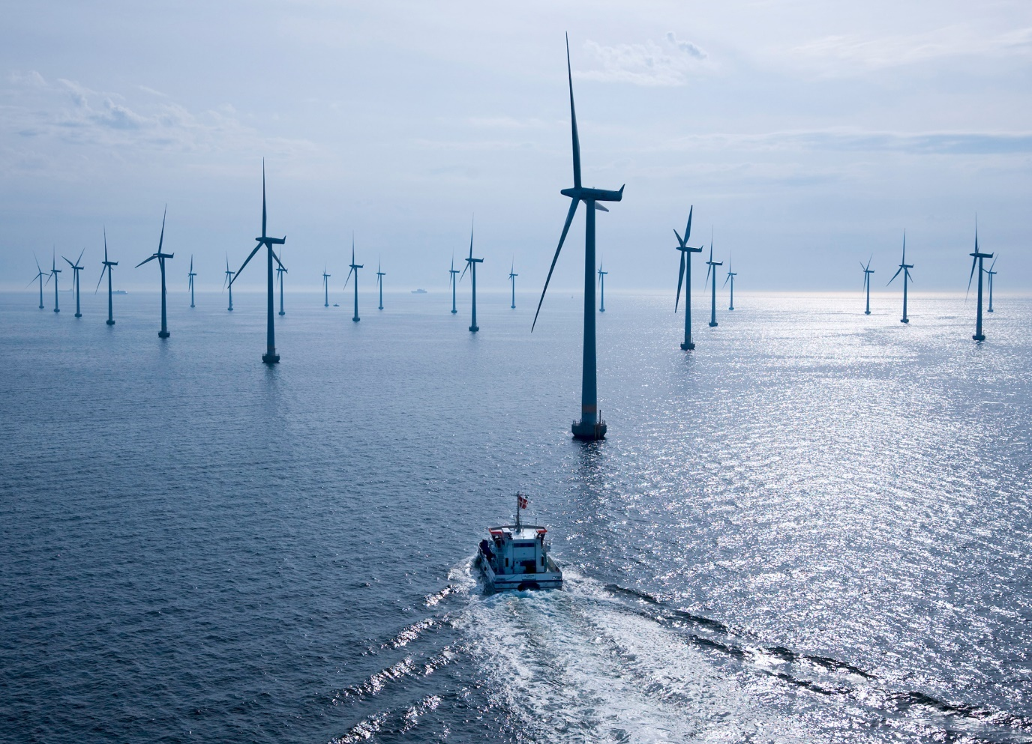
NY STATE- PUSHES AHEAD WITH RENEWABLES
Cut emissions another 30%, require 50% renewable power in 2030
Early shutdown of Indian Point Nuclear (fill gap with renewables)
Build offshore wind of 2400 megawatts- to power 1.25 million New York homes by 2030
Build Power lines into NYC from wind & upstate hydro
Modernize grid for distributed energy (community solar; microgrids)
Photo from www.ewind.es (2008)
Notes:
SOURCES: wind farm photo www.ewind.es
https://www.nrdc.org/experts/kit-kennedy/new-york-state-plans-2400-mw-offshore-wind-2030
https://thinkprogress.org/indian-point-closure-bce1df0dc863
Fundamental question about nuclear: “With climate change, there is a high probability of a global disaster in the future. With nuclear power, there is low probability of a local disaster in the present. How we should balance these risks”
Background: attacking a nuclear plant was under consideration by the attackers of the World Trade Center
NYState, led by Gov Cuomo, is aggressively pushing for renewables
Wind farm 30 miles off Long Island (not visible from land) – more likely to be accepted
Modernizing grid – for self-sustaining microgrids – is the wave of the future!

Slide 27
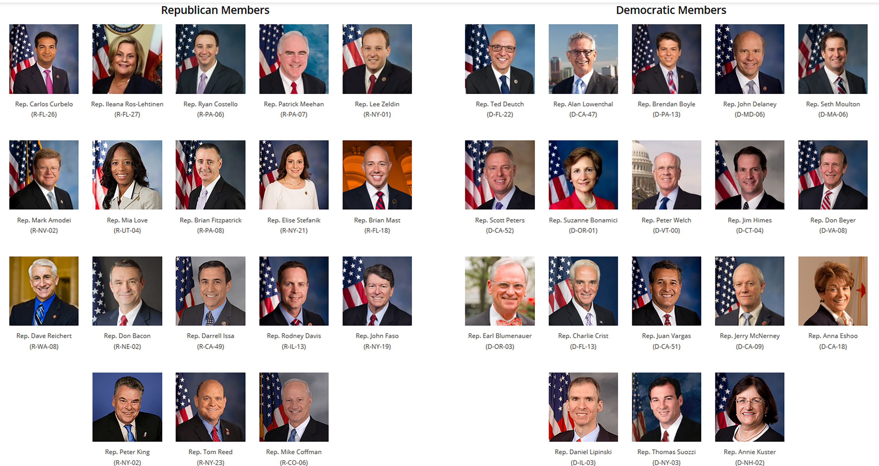
Members of Climate Solutions Caucus-June, 2017
ONLY 12 MEMBERS ON JANUARY 3 CONGRESSIONAL START
RAPIDLY INCREASED TO 36 BY APRIL, 2017
PURPOSE: ”Educate members on economically-viable options to reduce climate risk and protect our nation’s economy, security, infrastructure, agriculture, water supply, and public safety”
Source/credit information goes here
Notes:
SOURCE: http://citizensclimatelobby.org/climate-solutions-caucus/ & http://www.eesi.org/articles/view/membership-of-bipartisan-climate-solutions-caucus-has-more-than-doubled
The Climate Solutions Caucus was founded in Feb, of 2016
In 6 months, since January, QUADRUPLED in size from 12 to 52 (8/2017)!
A bipartisan group in the US House of Representatives
Must join in pairs of Republican and Democrat

Slide 28
NJ EXECUTIVE ORDER # 54 2/13/2007 Governor Jon S. Corzine
WHEREAS, the vast weight of scientific evidence compels the conclusion that global climate change is currently underway and is directly driven by the emission of greenhouse gases resulting from human activity; and…….
The following statewide greenhouse gas emissions reduction targets are hereby established for New Jersey:
Stabilization of greenhouse gas emissions at 1990 levels by 2020; and
Reduction of greenhouse gas emissions to 80% below 2006 levels by 2050
http://nj.gov/infobank/circular/eojsc54.htm
Notes:
TWO LEGAL DRIVERS
1, 2007: EXECUTIVE ORDER: reduce greenhouse gas 80% by 2050 (Followed by a NJ state law)

Slide 29
PARIS AGREEMENT
Limit emissions so global warming is well below 2 degrees C of pre-industrial average (aspire toward limiting to 1.5 degrees C)
Peak emissions “as soon as possible”
Reduce emissions (to Net Zero) such that after 2050 there is a balance between emissions and sinks (sequestration can be natural + carbon capture/storage)
Various sources
Notes:
2nd legal requirement: PARIS AGREEMENT: keep world temperature rise below 2 degrees C (desire less than 1.5 degrees)
(to accomplish this: meet various details of GreenHouse Gas Emissions- “netzero” emissions before 2050)

Slide 30
Why a Clean Energy Plan?
Increase energy efficiency: save on utility bills for municipal, residence, business
Power new jobs and new business; enhance our economic vitality
Augment resilience and preparedness for climate impact; shore up our tax base
Protect our own health and that of our children and future generations to come
Progress toward Sustainable Jersey Silver Level & Energy Gold Star
Notes:
Move to renewable energy and save money
Move to a green future of jobs, business and vitality
Increase resilience to recover quickly from climate impact
Ensure a clean, stable future environment
Protect our health into the future
Gain sustainable jersey point toward silver

Slide 31
BE ON THE CUTTING EDGE
ACHIEVE CLIMATE GOALS AT A LOCAL LEVEL
ACHIEVE “GOLD STAR IN ENERGY”
Complete as few as 2 of 6 actions
Renewable Energy Aggregation (up to 50 points!)
Change zoning and permitting to enable solar projects
LEARN MORE AT THE 6/21/2017 SUSTAINABLE JERSEY SUMMIT College of NJ, Ewing
Source: 6/7/2017 conversation with Randall Solomon, Director, “SustainableJersey”
Notes:
Big drive on “energy Gold Star” –select from 6 actions (2 critical would gain the star)
7 NJ Towns had Energy Aggregation programs (2014);
Several more have proposed plans;
Essex County is planning a regional renewable electrical supply partnership
Final Documentation available ~6/21

