Slide 1
Advocating for Clean Energy in Your Town
To Fight Climate Change
Pat and Steve Miller
patmiller@comcast.net stevemiller@comcast.net

Slide 2
Sierra Club
100% Committed
Our mission is to leave a legacy of a livable world for our children and grandchildren.

Slide 3
Your world depends on it.
Source: NASA
Notes:
ID #5132 - Can be used in noncommercial online and TV broadcasts of your presentation.
…because, after all, your world does depend on it. Thank you.
DESCRIPTION: Photo of the Earth with text stating that your world depends on it

Slide 4
Middletown 2020 Energy Plan Goals
Make Middletown 100% clean energy by 2050
As per NJ Global Warming Response Act
As per NJ Energy Master Plan (carbon neutral by 2050)
Reduce energy usage
Reduce energy costs to consumers
Reduce detrimental impact of climate change
Achieve Sustainable Jersey Gold Star in Energy
Notes:
Edit to introduce Energy Plan.

Slide 5
NJ Energy Master Plan (EMP) 7 Strategies
Transportation: Conservation (public transportation, ride sharing); EV municipal fleet; charging stations in municipal, business & multi-fam housing
Renewable & Distributed Energy: Rooftop & community solar; onshore & offshore wind
Efficiency & Conservation: Insulation, seal air leaks, upgrade appliances in existing buildings; preserve trees; landscaping to reduce heat, conserve water, or provide food
Buildings (new & renovated): Net-zero carbon buildings – rooftop solar, siting for solar, all-electric heat & appliances, EV-ready
Notes:
TONIGHT’s visioning focuses on these 5 strategies, found in the NJ 2019 Energy Master Plan.
We need YOUR visioning of what do you expect in an energy plan to enhance YOUR quality of life??
Following are examples of the 5 (These are also printed in front, above the white poster boards)

Slide 6
2019 NJ EMP 7 Strategies, cont.
Environmental Justice Communities: seek local benefit of clean energy transition - clean power, jobs & training, public EV transport & charging, all local
Modernize the Grid & Utility Infrastructure: smart metering, batteries, bi-directional grid flow
Clean Energy Innovation Economy: grow world-class research, create jobs, workforce training
Released Jan 2020
Notes:
TONIGHT’s visioning focuses on these 5 strategies, found in the NJ 2019 Energy Master Plan.
We need YOUR visioning of what do you expect in an energy plan to enhance YOUR quality of life??
Following are examples of the 5 (These are also printed in front, above the white poster boards)

Slide 7
Integrated Energy Plan Cost Analysis
Consultant: Rocky Mountain Institute
Conclusion: Least cost scenario for reaching carbon neutral by 2050 would cost only a few % more than business as usual
Assumes cost of renewable stays flat (and does not fall)
Assumes price of fossil fuel stays flat (and does not rise)
Assumes no new technology
Does not count benefits of reduced emissions at all

Slide 8
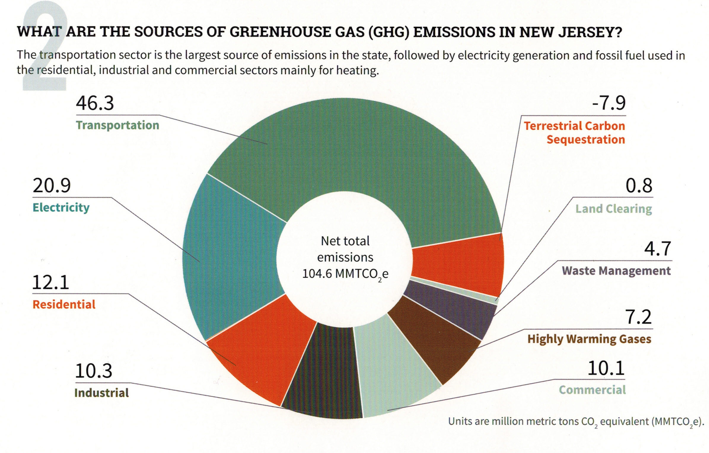
Your (Typical NJ) GHG Emissions EEEmissions
“Reducing NJ Greenhouse Gas Emissions”, Rutgers, Jan 2018
Notes:
This is the NJ “Footprint” of sources of world-heating Greenhouse gases, to show what to tackle first.
Sustainable Jersey states: “the primary goal [of “Gold Star in Energy” is reducing Green House Gases. Responding to this overarching imperative will help achieve all the other [sustainability] goals.”
20% of the GHG is from electricity generation; nearly 50% is from transportation.
Switching electricity to 100% wind/solar, then switching all vehicles to batteries charged by renewable electricity will ELIMINATE almost 70% of our GHG.
VERY IMPORTANT: -8% carbon sequestration by marshes, mudflats, trees, landscaping

Slide 9
WHY WE WANT TO SAVE THE WORLD

Slide 10
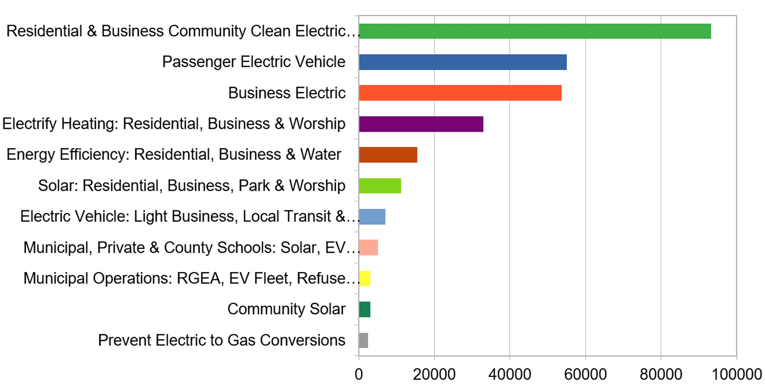
Middletown Energy Plan: GHG emission reductions during year 2030 In 2018, Middletown emissions were 705K Tons (CO2 equiv)- calculated per capita of NJ total
266K Tons TotAl CO2 (equiv) reduction in 2030
(38% of 2018 share)
Tons CO2 reduction in 2030
Notes:
Start with personal story [show grandkids photo]- I now have 2 grandsons- and want a better life for them. This afternoon’s talk Joseph Fiordliso, longtime President of the NJ Board of Public Utilities stressed that it is NOW OBVIOUS that our descendants lives will be affected by climate change- it will be a different less friendly life for them. Joseph is
Residential (100%) & Business (10%) Community Choice Electric
Passenger Vehicles 25%are electric
Business Electric RPS + 10% for all remaining
Electrify heating 25%
savings in Energy Efficiency (10%) – consistent with projection from Middletown actual experience
Solar: (10% solar penetration) Residential, Business, park & workship
Delivery trucks ALREADY moving to EV Trucks
Municipal/private/schools: 25% area utilized for solar
Municipal operations: 25% conversations of vehicles & buildings to electric heat

Slide 11
New Jersey Renewable Government Energy (Electric) Aggregation (R-GEA) for Community
Also called Community Choice Aggregation
Most effective carbon reduction action: accounts for 40% of potential savings of first decade actions
Provides cost savings to residents; low or no cost to Township
Notes:
For last 3 years, I have maintained a price-ranked list of 3rd party suppliers of renewable electricity

Slide 12
Renewable Community Choice Electric Aggregation
Town purchases electricity with greater renewable content for residents
Better price; guaranteed for life of contract
Cleaner electricity; increasing to 100% by 2030
More consumer protection
Renewables are now cheaper than natural gas or nuclear and falling (by 95% in last 20 years)
Lowest priced Electric vendors http://electric.smiller.org/
Notes:
Edit to introduce Energy Plan.

Slide 13
Renewable Community Electric Aggregation Towns That Have Contracted 2019-2020
CITY | RENEWABLE CONTENT | RESIDENT SAVINGS
Essex Hub: South Orange, Glen Ridge, Maplewood, Montclair, Verona (PSE&G) | 41% | 10%
West Orange (PSE&G) | 100% | 5%
Glen Rock (PSE&G) | 100% | 8%
New Brunswick (PSE&G) | 2 options: 50% 100% | 10% 5%
Livingston: 2 (PSE&G) territories (JCP&L) | 100% ($.113/kwh) 41% ($.090/kwh) | $165 annual avg. 8%
Plainsboro (PSE&G) | 41% | $140 annual avg.
Princeton (PSE&G) | 100% ($.1363/kwh) 50% ($.1305/kwh) | 1.1% premium 3.4%
Piscataway (PSE&G) | 100% 50% 31% | 5.5% premium 1.4% premium 2%
Notes:
OTHERS PENDING: Red Bank & regional towns; Edison; East Brunswick

Slide 14
Renewable Community Electric Aggregation How It Works for Residents
Town states desired options; consultant goes out for bid.
Town chooses best supplier bid, enters 1-3 year contract.
Consultant provides customer support, incl. managing opt-ins & opt-outs & billing issues.
JCP&L provides physical grid/wiring service, & bills.
All residents are opted-in except
Residents with home solar or 3rd party supplier contracts
Businesses
All may change opt-in or opt-out at any time.
At end of contract, new bids are solicited.
Notes:
Edit to introduce Energy Plan.

Slide 15
Sustainable Jersey Actions: A Framework for Getting To 100% Clean Energy
Sustainable Jersey Certification: A Prestigious Designation For Municipal Governments In New Jersey
450 NJ Towns Participating
203 Towns Currently Certified
Actions To Score Points Toward Certification Are Documented And Reviewed.
Certification Is Free And Completely Voluntary.
http://sustainablejersey.com Has All Actions, Resources, Numerous Presentations, And Complete Documentation From All Certified Communities.

Slide 16
Sustainable Jersey Certifications
Bronze certification: commitment to sustainability, implemented first significant steps, 150 points
Silver certification: significant progress toward sustainability, 350 points, state-wide and national leader
Middletown was silver certified in 2019
Gold Star Standard is a NEW level of recognition for silver certified communities.
1 Town has Achieved Gold Energy Star: Woodbridge

Slide 17
Gold Star in Energy
Municipal Operations: Demonstrate GHG reduction of
at least 3.6% per year
for 3 years (10.8% over 3 years or less)
“Municipal Carbon Footprint Action” at beginning and end
Community-wide emissions: Demonstrate GHG reduction of
1% per year from entire community – residents, schools, businesses, industries, and municipal operations.
6 specific Sustainable Jersey actions (or pre-approved substitutes) completed
Notes:
The catch: Middletown Energy Plan depends upon 4% emission reduction/year (compared to above 1%/year), achieved by
- MULTIPLE Parallel actions each year
- REPEATED year after year
Larger cities such as those committing to the Paris Agreement likely have full time staff.
For instance, Woodbridge, the ONLY town achieving Gold Star in Energy, has a VERY active SustainableWoodbridge Team, led by the Woodbridge “Chief of Staff” who presumably has a lot of clout.

Slide 18
Strategies for Getting to Gold After Energy Efficiency
Municipal operations: Lower GHG emissions 3.6% per year
Municipal buildings
Fleet Management
Operations (landscaping, energy and water conservation, etc.)
Community-wide: Lower community-wide GHG 1% per year
Make Your Town Electric Vehicle Friendly; Public EV Charging
Make Your Town Solar Friendly; Community Led Solar Initiatives
Renewable Electric Aggregation

Slide 19
Middletown Energy Plan: GHG emission reductions during year 2030 In 2018, Middletown emissions were 705K Tons (CO2 equiv)- calculated per capita of NJ total
Sustainable jersey actions: Gold star in energy
Renewable Community Choice electricity
PUBLIC EV CHARGING STATIONS; MAKE TOWN EV FRIENDLY
(Renewable electric selection*)
Residential and commercial energy efficiency
Make your town solar friendly; community-led solar
266K Tons TotAl CO2 (equiv) reduction in 2030
(38% of 2018 share)
Sustainable jersey actions for schools
Numerous actions for municipal operations
* 3rd party renewable electric: http://electric.smiller.org
Tons CO2 reduction in 2030

Slide 20
VALIDATION: “We Are Still In”, America’s Pledge”,…
4000 cities, states, and businesses are committed to the Paris Goals
One in three Americans live in a jurisdiction committed to 100% clean electric
Paris Agreement Commitments cover 68% of US GDP, 65% of US pop and 51% of US emissions
U.S. EMISSION REDUCTIONS expected by 2030:
25% with current cities, states, businesses who are committed
37% “All-in” for the entire US population, under current Fed support (38% is projected by Middletown Energy Plan)
49% if U.S. rejoins Paris Agreement
Source: “Accelerating America’s Pledge” Executive Summary of data; report to UN COP25, dec, 2019 https://assets.bbhub.io/dotorg/sites/28/2019/12/Accelerating-Americas-Pledge-Executive-Summary-.pdf
Notes:
Location of this slide:
Source: “Accelerating America’s Pledge” Executive Summary of supporting data (dec, 2019) report to UN COP25):
Slide by Steve Miller stevemiller@comcast.net. Reference: Middletown Energy Plan http://climate.smiller.org/energy-plan/Middletown-2020-Energy-Plan/MiddletownEnergyPlan-V2-2020-8-8.pdf

Slide 21
Your world depends on it.
Source: NASA
Notes:
ID #5132 - Can be used in noncommercial online and TV broadcasts of your presentation.
…because, after all, your world does depend on it. Thank you.
DESCRIPTION: Photo of the Earth with text stating that your world depends on it

