Slide 1

NJ Electrification Coaching Network
Pat Miller
Betsy Longendorfer
Ila Vassallo
Steve Miller
Chris Proulx
November 21, 2024

Slide 2
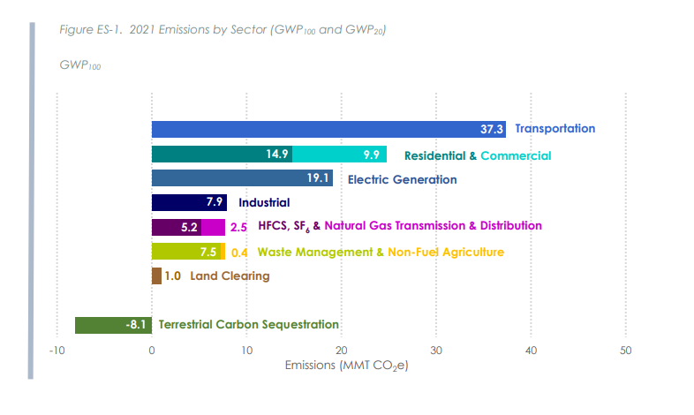
2024 NJ Greenhouse Gas Emissions Inventory Report
New Jersey Department of Environmental Protection

Slide 3
Top 3 Greenhouse Gas (GHG) Emissions
Sources in NJ: 81% of All Emissions
  Electricity generation (19%)
  Transportation (37%)
  Residential/commercial buildings (25%)
RedUCE All 3
Source: 2024 NJ Greenhouse Gas Emissions Inventory Report
New Jersey Department of Environmental Protection

Slide 4
NJ Electrification Coach Network
How does a coaching session proceed?
Without a good plan, you can’t expect good results!

Slide 5
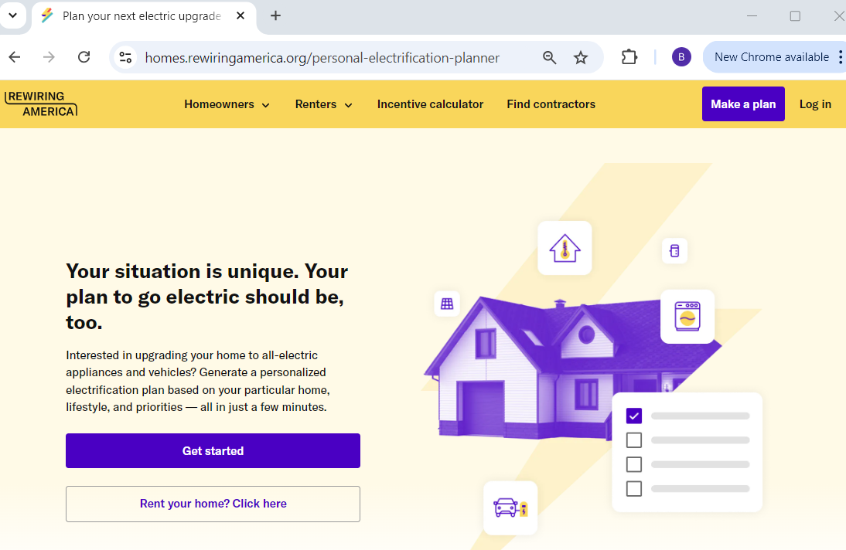
Quick tour: Rewiring America’s Personal Electrification Planner
Your coach will ask similar questions and be able to account for special situations not covered here, as well as explaining the process.

Slide 6
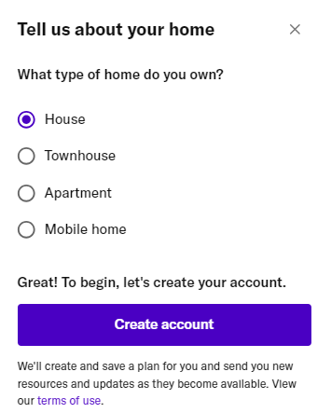
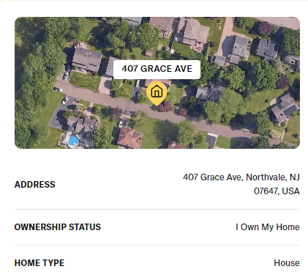
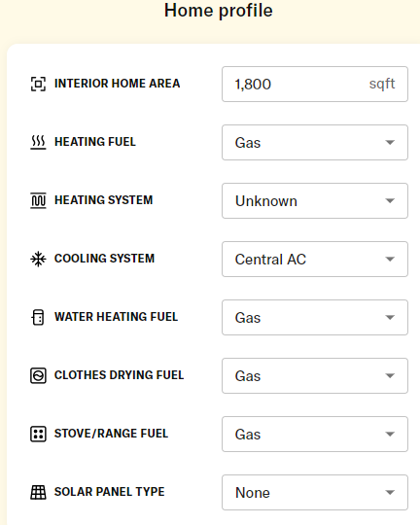
Enter data about yourself and your home
Notes:
Login Go to Settings and under the first header about “Your home”, click RESET to start over

Slide 7
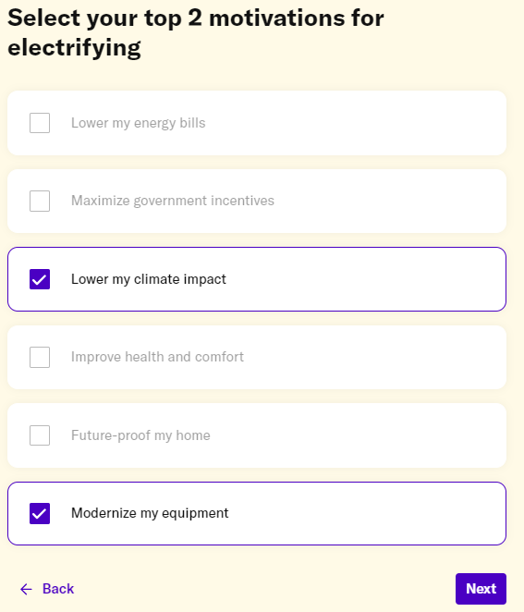
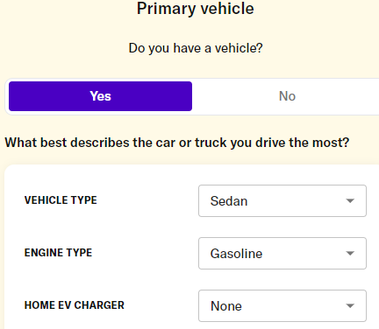
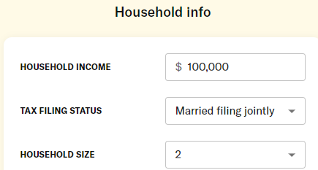
Enter data about yourself and your home
Household income is used to determine whether you are a low or moderate income household, which affects the rebates and credit amounts
Notes:
Income is for determining whether low or moderate income, for rebates

Slide 8
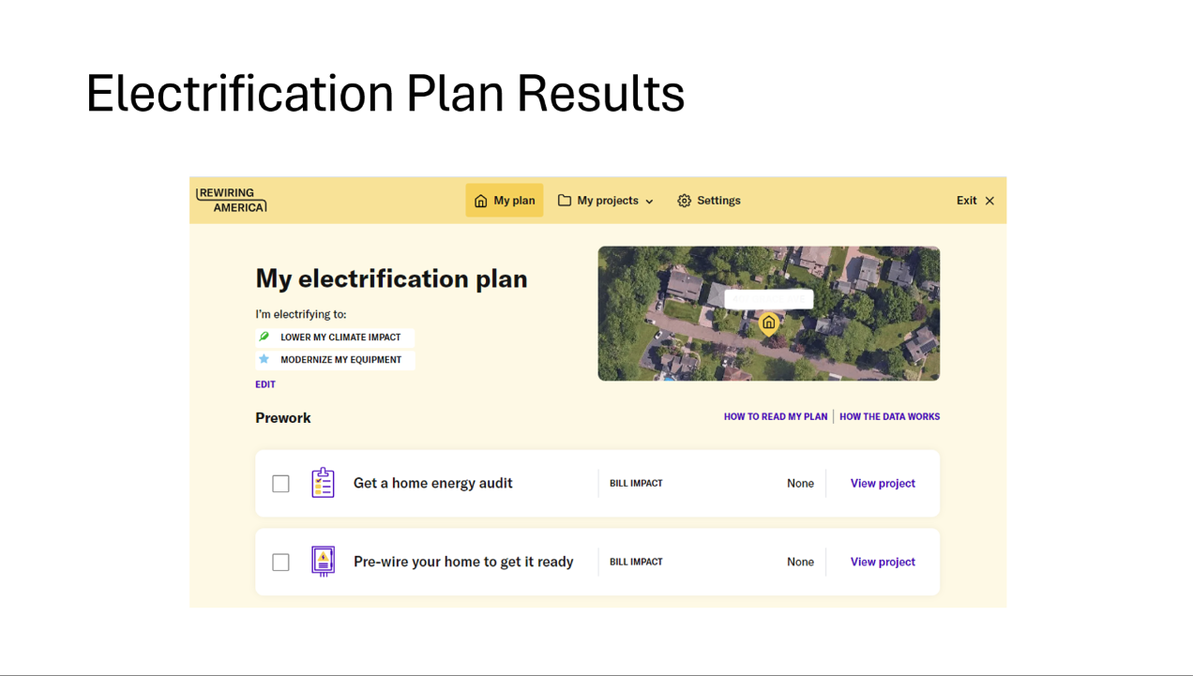

Slide 9
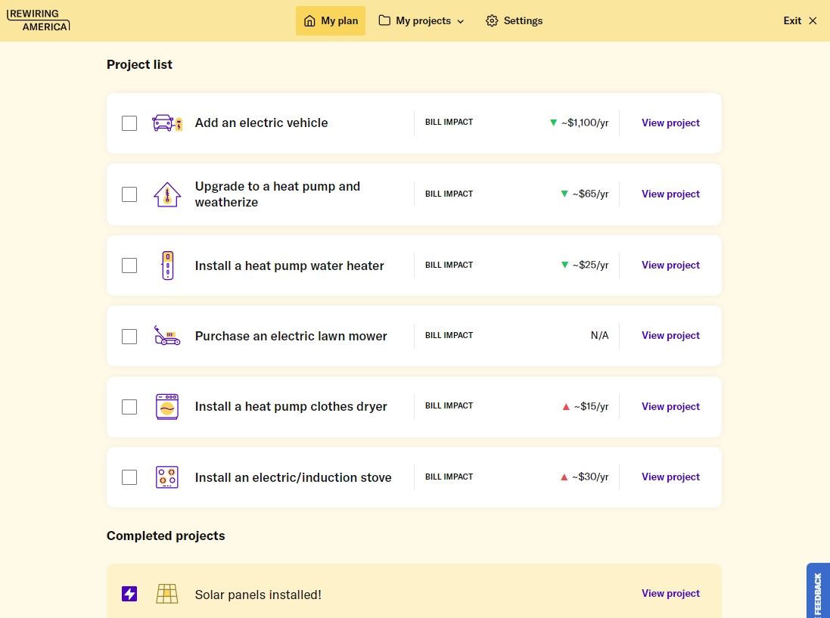
Plan (Cont’d)
Notes:
From here, click “View Project” to get all of the info in the following slides, for EACH of the projects

Slide 10
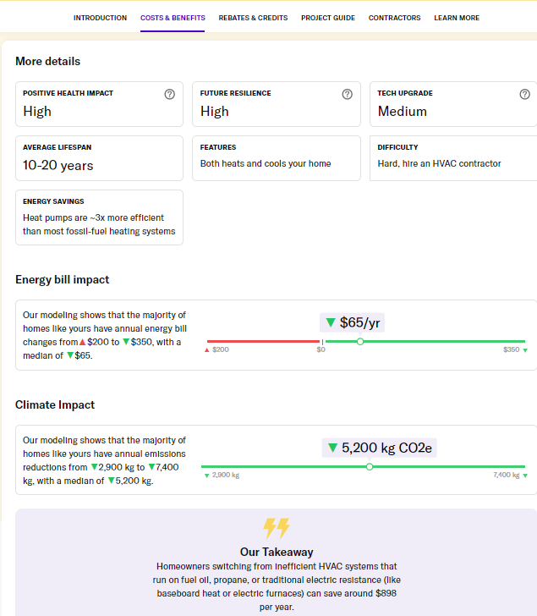
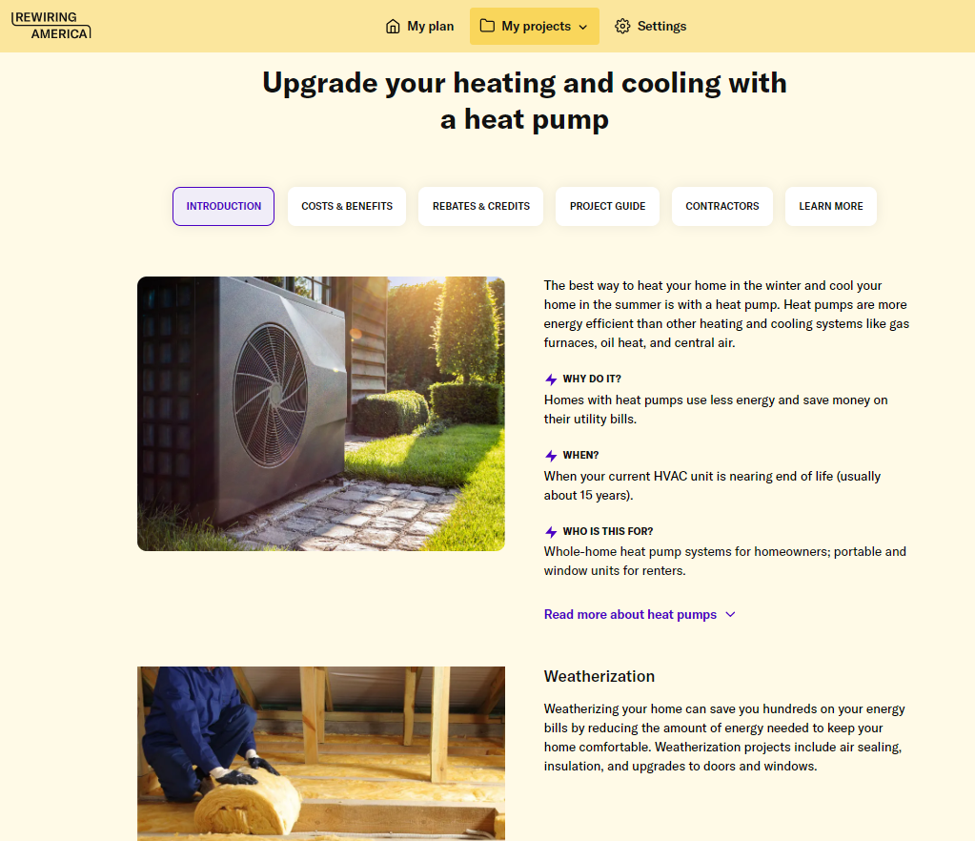
Clicking “View Project” for Heat Pumps shows:
Notes:
Then click on each of the tabs across the top – Costs & Benefits, etc

Slide 11
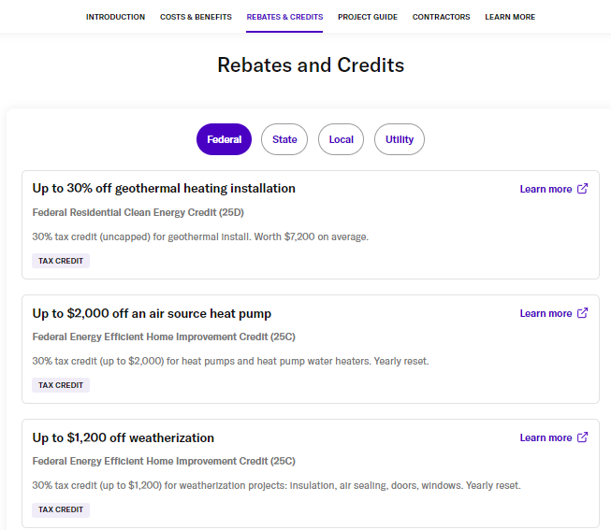
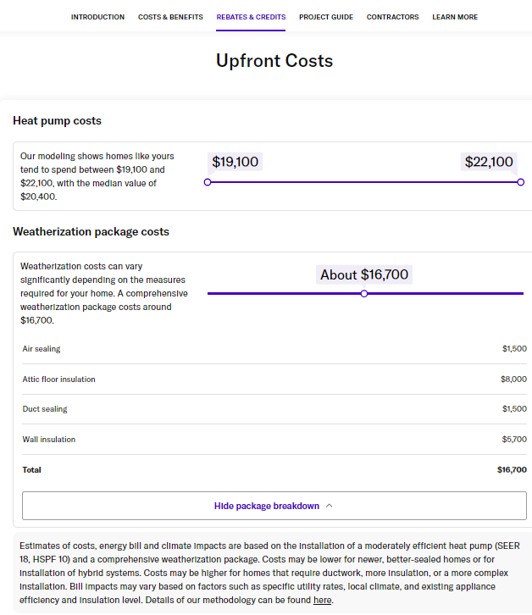
Notes:
Continuing to click on tabs at top – You can also click on Federal/State/Local/Utility rebates

Slide 12
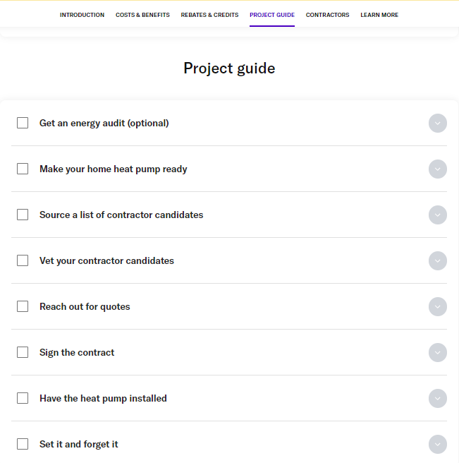

Slide 13
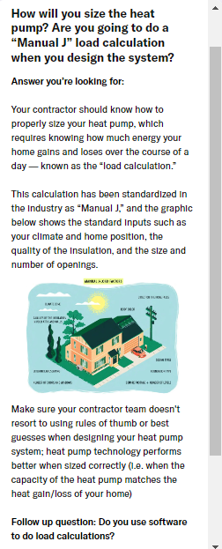
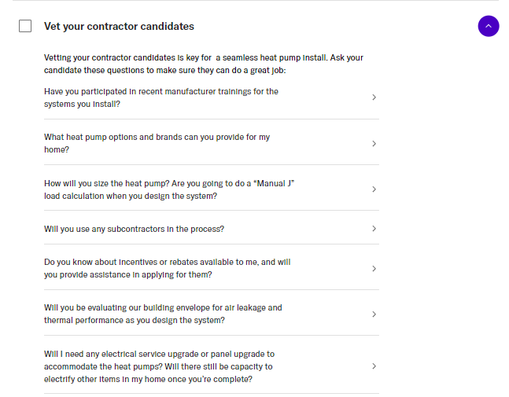
Additional click on down arrow next to “Vet Your Contractor” step, then right arrow for details:
Notes:
Each of the Project Steps has more info and also some hints on what you are looking for.

Slide 14
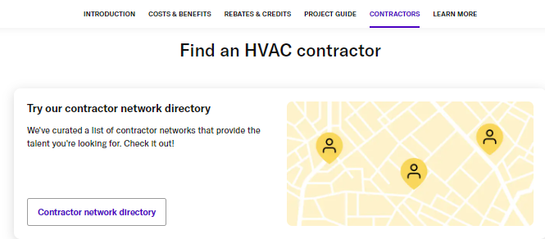


Slide 15
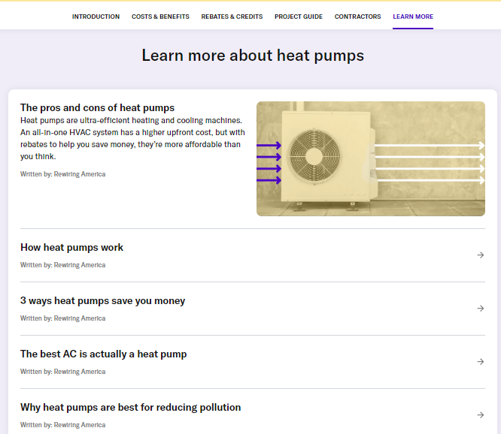
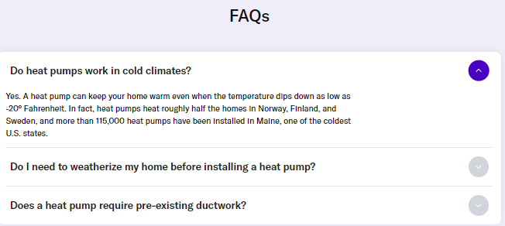

Slide 16
What will it cost? What will it save?

Slide 17
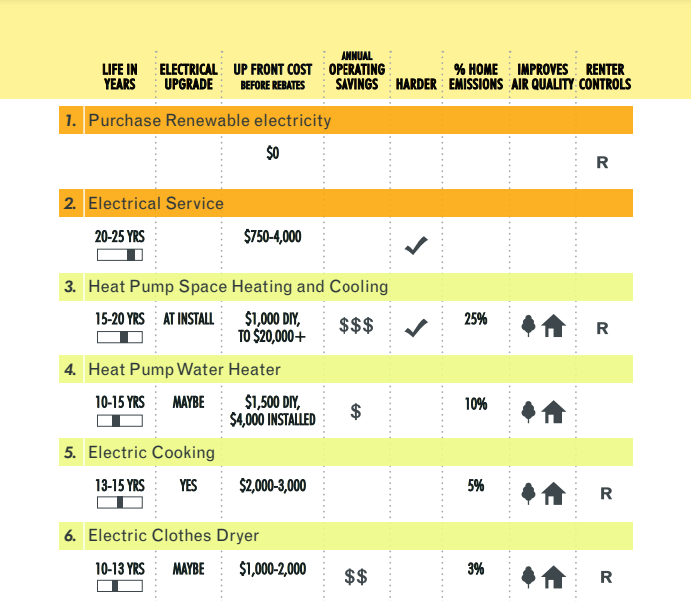
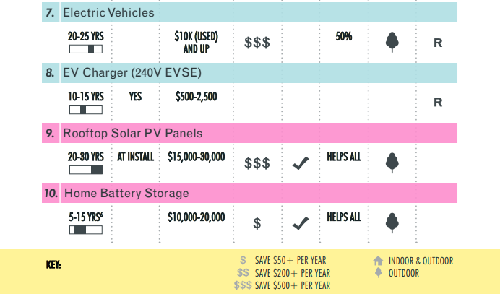
Federal Financing
BEST: Rewiring America’s IRA Calculator website: https://www.rewiringamerica.org/app/ira-calculator
Notes:
Here’s a summary chart from the planning tool, with categories for electrical service, heating & cooling, transportation, solar power.
Note that there is an expected lifetime of the equipment, what the upfront cost is, as well as a relative amount of money to save, how much of your emissions you will reduce, whether your air quality is improved, and whether a renter can also take advantage of these incentives.

Slide 18
Financing
* Numbers are VERY uncertain, due to pending NJ BPU decisions and to possible national political changes

Slide 19
IRA – Federal Tax Credits (Now)
No income limit
25C: Energy Efficient Home Improvement
  Max dollars (30%, up to $2000), no carryover
25D: Residential Clean Energy Credit
  No max dollars (30%), can carry over unused credits

Slide 20
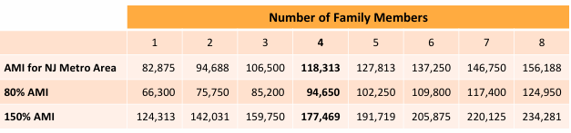
IRA Rebates*
Awaiting submission and approval of NJ plan
  NJ BPU proposal: only for multi-family buildings in low-income NJ neighborhoods (income <80% of the area median income)
* Numbers are VERY uncertain, due to pending NJ BPU decisions and to possible national political changes
Notes:
The beginning of the presentation goes through 6 basic questions about electrification. This gives an overview of “the what, the how and the why” of home electrification.
Then we will cover, one by one, the 8 types of items that may be part of your home electrification like heat pumps.
Then we will take a look at the financial support the IRA will provide for home electrification.
And finally we will take a look at a few examples of families going through this process.

Slide 21
Financial Support: can combine rebates and take tax credit
 | IRA rebate* multi-family, low-income neighborhoods | Utility rebate (proposed for 2025) | 25C tax credit** | 25D tax credit
Electrical wiring | 100% to $2,500
Electrical panel | 100% to $4,000 |  | 30% to $600
Cold climate heat pump | 100% to $8,000 | $2,000^ | 30% to $2,000
Heat pump water heater | 100% to $1,750 | $750 | 30% to $2,000
Heat pump clothes dryer | 100% to $840 | $500
Electric/induction stove | 100% to $840 | $150
Ground source heat pump |  | $10,000 |  | 30% no $ limit
Rooftop solar |  |  |  | 30% no $ limit^^^
Battery storage |  |  |  | 30% no $ limit
Weatherization | 100% to $1,600 |  | 30% to $1,200^^
Increase house efficiency 20-35% | 80% to $4,000
Increase house efficiency > 35% | 80% to $8,000
Increase house efficiency 5-32.5% |  | $2,000-$7,500
* $14,000 maximum rebate for the top 6 items combined over the multi-year duration of the program ** $2,000/year limit on heat pumps; $1,200/year limit on all other items combined ^ $750 for non-cold climate heat pump ^^ Includes replacing windows and doors and to $150 for home energy audit ^^^ Credit can also include any cost for electrical panel if needed

Slide 22
Financial Support: excluding multi-family, low-income neighborhood rebates
 | Utility rebate (proposed for 2025) | 25C tax credit** | 25D tax credit
Electrical wiring
Electrical panel |  | 30% to $600
Cold-climate heat pump^ | $2,000 | 30% to $2,000
Heat pump water heater | $750 | 30% to $2,000
Heat pump clothes dryer | $500
Electric/induction stove | $150
Ground source heat pump | $10,000 |  | 30% no $ limit
Rooftop solar |  |  | 30% no $ limit^^^
Battery storage |  |  | 30% no $ limit
Weatherization |  | 30% to $1,200^^
Increase house efficiency 20-35%
Increase house efficiency > 35%
Increase house efficiency 5-32.5% | $2,000-$7,500
** $2,000/year maximum rebate: heat pumps combined; $1,200/year all other items combined ^ $750 for a non-cold climate heat pump ^^ Includes replacing windows and doors and to $150 for home energy audit ^^^ Credit can also include any cost for electrical panel if needed
* Numbers are VERY uncertain, due to pending NJ BPU decisions and to possible national political changes, talk to your coach

Slide 23

IRA – Federal Energy Rebates (Now)
Also called HOMES or HER (Home Efficiency Rebate)
Income-dependent
Single energy-efficient project, e.g. weatherization
* Numbers are VERY uncertain, due to pending NJ BPU decisions and to possible national political changes
Income from https://www.huduser.gov/portal/datasets/il/il2023/2023summary.odn
Notes:
confused

Slide 24
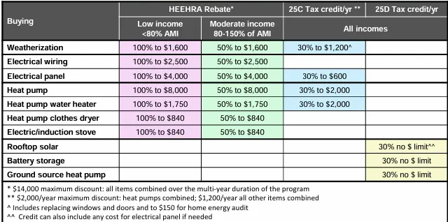
IRA- Federal Home Electrification and Appliance Rebate (HEEHRA/HEAR)
Waiting for federal approval of NJ Rebates in 2025
Discounts for items that replace fossil fuel appliances
Available only to low-to-moderate income households
* Numbers are VERY uncertain, due to pending NJ BPU decisions and to possible national political changes
Notes:
confused

Slide 25
Utilities
Check for low- or zero-interest loans
Check for posted sales on energy efficient equipment like smart thermostats, LEDs, etc.

Slide 26
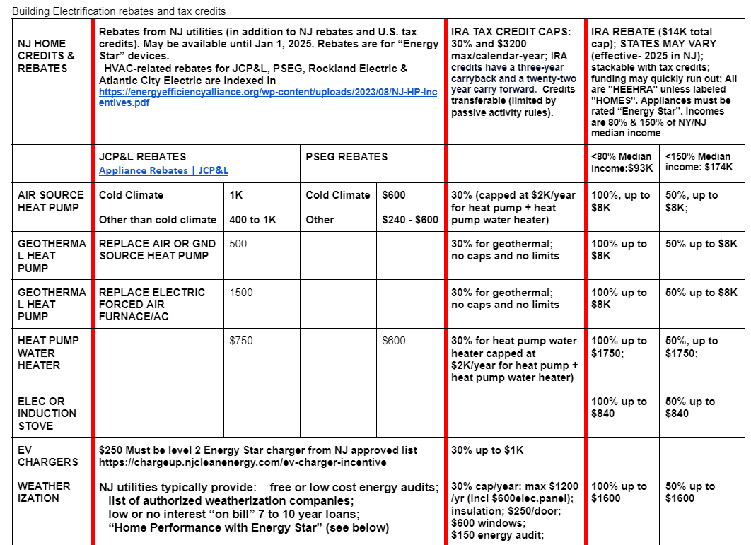
Federal, State, Utility
Financing Summary
Miller’s Google Doc which includes utility info: https://docs.google.com/document/d/10vSXEtbjYZ3fBYhZbBahOLVxXrn82QKHkJGHGTRnvyg/edit

Slide 27
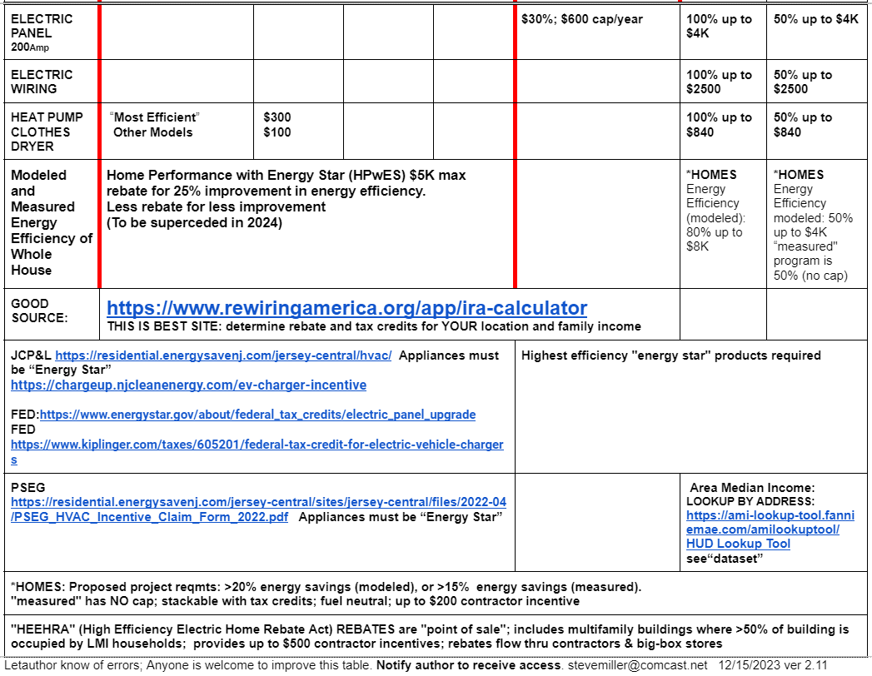
Financing cont’d

Slide 28

EnergyStar Rebate Finder
Federal govt + local utilities
https://www.energystar.gov/rebate-finder

Slide 29
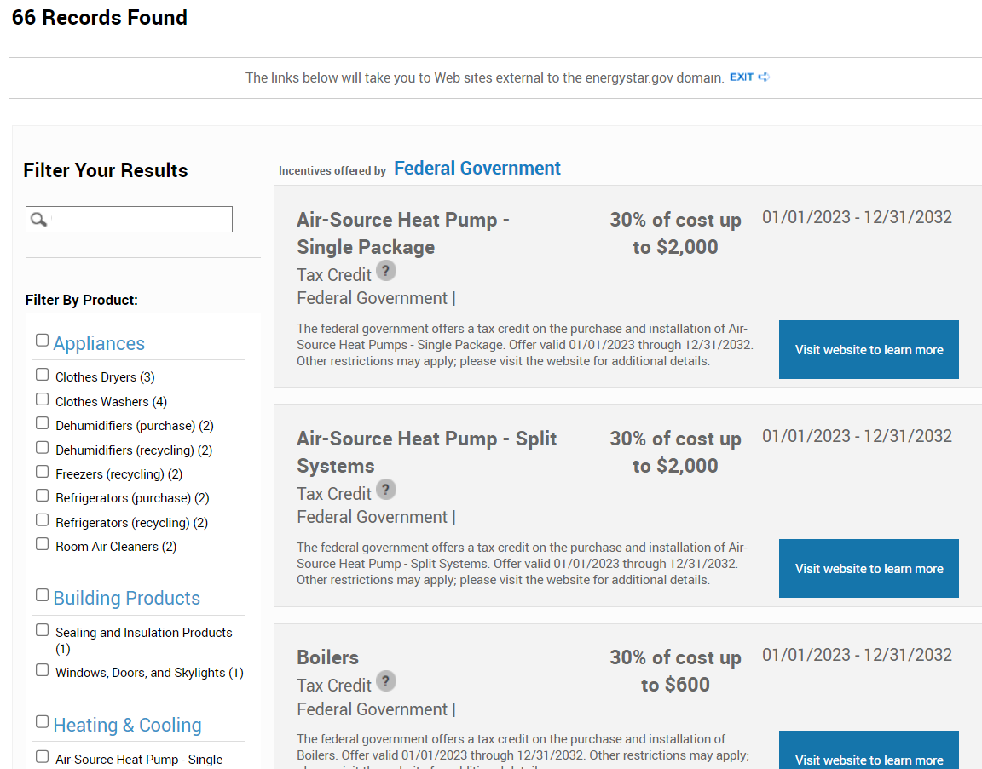
EnergyStar
Rebate
Results
(Partial)

Slide 30
Finding an HVAC Contractor
…and evaluating the quote

Slide 31
Finding a contractor
Contractors are also scrambling to adopt newer technology
  New rules requiring new refrigerants take effect 1/1/25
Utilize existing certifications
  BPI-Certification (Building Performance Institute)
  Manufacturer Certification: Mitsubishi/LG/Daikin etc
RewiringAmerica.org contractor recommendations
Your utility might have recommendations, but beware whether their list has requirements that must be met, or is simply self-recommended. Note: PSE&G can use their own employees, called “Whole Home” or “Home Performance w/Energy Star” instead of HVAC contractors.
We (NJ Electrification Coaching Network) are developing a database!
Other states – NYSERDA, TheSwitchIsOn

Slide 32
Evaluating the Contractor and Bid
Get at least 3 proposals/job scopes.
  They should ask about specific problems, such as draftiness, uneven heating.
  Can it be done without fossil fuel? Don’t just replace one gas appliance with another.
  If you don’t have a good plan, you won’t have good results!
  Talk to your coach
Recommendations: Ask for other customers for heat pump installations
Financing:
  Ask about rebates and credits, low interest or zero interest loans, and about predicted energy savings.
  If the job is cheaper, what is the reason? What are they not doing?
Technical: Ask…
  Whether electrical panel upgrades are required and if they could be avoided, or conversely if they are enough for your future projects.
  Whether additional weatherization measures are needed and/or beneficial (insulation, ducts, windows/doors)
  About space/ventilation requirements

Slide 33
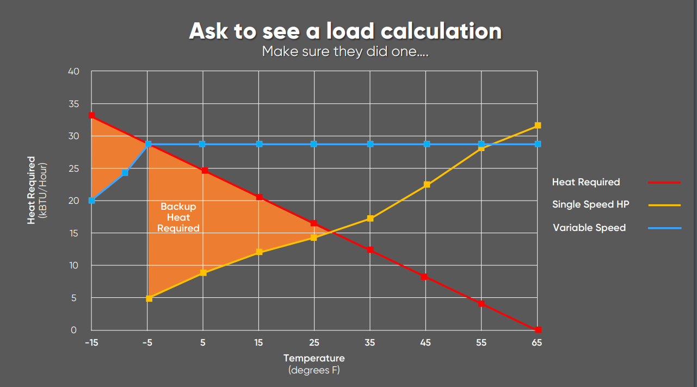
Technical: Ask if they computed your heating/cooling load and ask to see it, including the lowest temperature supported and whether backup heat is required

Slide 34
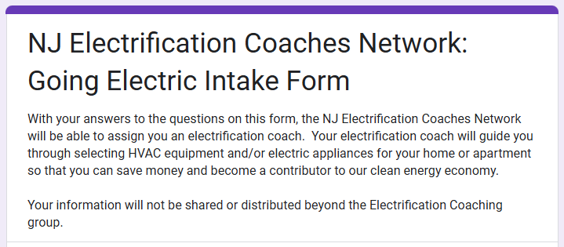
INTAKE FORM
NJ Electrification Coaches Network
Ila Vassallo​​
November 2024
Notes:
Good evening. My name is Ila.I am a resident of Evesham Township better know as Marlton which is in Burlington County. I’m going to take a few minutes to talk about our “Going Electric Intake Form.”

Slide 35

The purpose of the “Going Electric Intake Form” is to assign you an electrification coach to help you on your electrification journey.​​
Notes:
The purpose of the “Going Electric Intake Form” is to collect some basic contact information from you and have you answer a few questions on why you want to electrify so that an electrification coach can be assigned to you to help you on your electrification journey.

Slide 36

GOING ELECTRIC INTAKE FORM
Provide your name, city, county, state, and email
Notes:
To sign up, simply enter your name, city, county, state and email. The email is required so that we can contact you. And your location will help us assign an electrification coach that is in your area.

Slide 37
Answer a few simple questions
Why do you want to electrify your home / apartment?
Do you have an anticipated time frame to start on your electrification journey?
Do you have an estimated cost in mind for your electrification improvements?
Are you familiar with Rewiring America and their ​Personal Electrification Planner?
Notes:
After you’ve entered your contact info, there are a few simple questions to help us understand why you want to electrify (it is okay to not have a detailed explanation), any associated time frame or costs you have in mind, and if you are familiar with Rewiring America’s Personal Electrification Planner or PEP.

Slide 38


An electrification coach will contact you to get started
Link to Intake Form:
https://tinyurl.com/yc2ew6rc
Notes:
It’s that easy. Once you have submitted your intake form, an electrification coach will be in touch with you. We want to note that your information will not be shared or distributed beyond the Electrification Coaching group. And you can see on this slide, there is a link to the Intake Form and a QR code. Thank you. I’m now happy to turn things over to Steve Miller, one of our premier electrification coaches.

Slide 39

NJ ELECTRIFICATION COACHING NETWORK
KAREN CASE STUDY, NEPTUNE CITY, NJ 2024-11-21

Slide 40
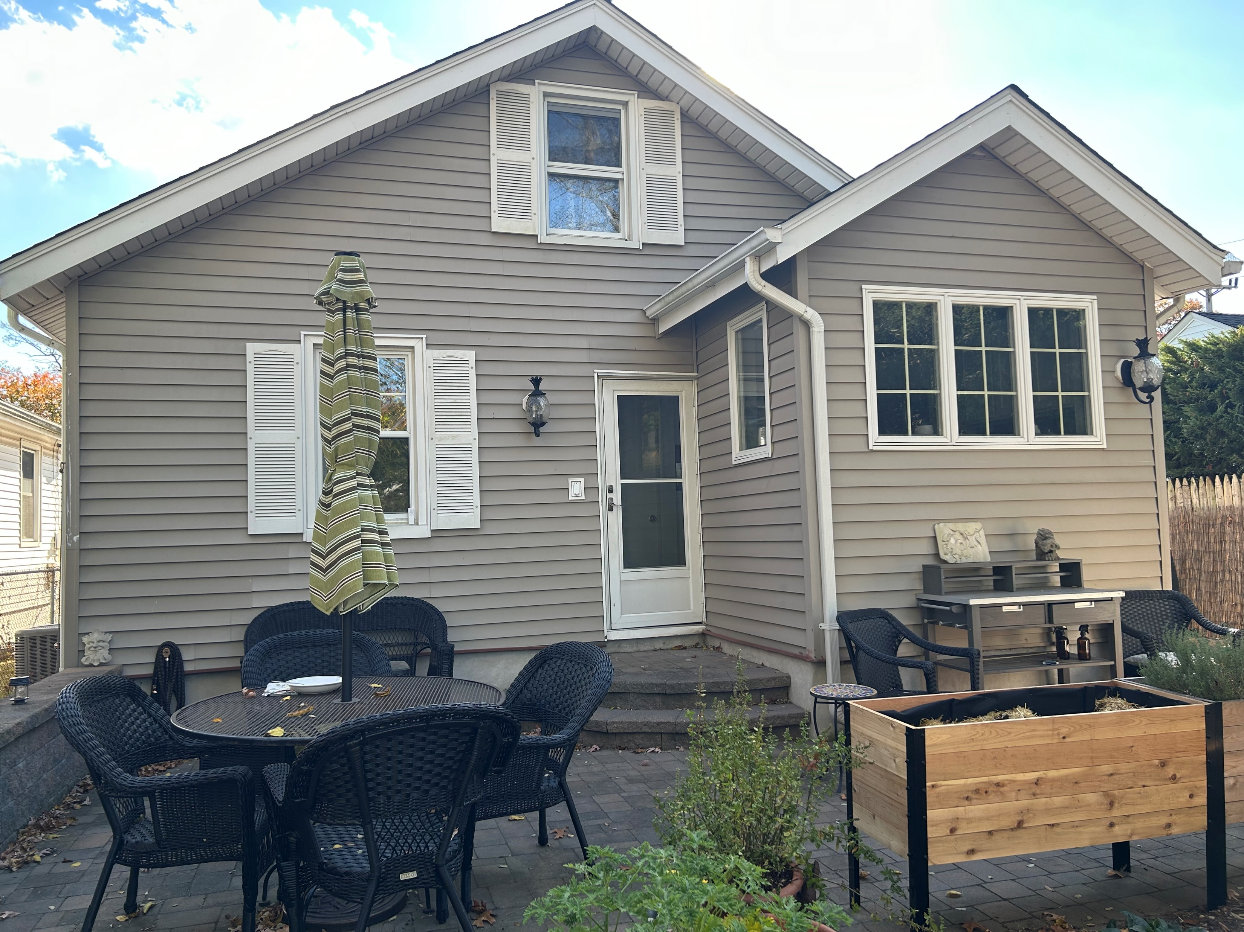

Slide 41
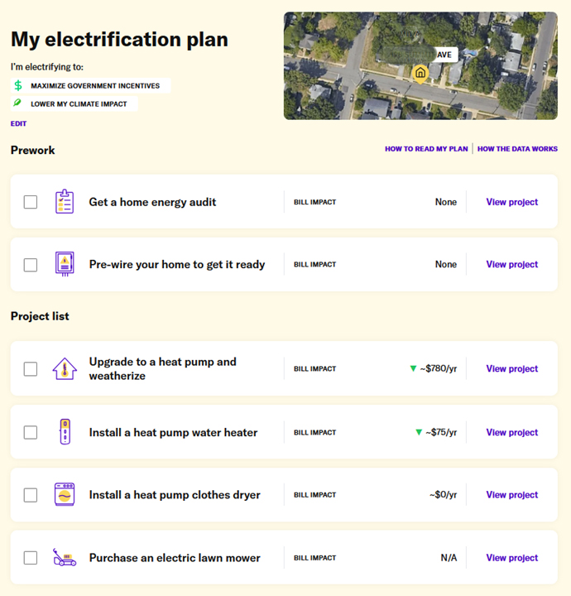
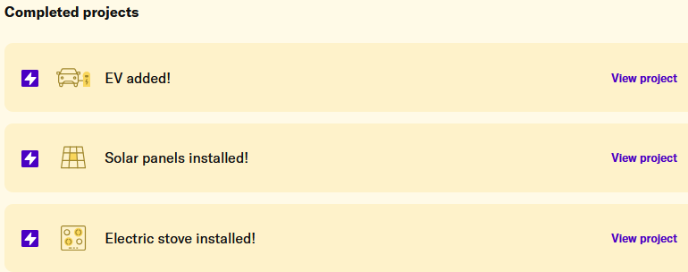

Slide 43
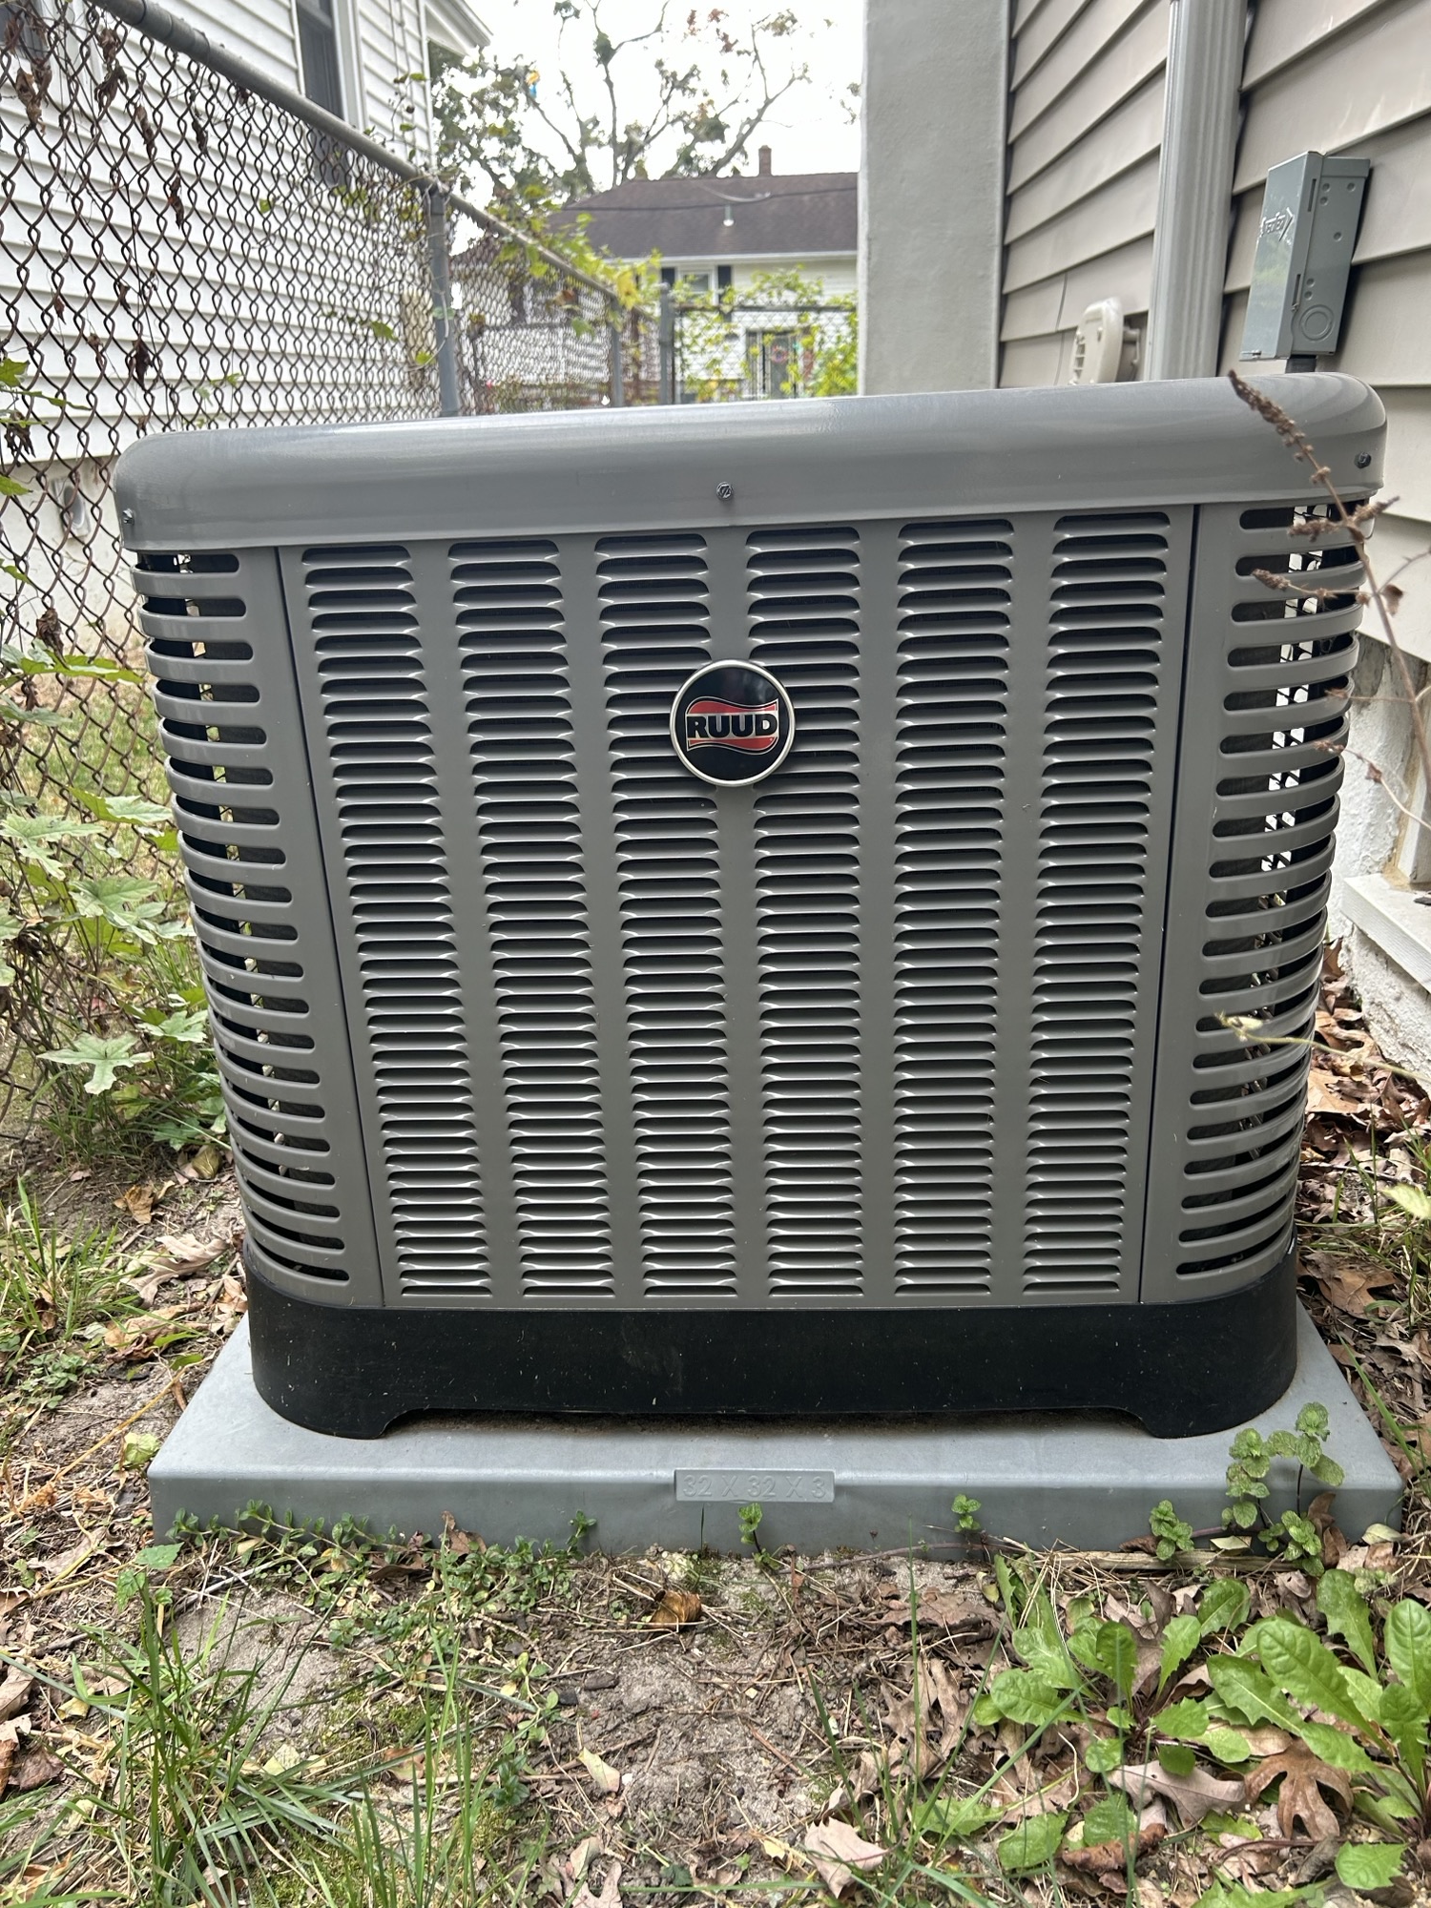
Notes:
We take a quick look outside, at the air conditioner.

Slide 44
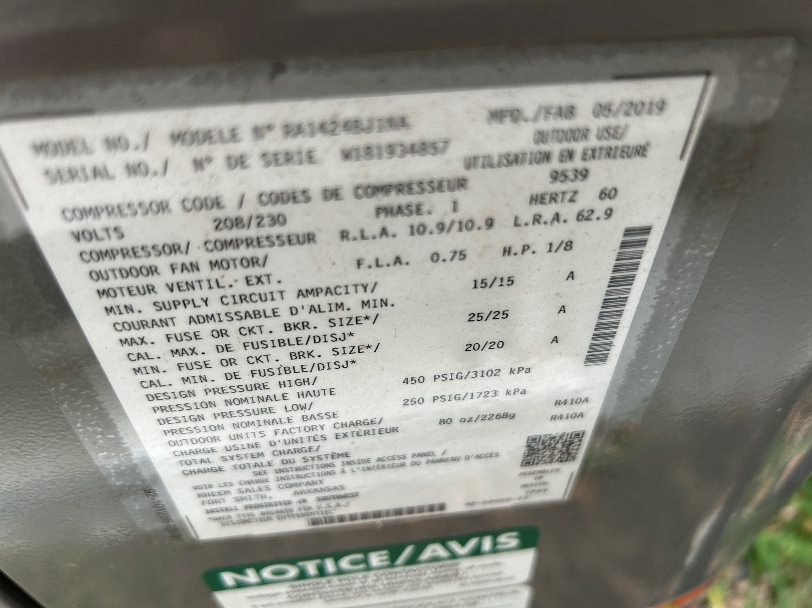

Slide 45
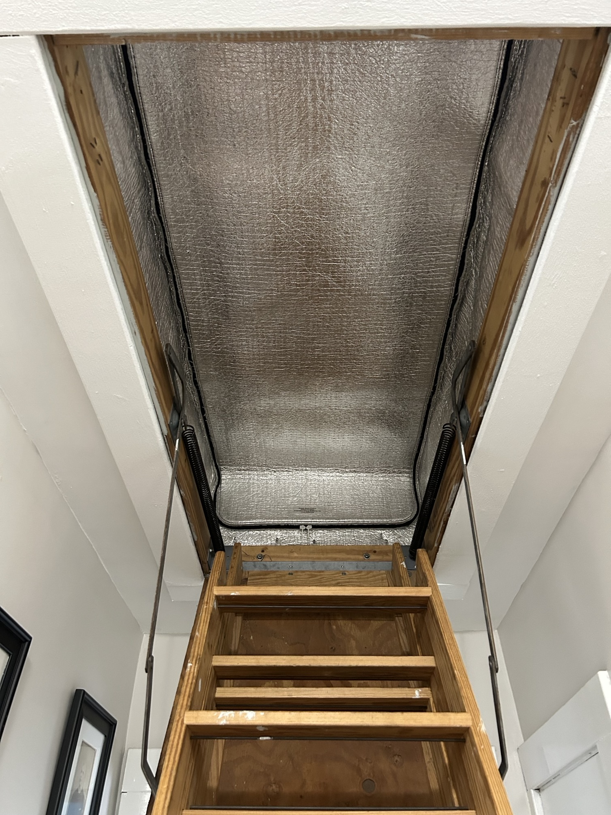

Slide 46
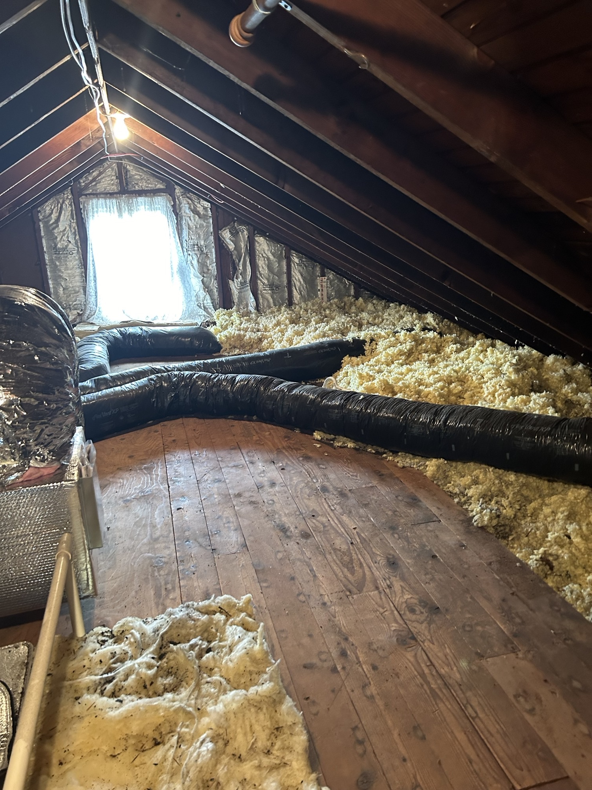

Slide 47
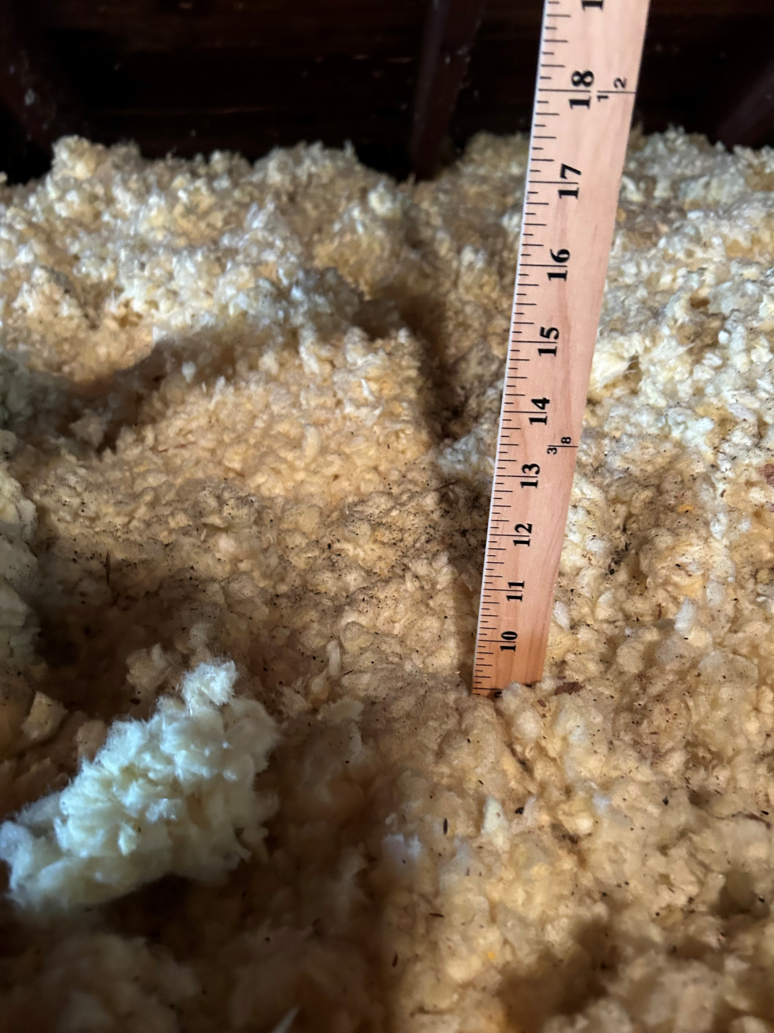

Slide 48
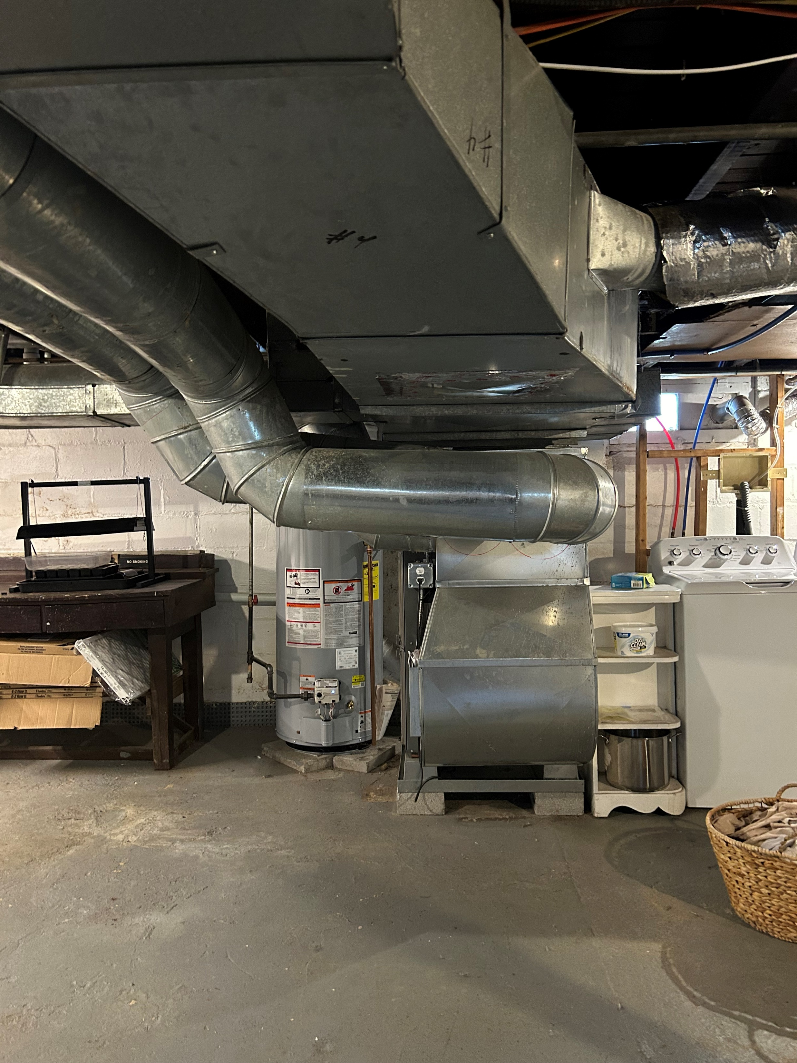
Notes:
.

Slide 49
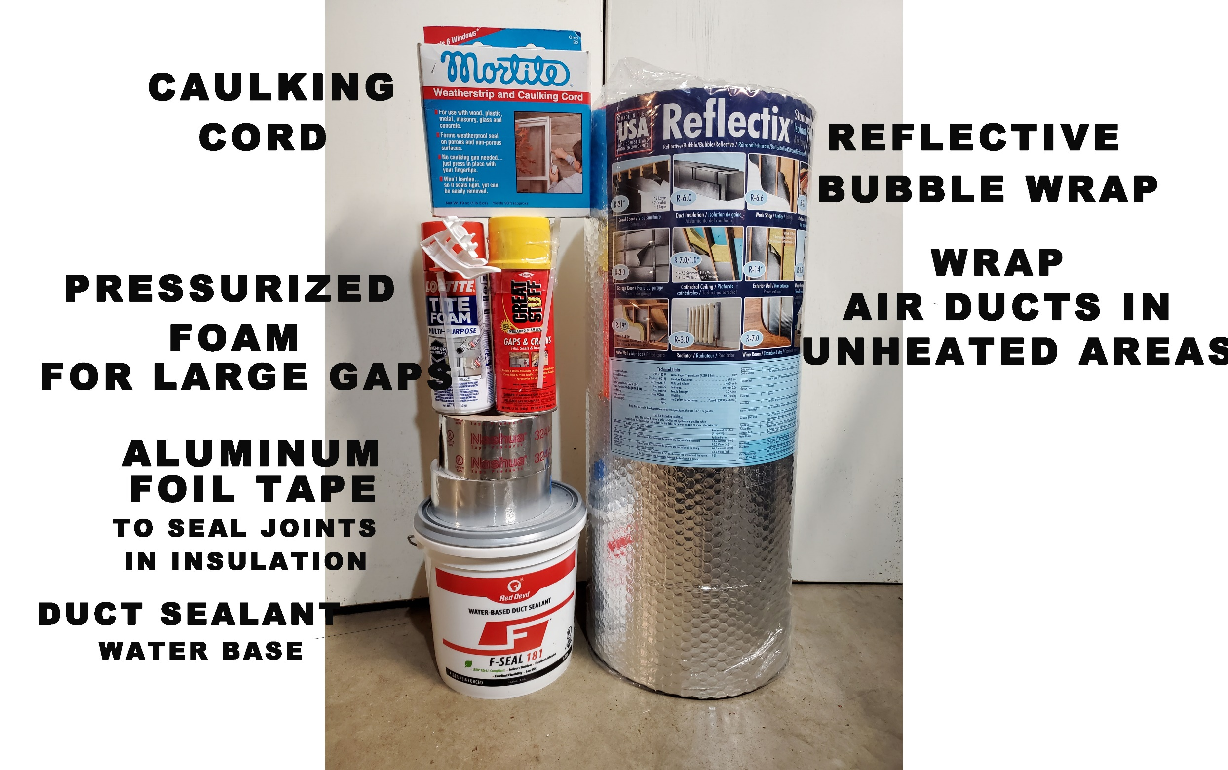
A SIMPLE DO-IT-YOURSELF PROJECT
DUCT SEALING

Slide 50
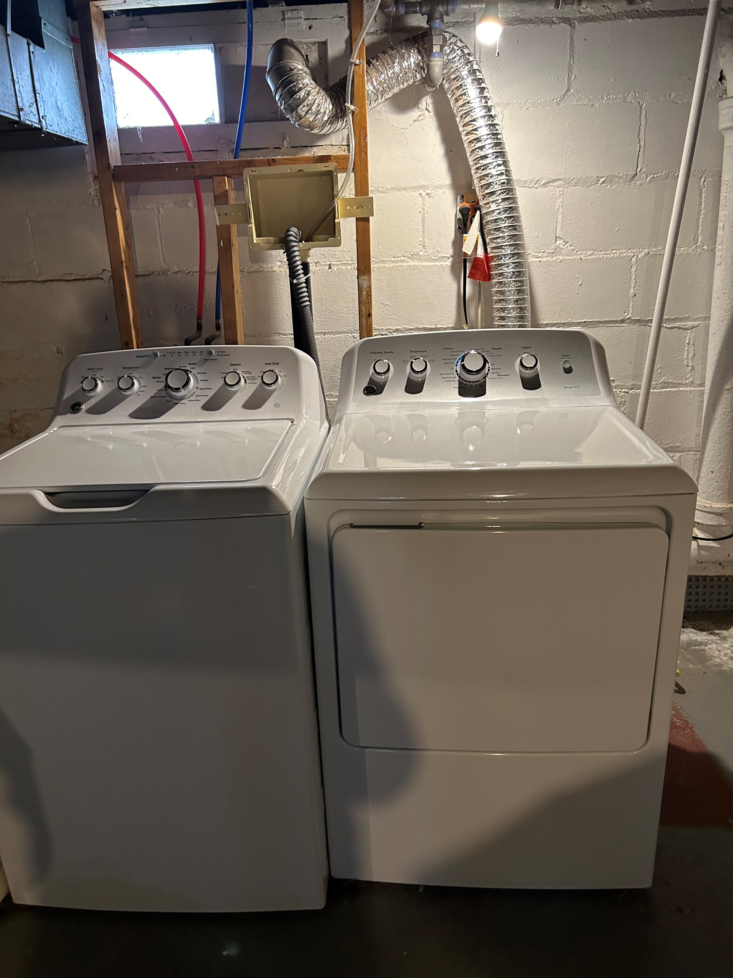

Slide 51
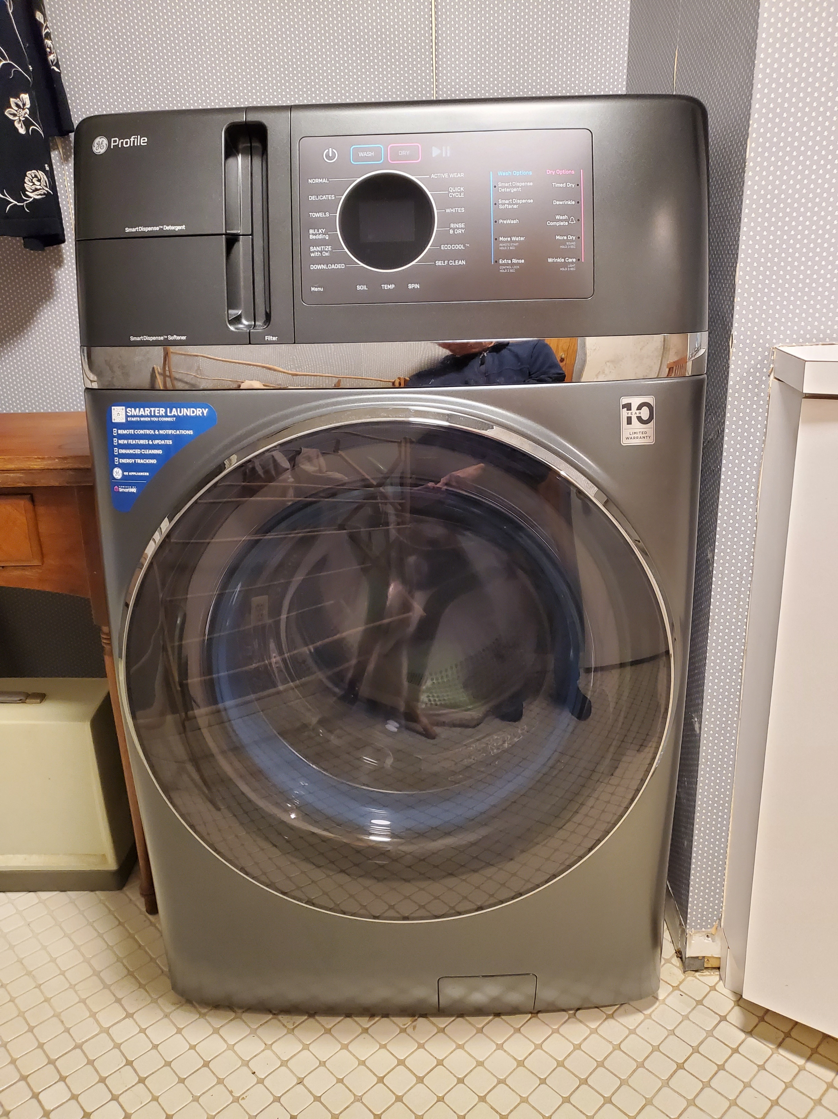

Slide 52
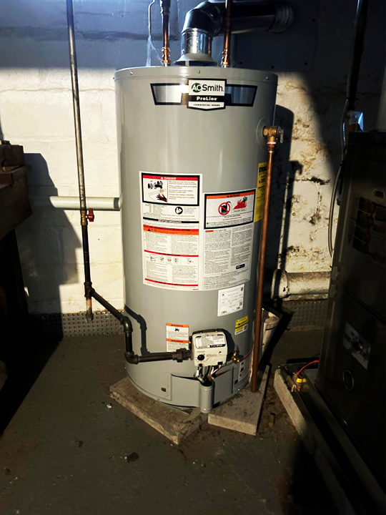

Slide 53
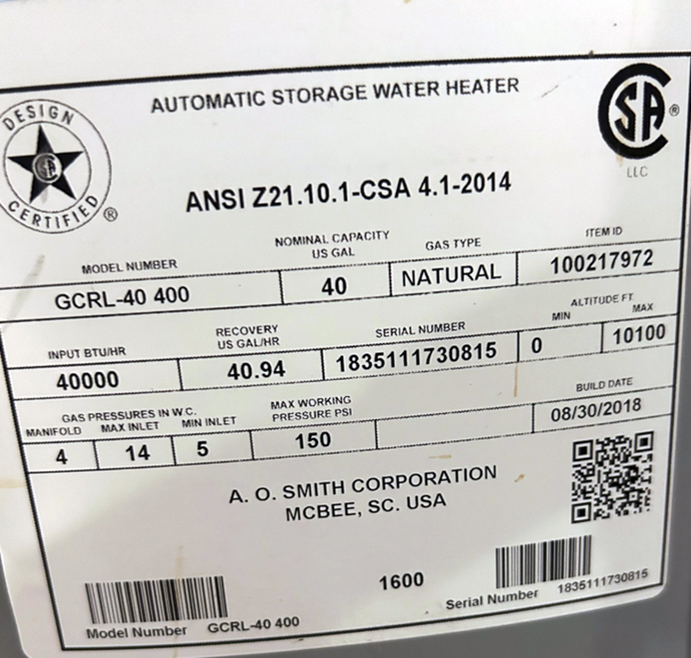
Notes:
The label for Karen’s current hot water tank. Capacity is 40 gallons, and manufactured in 2018. It is 6 years old. Tanks often leak after 10 years, so it is good you plan to replace

Slide 54
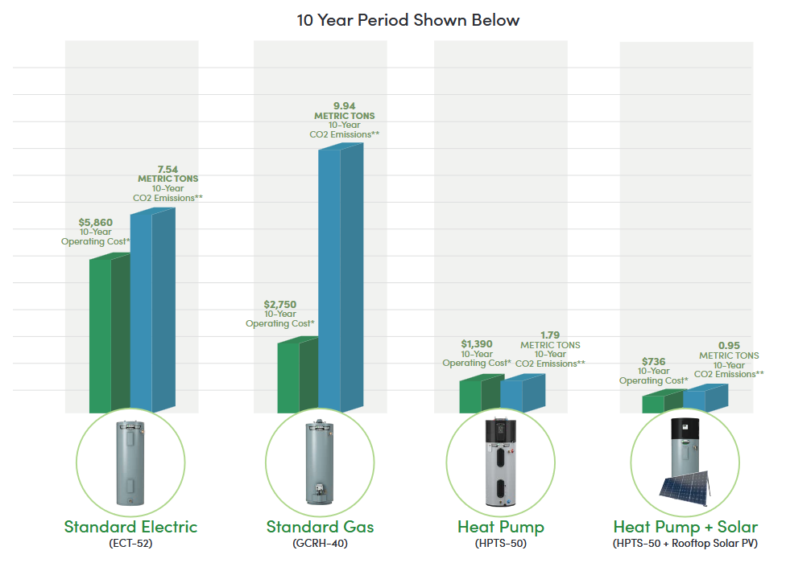
TOTAL OPERATING COST AND CO2 EMISSIONS
VARIOUS TYPES OF HOT WATER HEATER
Notes:
Based on DOE test procedure and Energy Guide comparison of 50-gallon nominal capacity pre-2015 standard electric (using DOE EF to UEF conversion rates),
A. O. Smith 40-gallon nominal capacity standard gas model GCRH-40 and A. O. Smith 50-gallon Voltex® AL heat pump water heaters. Annual energy cost based on $15.19
per thousand cubic feet natural gas and residential electricity cost of 16.25 cents/kWh in New Jersey. With rooftop PV it is assumed that 47% of the HPWH energy is pulled
from existing solar panels.
Source accessed February 2023: https://www.eia.gov/dnav/ng/ng_sum_lsum_a_EPG0_PRS_DMcf_m.htm
Source accessed February 2023: https://www.eia.gov/electricity/monthly/epm_table_grapher.php?t=epmt_5_06_a
**Sources for the CO2 emission calculations: https://www.nrel.gov/buildings/end-use-load-profiles.html; https://www.eia.gov/electricity/state/newjersey/

Slide 55
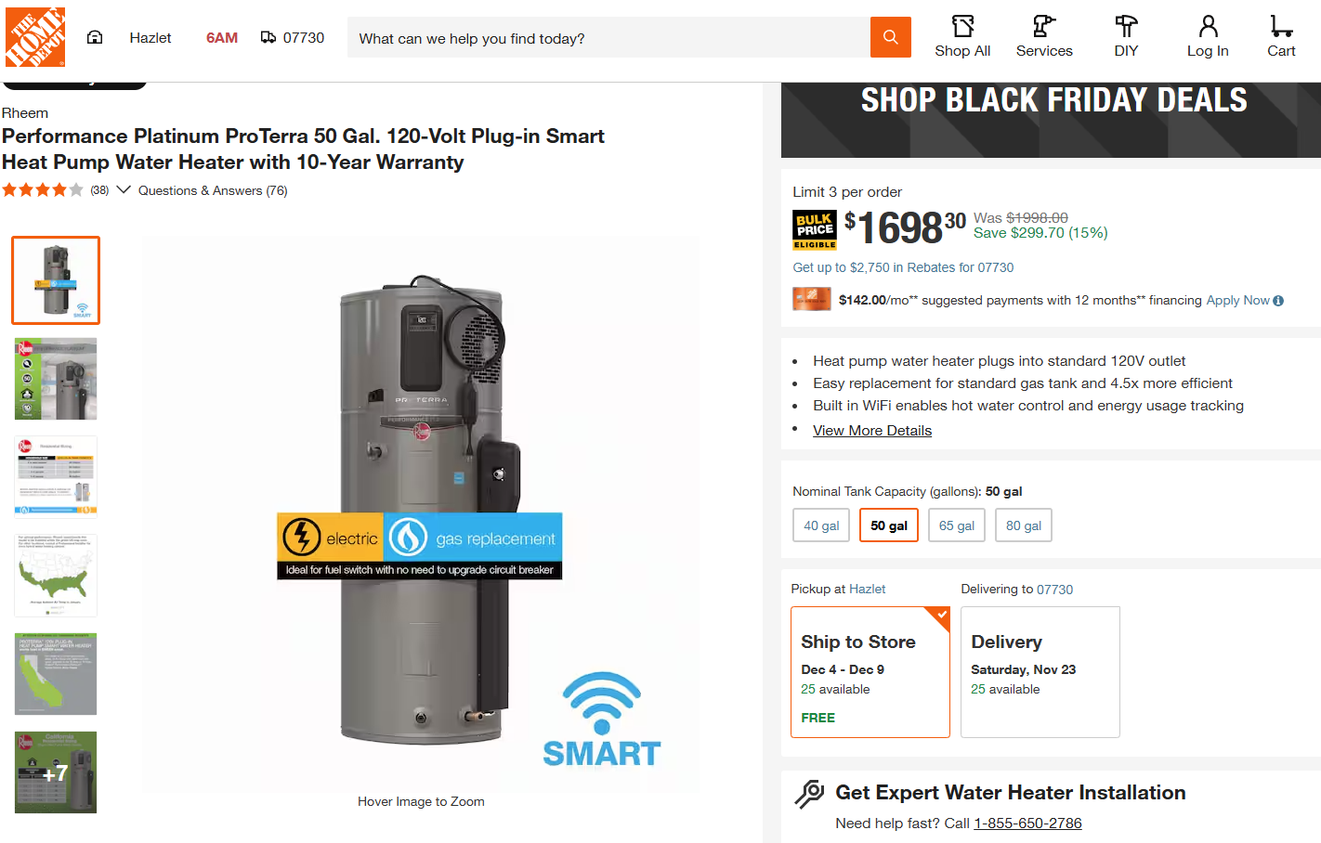

Slide 56
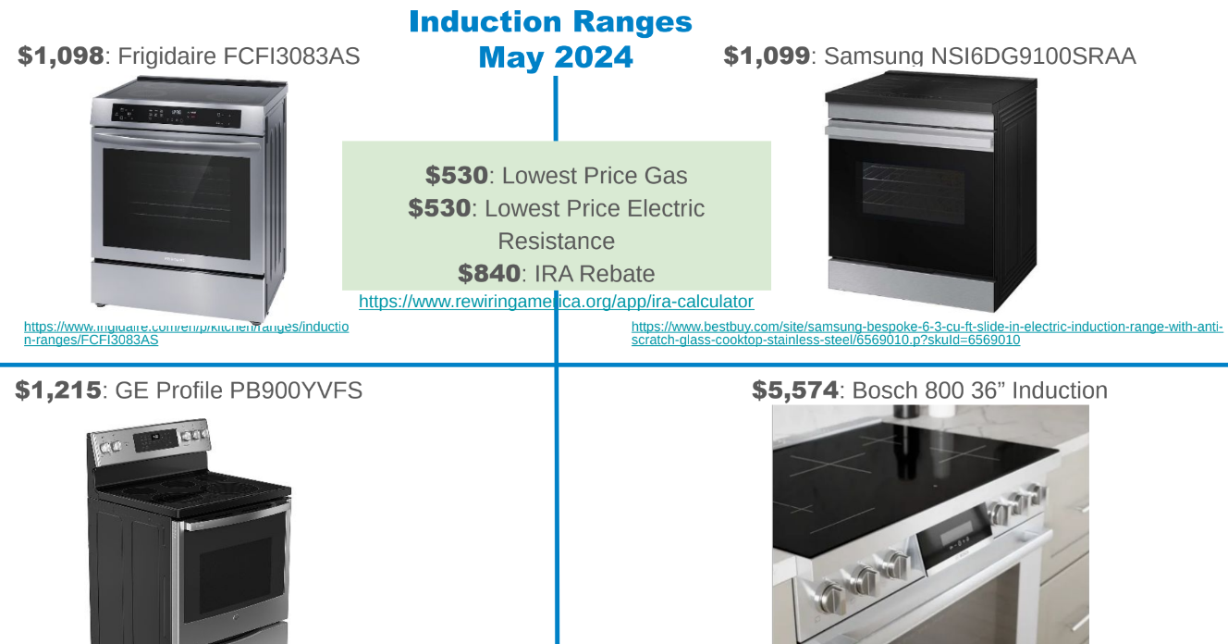

Slide 57
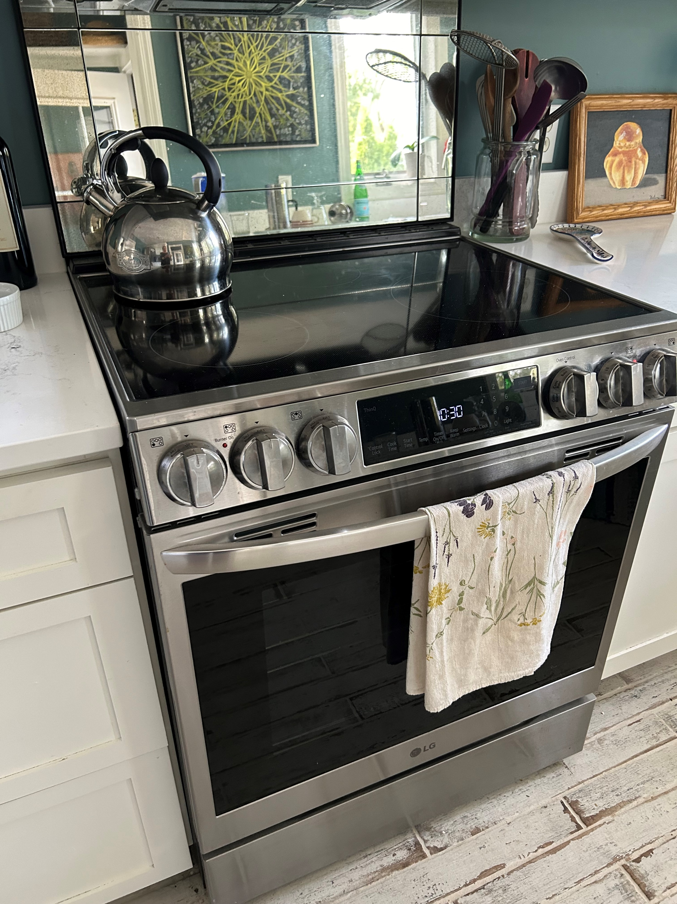

Slide 58
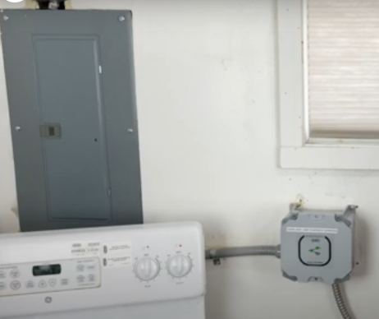

SHARE A 40 AMP CIRCUIT (RANGE SHOWN HERE) WITH AN EV CHARGER
(NO INCREASE IN PANEL ELECTRICAL LOAD)
ADD THIS “SIMPLESWITCH”
NEW CONDUIT
TO EXISTING PANEL
ELECTRIC RANGE
NEW CONDUIT TO NEW EV CHARGER

Slide 59
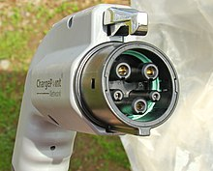
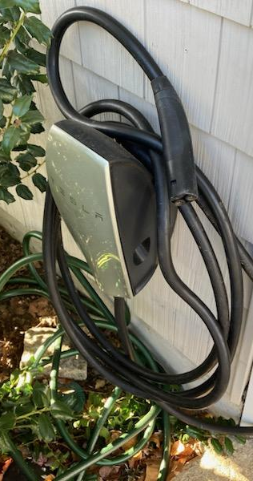


EV CHARGING
“UNIVERSAL WALL CONNECTOR” (mfd by Tesla)
$500 (Amazon); 24 foot cable
Program for your available power and car capability:
max currents of
48A, 40A, 32A, 24A, 16A, 12A
BOTH EV STANDARDS
two in one
(Charges Chevy Bolt)

Slide 60

MITSUBISHI COLD CLIMATE HEAT PUMP NTXSKH18A1124AA
Heat required by Karen’s house
Source: https://ashp.neep.org/#!/product_list/
Cooling required by Karen’s house

Slide 61

https://www.redwoodenergy.net/research/a-pocket-guide-to-all-electric-retrofits-of-single-family-homes (being updated)
Notes:
I highly recommend Redwood Energy “Quick Reference Guides”

Slide 62
USEFUL REFERENCES – pg 1
Redwood Energy (talks, plus research booklets) Several “pocket guides” available - see right panel of 1st page
BEST: https://www.redwoodenergy.net/research/a-pocket-guide-to-all-electric-retrofits-of-single-family-homes (being updated)
TOOLS:
"Electrification of Homes Without an Electrical Service Upgrade": Redwood Energy; appliance swapping; load-sharing devices;
"Watt Diet Calculator" Redwood Energy; (calculate electrical panel remaining capacity; share circuits; calculate house heat loss)

Slide 63
USEFUL REFERENCES- pg 2
ALL REFERENCES: https://climate.smiller.org/REF/ (600+)
“Climate Change and What you Can DO “ (5/16/2024)
https://smiller.org/REF1.docx
How To Identify Best Contractors & Best Heat Pumps
https://climate.smiller.org/50x30/building-electrification/vendor-recommendations.html
Weatherization overview: https://climate.smiller.org/50x30/building-electrification/vendor-recommendations-1.html
JCP&L Weatherization programs:
https://residential.energysavenj.com/jersey-central/MIWX/

Slide 64

Source: https://ashp.neep.org/#!/product_list
MITSUBISHI NTXSKH18A1124AA in Karen’s house

Slide 65


Slide 66


Slide 67


Slide 68


Slide 69

Pace of Progress | Rewiring America

Slide 70

Ex: Space Heating: 140 Million homes to convert by 2050
We need many Electrification Coaches and trained Contractors

Slide 71


Slide 72


Slide 73


Slide 74

Electric Coaches (rewiringamerica.org)

Slide 75
Volunteers Needed!
If you would like to learn how to become an Electrification Coach
  Email
    Pat Miller at patmiller@comcast.net
    Steve Miller at stevemiller@comcast.net
    Chris Proulx at chrisproulx98@yahoo.com

