Slide 1
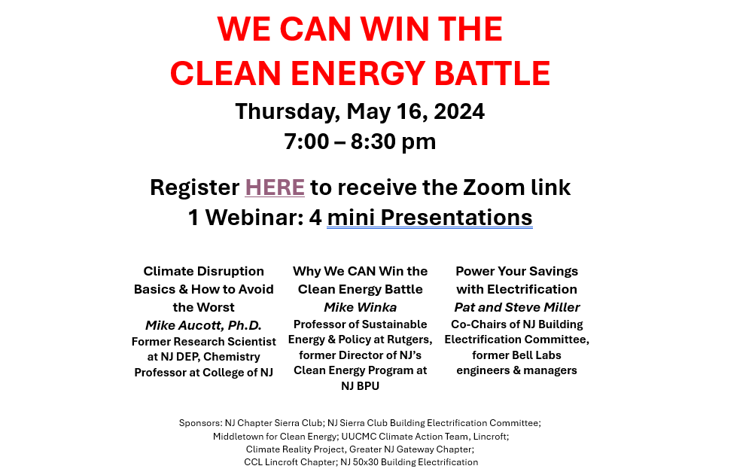

Slide 2

Pat and Steve Miller
May 2024
Power Your Savings with Electrification
and Inflation Reduction Act (IRA)
Source: NASA
Notes:
J:\s\Documents\BE\2022-11-6-Trinity-Episcopal\2022-11-06-Moorestown-Slides.pptx
ID #3 - Can be used in noncommercial online and TV broadcasts of your presentation.
And then on the last of the Apollo missions, this image known as the Blue Marble, became the most reproduced photograph in all of human history. The climate crisis is now the biggest and most serious challenge that humanity has ever faced.
DESCRIPTION: Photo of Earth from Apollo 17, taken as the crew was traveling toward the moon, December 7, 1972
ADDITIONAL TALKING POINTS: This picture is called the “Blue Marble,” taken during the last Apollo mission.
What makes the photograph so unique and powerful is that it captures the complete circle of the earth, helping us see the big picture of our planet – and our lives on it.[1*] It was the first time the Apollo mission made it possible to capture almost the entire southern polar ice cap.[2*]
REFERENCES:
[1*] Ben Cosgrove, “Home, Sweet Home: In Praise of Apollo 17’s ‘Blue Marble’,” Time, April 11, 2014. http://time.com/3879555/blue-marble-apollo-17-photo-of-earth-from-space/
[2*] NASA Visible Earth, “The Blue Marble from Apollo 17," December 7, 1972. http://visibleearth.nasa.gov/view.php?id=55418

Slide 3


Notes:
ID #7753 - This slide deck may be used in non-commercial presentations that are recorded, broadcast, livestreamed, or presented in-person. You may add your own personal slides to it, but users should make sure they have permission to include any third-party content in their personal slides. You may also remove slides to reduce the length. This slide deck may not be re-published without permission from Climate Reality, used for commercial purposes, or used to support or oppose candidates (or groups of candidates) for elected office. Finally, this slide deck may not be used to claim that The Climate Reality Project endorses any particular legislative action.
This Act allocates almost $370 billion, according to the official estimate, to climate solutions and energy security, but it comes largely in the form of tax credits that don't have a limit on how many of them can be activated. So there are many experts who believe that it's going to be much larger than that.
DESCRIPTION: Text stating that as written, the IRA allocates $369 billion to energy security and climate solutions
SLIDE SOURCE(S): https://www.whitehouse.gov/wp-content/uploads/2022/12/Inflation-Reduction-Act-Guidebook.pdf; https://www.democrats.senate.gov/imo/media/doc/inflation_reduction_act_one_page_summary.pdf

Slide 4
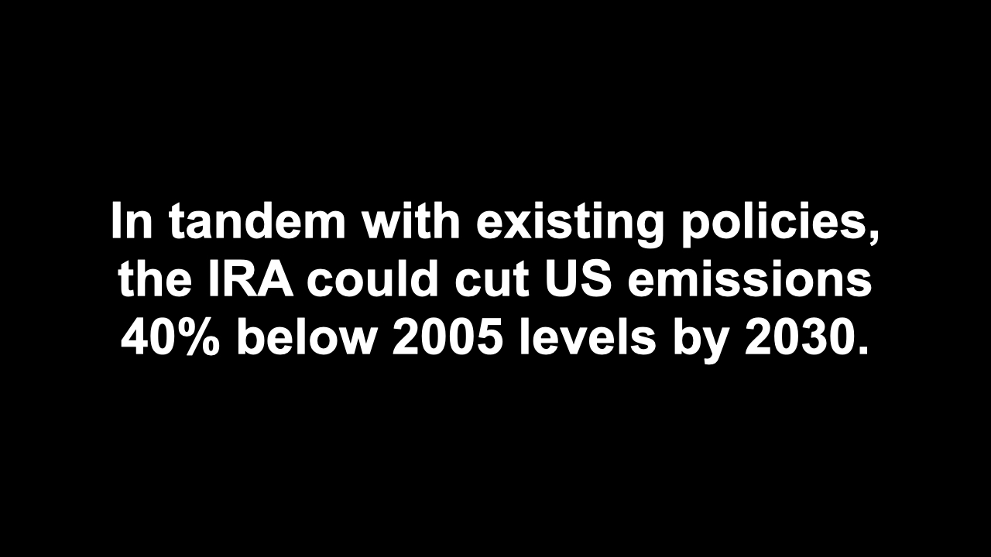
Notes:
ID #7759 - This slide deck may be used in non-commercial presentations that are recorded, broadcast, livestreamed, or presented in-person. You may add your own personal slides to it, but users should make sure they have permission to include any third-party content in their personal slides. You may also remove slides to reduce the length. This slide deck may not be re-published without permission from Climate Reality, used for commercial purposes, or used to support or oppose candidates (or groups of candidates) for elected office. Finally, this slide deck may not be used to claim that The Climate Reality Project endorses any particular legislative action.
This law, when combined with existing policy, will enable the US to sharply reduce global warming pollution by 40% or so below the 2005 levels. That's getting close to the commitments we made as part of the Paris Agreement.
DESCRIPTION: Text stating that in tandem with existing policies, the IRA could cut US emissions 40% below 2005 levels by 2030
SLIDE SOURCE(S): https://rhg.com/research/climate-clean-energy-inflation-reduction-act/

Slide 5

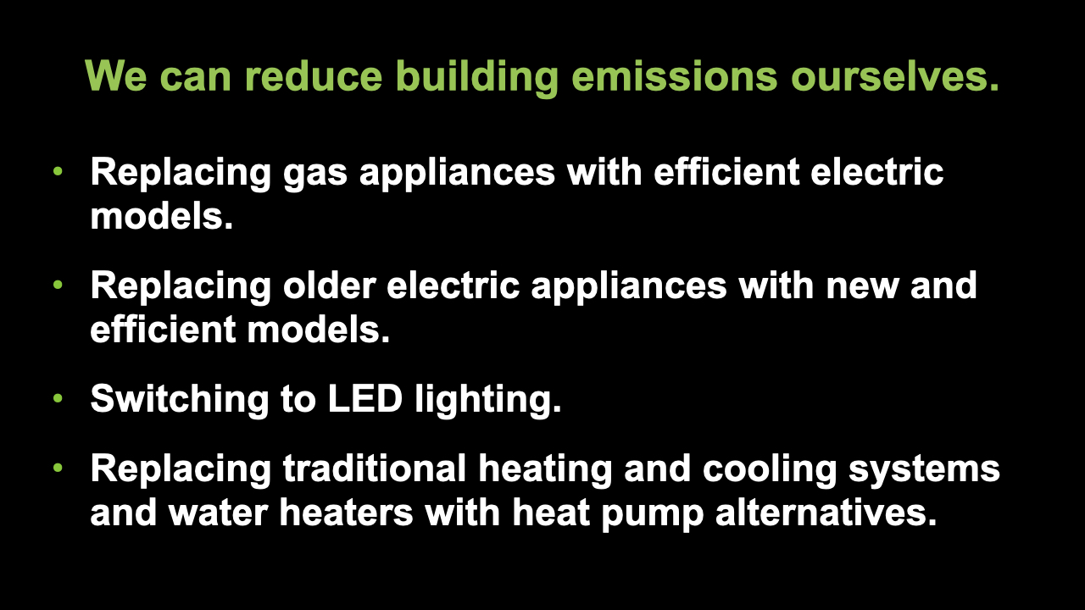
Notes:
ID #7850 - This slide deck may be used in non-commercial presentations that are recorded, broadcast, livestreamed, or presented in-person. You may add your own personal slides to it, but users should make sure they have permission to include any third-party content in their personal slides. You may also remove slides to reduce the length. This slide deck may not be re-published without permission from Climate Reality, used for commercial purposes, or used to support or oppose candidates (or groups of candidates) for elected office. Finally, this slide deck may not be used to claim that The Climate Reality Project endorses any particular legislative action.
There are many ways that individuals can pursue building decarbonization, including the replacement of gas-fueled appliances with more efficient electric alternatives. They can replace older electric appliances with newer, far more efficient models, because they've gotten a lot better in recent years. They can change the lightbulbs. I always say, "It's important to change the lightbulbs, more important to change the laws." But the lightbulbs are important. There are so many new options and different kinds of LEDs. They're cheaper, they last 10 times as long, they use far less electricity. Some people know this already, but for those who don't, let's encourage them to switch as well. They can replace their traditional HVAC systems, heating and air conditioning, with heat pumps, and they can replace their traditional water heaters with heat pump water heaters. This technology doesn't sound like it has a lot of so-called "sex appeal," but they're great, they're so much more efficient, and they save you so much money, and it doesn't matter how cold the climate is where you live. People in Maine, people in Canada, it works fine, doesn't matter how cold it is. Heat pumps are just much better.
DESCRIPTION: Text stating that we can reduce building emissions ourselves by replacing gas appliances with efficient electric models; replacing older electric appliances with new and efficient models; switching to LED lighting; and replacing traditional heating and cooling systems and water heaters with heat pump alternatives
SLIDE SOURCE(S): https://surveys.signforgood.com/rewiring-america-electrify-everything?code=jtk9-ot-fl

Slide 6

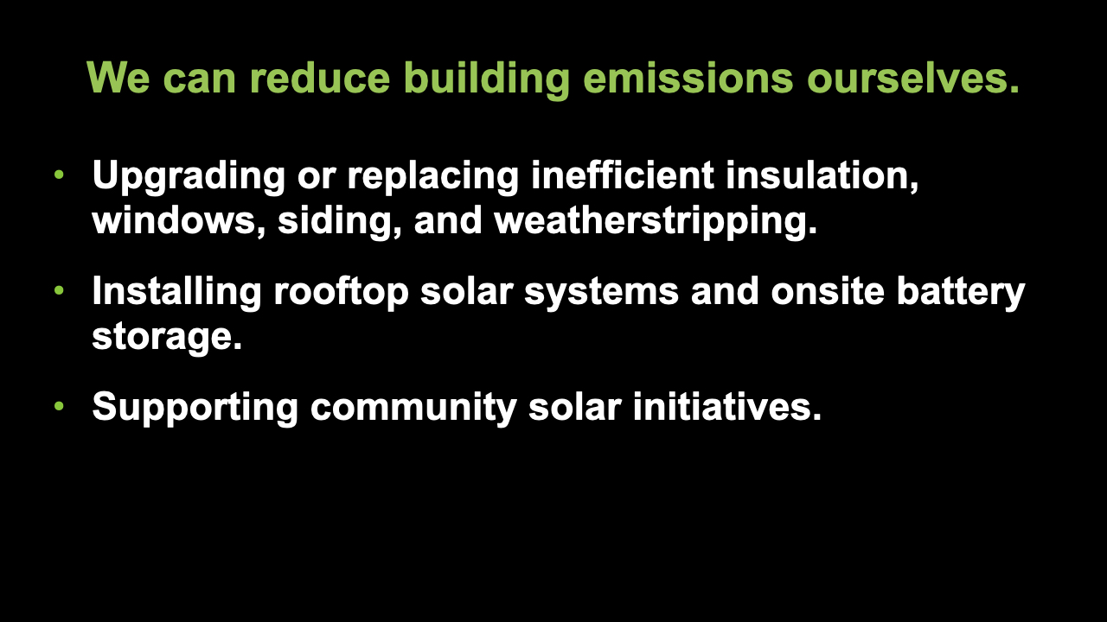
Notes:
ID #7869 - This slide deck may be used in non-commercial presentations that are recorded, broadcast, livestreamed, or presented in-person. You may add your own personal slides to it, but users should make sure they have permission to include any third-party content in their personal slides. You may also remove slides to reduce the length. This slide deck may not be re-published without permission from Climate Reality, used for commercial purposes, or used to support or oppose candidates (or groups of candidates) for elected office. Finally, this slide deck may not be used to claim that The Climate Reality Project endorses any particular legislative action.
It also means, by the way, replacing inefficient insulation, upgrading your insulation, making sure you have the best kinds of windows. Lots of heat goes out of poorly made, poorly designed windows in the winter, and a lot of cooling air goes out in the summer. Keep up with the weatherstripping and siding. There are now benefits available to help you do all of these things, including installing rooftop photovoltaic systems and installing on-site battery storage. Lots of people are doing this, and the provisions of this new law make it much easier for everybody to do it. Also, we can support community solar initiatives where individual solar systems aren't really that viable. Say, if you're living in an apartment, you can't put it on your windowsill, but you can be part of a group using community solar. That's a very fast-growing form of solar energy.
DESCRIPTION: Text stating that we can reduce building emissions ourselves by upgrading or replacing inefficient insulation, windows, siding, and weatherstripping; installing rooftop solar systems and onsite battery storage; and supporting community solar initiatives
SLIDE SOURCE(S): https://surveys.signforgood.com/rewiring-america-electrify-everything?code=jtk9-ot-fl

Slide 7
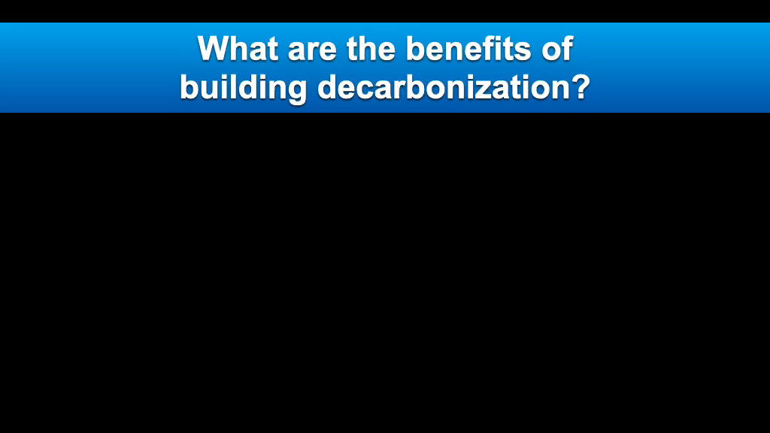
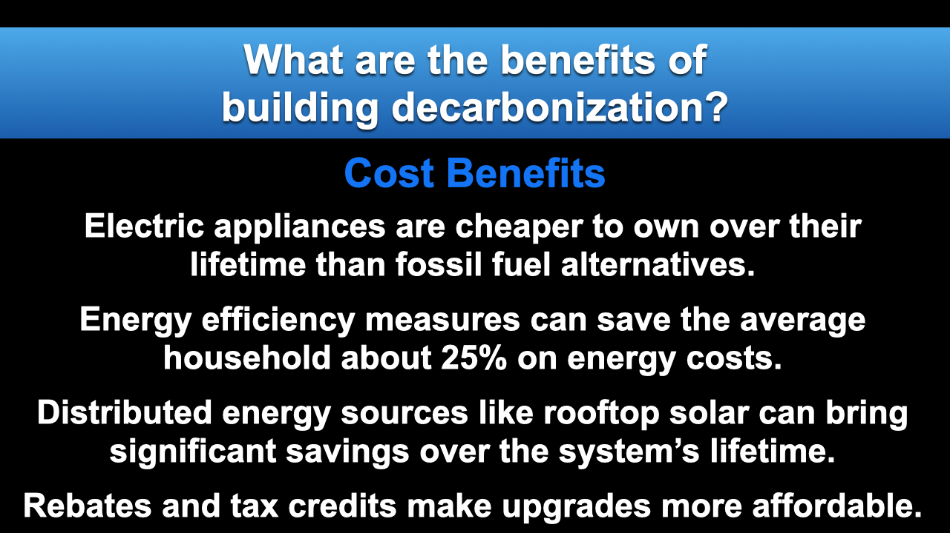
Notes:
ID #7852 - This slide deck may be used in non-commercial presentations that are recorded, broadcast, livestreamed, or presented in-person. You may add your own personal slides to it, but users should make sure they have permission to include any third-party content in their personal slides. You may also remove slides to reduce the length. This slide deck may not be re-published without permission from Climate Reality, used for commercial purposes, or used to support or oppose candidates (or groups of candidates) for elected office. Finally, this slide deck may not be used to claim that The Climate Reality Project endorses any particular legislative action.
And there are cost benefits. The electric appliances have a much lower lifetime cost of operating and cost of ownership than the fossil fuel-based alternatives. It's been proven. The energy efficiency measures can save the average household about 25% on energy costs, and that adds up to real money. Distributed energy sources – that's a phrase that often applies to rooftop solar – can bring significant savings over the life of the system. And the rebates and tax credits in this law make all of these upgrades far more affordable.
DESCRIPTION: Text explaining the cost benefits of building decarbonization. Electric appliances are cheaper to own over their lifetime than fossil fuel alternatives. Energy efficiency measures can save the average household about 25% on energy costs. Distributed energy sources like rooftop solar can bring significant savings over the system’s lifetime. Rebates and tax credits make upgrades more affordable.
SLIDE SOURCE(S): https://rmi.org/insight/the-economics-of-electrifying-buildings/; https://www.energysage.com/energy-efficiency/why-conserve-energy/cost-of-ee/; https://news.energysage.com/much-solar-panels-save/

Slide 8
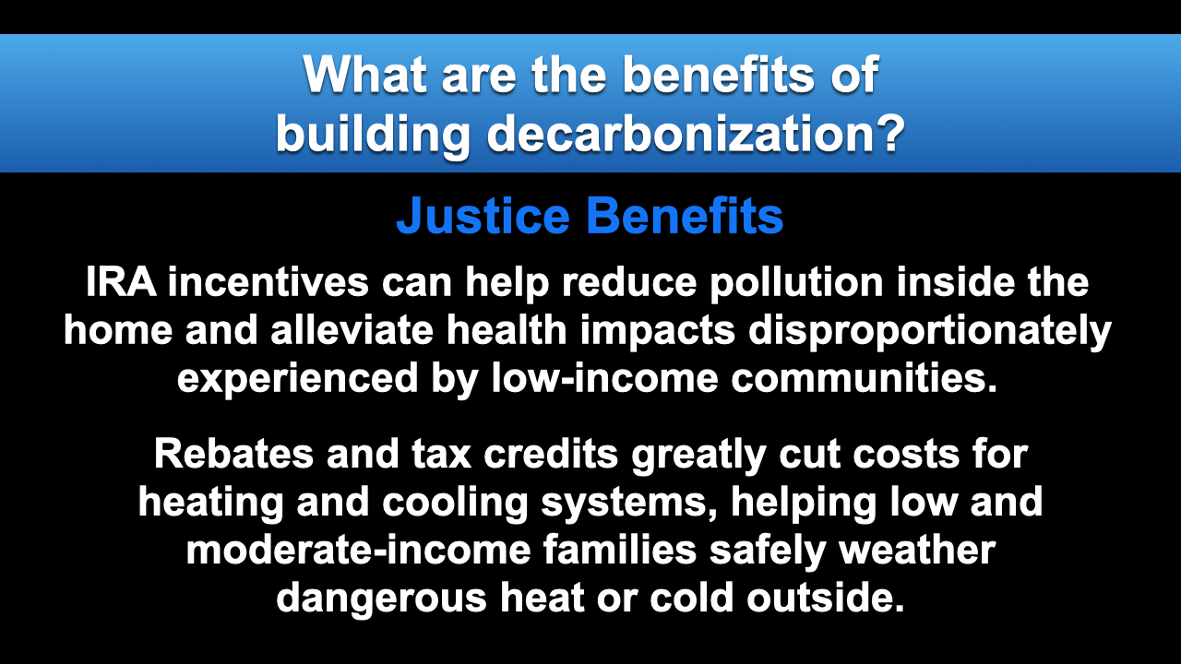
Notes:
ID #7853 - This slide deck may be used in non-commercial presentations that are recorded, broadcast, livestreamed, or presented in-person. You may add your own personal slides to it, but users should make sure they have permission to include any third-party content in their personal slides. You may also remove slides to reduce the length. This slide deck may not be re-published without permission from Climate Reality, used for commercial purposes, or used to support or oppose candidates (or groups of candidates) for elected office. Finally, this slide deck may not be used to claim that The Climate Reality Project endorses any particular legislative action.
There are benefits where environmental justice is concerned, and it's high time that we pay the kind of attention to that horrible challenge and the needed solutions that we see in this law. Home environments have been shown to be extremely important determinants of the health of the people who live in those homes, and low-income communities experience higher rates of asthma, especially among children, and are far more likely to suffer from the health impacts related to pollution and the exposure to extreme heat. These incentives will have maybe the biggest impact in the communities that have been unable, financially, to make these improvements. They're subsidized, and the benefits are tremendous. Available incentives also especially benefit the frontline communities by lowering their exposure to pollution inside the homes and increasing access to clean and affordable heating and cooling technologies.
DESCRIPTION: Text explaining the justice benefits of building decarbonization. IRA incentives can help reduce pollution inside the home and alleviate health impacts disproportionately experienced by low-income communities. Rebates and tax credits greatly cut costs for heating and cooling systems, helping low and moderate-income families safely weather dangerous heat or cold outside.
SLIDE SOURCE(S): https://rmi.org/eight-benefits-of-building-electrification-for-households-communities-and-climate/; https://rmi.org/insight/decarbonizing-homes/; https://www.novoco.com/notes-from-novogradac/inflation-reduction-act-overview-clean-energy-provisions-and-their-impact-affordable-housing

Slide 9
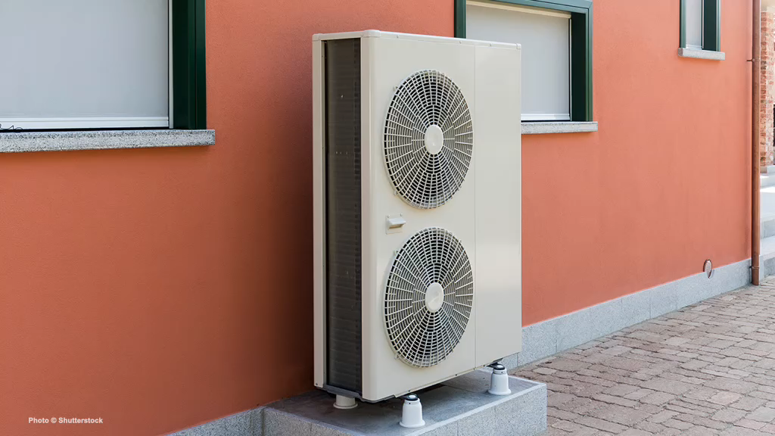
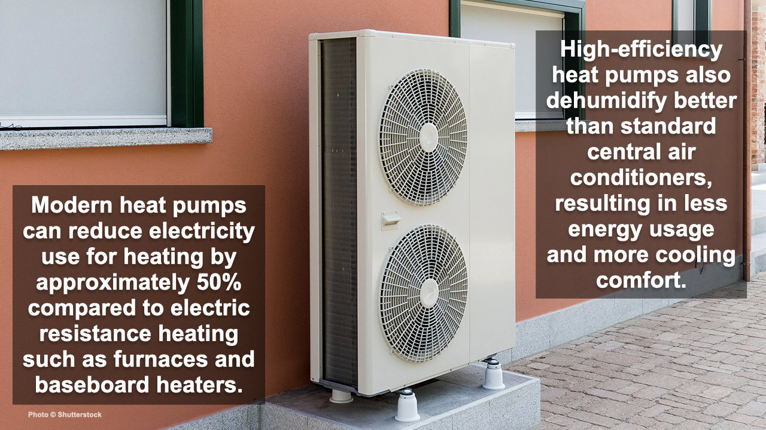
Notes:
ID #7871 - This slide deck may be used in non-commercial presentations that are recorded, broadcast, livestreamed, or presented in-person. You may add your own personal slides to it, but users should make sure they have permission to include any third-party content in their personal slides. You may also remove slides to reduce the length. This slide deck may not be re-published without permission from Climate Reality, used for commercial purposes, or used to support or oppose candidates (or groups of candidates) for elected office. Finally, this slide deck may not be used to claim that The Climate Reality Project endorses any particular legislative action.
I told you we'd talk about heat pumps. Here's an example of one. These modern heat pumps are incredibly efficient. They reduce electricity use for heating by half compared to electric resistance heating like furnaces and baseboard heaters. And the high-efficiency heat pumps dehumidify much better than the standard central air conditioning units, and that results in less energy use and more cooling comfort.
DESCRIPTION: Photo of a heat pump outside an orange building, with text stating that modern heat pumps can reduce electricity use for heating by approximately 50% compared to electric resistance heating such as furnaces and baseboard heaters. High-efficiency heat pumps also dehumidify better than standard central air conditioners, resulting in less energy usage and more cooling comfort.
SLIDE SOURCE(S): https://www.energy.gov/energysaver/heat-pump-systems

Slide 10
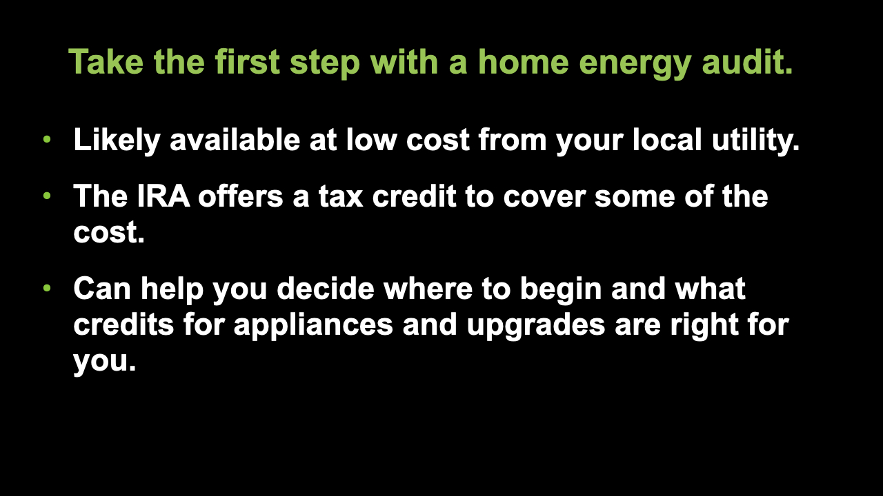
Notes:
ID #7874 - This slide deck may be used in non-commercial presentations that are recorded, broadcast, livestreamed, or presented in-person. You may add your own personal slides to it, but users should make sure they have permission to include any third-party content in their personal slides. You may also remove slides to reduce the length. This slide deck may not be re-published without permission from Climate Reality, used for commercial purposes, or used to support or oppose candidates (or groups of candidates) for elected office. Finally, this slide deck may not be used to claim that The Climate Reality Project endorses any particular legislative action.
A home energy audit is the first step on your journey toward electrification of your home. Your local electric utility likely offers this service at a very low price, and the IRA offers a tax credit to cover some of the cost of a home energy audit. It's worth getting. An audit can help you decide where to begin investing in the electrification of your home and in choosing the tax credits for efficient appliances and weatherization upgrades that are best for you.
DESCRIPTION: Text stating: take the first step with a home energy audit. Likely available at low cost from your local utility; the IRA offers a tax credit to cover some of the cost; and can help you decide where to begin and what credits for appliances and upgrades are right for you.
ADDITIONAL TALKING POINTS: A home energy audit will help you identify where your house may be leaking heat or otherwise consuming unnecessary energy.
SLIDE SOURCE(S): https://www.energy.gov/energysaver/professional-home-energy-assessments; https://www.nrdc.org/stories/consumer-guide-inflation-reduction-act; https://www.rewiringamerica.org/app/ira-calculator/information/weatherization

Slide 11
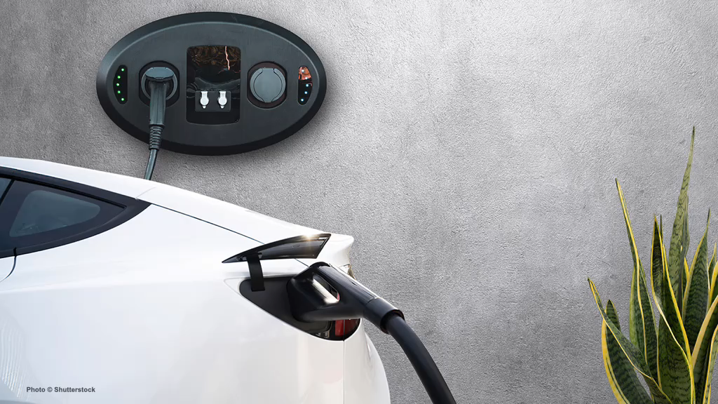
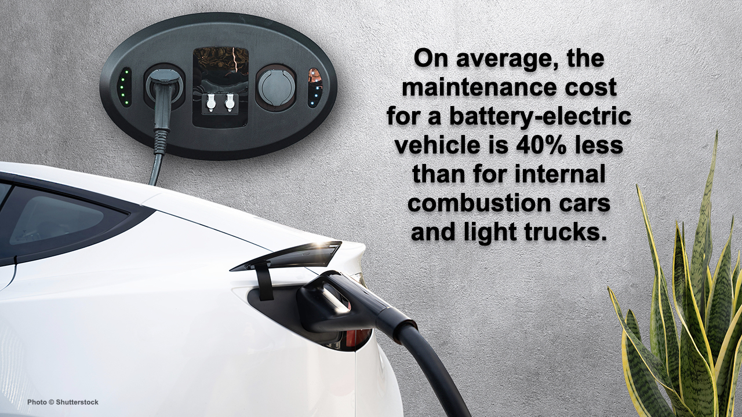
Notes:
ID #7872 - This slide deck may be used in non-commercial presentations that are recorded, broadcast, livestreamed, or presented in-person. You may add your own personal slides to it, but users should make sure they have permission to include any third-party content in their personal slides. You may also remove slides to reduce the length. This slide deck may not be re-published without permission from Climate Reality, used for commercial purposes, or used to support or oppose candidates (or groups of candidates) for elected office. Finally, this slide deck may not be used to claim that The Climate Reality Project endorses any particular legislative action.
When it comes to electric vehicles (EVs), you see the same improvements. On average, the maintenance cost for a battery-electric vehicle is 40% less than the maintenance cost for internal combustion engines and, of course, the cost of operation is much, much lower.
DESCRIPTION: Photo of a white EV plugged into a wall charger, with text stating that on average, the maintenance cost for a battery-electric vehicle is 40% less than for internal combustion cars and light trucks
SLIDE SOURCE(S): https://cleantechnica.com/2021/06/22/its-official-us-government-says-electric-vehicles-cost-40-less-to-maintain/

Slide 12
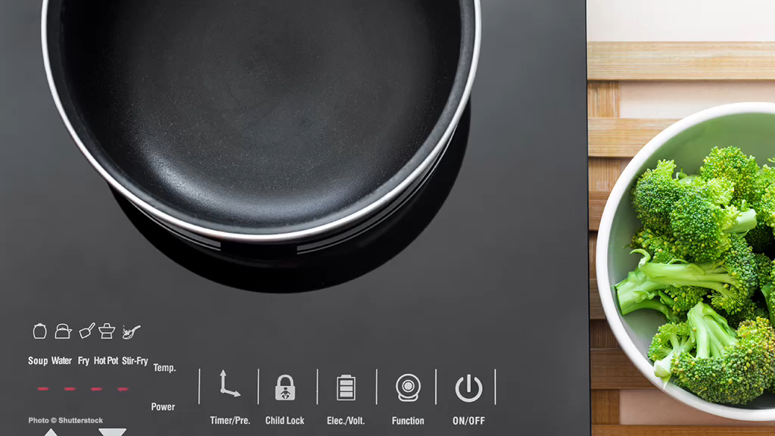
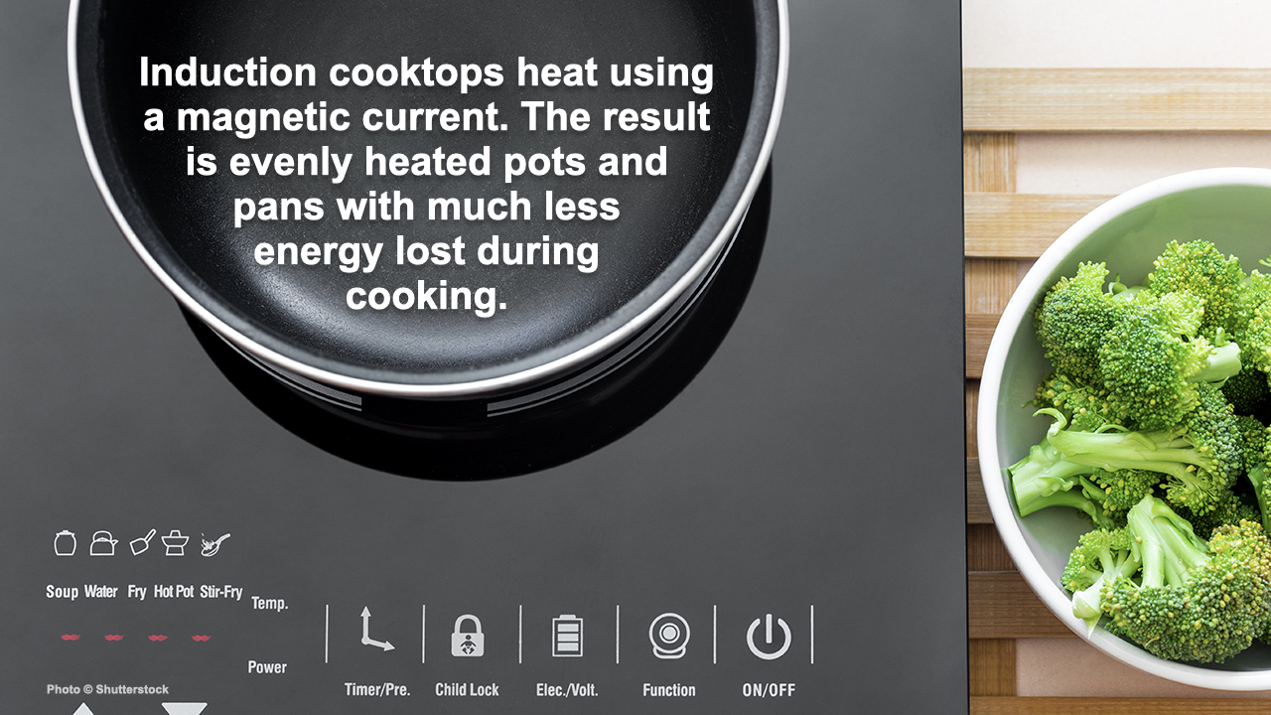
Notes:
ID #7870 - This slide deck may be used in non-commercial presentations that are recorded, broadcast, livestreamed, or presented in-person. You may add your own personal slides to it, but users should make sure they have permission to include any third-party content in their personal slides. You may also remove slides to reduce the length. This slide deck may not be re-published without permission from Climate Reality, used for commercial purposes, or used to support or oppose candidates (or groups of candidates) for elected office. Finally, this slide deck may not be used to claim that The Climate Reality Project endorses any particular legislative action.
Induction cooktops use heat in an unusual way. They use a magnetic current that is evenly distributed through the cooking pan. The experts have been recommending it for a long time. Now with these incentives, it's time to make that switch.
DESCRIPTION: Photo of an induction cooktop next to a bowl of broccoli, with text stating that induction cooktops heat using a magnetic current, and the result is evenly heated pots and pans with much less energy lost during cooking
SLIDE SOURCE(S): https://www.cnet.com/home/kitchen-and-household/induction-vs-electric-cooktops-which-is-right-for-you-in-2021/

Slide 13
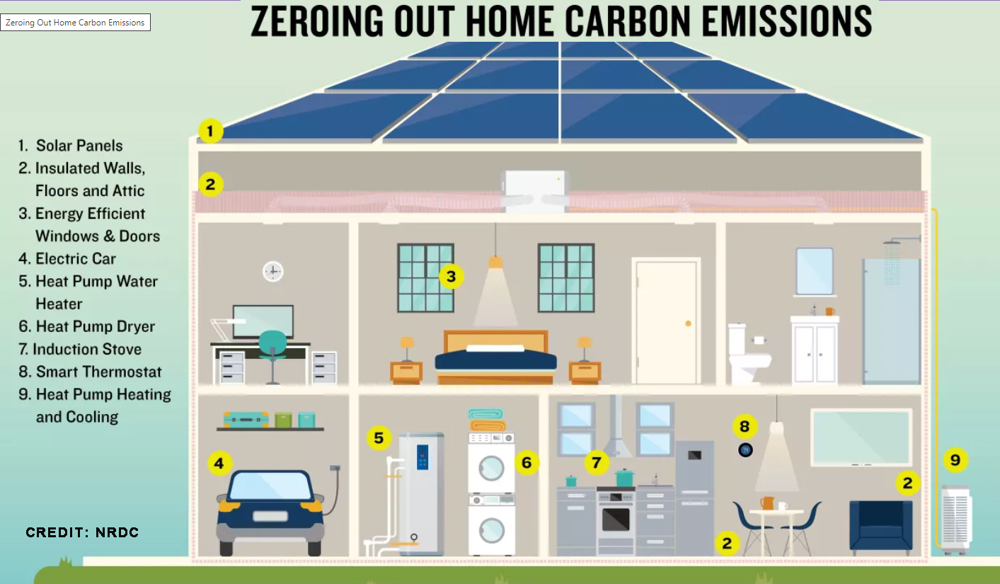

Slide 14
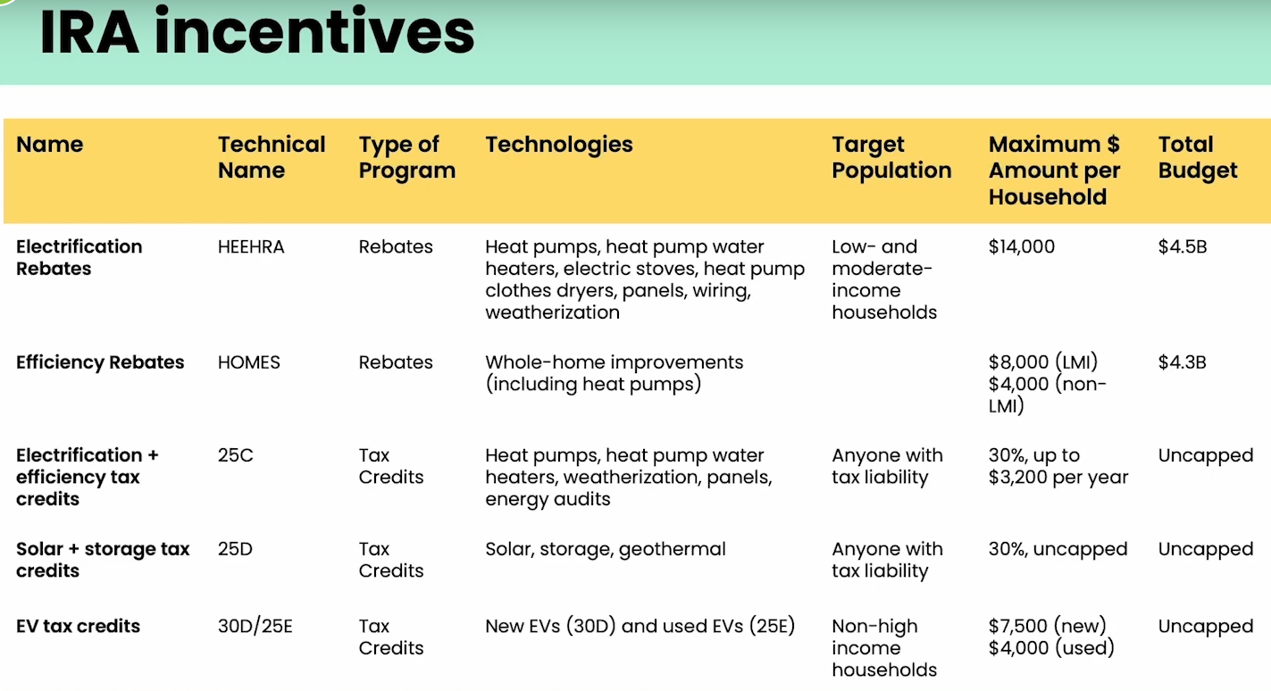
Navigating Individual incentives, by Dr. Leah Stokes
https://www.climaterealityproject.org/electrification-journey
Notes:
We know there are still many, many questions we all have about how the IRA rebates and tax credits will work. Pat showed some of the individual amounts that are available for some building electrification and efficiency measures, Evs and solar. This chart is a different view of the rebates and tax credits, by different programs they fall into. This is from a talk by Dr. Leah Stokes, who is affiliated with Rewiring America. She is showing the different provisions among the programs. For example, the top 2 lines are rebate programs covering electrification and efficiency, respectively. The electrification program, called HEEHRA, includes mostly electric appliances and basic weatherization for space heating. It is available only to low or moderate income, and has a cap for household and an overall budget cap. When the money allocated to each state runs out, it is done with.
The HOMES program is for whole-home efficiency measures. It is available to all, but in different amounts. The bottom 3 lines are tax credits. They each have different limitations such as annual caps by household, but the total budget is uncapped, meaning anyone can use them any year, and they never run out. The program names 25C, 25D,etc are IRS codes. You can google them to find details, but they are already in existence and change in 2023 so make sure you google 2023 details.

Slide 15
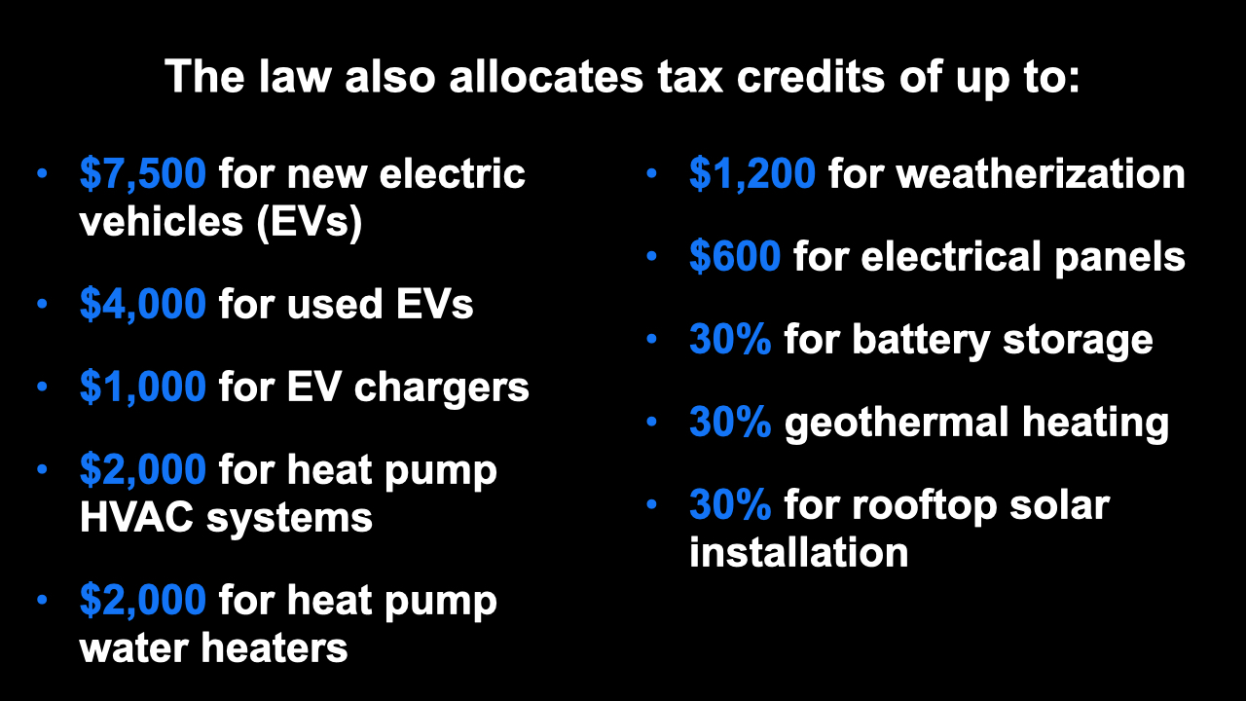
Notes:
ID #7856 - This slide deck may be used in non-commercial presentations that are recorded, broadcast, livestreamed, or presented in-person. You may add your own personal slides to it, but users should make sure they have permission to include any third-party content in their personal slides. You may also remove slides to reduce the length. This slide deck may not be re-published without permission from Climate Reality, used for commercial purposes, or used to support or oppose candidates (or groups of candidates) for elected office. Finally, this slide deck may not be used to claim that The Climate Reality Project endorses any particular legislative action.
The law also allocates tax credits of up to $7,500 for new EVs, and $4,000 for used EVs. That was an interesting debate when it took place, and the advocates made it clear this is really going to help low-income people who want to buy EVs and can't afford a new one. $1,000 for EV chargers you can put in your garage or wherever. And of course, they're also expanding in other provisions of the law, the public network of charging. $2,000 for heat pump HVAC systems. Another $2,000 for heat pump water heaters. These are all tax credits. $1,200 for weatherization. And again, money for the electrical panels, $600. And 30% for battery storage. 30% for geothermal heating – I use that. Not everybody does. I think everybody should, for new construction particularly. 30% for rooftop solar installation.
DESCRIPTION: Text stating that the law also allocates tax credits of up to: $7,500 for new electric vehicles (EVs); $4,000 for used EVs; $1,000 for EV chargers; $2,000 for heat pump HVAC systems; $2,000 for heat pump water heaters; $1,200 for weatherization; $600 for electrical panels; 30% for battery storage; 30% for geothermal heating; and 30% for rooftop solar installation
SLIDE SOURCE(S): https://www.rewiringamerica.org/app/ira-calculator

Slide 16
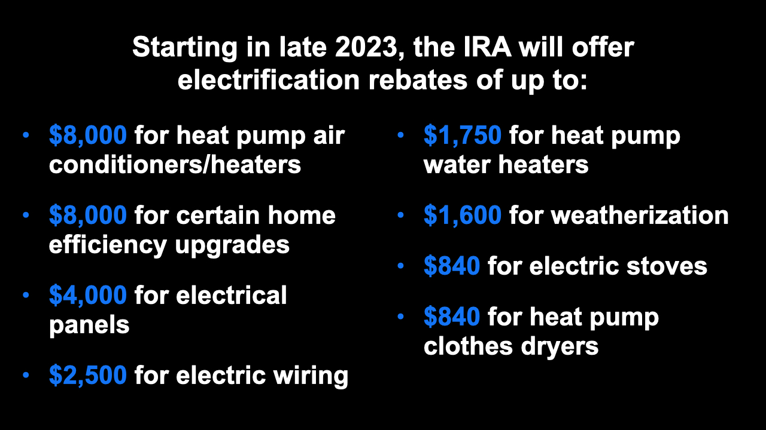
Notes:
ID #7855 - This slide deck may be used in non-commercial presentations that are recorded, broadcast, livestreamed, or presented in-person. You may add your own personal slides to it, but users should make sure they have permission to include any third-party content in their personal slides. You may also remove slides to reduce the length. This slide deck may not be re-published without permission from Climate Reality, used for commercial purposes, or used to support or oppose candidates (or groups of candidates) for elected office. Finally, this slide deck may not be used to claim that The Climate Reality Project endorses any particular legislative action.
Starting late this year, the IRA is going to offer rebates for electrification of up to $8,000 for heat pumps. So that makes it possible for virtually everybody to get. Another $8,000 for some home efficiency upgrades. These are really super important. $4,000 for electrical panels, and also $2,500 for electric wiring. So this is really helpful. And the heat pump water heaters that are so much more efficient, $1,750 per individual in the form of a rebate if you want to switch there, which you should. $1,600 for weatherization, which we were just talking about. $840 to help purchase the induction electric stoves, and $840 for heat pump clothes dryers also, another big efficiency gain.
DESCRIPTION: Text stating that starting in late 2023, the IRA will offer electrification rebates of up to: $8,000 for heat pump air conditioners/heaters; $8,000 for certain home efficiency upgrades; $4,000 for electrical panels; $2,500 for electric wiring; $1,750 for heat pump water heaters; $1,600 for weatherization; $840 for electric stoves; and $840 for heat pump clothes dryers
SLIDE SOURCE(S): https://www.rewiringamerica.org/app/ira-calculator

Slide 17
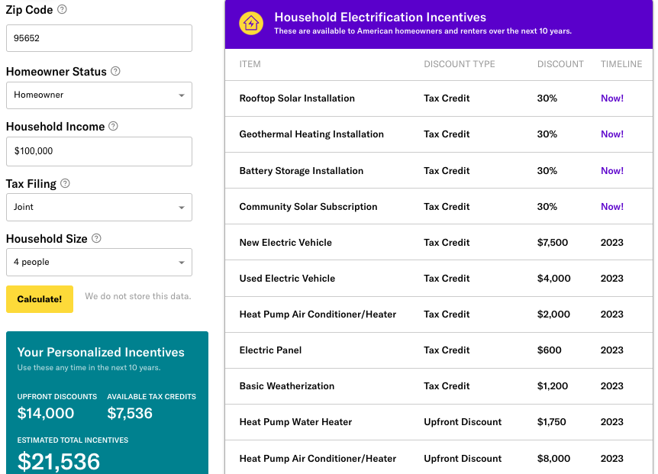
Rewiring America Savings Calculator https://www.rewiringamerica.org/app/ira-calculator
Rebates available up to $14,000 per household, plus tax credits
100% cost coverage for low-income households
  Up to $83,000 per year
50% cost coverage for mid-income households
  $83,000 to $155,000
Notes:
The home electrification and efficiency rebates in the bill include:
heat pumps for heating/air conditioning, water heaters, and clothes dryers
electric stoves;
electric cars;
home weatherization like improved insulation and windows;
rooftop solar and battery storage;
and wiring and breaker box upgrades.
• For low-income: will cover 100% of the costs of these upgrades up to $14,000
- low-income = 80% of median: Monmouth County: $83,000
• For middle-income: will cover 50% of the costs
- $83,000 — $155.000
• See URL above for Rewiring America to calculate your possible rebates and tax credits and when they go into effect

Slide 18
https://docs.google.com/document/d/10vSXEtbjYZ3fBYhZbBahOLVxXrn82QKHkJGHGTRnvyg/edit
TAX CREDITS & REBATE SUMMARY
NJ HOME CREDITS & REBATES | Rebates from NJ utilities (in addition to NJ rebates and U.S. tax credits). May be available until Jan 1, 2025. Rebates are for “Energy Star” devices. HVAC-related rebates for JCP&L, PSEG, Rockland Electric & Atlantic City Electric are indexed in https://energyefficiencyalliance.org/wp-content/uploads/2023/08/NJ-HP-Incentives.pdf Beginning 1/1/2025, the “up to” rebates shown below are identical for PSEG electric, JCP&L, ACE and Rockland Electric (see “Note 1”). In addition, each utility is considering higher rebates to meet BPU goals to more rapidly decarbonize- see filings & page numbers at very bottom |  |  |  | IRA TAX CREDIT CAPS: 30% and $3200 max/calendar-year; IRA credits have a three-year carryback and a twenty-two year carry forward. Credits transferable (limited by passive activity rules). | IRA REBATE ($14K total cap); (eff~2025 in NJ); stackable with tax credits & utility rebates; funding may quickly run out; All are "HEEHRA" unless labeled "HOMES". Appliances must be rated “Energy Star”. Incomes requirement is less than 80% of area median income. Proposed by BPU on May 7. Hearing May Comments due May 21
 | JCP&L REBATES Appliance Rebates 2024 2025 |  | PSEG REBATES 2024 2025 |  |  | <80% Median Income
AIR SOURCE HEAT PUMP | Cold Climate Other than cold climate | 1K 400 to 1K up to $3500 (includes mini-split) | Cold Climate Other | $600 $240 - $600 up to $3500 (includes mini-split) | 30% (capped at $2K/year for heat pump + heat pump water heater) | 100%, up to $8K
GEOTHERMAL HEAT PUMP | REPLACE AIR OR GND SOURCE HEAT PUMP | $500 |  |  | 30% for geothermal; no caps and no limits | 100% up to $8K
GEOTHERMAL HEAT PUMP | REPLACE ELECTRIC FORCED AIR FURNACE/AC | $1500 up to $10K |  | up to $10K | 30% for geothermal; no caps and no limits | 100% up to $8K
HEAT PUMP WATER HEATER |  | $750 up to $2500 |  | $600 up to $2500 | 30% for heat pump water heater capped at $2K/year for heat pump + heat pump water heater) | 100% up to $1750;

Slide 19
ELEC OR INDUCTION STOVE |  | $150 up to $150 |  | up to $150 |  | 100% up to $840
EV CHARGERS | $250 Must be level 2 Energy Star charger from NJ approved list https://chargeup.njcleanenergy.com/ev-charger-incentive |  |  |  | 30% up to $1K
WEATHER IZATION | NJ utilities typically provide: free or low cost energy audits; list of authorized weatherization companies; low or no interest “on bill” up to 5 to 10 year loans; “Home Performance with Energy Star” (see below) |  |  |  | 30% cap/year: max $1200 /yr (incl $600elec.panel); insulation; $250/door; $600 windows; $150 energy audit; | 100% up to $1600
ELECTRIC PANEL 200Amp & SUBPANEL |  |  |  |  | $30%; $600 cap/year | 100% up to $4K
ELECTRIC WIRING |  | up to ? |  |  | Branch Circuits & Feeders | 100% up to $2500
HEAT PUMP CLOTHES DRYER | “Most Efficient” Other Models | $300 up to $500 $100 |  | up to $500 |  | 100% up to $840
Modeled and Measured Energy Efficiency of Whole House | 2025: “Whole House Project” is capped at $7500 OR“up to 75% of “weatherization measures covered” plus fixed amount for each “EE Prescriptive Measure” 2024:Home Performance with Energy Star (HPwES) $5K max rebate for 25% improvement in energy efficiency. Less rebate for less improvement (HPwES will be discontinued before 2025) 3 different programs; eligibility based upon family income Do not choose (superficial) “Quick…Check-up” PSEG: https://homeenergy.pseg.com/assessments JCP&L: https://residential.energysavenj.com/ Obtain several bids from approved contractor list |  |  |  |  | *HOMES Energy Efficiency (modeled): 80% up to $8K
GOOD SOURCE: | https://www.rewiringamerica.org/app/ira-calculator THIS IS BEST SITE: determine rebate and tax credits for YOUR location and family income |  |  |  |  | IRA Frequently Asked Questions
JCP&L https://residential.energysavenj.com/jersey-central/hvac/ Appliances must be “Energy Star” https://chargeup.njcleanenergy.com/ev-charger-incentive FED:https://www.energystar.gov/about/federal_tax_credits/electric_panel_upgrade FED https://www.kiplinger.com/taxes/605201/federal-tax-credit-for-electric-vehicle-chargers |  |  |  |  | Highest efficiency "energy star" products required

Slide 20
MILLER HOME
MIDDLETOWN, NJ
STAGED EFFICIENCY
AND ELECTRIFICATION by Steve Miller
REFERENCES (including these slides)
https://smiller.org/REF1.docx

Slide 21
Top 3 Greenhouse Gas (GHG) Emissions
Sources in NJ: (87%) of All Emissions
Sources in Pa: [63%] of All Emissions
  Electricity generation (19%) [29%]
  Transportation (42%) [22%]
  Residential/commercial bldgs (26%) [12%]
RedUCE All 3

Slide 22

COMMUNITY SOLAR
Clean Energy
Lower Energy Costs
No Panels on Your Property
BPU/Sustainable Jersey Community Solar www.sustainablejersey.com/communitysolar
Notes:
A REALLY GOOD COMMUNITY SOLAR BILL House Bill 1842 was approved by the PA General Assembly on MARCH 26, 2024 It is important to reduce the GHG of PA electricity: electric generation is nearly 1/3 of PA TOTAL GHG emissions. A REALLY GOOD pro-climate activity for each of you living in PA:
ask your PA senator to encourage your PA Senator to take up and approve a Community Solar bill “providing for community solar facilities” AND THEN request the PA governor to sign the bill.
It would be good for you: 20% reduction in electric bill (esp if the economics, are even better than NJ); immediately green your electricity to power your house, and power your future EV, and help PA to reduce iGHG emissions from its electrical generation, and help save the world for our children and grandchildren.

Slide 23
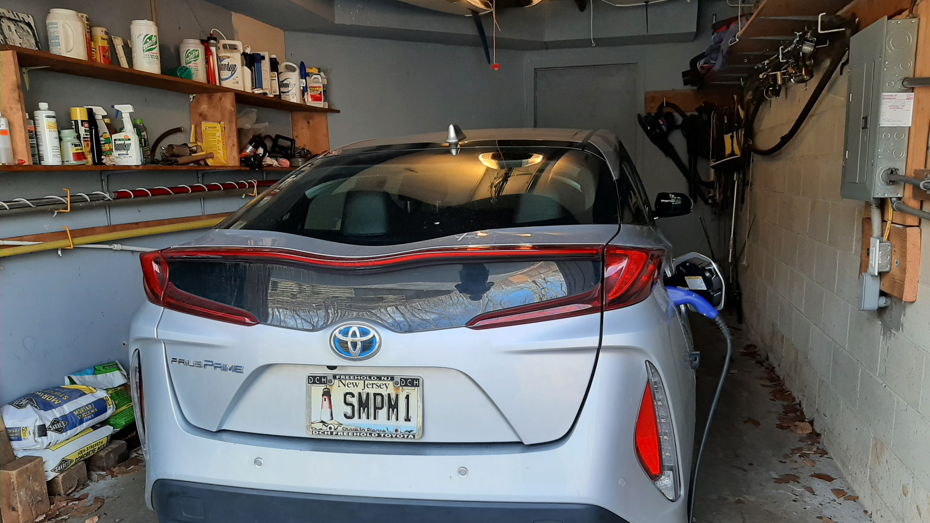
OUR EV – PRIUS PRIME PLUG-IN
Notes:
J:\s\Documents\UUCMC\UUCMC-gas-electric-calculations\2023-actual-GHG-and-bar-charts.xlsx
NOTES: 20 POUNDS of CO2 per gallon (US DOT)
12,000 miles driven per year
0.35 kWh/mile for EV sources: many (3 to 4 miles/kWh seems common across EVs)
NJ Electricity: 530 pounds/megaWh= 0.530 pounds/kWh (EIA- NJ.
NOTE: currently, ~50% of NJ is nuclear ~35% , plus RPS (~30%), so I chose CO2 contribution of ½ = 0.27 pounds, kWh
HOWEVER, both my electric, AND my daughter’s electric are from Community Solar
(if I assume zero GHG-not exactly true- then my Prius Prime and Joellen Tesla electric car are close to zero (often charged off-premise)
I assumed prius prime is ALWAYS charged at home (via Community Solar)
AND joEllen’s Tesla is charge ½ at external fast chargers and ½ in-house (zero GHG)
2012 Toyota Camry 4 cyl: 68240 miles; avg 37mpg lifetime (odometer read 4/5/2024)
2017 Toyota Prius Prime 4 cyl 53454 miles; avg 156 mpg lifetime (odometer read 4/5/2024)

Slide 24
Charge from current nj grid
Annual Pounds CO2 EMISSIONS (12K miles/yr)
Notes:
A REALLY GOOD COMMUNITY SOLAR BILL was approved in PA on MARCH 26, 2024 House Bill 1842 passed PA General Assembly on March 26, 2024. It is important to reduce the GHG of PA electricity: electric generation is nearly 1/3 of PA TOTAL GHG emissions. A REALLY GOOD pro-climate activity for each of you living in PA:
ask your PA senator to encourage your PA Senator to take up and approve a Community Solar bill “providing for community solar facilities” AND THEN request the PA governor to sign the bill.
It would be good for you: 20% reduction in electric bill (esp if the economics, are even better than NJ); immediately green your electricity to power your house, and power your future EV, and help PA to reduce iGHG emissions from its electrical generation, and help save the world for our children and grandchildren.
J:\s\Documents\UUCMC\UUCMC-gas-electric-calculations\2023-actual-GHG-and-bar-charts.xlsx
NOTES: 20 POUNDS of CO2 per gallon (US DOT)
12,000 miles driven per year
0.35 kWh/mile for EV sources: many (3 to 4 miles/kWh seems common across EVs)
NJ Electricity: 530 pounds/megaWh= 0.530 pounds/kWh (EIA- NJ.
NOTE: currently, ~50% of NJ is nuclear ~35% , plus RPS (~30%), so I chose CO2 contribution of ½ = 0.27 pounds, kWh
HOWEVER, both my electric, AND my daughter’s electric are from Community Solar
(if I assume zero GHG-not exactly true- then my Prius Prime and Joellen Tesla electric car are close to zero (often charged off-premise)
I assumed prius prime is ALWAYS charged at home (via Community Solar)
AND joEllen’s Tesla is charge ½ at external fast chargers and ½ in-house (zero GHG)
2012 Toyota Camry 4 cyl: 68240 miles; avg 37mpg lifetime (odometer read 4/5/2024)
2017 Toyota Prius Prime 4 cyl 53454 miles; avg 156 mpg lifetime (odometer read 4/5/2024)

Slide 25
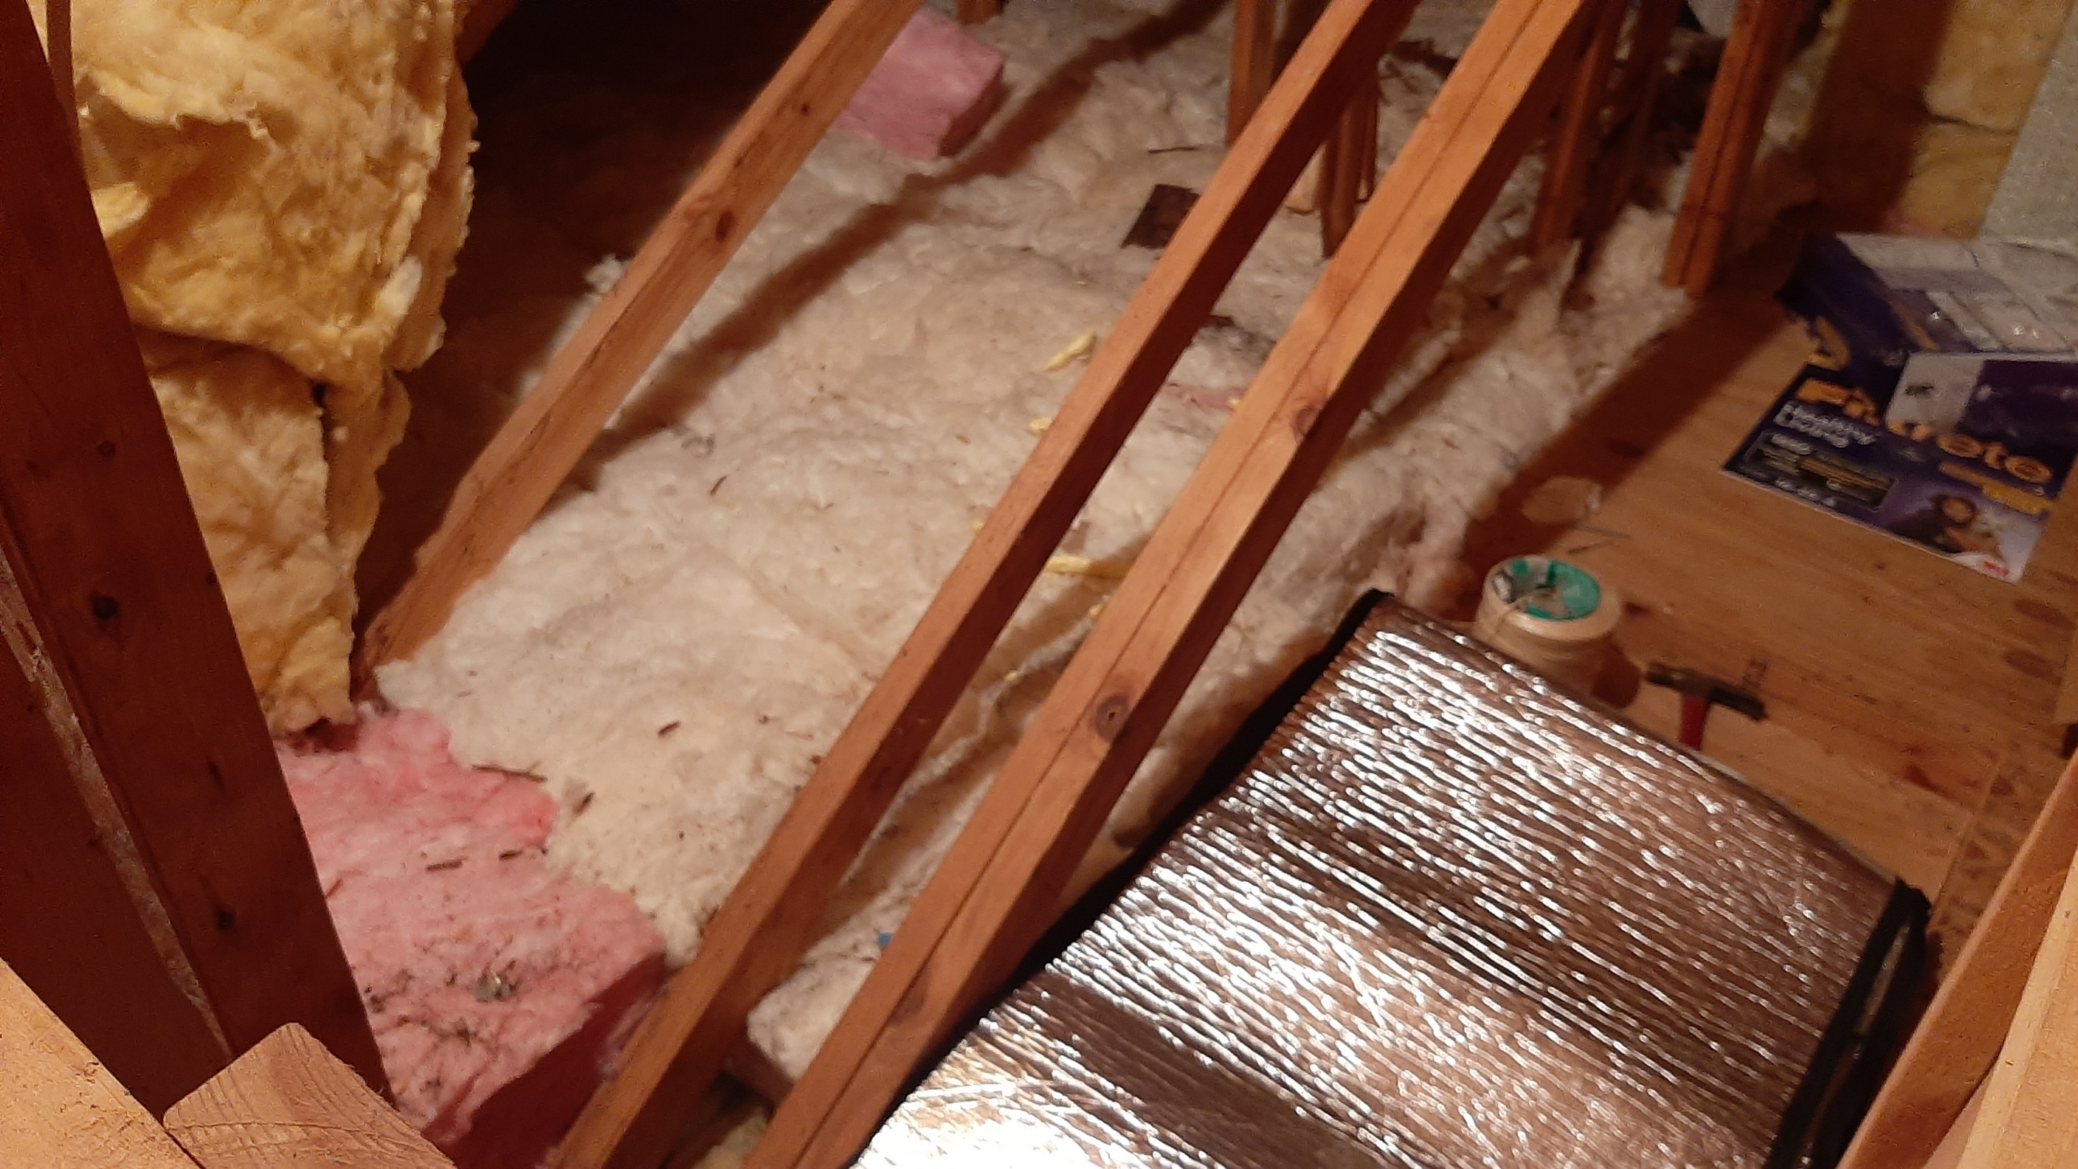
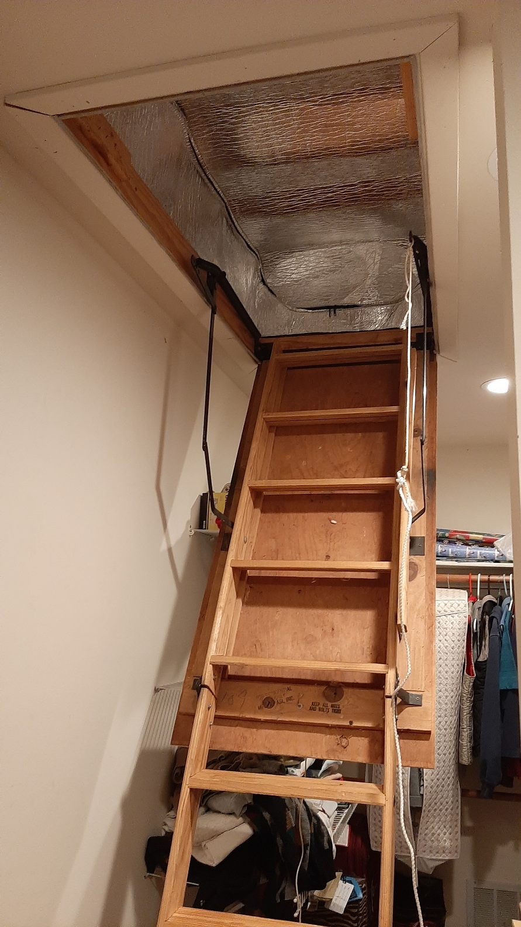
Energy Efficiency – Use Less Energy
Notes:
READ

Slide 26
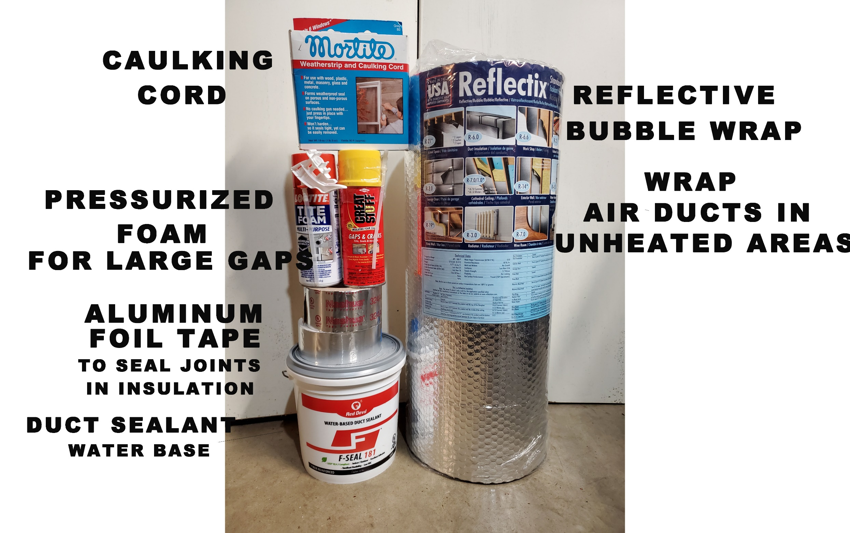
A SIMPLE DO-IT-YOURSELF PROJECT
DUCT SEALING

Slide 27
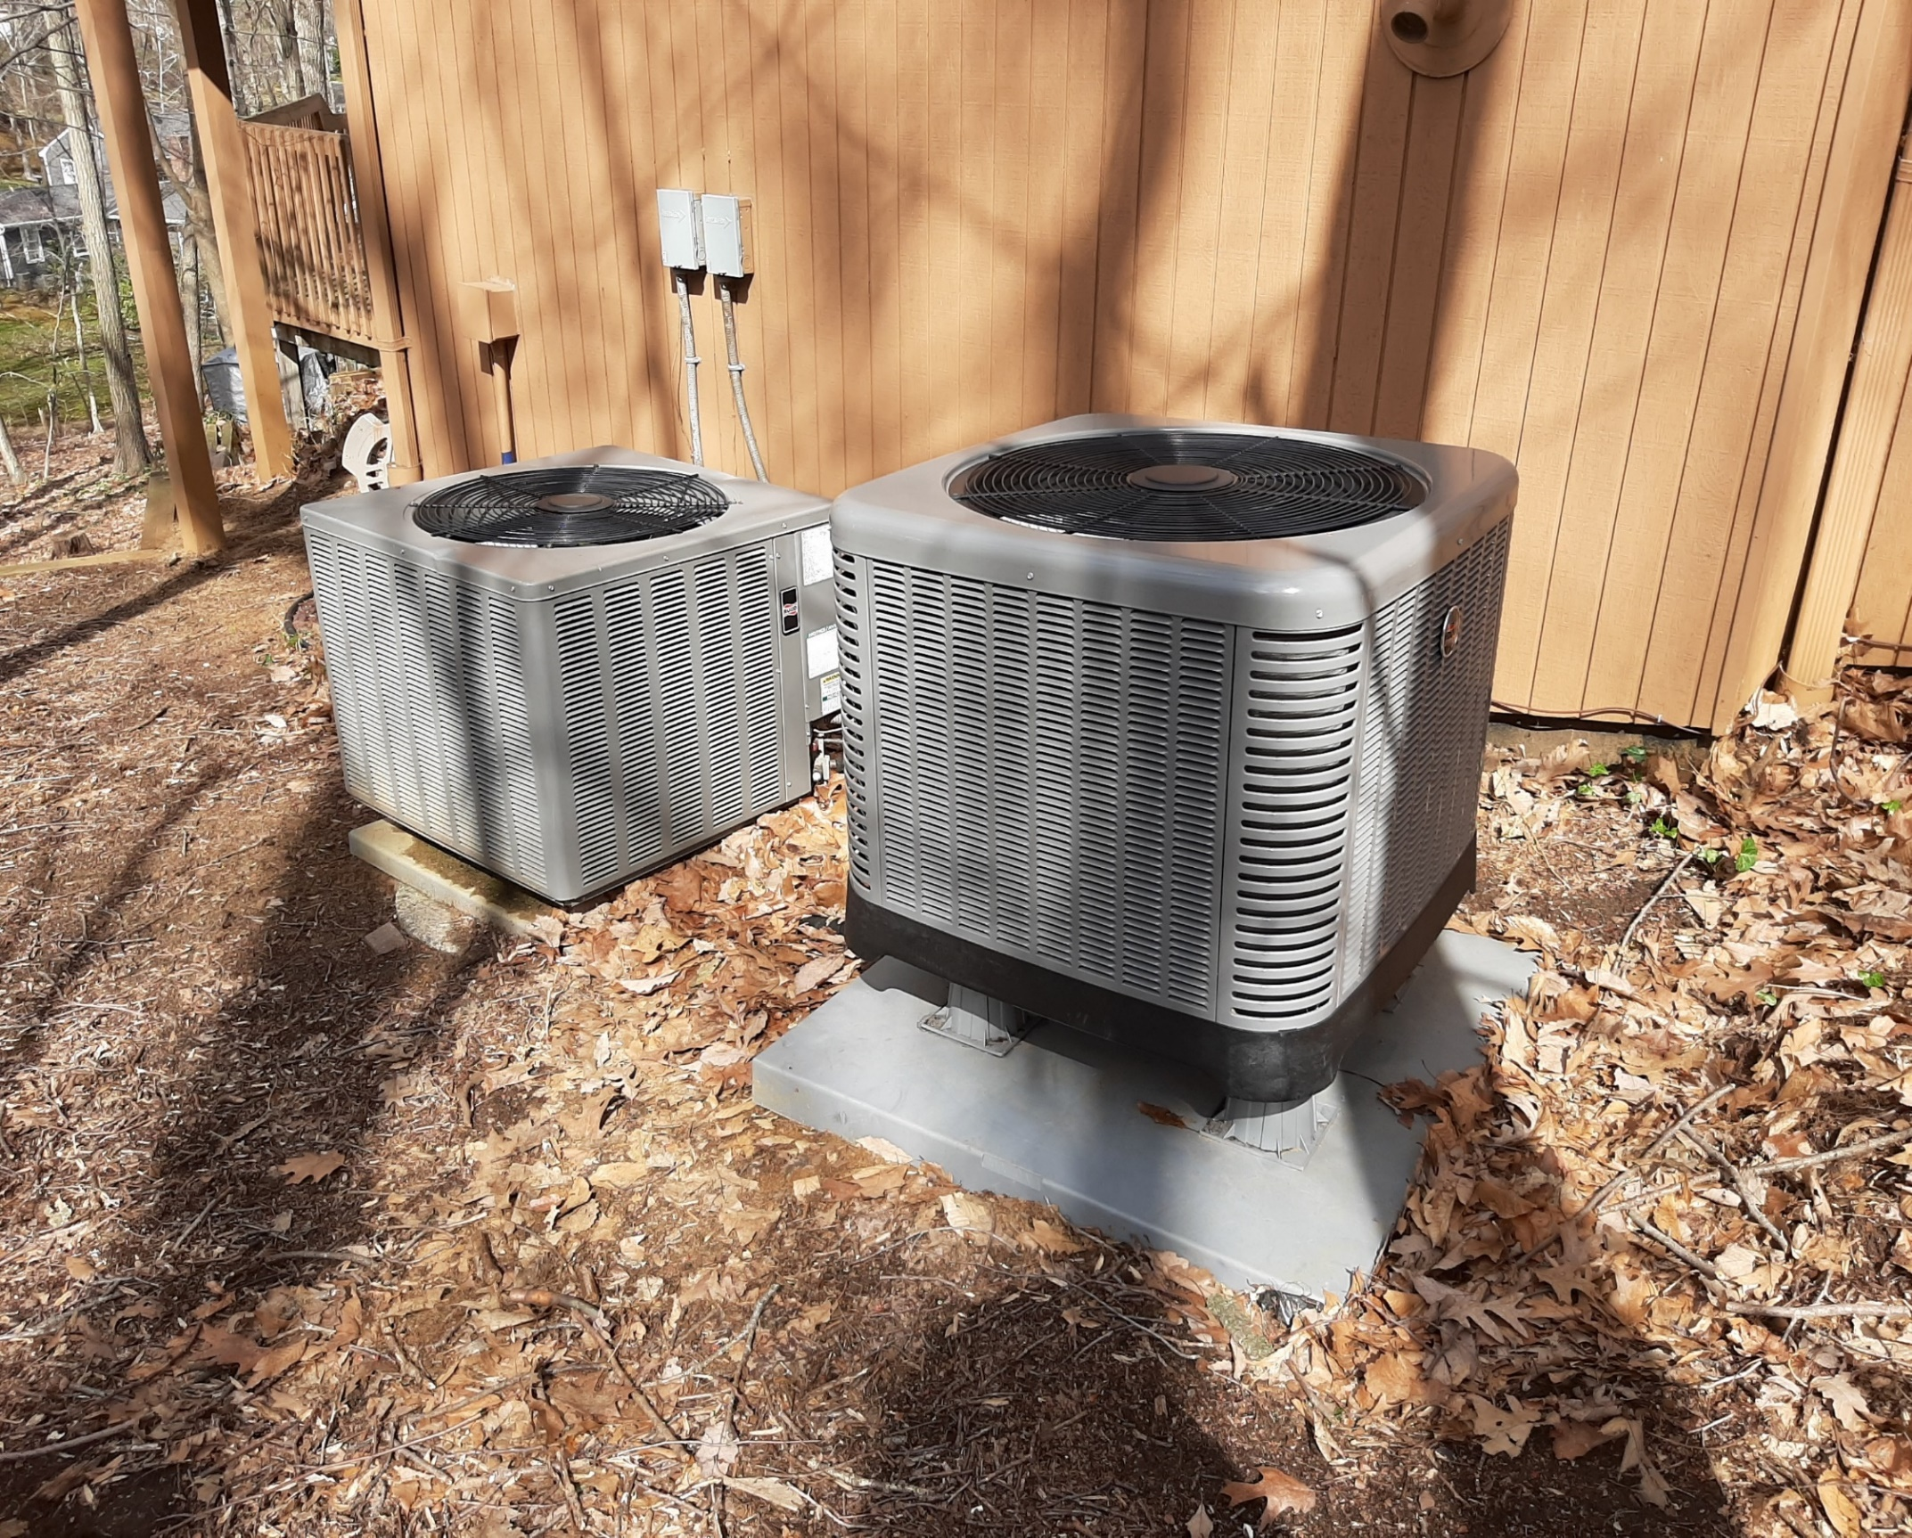
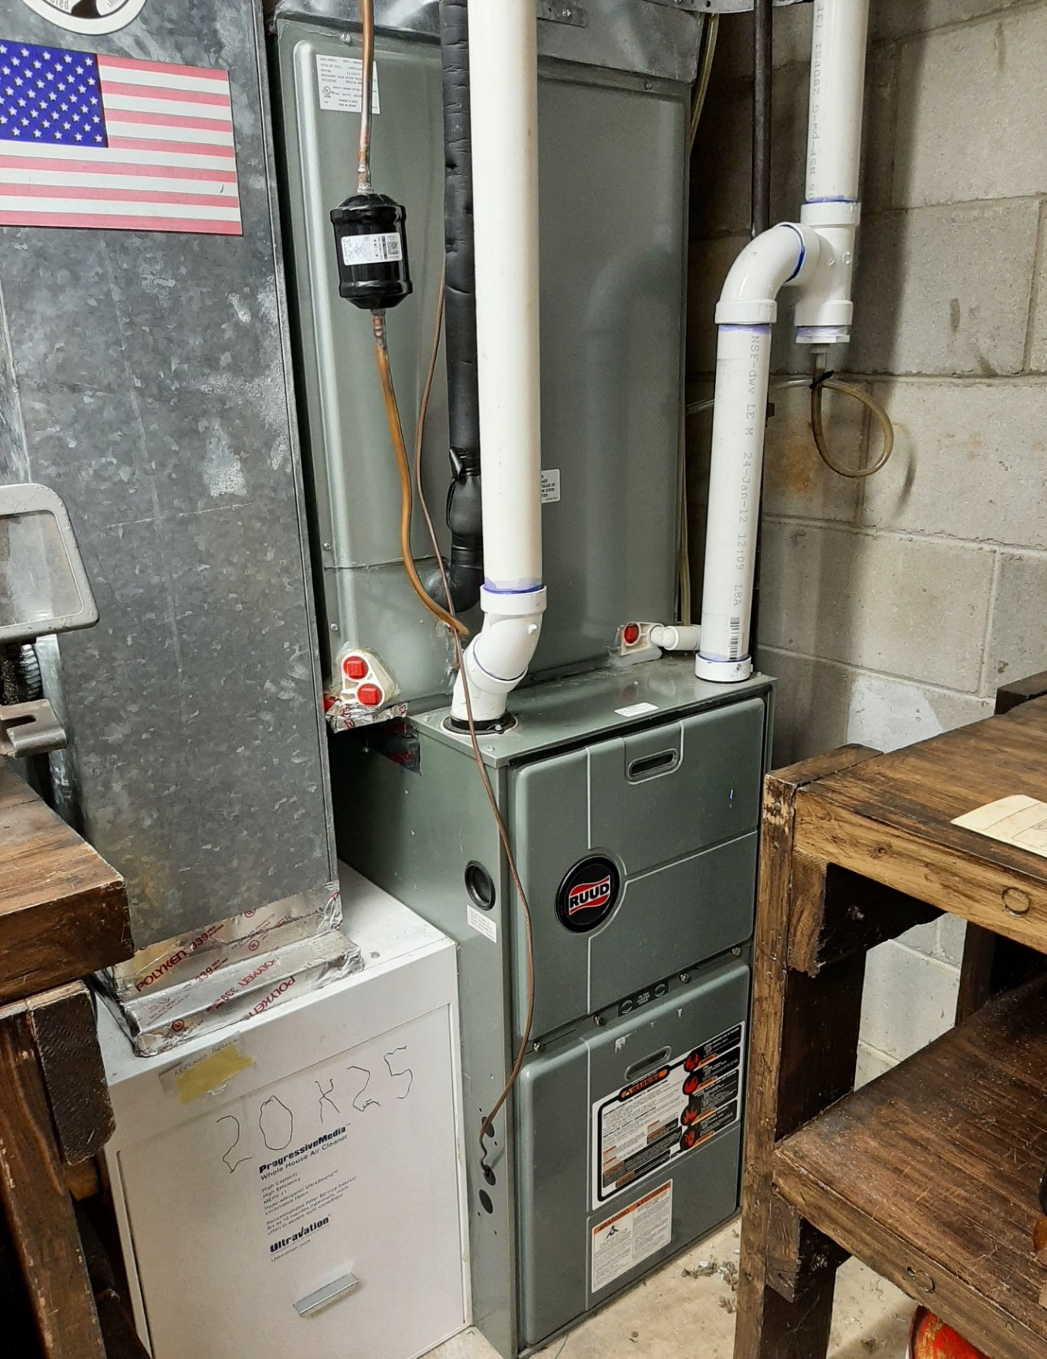
SPACE HEATING & COOLING WITH ELECTRIC HEAT PUMP
Gas Furnace Backup on Right
Notes:
READ

Slide 28
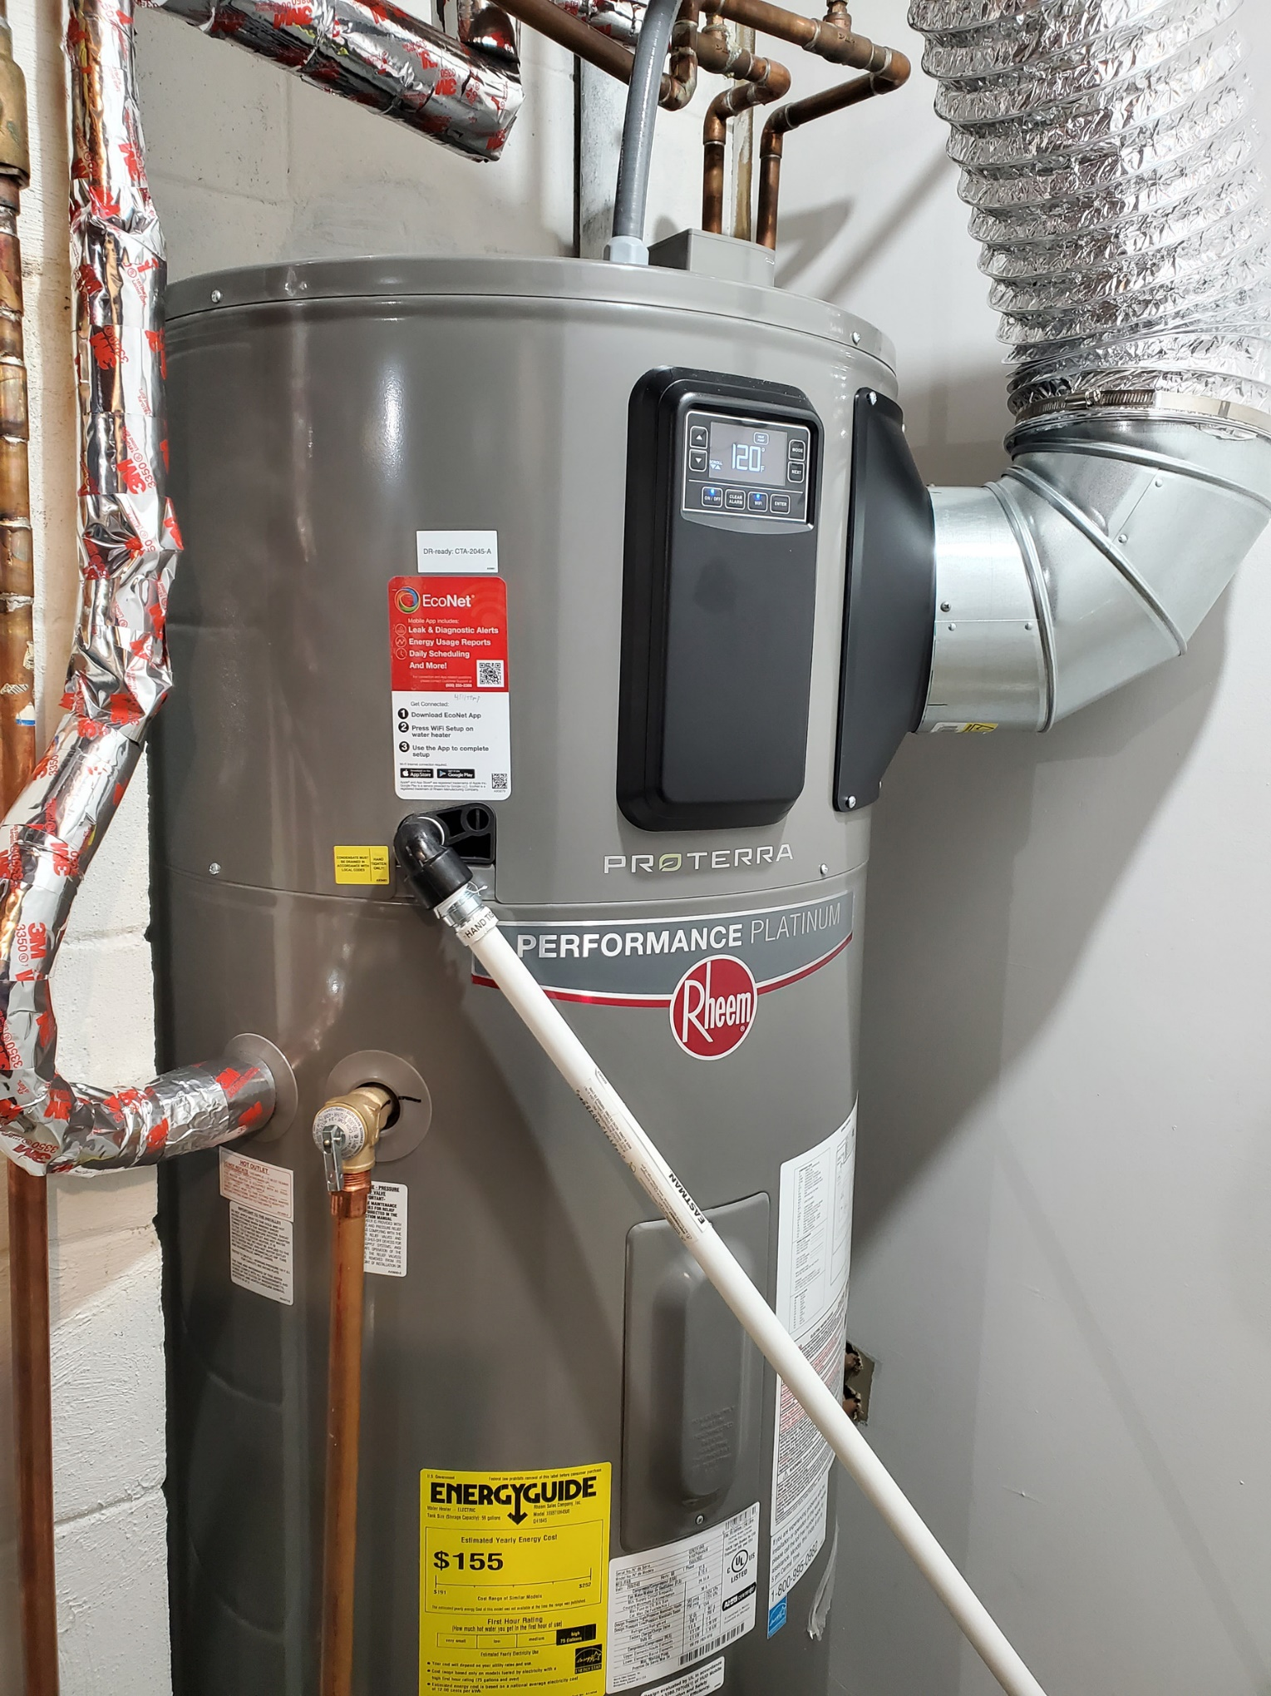
ELECTRIC HEAT PUMP WATER HEATER

Slide 29
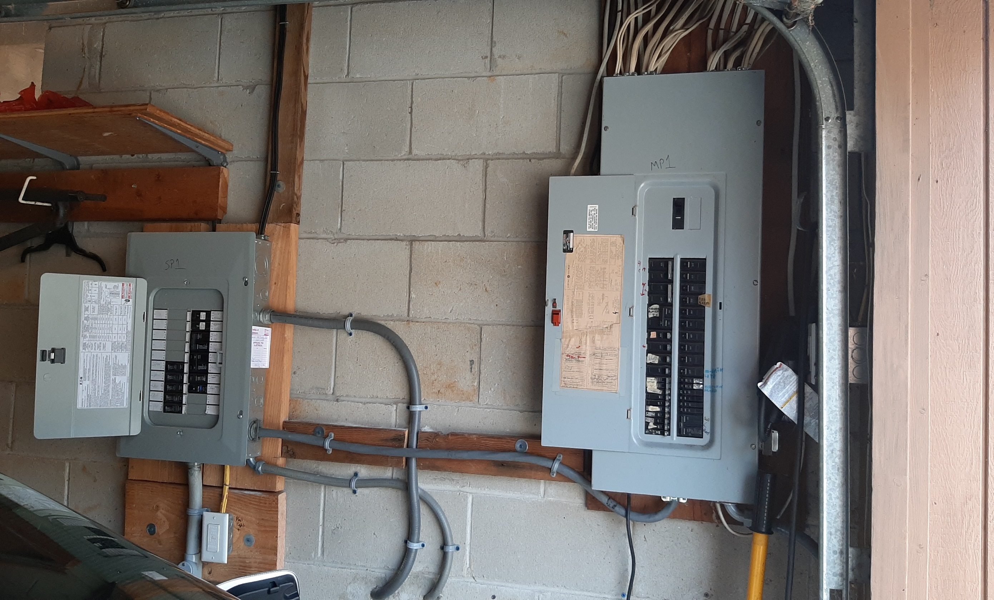
Spare Circuits for Future Electric Appliances
New Box on Left for New/Future
2nd Heat Pump Space Heater/AC
Stove
Dryer
2nd EV
Notes:
READ

Slide 30
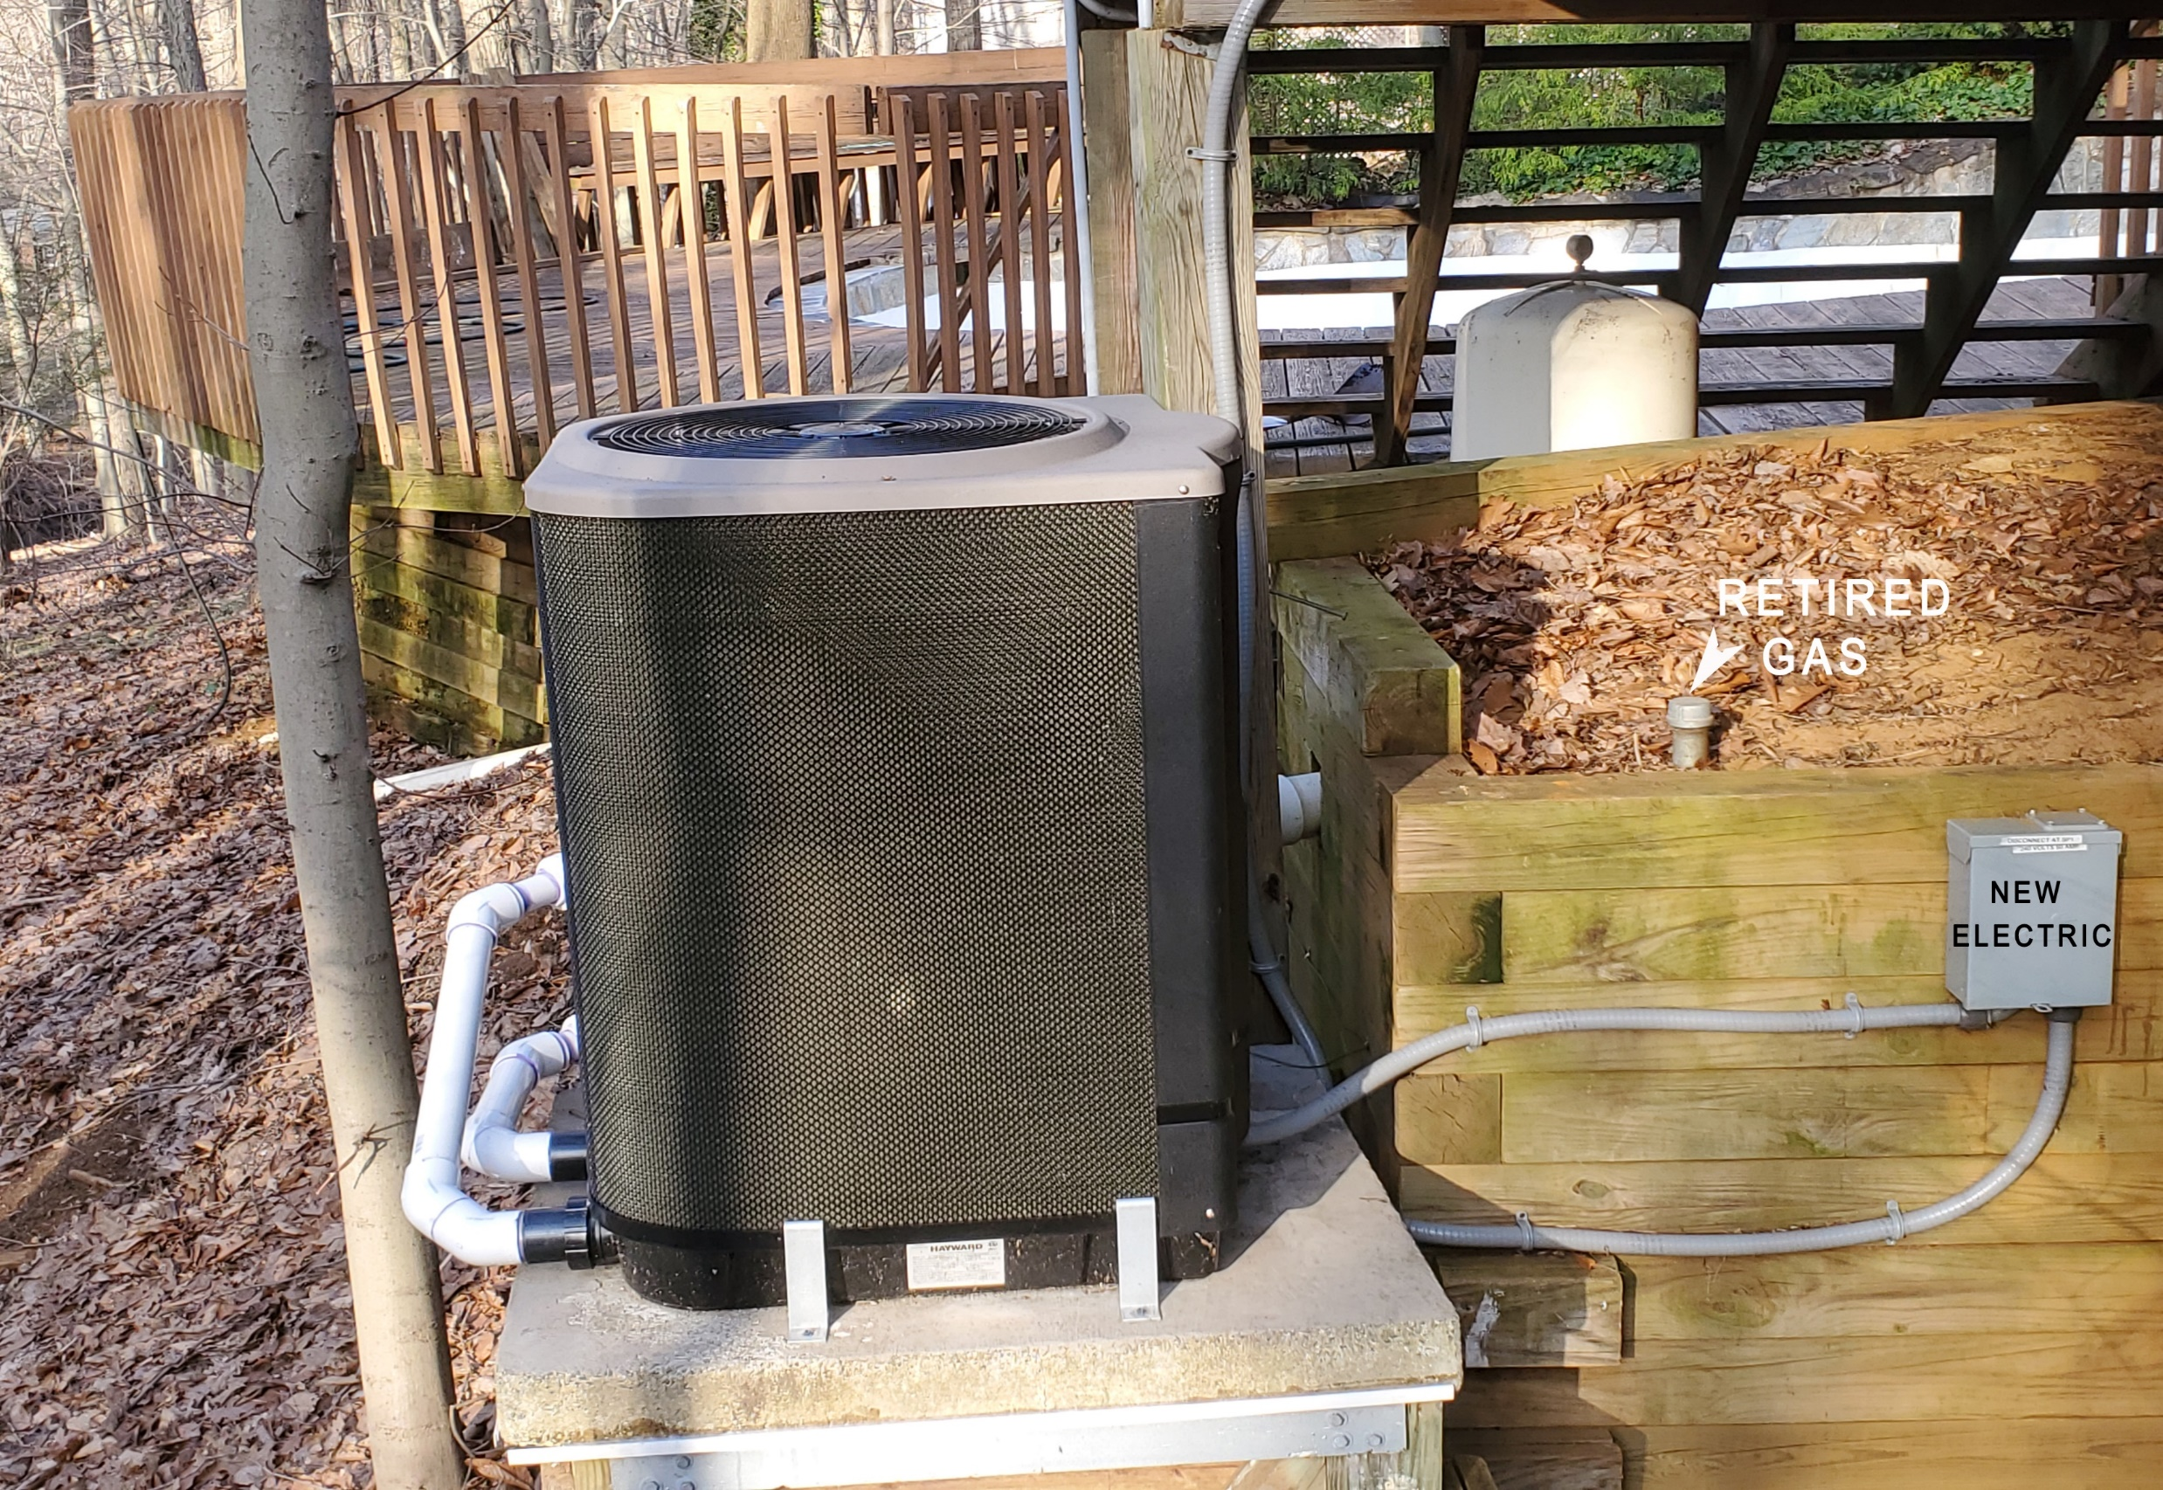
Pool Heater – Electric Heat Pump
Notes:
READ

Slide 31
Electric Heat Costs Less, Pollutes Less
2023 ENERGY COSTS v2 8/5/2024
 | ACTUAL 2023 with heat pumps for space & water heating | ACTUAL 2021 with gas for space &water heating | % CHANGE with heat pumps | With Heat Pumps
TOTAL Gas + Electric* | $1703 | $1967 | (13%) | Savings
GAS Cost | $49 | $1113 | (96%) | Reduction
ELECTRIC Cost | $1654 | $854 | 94% | Increase
THERMS Gas Burned | 29 | 954 | (97%) | Savings
TONS CO₂ Emitted | 0.2 | 5.6 | (96%) | Savings
2
*Electricity in 2024 is 100% clean AND 21% lower cost, supplied by nearby Community Solar
Miller residence, single family house, Middletown, NJ

Slide 32

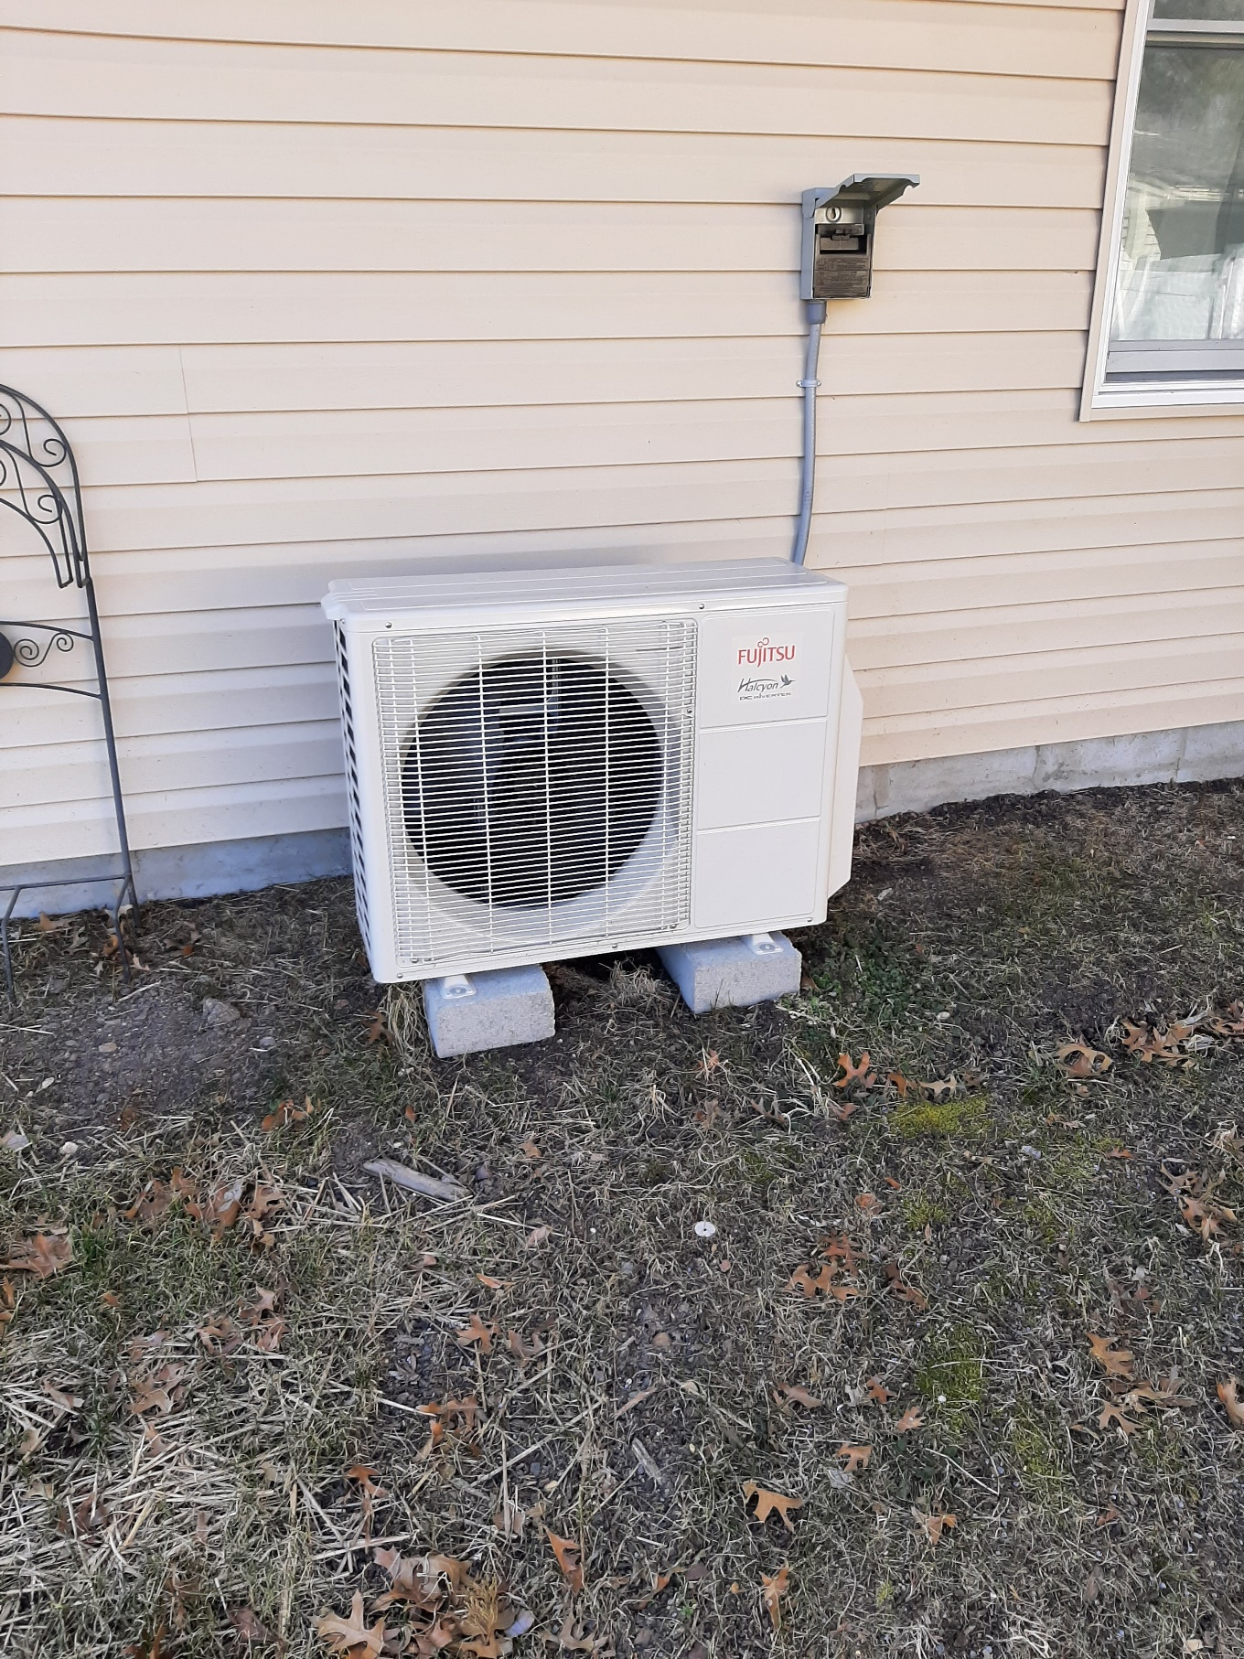
Daughter’s Whole House Efficiency and Electrification for New Addition

Slide 33
HOME PERFORMANCE WITH ENERGY STAR
NJ & NATION-WIDE Rebate Program
South Brunswick, NJ | May 11, 2023
Install 50 Gallon Heat Pump Water Heater w. UEF of 3.88 | $5,460
Shell Test & Seal Incl. Applicable Air Seal Top-Plates & Penetrations | $2,960
Attic Hatch Insulated to R-13 | $275
Attic Stair Cover Insulated to R-13 | $475
4” of Dense-Packed Cellulose in Exterior Walls R-13, 564 Sq Ft | $3,412
4” of Dense-Packed Cellulose in Garage Buffered Walls R-13, 267 Sq Ft | $1,775
Audit Refund ($99) | ($99)
Total Project Cost | $14,258
Rebate to Ciel Power, LLC | $5,000
Balance Due Upon Completion of Project | $9,258
* Can be paid with PSE&G 0% On-Bill Repayment
Project qualifies for a $5,000 rebate to contractor through NJ HPwES Program
Notes:
This is an example of a NJ rebate home efficiency program called Home Performance with Energy Star, that will probably be incorporated into the HOMES IRA program. The above work proposal is how it works now on a home belonging to our daughter. This customized solution includes all the above energy efficiency improvements and provides a $5,000 rebate, paid to the contractor, since the calculated energy efficiency improvement is more than 25%

Slide 34
Unitarian Universalist Congregation of Monmouth County (UUCMC)
Lincroft, NJ
20-Year Energy Saver Award
Interfaith Power & Light

Slide 35

UUCMC
VIRTUAL TOUR
Oct 6 - Oct 8, 2023
U.S. largest grassroots solar,
renewable energy, and
sustainable living event
description, VIDEO AND PHOTOS LOCATED AT:
https://www.nationalsolartour.org/tourmap/unitarian-universalist-congregation-of-monmouth-county/

Slide 36
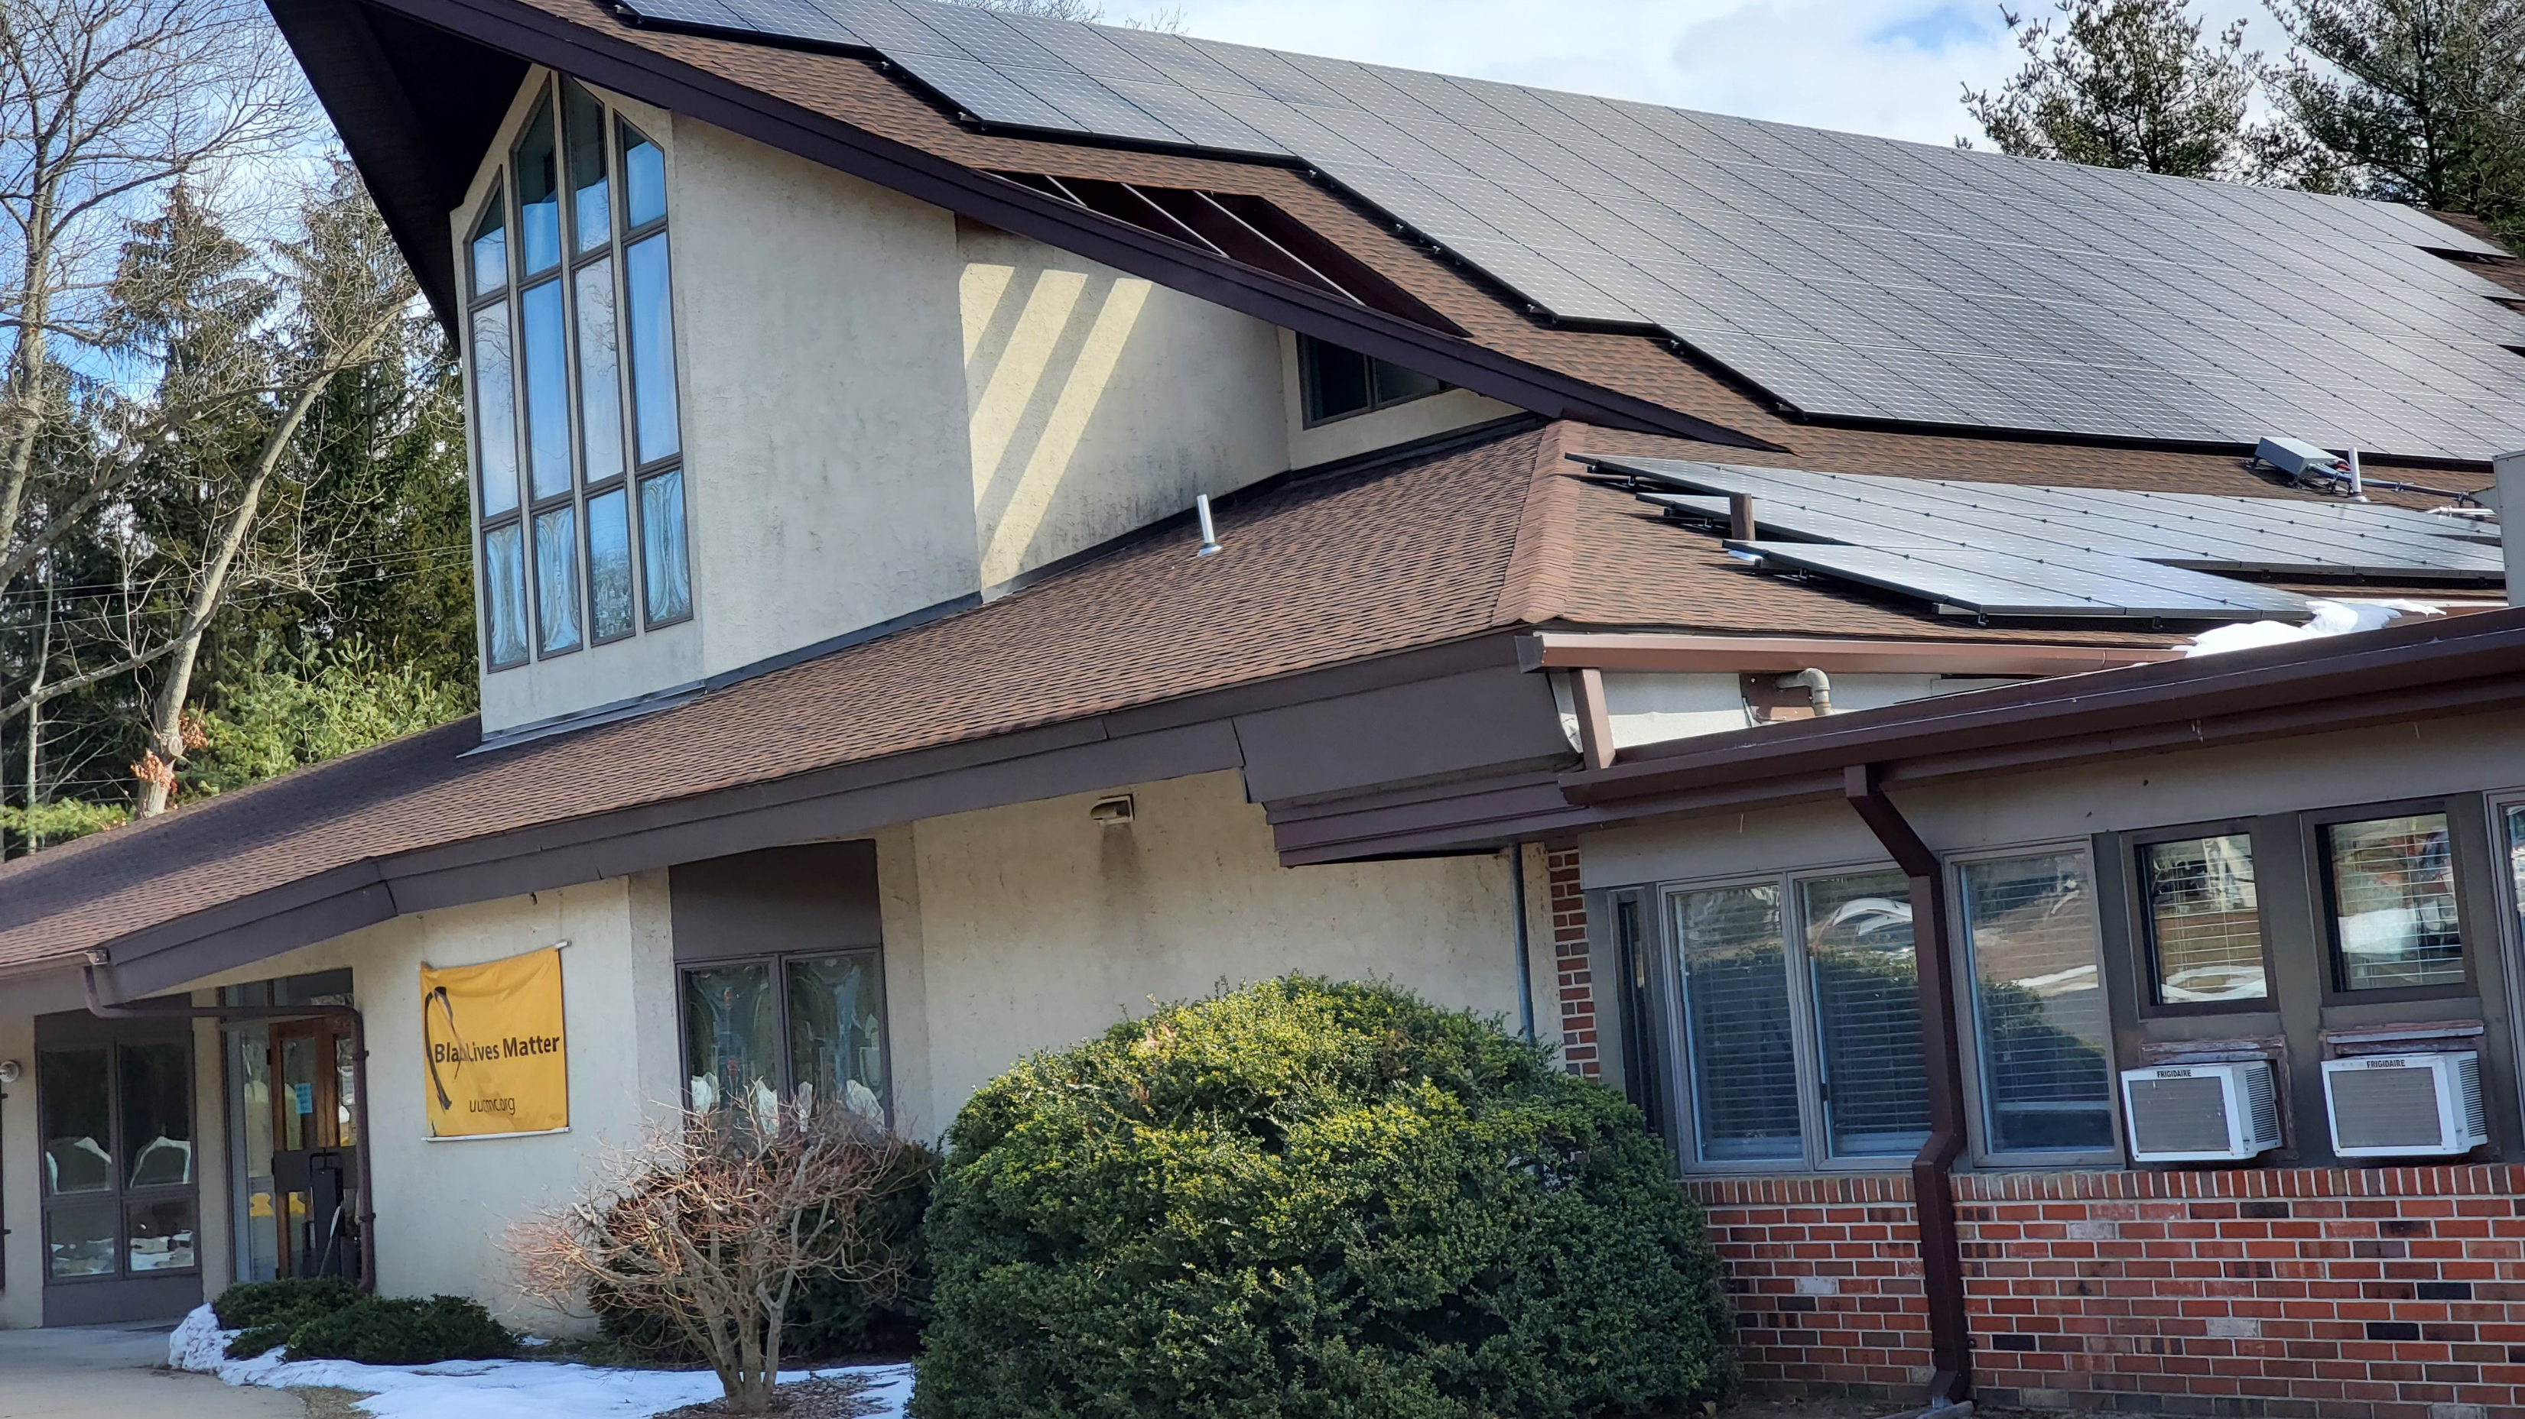
UUCMC 2022 Rooftop Solar
4 x Capacity of Old System

Slide 37
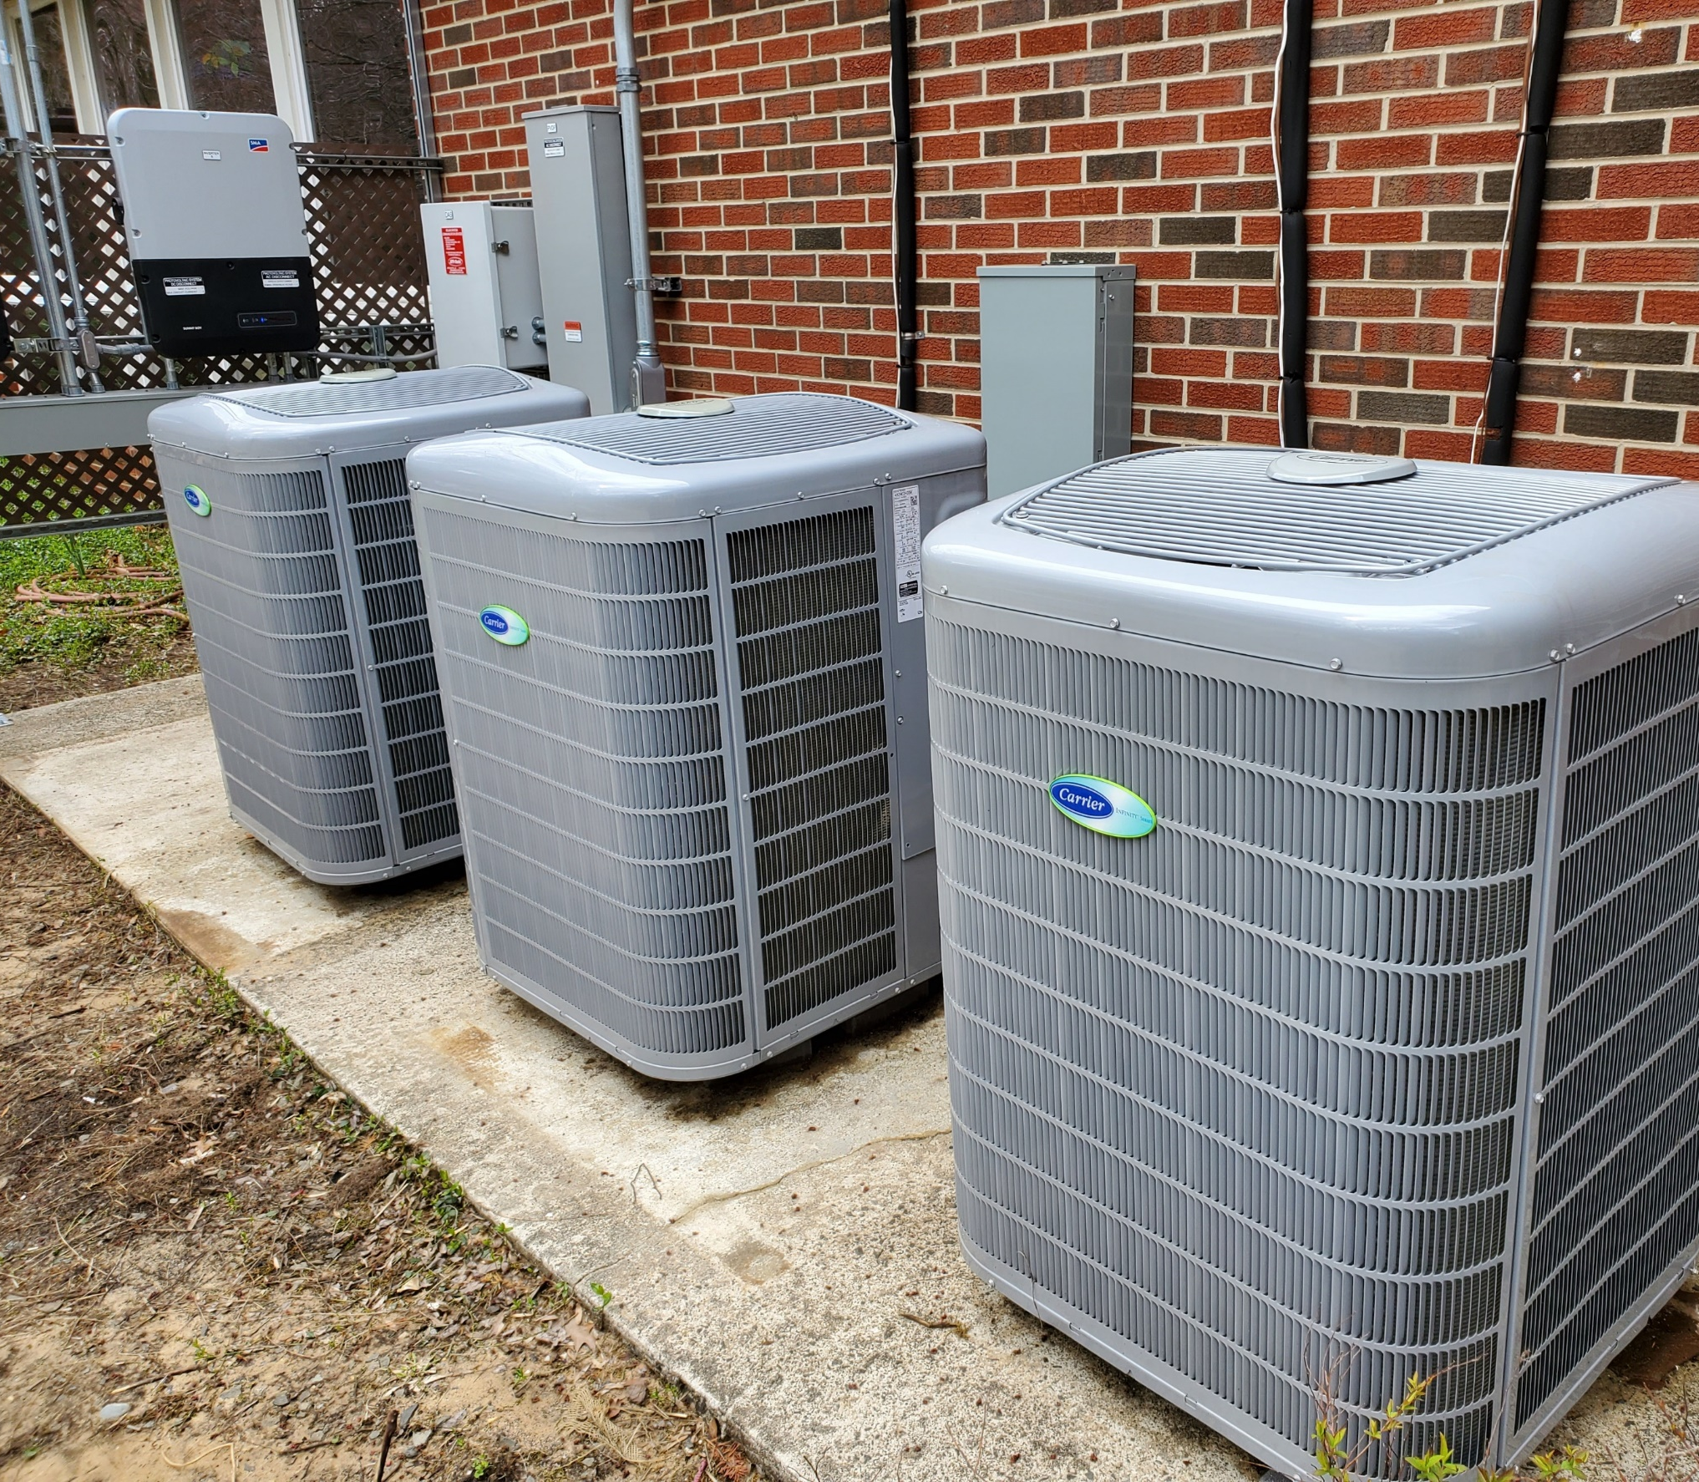
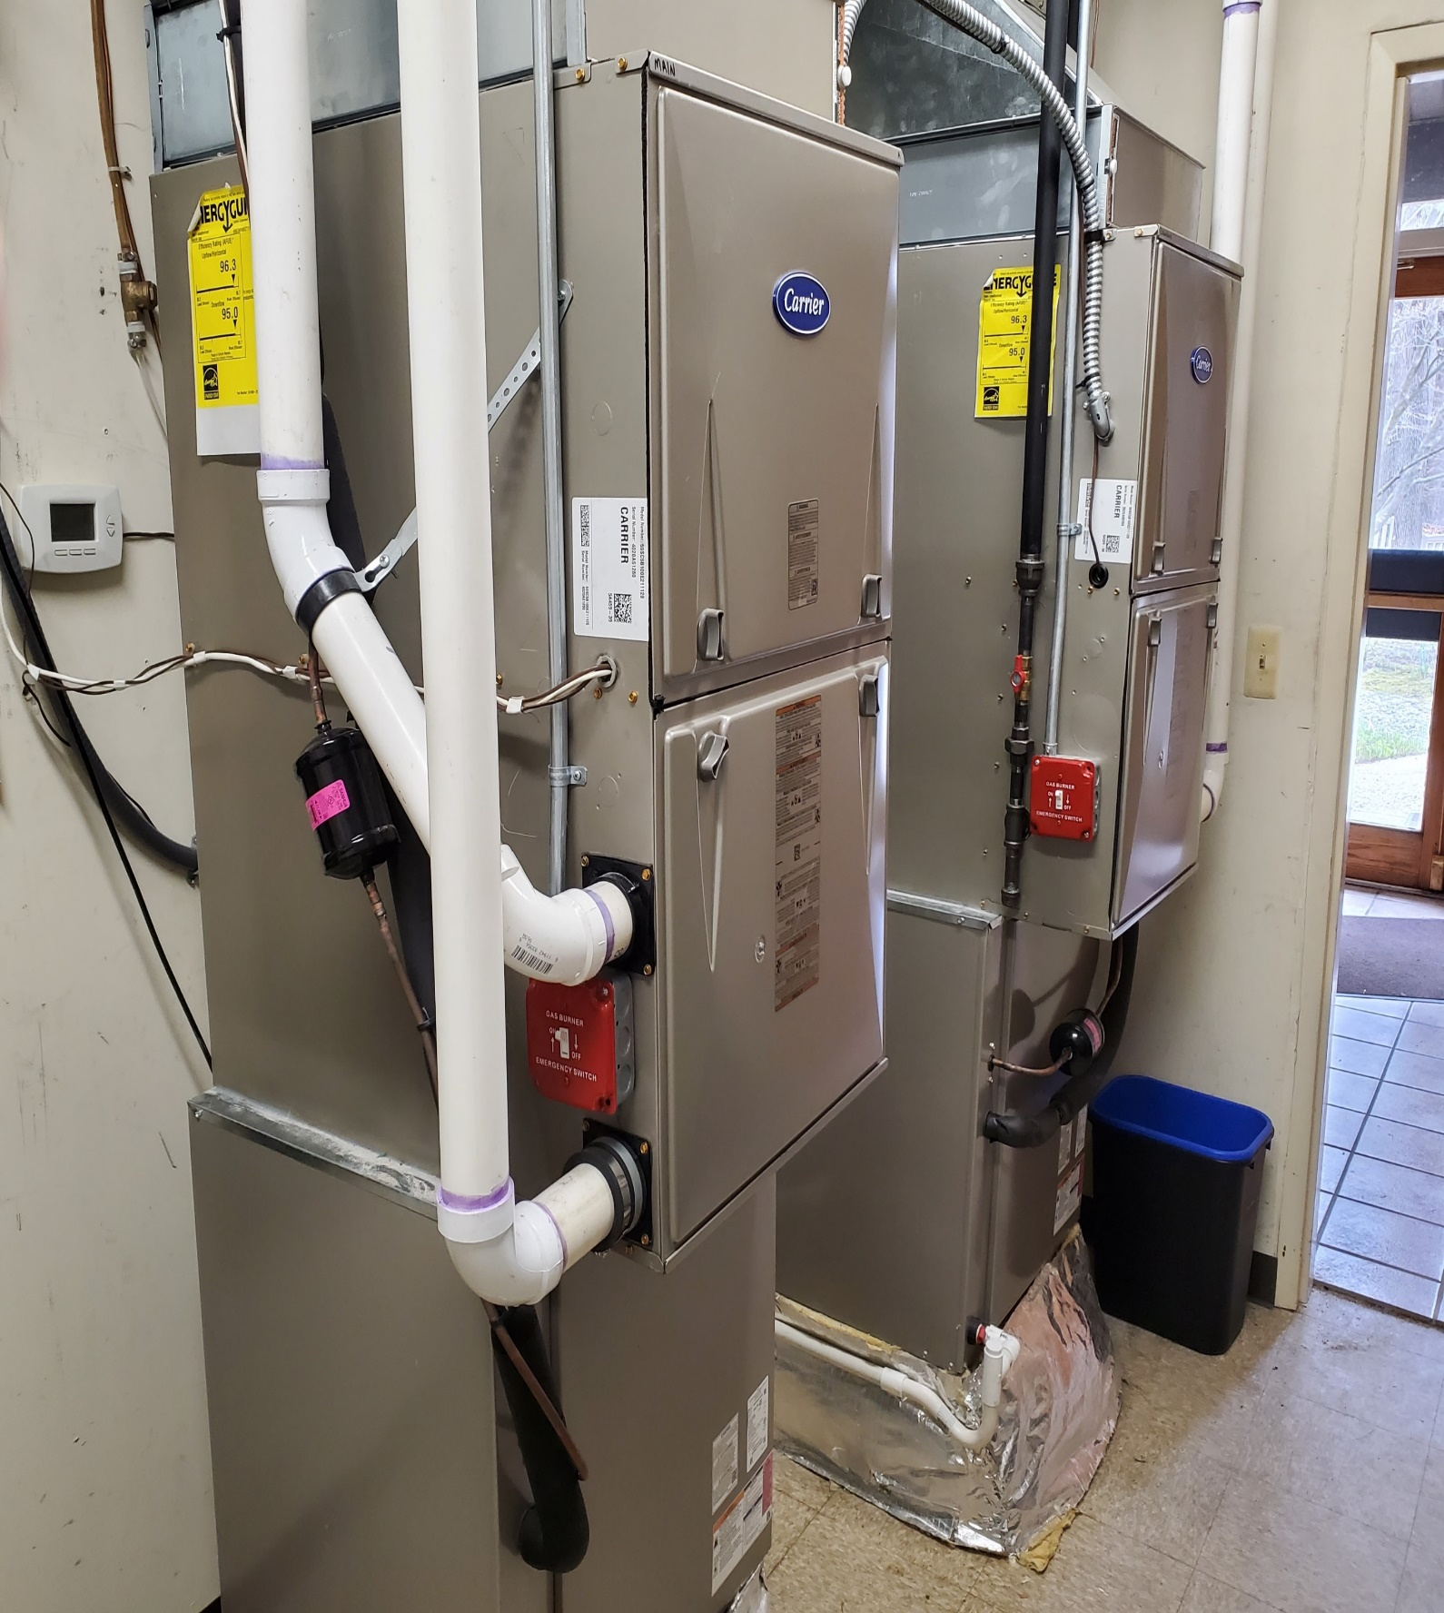
UUCMC 2021 Heat Pumps

Slide 39
UUCMC REDUCTIONS IN CO₂ AND UTILITY BILL
2003 - 2019 Insulated, sealed, LED bulbs, heat pump water heater…
2021 - 2022 6 furnaces replaced with heat pumps;
+ installed large rooftop solar array
YEAR | GAS CO₂ Tons | ELECTRIC CO₂ Tons | TOTAL CO₂ Tons | % TOTAL CO₂ REDUCTION | ELECTRIC MWh from GRID | TOTAL BILL GAS+ELECTRIC | % TOTAL BILL REDUCTION
2003 | 49 | 21 | 70 |  | 72.4 | $22.1K
2019 | 26 | 10 | 36 | 49% | 32.8 | $12.4K | 44%
2023 | 14 | 3 | 17 | 76% | 10.0 | $6.3K | 71%
Notes:
Data is from several sources:
1. table within “2023-actual-GHG-and-bar-charts.xlsx” cell A134 and cell A63
2. Notes at cell S7 “demand charges 2019 2023-bills.xlsx”

Slide 40

JOIN NEXT MONTH’S BE Webinar
Hosted by Pat and Steve Miller
REGISTER https://bit.ly/3tmyd1g for 7PM, Thurs, JUNE 20
Join our House Electrification Case Study
(we are evaluating two possibilities)
Sponsors: UUCMC Climate Action Team; Sierra Club NJ Chapter, NJ Building Electrification Committee;
Climate Reality Project, Greater NJ Gateway Chapter; Citizens Climate Lobby, NJ Chapter;

Slide 41
Speak up, act, and vote
Like your world depends on it
Notes:
ID #6251 - Can be used in noncommercial online and TV broadcasts of your presentation, but not modified.
Become a part of this movement to speak truth to power. Do it like your world depends on it…
DESCRIPTION: Text slide encouraging the audience to speak truth to power - like your world depends on it

Slide 42

Your world depends on it.
Source: NASA
Notes:
ID #5132 - Can be used in noncommercial online and TV broadcasts of your presentation.
…because, after all, your world does depend on it. Thank you.
DESCRIPTION: Photo of the Earth with text stating that your world depends on it

Slide 43

REFERENCES: Climate change & what you can do
all references https://smiller.org/REF1.docx

