Slide 1
PLANNING FOR A FOSSIL FUEL-FREE FUTURE ONE HOME AT A TIME
LEARN TO ELECTRIFY YOUR HOUSEHOLD
Pat and Steve Miller
Sept 19, 2024

Slide 2
Top 3 Greenhouse Gas (GHG) Emissions
Sources in NJ: (87%) of All Emissions
  Electricity generation (19%)
  Transportation (42%)
  Residential/commercial buildings (26%)
RedUCE All 3

Slide 3
MILLER ELECTRIFICATION PROJECTS
100% Clean Electricity – 2017 (3rd party wind, then Community Solar)
Plug-in Hybrid Prius Prime (Hybrid EV) – 2018
Electric Cooktop – 2011
Heat Pump Pool Heater, Electric Panel/Wiring – 2019
Weatherization – 2019
1st Floor Heat Pump Space Heat/Cool – 2022
Heat Pump Water Heater – 2022
Combo Washer/Heat Pump Dryer – 2024

Slide 4

Carbon Sequestration but No Solar
Tree Cover At High Noon
50 Foot Trees

Slide 5

COMMUNITY SOLAR
Clean Energy
Lower Energy Costs
No Panels on Your Property
BPU/Sustainable Jersey Community Solar www.sustainablejersey.com/communitysolar

Slide 6
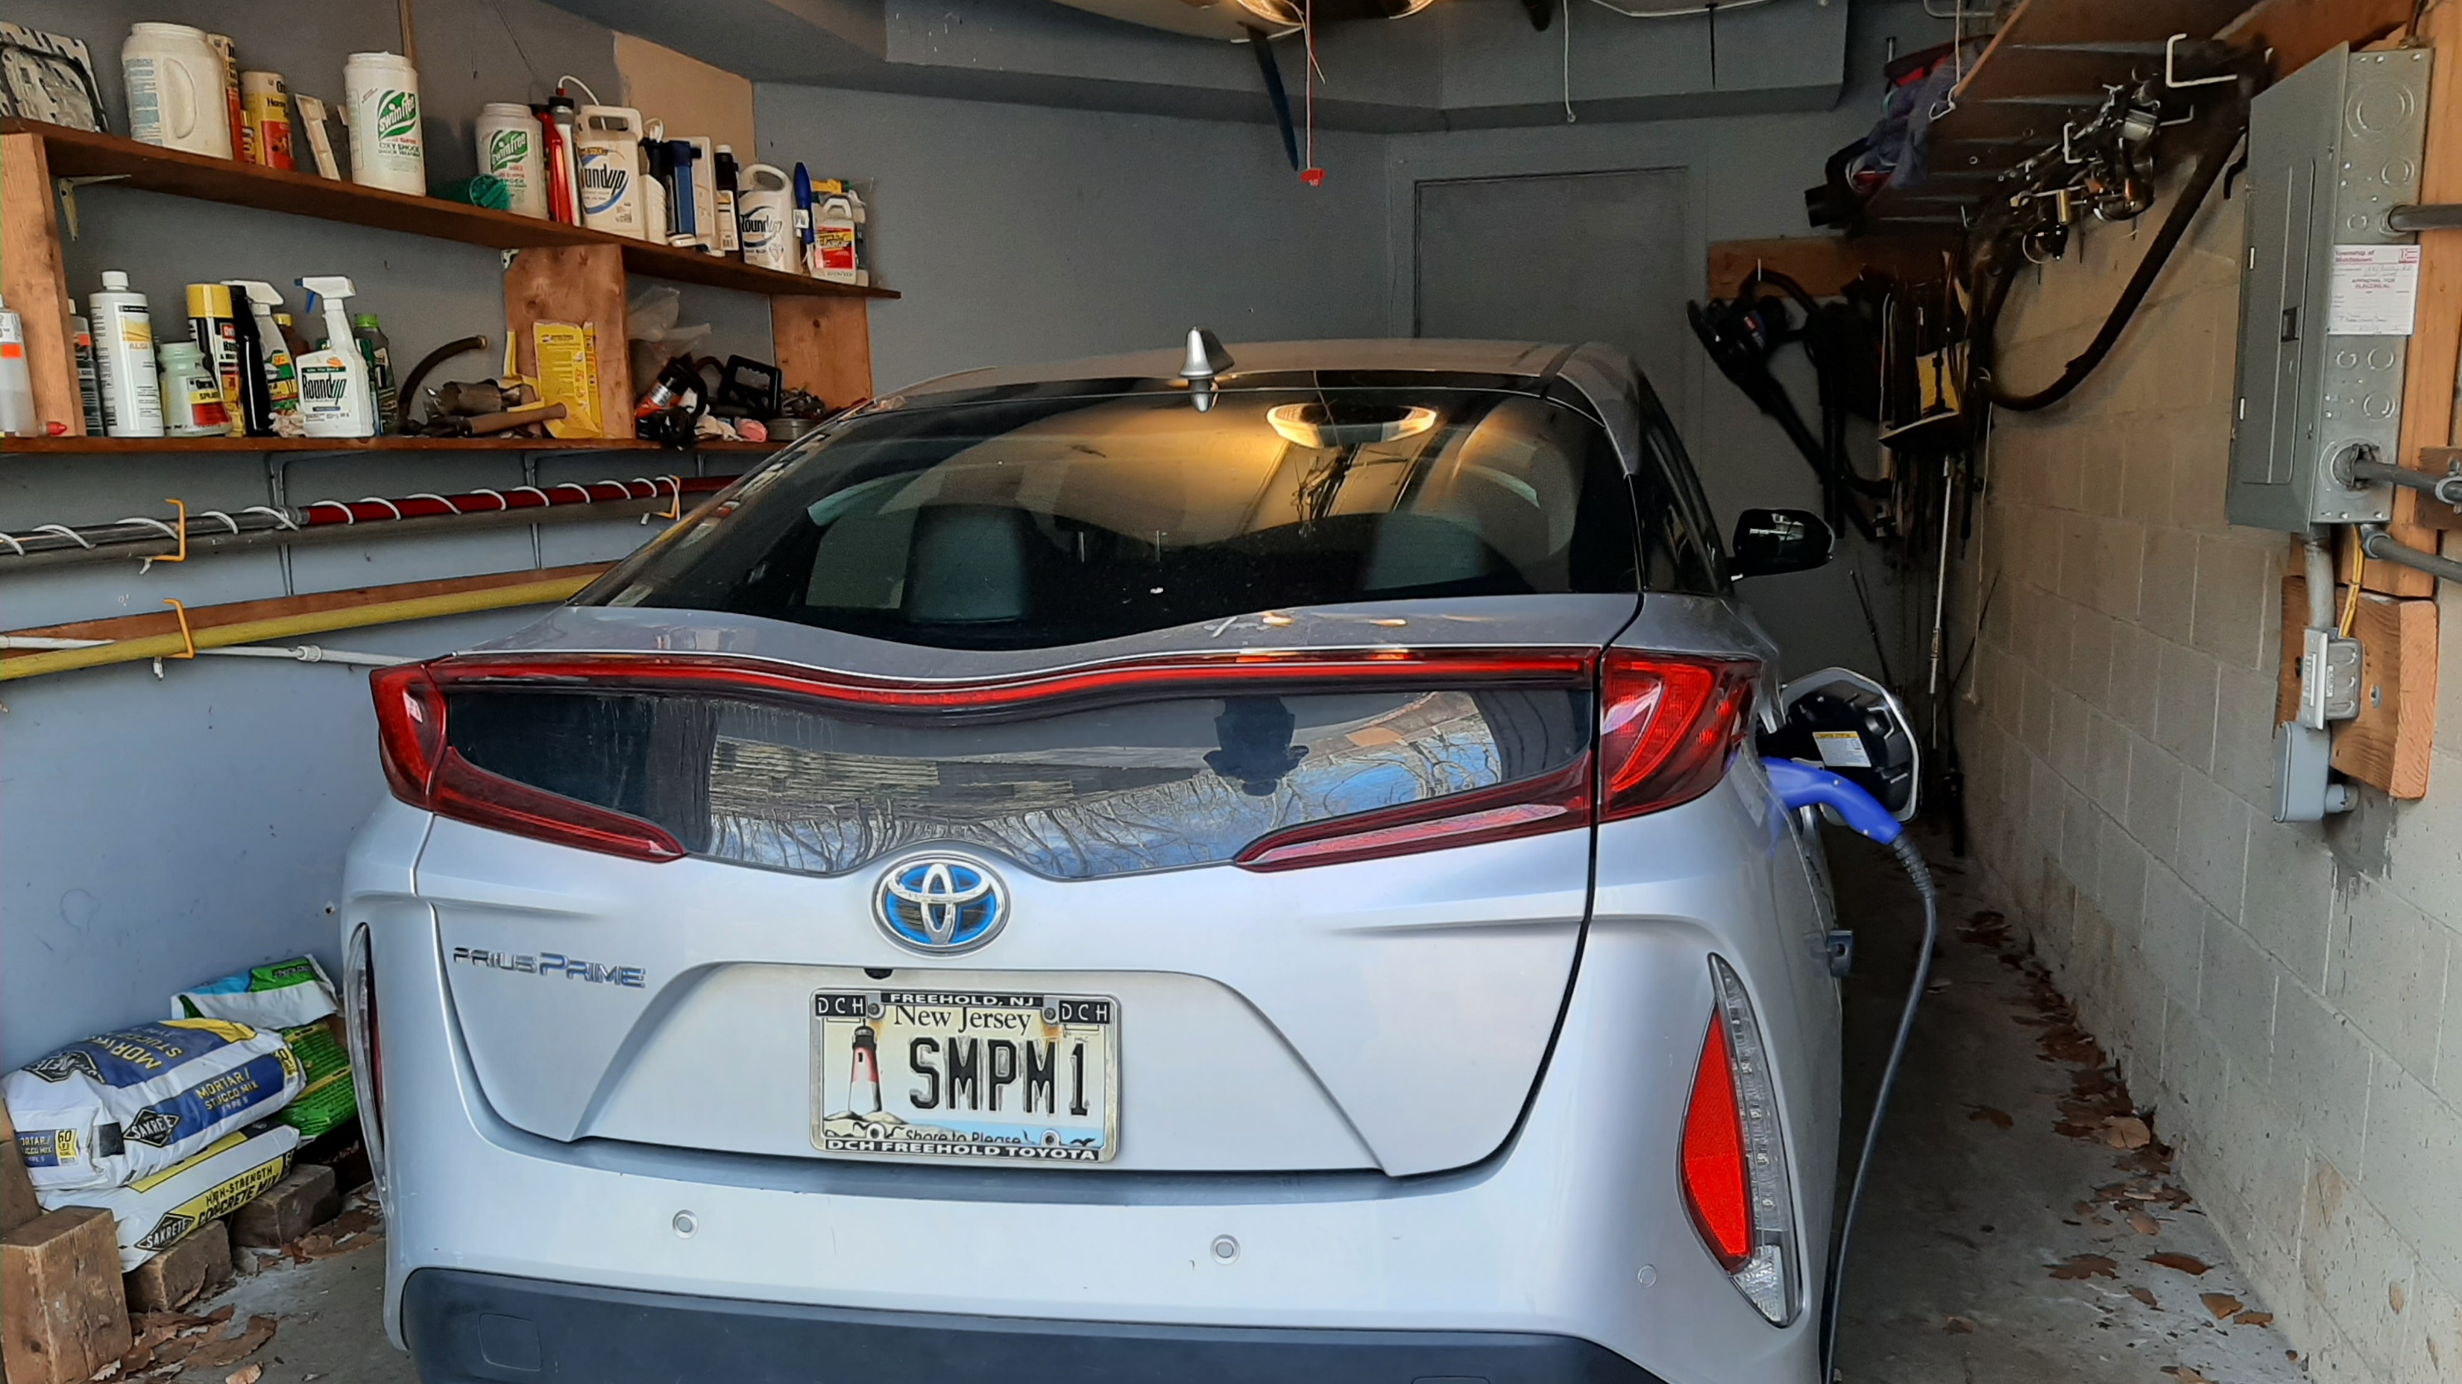
OUR EV – PRIUS PRIME PLUG-IN
Notes:
J:\s\Documents\UUCMC\UUCMC-gas-electric-calculations\2023-actual-GHG-and-bar-charts.xlsx
NOTES: 20 POUNDS of CO2 per gallon (US DOT)
12,000 miles driven per year
0.35 kWh/mile for EV sources: many (3 to 4 miles/kWh seems common across EVs)
NJ Electricity: 530 pounds/megaWh= 0.530 pounds/kWh (EIA- NJ.
NOTE: currently, ~50% of NJ is nuclear ~35% , plus RPS (~30%), so I chose CO2 contribution of ½ = 0.27 pounds, kWh
HOWEVER, both my electric, AND my daughter’s electric are from Community Solar
(if I assume zero GHG-not exactly true- then my Prius Prime and Joellen Tesla electric car are close to zero (often charged off-premise)
I assumed prius prime is ALWAYS charged at home (via Community Solar)
AND joEllen’s Tesla is charge ½ at external fast chargers and ½ in-house (zero GHG)
2012 Toyota Camry 4 cyl: 68240 miles; avg 37mpg lifetime (odometer read 4/5/2024)
2017 Toyota Prius Prime 4 cyl 53454 miles; avg 156 mpg lifetime (odometer read 4/5/2024)

Slide 7
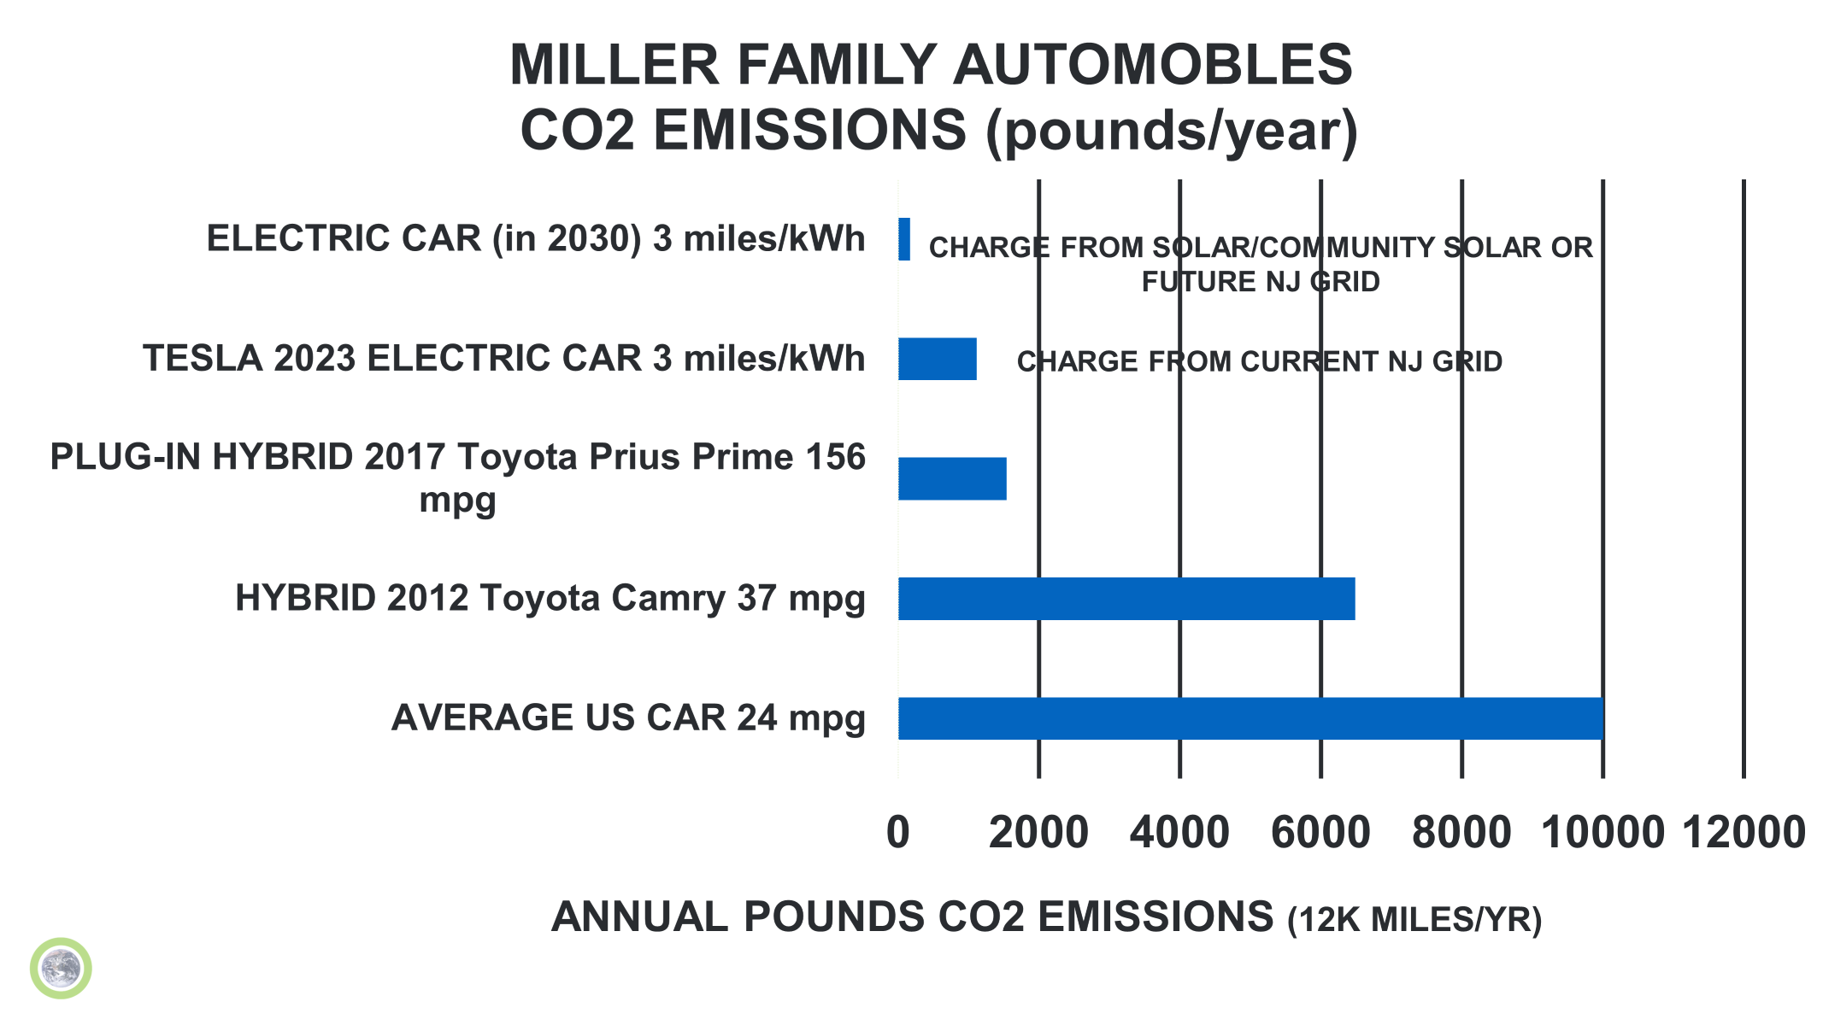
Notes:
J:\s\Documents\UUCMC\UUCMC-gas-electric-calculations\2023-actual-GHG-and-bar-charts.xlsx
NOTES: 20 POUNDS of CO2 per gallon (US DOT)
12,000 miles driven per year
0.35 kWh/mile for EV sources: many (3 to 4 miles/kWh seems common across EVs)
NJ Electricity: 530 pounds/megaWh= 0.530 pounds/kWh (EIA- NJ.
NOTE: currently, ~50% of NJ is nuclear ~35% , plus RPS (~30%), so I chose CO2 contribution of ½ = 0.27 pounds, kWh
HOWEVER, both my electric, AND my daughter’s electric are from Community Solar
(if I assume zero GHG-not exactly true- then my Prius Prime and Joellen Tesla electric car are close to zero (often charged off-premise)
I assumed prius prime is ALWAYS charged at home (via Community Solar)
AND joEllen’s Tesla is charge ½ at external fast chargers and ½ in-house (zero GHG)
2012 Toyota Camry 4 cyl: 68240 miles; avg 37mpg lifetime (odometer read 4/5/2024)
2017 Toyota Prius Prime 4 cyl 53454 miles; avg 156 mpg lifetime (odometer read 4/5/2024)

Slide 8
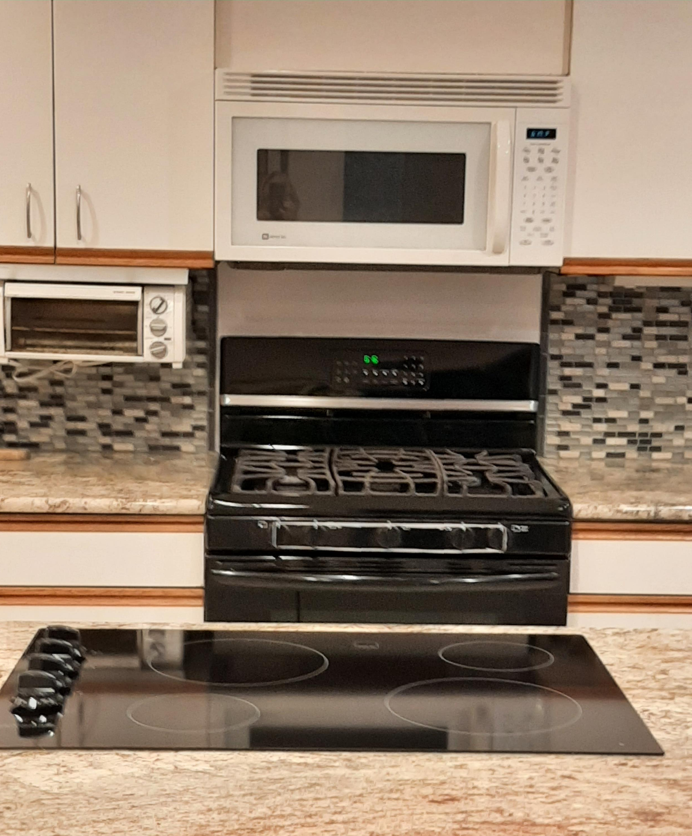
OUR FIRST ELECTRIC APPLIANCE REPLACEMENT – CERAMIC STOVETOP

Slide 9
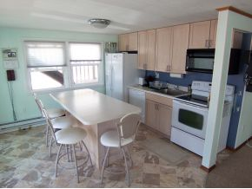
KITCHEN of Our
Prior
All-Electric Home

Slide 10

Space Heating & Cooling w. Electric Heat Pump
Notes:
READ

Slide 11
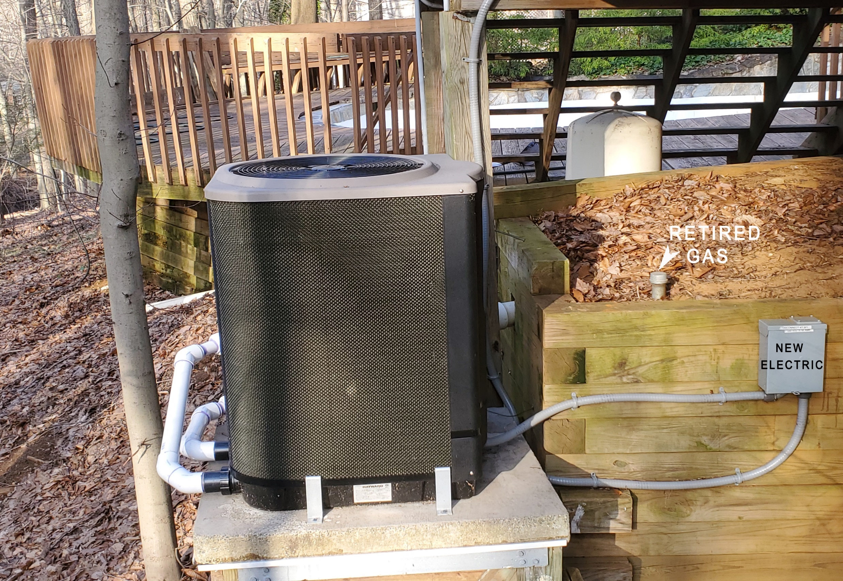
Pool Heater – Electric Heat Pump
Notes:
READ

Slide 12
ANNUAL SAVINGS COMPARISON OF GAS VERSUS HEAT PUMP POOL HEATERS
NJ JCPL electric and NJNG GAS territory
All costs are relative to an arbitrary $1000 annual POOL gas heating bill
A seasonal average COP of 5.0 was used to determine heat pump savings.
100KBTU = 1 THERM = 29.3 KWH
NJNG gas: $1.402/THERM
JCP&L electric: $0.147/KWH
THIS TABLE WAS ADAPTED FROM A TABLE AT DOE SITE:
https://www.energy.gov/energysaver/heat-pump-swimming-pool-heaters
USE EXPANDED TABLE (to change this table to your local gas and electric rates)
https://climate.smiller.org/50x30/building-electrification/2023-7-18-ask-sean-show/pool-water-heating-gas-vs-heat-pump-NJ-CA-data.xls
Notes:
A REALLY useful site for pool owners is https://www.energy.gov/energysaver/heat-pump-swimming-pool-heaters
It compares heat pumps vs gas pool heating, provides many ways to reduce pool energy costs, covers selection and maintenance of solar pool heating,…
Gas pool heater efficiency range is from DOE www.energy.gov
COP Coefficient of Performance is the ratio of output water heating to the input consumption of electricity (ratio of output energy to input energy)
This is typical of the Hayward line of electric pool heaters (my COP is 5+ in summer, and as low as 4.0 in off-season: 50 degree air and 80 degree water
Electric and gas are current prices for NJNatural Gas and Jersey Central power and Light
Use the expanded table to calculate your personal savings in your region

Slide 13
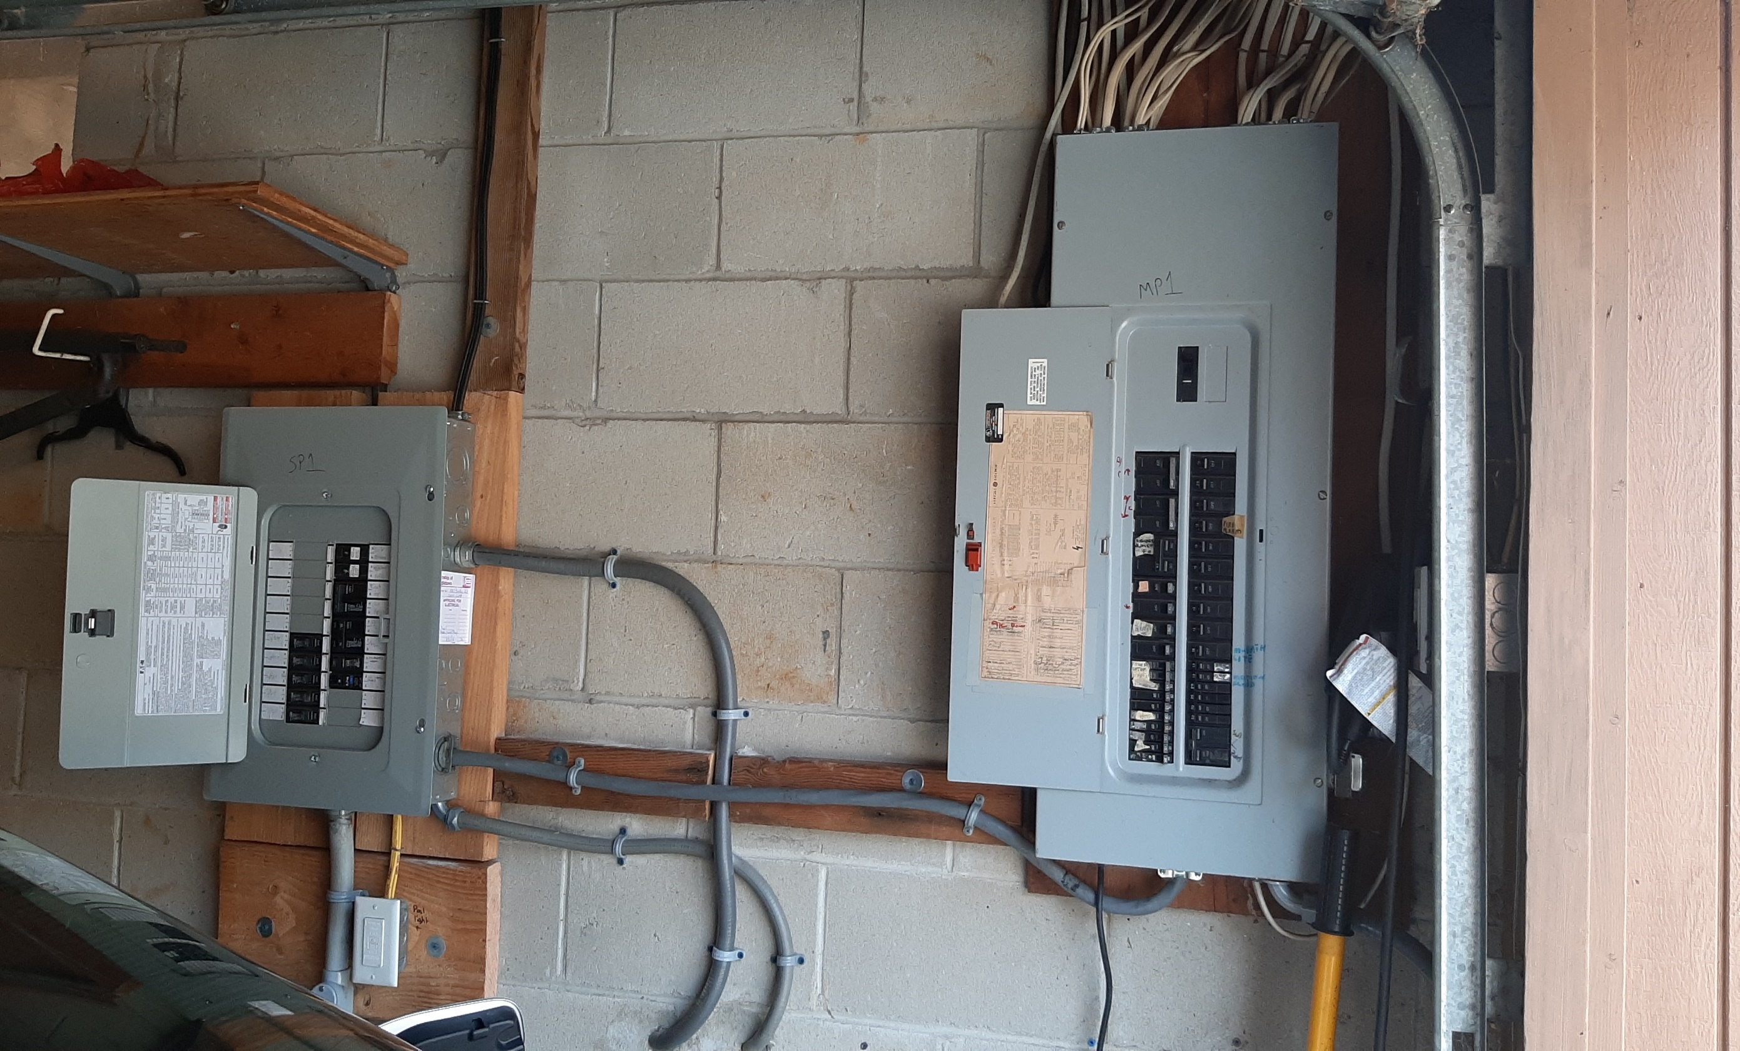
Spare Circuits for Future Electric Appliances
New Box on Left for New/Future
2nd Heat Pump Space Heater/AC
Stove
2nd EV
Notes:
READ

Slide 14
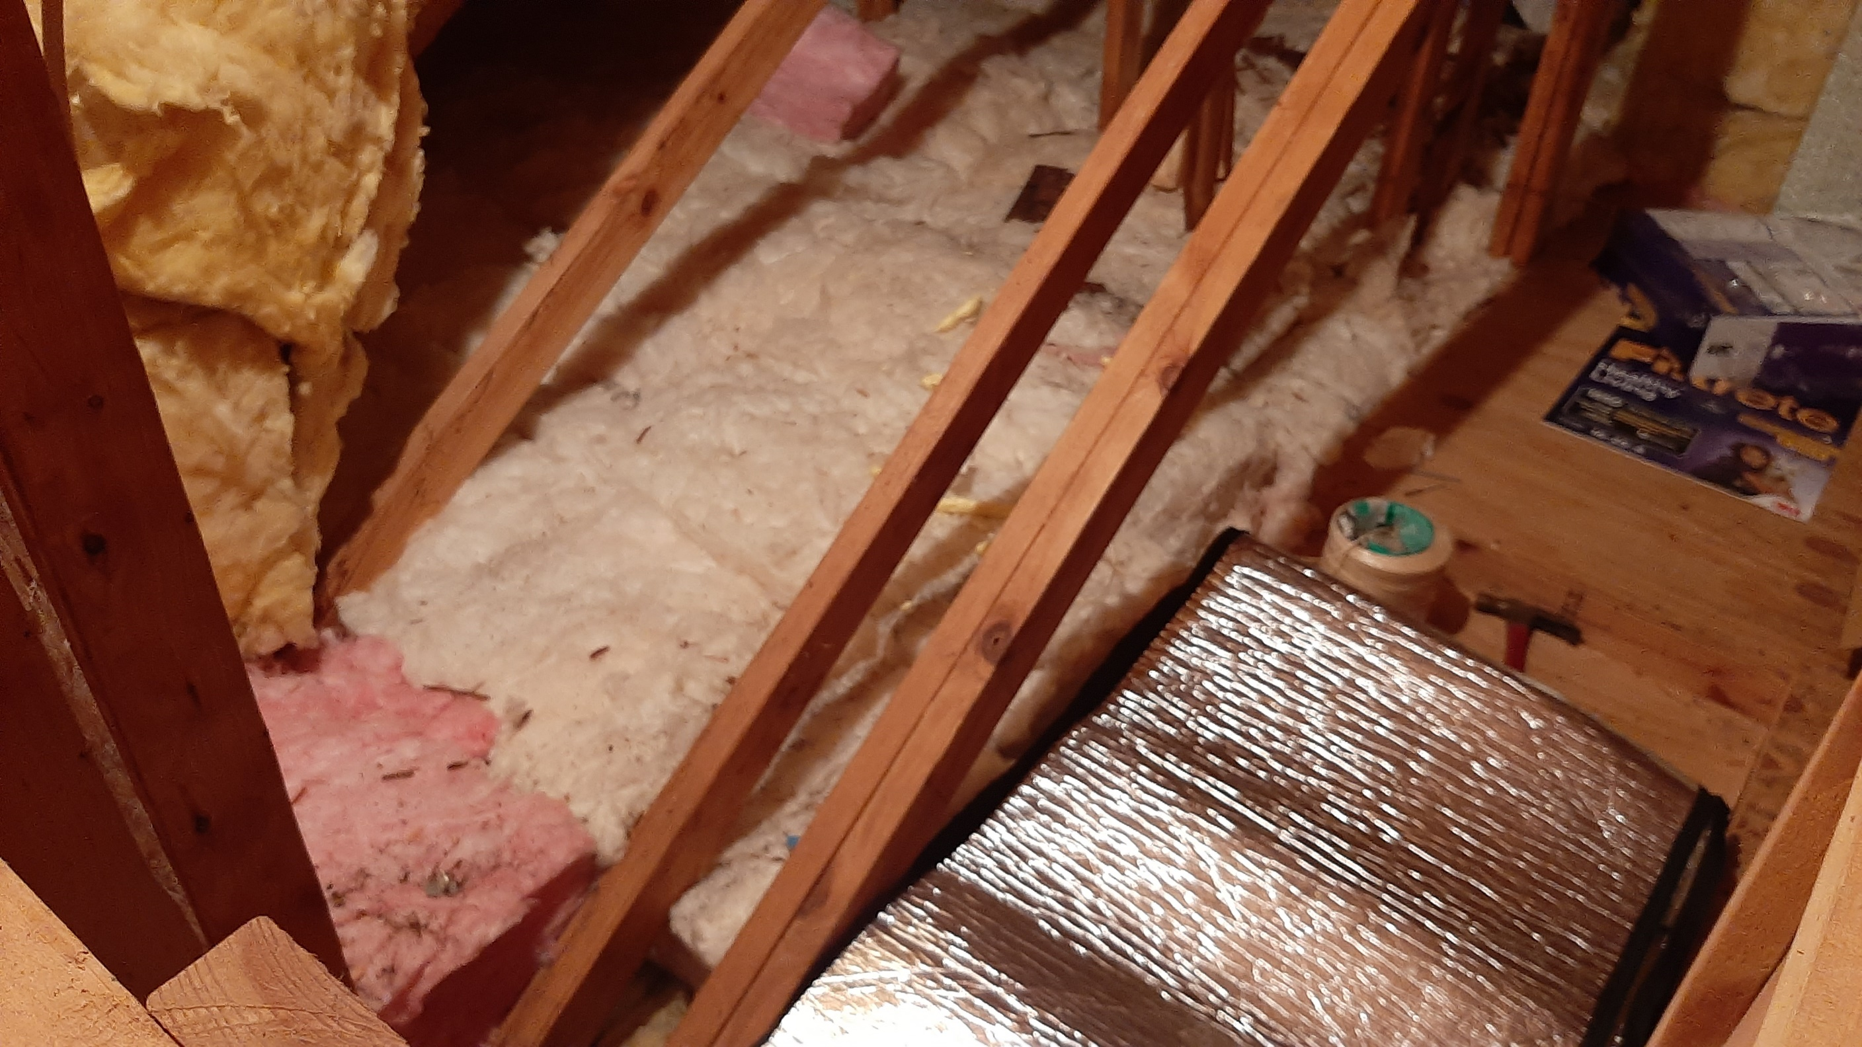
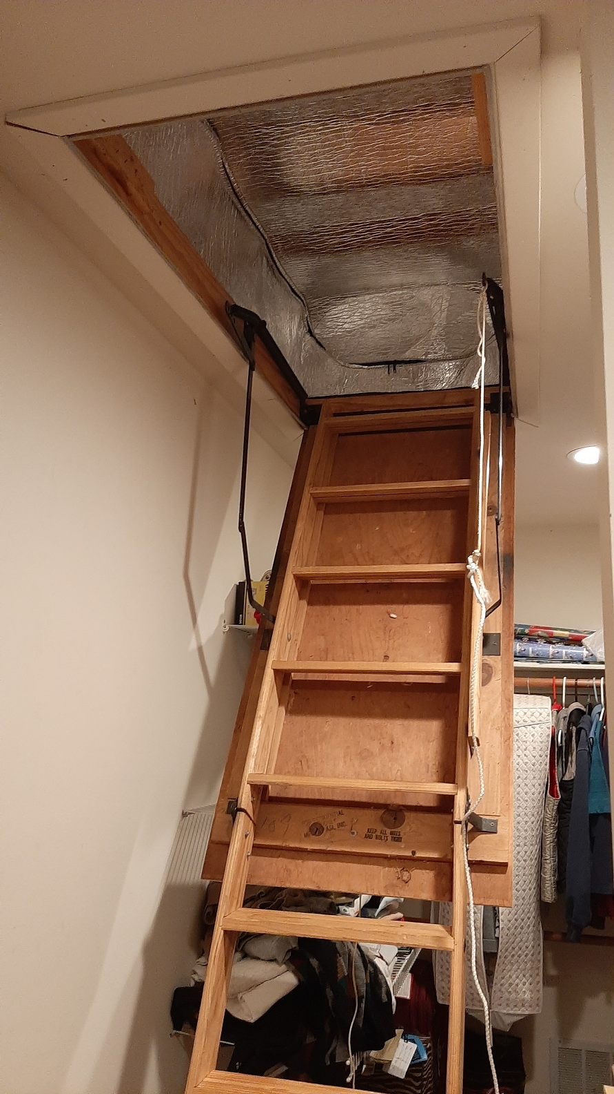
Energy Efficiency – Use Less Energy
Notes:
READ

Slide 15
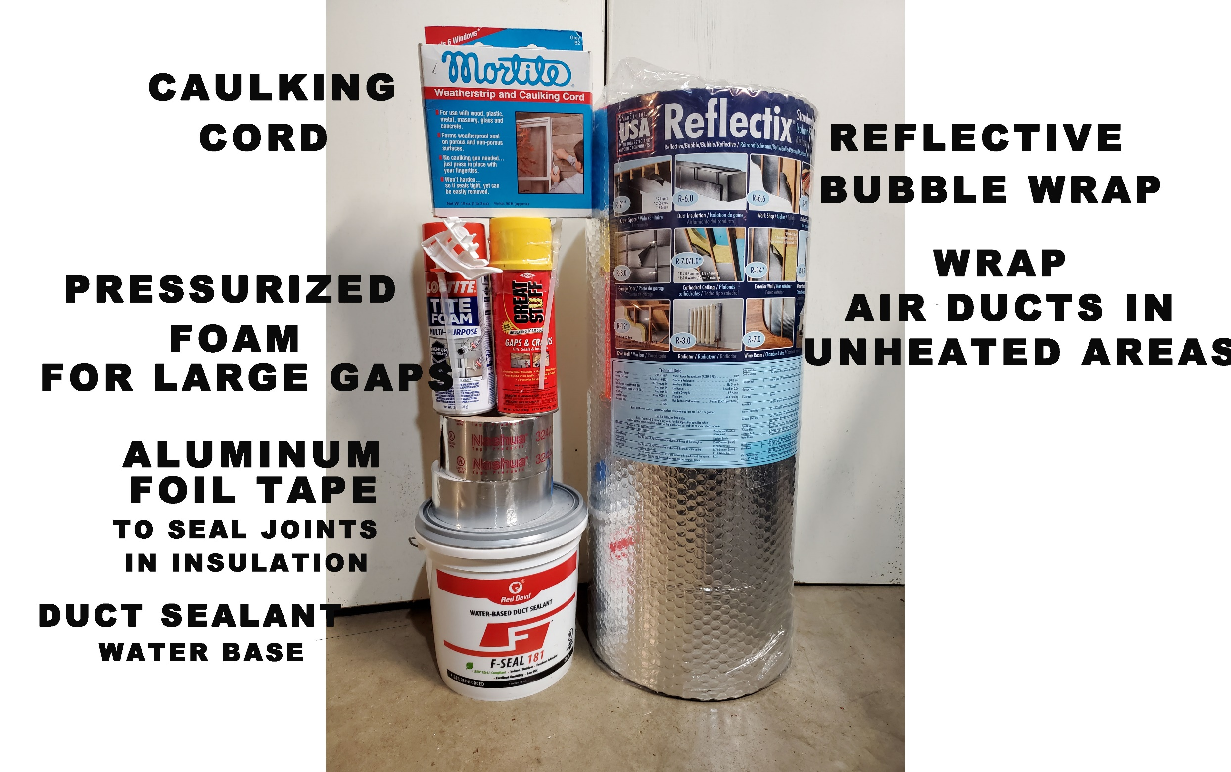
A SIMPLE DO-IT-YOURSELF PROJECT
DUCT SEALING

Slide 16
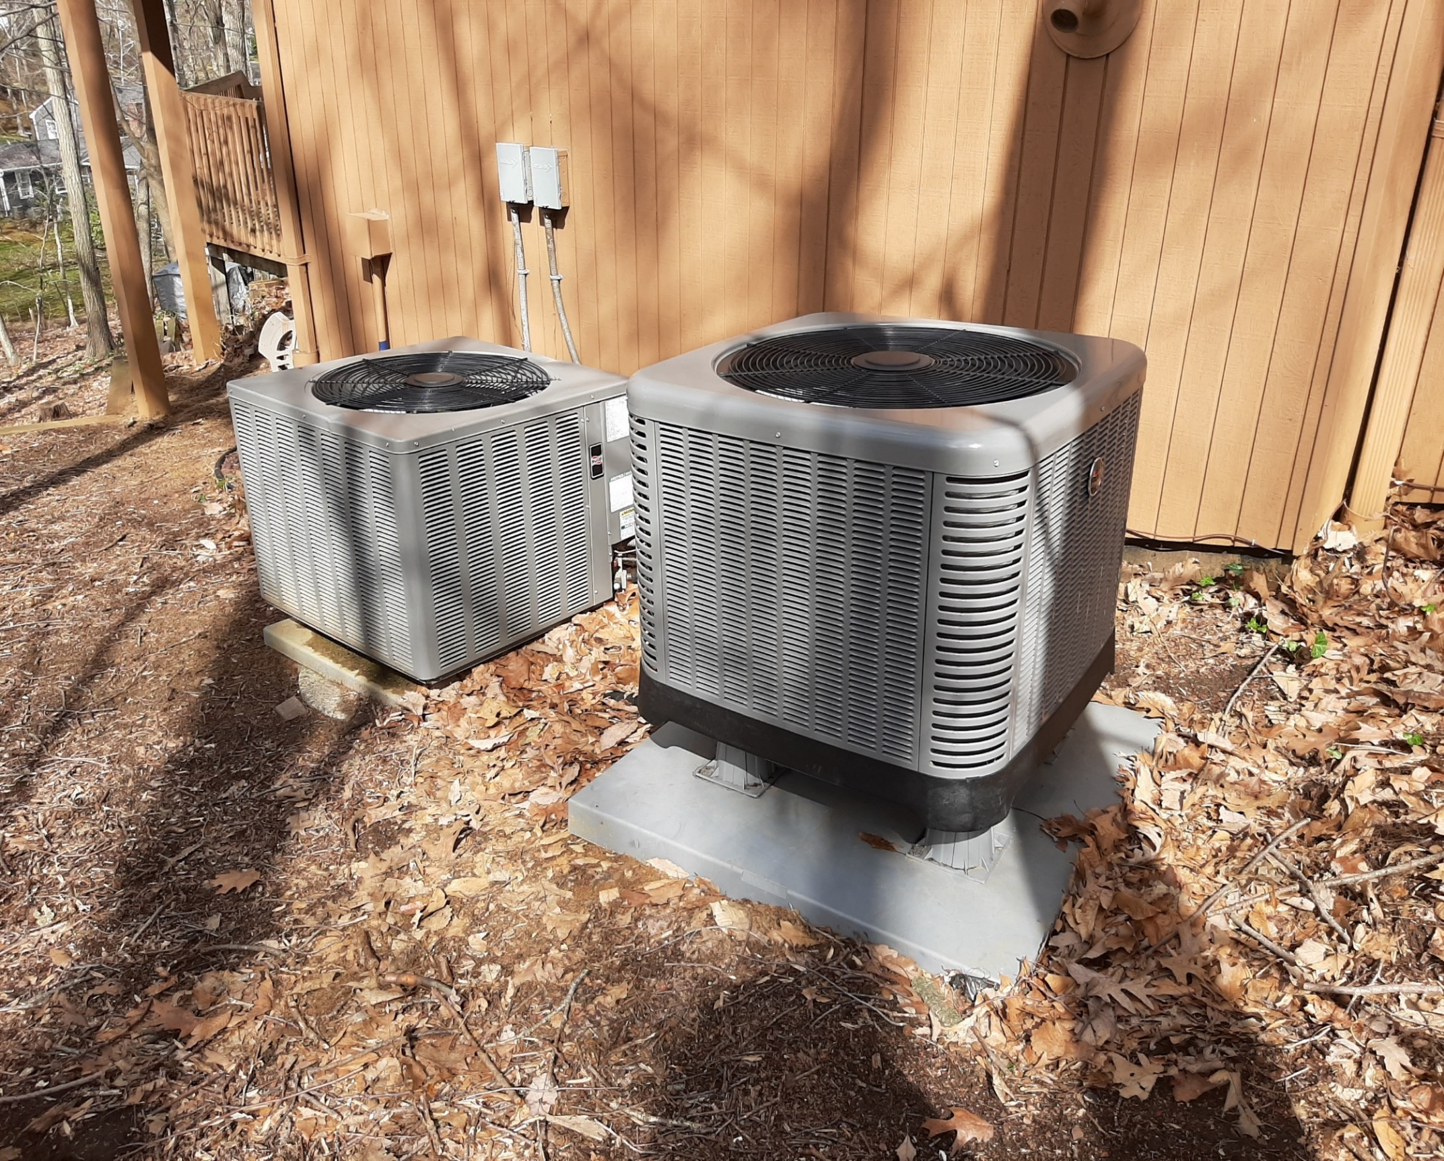
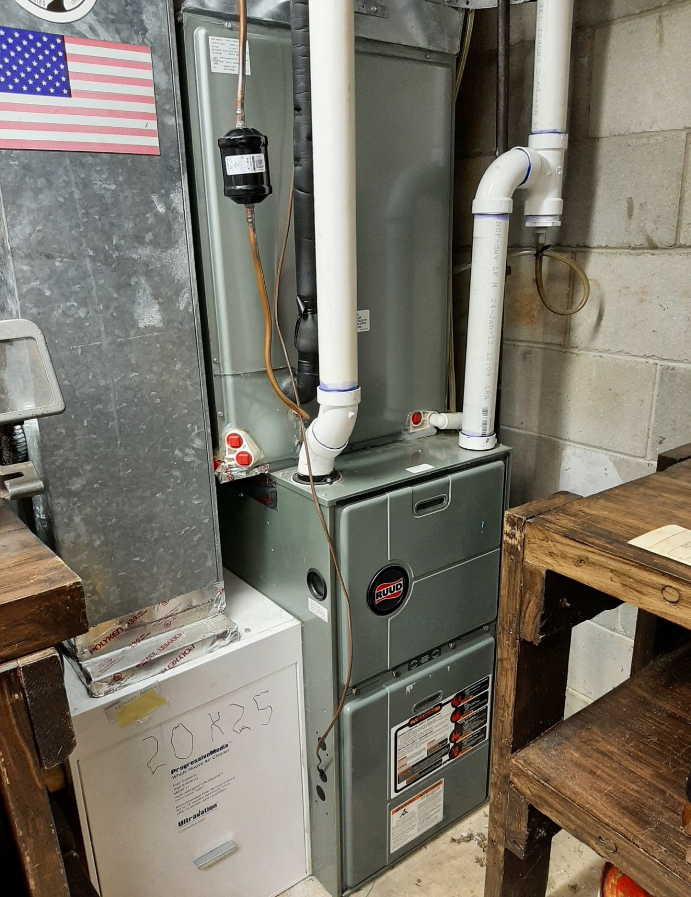
SPACE HEATING & COOLING WITH ELECTRIC HEAT PUMP
Gas Furnace Backup on Right
Notes:
READ

Slide 17
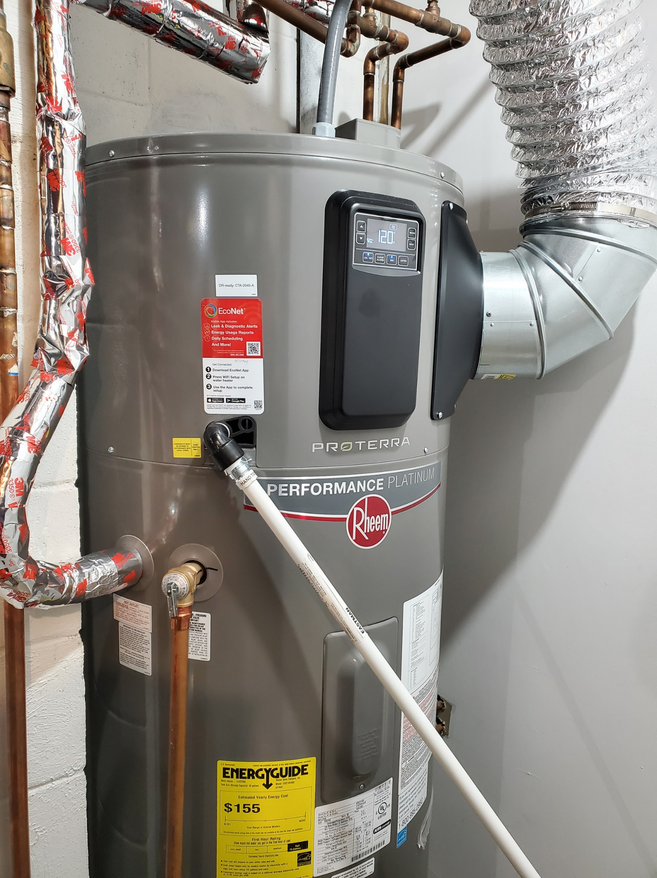
ELECTRIC HEAT PUMP WATER HEATER

Slide 18
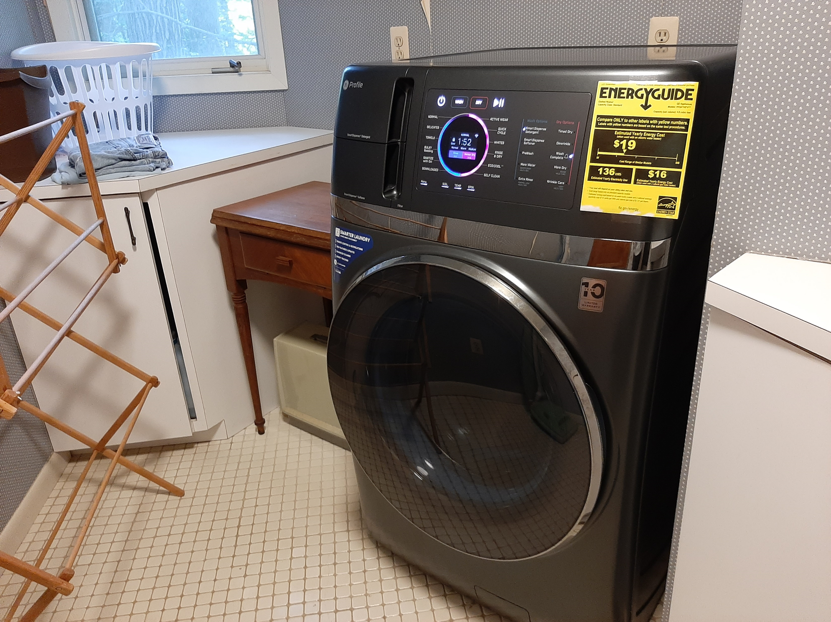
HEAT PUMP COMBO WASHER/DRYER

Slide 19
Electric Heat Costs Less, Pollutes Less
2023 ENERGY COSTS v2 8/5/2024
 | ACTUAL 2023 with heat pumps for space & water heating | ACTUAL 2021 with gas for space &water heating | % CHANGE with heat pumps | With Heat Pumps
TOTAL Gas + Electric* | $1703 | $1967 | (13%) | Savings
GAS Cost | $49 | $1113 | (96%) | Reduction
ELECTRIC Cost | $1654 | $854 | 94% | Increase
THERMS Gas Burned | 29 | 954 | (97%) | Savings
TONS CO₂ Emitted | 0.2 | 5.6 | (96%) | Savings
2
*Electricity in 2024 is 100% clean AND 21% lower cost, supplied by nearby Community Solar
Miller residence, single family house, Middletown, NJ

Slide 20
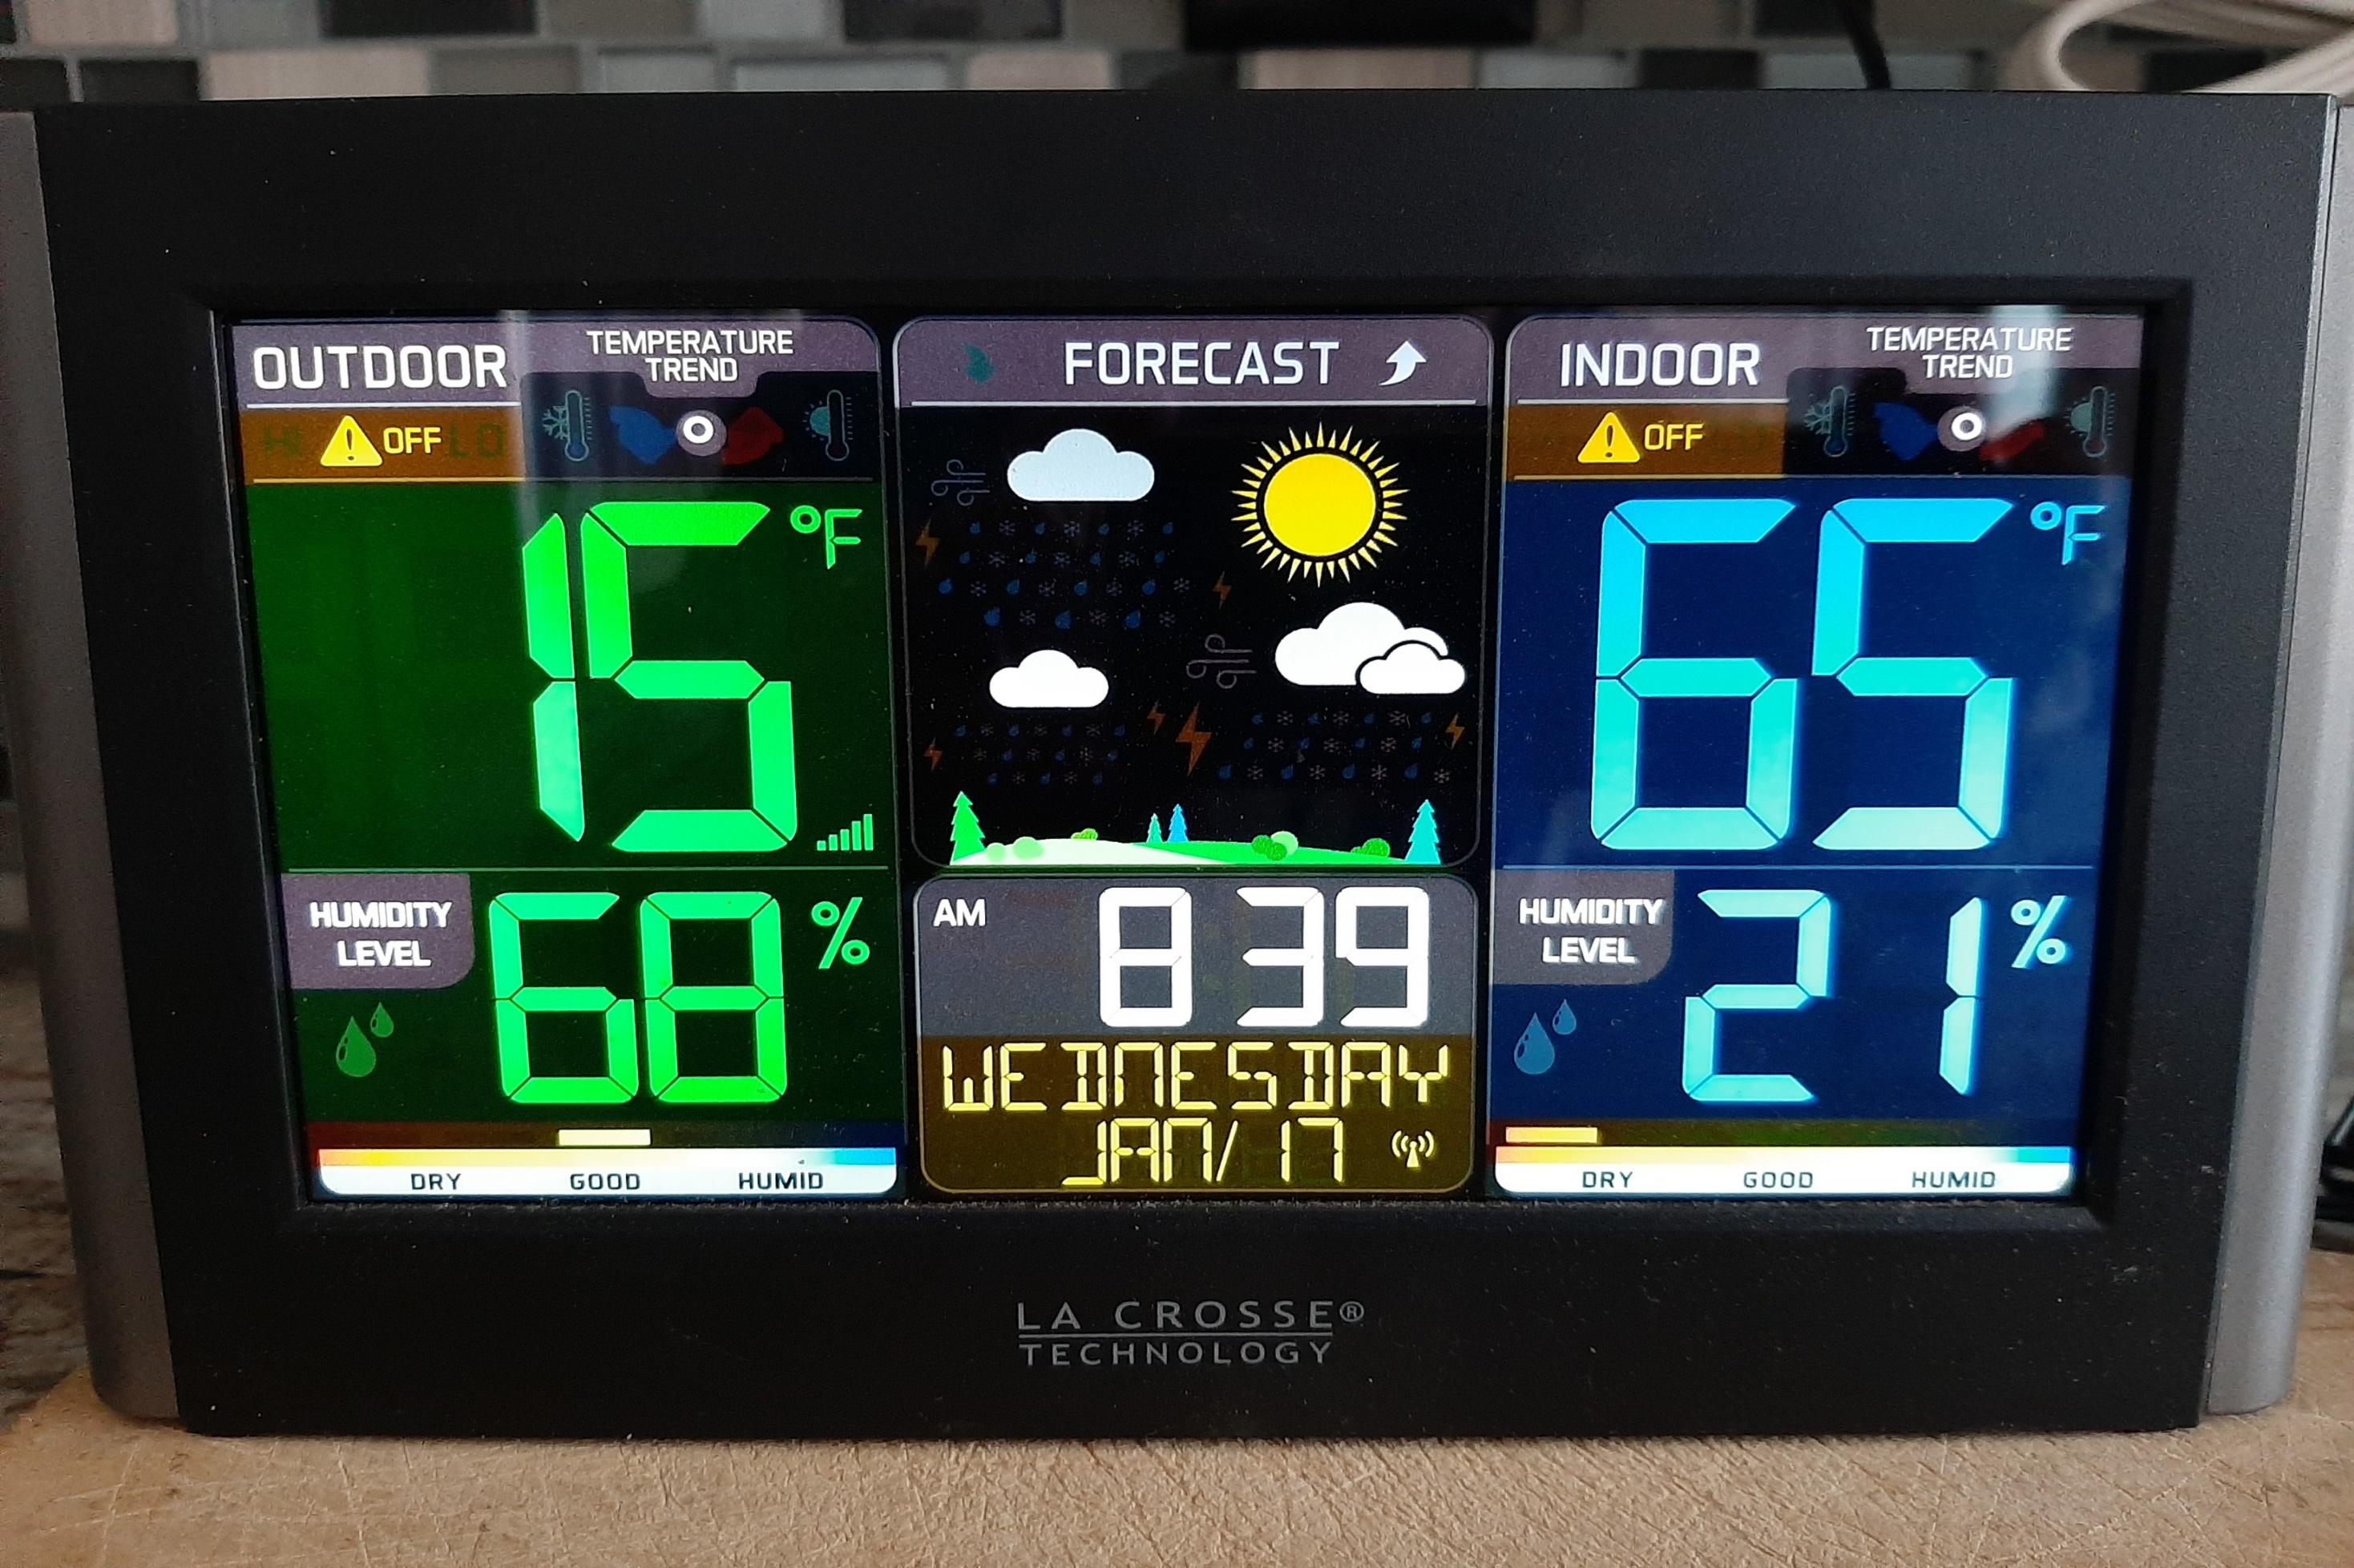
HEAT PUMP IN COLDEST WEATHER
Notes:
Heat pump was on; normal indoor temps ~70 degrees.
Overnight, outdoor temps dropped rapidly, and indoor temp dropped to 65 degrees (insufficiently sized heat pump, normally did not keep up with heat loss)
We subsequently turned off heat pump and turned on old gas furnace to warm up the house for a few hours until outdoor temps rose above 20 degrees F
NOTE: Normally, the thermostat is set to automatically switch between heat pump and backup furnace at about 20 degrees outdoor temps

Slide 21
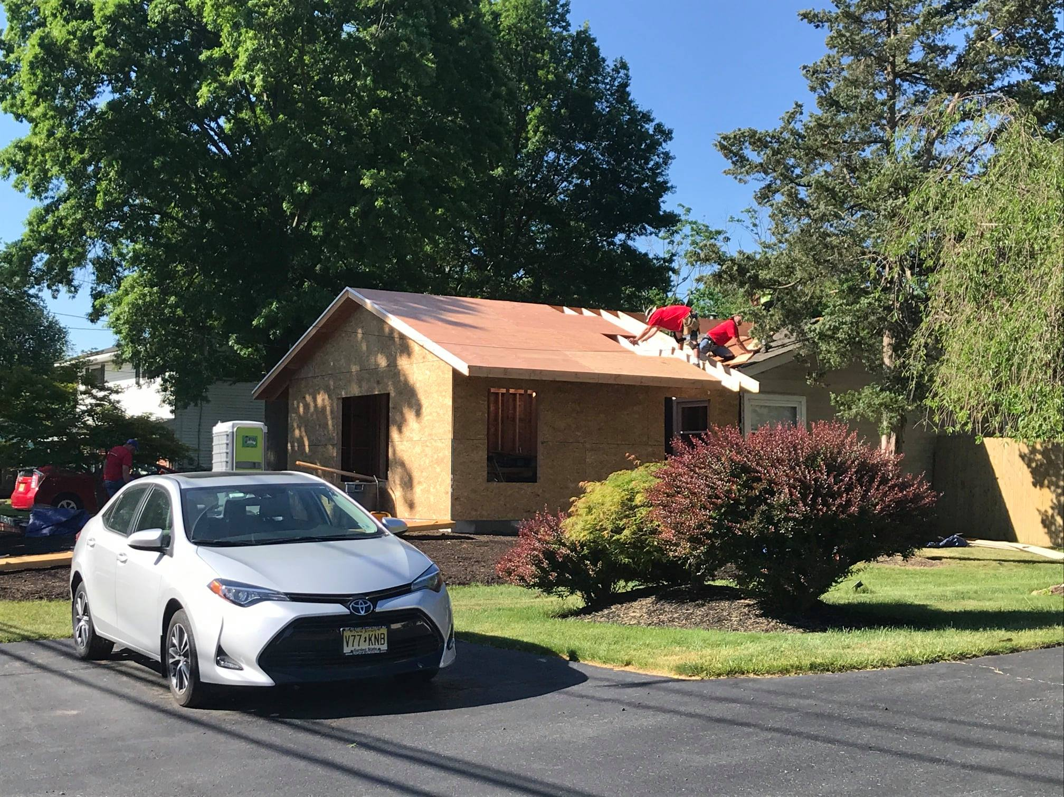
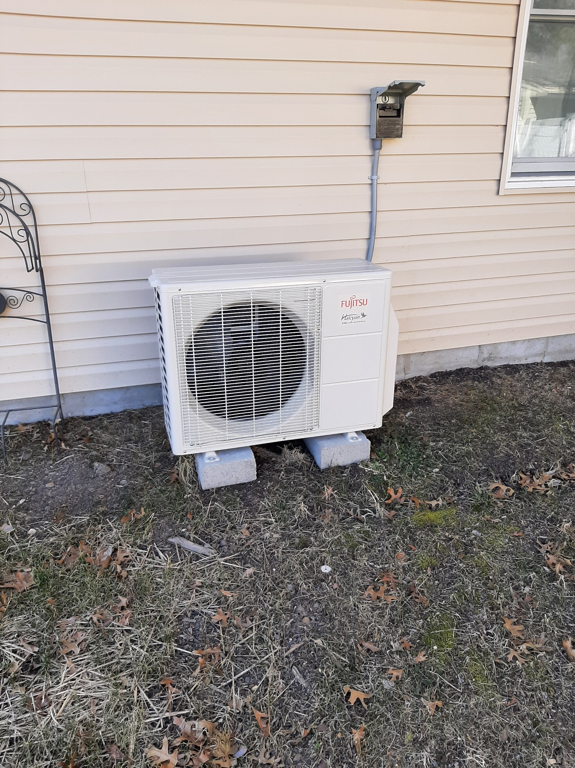
Daughter’s New Efficient Addition
Electrified with Ducted Heat Pump

Slide 22
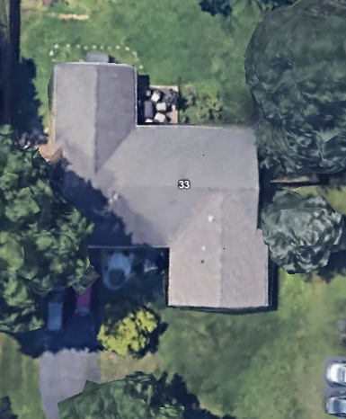
Daughter’s House
Google Earth
After New Addition in Front
(lower right corner)
Shows Older Addition in
Rear Left

Slide 23
HOME PERFORMANCE WITH ENERGY STAR
NJ & Nation-wide Weatherization Program
South Brunswick, NJ | May 11, 2023
Install 50 Gallon Heat Pump Water Heater w. UEF of 3.88 | $5,460
Shell Test & Seal Incl. Applicable Air Seal Top-Plates & Penetrations | $2,960
Attic Hatch Insulated to R-13 | $275
Attic Stair Cover Insulated to R-13 | $475
4” of Dense-Packed Cellulose in Exterior Walls R-13, 564 Sq Ft | $3,412
4” of Dense-Packed Cellulose in Garage Buffered Walls R-13, 267 Sq Ft | $1,775
Audit Refund ($99) | ($99)
Total Project Cost | $14,258
Rebate to Ciel Power, LLC | $5,000
Balance Due Upon Completion of Project | $9,258
* Can be paid with PSE&G 0% On-Bill Repayment
Project qualifies for a $5,000 rebate to contractor through NJ HPwES Program
Notes:
This is an example of a NJ rebate home efficiency program called Home Performance with Energy Star, that will probably be incorporated into the HOMES IRA program. The above work proposal is how it works now on a home belonging to our daughter. This customized solution includes all the above energy efficiency improvements and provides a $5,000 rebate, paid to the contractor, since the calculated energy efficiency improvement is more than 25%

Slide 24
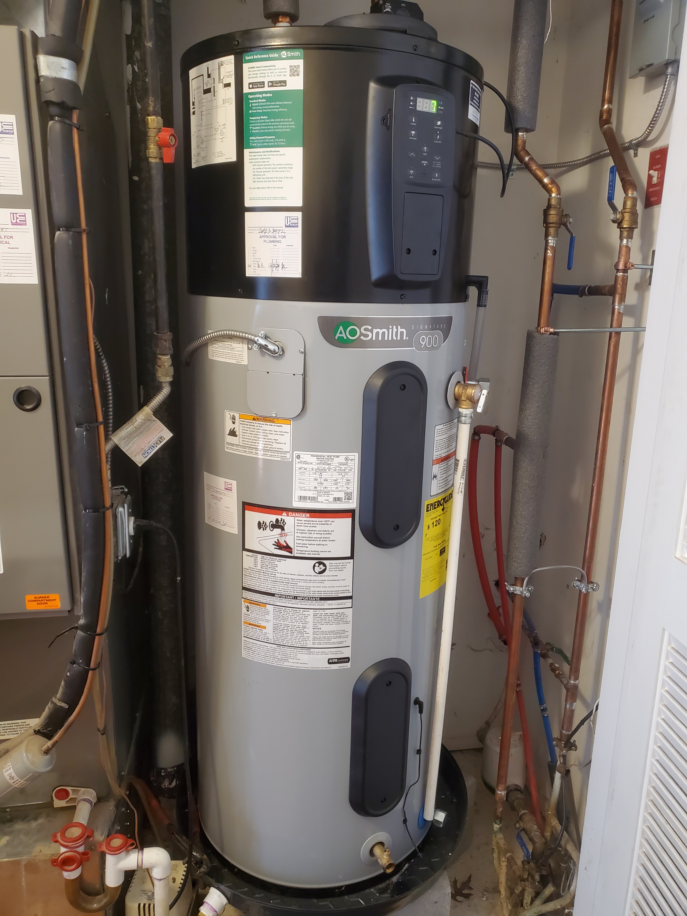

Heat Pump Water Heater beside Gas Furnace in Closet with Louvered Doors
Spackled Holes for insulation in inside garage walls

Slide 25
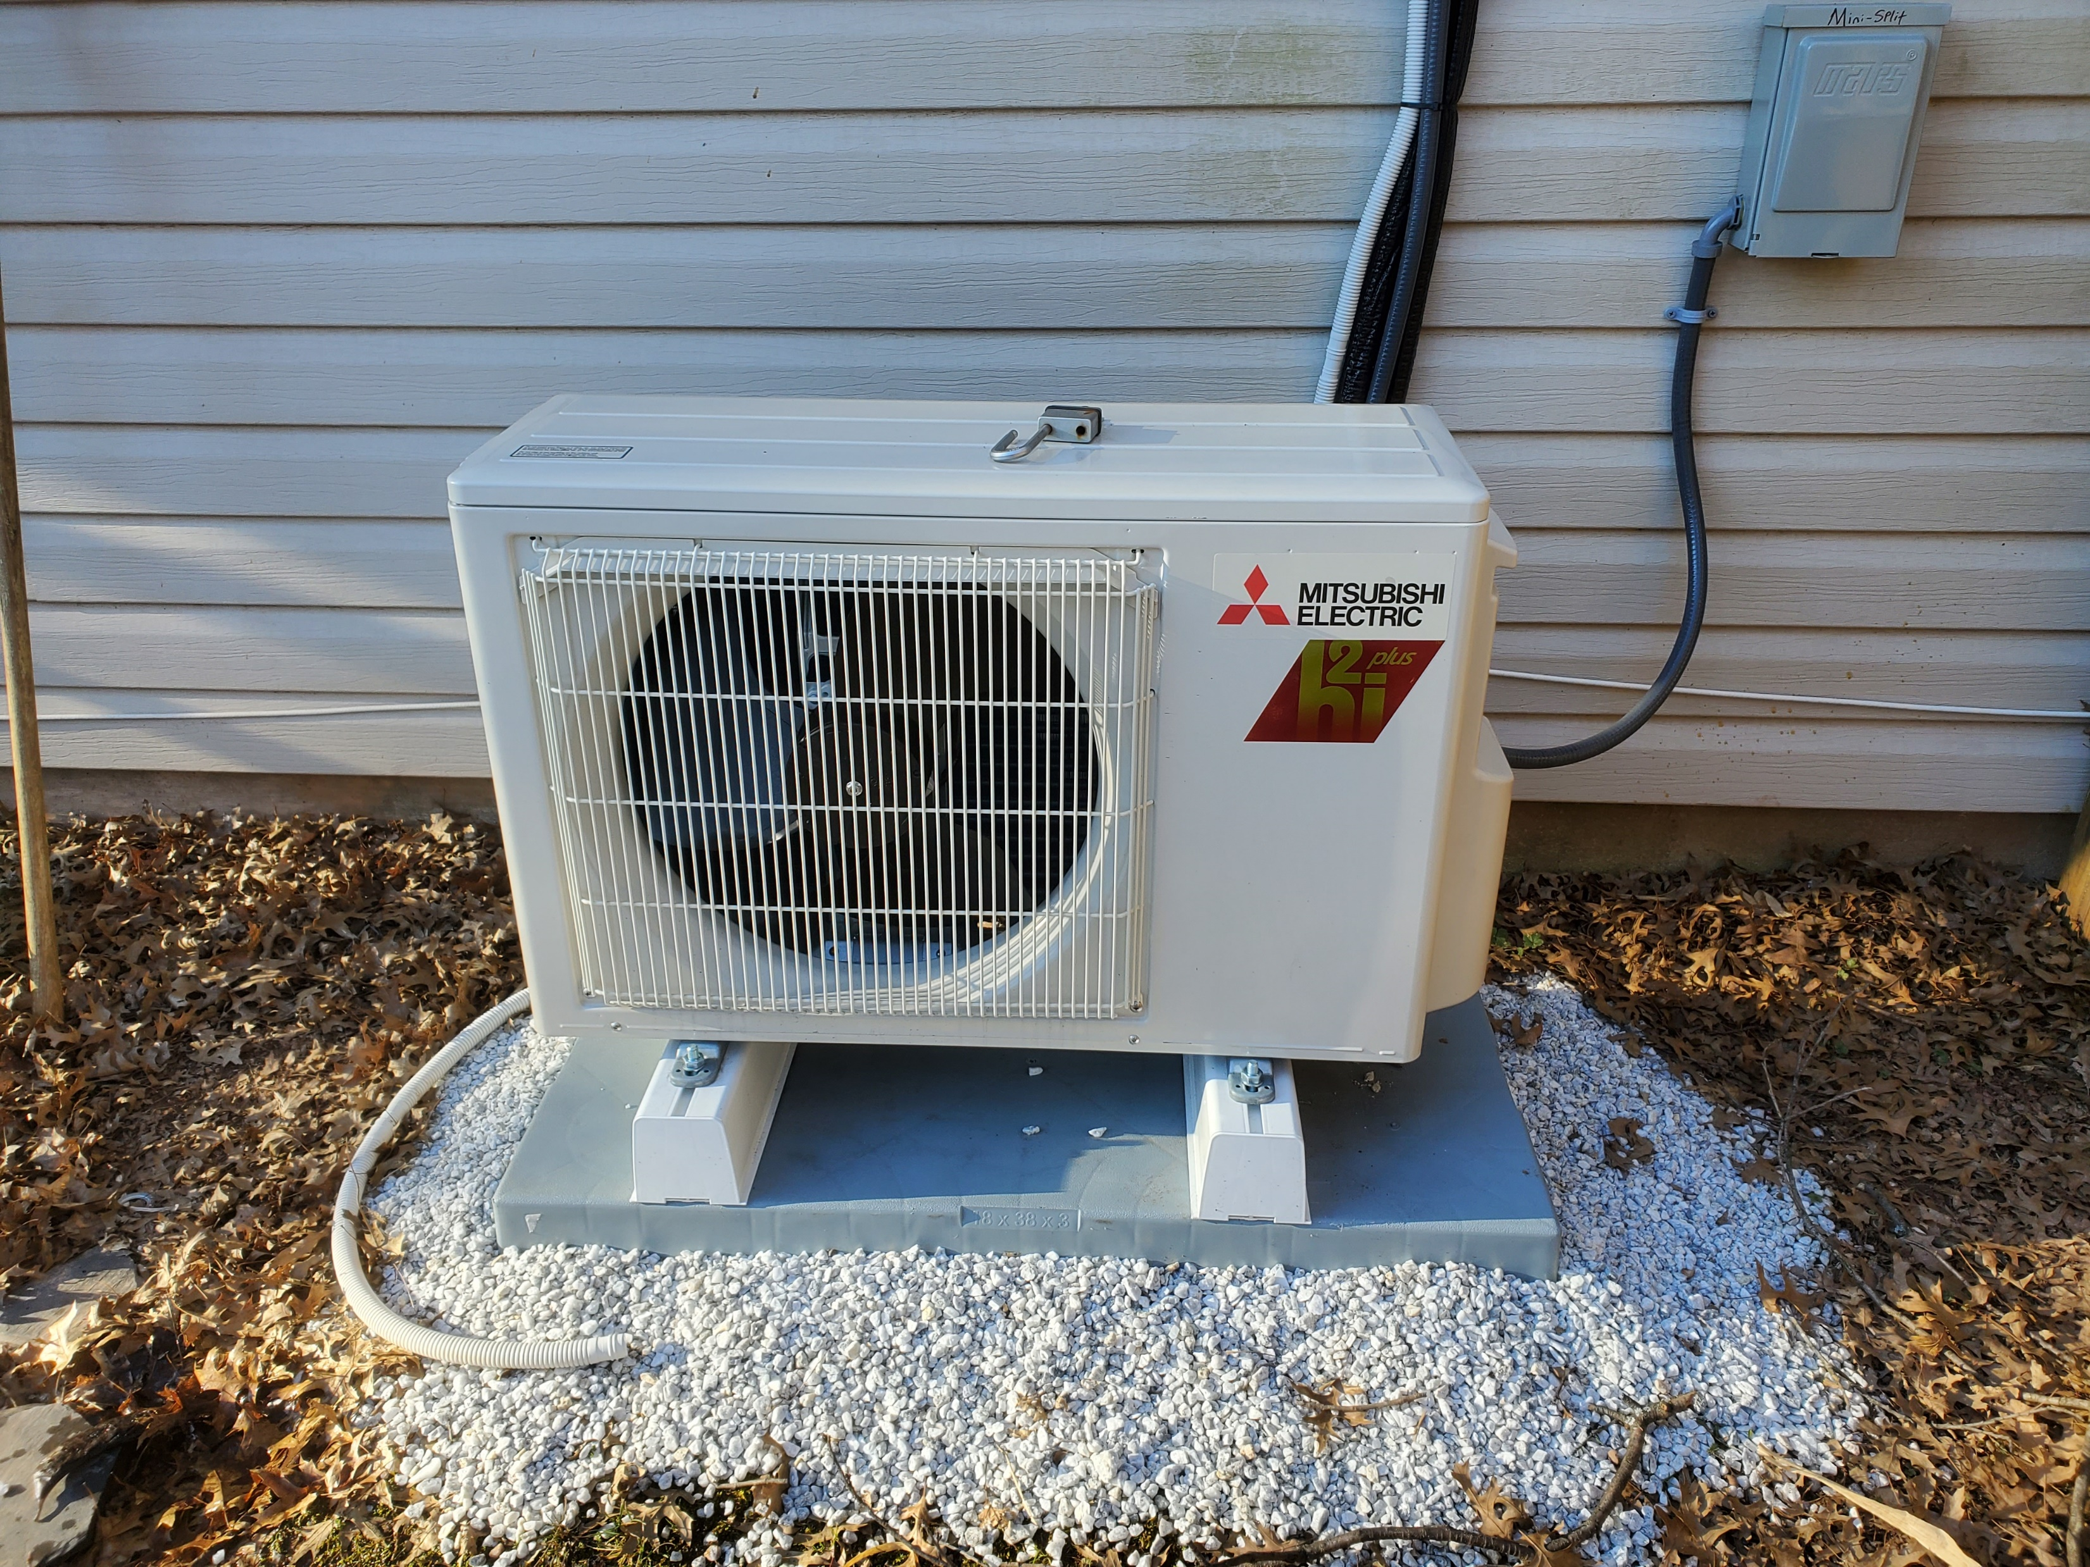

Family Room (Rear) Addition Mini-Split Heat Pump
Insulation Blown Under Siding

Slide 26
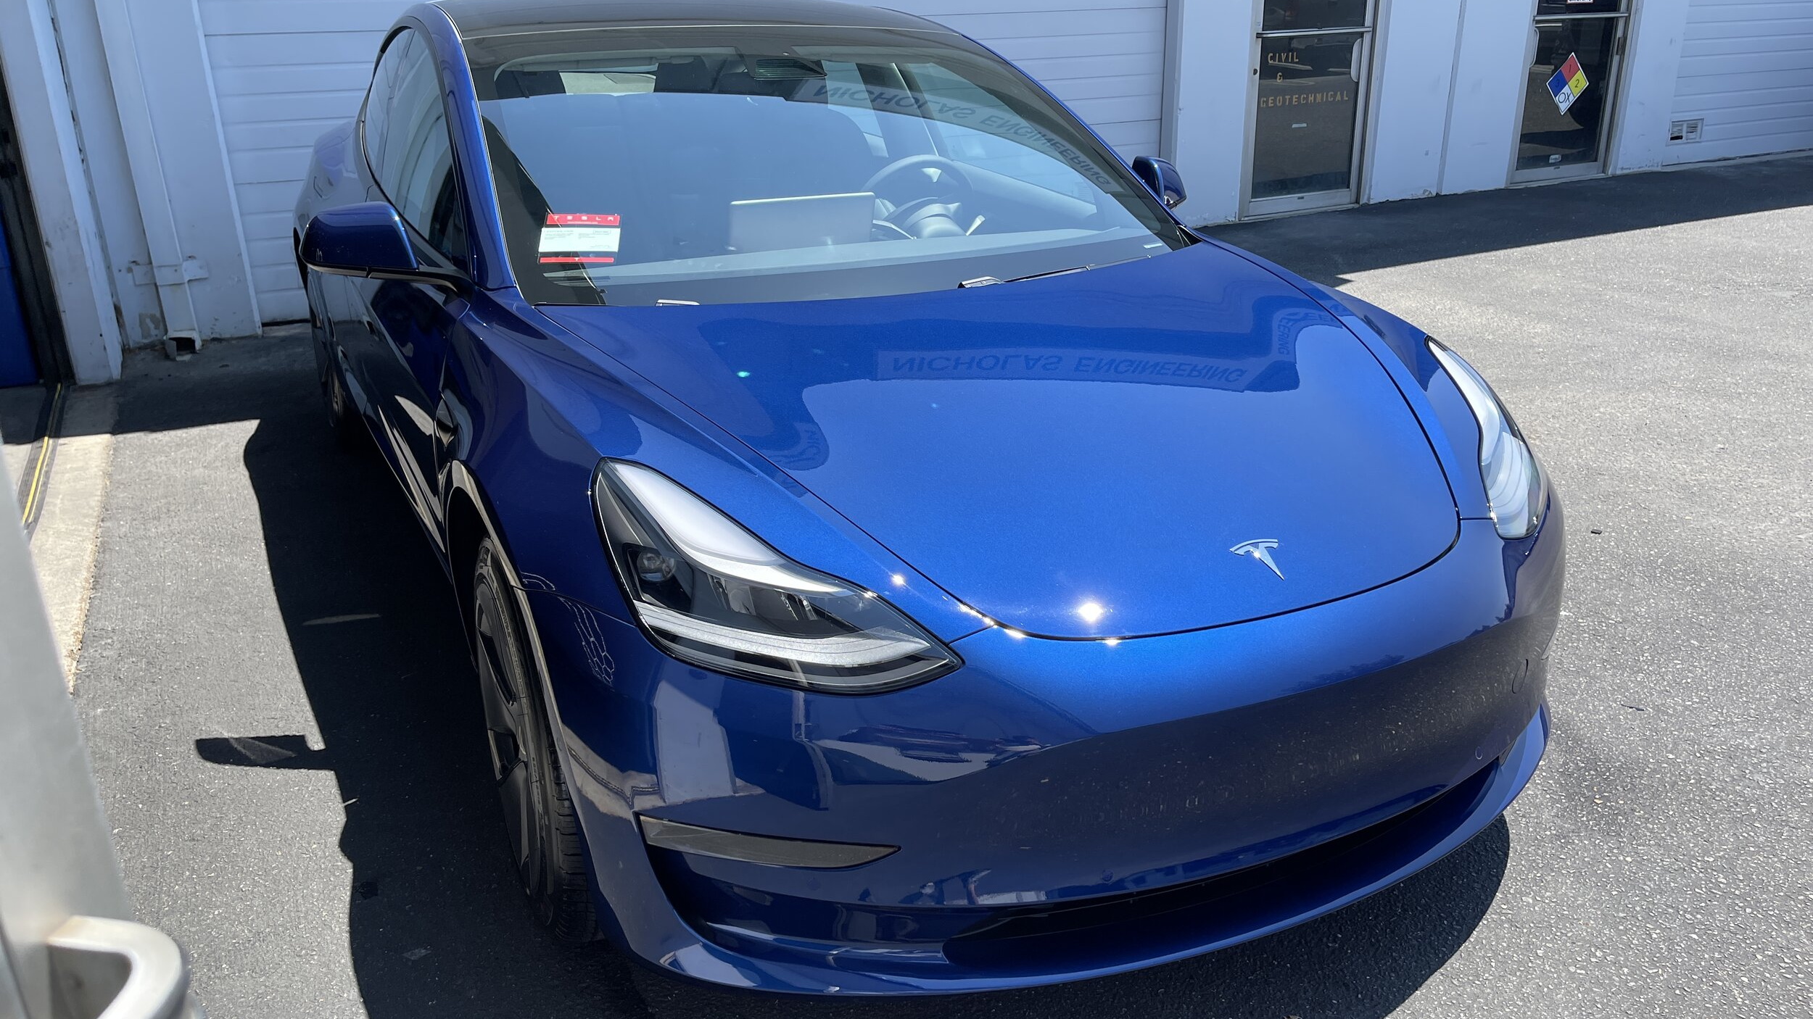
NEW EV

Slide 27
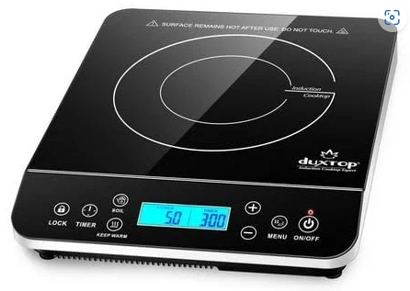
Experimental Induction Stovetop
1 Burner Portable Induction Hot Plate - $109.

Slide 28
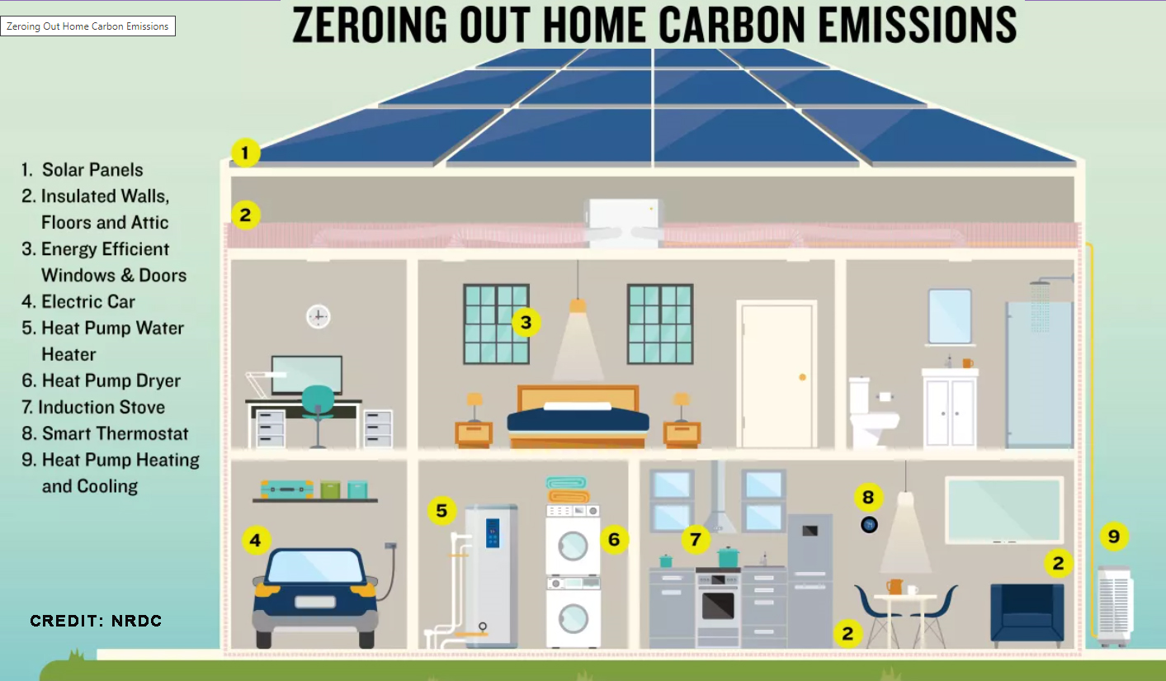

Slide 29
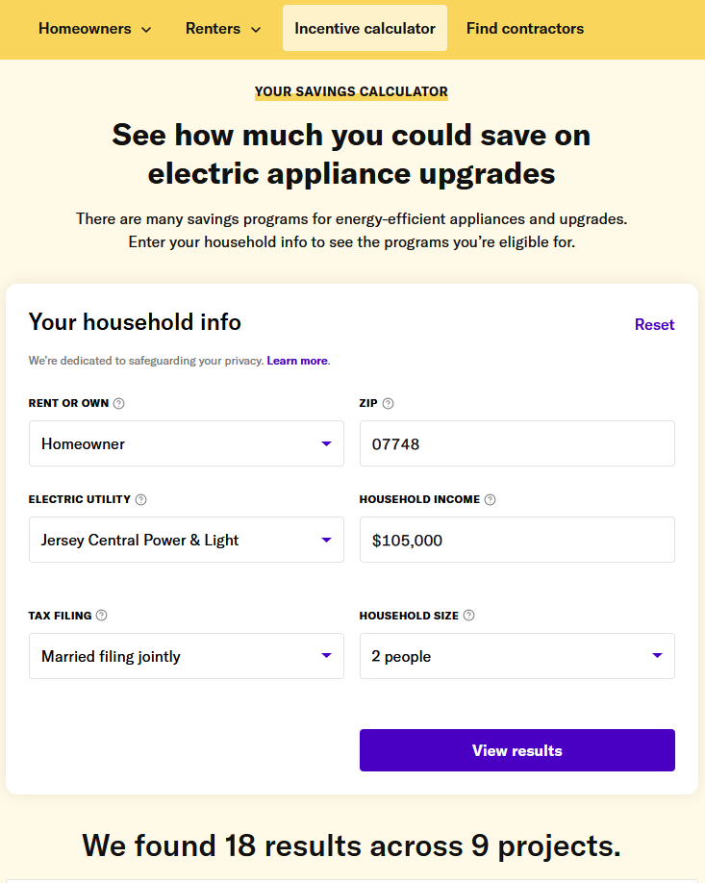
Calculate your potential IRA electrification incentives with
Rewiring America
https://homes.rewiringamerica.org/calculator
AMI: HUD Area Median Income

Slide 30
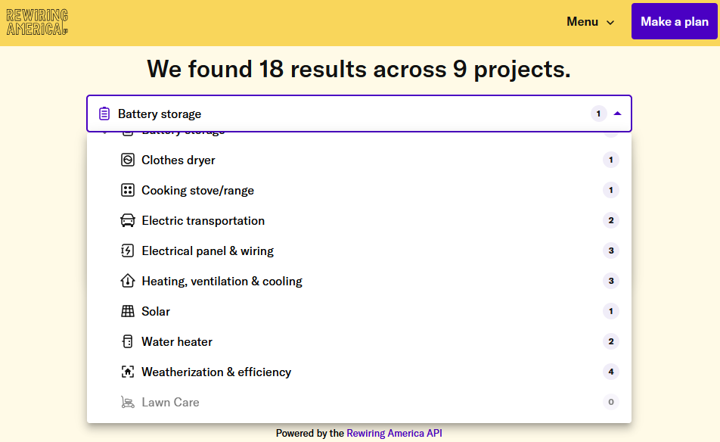

Slide 31
IRA TAX CREDITS FOR MODERATE INCOME HOUSEHOLDS
Category | Project | Amount | Annual Cap | IRS Code
Battery | Battery storage | 30% of cost | Uncapped (Avg $4,800) | Fed Res Clean Energy Credit 25D
EV | New EV | $7,500 | Cars max MSRP $55,000 Truck/van max $80,000 | Fed Clean Vehicle Credit 30D
EV | Used EV | 30% of cost | Cap $4,000 max MSRP $25,000 | Fed Credit Prev-Owned EV 25E
Elec Panel/Wiring | Elec Panel | 30% of cost | Cap $600; must accompany 2nd 25C or 25D upgrade | Fed Energy Effic Home Improvement 25C
Heating, Vent, Cooling | Geothermal Heat Install | 30% of cost | Uncapped (Avg $7,200) | Fed Res Clean Energy Credit 25D
Heating, Vent, Cooling | Air Source Heat Pump | 30% of cost | Cap $2,000 | Fed Energy Effic Home Improvement 25C
Solar | Rooftop Solar | 30% of cost | Uncapped (Avg $4,600); includes panel upgrade | Fed Res Clean Energy Credit 25D
Water Heater | Heat Pump Water Heater | 30% of cost | Cap $2,000 | Fed Energy Effic Home Improvement 25C
Weatherization | Insulation, Air Sealing, etc | 30% of cost | Cap $1,200 | Fed Energy Effic Home Improvement 25C
Weatherization | Energy Audit | 100% of cost | Cap $150 | Fed Energy Effic Home Improvement 25C
* Many items can be supplemented by more generous state or utility rebates in Triennium 2 starting 1/1/2025.

Slide 32
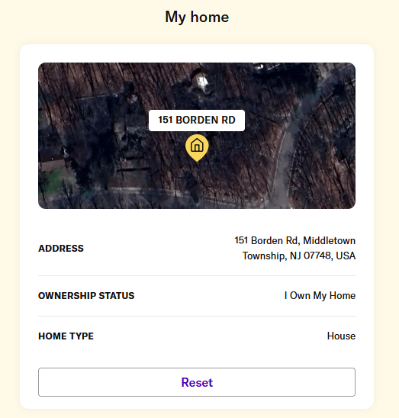
Create a Home Electrification Plan with
Rewiring America
Plan your next electric upgrade today (rewiringamerica.org)

Slide 33
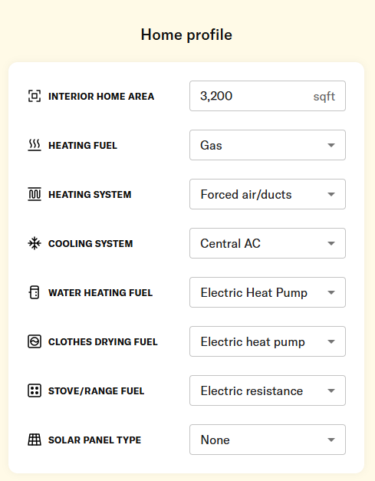
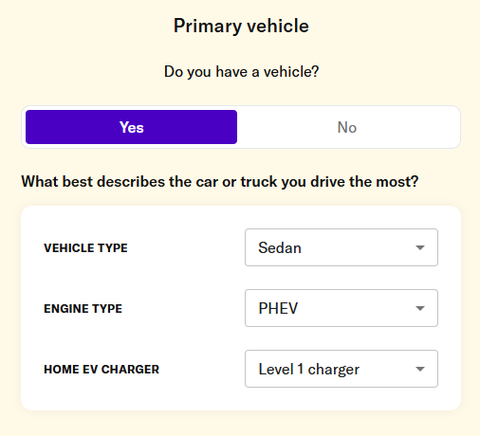
USER INPUT FOR PLANNING

Slide 34
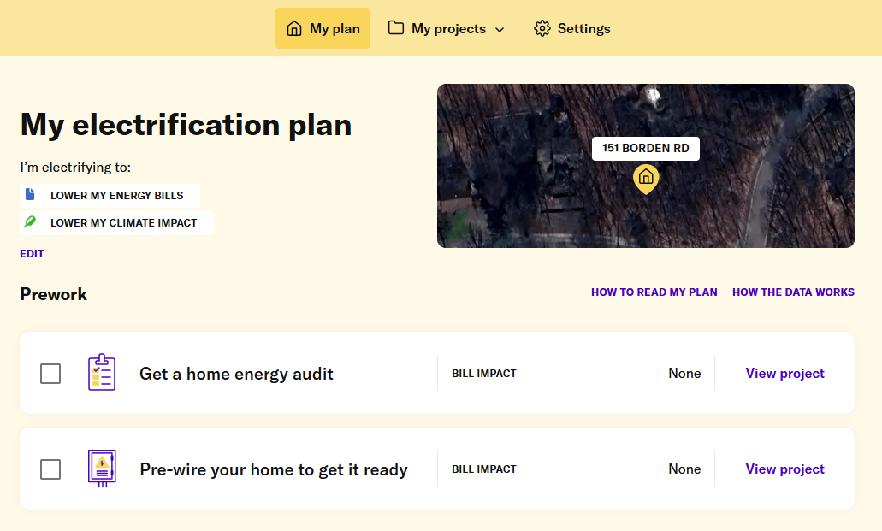

Slide 35
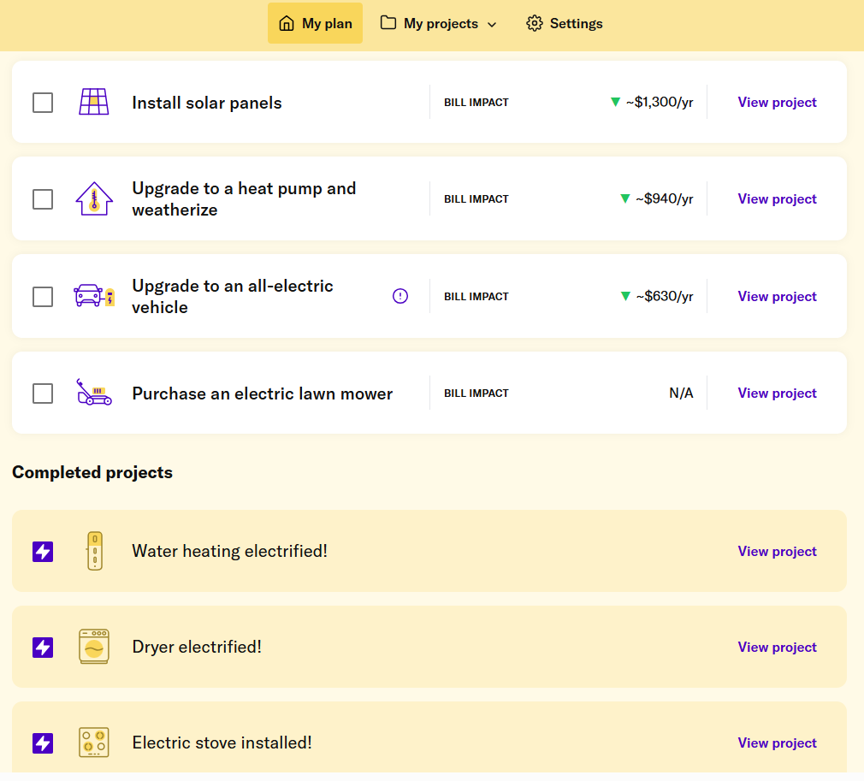
MY ELECTRIFICATION PLAN: Projects

Slide 36



Slide 37
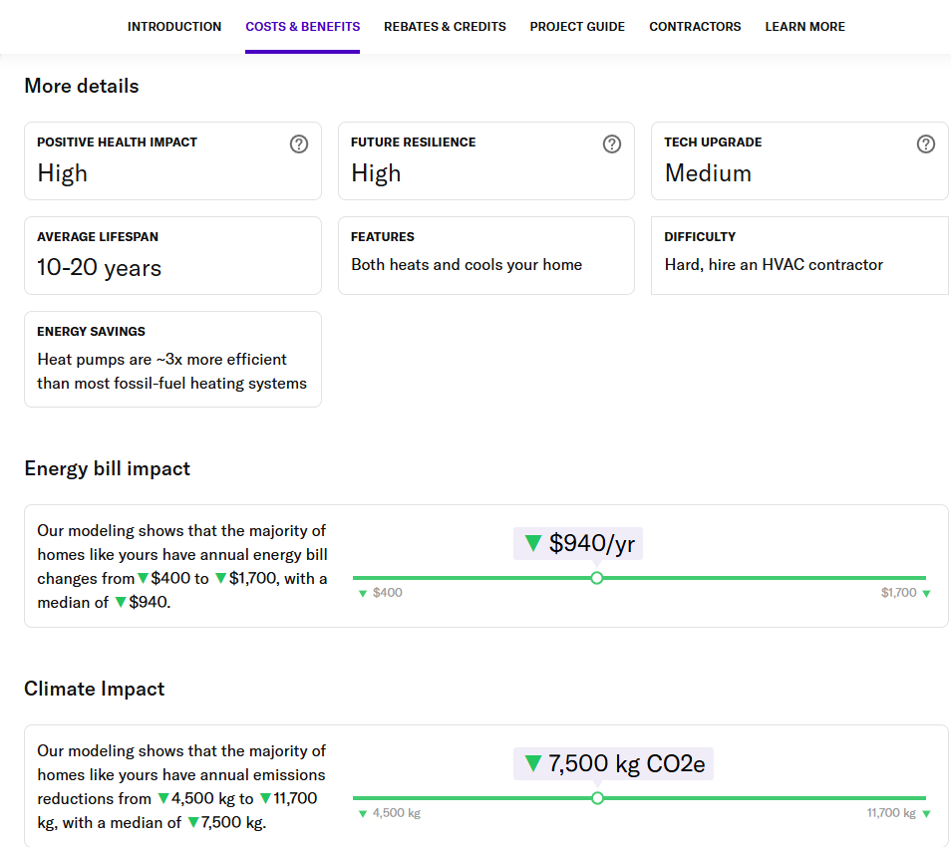
PROJECT HEAT PUMP DETAILS

Slide 38
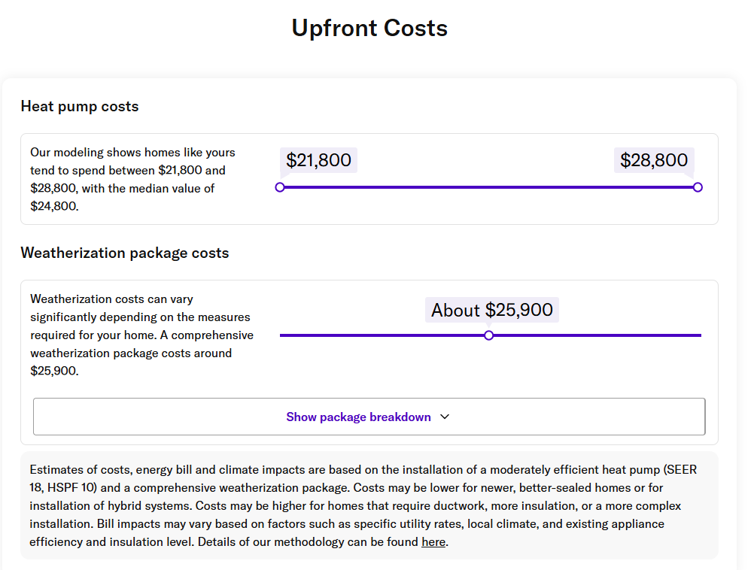
PROJECT HEAT PUMP UP-FRONT COSTS

Slide 39

PROJECT HEAT PUMP CONTRACTORS

Slide 40
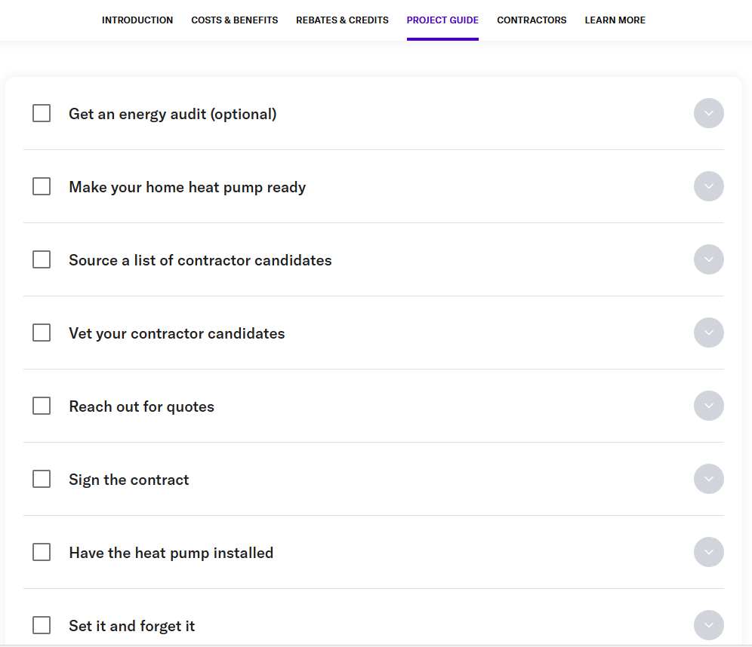
PROJECT HEAT PUMP PROJECT GUIDE

Slide 41

WHY WE WANT TO SAVE THE WORLD
TO LEAVE A LIVABLE WORLD FOR OUR GRANDCHILDREN

Slide 42
Speak up, act, and vote
Like your world depends on it
Notes:
ID #6251 - Can be used in noncommercial online and TV broadcasts of your presentation, but not modified.
Become a part of this movement to speak truth to power. Do it like your world depends on it…
DESCRIPTION: Text slide encouraging the audience to speak truth to power - like your world depends on it

Slide 43

Your world depends on it.
Source: NASA
Notes:
ID #5132 - Can be used in noncommercial online and TV broadcasts of your presentation.
…because, after all, your world does depend on it. Thank you.
DESCRIPTION: Photo of the Earth with text stating that your world depends on it

