Slide 1
PLANNING FOR A FOSSIL FUEL-FREE FUTURE ONE HOME AT A TIME
LEARN TO ELECTRIFY YOUR HOUSEHOLD
Pat and Steve Miller
Sept 24, 2024

Slide 2
Top 3 Greenhouse Gas (GHG) Emissions
Sources in NJ: (87%) of All Emissions
  Electricity generation (19%)
  Transportation (42%)
  Residential/commercial buildings (26%)
RedUCE All 3

Slide 3

Space Heating & Cooling w. Electric Heat Pump
Notes:
READ

Slide 4
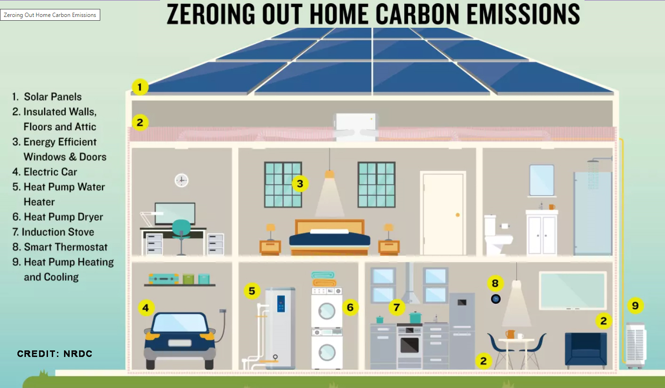

Slide 5
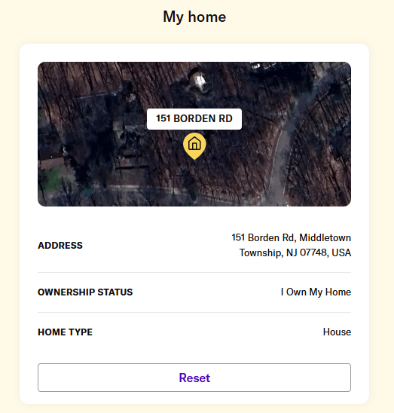
Create a Home Electrification Plan with
Rewiring America
Plan your next electric upgrade today (rewiringamerica.org)

Slide 6
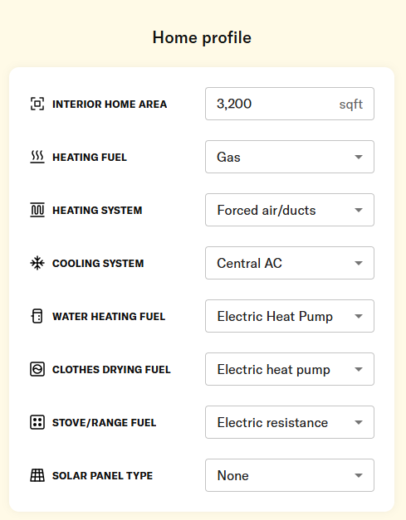
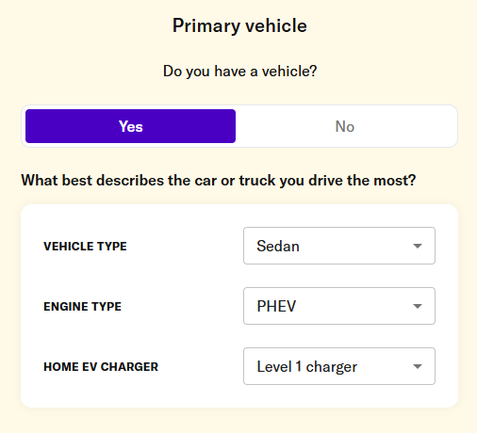
USER INPUT FOR PLANNING

Slide 7
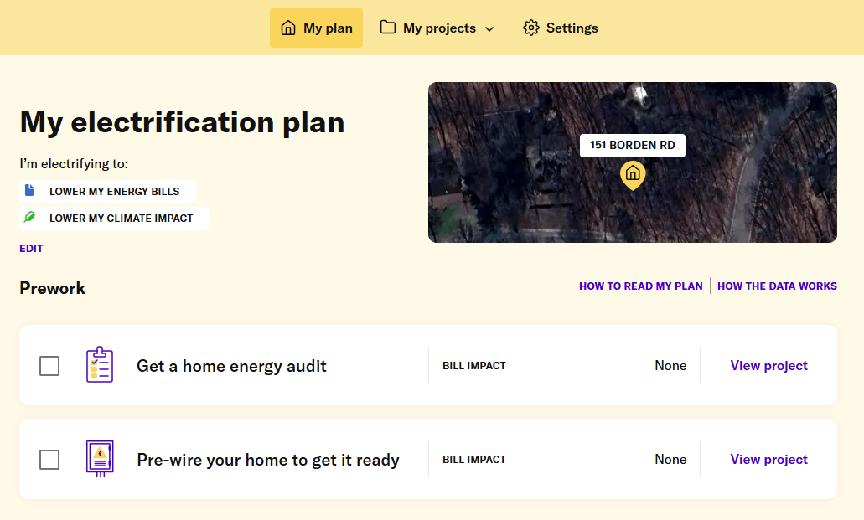

Slide 8
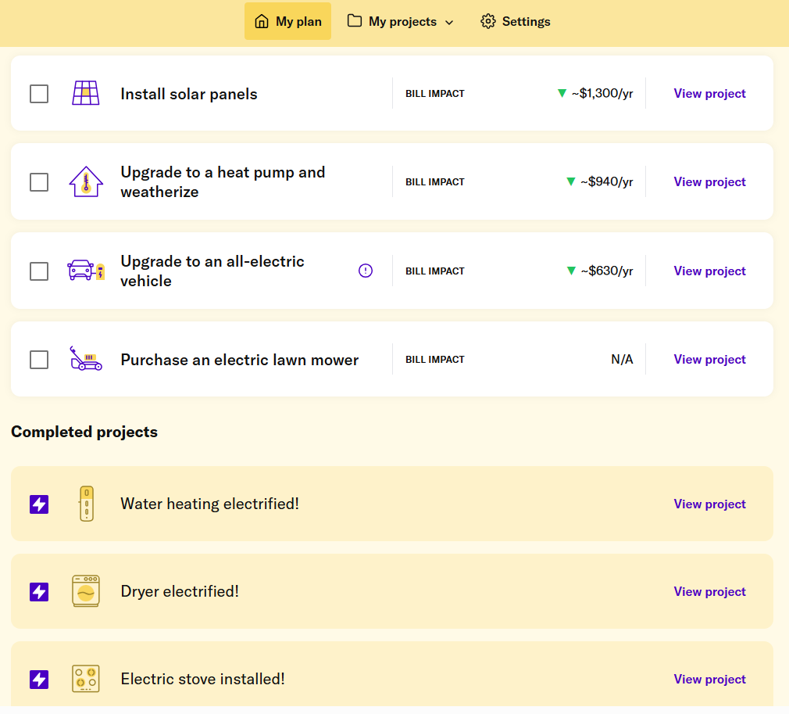
MY ELECTRIFICATION PLAN: Projects

Slide 9
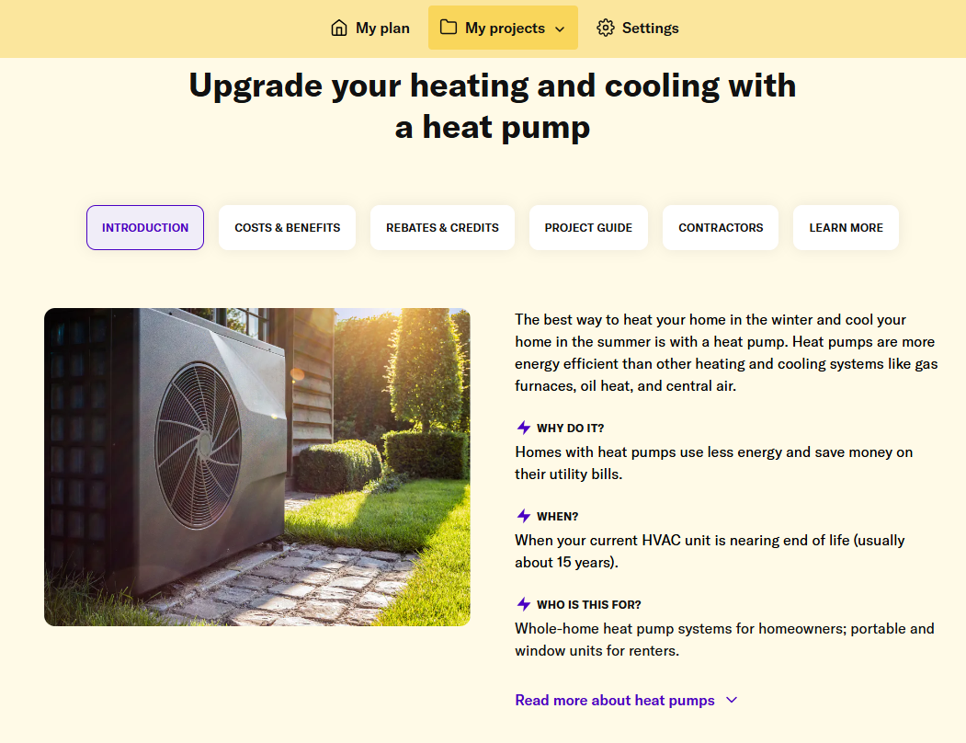
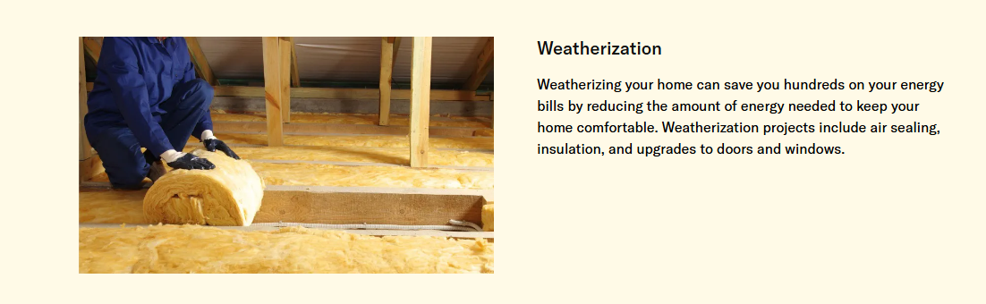

Slide 10
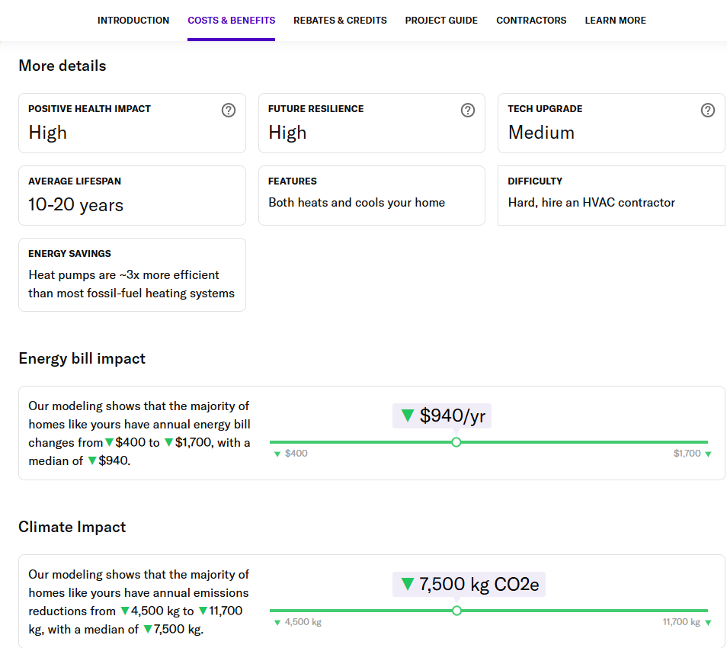
PROJECT HEAT PUMP DETAILS

Slide 11
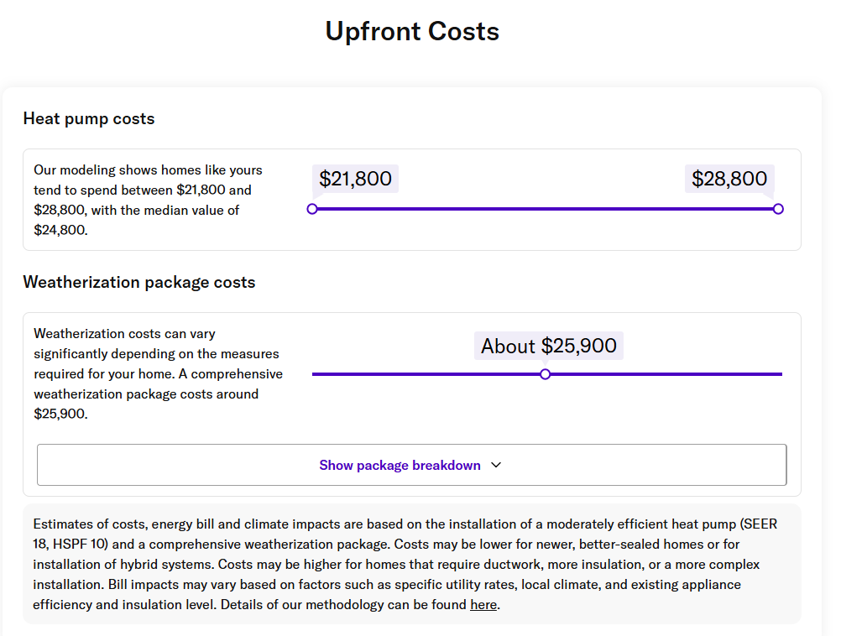
PROJECT HEAT PUMP UP-FRONT COSTS

Slide 12

PROJECT HEAT PUMP CONTRACTORS

Slide 13
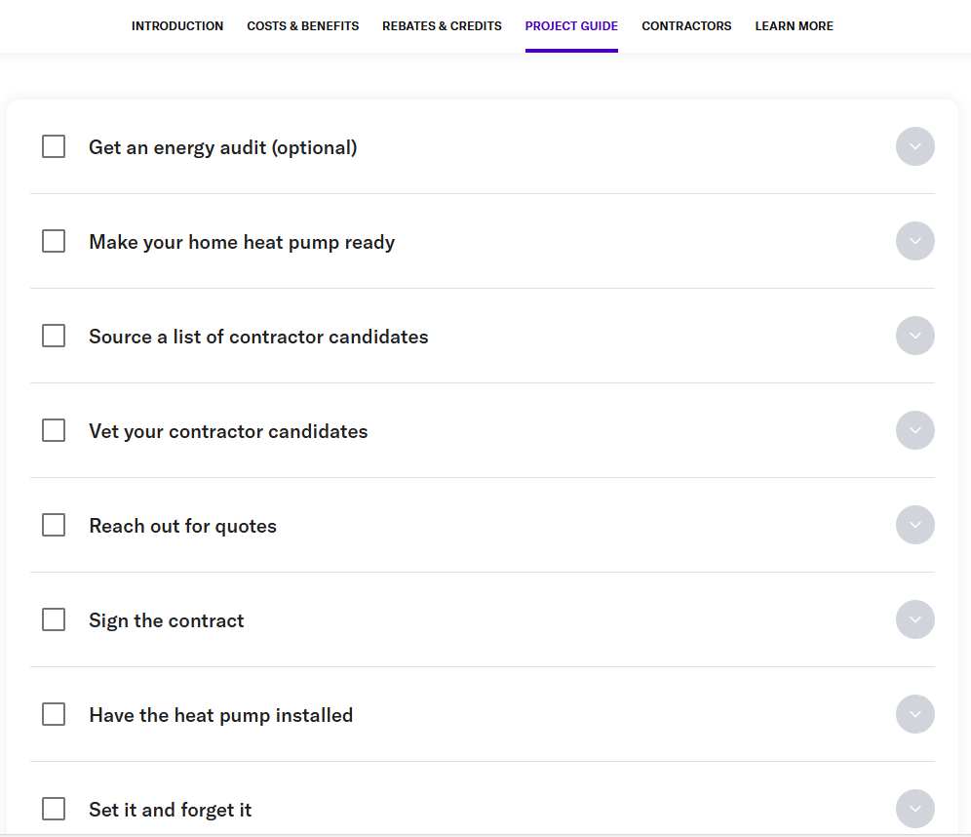
PROJECT HEAT PUMP PROJECT GUIDE

Slide 14

WHY WE WANT TO SAVE THE WORLD
TO LEAVE A LIVABLE WORLD FOR OUR GRANDCHILDREN

Slide 15
Speak up, act, and vote
Like your world depends on it
Notes:
ID #6251 - Can be used in noncommercial online and TV broadcasts of your presentation, but not modified.
Become a part of this movement to speak truth to power. Do it like your world depends on it…
DESCRIPTION: Text slide encouraging the audience to speak truth to power - like your world depends on it

Slide 16
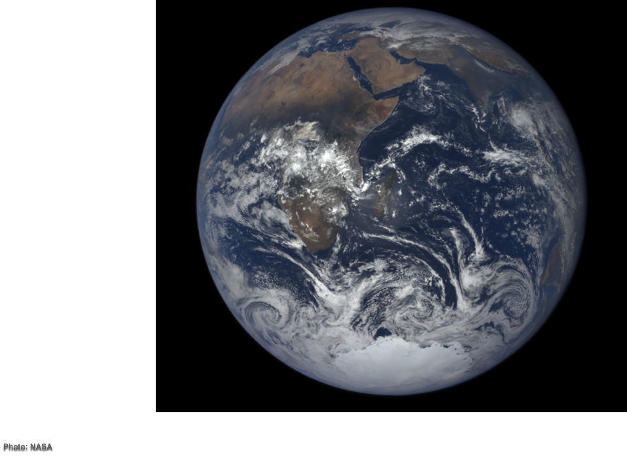
Your world depends on it.
Source: NASA
Notes:
ID #5132 - Can be used in noncommercial online and TV broadcasts of your presentation.
…because, after all, your world does depend on it. Thank you.
DESCRIPTION: Photo of the Earth with text stating that your world depends on it

