Slide 1
Why NJ Electric Rates Are Increasing So Dramatically in June and What You Can Do About It
The NJ Electrification Coaching Network Explains:
It’s NOT due to the push for clean energy
NJECN.substack.com:
Notes:
You may have heard that NJ customers will get an Increase in electric rates of about 20% in June. Why is that? What can you do?
NJECN is group of volunteers and clean energy advocates who can help advise you for free on various electrification projects for your home.
We felt obliged to make a statement about why this increase is happening, because we don’t want it to be unfairly blamed on clean energy.
Visit our Substack website and look for two articles about these price changes that will be posted by tomorrow – a shorter one with a little more detail than is in this talk, and a somewhat longer, more detailed one for the curious people out there.

Slide 2
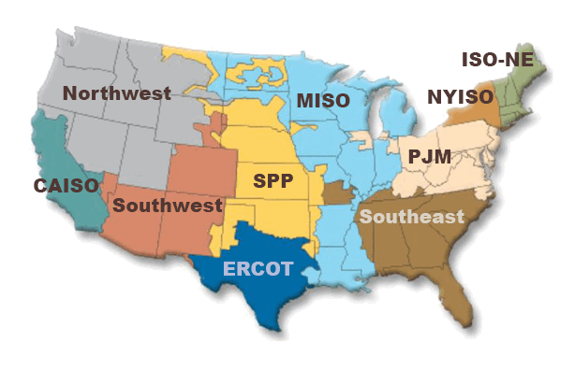
PJM Controls Your Power
Who are they?

Slide 3
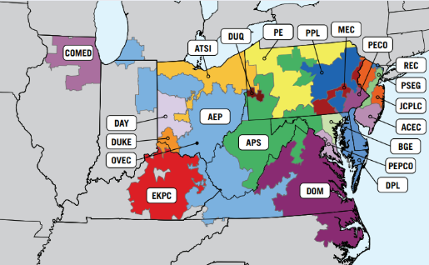
Electric Utilities within PJM

Slide 4
Your Bill
(40%) Delivery cost
Transmission lines, meters, etc) managed by local utility
Regulated by NJ BPU. NOT the cause of the increase.
(60%) Supply cost
Energy cost, managed by PJM, NOT the State of NJ
Price is determined by auctions
Energy purchase: Daily auctions
Capacity purchase: Yearly auctions: THIS IS THE CAUSE
Power generators are paid simply to be available in case they are needed

Slide 5
Energy Auction Prices ⬄ Supply & Demand
Demand
PJM forecast a large demand increase: data centers, AI, onshoring of mfg
Not conversion to clean energy: EVs < 1%, heat pumps less
Heat pumps and solar energy help by decreasing the summer peak
Supply
PJM has a HUGE backlog of energy suppliers waiting for permission to connect
Suppliers that HAVE been approved haven’t been built/connected (50 GW)
PJM auction rule changes understated the supply
Later changed via lawsuit & FERC, new auction in July
Notes:
You may never have heard of PJM, but it is the organization that oversees the utilities in 13 states – PA, NJ, MD…west to IN, south to VA.
PJM sets the price for the energy that you use. That price is combined with some additional costs from your individual utility, and together, that makes up your bill.
How are these prices set? PJM conducts various auctions, where power generators each submit bids specifying the amount of energy they can supply and its price, and PJM selects enough of these bidders to fill their energy forecast.
But this time, some very different things happened on both the supply and demand side. You may have heard that Gov Murphy today suggested that this auction should be investigated by FERC, the Federal Energy Regulatory Commission. And there has been a lawsuit.
On the Demand side:
PJM forecast some large new users – data centers, AI, and new mfg. Are the new demands real? Are they duplicated due to shopping for sites? Should these large users pay a deposit before PJM decides to acquire the energy they said they want? Should large users pay the full cost?
Some say that new electrification is causing the new demand increase. No – EV’s < 1%, heat pumps even less. In fact, heat pumps and solar energy help decrease the summer peak energy usage (currently around 145 GW for NJ).
There are also big problems on the supply side:
New suppliers haven’t been approved by PJM, and approved ones haven’t been connected.
And some complex PJM rule changes understated the supply.
So PJM had issues in managing both the supply and forecasting the demand.
Auction wound up with 10x price increase, translating to 20% on your bill.

Slide 6
Recommendations
For You Now
For Everyone Later

Slide 7
What can YOU do NOW to decrease your bill?
Cut down on wasted energy by getting an energy audit and weatherizing your home
Subscribe to the new Demand Response programs from your utility to qualify for reduced prices. Ask your utility how you can sign up.
Buy lower cost clean energy
Subscribe to Community Solar
Install rooftop solar
Buy from an independent supplier instead of your utility, but be careful to read the fine print since a long term variable rate can also result in a higher bill.
Notes:
There is much that can be done by legislators and regulators to correct some of these problems, but what can YOU do?
NJECN can help you with these.
Stop throwing away energy. Get an energy audit and weatherize your home. There are rebates to help with that.
Sign up for Demand/Response and qualify for lower energy prices from your utility. Demand/Response allows the utility, WITH YOUR PERMISSION, to turn your thermostat up or down when peak energy usage is threatening to create problems on the electric grid.
You can also buy LOWER COST and CLEAN energy.
Easiest: Sign up for Community Solar. Community Solar is a program where large buildings construct solar installations on THEIR roofs, and you sign up for the energy produced by specific panels assigned to you. With a little fancy bookkeeping, you get the reduced cost energy from your assigned panels, instead of the energy that your utility sells you. You also get credits if they produce more energy than you consume, and in the case where they don’t produce ENOUGH power, you get the remaining energy you need at the regular utility price.
Harder: Rooftop solar panels also help – there’s usually about a 7 year ROI. I installed some and haven’t paid for electricity in 3 years except for January of 2024 which was very cloudy.
You can also buy from an independent supplier, but this is trickier – it could be more expensive.

Slide 8
How can future price increases
be prevented?
(NJ BPU):
Make Offshore Wind (OSW) a reality
11GB of power substantially affects supply & reliability
(PJM):
Speed up the energy review process
(Legislators/Developers):
Quickly build and connect already approved energy sources
57 projects in NJ / 300 in PJM
(NJ BPU & Utilities):
Encourage adoption of Demand Response Programs
(PJM):
Return to rules that allowed artificially high prices
(Legislators): Pass bills S4143 and A5564
They require new large users of power, like data centers, to pay, instead of customers.

Slide 9
Price increases are due to supply/demand mismanagement. NOT the push for clean energy.
Request a free electrification coaching session at NJECN.substack.com
Summary here:
QR code for this article
Notes:
So that was the executive summary version of the price increases. Clean energy is not the problem. Better management of supply and demand is needed.
Look for the more expanded version of this talk in the two articles that will soon be on our Substack site.

