Slide 1
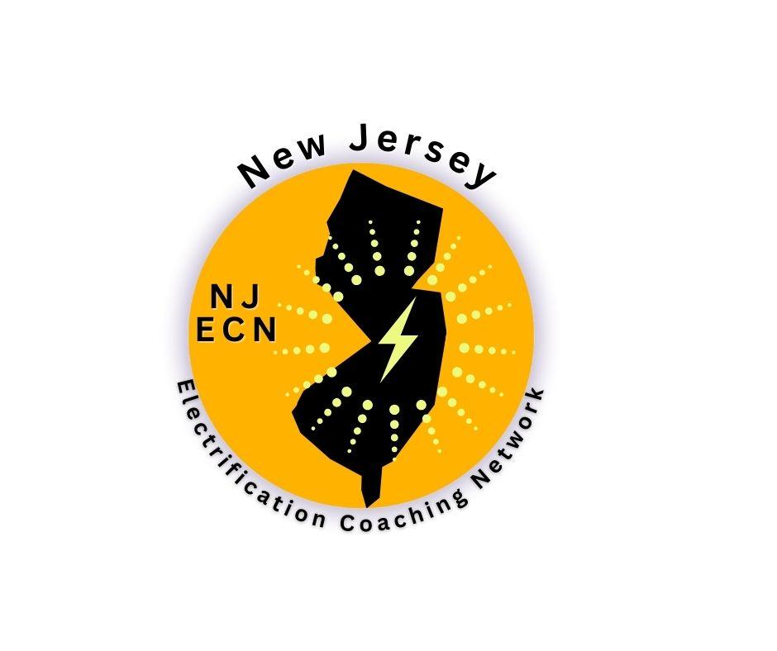
HOME ELECTRIFICATION
SAVE MONEY, PRESERVE HEALTH, AND REDUCE EMISSIONS
New Jersey Electrification Coaching Network (NJ ECN)
April 17, 2025
Pat Miller
Notes:
Welcome. My name is [name] and thank you for inviting me [us] to speak with you today on home electrification.

Slide 2
About
NJ ECN
BACKGROUND
The NJ Electrification Coaching Network (or NJ ECN) guides homeowners and renters in how to electrify their homes.
Free guidance, tailored to you and your home’s electrification needs
Save money
Reduce emissions
Protect your health and our environment
New Jersey Electrification Coaching Network
Notes:
The NJ Electrification Coaching Network, or NJ ECN, guides homeowner and renters, for free, in how to electrify their homes. Our guidance is tailored to you and your home’s electrification needs. Together, we can help you save money, reduce emissions, and protect your health and our environment. (If you want to add the specifics of home electrification: by installing heat-pumps/water heaters/dryers, EV chargers, solar panels, and induction ranges.

Slide 3
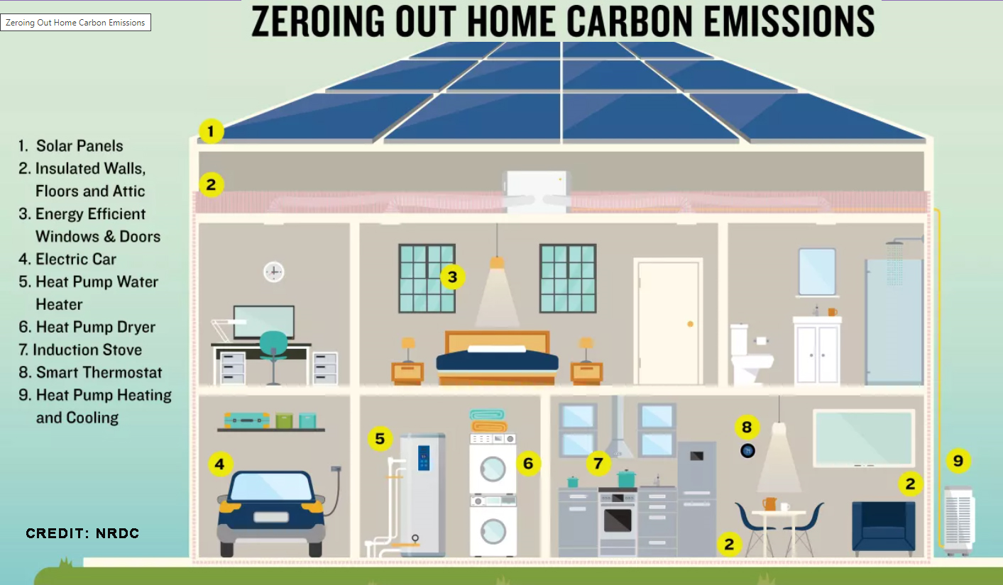
What is Electrification?
Electrification means replacing fossil fuel appliances with clean, efficient electric alternatives.
New Jersey Electrification Coaching Network
Notes:
Electrification - Instead of burning fossil fuels (gas, oil, propane), we use clean electricity to power our homes and vehicles.
This shift eliminates indoor air pollution and reduces reliance on volatile fossil fuel prices.
Even if your electricity still comes from some fossil fuels, electrification immediately reduces household carbon emissions, and the benefits only increase as the grid gets cleaner.

Slide 4
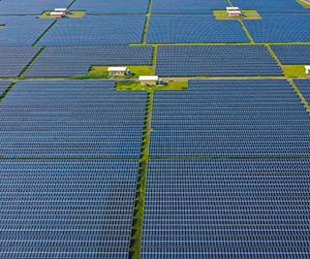
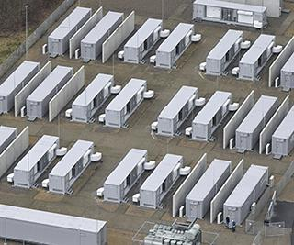
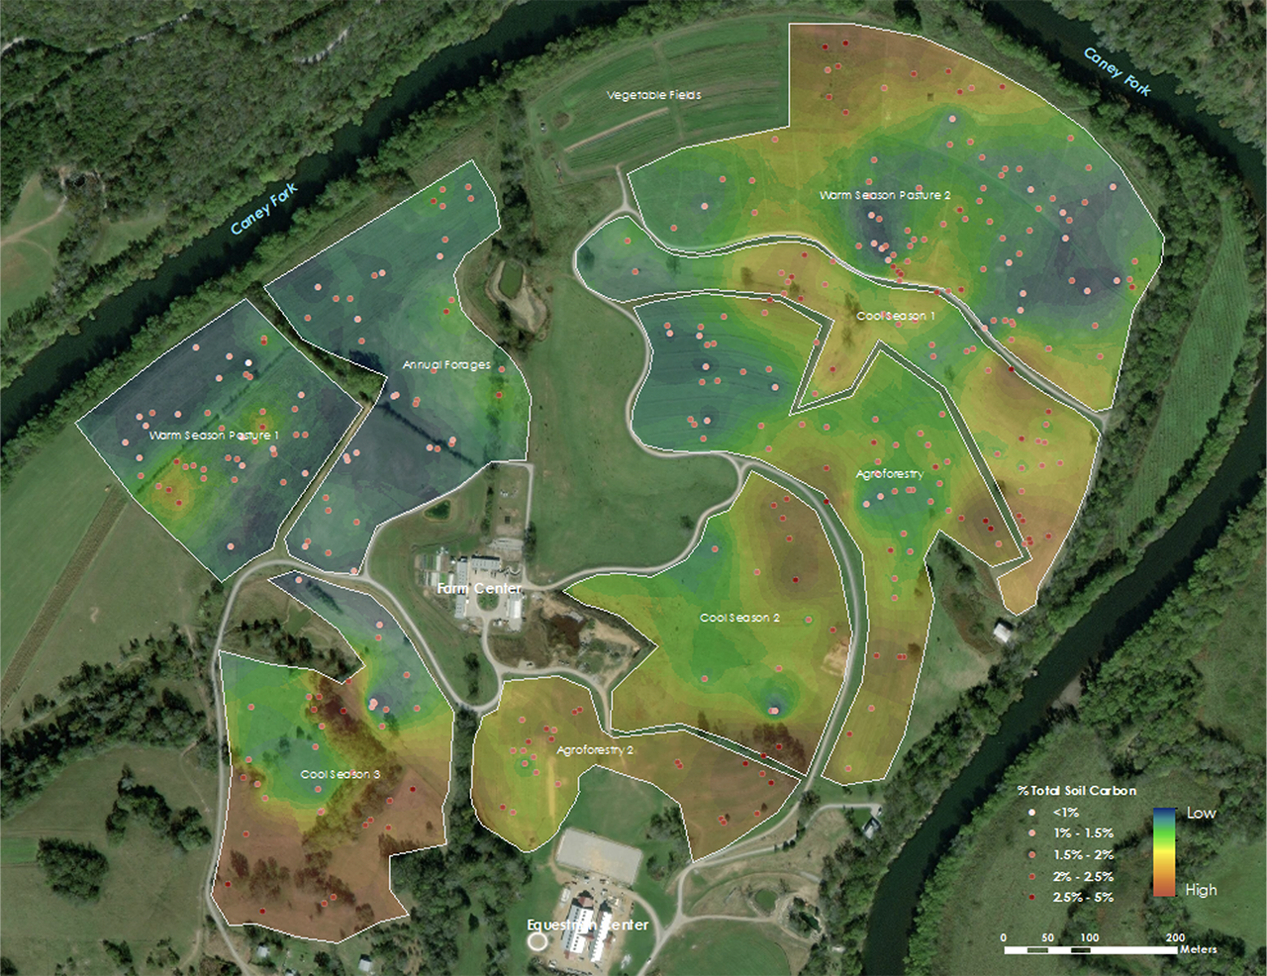
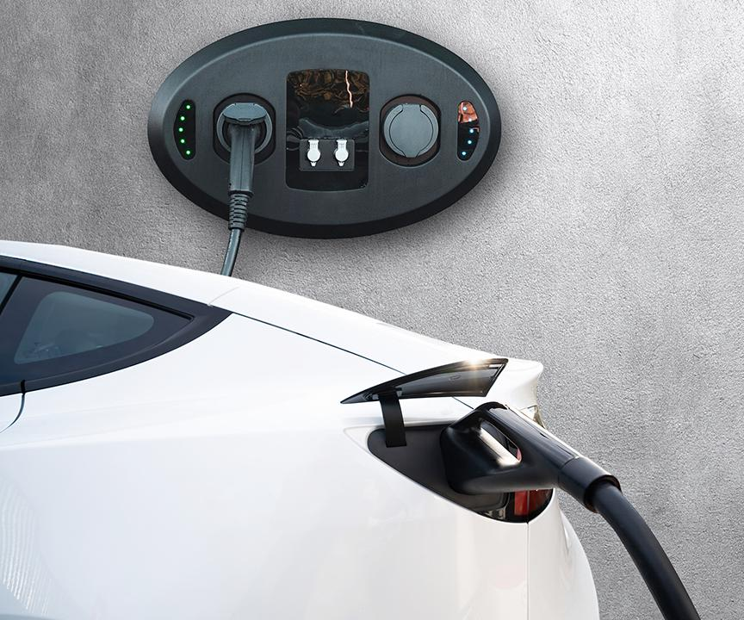
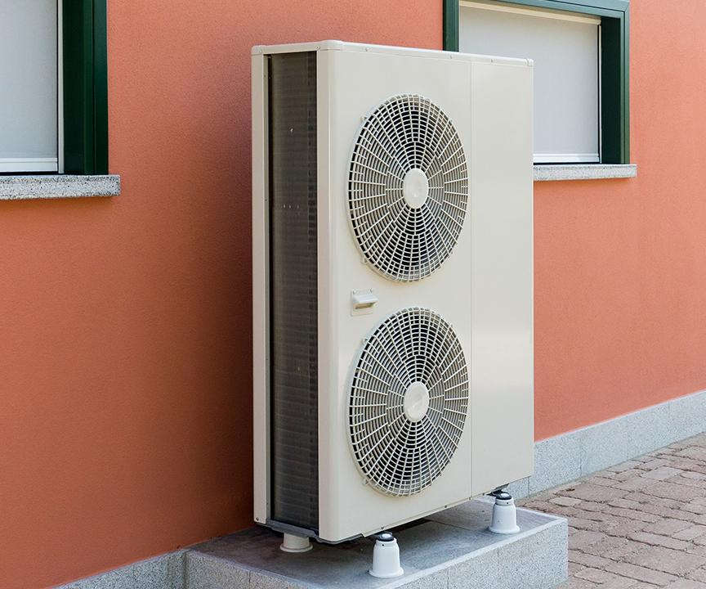
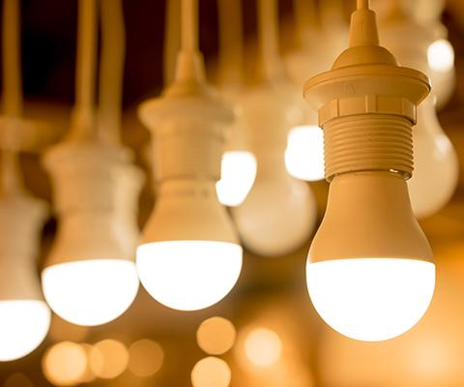
Photo © 2023 Patrick Pleul/picture-alliance/dpa/
AP Images
Photo © Shutterstock
Photo © 2023 Patrick Pleul/picture-alliance/dpa/
AP Images
Caney Fork Farms/Skidmore College
The Good News:
We have the technologies in hand today
to reduce emissions 50% in this decade.
Photo © Shutterstock
Photo © Shutterstock
© 2014 AP Photo/The Pantagraph, David Proeber
Photo © Shutterstock
Notes:
ID #7976.B - May be live-streamed, broadcast, and presented in-person, but may not be recorded or modified.
We have all the technologies we need right now, with proven deployment models, to reduce emissions 50% in this decade and reach net zero by 2050 if we decide to make the changes that are necessary.
SLIDE SOURCE(S):
https://iea.blob.core.windows.net/assets/7ebafc81-74ed-412b-9c60-5cc32c8396e4/NetZeroby2050-ARoadmapfortheGlobalEnergySector-SummaryforPolicyMakers_CORR.pdf

Slide 5
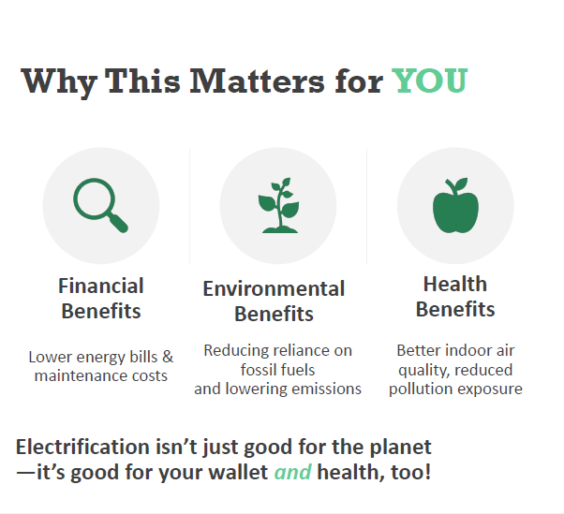

Slide 6
How NJ ECN can help
We offer education, resources and electrification coaches
Provide one-on-one advice when you sign up for an individual home electrification coach
Host a webinar or in-person talk on home electrification for community groups, Green Teams or local officials
Provide access to our incredible database of webinars, presentations, and home electrification case studies
Up-to-date articles on electrification on our NJ ECN Substack
Remember: Electrified homes are healthier and more comfortable – No gas leaks, no combustion byproducts, better indoor air quality, stable temperature and humidity
New Jersey Electrification Coaching Network

Slide 7
What YOU can do
Request an electrification coach or community presentation
Browse our database of webinars, presentations, and home electrification case studies or our NJ ECN Substack
Visit Rewiring America’s Personal Electrification Planner
Begin your home electrification with Rooftop or Community Solar
Sign up for Rewiring America’s Electrification Coach Training and become a coach
New Jersey Electrification Coaching Network

Slide 8
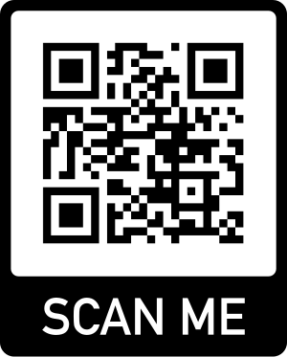
NJ ECN’s Resources
The goal is to reduce GHG in NJ. NJ ECN offers resources for building a clean energy economy.
Coaching request Intake Form https://tinyurl.com/yc2ew6rc
BE Webinar Database https://climate.smiller.org/50x30/building-electrification/All-heat-pump-webinars.html
NJ ECN Substack https://njecn.substack.com/
Rewiring America https://www.rewiringamerica.org/
for Personal Electrification Planner, IRA Incentive
Tracker or to sign up for EC training
New Jersey Electrification Coaching Network

Slide 9
Invite NJ ECN into your community
Email Steve and Pat Miller, Founders, NJ ECN
njecn2024@gmail.com

