Slide 1
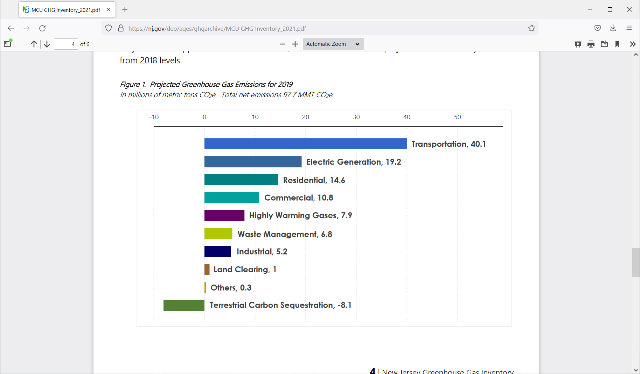
Stawman - NJ Building Electrification – 1 (R. Erickson, 1/21/2022)
Residential/Commercial Heating accounts for annual 25.4 MMT GHG (24% of NJ GHG) (MMT = Million Metric Tons; GHG = Greenhouse Gas)
3 Smokestacks of GHG emissions in NJ: Electricity, Transportation and Residential/Commercial Heating together account for 80% of NJ GHG
Seek 100% emissions free by 2050 to avoid the worst consequences of global warming.
Goal of 50% NJ GHG reduction by 2030.
→ Starting now, need Building Electrification to replace fossil fuel heating!
.

Slide 2
NJ Building Electrification - 2
Building Electrification needed to reduce the 24% Residential/Commercial Heating GHG emissions to zero.
When coupled with 100% clean electric.
Residential Solutions/Objectives:
→ Get to 900,000 fully electrified NJ residential units by 2030 (25% of residential stock)
→ Deploy “Cold Climate” electric air source heat pumps thus replacing polluting natural gas, oil & propane heat (or use geothermal heat pumps where applicable)
Replace existing central AC and for New Construction (no new gas furnaces) with “Cold Climate” Heat Pumps. Or “Cold Climate” Mini-Splits where appropriate.
→ Electrify hot water heating, cooking & clothes drying. Use “heat pump” appliances for hot water heaters & dryers.
Commercial Solutions:
→ [TBD – experts to provide; probably “heat pump” point pertains]
Energy Efficiency:
→ Energy efficiency measures reduce fuel usage/emissions before conversion to electric air source heat pumps. And avoid future electric load on grid. Save money.

Slide 3
Action Items - A
[Residential] Building Electrification Action Items:
What are the team’s specific objectives to support Building Electrification?
How to get to 900000 fully electrified NJ residential units by 2030?
Convert NY Bill Sheet (see next slide) to NJ Bill Sheet
Develop Legislative Agenda, Bills, and legislative/lobbying strategy & plan.
Cost model demonstrating savings, break even year, etc.
Carbon reduction model from proposed bill requirements (see included draft example that includes but does not display Building Electrification at this time)
Is “cold climate” heat pump refrigerant a GHG issue?
“cold climate” Heat Pump product list
List of “cold climate” Heat Pump installation contractors
Heat pump water heater and dryer product list
Summarize NJ heat pump (HVAC & appliance) rebates. How to improve them?
Summarize Federal rebates and legislative status.
Eliminate ALL incentives for gas appliances
What are the “code” action items that support Building Electrification?
Develop renewableheatnowNJ.org Building Electrification website that outlines the problem, goals, bills, points to NJ rebates, covers the topics above, etc. See https://renewableheatnow.org/
What needs to be done for Commercial heating?

Slide 4
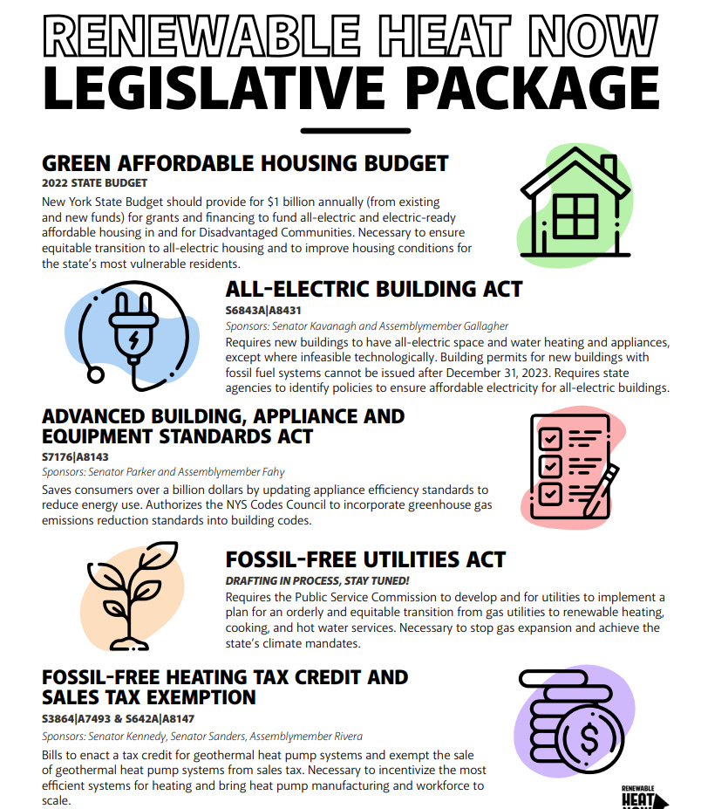
NJ Bill Sheet Action Item
ACTION: Convert NY Bill sheet to proposed NJ Bill Sheet. Also, modify the associated “Talking Points” for each bill. https://renewableheatnow.org/

Slide 5
Action Items - B
Supporting Action Items:
Explain need for 100% clean electric to support Building Electrification (Note, in this draft, some prior 100% clean electric slides are included under Supporting material)
How to get New Jersey to 100% RPS for 100% clean electric?
Battery storage (Product list, cost model, how to encourage, etc)
Grid reliability
Grid investments (ref Infrastructure Bill → does it help NJ?; how about other Federal bills)

Slide 6
Carbon Reduction Model
Example Carbon Reduction Model
(under development, not supported, not for release, draft 1-20-22)

Slide 7
Supplementary Material
Clean Electric Supplementary Material Follows
These are suggested opportunities for the “Energy” Team, but members of the “Building Electrification” Team are knowledgeable about specific issues and willing to pursue (to be negotiated)

Slide 8
100% Clean Electric by 2035 - 1
Why 100% Clean Electric by 2035?
Help avoid the worst consequences of global warming
President Biden’s 1/27/21 executive order: Develop plan for “a carbon pollution-free electricity sector no later than 2035”
The PJM to which NJ belongs “gets only 6% of its power from renewable sources such as wind and solar, compared with more than 40% in California and more than 25% in Texas”*
Saves 83% of Greenhouse Gas (GHG) emissions when implemented with 100% Electric Vehicles and 100% Building Electrification by 2050**
Large increase in 100% clean electric is also needed to support Electric Vehicles and Building Electrification
Existing NJ wind and solar projections fall far short of anticipated need for renewable electric during 2035+ at only ~40% of existing electrical consumption, without considering Electric Vehicles or Building Electrification (see Statistics slide)
→ Far more action is needed!
* “The Biggest U.S. Electrical Grid Braces for Green Energy” (Bloomberg 8/10/21) regarding PJM pool to which NJ belongs. Also see EIA data as per Statistics slide.
**Based on extrapolation of data used for Middletown Energy Plan V2 8/20 submitted for Middletown, NJ. Assumes 100% clean electric.

Slide 9
100% Clean Electric by 2035 - 2
How to Get There:
A. Implement a PJM-wide or New Jersey-only Integrated Clean Capacity Market (ICCM). As reported by NJ BPU staff:
92% Clean Energy can be achieved by 2030 (* Figure 15, page 48)
“achieving 90%+ percent of clean energy can be achieved at modest costs through a PJM-wide or New Jersey-only ICCM approach to resource adequacy” (* Page 5)
B. Implement the 7/21/21 Petition Request to NJ DEP to implement 50% GHG reductions by 2030 from 2005 levels, including Clean Energy Portfolios to avoid fossil fuel infrastructure**
C. Fix the NJ Renewable Portfolio Standard*** for electricity so it gets to 100% by 2035. Currently, it terminates at 50% for the years 2030 to 2033, thus falling far short.
D. Strengthen NJ RGEA (Renewable Government Energy Aggregation). Currently there is only small participation. Municipalities and counties need stronger incentives for RGEA. Provide strong NJ state central administrative support and contracting, instead of relying on 565 NJ municipalities to provide their own.
E. Offer a state wide customer RGEA option.
F. Expand solar incentives
* “Alternative Resource Adequacy Structures for New Jersey”, NJ BPU report, June 2021. See page 5, and also, Figure 15 page 48.
** https://www.nj.gov/dep/rules/petition/pet20210721.pdf
*** https://www.state.nj.us/oal/rules/accessp/

Slide 10
100% Clean Electric by 2035 - 3
Additional Actions:
Ensure grid transport, capacity, peaking, backup, and resiliency
Expand incentives for residential and business solar
Expand incentives for community solar
Ramp-up Energy Efficiency programs
Related electrification actions for Greenhouse Gas (GHG) reduction:
Provide substantial incentives for electric “cold climate” heat pumps to replace existing fossil fuel space heating & AC, and radiant electric heat*.
Expand incentives for electric appliances, e.g. stoves, heat pump water heaters and heat pump dryers.
Provide incentives for building electric service renovation to support electric appliances and Electric Vehicles
Stop all conversions of electric, oil or propane to natural gas.
Eliminate incentives for gas appliances
Incentives for Electric Vehicle purchase
Incentives for EV charger infrastructure including residential and business
Provide strong Building codes to support the above
* See 2019 NJ Energy Master Plan for numerous heat pump references

Slide 11
100% Clean Electric - Statistics
Statistics:
NJ electric generation for 2021: ~ 52 TWH* (only 2.9 TWH renewables)
NJ offshore wind goal is 7.5 GW** by 2035 (3.7 GW currently planned)
Thus wind is estimated at 32%*** of routine electric needed by 2035
NJ installed solar power at 2740 MW or 4.2%**** of NJ electric in 2018
NJ incentives established to obtain projected 3750 MW solar by 2026 and seeks solar at 10% of consumption by 2050*****
Thus solar and wind generation extrapolates by 2035 to an average of ~40% of existing NJ electric consumption. But also needed is clean electric to power Electric Vehicles and Building Electrification as natural gas, propane and oil are replaced.
Thus existing NJ wind and solar projections fall far short of anticipated need for renewable electric
→ Far more needs to be done!
* Terawatt hours Based on EIA NJ May 2021 projected annually
** https://www.njcleanenergy.com/renewable-energy/programs/nj-offshore-wind
*** Wind estimated at 16.4 TWH annually on assumption of 25% power generation for 24 hours based on https://www.totemcontracting.com/how-much-energy-do-wind-turbines-produce/
**** https://en.wikipedia.org/wiki/Solar_power_in_New_Jersey
***** 7/29/21 https://www.njspotlight.com/2021/07/nj-solar-sector-new-development-incentives-adopted-target-rapid-increase/

Slide 12
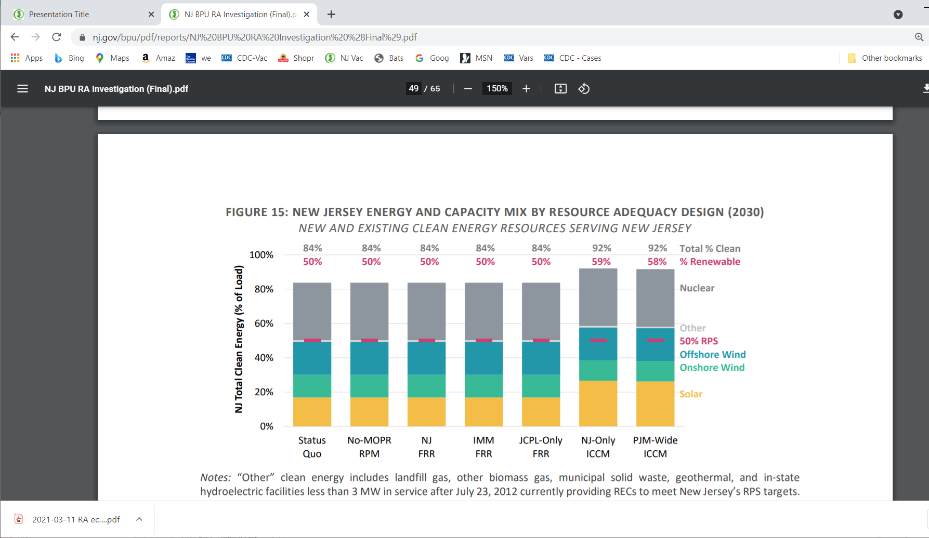
NJ BPU Report June 2021

Slide 13
Middletown Energy Plan V2
Estimated tons of GHG reduction for each Middletown scenario (or partial scenario) in 2030 relative to 2018
(2030 scenario projection: Save 266K tons or 38% of Middletown's 705K pro-rata tons in 2018)
(2050 scenario projection: Save 584K tons or 83%; consists of 100% clean electric (saves 29%), 100% EV (saves 35%) & 100% heating electrification (saves 19%)) projected GHG reduction by 2030, if Middletown adopts this “Middletown Energy Plan V2”

