Slide 1
Our Town and a 100% Clean Energy Future
Pat and Steve Miller
24 Hours of Reality

Slide 2
Sierra Club
100% Committed
Our mission is to leave a legacy of a livable world for our children and grandchildren.

Slide 3
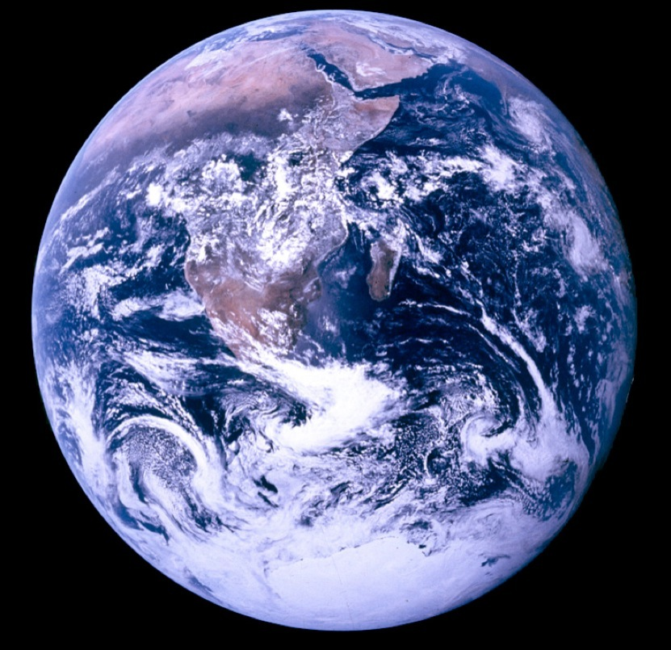
Source: NASA
Notes:
ID #3 - Can be used in noncommercial online and TV broadcasts of your presentation.
This is the famous “Blue Marble” image that shows our Earth from space and reminds us that we all share the same home.
DESCRIPTION: Photo of Earth from Apollo 17, taken as the crew was traveling toward the moon, December 7, 1972
ADDITIONAL TALKING POINTS: This picture is called the “Blue Marble,” taken during the last Apollo mission.
What makes the photograph so unique and powerful is that it captures the complete circle of the earth, helping us see the big picture of our planet – and our lives on it.[1*] It was the first time the Apollo mission made it possible to capture almost the entire southern polar ice cap.[2*]
REFERENCES:
[1*] Jeffrey Kluger, “Earth From Above: The Blue Marble,” Time, February 9, 2012. https://time.com/3785942/blue-marble/
[2*] NASA Visible Earth, “The Blue Marble from Apollo 17," December 7, 1972. http://visibleearth.nasa.gov/view.php?id=55418

Slide 4
WHY WE WANT TO SAVE THE WORLD

Slide 5
Source: NASA
Notes:
ID #3621 - Can be used in noncommercial online and TV broadcasts of your presentation.
Yes, because we're using this thin shell of atmosphere surrounding our planet as an open sewer. And we're spewing all the manmade global warming pollution into it.
DESCRIPTION: Photo of the sun shining over Earth’s horizon through the two lowermost layers of the atmosphere: the troposphere and the stratosphere
ADDITIONAL TALKING POINTS: The sun releases energy as radiation, which travels out as a ray or in a straight line in all directions.[1*]
The energy released is known as “the solar spectrum.”[1*]
This energy is comprised largely of three regions of the electromagnetic spectrum:
Ultraviolet energy (high frequency energy that is responsible for sunburns)
Visible energy (light)
Infrared energy (heat).[1*]
Nearly half of the solar energy that reaches the top of the Earth’s atmosphere is absorbed by the planet’s surface.[2*]
The average solar radiation striking the top of the atmosphere is 340 watts per square meter.[2*]
About 29 percent is reflected back into space.[2*]
About 23 percent is absorbed by the atmosphere.[2*]
About 48 percent is absorbed by the Earth’s surface.[2*]
The Earth’s surface releases more heat than it receives from the sun.[2*]
The planet’s surface releases heat equivalent to 117 percent of the incoming solar radiation (about 398 watts per square meter).[2*]
Greenhouse gases play an instrumental role in amplifying solar energy and retaining heat.[2*]
Greenhouse gases like CO2, methane, nitrous oxide, and water vapor are opaque to many wavelengths of outgoing thermal infrared energy.[2*]
Each blocks a particular wavelength of energy, absorbs it, and radiates about half back to earth and the other half towards space.[2*]
Some of the heat radiated downwards is absorbed again by the Earth and ultimately radiated back into the atmosphere.[2*]
This is how the Earth radiates more energy as heat than it receives as solar radiation.[2*]
This process of trapping and radiating heat keeps the Earth’s temperature stable.[3*]
The process raises the surface temperature to about 15 degrees Celsius (59 degrees Fahrenheit) on average.[3*]
This is more than 30 degrees Celsius warmer than surface temperatures would be if the Earth didn’t have an atmosphere.[3*]
In an ideal scenario, where the Earth’s energy system is unaltered and working as expected, the energy that escapes as heat is roughly equal to what comes in as solar radiation.[2*]
Ideally, this would mean approximately 340 watts of energy per square meter leaving our atmosphere.[2*]
Burning fossil fuels means greater concentrations of greenhouse gases have disrupted this process and put the Earth’s energy equilibrium out of balance.[4*]
Today, less average energy leaves the atmosphere than comes in.[4*]
Today, higher concentrations of greenhouse gases trap about extra 3 watts of incoming solar energy per square meter of the Earth’s surface.[4*]
While the amount of extra heat energy seems small on paper, it has a large effect over the entire planet.[4*]
The result is global warming.[4*]
By the end of 2018, the warming influence of greenhouse gases had risen 43 percent above the 1990 baseline.[4*]
REFERENCES:
[1*] Ed. Rob Garner, "Solar Irradiance," National Aeronautics and Space Administration, last updated November 12, 2017. https://www.nasa.gov/mission_pages/sdo/science/solar-irradiance.html
[2*] Thomas F. Stocker et al., “Climate Change 2013: The Physical Science Basis,” Contribution of Working Group I to the Fifth Assessment Report of the Intergovernmental Panel on Climate Change, Cambridge University Press, Chapter 2 (September 30, 2013): 165-185. https://www.ipcc.ch/site/assets/uploads/2017/09/WG1AR5_Chapter02_FINAL.pdf
[3*] NASA Earth Observatory, “The Atmosphere’s Energy Budget,” January 14, 2009. https://earthobservatory.nasa.gov/Features/EnergyBalance/page6.php
[4*] LuAnn Dahlman, “Climate Change: Annual Greenhouse Gas Index,” National Oceanic and Atmospheric Administration, September 26, 2019. https://www.climate.gov/news-features/understanding-climate/climate-change-annual-greenhouse-gas-index

Slide 6
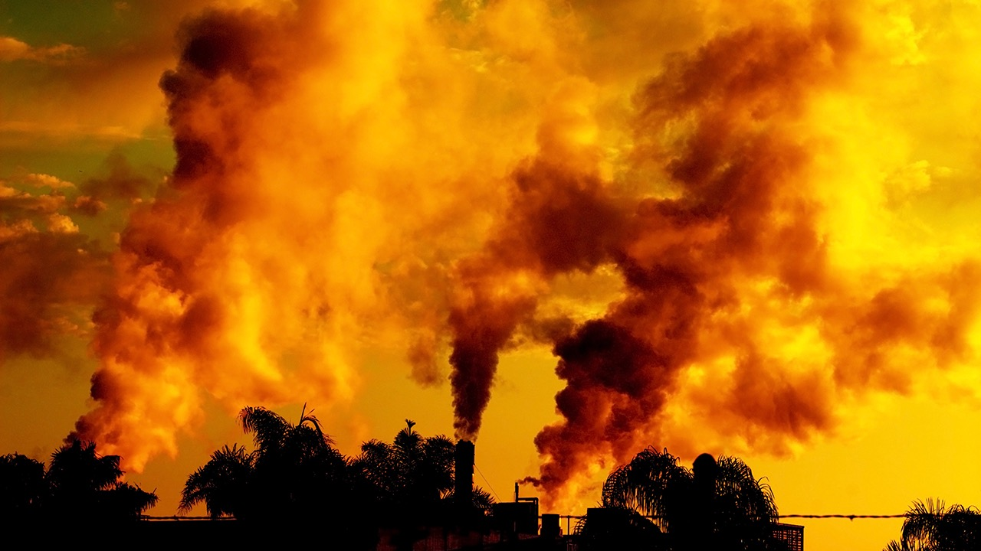
We are spewing 152 million tons of manmade global
warming pollution into the thin shell of our
atmosphere every 24 hours — as if it were
an open sewer.
Photo © Peter Weber/Shutterstock
Notes:
ID #3803.E - Can be used in noncommercial online and TV broadcasts of your presentation, but not modified.
It's getting thicker because we're spewing 152 million tons of manmade global warming pollution into it every day, treating it like an open sewer.
DESCRIPTION: Photo of smokestacks spewing greenhouse gases, including water vapor, with text stating that we are spewing 152 million tons of manmade global warming pollution into the atmosphere every 24 hours
ADDITIONAL TALKING POINTS: The sun releases energy as radiation, which travels out as a ray or in a straight line in all directions.[1*]
The energy released is known as “the solar spectrum.”[1*]
This energy is comprised largely of three regions of the electromagnetic spectrum:
Ultraviolet energy (high frequency energy that is responsible for sunburns)
Visible energy (light)
Infrared energy (heat).[1*]
Nearly half of the solar energy that reaches the top of the Earth’s atmosphere is absorbed by the planet’s surface.[2*]
The average solar radiation striking the top of the atmosphere is 340 watts per square meter.[2*]
About 29 percent is reflected back into space.[2*]
About 23 percent is absorbed by the atmosphere.[2*]
About 48 percent is absorbed by the Earth’s surface.[2*]
The Earth’s surface releases more heat than it receives from the sun.[2*]
The planet’s surface releases heat equivalent to 117 percent of the incoming solar radiation (about 398 watts per square meter).[2*]
Greenhouse gases play an instrumental role in amplifying solar energy and retaining heat.[2*]
Greenhouse gases like CO2, methane, nitrous oxide, and water vapor are opaque to many wavelengths of outgoing thermal infrared energy.[2*]
Each blocks a particular wavelength of energy, absorbs it, and radiates about half back to earth and the other half towards space.[2*]
Some of the heat radiated downwards is absorbed again by the Earth and ultimately radiated back into the atmosphere.[2*]
This is how the Earth radiates more energy as heat than it receives as solar radiation.[2*]
This process of trapping and radiating heat keeps the Earth’s temperature stable.[3*]
The process raises the surface temperature to about 15 degrees Celsius (59 degrees Fahrenheit) on average.[3*]
This is more than 30 degrees Celsius warmer than surface temperatures would be if the Earth didn’t have an atmosphere.[3*]
In an ideal scenario, where the Earth’s energy system is unaltered and working as expected, the energy that escapes as heat is roughly equal to what comes in as solar radiation.[2*]
Ideally, this would mean approximately 340 watts of energy per square meter leaving our atmosphere.[2*]
Burning fossil fuels means greater concentrations of greenhouse gases have disrupted this process and put the Earth’s energy equilibrium out of balance.[4*]
Today, less average energy leaves the atmosphere than comes in.[4*]
Today, higher concentrations of greenhouse gases trap about extra 3 watts of incoming solar energy per square meter of the Earth’s surface.[4*]
While the amount of extra heat energy seems small on paper, it has a large effect over the entire planet.[4*]
The result is global warming.[4*]
By the end of 2018, the warming influence of greenhouse gases had risen 43 percent above the 1990 baseline.[4*]
REFERENCES:
[1*] Ed. Rob Garner, "Solar Irradiance," National Aeronautics and Space Administration, last updated November 27, 2017. https://www.nasa.gov/mission_pages/sdo/science/solar-irradiance.html
[2*] Thomas F. Stocker et al., “Climate Change 2013: The Physical Science Basis,” Contribution of Working Group I to the Fifth Assessment Report of the Intergovernmental Panel on Climate Change, Cambridge University Press, Chapter 2 (September 30, 2013): 165-185. https://www.ipcc.ch/site/assets/uploads/2017/09/WG1AR5_Chapter02_FINAL.pdf
[3*] NASA Earth Observatory, “The Atmosphere’s Energy Budget,” January 14, 2009. https://earthobservatory.nasa.gov/Features/EnergyBalance/page6.php
[4*] LuAnn Dahlman, “Climate Change: Annual Greenhouse Gas Index,” National Oceanic and Atmospheric Administration, September 26, 2019. https://www.climate.gov/news-features/understanding-climate/climate-change-annual-greenhouse-gas-index
SLIDE SOURCE(S): https://wedocs.unep.org/bitstream/handle/20.500.11822/30797/EGR2019.pdf?sequence=1&isAllowed=y

Slide 7
THAWING PERMAFROST
COAL MINING
LANDFILLS
© 2017 Don Foley
Notes:
ID #3622.D - May be live-streamed, broadcast, and presented in-person, but may not be recorded or modified.
It comes from lots of different sources. It comes from landfills, from transportation, burning forest and crop land, animal agriculture; the permafrost is thawing and that's playing a role now.
DESCRIPTION: Graphic representation of major sources of greenhouse gas emissions
ADDITIONAL TALKING POINTS: The sun releases energy as radiation, which travels out as a ray or in a straight line in all directions.[1*]
The energy released is known as “the solar spectrum.”[1*]
This energy is comprised largely of three regions of the electromagnetic spectrum:
Ultraviolet energy (high frequency energy that is responsible for sunburns)
Visible energy (light)
Infrared energy (heat).[1*]
Nearly half of the solar energy that reaches the top of the Earth’s atmosphere is absorbed by the planet’s surface.[2*]
The average solar radiation striking the top of the atmosphere is 340 watts per square meter.[2*]
About 29 percent is reflected back into space.[2*]
About 23 percent is absorbed by the atmosphere.[2*]
About 48 percent is absorbed by the Earth’s surface.[2*]
The Earth’s surface releases more heat than it receives from the sun.[2*]
The planet’s surface releases heat equivalent to 117 percent of the incoming solar radiation (about 398 watts per square meter).[2*]
Greenhouse gases play an instrumental role in amplifying solar energy and retaining heat.[2*]
Greenhouse gases like CO2, methane, nitrous oxide, and water vapor are opaque to many wavelengths of outgoing thermal infrared energy.[2*]
Each blocks a particular wavelength of energy, absorbs it, and radiates about half back to earth and the other half towards space.[2*]
Some of the heat radiated downwards is absorbed again by the Earth and ultimately radiated back into the atmosphere.[2*]
This is how the Earth radiates more energy as heat than it receives as solar radiation.[2*]
This process of trapping and radiating heat keeps the Earth’s temperature stable.[3*]
The process raises the surface temperature to about 15 degrees Celsius (59 degrees Fahrenheit) on average.[3*]
This is more than 30 degrees Celsius warmer than surface temperatures would be if the Earth didn’t have an atmosphere.[3*]
In an ideal scenario, where the Earth’s energy system is unaltered and working as expected, the energy that escapes as heat is roughly equal to what comes in as solar radiation.[2*]
Ideally, this would mean approximately 340 watts of energy per square meter leaving our atmosphere.[2*]
Burning fossil fuels means greater concentrations of greenhouse gases have disrupted this process and put the Earth’s energy equilibrium out of balance.[4*]
Today, less average energy leaves the atmosphere than comes in.[4*]
Today, higher concentrations of greenhouse gases trap about extra 3 watts of incoming solar energy per square meter of the Earth’s surface.[4*]
While the amount of extra heat energy seems small on paper, it has a large effect over the entire planet.[4*]
The result is global warming.[4*]
By the end of 2018, the warming influence of greenhouse gases had risen 43 percent above the 1990 baseline.[4*]
REFERENCES:
[1*] Ed. Rob Garner, "Solar Irradiance," National Aeronautics and Space Administration, last updated November 27, 2017. https://www.nasa.gov/mission_pages/sdo/science/solar-irradiance.html
[2*] Thomas F. Stocker et al., “Climate Change 2013: The Physical Science Basis,” Contribution of Working Group I to the Fifth Assessment Report of the Intergovernmental Panel on Climate Change, Cambridge University Press, Chapter 2 (September 30, 2013): 165-185. https://www.ipcc.ch/site/assets/uploads/2017/09/WG1AR5_Chapter02_FINAL.pdf
[3*] NASA Earth Observatory, “The Atmosphere’s Energy Budget,” January 14, 2009. https://earthobservatory.nasa.gov/Features/EnergyBalance/page6.php
[4*] LuAnn Dahlman, “Climate Change: Annual Greenhouse Gas Index,” National Oceanic and Atmospheric Administration, September 26, 2019. https://www.climate.gov/news-features/understanding-climate/climate-change-annual-greenhouse-gas-index

Slide 8
Global Surface Temperature – Departure from Average
1880 – 2019
There is a 72% chance 2020 will be the new hottest year ever.
Anomaly (°C)
Source: NASA
Notes:
ID #3628.G - Can be used in noncommercial online and TV broadcasts of your presentation, but not modified.
As a result, the temperatures are going up very fast. It's unmistakably clear, and the scientists are telling us that this year already has more than a 70 percent chance of being the hottest year ever measured with instruments.
DESCRIPTION: Graph showing the global average land and ocean temperature anomalies every year from 1880 - 2019 with a projection that that there is a 72 percent chance that 2020 will be the new hottest year ever
ADDITIONAL TALKING POINTS: Increasing levels of heat-trapping greenhouse gases – such as carbon dioxide (CO2), methane, and nitrous oxide – in the atmosphere are causing global average temperatures to rise.[1*]
We can see it happening: Surface temperatures in each of the last three decades have been successively warmer than in any preceding decade since 1850.[1*]
In 2019, global average surface temperature (both land and sea) was 0.95 degrees Celsius (1.71 degrees Fahrenheit) above the twentieth-century average, making it the second-hottest year in history.[2*]
According to the Intergovernmental Panel on Climate Change (IPCC) and based on multiple independent analyses of measurements, it is virtually certain (99-100 percent confidence) that the lowest level of the atmosphere (the troposphere) all around the world has warmed since the mid-twentieth century.[1*]
Oceans have stored much of the increased energy in our climate system.[1*]
Ocean warming accounts for more than 90 percent of the energy accumulated between 1971 and 2010.[1*]
This is in contrast to only about 1 percent stored in the atmosphere.[1*]
Globally, the ocean has warmed the most in the water closest to the surface, with the upper 75 meters warming 0.11 degrees Celsius per decade from 1971–2010.[1*]
In 2019, the amount of heat stored by the oceans was the highest ever recorded [3*]
Heat waves are becoming more frequent in many regions, thanks to human activity.[1*]
According to the IPCC, it is likely (66-100 percent confidence) that heat waves are becoming more and more frequent in large parts of Europe, Asia, and Australia and that human activity has made them twice as probable.[1*]
IPCC scientists say is very likely (90-100 percent confidence) that heat waves will occur more often and last longer over the twentieth century.[1*]
Temperatures keep rising.[1*]
Scientists expect global mean surface temperatures to increase an additional 0.3-0.7 degrees Celsius from 2016–2035.[1*]
Scientists expect global surface temperature change will likely exceed 1.5 degrees Celsius between 2081–2100 in all but the most conservative projections.[1*]
REFERENCES:
[1*] Rajendra K. Pachauri et al., “Climate Change 2014: Synthesis Report,” Contribution to the Fifth Assessment Report of the Intergovernmental Panel on Climate Change, Cambridge University Press, Topics 1 and 2 (November 2, 2014): 40-62. https://www.ipcc.ch/site/assets/uploads/2018/05/SYR_AR5_FINAL_full_wcover.pdf
[2*] Rebecca Lindsey and LuAnn Dahlman, “Climate Change: Global Temperature,” NOAA, January 16, 2020. https://www.climate.gov/news-features/understanding-climate/climate-change-global-temperature
[3*] NOAA, “2019 was the 2nd hottest year on record for Earth say NOAA, NASA,” January 15, 2020. https://www.noaa.gov/news/2019-was-2nd-hottest-year-on-record-for-earth-say-noaa-nasa
SLIDE SOURCE(S): https://www.cbsnews.com/news/warmest-year-on-record-2020-likely/; https://data.giss.nasa.gov/gistemp/graphs/customize.html

Slide 9
The Hottest of All Have Been the Last Five Years
19 of the 20 Hottest Years on Record Have Occurred Since the Year 2001
2016
2019
2017
2015
2018
2014
2010
2013
2005
2009
2007
2012
2006
2002
2003
2011
1998
2008
2004
2001
Data: NASA/GISS
Notes:
ID #3629.G - Can be used in noncommercial online and TV broadcasts of your presentation, but not modified.
Nineteen of the 20 hottest years have been since 2001. The five hottest have been the last five years.
DESCRIPTION: Text slide stating that 19 out of the 20 hottest years have occurred since the year 2001 with red dots displaying the 20 hottest years on record, in order, according to the National Aeronautics and Space Administration Goddard Institute for Space Studies’ surface temperature analysis
ADDITIONAL TALKING POINTS: This slide has sometimes confused both Climate Reality Leaders and audience members because it includes the year 1998 but claims “19 out of the 20 hottest years have occurred since 2001.” What about the other year? Well, that is 1998. Which means that the 19 hottest years on record have come in just the past 20 years.[1*]
If you are still confused, take a closer look at the two pieces of information that the slide displays. The first is the statement, “19 out of the 20 hottest years have occurred since 2001”. You can verify this by reviewing NASA Goddard Institute for Space Studies’ (GISS) data* (look at the column labeled “J-D” for the annual mean from January to December). Of the 19 hottest years, 1998 is the only one that occurred before 2001.[1*]
The second piece of information is the red dots. They represent the 20 hottest years on record, animated in descending order, according to the same NASA GISS dataset.* To be fair, the order changes slightly if you use different datasets (like NOAA’s for example). Regardless, if you use the cited dataset, you will see that the years are in order (starting in the top left, proceeding right, restarting on the second line, and finishing at the bottom right with the 19th hottest year). Interestingly, 1998 is tied with 2012, 2006, and 2002. If you were to include the 20th hottest year, that dot would belong to 2008.[1*]
Therefore, while the title and dots may seem at odds, they work together to tell a story about how global average temperatures are increasing in a drastic manner.[1*]
REFERENCES:
[1*] National Aeronautics and Space Administration Goddard Institute for Space Studies, “GISS Surface Temperature Analysis (GISTEMP): Global-mean monthly, seasonal, and annual means,” last updated February 2018. https://data.giss.nasa.gov/gistemp/tabledata_v3/GLB.Ts.txt
SLIDE SOURCE(S): https://climate.nasa.gov/vital-signs/global-temperature/

Slide 10
Miami, Florida
June 29, 2020
Miami just recorded its hottest
week ever.
© 2020 AP Photo/Wilfredo Lee
Notes:
ID #6672 - May be live-streamed, broadcast, and presented in-person, but may not be recorded or modified.
We're seeing the heat go up all over the world. Miami just had its hottest week ever measured.
DESCRIPTION: Photo of a man pouring water on his face in Miami, Florida on June 29, 2020 with text stating that Miami recorded its hottest week ever
ADDITIONAL TALKING POINTS: Increasing levels of heat-trapping greenhouse gases – such as carbon dioxide (CO2), methane, and nitrous oxide – in the atmosphere are causing global average temperatures to rise.[1*]
We can see it happening: Surface temperatures in each of the last three decades have been successively warmer than in any preceding decade since 1850.[1*]
In 2019, global average surface temperature (both land and sea) was 0.95 degrees Celsius (1.71 degrees Fahrenheit) above the twentieth-century average, making it the second-hottest year in history.[2*]
According to the Intergovernmental Panel on Climate Change (IPCC) and based on multiple independent analyses of measurements, it is virtually certain (99-100 percent confidence) that the lowest level of the atmosphere (the troposphere) all around the world has warmed since the mid-twentieth century.[1*]
Oceans have stored much of the increased energy in our climate system.[1*]
Ocean warming accounts for more than 90 percent of the energy accumulated between 1971 and 2010.[1*]
This is in contrast to only about 1 percent stored in the atmosphere.[1*]
Globally, the ocean has warmed the most in the water closest to the surface, with the upper 75 meters warming 0.11 degrees Celsius per decade from 1971–2010.[1*]
In 2019, the amount of heat stored by the oceans was the highest ever recorded [3*]
Heat waves are becoming more frequent in many regions, thanks to human activity.[1*]
According to the IPCC, it is likely (66-100 percent confidence) that heat waves are becoming more and more frequent in large parts of Europe, Asia, and Australia and that human activity has made them twice as probable.[1*]
IPCC scientists say is very likely (90-100 percent confidence) that heat waves will occur more often and last longer over the twentieth century.[1*]
Temperatures keep rising.[1*]
Scientists expect global mean surface temperatures to increase an additional 0.3-0.7 degrees Celsius from 2016–2035.[1*]
Scientists expect global surface temperature change will likely exceed 1.5 degrees Celsius between 2081–2100 in all but the most conservative projections.[1*]
REFERENCES:
[1*] Rajendra K. Pachauri et al., “Climate Change 2014: Synthesis Report,” Contribution to the Fifth Assessment Report of the Intergovernmental Panel on Climate Change, Cambridge University Press, Topics 1 and 2 (November 2, 2014): 40-62. https://www.ipcc.ch/site/assets/uploads/2018/05/SYR_AR5_FINAL_full_wcover.pdf
[2*] Rebecca Lindsey and LuAnn Dahlman, “Climate Change: Global Temperature,” NOAA, January 16, 2020. https://www.climate.gov/news-features/understanding-climate/climate-change-global-temperature
[3*] NOAA, “2019 was the 2nd hottest year on record for Earth say NOAA, NASA,” January 15, 2020. https://www.noaa.gov/news/2019-was-2nd-hottest-year-on-record-for-earth-say-noaa-nasa
SLIDE SOURCE(S): https://www.washingtonpost.com/weather/2020/06/29/miami-hottest-week/

Slide 11
Temperatures in Europe
2019 was Europe’s hottest year on record. France, Germany, the Netherlands, the UK, Belgium and Luxembourg all broke their all-time high temperature records.
July 25, 2019
Air Temperature (°F)
≤77°
95°
≥113°
Data: NASA
Notes:
ID #6204.B - Can be used in noncommercial online and TV broadcasts of your presentation, but not modified.
Europe had the hottest year ever last year, and all of these countries have set all-time records.
DESCRIPTION: Map indicating the air temperature in Europe on July 25, 2019 with text stating that 2019 was Europe’s hottest year on record and that France, Germany, the Netherlands, the United Kingdom, Belgium, and Luxembourg all broke their all-time high temperature records
ADDITIONAL TALKING POINTS: Increasing levels of heat-trapping greenhouse gases – such as carbon dioxide (CO2), methane, and nitrous oxide – in the atmosphere are causing global average temperatures to rise.[1*]
We can see it happening: Surface temperatures in each of the last three decades have been successively warmer than in any preceding decade since 1850.[1*]
Between 1880 and 2012, global average temperatures (land and sea temperatures combined) rose 0.85 degrees Celsius (1.5 degrees Fahrenheit).[1*]
According to the Intergovernmental Panel on Climate Change (IPCC) and based on multiple independent analyses of measurements, it is virtually certain (99-100 percent confidence) that globally the lowest level of the atmosphere (the troposphere) has warmed since the mid-twentieth century.[1*]
Oceans have stored much of the increased energy in our climate system.[1*]
Ocean warming accounts for more than 90 percent of the energy accumulated between 1971 and 2010.[1*]
This is in contrast to only about 1 percent stored in the atmosphere.[1*]
Globally, the ocean has warmed the most in the water closest to the surface, with the upper 75 meters warming 0.11 degrees Celsius per decade from 1971—2010.[1*]
Heat waves are becoming more frequent in many regions, thanks to human activity.[1*]
According to the IPCC, is it likely (66-100 percent confidence) that heat waves are becoming more and more frequent in large parts of Europe, Asia, and Australia and that human activity has made them twice as probable.[1*]
IPCC scientists say is very likely (90-100 percent confidence) that heat waves will occur more often and last longer over the twentieth century.[1*]
Temperatures keep rising.[1*]
Scientists expect global mean surface temperatures to increase an additional 0.3-0.7 degrees Celsius from 2016—2035.[1*]
Scientists expect global surface temperature change will likely exceed 1.5 degrees Celsius between 2081—2100 in all but the most conservative projections.[1*]
REFERENCES:
[1*] Rajendra K. Pachauri et al., “Climate Change 2014: Synthesis Report,” Contribution to the Fifth Assessment Report of the Intergovernmental Panel on Climate Change, Cambridge University Press, Topics 1 and 2 (November 2, 2014): 40-62. https://www.ipcc.ch/site/assets/uploads/2018/05/SYR_AR5_FINAL_full_wcover.pdf
SLIDE SOURCE(S): https://earthobservatory.nasa.gov/images/145377/a-second-scorching-heatwave-in-europe?src=eoa-iotd

Slide 12
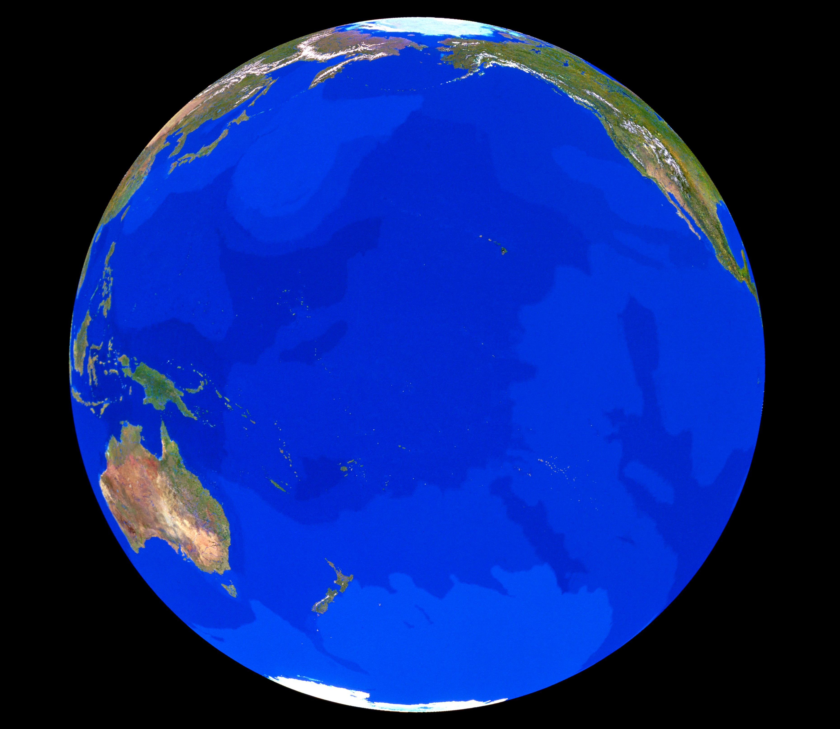
93% of the extra Heat
trapped by manmade
global warming pollution
goes into the
Ocean
© Tom Van Sant/Geosphere Project, Santa Monica/Science Photo Library
Notes:
ID #3633.B - May be live-streamed, broadcast, and presented in-person, but may not be recorded or modified.
And in the world as a whole, it's useful to remember that 93 percent of all this heat goes into the oceans, and this disrupts the water cycle.
DESCRIPTION: Photo slide with text about most of the extra heat from manmade global warming pollution being trapped in the ocean with a photo of the Earth in the background
ADDITIONAL TALKING POINTS: Oceans are absorbing most of the extra heat energy trapped by increased greenhouse gases.[1*]
Between 1971 and 2010, the world’s oceans absorbed more than 90 percent of the extra accumulated heat energy resulting from higher greenhouse gas levels.[1*]
This extra energy is warming the oceans, especially in the water closest to the surface.[1*]
Globally, from 1971–2010, the upper 75 meters of ocean warmed an average of 0.11 degrees Celsius per decade.[1*]
Scientists project that the oceans will continue to warm during the twenty-first century, with the strongest ocean warming forecasted for the surface in tropical and Northern Hemisphere subtropical regions.[1*]
In deeper waters, the warming will be most pronounced in the Southern Ocean.[1*]
Climate change is disrupting how oceans regulate global temperatures.
Oceans circulate heat around the world through massive surface and deep-water currents – one of the largest of which is the Atlantic Meridional Overturning Circulation (AMOC) – which help regulate global climate and weather.[2*]
Warmer, less dense water can slow down ocean heat circulation, as can salinity changes (a notable consequence of runoff from melting land-based freshwater ice).[2*]
According to the Intergovernmental Panel on Climate Change, it is very likely (90–100 percent confidence) that the AMOC could weaken between 11 and 34 percent, depending on future emissions levels, over the twenty-first century.[1*]
This slowdown could mean cooling across the entire Northern Hemisphere while parts of the Southern Hemisphere become hotter.[2*]
While cooler temperatures might sound good in the face of global warming, it could mean massive sea-level rise in eastern North America and shifting rainfall patterns that could dry up Europe’s rivers.[2*]
Warming oceans are devastating the world’s coral reefs.
Coral reefs are some of the most biodiverse habitats on the planet, home to nearly one-quarter of all ocean species, yet occur in less than 1 percent of the world’s oceans.[3*]
Prolonged high water temperatures (among other factors) can cause coral polyps to expel their symbiotic algae partners (zooxanthellae) that help them produce food.[3*]
The result is coral bleaching, which puts the health of the whole reef system at risk.[3*]
The world’s largest reef, the Great Barrier Reef off the Australian coast, frequently suffers from catastrophic bleaching events in response to regular heat stress.[4*]
During the nine-month marine heatwave of 2016, an estimated 30 percent of the Great Barrier Reef’s corals died.[4*]
Higher levels of carbon dioxide in the atmosphere are making oceans increasingly acidic, disrupting natural processes and entire ecosystems.[6*]
The ocean plays a critical role in the storage of carbon, as it holds about 50 times more carbon than the atmosphere.[5*]
The ocean absorbs this carbon largely through a chemical reaction at its surface: CO2 combines with sea water to form carbonic acid, which then breaks down into bicarbonate ions and hydrogen ions. This increase in hydrogen ions results in increased ocean acidity.[6*]
Since 1750, the global ocean has absorbed about 28 percent of the CO2 from burning fossil fuels.[6*]
Ocean acidification makes it more difficult for creatures – like plankton, corals, and shellfish – to produce calcium carbonate, the main ingredient in their hard skeletons or shells.[6*]
This can lead to broader changes in the overall structure of ocean and coastal ecosystems, which can affect fish populations and the people that depend on them.[6*]
The degradation of coral reef ecosystems due to warming and acidification will significantly affect communities in tropical developing nations that heavily depend on them for both nutrition and livelihoods.[7*]
Warmer oceans can encourage dangerous algae overgrowths that produce toxins and lower oxygen levels in the water.
Increased ocean temperature combined with excessive nutrients like phosphorous and nitrogen (often from agricultural fertilizer runoff) is conducive to rapid algae growth known as algal blooms.[8*]
Some types of algal blooms can produce extremely dangerous toxins that can cause eye and lung irritation and worsen asthma. These blooms can even kill people and animals.[8*]
The growth of the algae depletes oxygen content necessary for marine organisms to live, forcing species to flee or perish.[8*]
From 1960–2010, the oceans lost an estimated 77 billion metric tons of oxygen, affecting an accumulated area approximately the size of the European Union.[9*]
According to the National Oceanic and Atmospheric Administration (NOAA), 65 percent of studied estuaries and coastal water bodies in the contiguous US are moderately to severely degraded by excessive nutrients such as phosphorous from agricultural fertilizer runoff, treated sewage wastewater, and atmospheric fallout from burning fossil fuels.[10*]
Pollution has severe impacts on ocean ecosystems and communities that depend on them.
Plastic pollution in oceans has become an increasing concern, with 4.8–12.7 million metric tons entering the ocean in 2010 according to UN Environment. Marine mammals, seabirds, turtles, fish, and crustaceans can become entangled in debris or ingest plastic materials, causing them to drown, starve, or incur wounds. The plastic can also cover phototropic organisms, cutting off access to light and oxygen.[11]
Oil spills in the ocean interfere with the insulating ability of fur-bearing mammals and the water repellency of birds, exposing them to the elements and raising the risk of death by hypothermia. Oil can also poison birds and animals that accidentally ingest it while trying to clean themselves. Exposure to oil can cause reduced growth, enlarged livers, eroded fins, altered heart and respiration rates, and reduced egg and larval survival in fish.[12*]
The economic impacts of oil spills include the cost of cleanup as well as losses from fisheries, aquaculture, tourism, recreation, and industries that depend on clean water such as nuclear power plants and desalination plants.[13*]
Poor and vulnerable communities are disproportionately affected by mismanaged plastic waste, oil spills, and other sources of harmful pollution.[14*][15*]
REFERENCES:
[1*] Rajendra K. Pachauri et al., “Climate Change 2014: Synthesis Report,” Contribution to the Fifth Assessment Report of the Intergovernmental Panel on Climate Change, Cambridge University Press, Topics 1 and 2 (November 2, 2014): 40-62. http://www.ipcc.ch/pdf/assessment-report/ar5/syr/SYR_AR5_FINAL_full.pdf
[2*] Nicola Jones, “How Climate Change Could Jam The World’s Ocean Circulation,” Yale Environment 360, September 6, 2016. https://e360.yale.edu/features/will_climate_change_jam_the_global_ocean_conveyor_belt
[3*] NOAA Fisheries, “Shallow Coral Reef Habitat,” National Oceanic and Atmospheric Administration, last updated February 6, 2018. https://www.fisheries.noaa.gov/national/habitat-conservation/shallow-coral-reef-habitat
[4*] Ben Smee, “Great Barrier Reef: 30% of coral died in ‘catastrophic’ 2016 heatwave,” The Guardian, April 18, 2018. https://www.theguardian.com/environment/2018/apr/19/great-barrier-reef-30-of-coral-died-in-catastrophic-2016-heatwave
[5*] National Oceanic and Atmospheric Administration, “Carbon Cycle,” last updated February 2019. http://www.noaa.gov/resource-collections/carbon-cycle
[6*] US Environmental Protection Agency, “Climate Change Indicators: Ocean Acidity,” last updated December 17, 2016. https://www.epa.gov/climate-indicators/climate-change-indicators-ocean-acidity
[7*] Christopher D. Golden et al., “Fall in fish catch threatens human health,” Nature, June 16, 2016. https://www.nature.com/news/polopoly_fs/1.20074!/menu/main/topColumns/topLeftColumn/pdf/534317a.pdf
[8*] National Institute of Environmental Health Sciences, “Algal Blooms,” last updated July 13, 2020. https://www.niehs.nih.gov/health/topics/agents/algal-blooms/index.cfm
[9*] Mindy Weisberger, “The Ocean Is Suffocating and It’s Our Fault,” Live Science, January 4, 2018. https://www.livescience.com/61338-ocean-losing-oxygen.html
[10*] NOAA, “What is eutrophication?” last updated January 7, 2020. https://oceanservice.noaa.gov/facts/eutrophication.html
[11*] UNEP, “Research highlights true impacts of plastics on our planet, ecosystems and people,” March 12, 2019. https://www.unenvironment.org/news-and-stories/press-release/research-highlights-true-impacts-plastics-our-planet-ecosystems
[12*] NOAA, “How does oil impact marine life?” last updated March 11, 2020. https://oceanservice.noaa.gov/facts/oilimpacts.html
[13*] Jonathan L. Ramseur, "Oil Spills: Background and Governance,” Congressional Research Service, September 15, 2017. https://fas.org/sgp/crs/misc/RL33705.pdf
[14*] Columbia Magazine, “Children and the Poor Hurt Worst by Gulf Spill,” Fall 2010. https://magazine.columbia.edu/article/children-and-poor-hurt-worst-gulf-spill
[15*] Fiona Harvey, “Mismanaged Waste ‘kills up to a million people a year globally,’” The Guardian, May 13, 2019. https://www.theguardian.com/environment/2019/may/14/mismanaged-waste-kills-up-to-a-million-people-a-year-globally
SLIDE SOURCE(S): https://www.iucn.org/news/secretariat/201609/latest-ocean-warming-review-reveals-extent-impacts-nature-and-humans

Slide 13
Ocean Temperatures Set a New Record in 2019
2020 is likely to set a new record again.
Change in Heat Content (Upper 2,000 m)
Relative to 1981-2010 Avg. (ZJ)
Data: Cheng, L. J., and J. Zhu, 2018: “2017 was the warmest year on record for the global ocean,” Advances in Atmospheric Sciences, 34(3)
Notes:
ID #5241.D - Can be used in noncommercial online and TV broadcasts of your presentation, but not modified.
We're seeing ocean temperatures also hit a new record last year, and almost certainly again, this year. This makes the ocean-based storms stronger.
DESCRIPTION: Chart showing global ocean temperature anomalies (from baseline), 1940 - 2019 with a projection that 2020 will likely set a new record in 2020
ADDITIONAL TALKING POINTS: Oceans are absorbing most of the extra heat energy trapped by increased greenhouse gases.[1*]
Between 1971 and 2010, the world’s oceans absorbed more than 90 percent of the extra accumulated heat energy resulting from higher greenhouse gas levels.[1*]
This extra energy is warming the oceans, especially in the water closest to the surface.[1*]
Globally, from 1971–2010, the upper 75 meters of ocean warmed an average of 0.11 degrees Celsius per decade.[1*]
Scientists project that the oceans will continue to warm during the twenty-first century, with the strongest ocean warming forecasted for the surface in tropical and Northern Hemisphere subtropical regions.[1*]
In deeper waters, the warming will be most pronounced in the Southern Ocean.[1*]
Climate change is disrupting how oceans regulate global temperatures.
Oceans circulate heat around the world through massive surface and deep-water currents – one of the largest of which is the Atlantic Meridional Overturning Circulation (AMOC) – which help regulate global climate and weather.[2*]
Warmer, less dense water can slow down ocean heat circulation, as can salinity changes (a notable consequence of runoff from melting land-based freshwater ice).[2*]
According to the Intergovernmental Panel on Climate Change, it is very likely (90–100 percent confidence) that the AMOC could weaken between 11 and 34 percent, depending on future emissions levels, over the twenty-first century.[1*]
This slowdown could mean cooling across the entire Northern Hemisphere while parts of the Southern Hemisphere become hotter.[2*]
While cooler temperatures might sound good in the face of global warming, it could mean massive sea-level rise in eastern North America and shifting rainfall patterns that could dry up Europe’s rivers.[2*]
Warming oceans are devastating the world’s coral reefs.
Coral reefs are some of the most biodiverse habitats on the planet, home to nearly one-quarter of all ocean species, yet occur in less than 1 percent of the world’s oceans.[3*]
Prolonged high water temperatures (among other factors) can cause coral polyps to expel their symbiotic algae partners (zooxanthellae) that help them produce food.[3*]
The result is coral bleaching, which puts the health of the whole reef system at risk.[3*]
The world’s largest reef, the Great Barrier Reef off the Australian coast, frequently suffers from catastrophic bleaching events in response to regular heat stress.[4*]
During the nine-month marine heatwave of 2016, an estimated 30 percent of the Great Barrier Reef’s corals died.[4*]
Higher levels of carbon dioxide in the atmosphere are making oceans increasingly acidic, disrupting natural processes and entire ecosystems.[6*]
The ocean plays a critical role in the storage of carbon, as it holds about 50 times more carbon than the atmosphere.[5*]
The ocean absorbs this carbon largely through a chemical reaction at its surface: CO2 combines with sea water to form carbonic acid, which then breaks down into bicarbonate ions and hydrogen ions. This increase in hydrogen ions results in increased ocean acidity.[6*]
Since 1750, the global ocean has absorbed about 28 percent of the CO2 from burning fossil fuels.[6*]
Ocean acidification makes it more difficult for creatures – like plankton, corals, and shellfish – to produce calcium carbonate, the main ingredient in their hard skeletons or shells.[6*]
This can lead to broader changes in the overall structure of ocean and coastal ecosystems, which can affect fish populations and the people that depend on them.[6*]
The degradation of coral reef ecosystems due to warming and acidification will significantly affect communities in tropical developing nations that heavily depend on them for both nutrition and livelihoods.[7*]
Warmer oceans can encourage dangerous algae overgrowths that produce toxins and lower oxygen levels in the water.
Increased ocean temperature combined with excessive nutrients like phosphorous and nitrogen (often from agricultural fertilizer runoff) is conducive to rapid algae growth known as algal blooms.[8*]
Some types of algal blooms can produce extremely dangerous toxins that can cause eye and lung irritation and worsen asthma. These blooms can even kill people and animals.[8*]
The growth of the algae depletes oxygen content necessary for marine organisms to live, forcing species to flee or perish.[8*]
From 1960–2010, the oceans lost an estimated 77 billion metric tons of oxygen, affecting an accumulated area approximately the size of the European Union.[9*]
According to the National Oceanic and Atmospheric Administration (NOAA), 65 percent of studied estuaries and coastal water bodies in the contiguous US are moderately to severely degraded by excessive nutrients such as phosphorous from agricultural fertilizer runoff, treated sewage wastewater, and atmospheric fallout from burning fossil fuels.[10*]
Pollution has severe impacts on ocean ecosystems and communities that depend on them.
Plastic pollution in oceans has become an increasing concern, with 4.8–12.7 million metric tons entering the ocean in 2010 according to UN Environment. Marine mammals, seabirds, turtles, fish, and crustaceans can become entangled in debris or ingest plastic materials, causing them to drown, starve, or incur wounds. The plastic can also cover phototropic organisms, cutting off access to light and oxygen.[11]
Oil spills in the ocean interfere with the insulating ability of fur-bearing mammals and the water repellency of birds, exposing them to the elements and raising the risk of death by hypothermia. Oil can also poison birds and animals that accidentally ingest it while trying to clean themselves. Exposure to oil can cause reduced growth, enlarged livers, eroded fins, altered heart and respiration rates, and reduced egg and larval survival in fish.[12*]
The economic impacts of oil spills include the cost of cleanup as well as losses from fisheries, aquaculture, tourism, recreation, and industries that depend on clean water such as nuclear power plants and desalination plants.[13*]
Poor and vulnerable communities are disproportionately affected by mismanaged plastic waste, oil spills, and other sources of harmful pollution.[14*][15*]
REFERENCES:
[1*] Rajendra K. Pachauri et al., “Climate Change 2014: Synthesis Report,” Contribution to the Fifth Assessment Report of the Intergovernmental Panel on Climate Change, Cambridge University Press, Topics 1 and 2 (November 2, 2014): 40-62. http://www.ipcc.ch/pdf/assessment-report/ar5/syr/SYR_AR5_FINAL_full.pdf
[2*] Nicola Jones, “How Climate Change Could Jam The World’s Ocean Circulation,” Yale Environment 360, September 6, 2016. https://e360.yale.edu/features/will_climate_change_jam_the_global_ocean_conveyor_belt
[3*] NOAA Fisheries, “Shallow Coral Reef Habitat,” National Oceanic and Atmospheric Administration, last updated February 6, 2018. https://www.fisheries.noaa.gov/national/habitat-conservation/shallow-coral-reef-habitat
[4*] Ben Smee, “Great Barrier Reef: 30% of coral died in ‘catastrophic’ 2016 heatwave,” The Guardian, April 18, 2018. https://www.theguardian.com/environment/2018/apr/19/great-barrier-reef-30-of-coral-died-in-catastrophic-2016-heatwave
[5*] National Oceanic and Atmospheric Administration, “Carbon Cycle,” last updated February 2019. http://www.noaa.gov/resource-collections/carbon-cycle
[6*] US Environmental Protection Agency, “Climate Change Indicators: Ocean Acidity,” last updated December 17, 2016. https://www.epa.gov/climate-indicators/climate-change-indicators-ocean-acidity
[7*] Christopher D. Golden et al., “Fall in fish catch threatens human health,” Nature, June 16, 2016. https://www.nature.com/news/polopoly_fs/1.20074!/menu/main/topColumns/topLeftColumn/pdf/534317a.pdf
[8*] National Institute of Environmental Health Sciences, “Algal Blooms,” last updated July 13, 2020. https://www.niehs.nih.gov/health/topics/agents/algal-blooms/index.cfm
[9*] Mindy Weisberger, “The Ocean Is Suffocating and It’s Our Fault,” Live Science, January 4, 2018. https://www.livescience.com/61338-ocean-losing-oxygen.html
[10*] NOAA, “What is eutrophication?” last updated January 7, 2020. https://oceanservice.noaa.gov/facts/eutrophication.html
[11*] UNEP, “Research highlights true impacts of plastics on our planet, ecosystems and people,” March 12, 2019. https://www.unenvironment.org/news-and-stories/press-release/research-highlights-true-impacts-plastics-our-planet-ecosystems
[12*] NOAA, “How does oil impact marine life?” last updated March 11, 2020. https://oceanservice.noaa.gov/facts/oilimpacts.html
[13*] Jonathan L. Ramseur, "Oil Spills: Background and Governance,” Congressional Research Service, September 15, 2017. https://fas.org/sgp/crs/misc/RL33705.pdf
[14*] Columbia Magazine, “Children and the Poor Hurt Worst by Gulf Spill,” Fall 2010. https://magazine.columbia.edu/article/children-and-poor-hurt-worst-gulf-spill
[15*] Fiona Harvey, “Mismanaged Waste ‘kills up to a million people a year globally,’” The Guardian, May 13, 2019. https://www.theguardian.com/environment/2019/may/14/mismanaged-waste-kills-up-to-a-million-people-a-year-globally
SLIDE SOURCE(S): https://link.springer.com/content/pdf/10.1007/s00376-020-9283-7.pdf; data on file

Slide 14
Evaporation
Precipitation
The
Hydrological
Cycle
Water Returns to the Sea
Sources: Oak Ridge National Laboratory, U.S. Dept. of Energy; © Getty Images; © Pond5
Notes:
ID #961 - Can be used in noncommercial online and TV broadcasts of your presentation, but not modified.
When all of that water vapor comes over the land, the precipitation events increase, and when it rushes back to the sea, the floods and mudslides increase.
DESCRIPTION: Animated diagram of the hydrological (water) cycle
ADDITIONAL TALKING POINTS: As the world gets warmer, the extra heat increases evaporation and intensifies the water cycle, increasing the likelihood and ferocity of downpours.[1*]
Water molecules are constantly changing from one state to the next, and the movement of these water molecules around the world is the water cycle.[1*]
The transition from liquid to gas is known as “evaporation,” and from gas to liquid is “condensation” – which, in the atmosphere, creates clouds and falls as precipitation (rain, snow).[1*]
The amount of evaporated water the air can hold is affected by how warm the air is.[1*]
For each one degree Celsius of warming, the air’s holding capacity for water vapor goes up by almost 7 percent.[2*]
With more water vapor in the air, there is more water available to precipitate in extreme, single-event downpours.[2*]
Heavy downpours are instances when the amount of rain or snow exceeds what is normal, which varies by location and season, and these events are on the rise with climate change.[3*]
In the US, extreme downpours are now happening 30 percent more often than in 1948 (taking place every nine months rather than every 12 months).[4*]
These downpours are also 10 percent more intense on average, nationwide.[4*]
Projections show downpours will become more frequent and intense as temperatures continue to rise.[6*]
These extreme downpours are sometimes characterized as one-in-100 years, one-in-1,000 years, one-in-10,000 years, etc. rainfall events.[5*]
These terms can be confusing when multiple one-in-100 years events occur in a single year.[5*]
The reason is that these terms reference the probability that such an event could occur in a given year, based on the historical average.[5*]
In other words, a one-in-100 years event has a 1 percent chance of happening annually.[5*]
REFERENCES:
[1*] NASA, “The Water Cycle and Climate Change,” last accessed February 2020. https://earthobservatory.nasa.gov/Features/Water/page3.php
[2*] Center for Climate and Energy Solutions, “Extreme Precipitation and Climate Change,” last accessed February 2020. https://www.c2es.org/content/extreme-precipitation-and-climate-change/
[3*] Environmental Protection Agency, “Climate Change Indicators: Heavy Precipitation,” last updated August 2016. https://www.epa.gov/climate-indicators/climate-change-indicators-heavy-precipitation
[4*] Travis Madsen and Nathan Willcox, “When It Rains, It Pours: Global Warming and the Increase in Extreme Precipitation from 1948 to 2011,” (Environment America Research & Policy Center, 2012). https://environmentamerica.org/sites/environment/files/reports/When%20It%20Rains,%20It%20Pours%20vUS.pdf
[5*] United States Geological Survey, “Floods: Recurrence Intervals and 100-year Floods,” last accessed February 2020. http://water.usgs.gov/edu/100yearflood.html
[6*] Alexandra Witze, “Why extreme rains are gaining strength as the climate warms,” Nature, last updated November 22, 2018. https://www.nature.com/articles/d41586-018-07447-1
SLIDE SOURCE(S): https://earthobservatory.nasa.gov/Features/Water/page3.php

Slide 15
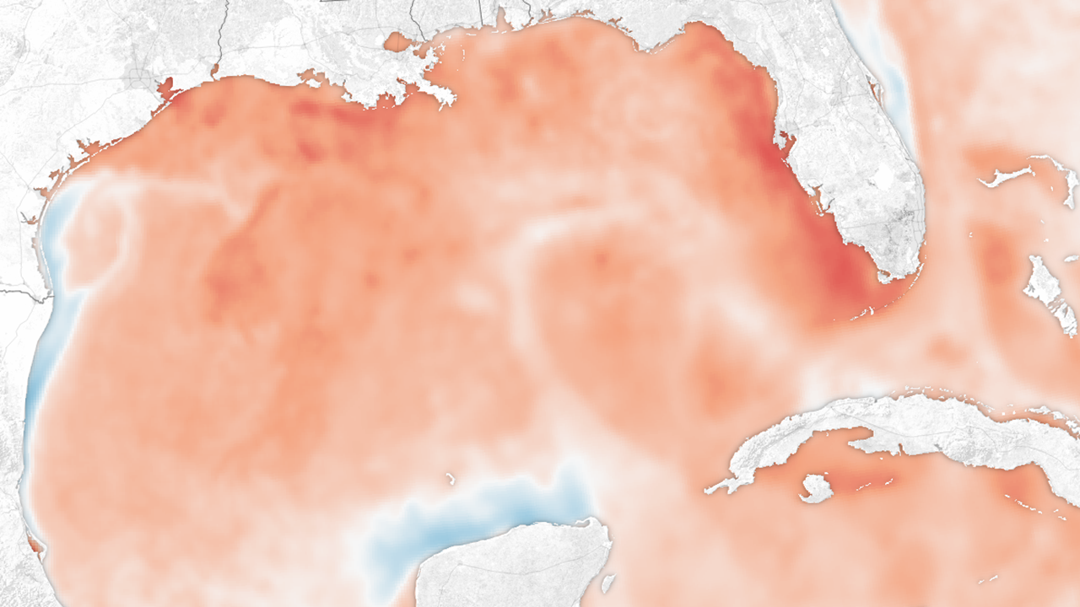
Louisiana
Texas
Houston
Florida
Hurricane Harvey crossed waters in the Gulf of Mexico that were up to 7° F (4° C) hotter than normal, up to 200 meters deep.
Cuba
Path of Harvey August 23 – 30
Sea Surface Temperature August 23, 2017 (° C)
Mexico (Yucatán)
26°
28°
30°
32°
Source: 2017 NASA Earth Observatory
Notes:
Harris County has now suffered one 500-year rainfall event and two 100-year events since 2016. Houston has been hit by nine major flood events between May 2015 and May 2019 — three 1-in-500 year floods and two 1-in-1,000 year downpours.
ID #4951 - Can be used in noncommercial online and TV broadcasts of your presentation, but not modified.
Imelda hit parts of the county with two and a half feet of rain, killed five people and caused an estimated $8 billion in damage across the region, according to AccuWeather. The storm, which struck two years and two weeks after Harvey, means Warmer oceans also make the storms that come from the ocean, over the ocean much stronger. Here is an example. Hurricane Harvey that devastated Houston and the surrounding area passed over waters of the Gulf of Mexico that were 7 degrees Fahrenheit warmer than normal. And that made this a monster storm because the heat went all the way down to the bottom of the ocean and the areas close to land, so that it didn’t begin to weaken as hurricanes normally have in the past as they approach land, it kept on getting stronger.
DESCRIPTION: Image showing sea surface temperatures in the Gulf of Mexico, late August 2017
ADDITIONAL TALKING POINTS: Climate change can influence hurricanes in several ways. Since 1995, more than 90 percent of the excess heat retained by earth has been absorbed by the oceans.[1*] Warmer ocean temperatures – which are like fuel for tropical storms – can result in more intense storms, rapid intensification of storms, and higher wind speeds. Furthermore, warmer oceans and warmer air above the oceans results in more water evaporating from ocean’s surface into the atmosphere. For every 1 degree Fahrenheit that the atmosphere warms, it can hold about 4 percent more water vapor. In turn, extra water vapor can lead to heavier downpours and subsequent flooding. Warmer water also takes up more space, this along with melting land ice has caused global sea levels to rise, yielding storm surges that are higher and can move further inland than they otherwise would.[2*]
Rainfall associated with Harvey of over 30 inches impacted much of southeastern Texas, including the Houston metro area, and far southwestern Louisiana.[3*] The highest total reported was near Nederland, Texas where 64.58 inches fell.[4*]
Estimates of the return period frequency for Harvey’s rainfall vary and will continue to be studied. One early analysis from the University of Wisconsin found that several locations in Texas received a 0.1 percent annual chance (also known as a one-in-one-thousand-year) rainfall. Another analysis by MetSat found some spots received rainfall amounts that had a 0.004 percent to 0.0002 percent chance of occurring in any given year. The main point here is that a rainfall event of this magnitude is exceptionally rare.[3*]
REFERENCES:
[1*]Tim Wallace, “Oceans Are Absorbing Almost All of the Globe’s Excess Heat,” The New York Times, September 12, 2016. https://www.nytimes.com/interactive/2016/09/12/science/earth/ocean-warming-climate-change.html
[2*]Climate Central, “Hurricanes and Climate Change: What We Know,” September 6, 2017. http://www.climatecentral.org/gallery/graphics/hurricanes-and-climate-change-what-we-know
[3*]Tom Di Liberto, “Reviewing Hurricane Harvey’s catastrophic rain and flooding,” National Oceanic and Atmospheric Administration, September 18, 2017. https://www.climate.gov/news-features/event-tracker/reviewing-hurricane-harveys-catastrophic-rain-and-flooding
[4*]John D. Harden, “Weather service confirms a new record of 64 inches of rain fell during Harvey,” Chron, September 27, 2017. http://www.chron.com/about/article/Weather-service-confirms-64-inches-of-rain-fell-12233072.php

Slide 16
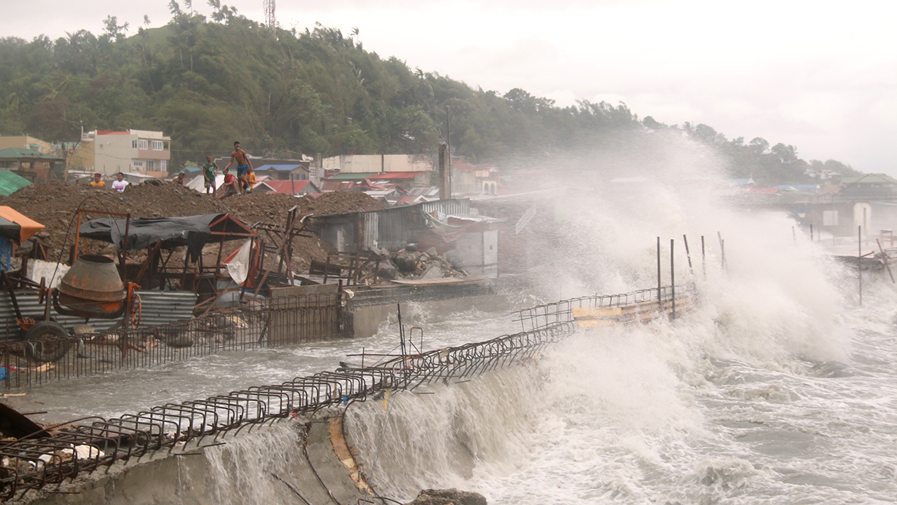
Catbalogan City, Philippines
May 14, 2020
At least 578,000 people were affected by Typhoon Vongfong.
Photo © 2020 AP Photo/Simvale Sayat
Notes:
ID #6548 - May be live-streamed, broadcast, and presented in-person, but may not be recorded or modified.
We just saw this devastating storm two months ago in the Philippines; more than a half million people affected by it.
DESCRIPTION: Photo of strong waves battering the coastline of Catbalogan City, Philippines on May 14, 2020 with text stating that at least 578,000 people were affected by Typhoon Vongfong
ADDITIONAL TALKING POINTS:
Typhoon Vongfong came ashore near in San Policarpo, Eastern Samar, just after noon on May 14, 2020, as a Category 3 typhoon bringing strong winds, heavy rains, and a damaging storm surge that destroyed over 1,000 homes and damaged over 6,000 others.[1*]
Climate change can influence tropical cyclones (typhoons/hurricanes/cyclones) in several ways.[3*] Since 1995, more than 90 percent of the excess heat retained by earth has been absorbed by the oceans.[2*] Warmer ocean temperatures – which are like fuel for tropical storms – can result in more intense storms, rapid intensification of storms, and higher wind speeds. Furthermore, warmer oceans and warmer air above the oceans results in more water evaporating from ocean’s surface into the atmosphere. For every 0.56 degrees Celsius (one degree Fahrenheit) that the atmosphere warms, it can hold about four percent more water vapor. In turn, extra water vapor can lead to heavier downpours and subsequent flooding.[3*]
Warmer water also takes up more space. This along with melting land ice has caused global sea levels to rise, yielding storm surges that are higher and can move further inland than they otherwise would.[2*]
REFERENCES:
[1*] Relief Web, “Typhoon Vongfong – May 2020,” last accessed July 9, 2020. https://reliefweb.int/disaster/tc-2020-000134-phl
[2*] Tim Wallace, “Oceans Are Absorbing Almost All of the Globe’s Excess Heat,” The New York Times, September 12, 2016. https://www.nytimes.com/interactive/2016/09/12/science/earth/ocean-warming-climate-change.html
[3*] Climate Central, “Hurricanes and Climate Change: What We Know,” September 6, 2017. https://medialibrary.climatecentral.org/resources/hurricanes-climate-change-2017
SLIDE SOURCE(S): https://reliefweb.int/disaster/tc-2020-000134-phl

Slide 17
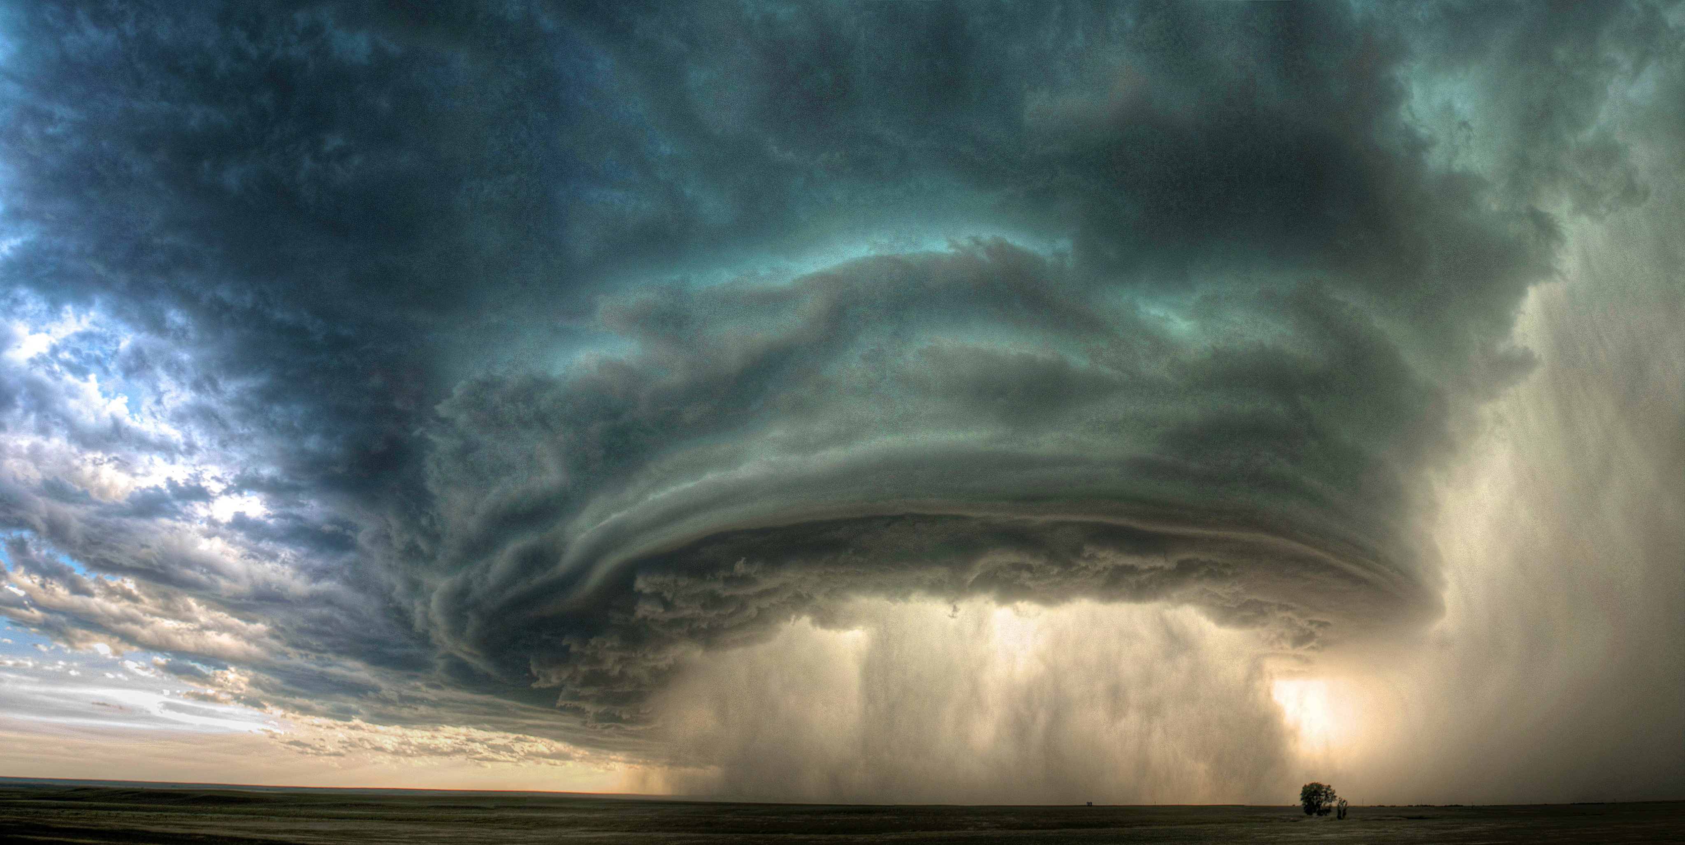
© 2010 Sean R. Heavey
Notes:
ID #1364 - May be live-streamed, broadcast, and presented in-person, but may not be recorded or modified.
And we're seeing rainfall that breaks all records.
DESCRIPTION: Photo of a supercell with a column of rain at its center, near Glasgow, Montana
ADDITIONAL TALKING POINTS: As the world gets warmer, the extra heat increases evaporation and intensifies the water cycle, increasing the likelihood and ferocity of downpours.[1*]
Water molecules are constantly changing from one state to the next, and the movement of these water molecules around the world is the water cycle.[1*]
The transition from liquid to gas is known as “evaporation,” and from gas to liquid is “condensation” – which, in the atmosphere, creates clouds and falls as precipitation (rain, snow).[1*]
The amount of evaporated water the air can hold is affected by how warm the air is.[1*]
For each one degree Celsius of warming, the air’s holding capacity for water vapor goes up by almost 7 percent.[2*]
With more water vapor in the air, there is more water available to precipitate in extreme, single-event downpours.[2*]
Heavy downpours are instances when the amount of rain or snow exceeds what is normal, which varies by location and season, and these events are on the rise with climate change.[3*]
In the US, extreme downpours are now happening 30 percent more often than in 1948 (taking place every nine months rather than every 12 months).[4*]
These downpours are also 10 percent more intense on average, nationwide.[4*]
Projections show downpours will become more frequent and intense as temperatures continue to rise.[6*]
These extreme downpours are sometimes characterized as one-in-100 years, one-in-1,000 years, one-in-10,000 years, etc. rainfall events.[5*]
These terms can be confusing when multiple one-in-100 years events occur in a single year.[5*]
The reason is that these terms reference the probability that such an event could occur in a given year, based on the historical average.[5*]
In other words, a one-in-100 years event has a 1 percent chance of happening annually.[5*]
REFERENCES:
[1*] NASA, “The Water Cycle and Climate Change,” last accessed February 2020. https://earthobservatory.nasa.gov/Features/Water/page3.php
[2*] Center for Climate and Energy Solutions, “Extreme Precipitation and Climate Change,” last accessed February 2020. https://www.c2es.org/content/extreme-precipitation-and-climate-change/
[3*] Environmental Protection Agency, “Climate Change Indicators: Heavy Precipitation,” last updated August 2016. https://www.epa.gov/climate-indicators/climate-change-indicators-heavy-precipitation
[4*] Travis Madsen and Nathan Willcox, “When It Rains, It Pours: Global Warming and the Increase in Extreme Precipitation from 1948 to 2011,” (Environment America Research & Policy Center, 2012). https://environmentamerica.org/sites/environment/files/reports/When%20It%20Rains,%20It%20Pours%20vUS.pdf
[5*] United States Geological Survey, “Floods: Recurrence Intervals and 100-year Floods,” last accessed February 2020. http://water.usgs.gov/edu/100yearflood.html
[6*] Alexandra Witze, “Why extreme rains are gaining strength as the climate warms,” Nature, last updated November 22, 2018. https://www.nature.com/articles/d41586-018-07447-1

Slide 18
“…the gravest effects of all attacks on the environment
are suffered by the poorest.”
Encyclical Letter of His Holiness, Pope Francis On Care for our Common Home
June 18, 2015
Notes:
ID #3637.C - Can be used in noncommercial online and TV broadcasts of your presentation, but not modified.
We're also seeing the same pattern all over the world. As Pope Francis reminded the world powerfully, the poor are the ones most affected, and communities of color are most affected.
DESCRIPTION: Quote from Pope Francis’ Laudato si’: On Care for Our Common Home, about the disproportionate vulnerability of the poor to environmental degradation, published June 18, 2015
ADDITIONAL TALKING POINTS: In November of 2013, Super Typhoon Haiyan hit Palau, the Philippines, Vietnam, and China. The central Philippines was considered the most severely impacted region by the storm, which brought extreme rain, flooding, storm surges as high as 20 feet, and destructive winds to the areas within the tropical cyclone's path. At landfall, the storm's sustained winds reached 195 mph, and there were recorded gusts up to 235 mph, making Super Typhoon Haiyan one of the strongest tropical cyclones to ever make landfall.[1*]
In the Philippines, Haiyan left between 5,000 - 10,000 dead, along with displacing upwards of four million people and affecting approximately 16 million. It is also estimated that upwards of one million homes experienced significant damage, with half being entirely destroyed.[1*]
Following a period of significant growth, as the economy grew by 7.6 percent in the first half of 2013, it was estimated Haiyan would result in a loss of 12 to 15 billion dollars, equivalent to five percent of the country's GDP; compare this figure to the World Bank's estimate of standard annual losses in The Philippines due to typhoon season of only 0.8 percent GDP. This significant loss was partially due to the damage inflicted upon the country's agricultural industry, with crop production concentrated to some of the worst-hit regions by Haiyan.[2*]
REFERENCES:
[1*] Encyclopedia Britannica, "Super Typhoon Haiyan," 2013. https://www.britannica.com/event/Super-Typhoon-Haiyan
[2*] Amie Tsang and Luisa Frey, "The economic cost of Typhoon Haiyan," The Financial Times, November 13, 2013. https://www.ft.com/content/d8199e65-5551-3828-b2bb-6016a75bf6ff
SLIDE SOURCE(S): http://w2.vatican.va/content/francesco/en/encyclicals/documents/papa-francesco_20150524_enciclica-laudato-si.html

Slide 19
The Poor People’s Campaign lists “ecological devastation” as one of the primary “evils.”
Notes:
ID #5852 - Can be used in noncommercial online and TV broadcasts of your presentation, but not modified.
Here in the United States, the Poor People's Campaign is campaigning against ecological devastation, along with racism and poverty and the other evils they've identified.
DESCRIPTION: Image of the Poor People’s Campaign’s logo with text stating that the Poor People’s Campaign lists “ecological devastation” as one of the primary “evils”
ADDITIONAL TALKING POINTS: The Poor People’s Campaign is a national movement dedicated to challenging the evils of systemic racism, poverty, the war economy, ecological devastation, and distorted morality. According to their fundamental principles the campaign focuses on what is right and wrong and works in a non-partisan way.[1*]
According to The Poor People’s Campaign, ecological devastation is a primary evil that faces America because private and financial interests of the natural gas, coal, and oil industries have been placed above a healthy environment.[2*]
REFERENCES:
[1*] The Poor People’s Campaign, “Our Principles,” last accessed February 2020. https://www.poorpeoplescampaign.org/index.php/fundamental-principles/
[2*] The Poor People’s Campaign, “Our Demands,” last accessed February 2020. https://www.poorpeoplescampaign.org/demands/
SLIDE SOURCE(S): https://www.poorpeoplescampaign.org/about/

Slide 20
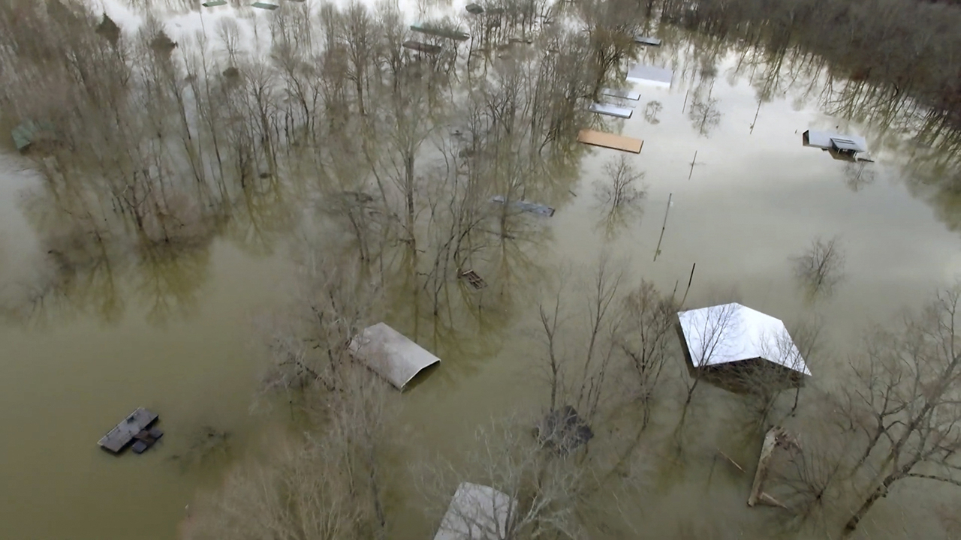
Savannah, Tennessee
February 15, 2020
Torrential rains caused severe flooding in parts of Tennessee and Mississippi in February.
Photo © 2020 Melvin Martin/Hardin County Fire Department via AP
Notes:
ID #6514.B - May be live-streamed, broadcast, and presented in-person, but may not be recorded or modified.
This was in my home state a few months ago.
DESCRIPTION: Photo of a flooded neighborhood in Savannah, Tennessee on February 15, 2020 with text stating that torrential rains caused severe flooding in parts of Tennessee and Mississippi in February
ADDITIONAL TALKING POINTS: As the world gets warmer, the extra heat increases evaporation and intensifies the water cycle, increasing the likelihood and ferocity of downpours.[1*]
Water molecules are constantly changing from one state to the next, and the movement of these water molecules around the world is the water cycle.[1*]
The transition from liquid to gas is known as “evaporation,” and from gas to liquid is “condensation” – which, in the atmosphere, creates clouds and falls as precipitation (rain, snow).[1*]
The amount of evaporated water the air can hold is affected by how warm the air is.[1*]
For each one degree Celsius of warming, the air’s holding capacity for water vapor goes up by almost 7 percent.[2*]
With more water vapor in the air, there is more water available to precipitate in extreme, single-event downpours.[2*]
Heavy downpours are instances when the amount of rain or snow exceeds what is normal, which varies by location and season, and these events are on the rise with climate change.[3*]
In the US, extreme downpours are now happening 30 percent more often than in 1948 (taking place every nine months rather than every 12 months).[4*]
These downpours are also 10 percent more intense on average, nationwide.[4*]
Projections show downpours will become more frequent and intense as temperatures continue to rise.[6*]
These extreme downpours are sometimes characterized as one-in-100 years, one-in-1,000 years, one-in-10,000 years, etc. rainfall events.[5*]
These terms can be confusing when multiple one-in-100 years events occur in a single year.[5*]
The reason is that these terms reference the probability that such an event could occur in a given year, based on the historical average.[5*]
In other words, a one-in-100 years event has a 1 percent chance of happening annually.[5*]
REFERENCES:
[1*] NASA, “The Water Cycle and Climate Change,” last accessed February 2020. https://earthobservatory.nasa.gov/Features/Water/page3.php
[2*] Center for Climate and Energy Solutions, “Extreme Precipitation and Climate Change,” last accessed February 2020. https://www.c2es.org/content/extreme-precipitation-and-climate-change/
[3*] Environmental Protection Agency, “Climate Change Indicators: Heavy Precipitation,” last updated August 2016. https://www.epa.gov/climate-indicators/climate-change-indicators-heavy-precipitation
[4*] Travis Madsen and Nathan Willcox, “When It Rains, It Pours: Global Warming and the Increase in Extreme Precipitation from 1948 to 2011,” (Environment America Research & Policy Center, 2012). https://environmentamerica.org/sites/environment/files/reports/When%20It%20Rains,%20It%20Pours%20vUS.pdf
[5*] United States Geological Survey, “Floods: Recurrence Intervals and 100-year Floods,” last accessed February 2020. http://water.usgs.gov/edu/100yearflood.html
[6*] Alexandra Witze, “Why extreme rains are gaining strength as the climate warms,” Nature, last updated November 22, 2018. https://www.nature.com/articles/d41586-018-07447-1
SLIDE SOURCE(S): http://floodlist.com/america/usa/floods-mississippi-february-2020

Slide 21
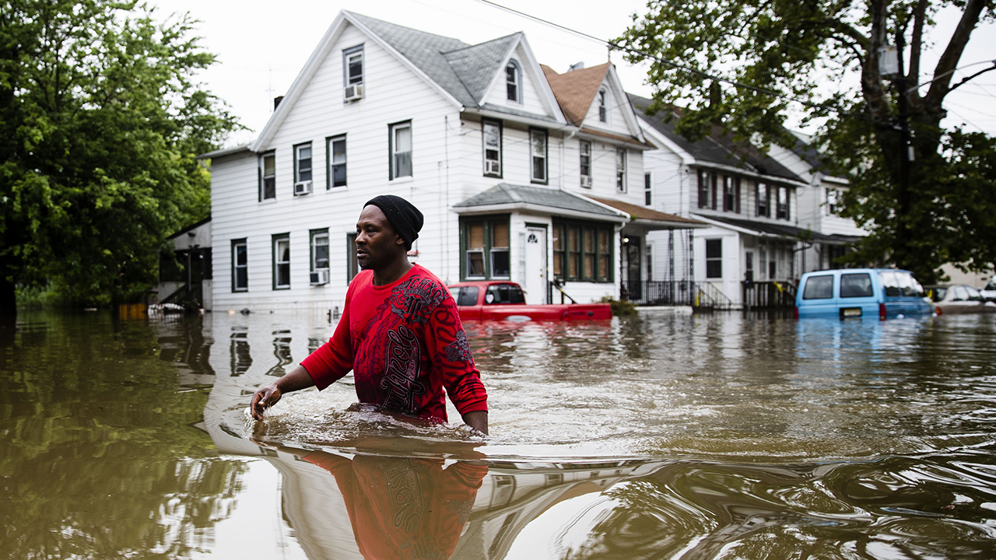
Westville, New Jersey
June 20, 2019
Photo © 2019 AP Photo/Matt Rourke
Notes:
ID #6101 - May not be modified or used in presentations that are recorded, streamed, or broadcast.
This was in New Jersey.
DESCRIPTION: Photo of a man wading through waist-high flooded waters in Westville, New Jersey on June 20, 2019
ADDITIONAL TALKING POINTS: As the world gets warmer, the extra heat is intensifying the water cycle and leading to more extreme floods in many places around the world.[1*]
Floods are caused or amplified by both weather- and human-related factors.
Major weather factors include heavy and/or prolonged precipitation, snowmelt, thunderstorms, storm surges from hurricanes, and collapsed ice or debris jams in waterways.[1*]
Human factors include structural failures of dams and levees, altered drainage, and land-cover alterations.[1*]
Heavy downpours are instances when the amount of rain or snow exceeds what is normal, which varies by location and season, and these events are on the rise with climate change.[2*]
There are four major flood categories: flash, urban, river, and coastal flooding.[1*]
Flash floods occur in small and steep watersheds and waterways and can be caused by short-duration intense precipitation.[1*] Low lying areas or areas with poor drainage have increased vulnerability.[2*]
Urbanization creates large areas of impervious surfaces (such as roads, pavement, parking lots, and buildings). During brief but very heavy precipitation, these surfaces increase immediate runoff that can exceed the capacity of storm drains and lead to urban flooding.[1*]
River flooding occurs when surface water drained from a watershed into a stream or a river exceeds channel capacity, overflows the banks, and inundates adjacent low-lying areas.[1*] Between 13–41 million US residents are now at risk due to river flooding.[3*]
Coastal flooding is predominantly caused by storm surges that accompany hurricanes and other storms that push seawater toward the shore.[1*]
Extreme floods used to be rare events but in recent years they have become more frequent, intense, and costly.[4*]
In the past two decades, the world’s 10 worst floods have done more than $165 billion in damage and have driven more than 1 billion people from their homes.[5*]
By 2050, flooding is projected to inundate coastal cities an average of 40 times more often than present day.[4*]
The risk of extreme floods – such as those caused by Hurricane Sandy in 2012 – striking will likely increase to about once per year after 2100.[4*]
REFERENCES:
[1*] National Climate Assessment, “Extreme Weather,” last accessed February 2020. https://nca2014.globalchange.gov/highlights/report-findings/extreme-weather
[2*] Environmental Protection Agency, “Climate Change Indicators: Heavy Precipitation,” last updated August 2016. https://www.epa.gov/climate-indicators/climate-change-indicators-heavy-precipitation
[3*] FloodList News, “New Study Finds Over 40 Million Americans at Risk from River Flooding,” March 1, 2018. http://floodlist.com/america/usa/study-40-million-americas-flood-risk
[4*] Georgina Gustin, “U.S. Coastal Cities Will Flood More Often and More Severely, Study Warns,” Inside Climate News, June 7, 2017. https://insideclimatenews.org/news/07062017/coastal-flooding-extreme-sea-level-rise-forecast
[5*] Emily Anthes, “A Floating House to Resist the Floods of Climate Change,” The New Yorker, January 3, 2018. https://www.newyorker.com/tech/elements/a-floating-house-to-resist-the-floods-of-climate-change

Slide 22
U.S. Counties Most Vulnerable to Disaster
Brooks, TX
Dimmit, TX
Duval, TX
Luna, NM
Zavala, TX
Cibola, NM
Presidio, TX
Imperial, CA
Evangeline, LA
Culberson, TX
The population in the 10 U.S. counties rated most vulnerable to disasters by the Centers for Disease Control and Prevention is 81% minority, on average.
Data: U.S. CDC
Notes:
ID #6575 - Can be used in noncommercial online and TV broadcasts of your presentation, but not modified.
If you look at the 10 counties most affected by flooding in the United States, 81 percent of the population is minority, on average.
DESCRIPTION: Graphic highlighting the U.S. counties most vulnerable to disaster, with text stating that the population in the 10 U.S. counties rated most vulnerable to disasters by the Centers for Disease Control and Prevention is 81 percent minority, on average
ADDITIONAL TALKING POINTS:
We know that communities of color and low-income neighborhoods are disproportionately at risk from the climate crisis. Notably, minority communities are more vulnerable to disasters and extreme heat.
Counties, cities, and neighborhoods with large numbers of black and Hispanic residents are more likely than others to suffer from events such as flooding and extreme heat because they are often located in damage-prone areas and frequently lack the resources and investment to recover quickly from disaster.
In the US, this is in part a result of decades-long policies that clustered minorities in undesirable areas such as floodplains and denied amenities like green spaces and tree canopies.
In the ten counties rated most vulnerable to extreme heat by the National Oceanic and Atmospheric Administration (NOAA), the population is 67 percent minority on average.[1*]
REFERENCES:
[1*] Thomas Frank, “Population of top 10 counties for disasters: 81% minority,” E&E News, June 8, 2020. https://www.eenews.net/climatewire/2020/06/08/stories/1063347205?utm_campaign=edition%2BMGkN8vMVEV1xZhYWhDA0AQ%3D%3D&utm_medium=email&utm_source=eenews%3Aclimatewire
SLIDE SOURCE(S): https://www.eenews.net/climatewire/2020/06/08/stories/1063347205?utm_campaign=edition%2BMGkN8vMVEV1xZhYWhDA0AQ%3D%3D&utm_medium=email&utm_source=eenews%3Aclimatewire

Slide 23
U.S. farmers were prevented from planting on 20 million acres in 2019, mainly due to heavy rainfall and flooding.
Data: U.S. Department of Agriculture
Notes:
ID #6324.B - Can be used in noncommercial online and TV broadcasts of your presentation, but not modified.
That's a pattern holding around the world. Farmers were hurt last year in the prime farmland of the Midwest. Twenty million acres couldn't be farmed because of the massive downpours.
DESCRIPTION: Text slide stating that U.S. farmers were prevented from planting on 20 million acres in 2019, mainly due to heavy rainfall and flooding
ADDITIONAL TALKING POINTS: As of August 2019, US farmers were prevented from planting crops (mostly corn, soybeans, and wheat) on over 19.4 million acres – nearly 17.5 million acres more than reported at the same time in 2018 and the largest acreage since the USDA’s first report in 2007. More than 73 percent of this land was in Midwestern states effected by heavy rainfall and flooding.[1*]
REFERENCES:
[1*] US Department of Agriculture, Farm Service Agency, “Report: Farmers Prevented from Planting Crops on More than 19 Million Acres,” August 12, 2019. https://www.fsa.usda.gov/news-room/news-releases/2019/report-farmers-prevented-from-planting-crops-on-more-than-19-million-acres
SLIDE SOURCE(S): https://www.fsa.usda.gov/news-room/news-releases/2019/report-farmers-prevented-from-planting-crops-on-more-than-19-million-acres

Slide 24
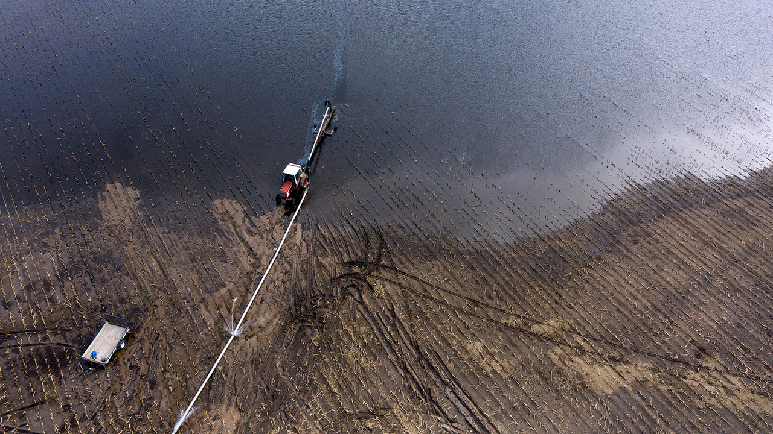
Orchard, Nebraska
May 5, 2019
The U.S. spring 2019 flooding caused $20 billion in damages, including $6.4 billion in federal crop insurance payouts.
© 2019 Johannes Eisele/AFP/Getty Images
Notes:
ID #6326.B - May be live-streamed, broadcast, and presented in-person, but may not be recorded or modified.
There was $20 billion in damages.
DESCRIPTION: Photo of a tractor pumping water from a flooded field, near Orchard, Antelope County Nebraska on May 5, 2019 with text stating that the U.S. spring 2019 flooding caused $20 billion in damages, including $6.4 billion in federal crop insurance payouts
ADDITIONAL TALKING POINTS: As the world gets warmer, the extra heat is intensifying the water cycle and leading to more extreme floods in many places around the world.[1*]
Floods are caused or amplified by both weather- and human-related factors.
Major weather factors include heavy and/or prolonged precipitation, snowmelt, thunderstorms, storm surges from hurricanes, and collapsed ice or debris jams in waterways.[1*]
Human factors include structural failures of dams and levees, altered drainage, and land-cover alterations.[1*]
Heavy downpours are instances when the amount of rain or snow exceeds what is normal, which varies by location and season, and these events are on the rise with climate change.[2*]
There are four major flood categories: flash, urban, river, and coastal flooding.[1*]
Flash floods occur in small and steep watersheds and waterways and can be caused by short-duration intense precipitation.[1*] Low lying areas or areas with poor drainage have increased vulnerability.[2*]
Urbanization creates large areas of impervious surfaces (such as roads, pavement, parking lots, and buildings). During brief but very heavy precipitation, these surfaces increase immediate runoff that can exceed the capacity of storm drains and lead to urban flooding.[1*]
River flooding occurs when surface water drained from a watershed into a stream or a river exceeds channel capacity, overflows the banks, and inundates adjacent low-lying areas.[1*] Between 13–41 million US residents are now at risk due to river flooding.[3*]
Coastal flooding is predominantly caused by storm surges that accompany hurricanes and other storms that push seawater toward the shore.[1*]
Extreme floods used to be rare events but in recent years they have become more frequent, intense, and costly.[4*]
In the past two decades, the world’s 10 worst floods have done more than $165 billion in damage and have driven more than 1 billion people from their homes.[5*]
By 2050, flooding is projected to inundate coastal cities an average of 40 times more often than present day.[4*]
The risk of extreme floods – such as those caused by Hurricane Sandy in 2012 – striking will likely increase to about once per year after 2100.[4*]
REFERENCES:
[1*] National Climate Assessment, “Extreme Weather,” last accessed February 2020. https://nca2014.globalchange.gov/highlights/report-findings/extreme-weather
[2*] Environmental Protection Agency, “Climate Change Indicators: Heavy Precipitation,” last updated August 2016. https://www.epa.gov/climate-indicators/climate-change-indicators-heavy-precipitation
[3*] FloodList News, “New Study Finds Over 40 Million Americans at Risk from River Flooding,” March 1, 2018. http://floodlist.com/america/usa/study-40-million-americas-flood-risk
[4*] Georgina Gustin, “U.S. Coastal Cities Will Flood More Often and More Severely, Study Warns,” Inside Climate News, June 7, 2017. https://insideclimatenews.org/news/07062017/coastal-flooding-extreme-sea-level-rise-forecast
[5*] Emily Anthes, “A Floating House to Resist the Floods of Climate Change,” The New Yorker, January 3, 2018. https://www.newyorker.com/tech/elements/a-floating-house-to-resist-the-floods-of-climate-change
SLIDE SOURCE(S): https://www.politico.com/newsletters/morning-agriculture/2020/02/04/the-trade-aid-train-keeps-chugging-785021

Slide 25
The same extra heat that evaporates more water from the ocean, causing bigger downpours and floods…
…pulls moisture even more quickly from the soil, causing longer and deeper droughts.
An Inconvenient Truth © 2006 by Paramount Classics, a Division of Paramount Pictures. All Rights Reserved.
Notes:
ID #3688 - May be live-streamed, broadcast, and presented in-person, but may not be recorded or modified.
The same extra heat that causes these rain bombs and floods also causes the droughts by sucking the moisture out of the topsoil, so the droughts take place more quickly. The groundwater is used up faster.
DESCRIPTION: Video illustrating how evaporation from oceans is the same process that pulls water from land, causing droughts
ADDITIONAL TALKING POINTS: As the world gets warmer, the extra heat increases evaporation, pulling more water from the soil and causing deeper and longer droughts.[1*]
When people think of drought, they often imagine a meteorological drought or a prolonged period of dryness compared to the regional average.[1*]
Other kinds of drought exist, including hydrological drought, which refers to the effects of decreased precipitation on streamflow, soil moisture, the level of freshwater bodies, and groundwater recharge.[1*]
Farmers are most concerned with agricultural drought, which is when the available water supplies are unable to meet crop water demands. There can be agricultural drought without meteorological drought – for example, when earlier snowmelt leads to reduced water availability during peak summer demand.[1*]
The risk of hydrological and agricultural drought increases as temperatures rise.[1*]
Increased evaporation from soils affects plant life and can both reduce rainfall and increase other risks.[2*]
When rainfall does come to drought-stricken areas, the drier soils it hits are less able to absorb the water, increasing the likelihood of flooding.[2*]
Nearly 40 percent of the world – 1.3 billion people – relies on agriculture as the main source of income. The result: water shortages put the health and wellbeing not only of animals and crops at risk, but also of the farmers and communities that depend on them, too.[2*]
Under future projections, soil moisture is expected to decrease globally with real and dangerous consequences.[3*]
Short-term droughts (four-to-six-month duration) are expected to increase in frequency throughout the twenty-first century.[3*]
Projections show that even in an optimistic scenario of only 1.5 degrees Celsius warming, more than 3.3 billion people will be exposed to water stress, and almost 500 million people will be exposed and vulnerable to water stress.[4*]
REFERENCES:
[1*] Union of Concerned Scientists, “Causes of Drought: What’s the Climate Connection?,” April 10, 2014. https://www.ucsusa.org/global-warming/science-and-impacts/impacts/causes-of-drought-climate-change-connection.html#.Wo7p-kyZOCQ
[2*] The Climate Reality Project, “The Facts About Climate Change and Drought,” June 15, 2016. https://www.climaterealityproject.org/blog/facts-about-climate-change-and-drought
[3*] Justin Sheffield and Eric F. Wood, “Projected changes in drought occurrence under future global warming from multi-model, multi-scenario, IPCC AR4 simulations” (2008): 31-79. https://www.ipcc.ch/report/ar4/wg2/
[4*] Ove Hoegh-Guldberg et al., “Impacts of 1.5˚C global warming on natural and human systems,” Contribution to the Special Report: Global Warming of 1.5˚C, Chapter 3 (October 8, 2018): 175-311. https://www.ipcc.ch/sr15/chapter/chapter-3/

Slide 26
Krakow am See, Poland
June 3, 2020
In parts of Poland and Romania, the drought is the worst in a century. In the Czech Republic it’s the worst in 500 years.
Photo © 2009 Joe Armao/The AGE/Fairfax Media via Getty Images via Getty Images
Notes:
ID #6585 - May be live-streamed, broadcast, and presented in-person, but may not be recorded or modified.
And the drought this year in Europe, Czech Republic has the worst drought in 500 years. Parts of Poland, the worst in 100 years.
DESCRIPTION: Photo of a dry field near Krakow am See, Poland on June 3, 2020 with text stating that in parts of Poland and Romania, the drought is the worst in a century and that in the Czech Republic it’s the worst in 500 years
ADDITIONAL TALKING POINTS: As the world gets warmer, the extra heat increases evaporation, pulling more water from the soil and causing deeper and longer droughts.[1*]
When people think of drought, they often imagine a meteorological drought or a prolonged period of dryness compared to the regional average.[1*]
Other kinds of drought exist, including hydrological drought, which refers to the effects of decreased precipitation on streamflow, soil moisture, the level of freshwater bodies, and groundwater recharge.[1*]
Farmers are most concerned with agricultural drought, which is when the available water supplies are unable to meet crop water demands. There can be agricultural drought without meteorological drought – for example, when earlier snowmelt leads to reduced water availability during peak summer demand.[1*]
The risk of hydrological and agricultural drought increases as temperatures rise.[1*]
Increased evaporation from soils affects plant life and can both reduce rainfall and increase other risks.[2*]
When rainfall does come to drought-stricken areas, the drier soils it hits are less able to absorb the water, increasing the likelihood of flooding.[2*]
Nearly 40 percent of the world – 1.3 billion people – relies on agriculture as the main source of income. The result: water shortages put the health and wellbeing not only of animals and crops at risk, but also of the farmers and communities that depend on them, too.[2*]
Under future projections, soil moisture is expected to decrease globally with real and dangerous consequences.[3*]
Short-term droughts (four-to-six-month duration) are expected to increase in frequency throughout the twenty-first century.[3*]
Projections show that even in an optimistic scenario of only 1.5 degrees Celsius warming, more than 3.3 billion people will be exposed to water stress, and almost 500 million people will be exposed and vulnerable to water stress.[4*]
REFERENCES:
[1*] Union of Concerned Scientists, “Causes of Drought: What’s the Climate Connection?,” April 10, 2014. https://www.ucsusa.org/global-warming/science-and-impacts/impacts/causes-of-drought-climate-change-connection.html#.Wo7p-kyZOCQ
[2*] The Climate Reality Project, “The Facts About Climate Change and Drought,” June 15, 2016. https://www.climaterealityproject.org/blog/facts-about-climate-change-and-drought
[3*] Justin Sheffield and Eric F. Wood, “Projected changes in drought occurrence under future global warming from multi-model, multi-scenario, IPCC AR4 simulations” (2008): 31-79. https://www.ipcc.ch/report/ar4/wg2/
[4*] Ove Hoegh-Guldberg et al., “Impacts of 1.5˚C global warming on natural and human systems,” Contribution to the Special Report: Global Warming of 1.5˚C, Chapter 3 (October 8, 2018): 175-311. https://www.ipcc.ch/sr15/chapter/chapter-3/
SLIDE SOURCE(S): https://www.bloomberg.com/news/articles/2020-05-20/100-year-drought-hits-poor-eu-region-already-reeling-from-virus

Slide 27
Hotter Years Typically Have More Fires
Western U.S. Large Fires and May – September Temperatures
Temperature
150
Average Temperature (°F)
100
Number of Large Fires
50
Fires
0
2018
Data: Westerling, et al.; Climate Central, “The Age of Western Wildfires,” Fig. 9, September, 2012 - Updated 2016
Notes:
ID #3697.E - Can be used in noncommercial online and TV broadcasts of your presentation, but not modified.
When we have high temperatures and drought, we also see more fires.
DESCRIPTION: Graph comparing the number of large fires in the western US with the region’s average spring-summer temperature from 1980 - 2018
ADDITIONAL TALKING POINTS: Research shows that changes in climate have led to hot, dry conditions that increase the risk of fire activity.[1*]
Wildfires are increasing in size, intensity, and duration, burning hotter and longer.[1*]
Fire seasons are also lasting longer.[2*]
Five main factors contribute to increased fire activity in some areas.[3*]
First, spring and summer are coming earlier and lasting longer, respectively, and arrive with more extreme temperatures.
Second, with spring arriving earlier, snowpack is melting sooner, resulting in less water available during the hottest months and giving vegetation more time to dry out.
Third, plants lose water during transpiration — and the higher the ambient temperature, the more water they lose, leaving them drier and more susceptible to fire.
Fourth, studies show that lightning-induced North American forest fires have increased since 1975 and predict that the number of lightning strikes in the United States could increase by about 12 percent for every degree Celsius of warming.
Finally, evidence suggests that climate change may cause more extreme winds in some parts of the world, fanning more flames when fires do break out.
Compared to natural causes, wildfires are most often the result of human activity, stemming from debris burning, arson, campfires, and fireworks – all made more dangerous under drier conditions.[2*]
In recent decades, man-made fires are estimated to have tripled the average fire season.[2*]
As of 2019, up to 90 percent of all US wildland fires were intentionally or accidentally caused by people.[4*]
Annually, wildfires can already burn millions of hectares and force hundreds of thousands to evacuate, with consequences for both immediate safety and long-term health.[5*]
Triggered by warmer temperatures and drier conditions, wildfires and related damages are projected to increase globally this century, particularly in parts of Europe and throughout western North America.[6*]
Since 1972, California’s annual burned area has increased by more than five times. In the past decade, California saw five of its 10 largest wildfires, and experienced seven of the 10 most destructive wildfires in state history – including the Camp Fire, California’s deadliest wildfire.[7*]
Forest fires are also a major threat to air quality: particle emissions can lead to increased health issues, such as cardiac and respiratory disease, as well as direct mortality.[6*]
Australia experienced its hottest and driest year on record in 2019, resulting in drier lands and early fires.[8*]
While fires have historically occurred primarily in places where few people lived, the 2019-2020 Australian fires were different, affecting populated areas. In New South Wales and Victoria alone, about 16 million acres of land burned, while millions more burned in other parts of the country, killing about 30 people, an estimated billion animals, and destroying at least 2,500 homes.[8*]
REFERENCES:
[1*] Center For Climate And Energy Solutions, “Wildfires and Climate Change,” last accessed July, 2020. https://www.c2es.org/content/wildfires-and-climate-change/
[2*] Jason Daley, “Study Shows 84% Of Wildfires Caused By Humans,” Smithsonian Magazine, February 28, 2017. https://www.smithsonianmag.com/smart-news/study-shows-84-wildfires-caused-humans-180962315/
[3*] Chelsea Harvey, “Here’s What We Know About Wildfires and Climate Change,” Climate Wire, Scientific American, October 13, 2017. https://www.scientificamerican.com/article/heres-what-we-know-about-wildfires-and-climate-change/
[4*] Insurance Information Institute, “Facts + Statistics: Wildfires,” last accessed July, 2020. https://www.iii.org/fact-statistic/facts-statistics-wildfires
[5*] Union Of Concerned Scientists, "The Connection Between Climate Change and Wildfires," last updated March 11, 2020. https://www.ucsusa.org/resources/climate-change-and-wildfires#.WuIWwtPwZTY
[6*] R. Sari Kovats et al., “Climate Change 2014: Impacts, Adaptation, and Vulnerability. Part B: Regional Aspects,” Contribution of Working Group II to the Fifth Assessment Report of the Intergovernmental Panel on Climate Change, Cambridge University Press, Section 23.4.4 (March 31, 2014): Pages 1267-1326. https://www.ipcc.ch/site/assets/uploads/2018/02/WGIIAR5-PartB_FINAL.pdf
[7*] Robinson Meyer, “California’s Wildfires Are 500 Percent Larger Due to Climate Change,” The Atlantic, July 16, 2019. https://www.theatlantic.com/science/archive/2019/07/climate-change-500-percent-increase-california-wildfires/594016/
[8*] Jamie Tarabay, “Why these Australia Fires Are Like Nothing We've Seen Before,” The New York Times, January 21, 2020. https://www.nytimes.com/2020/01/21/world/australia/fires-size-climate.html
SLIDE SOURCE(S): https://medialibrary.climatecentral.org/resources/wildfire-season-preview-2019

Slide 28
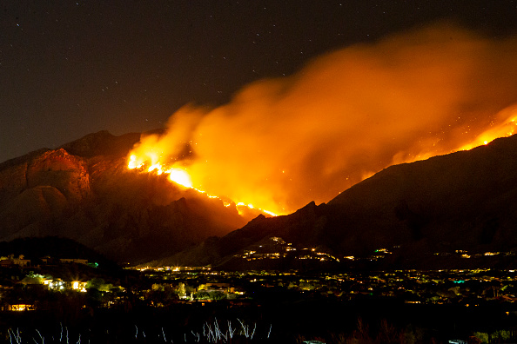
Tucson, Arizona
June 19, 2020
Wildfires have already burned hundreds of square miles in Arizona this year.
Photo © 2020 Jacob Snow/Icon Sportswire via Getty Images
Notes:
ID #6576 - May be live-streamed, broadcast, and presented in-person, but may not be recorded or modified.
And the fires have been devastating. This is one less than a month ago in Arizona.
DESCRIPTION: Photo of the Bighorn Fire burning in the Catalina Mountains on June 19, 2020 in Tucson, Arizona with text stating that wildfires have already burned hundreds of square miles in Arizona this year
ADDITIONAL TALKING POINTS: Research shows that changes in climate have led to hot, dry conditions that increase the risk of fire activity.[1*]
Wildfires are increasing in size, intensity, and duration, burning hotter and longer.[1*]
Fire seasons are also lasting longer.[2*]
Five main factors contribute to increased fire activity in some areas.[3*]
First, spring and summer are coming earlier and lasting longer, respectively, and arrive with more extreme temperatures.
Second, with spring arriving earlier, snowpack is melting sooner, resulting in less water available during the hottest months and giving vegetation more time to dry out.
Third, plants lose water during transpiration — and the higher the ambient temperature, the more water they lose, leaving them drier and more susceptible to fire.
Fourth, studies show that lightning-induced North American forest fires have increased since 1975 and predict that the number of lightning strikes in the United States could increase by about 12 percent for every degree Celsius of warming.
Finally, evidence suggests that climate change may cause more extreme winds in some parts of the world, fanning more flames when fires do break out.
Compared to natural causes, wildfires are most often the result of human activity, stemming from debris burning, arson, campfires, and fireworks – all made more dangerous under drier conditions.[2*]
In recent decades, man-made fires are estimated to have tripled the average fire season.[2*]
As of 2019, up to 90 percent of all US wildland fires were intentionally or accidentally caused by people.[4*]
Annually, wildfires can already burn millions of hectares and force hundreds of thousands to evacuate, with consequences for both immediate safety and long-term health.[5*]
Triggered by warmer temperatures and drier conditions, wildfires and related damages are projected to increase globally this century, particularly in parts of Europe and throughout western North America.[6*]
Since 1972, California’s annual burned area has increased by more than five times. In the past decade, California saw five of its 10 largest wildfires, and experienced seven of the 10 most destructive wildfires in state history – including the Camp Fire, California’s deadliest wildfire.[7*]
Forest fires are also a major threat to air quality: particle emissions can lead to increased health issues, such as cardiac and respiratory disease, as well as direct mortality.[6*]
Australia experienced its hottest and driest year on record in 2019, resulting in drier lands and early fires.[8*]
While fires have historically occurred primarily in places where few people lived, the 2019-2020 Australian fires were different, affecting populated areas. In New South Wales and Victoria alone, about 16 million acres of land burned, while millions more burned in other parts of the country, killing about 30 people, an estimated billion animals, and destroying at least 2,500 homes.[8*]
REFERENCES:
[1*] Center For Climate And Energy Solutions, “Wildfires and Climate Change,” last accessed July, 2020. https://www.c2es.org/content/wildfires-and-climate-change/
[2*] Jason Daley, “Study Shows 84% Of Wildfires Caused By Humans,” Smithsonian Magazine, February 28, 2017. https://www.smithsonianmag.com/smart-news/study-shows-84-wildfires-caused-humans-180962315/
[3*] Chelsea Harvey, “Here’s What We Know About Wildfires and Climate Change,” Climate Wire, Scientific American, October 13, 2017. https://www.scientificamerican.com/article/heres-what-we-know-about-wildfires-and-climate-change/
[4*] Insurance Information Institute, “Facts + Statistics: Wildfires,” last accessed July, 2020. https://www.iii.org/fact-statistic/facts-statistics-wildfires
[5*] Union Of Concerned Scientists, "The Connection Between Climate Change and Wildfires," last updated March 11, 2020. https://www.ucsusa.org/resources/climate-change-and-wildfires#.WuIWwtPwZTY
[6*] R. Sari Kovats et al., “Climate Change 2014: Impacts, Adaptation, and Vulnerability. Part B: Regional Aspects,” Contribution of Working Group II to the Fifth Assessment Report of the Intergovernmental Panel on Climate Change, Cambridge University Press, Section 23.4.4 (March 31, 2014): Pages 1267-1326. https://www.ipcc.ch/site/assets/uploads/2018/02/WGIIAR5-PartB_FINAL.pdf
[7*] Robinson Meyer, “California’s Wildfires Are 500 Percent Larger Due to Climate Change,” The Atlantic, July 16, 2019. https://www.theatlantic.com/science/archive/2019/07/climate-change-500-percent-increase-california-wildfires/594016/
[8*] Jamie Tarabay, “Why these Australia Fires Are Like Nothing We've Seen Before,” The New York Times, January 21, 2020. https://www.nytimes.com/2020/01/21/world/australia/fires-size-climate.html
SLIDE SOURCE(S): https://www.nytimes.com/2020/06/16/us/arizona-bush-fire-coronavirus.html?action=click&module=News&pgtype=Homepage

Slide 29
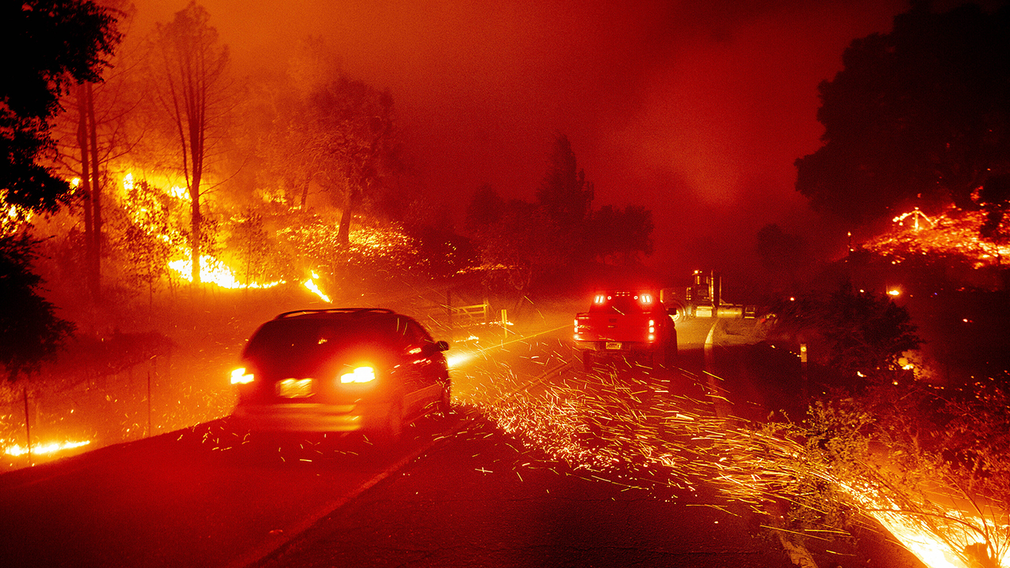
Kincade Fire, Jimtown, California
October 24, 2019
The Kincade fire grew to over 16,000 acres within 24 hours.
Photo © 2019 AP Photo/Noah Berger
Notes:
ID #6447 - May be live-streamed, broadcast, and presented in-person, but may not be recorded or modified.
In California last fall, they had devastating fires.
DESCRIPTION: Photo of embers flying across a roadway as the Kincade Fire burned through the Jimtown community of Sonoma County, California on October 24, 2019
ADDITIONAL TALKING POINTS: Research shows that changes in climate have led to hot, dry conditions that increase the risk of fire activity.[1*]
Wildfires are increasing in size, intensity, and duration, burning hotter and longer.[1*]
Fire seasons are also lasting longer.[2*]
Five main factors contribute to increased fire activity in some areas.[3*]
First, spring and summer are coming earlier and lasting longer, respectively, and arrive with more extreme temperatures.
Second, with spring arriving earlier, snowpack is melting sooner, resulting in less water available during the hottest months and giving vegetation more time to dry out.
Third, plants lose water during transpiration — and the higher the ambient temperature, the more water they lose, leaving them drier and more susceptible to fire.
Fourth, studies show that lightning-induced North American forest fires have increased since 1975 and predict that the number of lightning strikes in the United States could increase by about 12 percent for every degree Celsius of warming.
Finally, evidence suggests that climate change may cause more extreme winds in some parts of the world, fanning more flames when fires do break out.
Compared to natural causes, wildfires are most often the result of human activity, stemming from debris burning, arson, campfires, and fireworks – all made more dangerous under drier conditions.[2*]
In recent decades, man-made fires are estimated to have tripled the average fire season.[2*]
As of 2019, up to 90 percent of all US wildland fires were intentionally or accidentally caused by people.[4*]
Annually, wildfires can already burn millions of hectares and force hundreds of thousands to evacuate, with consequences for both immediate safety and long-term health.[5*]
Triggered by warmer temperatures and drier conditions, wildfires and related damages are projected to increase globally this century, particularly in parts of Europe and throughout western North America.[6*]
Since 1972, California’s annual burned area has increased by more than five times. In the past decade, California saw five of its 10 largest wildfires, and experienced seven of the 10 most destructive wildfires in state history – including the Camp Fire, California’s deadliest wildfire.[7*]
Forest fires are also a major threat to air quality: particle emissions can lead to increased health issues, such as cardiac and respiratory disease, as well as direct mortality.[6*]
Australia experienced its hottest and driest year on record in 2019, resulting in drier lands and early fires.[8*]
While fires have historically occurred primarily in places where few people lived, the 2019-2020 Australian fires were different, affecting populated areas. In New South Wales and Victoria alone, about 16 million acres of land burned, while millions more burned in other parts of the country, killing about 30 people, an estimated billion animals, and destroying at least 2,500 homes.[8*]
REFERENCES:
[1*] Center For Climate And Energy Solutions, “Wildfires and Climate Change,” last accessed July, 2020. https://www.c2es.org/content/wildfires-and-climate-change/
[2*] Jason Daley, “Study Shows 84% Of Wildfires Caused By Humans,” Smithsonian Magazine, February 28, 2017. https://www.smithsonianmag.com/smart-news/study-shows-84-wildfires-caused-humans-180962315/
[3*] Chelsea Harvey, “Here’s What We Know About Wildfires and Climate Change,” Climate Wire, Scientific American, October 13, 2017. https://www.scientificamerican.com/article/heres-what-we-know-about-wildfires-and-climate-change/
[4*] Insurance Information Institute, “Facts + Statistics: Wildfires,” last accessed July, 2020. https://www.iii.org/fact-statistic/facts-statistics-wildfires
[5*] Union Of Concerned Scientists, "The Connection Between Climate Change and Wildfires," last updated March 11, 2020. https://www.ucsusa.org/resources/climate-change-and-wildfires#.WuIWwtPwZTY
[6*] R. Sari Kovats et al., “Climate Change 2014: Impacts, Adaptation, and Vulnerability. Part B: Regional Aspects,” Contribution of Working Group II to the Fifth Assessment Report of the Intergovernmental Panel on Climate Change, Cambridge University Press, Section 23.4.4 (March 31, 2014): Pages 1267-1326. https://www.ipcc.ch/site/assets/uploads/2018/02/WGIIAR5-PartB_FINAL.pdf
[7*] Robinson Meyer, “California’s Wildfires Are 500 Percent Larger Due to Climate Change,” The Atlantic, July 16, 2019. https://www.theatlantic.com/science/archive/2019/07/climate-change-500-percent-increase-california-wildfires/594016/
[8*] Jamie Tarabay, “Why these Australia Fires Are Like Nothing We've Seen Before,” The New York Times, January 21, 2020. https://www.nytimes.com/2020/01/21/world/australia/fires-size-climate.html
SLIDE SOURCE(S): https://www.pressdemocrat.com/news/10216601-181/kincade-fire-starts-inside-the?artslide=0; https://www.usatoday.com/story/news/nation/2019/10/24/kincade-san-bernardino-fires-shutoff-power-california-evacuations/2452820001/

Slide 30
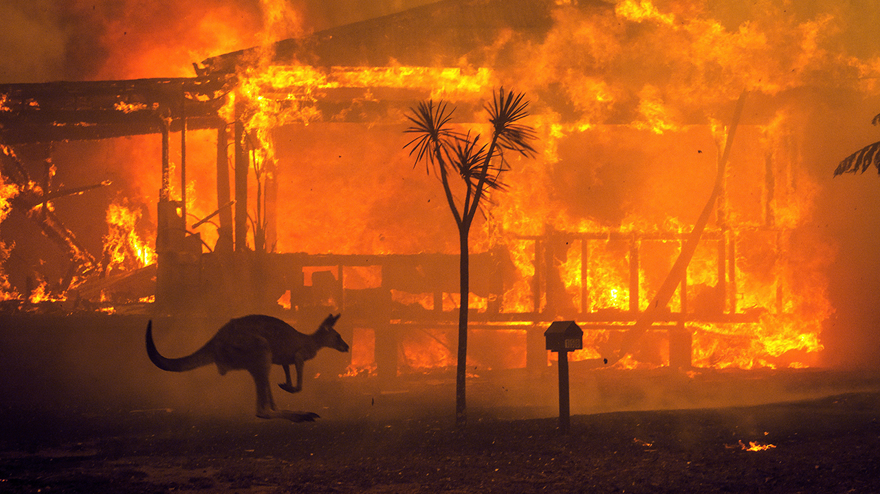
Lake Conjola, NSW, Australia
December 31, 2019
Photo © 2019 Matthew Abbott/The New York Times/Redux
Notes:
ID #6433 - May be live-streamed, broadcast, and presented in-person, but may not be recorded or modified.
The same thing was true in Australia at the turn of the year, the smoke circled the globe.
DESCRIPTION: Photo of a kangaroo hopping past a burning house in Lake Conjola, NSW, Australia on December 31, 2019
ADDITIONAL TALKING POINTS: Research shows that changes in climate have led to hot, dry conditions that increase the risk of fire activity.[1*]
Wildfires are increasing in size, intensity, and duration, burning hotter and longer.[1*]
Fire seasons are also lasting longer.[2*]
Five main factors contribute to increased fire activity in some areas.[3*]
First, spring and summer are coming earlier and lasting longer, respectively, and arrive with more extreme temperatures.
Second, with spring arriving earlier, snowpack is melting sooner, resulting in less water available during the hottest months and giving vegetation more time to dry out.
Third, plants lose water during transpiration — and the higher the ambient temperature, the more water they lose, leaving them drier and more susceptible to fire.
Fourth, studies show that lightning-induced North American forest fires have increased since 1975 and predict that the number of lightning strikes in the United States could increase by about 12 percent for every degree Celsius of warming.
Finally, evidence suggests that climate change may cause more extreme winds in some parts of the world, fanning more flames when fires do break out.
Compared to natural causes, wildfires are most often the result of human activity, stemming from debris burning, arson, campfires, and fireworks – all made more dangerous under drier conditions.[2*]
In recent decades, man-made fires are estimated to have tripled the average fire season.[2*]
As of 2019, up to 90 percent of all US wildland fires were intentionally or accidentally caused by people.[4*]
Annually, wildfires can already burn millions of hectares and force hundreds of thousands to evacuate, with consequences for both immediate safety and long-term health.[5*]
Triggered by warmer temperatures and drier conditions, wildfires and related damages are projected to increase globally this century, particularly in parts of Europe and throughout western North America.[6*]
Since 1972, California’s annual burned area has increased by more than five times. In the past decade, California saw five of its 10 largest wildfires, and experienced seven of the 10 most destructive wildfires in state history – including the Camp Fire, California’s deadliest wildfire.[7*]
Forest fires are also a major threat to air quality: particle emissions can lead to increased health issues, such as cardiac and respiratory disease, as well as direct mortality.[6*]
Australia experienced its hottest and driest year on record in 2019, resulting in drier lands and early fires.[8*]
While fires have historically occurred primarily in places where few people lived, the 2019-2020 Australian fires were different, affecting populated areas. In New South Wales and Victoria alone, about 16 million acres of land burned, while millions more burned in other parts of the country, killing about 30 people, an estimated billion animals, and destroying at least 2,500 homes.[8*]
REFERENCES:
[1*] Center For Climate And Energy Solutions, “Wildfires and Climate Change,” last accessed July, 2020. https://www.c2es.org/content/wildfires-and-climate-change/
[2*] Jason Daley, “Study Shows 84% Of Wildfires Caused By Humans,” Smithsonian Magazine, February 28, 2017. https://www.smithsonianmag.com/smart-news/study-shows-84-wildfires-caused-humans-180962315/
[3*] Chelsea Harvey, “Here’s What We Know About Wildfires and Climate Change,” Climate Wire, Scientific American, October 13, 2017. https://www.scientificamerican.com/article/heres-what-we-know-about-wildfires-and-climate-change/
[4*] Insurance Information Institute, “Facts + Statistics: Wildfires,” last accessed July, 2020. https://www.iii.org/fact-statistic/facts-statistics-wildfires
[5*] Union Of Concerned Scientists, "The Connection Between Climate Change and Wildfires," last updated March 11, 2020. https://www.ucsusa.org/resources/climate-change-and-wildfires#.WuIWwtPwZTY
[6*] R. Sari Kovats et al., “Climate Change 2014: Impacts, Adaptation, and Vulnerability. Part B: Regional Aspects,” Contribution of Working Group II to the Fifth Assessment Report of the Intergovernmental Panel on Climate Change, Cambridge University Press, Section 23.4.4 (March 31, 2014): Pages 1267-1326. https://www.ipcc.ch/site/assets/uploads/2018/02/WGIIAR5-PartB_FINAL.pdf
[7*] Robinson Meyer, “California’s Wildfires Are 500 Percent Larger Due to Climate Change,” The Atlantic, July 16, 2019. https://www.theatlantic.com/science/archive/2019/07/climate-change-500-percent-increase-california-wildfires/594016/
[8*] Jamie Tarabay, “Why these Australia Fires Are Like Nothing We've Seen Before,” The New York Times, January 21, 2020. https://www.nytimes.com/2020/01/21/world/australia/fires-size-climate.html

Slide 31
Worldwide Extreme Weather Catastrophes
1980 – 2019
Extreme temperatures, droughts, fires
Floods, mudslides
Storms
Number of Events
2019
Data: 2017 Munich Re, Geo Risks Research, NatCatSERVICE. As of January 2018.
Data: 2017 Munich Re, Geo Risks Research, NatCatSERVICE. As of January 2018.
Notes:
ID #3661.F - Can be used in noncommercial online and TV broadcasts of your presentation, but not modified.
The reinsurance companies are pointing to all these climate-related disasters and tell us that this is completely unsustainable.
DESCRIPTION: Graph of worldwide extreme weather catastrophes by number of events, 1980 - 2019
ADDITIONAL TALKING POINTS: In 2019, about 820 natural disasters were registered around the world with overall losses totaling USD $150 billion, with $52 billion — just over one-third — insured.[1*] In 2018, about 850 natural catastrophes were recorded around the world with the overall losses totaling USD $160 billion, of which roughly USD $80 billion was insured.[2*]
According to the reinsurance company Munich Re, overall losses from worldwide natural catastrophes in 2017 totaled USD $330 billion, with insured losses at USD $135 billion. [2*] In 2018, 10,400 deaths were reported due to natural catastrophes.[2*]
Note that natural catastrophes include: extreme temperatures, droughts, wildfires, floods, mass movements, tropical storms, extratropical storms, convective storms, local storms, earthquakes, tsunamis, and volcanic activity. Not all of these have been conclusively connected to climate change. The graph above does not include geophysical events (earthquakes, tsunamis, and volcanic activity) for this reason.[3*]
REFERENCES:
[1*] Petra Löw, Ernst Rauch, and Mark Bove, “Tropical cyclones cause highest losses. Natural disasters of 2019 in figures,” Munich Re. https://www.munichre.com/topics-online/en/climate-change-and-natural-disasters/natural-disasters/natural-disasters-of-2019-in-figures-tropical-cyclones-cause-highest-losses.html
[2*] Petra Löw, “The Natural Disasters of 2018 in Figures,” Munich Re, January 1, 2019. https://www.munichre.com/topics-online/en/climate-change-and-natural-disasters/natural-disasters/the-natural-disasters-of-2018-in-figures.html
[3*] Insurance Information Institute, “Facts + Statistics: Global catastrophes”,” last accessed February 2020. http://www.iii.org/fact-statistic/catastrophes-global
SLIDE SOURCE(S): https://www.munichre.com/topics-online/en/2018/01/2017-year-in-figures; https://www.munichre.com/topics-online/en/climate-change-and-natural-disasters/natural-disasters/the-natural-disasters-of-2018-in-figures.html; https://www.munichre.com/topics-online/en/climate-change-and-natural-disasters/natural-disasters/natural-disasters-of-2019-in-figures-tropical-cyclones-cause-highest-losses.html

Slide 32
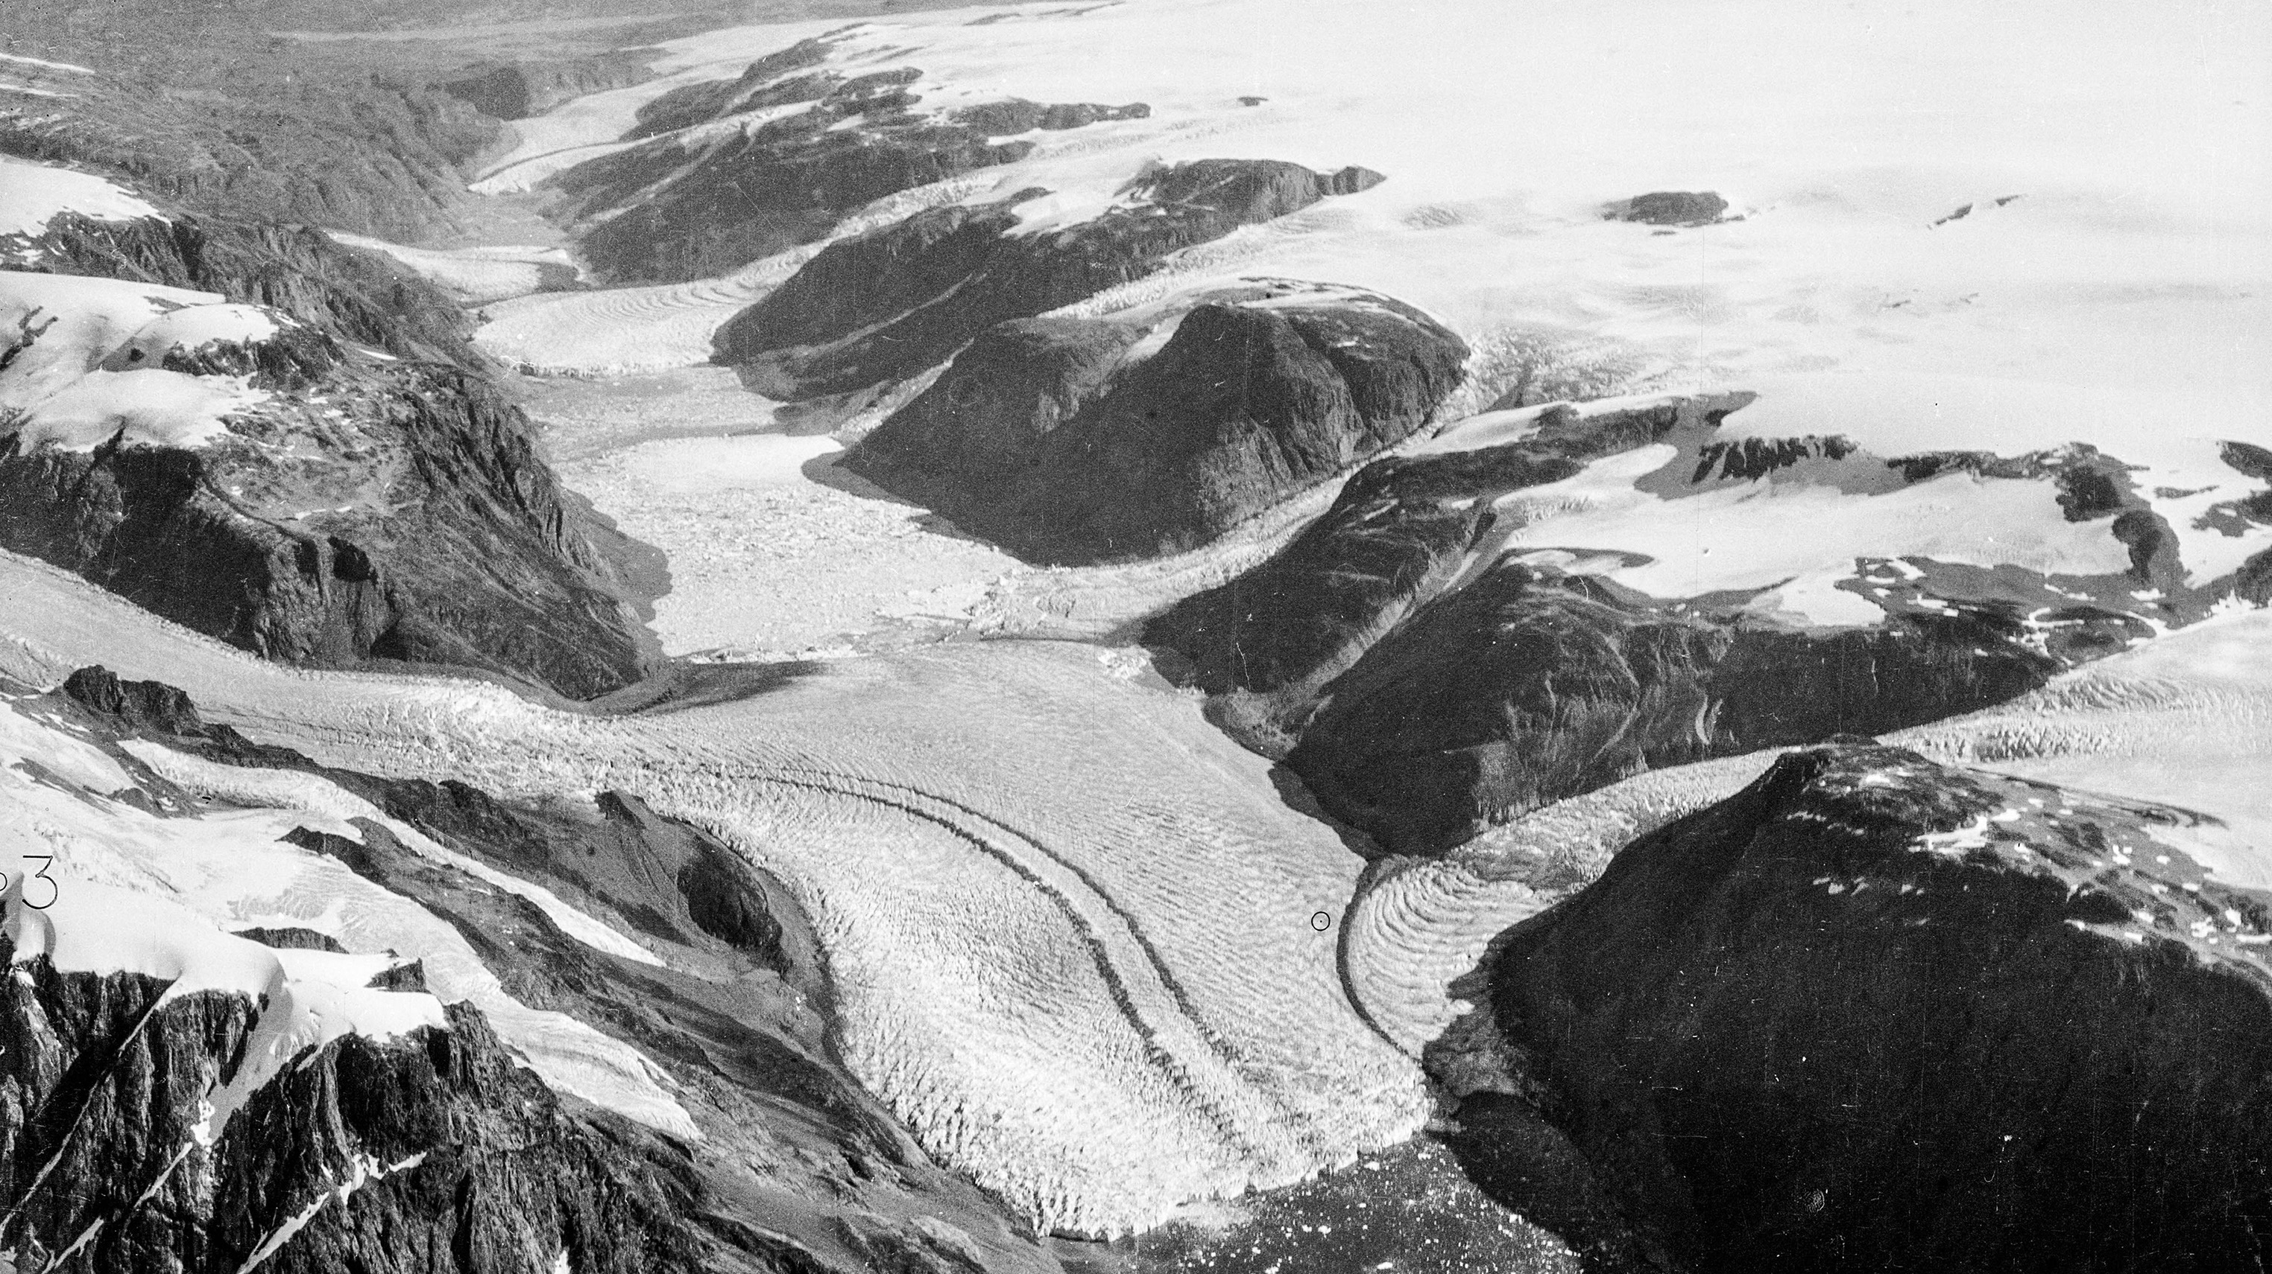
Unnamed Glacier, Southwest Greenland
Summer 1935
Summer 2013
Images courtesy Anders Bjørk, © Natural History Museum of Denmark/Tholstrup (2013) and Danish Geodata Agency (1935)
Notes:
ID #3076 - May be live-streamed, broadcast, and presented in-person, but may not be recorded or modified.
The heat is also melting the ice in Greenland. This glacier turned into water.
DESCRIPTION: Animation showcasing the drastic change of Unnamed Glacier in Southwest Greenland between 1935 - 2013
ADDITIONAL TALKING POINTS: With greenhouse gas emissions increasing and the planet warming, global mean sea-level rise is happening 25 percent faster than in the late twentieth century – with serious consequences for the planet.[1*]
Researchers conclude that even if the strictest global emissions standards are met, sea levels would still rise from 0.7 to 1.2 meters within the next two centuries.[2*]
Dozens of countries are exposed to the risk of coastal flooding caused by sea-level rise.[3*]
Nearly one-third of the world’s population, or 2.4 billion people, live within 100 kilometers of a coastline, further emphasizing the vulnerabilities associated with increased sea-level rise.[3*]
Sea-level rise is caused by melting glaciers and ice sheets, particularly on Greenland and Antarctica, as well as the thermal expansion of warmer ocean water.[4*]
Large land-based ice formations naturally retreat each summer, but unusually warm temperatures have led to greater-than-average melting.[4*]
In addition, winter seasons are becoming shorter, resulting in an imbalance that perpetuates ice melt and therefore increases sea-level rise.[5*]
These factors have contributed to the highest annual average of global sea-level rise on record.[4*]
Ice sheets and glaciers located in Greenland and Antarctica are disappearing faster than expected.[6*]
Between 2011 and 2014, satellite and modeling data found that the Greenland ice sheet lost an approximated 269 billion tons of snow and ice annually, raising sea levels about 0.74 millimeters (mm) each year.[6*]
This rapid decline in ice volume has triggered a positive feedback loop for additional warming and perpetuates sea-level rise.[6*]
Liquid water in glaciers, together with the plant and microbial life it fosters, darken the ice and increase absorption of solar energy, which leads to further ice melt.[6*]
In addition, scientists are discussing the impact of melting ice streams, which are located inside and under ice sheets, lubricating them and causing them to move more quickly into the sea.[5*]
Nearly half of the past century’s sea-level rise is attributed to thermal expansion – water expands when heated, so increased ocean heat means oceans are occupying more space.[5*]
Thermal expansion is responsible for about 1.6 mm per year of sea-level rise.[5*]
Projections show global sea-level rise could range from 0.2 to 2.5 meters by 2100.[7*]
REFERENCES:
[1*] The Maritime Executive, “Sea Level Rising Faster This Century,” April 26, 2017.
https://www.maritime-executive.com/article/sea-level-rising-faster-this-century
[2*] Josh Gabbatiss, “Global sea level to rise by up to 1.2 metres despite Paris agreement, say scientists,” Independent, February 20, 2018. https://www.independent.co.uk/environment/sea-level-rise-climate-change-paris-agreement-global-warming-greenhouse-gas-a8219681.html
[3*] National Aeronautics and Space Administration (NASA), “Living Ocean,” last updated July 2020. https://science.nasa.gov/earth-science/oceanography/living-ocean
[4*] National Oceanic Atmospheric Administration, “Is sea level rising?,” last accessed February 2020. https://oceanservice.noaa.gov/facts/sealevel.html
[5*] Christina Nunez, “Sea level rise, explained,” February 19, 2019. https://www.nationalgeographic.com/environment/global-warming/sea-level-rise/
[6*] Eli Kintisch, “The great Greenland meltdown,” Science Magazine, February 23, 2017. http://www.sciencemag.org/news/2017/02/great-greenland-meltdown
[7*] Rebecca Lindsey, "Climate Change: Global Sea Level," National Oceanic and Atmospheric Administration, last updated November 19, 2019. https://www.climate.gov/news-features/understanding-climate/climate-change-global-sea-level

Slide 33
Declining Ice Mass in Greenland
Change in Ice Mass (Gigatonnes)
Data: NASA
Images courtesy Anders Bjørk, © Natural History Museum of Denmark/Tholstrup (2013) and Danish Geodata Agency (1935)
Notes:
ID #3478.D - May be live-streamed, broadcast, and presented in-person, but may not be recorded or modified.
NASA's estimate of the ice loss in Greenland shows us that it's four times faster than they had originally thought.
DESCRIPTION: Graph showing the declining ice mass in Greenland in gigatonnes, 2002 - 2017
ADDITIONAL TALKING POINTS: With greenhouse gas emissions increasing and the planet warming, global mean sea-level rise is happening 25 percent faster than in the late twentieth century – with serious consequences for the planet.[1*]
Researchers conclude that even if the strictest global emissions standards are met, sea levels would still rise from 0.7 to 1.2 meters within the next two centuries.[2*]
Dozens of countries are exposed to the risk of coastal flooding caused by sea-level rise.[3*]
Nearly one-third of the world’s population, or 2.4 billion people, live within 100 kilometers of a coastline, further emphasizing the vulnerabilities associated with increased sea-level rise.[3*]
Sea-level rise is caused by melting glaciers and ice sheets, particularly on Greenland and Antarctica, as well as the thermal expansion of warmer ocean water.[4*]
Large land-based ice formations naturally retreat each summer, but unusually warm temperatures have led to greater-than-average melting.[4*]
In addition, winter seasons are becoming shorter, resulting in an imbalance that perpetuates ice melt and therefore increases sea-level rise.[5*]
These factors have contributed to the highest annual average of global sea-level rise on record.[4*]
Ice sheets and glaciers located in Greenland and Antarctica are disappearing faster than expected.[6*]
Between 2011 and 2014, satellite and modeling data found that the Greenland ice sheet lost an approximated 269 billion tons of snow and ice annually, raising sea levels about 0.74 millimeters (mm) each year.[6*]
This rapid decline in ice volume has triggered a positive feedback loop for additional warming and perpetuates sea-level rise.[6*]
Liquid water in glaciers, together with the plant and microbial life it fosters, darken the ice and increase absorption of solar energy, which leads to further ice melt.[6*]
In addition, scientists are discussing the impact of melting ice streams, which are located inside and under ice sheets, lubricating them and causing them to move more quickly into the sea.[5*]
Nearly half of the past century’s sea-level rise is attributed to thermal expansion – water expands when heated, so increased ocean heat means oceans are occupying more space.[5*]
Thermal expansion is responsible for about 1.6 mm per year of sea-level rise.[5*]
Projections show global sea-level rise could range from 0.2 to 2.5 meters by 2100.[7*]
REFERENCES:
[1*] The Maritime Executive, “Sea Level Rising Faster This Century,” April 26, 2017.
https://www.maritime-executive.com/article/sea-level-rising-faster-this-century
[2*] Josh Gabbatiss, “Global sea level to rise by up to 1.2 metres despite Paris agreement, say scientists,” Independent, February 20, 2018. https://www.independent.co.uk/environment/sea-level-rise-climate-change-paris-agreement-global-warming-greenhouse-gas-a8219681.html
[3*] National Aeronautics and Space Administration (NASA), “Living Ocean,” last updated July 2020. https://science.nasa.gov/earth-science/oceanography/living-ocean
[4*] National Oceanic Atmospheric Administration, “Is sea level rising?,” last accessed February 2020. https://oceanservice.noaa.gov/facts/sealevel.html
[5*] Christina Nunez, “Sea level rise, explained,” February 19, 2019. https://www.nationalgeographic.com/environment/global-warming/sea-level-rise/
[6*] Eli Kintisch, “The great Greenland meltdown,” Science Magazine, February 23, 2017. http://www.sciencemag.org/news/2017/02/great-greenland-meltdown
[7*] Rebecca Lindsey, "Climate Change: Global Sea Level," National Oceanic and Atmospheric Administration, last updated November 19, 2019. https://www.climate.gov/news-features/understanding-climate/climate-change-global-sea-level
SLIDE SOURCE(S): https://climate.nasa.gov/vital-signs/ice-sheets/

Slide 34
Antarctic Ice Loss
Ice Loss Per Year in Billion Metric Tons
Data: Rignot et al, 2019, PNAS
Notes:
ID #5874 - Can be used in noncommercial online and TV broadcasts of your presentation, but not modified.
The same thing is true in Antarctica, where the ice melting has accelerated quite dramatically. And when this massive amount of ice in those two regions melts, sea levels go up.
DESCRIPTION: Graph of Antarctic ice loss by period 1979 - 2017
ADDITIONAL TALKING POINTS: With greenhouse gas emissions increasing and the planet warming, global mean sea-level rise is happening 25 percent faster than in the late twentieth century – with serious consequences for the planet.[1*]
Researchers conclude that even if the strictest global emissions standards are met, sea levels would still rise from 0.7 to 1.2 meters within the next two centuries.[2*]
Dozens of countries are exposed to the risk of coastal flooding caused by sea-level rise.[3*]
Nearly one-third of the world’s population, or 2.4 billion people, live within 100 kilometers of a coastline, further emphasizing the vulnerabilities associated with increased sea-level rise.[3*]
Sea-level rise is caused by melting glaciers and ice sheets, particularly on Greenland and Antarctica, as well as the thermal expansion of warmer ocean water.[4*]
Large land-based ice formations naturally retreat each summer, but unusually warm temperatures have led to greater-than-average melting.[4*]
In addition, winter seasons are becoming shorter, resulting in an imbalance that perpetuates ice melt and therefore increases sea-level rise.[5*]
These factors have contributed to the highest annual average of global sea-level rise on record.[4*]
Ice sheets and glaciers located in Greenland and Antarctica are disappearing faster than expected.[6*]
Between 2011 and 2014, satellite and modeling data found that the Greenland ice sheet lost an approximated 269 billion tons of snow and ice annually, raising sea levels about 0.74 millimeters (mm) each year.[6*]
This rapid decline in ice volume has triggered a positive feedback loop for additional warming and perpetuates sea-level rise.[6*]
Liquid water in glaciers, together with the plant and microbial life it fosters, darken the ice and increase absorption of solar energy, which leads to further ice melt.[6*]
In addition, scientists are discussing the impact of melting ice streams, which are located inside and under ice sheets, lubricating them and causing them to move more quickly into the sea.[5*]
Nearly half of the past century’s sea-level rise is attributed to thermal expansion – water expands when heated, so increased ocean heat means oceans are occupying more space.[5*]
Thermal expansion is responsible for about 1.6 mm per year of sea-level rise.[5*]
Projections show global sea-level rise could range from 0.2 to 2.5 meters by 2100.[7*]
REFERENCES:
[1*] The Maritime Executive, “Sea Level Rising Faster This Century,” April 26, 2017.
https://www.maritime-executive.com/article/sea-level-rising-faster-this-century
[2*] Josh Gabbatiss, “Global sea level to rise by up to 1.2 metres despite Paris agreement, say scientists,” Independent, February 20, 2018. https://www.independent.co.uk/environment/sea-level-rise-climate-change-paris-agreement-global-warming-greenhouse-gas-a8219681.html
[3*] National Aeronautics and Space Administration (NASA), “Living Ocean,” last updated July 2020. https://science.nasa.gov/earth-science/oceanography/living-ocean
[4*] National Oceanic Atmospheric Administration, “Is sea level rising?,” last accessed February 2020. https://oceanservice.noaa.gov/facts/sealevel.html
[5*] Christina Nunez, “Sea level rise, explained,” February 19, 2019. https://www.nationalgeographic.com/environment/global-warming/sea-level-rise/
[6*] Eli Kintisch, “The great Greenland meltdown,” Science Magazine, February 23, 2017. http://www.sciencemag.org/news/2017/02/great-greenland-meltdown
[7*] Rebecca Lindsey, "Climate Change: Global Sea Level," National Oceanic and Atmospheric Administration, last updated November 19, 2019. https://www.climate.gov/news-features/understanding-climate/climate-change-global-sea-level
SLIDE SOURCE(S): https://www.washingtonpost.com/energy-environment/2019/01/14/ice-loss-antarctica-has-sextupled-since-s-new-research-finds/?utm_term=.058e64406459

Slide 35
Top 10 Cities at Risk from Sea Level Rise in 2070
By Assets at Risk
Estimated Exposed Assets (Trillion USD)
New York/Newark
Guangzhou
Shanghai
Kolkata
Mumbai
Hong Kong
Bangkok
Miami
Tianjin
Tokyo
Data: Nichols, et al., OECD Environment Working Paper No. 1 (ENV/WKP(2007)1)
Notes:
ID #1226 - Can be used in noncommercial online and TV broadcasts of your presentation, but not modified.
The top 10 by assets at risk. Number one is in Miami.
DESCRIPTION: Graph of the top 10 cities at risk from sea-level rise in 2070 ranked by assets at risk
ADDITIONAL TALKING POINTS: With greenhouse gas emissions increasing and the planet warming, global mean sea-level rise is happening 25 percent faster than in the late twentieth century – with serious consequences for the planet.[1*]
Researchers conclude that even if the strictest global emissions standards are met, sea levels would still rise from 0.7 to 1.2 meters within the next two centuries.[2*]
Dozens of countries are exposed to the risk of coastal flooding caused by sea-level rise.[3*]
Nearly one-third of the world’s population, or 2.4 billion people, live within 100 kilometers of a coastline, further emphasizing the vulnerabilities associated with increased sea-level rise.[3*]
Sea-level rise is caused by melting glaciers and ice sheets, particularly on Greenland and Antarctica, as well as the thermal expansion of warmer ocean water.[4*]
Large land-based ice formations naturally retreat each summer, but unusually warm temperatures have led to greater-than-average melting.[4*]
In addition, winter seasons are becoming shorter, resulting in an imbalance that perpetuates ice melt and therefore increases sea-level rise.[5*]
These factors have contributed to the highest annual average of global sea-level rise on record.[4*]
Ice sheets and glaciers located in Greenland and Antarctica are disappearing faster than expected.[6*]
Between 2011 and 2014, satellite and modeling data found that the Greenland ice sheet lost an approximated 269 billion tons of snow and ice annually, raising sea levels about 0.74 millimeters (mm) each year.[6*]
This rapid decline in ice volume has triggered a positive feedback loop for additional warming and perpetuates sea-level rise.[6*]
Liquid water in glaciers, together with the plant and microbial life it fosters, darken the ice and increase absorption of solar energy, which leads to further ice melt.[6*]
In addition, scientists are discussing the impact of melting ice streams, which are located inside and under ice sheets, lubricating them and causing them to move more quickly into the sea.[5*]
Nearly half of the past century’s sea-level rise is attributed to thermal expansion – water expands when heated, so increased ocean heat means oceans are occupying more space.[5*]
Thermal expansion is responsible for about 1.6 mm per year of sea-level rise.[5*]
Projections show global sea-level rise could range from 0.2 to 2.5 meters by 2100.[7*]
REFERENCES:
[1*] The Maritime Executive, “Sea Level Rising Faster This Century,” April 26, 2017.
https://www.maritime-executive.com/article/sea-level-rising-faster-this-century
[2*] Josh Gabbatiss, “Global sea level to rise by up to 1.2 metres despite Paris agreement, say scientists,” Independent, February 20, 2018. https://www.independent.co.uk/environment/sea-level-rise-climate-change-paris-agreement-global-warming-greenhouse-gas-a8219681.html
[3*] National Aeronautics and Space Administration (NASA), “Living Ocean,” last updated July 2020. https://science.nasa.gov/earth-science/oceanography/living-ocean
[4*] National Oceanic Atmospheric Administration, “Is sea level rising?,” last accessed February 2020. https://oceanservice.noaa.gov/facts/sealevel.html
[5*] Christina Nunez, “Sea level rise, explained,” February 19, 2019. https://www.nationalgeographic.com/environment/global-warming/sea-level-rise/
[6*] Eli Kintisch, “The great Greenland meltdown,” Science Magazine, February 23, 2017. http://www.sciencemag.org/news/2017/02/great-greenland-meltdown
[7*] Rebecca Lindsey, "Climate Change: Global Sea Level," National Oceanic and Atmospheric Administration, last updated November 19, 2019. https://www.climate.gov/news-features/understanding-climate/climate-change-global-sea-level
SLIDE SOURCE(S): http://www.oecd.org/env/cc/39721444.pdf

Slide 36
$129 Billion Worth Of New York City Real Estate Now Lies In Flood Zones
Photo: Getty Royalty Free
Source: Business Insider, 2014
Notes:
ID #5888 - May be live-streamed, broadcast, and presented in-person, but may not be recorded or modified.
New York and Newark, $130 billion of real estate assets at risk.
DESCRIPTION: Photo of the New York City skyline with text stating that $129 billion worth of New York City real estate now lies in flood zones
ADDITIONAL TALKING POINTS: With greenhouse gas emissions increasing and the planet warming, global mean sea-level rise is happening 25 percent faster than in the late twentieth century – with serious consequences for the planet.[1*]
Researchers conclude that even if the strictest global emissions standards are met, sea levels would still rise from 0.7 to 1.2 meters within the next two centuries.[2*]
Dozens of countries are exposed to the risk of coastal flooding caused by sea-level rise.[3*]
Nearly one-third of the world’s population, or 2.4 billion people, live within 100 kilometers of a coastline, further emphasizing the vulnerabilities associated with increased sea-level rise.[3*]
Sea-level rise is caused by melting glaciers and ice sheets, particularly on Greenland and Antarctica, as well as the thermal expansion of warmer ocean water.[4*]
Large land-based ice formations naturally retreat each summer, but unusually warm temperatures have led to greater-than-average melting.[4*]
In addition, winter seasons are becoming shorter, resulting in an imbalance that perpetuates ice melt and therefore increases sea-level rise.[5*]
These factors have contributed to the highest annual average of global sea-level rise on record.[4*]
Ice sheets and glaciers located in Greenland and Antarctica are disappearing faster than expected.[6*]
Between 2011 and 2014, satellite and modeling data found that the Greenland ice sheet lost an approximated 269 billion tons of snow and ice annually, raising sea levels about 0.74 millimeters (mm) each year.[6*]
This rapid decline in ice volume has triggered a positive feedback loop for additional warming and perpetuates sea-level rise.[6*]
Liquid water in glaciers, together with the plant and microbial life it fosters, darken the ice and increase absorption of solar energy, which leads to further ice melt.[6*]
In addition, scientists are discussing the impact of melting ice streams, which are located inside and under ice sheets, lubricating them and causing them to move more quickly into the sea.[5*]
Nearly half of the past century’s sea-level rise is attributed to thermal expansion – water expands when heated, so increased ocean heat means oceans are occupying more space.[5*]
Thermal expansion is responsible for about 1.6 mm per year of sea-level rise.[5*]
Projections show global sea-level rise could range from 0.2 to 2.5 meters by 2100.[7*]
REFERENCES:
[1*] The Maritime Executive, “Sea Level Rising Faster This Century,” April 26, 2017.
https://www.maritime-executive.com/article/sea-level-rising-faster-this-century
[2*] Josh Gabbatiss, “Global sea level to rise by up to 1.2 metres despite Paris agreement, say scientists,” Independent, February 20, 2018. https://www.independent.co.uk/environment/sea-level-rise-climate-change-paris-agreement-global-warming-greenhouse-gas-a8219681.html
[3*] National Aeronautics and Space Administration (NASA), “Living Ocean,” last updated July 2020. https://science.nasa.gov/earth-science/oceanography/living-ocean
[4*] National Oceanic Atmospheric Administration, “Is sea level rising?,” last accessed February 2020. https://oceanservice.noaa.gov/facts/sealevel.html
[5*] Christina Nunez, “Sea level rise, explained,” February 19, 2019. https://www.nationalgeographic.com/environment/global-warming/sea-level-rise/
[6*] Eli Kintisch, “The great Greenland meltdown,” Science Magazine, February 23, 2017. http://www.sciencemag.org/news/2017/02/great-greenland-meltdown
[7*] Rebecca Lindsey, "Climate Change: Global Sea Level," National Oceanic and Atmospheric Administration, last updated November 19, 2019. https://www.climate.gov/news-features/understanding-climate/climate-change-global-sea-level
SLIDE SOURCE(S): http://www.businessinsider.com/129-billion-worth-of-new-york-city-real-estate-now-lies-in-flood-zones-2014-10?utm_content=buffer03926&utm_medium=social&utm_source=twitter.com&utm_campaign=buffer

Slide 37
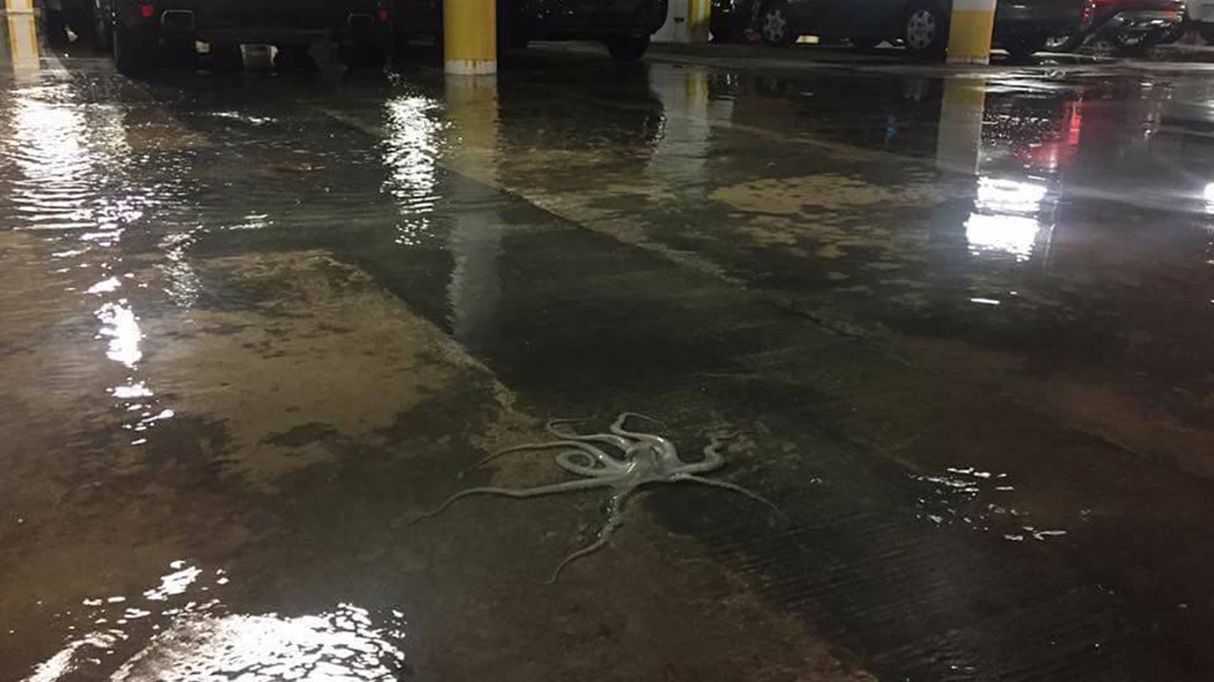
Miami Beach, Florida
November 14, 2016
© 2016 Richard Conlin
Notes:
ID #4671 - May be live-streamed, broadcast, and presented in-person, but may not be recorded or modified.
Sea level rise is the reason why this octopus showed up in a parking garage in Miami.
DESCRIPTION: Photo of an octopus in a parking garage in Miami Beach, Florida on November 14, 2016
ADDITIONAL TALKING POINTS: With greenhouse gas emissions increasing and the planet warming, global mean sea-level rise is happening 25 percent faster than in the late twentieth century – with serious consequences for the planet.[1*]
Researchers conclude that even if the strictest global emissions standards are met, sea levels would still rise from 0.7 to 1.2 meters within the next two centuries.[2*]
Dozens of countries are exposed to the risk of coastal flooding caused by sea-level rise.[3*]
Nearly one-third of the world’s population, or 2.4 billion people, live within 100 kilometers of a coastline, further emphasizing the vulnerabilities associated with increased sea-level rise.[3*]
Sea-level rise is caused by melting glaciers and ice sheets, particularly on Greenland and Antarctica, as well as the thermal expansion of warmer ocean water.[4*]
Large land-based ice formations naturally retreat each summer, but unusually warm temperatures have led to greater-than-average melting.[4*]
In addition, winter seasons are becoming shorter, resulting in an imbalance that perpetuates ice melt and therefore increases sea-level rise.[5*]
These factors have contributed to the highest annual average of global sea-level rise on record.[4*]
Ice sheets and glaciers located in Greenland and Antarctica are disappearing faster than expected.[6*]
Between 2011 and 2014, satellite and modeling data found that the Greenland ice sheet lost an approximated 269 billion tons of snow and ice annually, raising sea levels about 0.74 millimeters (mm) each year.[6*]
This rapid decline in ice volume has triggered a positive feedback loop for additional warming and perpetuates sea-level rise.[6*]
Liquid water in glaciers, together with the plant and microbial life it fosters, darken the ice and increase absorption of solar energy, which leads to further ice melt.[6*]
In addition, scientists are discussing the impact of melting ice streams, which are located inside and under ice sheets, lubricating them and causing them to move more quickly into the sea.[5*]
Nearly half of the past century’s sea-level rise is attributed to thermal expansion – water expands when heated, so increased ocean heat means oceans are occupying more space.[5*]
Thermal expansion is responsible for about 1.6 mm per year of sea-level rise.[5*]
Projections show global sea-level rise could range from 0.2 to 2.5 meters by 2100.[7*]
REFERENCES:
[1*] The Maritime Executive, “Sea Level Rising Faster This Century,” April 26, 2017.
https://www.maritime-executive.com/article/sea-level-rising-faster-this-century
[2*] Josh Gabbatiss, “Global sea level to rise by up to 1.2 metres despite Paris agreement, say scientists,” Independent, February 20, 2018. https://www.independent.co.uk/environment/sea-level-rise-climate-change-paris-agreement-global-warming-greenhouse-gas-a8219681.html
[3*] National Aeronautics and Space Administration (NASA), “Living Ocean,” last updated July 2020. https://science.nasa.gov/earth-science/oceanography/living-ocean
[4*] National Oceanic Atmospheric Administration, “Is sea level rising?,” last accessed February 2020. https://oceanservice.noaa.gov/facts/sealevel.html
[5*] Christina Nunez, “Sea level rise, explained,” February 19, 2019. https://www.nationalgeographic.com/environment/global-warming/sea-level-rise/
[6*] Eli Kintisch, “The great Greenland meltdown,” Science Magazine, February 23, 2017. http://www.sciencemag.org/news/2017/02/great-greenland-meltdown
[7*] Rebecca Lindsey, "Climate Change: Global Sea Level," National Oceanic and Atmospheric Administration, last updated November 19, 2019. https://www.climate.gov/news-features/understanding-climate/climate-change-global-sea-level

Slide 38
Climate change
“will likely lead to
food and water shortages,
pandemic disease,
disputes over refugees and resources, and destruction by natural disasters in regions across the globe.”
U.S. Department of Defense 2014 Climate Change Adaptation Roadmap
Notes:
ID #3701.B - Can be used in noncommercial online and TV broadcasts of your presentation, but not modified.
It's also a national security issue. It creates problems for food and water and health …
DESCRIPTION: Quote from the US Department of Defense’s 2014 Climate Change Adaptation Roadmap, publicly released October 13, 2014
ADDITIONAL TALKING POINTS: Many experts see climate change as a “threat multiplier” and a driver of conflict.[1*]
The Intergovernmental Panel on Climate Change has concluded that extreme weather and other climate-related hazards pose a threat to global food stocks and human security.[2*]
In October 2014, the US Department of Defense declared that climate change “poses immediate risks to US national security” and “will intensify the challenges of global instability, hunger, poverty, and conflict (among other impacts).”[3*][4*]
By exacerbating existing sociopolitical tensions, climate change was a contributing factor in the Arab Spring, a revolutionary wave across the Middle East and North Africa (MENA) region beginning in 2010.[5*]
Between 2010 and 2011, adverse weather wiped out crops worldwide – Canada, the US, China, Australia, Russia, and Ukraine were among the countries hit with a variety of climate disasters, ranging from extreme rainfall to droughts and fires.[5*]
The US Department of Agriculture forecasted global wheat production would fall below global consumption rates.[5*]
Russia, responsible for about 14 percent of the global wheat trade, responded by banning the export of wheat, barley, and rye; and Ukraine – another global supplier – limited their own grain exports.[5*]
MENA imports more food per capita than any other region, making the region particularly vulnerable to fluctuations in the global food supply and price.[5*]
Food prices were an aggravating factor (though not the principle cause) of the Arab Spring uprising. During the Tunisian Revolution, for example, protesters waved baguettes symbolically – though it is important to note they also chanted that they could endure poverty as long as they were rid of President Zine El Abidine Ben Ali and the ruling party.[5*]
While the Arab Spring is an important example of the climate crisis contributing to and/or exacerbating conflicts, there are several others, including the civil war in Syria.[6*]
The Horn of Africa is another region where there’s strong indication that climate change has exacerbated conflict.[7*]
The stresses of climate change on national resources have led to conflicts, especially in areas where communities rely heavily on communal resources such water and pasture for the livestock and crops.[7*]
Many coastal cities in the Horn of Africa, including Mombasa and Mogadishu, have seen rapid urbanization. Sea-level rise in these cities could displace many people and potentially incite more conflict.[7*]
The region has been experiencing severe droughts that have accelerated regional conflict, as seen in Somalia and Sudan, forcing more people to migrate to nearby countries. Those who have no means to migrate end up getting trapped, possibly dying from severe starvation and growing conflict.[7*]
By 2050, unmitigated climate change has the potential to push more than 140 million people – or almost three percent of the global population – from just three regions of the world to move from their homes, exacerbating an already growing migration crisis.[8*]
These mass migrations anticipated in Sub-Saharan African, Latin America, and South Asia could intensify and affect other drivers of conflict.[8*]
By mid-century, parts of the MENA region could become uninhabitable due to impacts like prolonged heat waves and dust storms, forcing large-scale human migrations.[9*]
REFERENCES:
[1*] UN News, “Climate change recognized as ‘threat multiplier’, UN Security Council debates its impact on peace,” January 25, 2019. https://news.un.org/en/story/2019/01/1031322
[2*] Suzanne Goldenberg, “Climate change a threat to security, food and humankind - IPCC report,” The Guardian, March 31, 2014. http://www.theguardian.com/environment/2014/mar/31/climate-change-threat-food-security-humankind
[3*] NBC News, “Pentagon: Climate Change Poses ‘Immediate Risks’ to National Security”, last updated October 13, 2014. https://www.nbcnews.com/science/environment/pentagon-climate-change-poses-immediate-risks-national-security-n224811
[4*] Secretary Chuck Hagel, “The Department of Defense Must Plan for the National Security Implications of Climate Change,” The White House, October 13, 2014. https://obamawhitehouse.archives.gov/blog/2014/10/13/defense-department-must-plan-national-security-implications-climate-change
[5*] Center for American Progress, “The Arab Spring and Climate Change: A Climate and Security Correlations Series,” (February 2013). https://cdn.americanprogress.org/wp-content/uploads/2013/02/ClimateChangeArabSpring.pdf
[6*] National Public Radio, “How Could A Drought Spark A Civil War?,” September 8, 2013. http://www.npr.org/2013/09/08/220438728/how-could-a-drought-spark-a-civil-war
[7*] The UNESCO Courier, “Climate change raises conflict concerns,” February 2018. https://en.unesco.org/courier/2018-2/climate-change-raises-conflict-concerns
[8*] Kumari Rigaud, et al. “Groundswell: Preparing for Internal Climate Migration,” (The World Bank, March 2018). https://openknowledge.worldbank.org/handle/10986/29461
[9*] Anmar Frangoul, “Climate change could make North Africa and Middle East 'uninhabitable’,” CNBC, May 4, 2016. https://www.cnbc.com/2016/05/04/climate-change-could-make-north-africa-and-middle-east-uninhabitable.html#:~:text=Climate%20change%20could%20make%20sections,according%20to%20a%20recent%20study.&text=Lelieveld%20went%20on%20to%20say,the%20amount%20of%20people%20migrating
SLIDE SOURCE(S): https://www.acq.osd.mil/eie/downloads/CCARprint_wForward_e.pdf

Slide 39
Tovarnik, Croatia
September 20, 2015
© 2015 Jeff J Mitchell/Getty Images
Notes:
ID #3546 - May be live-streamed, broadcast, and presented in-person, but may not be recorded or modified.
… and refugees, as we saw after the Syrian drought. This has destabilized the political equilibrium in parts of Europe.
DESCRIPTION: Photo of migrants desperately trying to board a train heading for Zagreb from Tovarnik station in Tovarnik, Croatia, September 20, 2015
ADDITIONAL TALKING POINTS: Many experts see climate change as a “threat multiplier” and a driver of conflict.[1*]
The Intergovernmental Panel on Climate Change has concluded that extreme weather and other climate-related hazards pose a threat to global food stocks and human security.[2*]
In October 2014, the US Department of Defense declared that climate change “poses immediate risks to US national security” and “will intensify the challenges of global instability, hunger, poverty, and conflict (among other impacts).”[3*][4*]
By exacerbating existing sociopolitical tensions, climate change was a contributing factor in the Arab Spring, a revolutionary wave across the Middle East and North Africa (MENA) region beginning in 2010.[5*]
Between 2010 and 2011, adverse weather wiped out crops worldwide – Canada, the US, China, Australia, Russia, and Ukraine were among the countries hit with a variety of climate disasters, ranging from extreme rainfall to droughts and fires.[5*]
The US Department of Agriculture forecasted global wheat production would fall below global consumption rates.[5*]
Russia, responsible for about 14 percent of the global wheat trade, responded by banning the export of wheat, barley, and rye; and Ukraine – another global supplier – limited their own grain exports.[5*]
MENA imports more food per capita than any other region, making the region particularly vulnerable to fluctuations in the global food supply and price.[5*]
Food prices were an aggravating factor (though not the principle cause) of the Arab Spring uprising. During the Tunisian Revolution, for example, protesters waved baguettes symbolically – though it is important to note they also chanted that they could endure poverty as long as they were rid of President Zine El Abidine Ben Ali and the ruling party.[5*]
While the Arab Spring is an important example of the climate crisis contributing to and/or exacerbating conflicts, there are several others, including the civil war in Syria.[6*]
The Horn of Africa is another region where there’s strong indication that climate change has exacerbated conflict.[7*]
The stresses of climate change on national resources have led to conflicts, especially in areas where communities rely heavily on communal resources such water and pasture for the livestock and crops.[7*]
Many coastal cities in the Horn of Africa, including Mombasa and Mogadishu, have seen rapid urbanization. Sea-level rise in these cities could displace many people and potentially incite more conflict.[7*]
The region has been experiencing severe droughts that have accelerated regional conflict, as seen in Somalia and Sudan, forcing more people to migrate to nearby countries. Those who have no means to migrate end up getting trapped, possibly dying from severe starvation and growing conflict.[7*]
By 2050, unmitigated climate change has the potential to push more than 140 million people – or almost three percent of the global population – from just three regions of the world to move from their homes, exacerbating an already growing migration crisis.[8*]
These mass migrations anticipated in Sub-Saharan African, Latin America, and South Asia could intensify and affect other drivers of conflict.[8*]
By mid-century, parts of the MENA region could become uninhabitable due to impacts like prolonged heat waves and dust storms, forcing large-scale human migrations.[9*]
REFERENCES:
[1*] UN News, “Climate change recognized as ‘threat multiplier’, UN Security Council debates its impact on peace,” January 25, 2019. https://news.un.org/en/story/2019/01/1031322
[2*] Suzanne Goldenberg, “Climate change a threat to security, food and humankind - IPCC report,” The Guardian, March 31, 2014. http://www.theguardian.com/environment/2014/mar/31/climate-change-threat-food-security-humankind
[3*] NBC News, “Pentagon: Climate Change Poses ‘Immediate Risks’ to National Security”, last updated October 13, 2014. https://www.nbcnews.com/science/environment/pentagon-climate-change-poses-immediate-risks-national-security-n224811
[4*] Secretary Chuck Hagel, “The Department of Defense Must Plan for the National Security Implications of Climate Change,” The White House, October 13, 2014. https://obamawhitehouse.archives.gov/blog/2014/10/13/defense-department-must-plan-national-security-implications-climate-change
[5*] Center for American Progress, “The Arab Spring and Climate Change: A Climate and Security Correlations Series,” (February 2013). https://cdn.americanprogress.org/wp-content/uploads/2013/02/ClimateChangeArabSpring.pdf
[6*] National Public Radio, “How Could A Drought Spark A Civil War?,” September 8, 2013. http://www.npr.org/2013/09/08/220438728/how-could-a-drought-spark-a-civil-war
[7*] The UNESCO Courier, “Climate change raises conflict concerns,” February 2018. https://en.unesco.org/courier/2018-2/climate-change-raises-conflict-concerns
[8*] Kumari Rigaud, et al. “Groundswell: Preparing for Internal Climate Migration,” (The World Bank, March 2018). https://openknowledge.worldbank.org/handle/10986/29461
[9*] Anmar Frangoul, “Climate change could make North Africa and Middle East 'uninhabitable’,” CNBC, May 4, 2016. https://www.cnbc.com/2016/05/04/climate-change-could-make-north-africa-and-middle-east-uninhabitable.html#:~:text=Climate%20change%20could%20make%20sections,according%20to%20a%20recent%20study.&text=Lelieveld%20went%20on%20to%20say,the%20amount%20of%20people%20migrating

Slide 40
“Climate Change
is a Medical Emergency.”
Professor Hugh Montgomery, Co-Chair, The 2015 Lancet Commission on Health and Climate Change
June 2015
Notes:
ID #3710.C - Can be used in noncommercial online and TV broadcasts of your presentation, but not modified.
It's also a health crisis, a climate, a medical emergency caused by the climate crisis all over the world.
DESCRIPTION: Quote from University College London Professor and Co-Chair of the 2015 Lancet Commission on Health and Climate Change, Hugh Montgomery, stating that “climate change is a medical emergency,” June 2015
ADDITIONAL TALKING POINTS: Climate change is stacking the deck against a healthy human population, with vulnerable communities particularly at risk.
Heat stress, air pollution, mental disorders, and vector-, food-, and water-borne diseases are all exacerbated by a changing climate.[1*]
Climate change-related health impacts disproportionately threaten low-income communities, some communities of color, immigrants, the elderly, infants and children, people with pre-existing medical conditions, and individuals with mental illnesses, among others.[2*]
Major impacts from climate change such as higher average temperatures, changing rainfall patterns, and sea level rise influence human health worldwide.
They affect the food we eat, the water we drink, the air we breathe, and the weather we experience.[1*]
Climate change is increasing the number of extreme heat days in many parts of the world – with real consequences for human health.[2*]
According to the Intergovernmental Panel on Climate Change, it is “virtually certain” that the Earth will experience an increase in the frequency and magnitude of unusually warm days and nights by the end of the century.[3*]
Extreme heat can have many impacts on human health, including increased muscle pains or spasms, heat exhaustion, heat stroke, and exacerbated cardiovascular issues.[3*]
In the US, extreme heat events cause more deaths annually than hurricanes, lightning, tornadoes, floods, and earthquakes combined.[4*]
Rising global average temperatures, precipitation changes, and increased flooding and storms enable diseases to spread further and faster.[5*]
Warming can allow vectors – small organisms such as mosquitos or ticks that can carry diseases – to expand their habitat ranges. Additionally, warmer temperatures can increase the number of days conducive for many vectors to reproduce, while in some cases allowing them to mature and reproduce faster.[5*]
Some viruses incubate faster inside mosquitos and other vectors when temperatures are hotter, further expanding the amount of time a vector is dangerous to human health.[5*]
Burning fossil fuels not only drives global warming – it also pollutes the air.[1*]
Worldwide, outdoor air pollution kills over four million people annually.[6*]
Climate change is predicted to make allergies worse in the coming decades.
Carbon pollution and warmer temperatures cause plants to produce more pollen over longer growing seasons.[7*]
Scientists predict that average pollen counts in 2040 will be more than double what they were in 2000.[7*]
Climate change is also creating more favorable conditions for the spread of waterborne diseases.[1*]
Warmer air holds more water, which is increasing the number of heavy downpours in many places around the world.[1*]
Increasing downpours, together with rising temperatures, can create more favorable environmental conditions for the growth, survival, and spread of waterborne diseases.[1*]
Waterborne diseases can be deadly: contaminated drinking water causes nearly 500,000 diarrheal deaths each year.[8*]
In the US, waterborne pathogens are estimated to cause acute gastrointestinal illness cases affecting between 12 and 19 million people annually.[9*]
Climate change-exacerbated extreme weather, changing weather patterns, damaged food and water resources, and polluted air impact human mental health.[10*]
Major acute mental health impacts include increases in trauma and shock, post-traumatic stress disorder (PTSD), compounded stress, anxiety, substance abuse, and depression.[10*]
Major chronic mental health impacts include higher rates of aggression and violence, more mental health emergencies, an increased sense of helplessness, hopelessness, or fatalism, and intense feelings of loss.[10*]
REFERENCES:
[1*] John Balbus, et al., “Climate and Health Assessment Chapter 1: Climate Change and Human Health,” (The US Global Change Research Program, 2016). https://health2016.globalchange.gov/climate-change-and-human-health
[2*] U.S. Environmental Protection Agency. 2016. Climate change indicators in the United States, 2016. Fourth edition. EPA 430-R-16-004. www.epa.gov/climate-indicators
[3*] Sonia I. Seneviratne et al., “Changes in climate extremes and their impacts on the natural physical environment,” A Special Report of Working Groups I and II of the Intergovernmental Panel on Climate Change (IPCC), Cambridge University Press, Managing the Risks of Extreme Events and Disasters to Advance Climate Change Adaptation (April 2012): 109 - 230. https://www.ipcc.ch/site/assets/uploads/2018/03/SREX-Chap3_FINAL-1.pdf
[4*] George Luber and Michael McGeehin, “Climate Change and Extreme Heat Events,” American Journal of Preventive Medicine Volume 35, Issue 5, (November 1, 2008): 429 – 435. https://doi.org/10.1016/j.amepre.2008.08.021
[5*] Climate Nexus, “Climate Change and Vector-Borne Diseases,” last accessed July, 2020. http://climatenexus.org/learn/public-health-impacts/climate-change-and-vector-borne-diseases
[6*] World Health Organization, “Air Pollution,” last accessed July, 2020. https://www.who.int/health-topics/air-pollution#tab=tab_3
[7*] Aaron Bernstein, "Climate Change and Allergies," Harvard Chan C-CHANGE, last accessed July, 2020. https://www.hsph.harvard.edu/c-change/subtopics/climate-change-and-allergies/
[8*] World Health Organization, “Drinking-water,” June 14, 2019. http://www.who.int/mediacentre/factsheets/fs391/en/
[9*] Juli M. Trtanj, et al., “Climate and Health Assessment: Chapter 6: Water-Related Illness,” (U.S. Global Change Research Program, 2016). https://health2016.globalchange.gov/water-related-illness
[10*] Clayton, S., et al., “Mental Health and Our Changing Climate: Impacts, Implications, and Guidance,” (American Psychological Association, and ecoAmerica, March 2017). https://www.apa.org/news/press/releases/2017/03/mental-health-climate.pdf
SLIDE SOURCE(S): https://climatehealthcommission.files.wordpress.com/2015/04/press-release-health-and-climate-commission.pdf

Slide 41
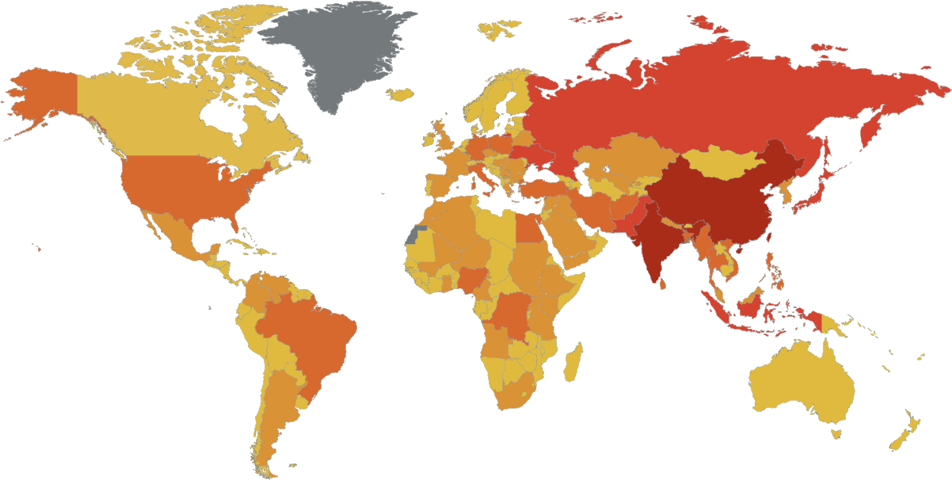
Deaths Attributable to Ambient Air Pollution
Deaths Per Year
0 – 4,999
5,000 – 19,999
20,000 – 49,999
50,000 – 149,999
> 150,000
Data: World Health Organization, 2016
Notes:
ID #3706.B - Can be used in noncommercial online and TV broadcasts of your presentation, but not modified.
Air pollution kills nine million people a year, and the same burning of fossil fuels that creates the global warming pollution also creates the particulates that causes more lung diseases and heart diseases.
DESCRIPTION: Map of deaths attributable to ambient air pollution with countries colored by the number of deaths per year
ADDITIONAL TALKING POINTS:
Pollution from extracting and burning fossil fuels isn’t only driving the climate crisis – it’s also creating a public and environmental health crisis worldwide.
Burning fossil fuels releases deadly pollution into the air.
Air pollution – such as that produced from burning fossil fuels like coal and oil – can expose people to small particulate matter of 2.5 microns or less in diameter (PM2.5). These particles can penetrate the lung barrier and enter the blood system, resulting in cardiovascular and respiratory diseases, and cancers.[1*]
Ambient outdoor air pollution kills millions of people every year.[1*]
In 2016, around 58 percent of deaths from ambient air pollution were due to ischaemic heart disease and strokes. Another 18 percent were due to chronic obstructive pulmonary disease, 18 percent were due to acute lower respiratory infections, and 6 percent were due to lung cancer.[1*]
Additionally, indoor smoke is a serious health risk for some 3 billion people who use biomass, kerosene fuels, and coal for cooking or for heating their homes.[1*]
People with pre-existing medical conditions are worse off. For example, chronic obstructive pulmonary disease (COPD) patients are especially sensitive to changes in ambient air quality associated with climate change.[2*]
Among the many byproducts of coal combustion is mercury, a potent neurotoxin that can bioaccumulate and biomagnify in organic tissue. Consuming contaminated fish, for example, can seriously harm both people and wildlife.[3*]
Fossil fuel pollution also impacts the water and land.
Coal mining operations can contaminate nearby rivers, lakes, and aquifers with heavy metals like arsenic, copper, and lead. One common technique, mountain top removal, requires clearcutting forests and vegetation before using explosives to blast away the tops of mountains, with the resulting debris typically dumped into the valleys below.[4*]
Before being burned, coal is washed with water and chemicals to remove impurities, producing a coal slurry that must be stored, either with coal ash or in improvised ponds that can leak, spill, or fail.[4*]
In 2000, the bottom of a Kentucky coal slurry impoundment gave way, contaminating more than a hundred miles of rivers and streams with more than 300,000,000 gallons of thick black sludge – a spill 30 times larger than the Exxon-Valdez oil spill.[4*]
Hydraulic fracturing (or “fracking”) is a drilling technique for extracting oil or natural gas by injecting huge quantities of water, chemicals, and sand deep underground, the hazardous consequences of which may include contaminating drinking water supplies and triggering small earthquakes.[5*]
Oil spills, such as from the Deepwater Horizon offshore oil rig in 2010, are devastating environmental disasters with long-lasting effects to the landscape, native species, and inhabitants who depend on the area.[6*]
While pollution is a threat to common resources, some people are disproportionately impacted.
Around the world, poor people are the most affected by air pollution.[7*]
As of 2016, more than 90 percent of air pollution-related deaths occurred in low- and middle-income countries.[1*]
In the United States, due to historical racism and economic inequality, minority and poor communities are most affected by air pollution: Black Americans have a 54 percent higher health burden compared to the overall population; non-White communities overall have a 28 percent higher health burden; and those living below the poverty line have a 35 percent higher burden.[8*]
The biggest polluters, including hazardous waste treatment, storage, and disposal plants, in the US are overwhelmingly located in poor, non-White areas.[9*]
Residents of Louisiana’s “Cancer Alley” – home to about 150 fossil fuel and petrochemical facilities – are about 50 times more likely to get cancer than the average American.[10*]
Fossil fuel pollution is changing our climate – and climate change is making the public health impacts of COVID-19 worse.
While there is no evidence of climate change directly contributing to the emergence of COVID-19, climate change can indirectly affect the larger COVID-19 response due to its impacts on public health and stress on health systems.[11*]
People living with poor air quality – especially those most vulnerable, like the homeless, people with homes lacking air filtration, or people with compromised health – are more likely to die from COVID-19, just as research shows that people exposed to more air pollution and who smoke fare worse with respiratory infections.[12*]
Due to longstanding racist housing policies and practices and other systemic inequalities, communities of color in the US are more likely to live with higher rates of pollution and be at higher risk of getting COVID-19 or contracting severe illness.[13*]
COVID-19 may affect planning and preparing for hurricanes and other natural disasters, as well as recovery efforts, due to the strained medical and personal hygiene resources and difficulty maintaining physical distancing in public shelters.[14*]
REFERENCES:
[1*] World Health Organization, "Ambient (outdoor) air pollution," May 2, 2018. https://www.who.int/news-room/fact-sheets/detail/ambient-(outdoor)-air-quality-and-health
[2*] John Balbus, et al., “Climate and Health Assessment Chapter 1: Climate Change and Human Health,” (The US Global Change Research Program, 2016). https://health2016.globalchange.gov/climate-change-and-human-health
[3*] US Geological Survey, "Mercury," last accessed July 2020. https://usgs.gov/mission-areas/water-resources/science/mercury?qt-science_center_objects=0#qt-science_center_objects
[4*] Union of Concern Scientists, "Coal and Water Pollution," December 6, 2017. https://www.ucsusa.org/resources/coal-and-water-pollution
[5*] Marc Lallanilla, "Facts About Fracking," Live Science, February 10, 2018. https://www.livescience.com/34464-what-is-fracking.html
[6*] US Geological Survey, "Large Oil Spills," last accessed July 2020. https://www.usgs.gov/mission-areas/water-resources/science/large-oil-spills
[7*] UN Environment, “Air pollution hurts the poorest most,” May 9, 2019. https://www.unenvironment.org/news-and-stories/story/air-pollution-hurts-poorest-most
[8*] Miranda Green, “EPA scientists find black communities disproportionately hit by pollution,” The Hill, February 23, 2018. https://thehill.com/policy/energy-environment/375289-epa-scientists-find-emissions-greater-impact-low-income-communities
[9*] Erik Sherman, “If You’re a Minority and Poor, You’re More Likely to Live Near a Toxic Waste Site,” Fortune, February 4, 2016. https://fortune.com/2016/02/04/environmental-race-poverty-flint/
[10*] James Pasley, “Inside Louisiana’s horrifying ‘Cancer Alley,’ an 85-mile stretch of pollution and environmental racism that’s now dealing with some of the highest coronavirus death rates in the country,” Business Insider, April 9, 2020. https://www.businessinsider.com/louisiana-cancer-alley-photos-oil-refineries-chemicals-pollution-2019-11#to-get-an-idea-of-the-toxicity-people-living-in-reserve-louisiana-are-50-times-more-likely-to-get-cancer-than-an-average-american-3
[11*] World Health Organization, "Q&A: Climate change and COVID-19," April 22, 2020. https://www.who.int/news-room/q-a-detail/q-a-on-climate-change-and-covid-19
[12*] Harvard T.H. Chan School of Public Health, "Coronavirus and Climate Change," last accessed July 2020. https://www.hsph.harvard.edu/c-change/subtopics/coronavirus-and-climate-change/
[13*] Center for Disease Control, “COVID-19 in Racial and Ethnic Minority Groups,” June 25, 2020. https://www.cdc.gov/coronavirus/2019-ncov/need-extra-precautions/racial-ethnic-minorities.html
[14*] US Centers for Disease Control and Prevention, "Natural Disasters, Severe Weather, and COVID-19," last updated July 1, 2020. https://www.cdc.gov/disasters/covid-19/disasters_severe_weather_and_covid-19.html
SLIDE SOURCE(S): apps.who.int/iris/bitstream/handle/10665/250141/9789241511353-eng.pdf?sequence=1

Slide 42
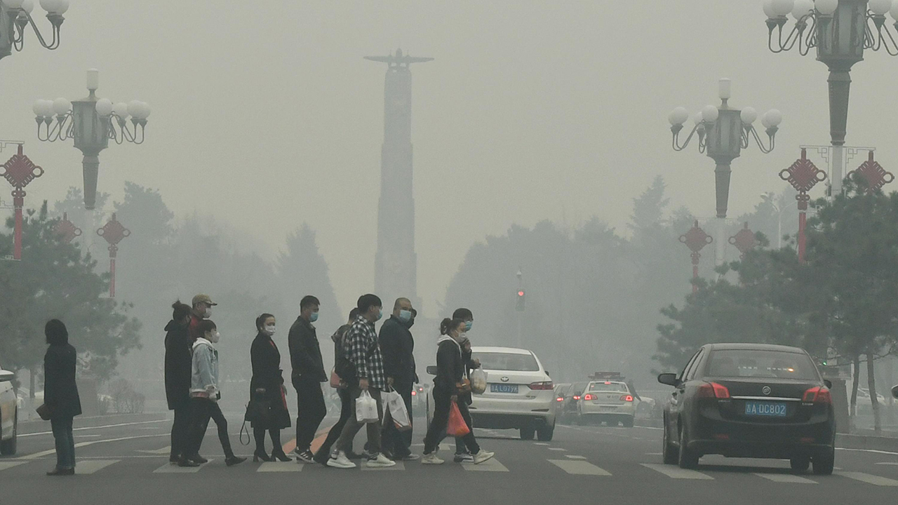
Changchun, Jilin Province, China
April 15, 2020
A study of 324 cities in China found a 15 – 22% increase in COVID-19 cases in areas with elevated levels of NO2 and PM 2.5 particulate pollution.
Photo © 2020 Marco Bertorello/AFP via Getty Images
Notes:
ID #6685 - May be live-streamed, broadcast, and presented in-person, but may not be recorded or modified.
It also makes people more vulnerable to the COVID-19 pandemic all over the world. More air pollution, a higher death rate from COVID-19.
DESCRIPTION: Photo of people wearing face masks walking through smog in Changchun, Jilin Province, China on April 15, 2020 with text stating that a study of 324 cities in China found a 15 – 22 percent increase in COVID-19 cases in areas with elevated levels of NO2 and PM 2.5 particulate pollution
ADDITIONAL TALKING POINTS:
Pollution from extracting and burning fossil fuels isn’t only driving the climate crisis – it’s also creating a public and environmental health crisis worldwide.
Burning fossil fuels releases deadly pollution into the air.
Air pollution – such as that produced from burning fossil fuels like coal and oil – can expose people to small particulate matter of 2.5 microns or less in diameter (PM2.5). These particles can penetrate the lung barrier and enter the blood system, resulting in cardiovascular and respiratory diseases, and cancers.[1*]
Ambient outdoor air pollution kills millions of people every year.[1*]
In 2016, around 58 percent of deaths from ambient air pollution were due to ischaemic heart disease and strokes. Another 18 percent were due to chronic obstructive pulmonary disease, 18 percent were due to acute lower respiratory infections, and 6 percent were due to lung cancer.[1*]
Additionally, indoor smoke is a serious health risk for some 3 billion people who use biomass, kerosene fuels, and coal for cooking or for heating their homes.[1*]
People with pre-existing medical conditions are worse off. For example, chronic obstructive pulmonary disease (COPD) patients are especially sensitive to changes in ambient air quality associated with climate change.[2*]
Among the many byproducts of coal combustion is mercury, a potent neurotoxin that can bioaccumulate and biomagnify in organic tissue. Consuming contaminated fish, for example, can seriously harm both people and wildlife.[3*]
Fossil fuel pollution also impacts the water and land.
Coal mining operations can contaminate nearby rivers, lakes, and aquifers with heavy metals like arsenic, copper, and lead. One common technique, mountain top removal, requires clearcutting forests and vegetation before using explosives to blast away the tops of mountains, with the resulting debris typically dumped into the valleys below.[4*]
Before being burned, coal is washed with water and chemicals to remove impurities, producing a coal slurry that must be stored, either with coal ash or in improvised ponds that can leak, spill, or fail.[4*]
In 2000, the bottom of a Kentucky coal slurry impoundment gave way, contaminating more than a hundred miles of rivers and streams with more than 300,000,000 gallons of thick black sludge – a spill 30 times larger than the Exxon-Valdez oil spill.[4*]
Hydraulic fracturing (or “fracking”) is a drilling technique for extracting oil or natural gas by injecting huge quantities of water, chemicals, and sand deep underground, the hazardous consequences of which may include contaminating drinking water supplies and triggering small earthquakes.[5*]
Oil spills, such as from the Deepwater Horizon offshore oil rig in 2010, are devastating environmental disasters with long-lasting effects to the landscape, native species, and inhabitants who depend on the area.[6*]
While pollution is a threat to common resources, some people are disproportionately impacted.
Around the world, poor people are the most affected by air pollution.[7*]
As of 2016, more than 90 percent of air pollution-related deaths occurred in low- and middle-income countries.[1*]
In the United States, due to historical racism and economic inequality, minority and poor communities are most affected by air pollution: Black Americans have a 54 percent higher health burden compared to the overall population; non-White communities overall have a 28 percent higher health burden; and those living below the poverty line have a 35 percent higher burden.[8*]
The biggest polluters, including hazardous waste treatment, storage, and disposal plants, in the US are overwhelmingly located in poor, non-White areas.[9*]
Residents of Louisiana’s “Cancer Alley” – home to about 150 fossil fuel and petrochemical facilities – are about 50 times more likely to get cancer than the average American.[10*]
Fossil fuel pollution is changing our climate – and climate change is making the public health impacts of COVID-19 worse.
While there is no evidence of climate change directly contributing to the emergence of COVID-19, climate change can indirectly affect the larger COVID-19 response due to its impacts on public health and stress on health systems.[11*]
People living with poor air quality – especially those most vulnerable, like the homeless, people with homes lacking air filtration, or people with compromised health – are more likely to die from COVID-19, just as research shows that people exposed to more air pollution and who smoke fare worse with respiratory infections.[12*]
Due to longstanding racist housing policies and practices and other systemic inequalities, communities of color in the US are more likely to live with higher rates of pollution and be at higher risk of getting COVID-19 or contracting severe illness.[13*]
COVID-19 may affect planning and preparing for hurricanes and other natural disasters, as well as recovery efforts, due to the strained medical and personal hygiene resources and difficulty maintaining physical distancing in public shelters.[14*]
REFERENCES:
[1*] World Health Organization, "Ambient (outdoor) air pollution," May 2, 2018. https://www.who.int/news-room/fact-sheets/detail/ambient-(outdoor)-air-quality-and-health
[2*] John Balbus, et al., “Climate and Health Assessment Chapter 1: Climate Change and Human Health,” (The US Global Change Research Program, 2016). https://health2016.globalchange.gov/climate-change-and-human-health
[3*] US Geological Survey, "Mercury," last accessed July 2020. https://usgs.gov/mission-areas/water-resources/science/mercury?qt-science_center_objects=0#qt-science_center_objects
[4*] Union of Concern Scientists, "Coal and Water Pollution," December 6, 2017. https://www.ucsusa.org/resources/coal-and-water-pollution
[5*] Marc Lallanilla, "Facts About Fracking," Live Science, February 10, 2018. https://www.livescience.com/34464-what-is-fracking.html
[6*] US Geological Survey, "Large Oil Spills," last accessed July 2020. https://www.usgs.gov/mission-areas/water-resources/science/large-oil-spills
[7*] UN Environment, “Air pollution hurts the poorest most,” May 9, 2019. https://www.unenvironment.org/news-and-stories/story/air-pollution-hurts-poorest-most
[8*] Miranda Green, “EPA scientists find black communities disproportionately hit by pollution,” The Hill, February 23, 2018. https://thehill.com/policy/energy-environment/375289-epa-scientists-find-emissions-greater-impact-low-income-communities
[9*] Erik Sherman, “If You’re a Minority and Poor, You’re More Likely to Live Near a Toxic Waste Site,” Fortune, February 4, 2016. https://fortune.com/2016/02/04/environmental-race-poverty-flint/
[10*] James Pasley, “Inside Louisiana’s horrifying ‘Cancer Alley,’ an 85-mile stretch of pollution and environmental racism that’s now dealing with some of the highest coronavirus death rates in the country,” Business Insider, April 9, 2020. https://www.businessinsider.com/louisiana-cancer-alley-photos-oil-refineries-chemicals-pollution-2019-11#to-get-an-idea-of-the-toxicity-people-living-in-reserve-louisiana-are-50-times-more-likely-to-get-cancer-than-an-average-american-3
[11*] World Health Organization, "Q&A: Climate change and COVID-19," April 22, 2020. https://www.who.int/news-room/q-a-detail/q-a-on-climate-change-and-covid-19
[12*] Harvard T.H. Chan School of Public Health, "Coronavirus and Climate Change," last accessed July 2020. https://www.hsph.harvard.edu/c-change/subtopics/coronavirus-and-climate-change/
[13*] Center for Disease Control, “COVID-19 in Racial and Ethnic Minority Groups,” June 25, 2020. https://www.cdc.gov/coronavirus/2019-ncov/need-extra-precautions/racial-ethnic-minorities.html
[14*] US Centers for Disease Control and Prevention, "Natural Disasters, Severe Weather, and COVID-19," last updated July 1, 2020. https://www.cdc.gov/disasters/covid-19/disasters_severe_weather_and_covid-19.html
SLIDE SOURCE(S): https://www.medrxiv.org/content/10.1101/2020.04.21.20073700v1

Slide 43
U.S. COVID-19 Deaths, by Race
Through June 23, 2020
The death rate for Black Americans from COVID-19 is more than twice that white Americans.
Deaths per 100,000 People
Data: APM Research Lab, June 2020
Notes:
ID #6608 - Can be used in noncommercial online and TV broadcasts of your presentation, but not modified.
And again, we see this pattern show up worse among minority populations and poor populations. Black Americans are dying at a rate more than twice as high as white Americans from COVID-19; many reasons, but the climate crisis is one of the principal ones.
DESCRIPTION: Graph of COVID-19 death rates by race through June 24, 2020 with text stating that the death rate for Black Americans from COVID-19 is more than twice that white Americans
ADDITIONAL TALKING POINTS:
Pollution from extracting and burning fossil fuels isn’t only driving the climate crisis – it’s also creating a public and environmental health crisis worldwide.
Burning fossil fuels releases deadly pollution into the air.
Air pollution – such as that produced from burning fossil fuels like coal and oil – can expose people to small particulate matter of 2.5 microns or less in diameter (PM2.5). These particles can penetrate the lung barrier and enter the blood system, resulting in cardiovascular and respiratory diseases, and cancers.[1*]
Ambient outdoor air pollution kills millions of people every year.[1*]
In 2016, around 58 percent of deaths from ambient air pollution were due to ischaemic heart disease and strokes. Another 18 percent were due to chronic obstructive pulmonary disease, 18 percent were due to acute lower respiratory infections, and 6 percent were due to lung cancer.[1*]
Additionally, indoor smoke is a serious health risk for some 3 billion people who use biomass, kerosene fuels, and coal for cooking or for heating their homes.[1*]
People with pre-existing medical conditions are worse off. For example, chronic obstructive pulmonary disease (COPD) patients are especially sensitive to changes in ambient air quality associated with climate change.[2*]
Among the many byproducts of coal combustion is mercury, a potent neurotoxin that can bioaccumulate and biomagnify in organic tissue. Consuming contaminated fish, for example, can seriously harm both people and wildlife.[3*]
Fossil fuel pollution also impacts the water and land.
Coal mining operations can contaminate nearby rivers, lakes, and aquifers with heavy metals like arsenic, copper, and lead. One common technique, mountain top removal, requires clearcutting forests and vegetation before using explosives to blast away the tops of mountains, with the resulting debris typically dumped into the valleys below.[4*]
Before being burned, coal is washed with water and chemicals to remove impurities, producing a coal slurry that must be stored, either with coal ash or in improvised ponds that can leak, spill, or fail.[4*]
In 2000, the bottom of a Kentucky coal slurry impoundment gave way, contaminating more than a hundred miles of rivers and streams with more than 300,000,000 gallons of thick black sludge – a spill 30 times larger than the Exxon-Valdez oil spill.[4*]
Hydraulic fracturing (or “fracking”) is a drilling technique for extracting oil or natural gas by injecting huge quantities of water, chemicals, and sand deep underground, the hazardous consequences of which may include contaminating drinking water supplies and triggering small earthquakes.[5*]
Oil spills, such as from the Deepwater Horizon offshore oil rig in 2010, are devastating environmental disasters with long-lasting effects to the landscape, native species, and inhabitants who depend on the area.[6*]
While pollution is a threat to common resources, some people are disproportionately impacted.
Around the world, poor people are the most affected by air pollution.[7*]
As of 2016, more than 90 percent of air pollution-related deaths occurred in low- and middle-income countries.[1*]
In the United States, due to historical racism and economic inequality, minority and poor communities are most affected by air pollution: Black Americans have a 54 percent higher health burden compared to the overall population; non-White communities overall have a 28 percent higher health burden; and those living below the poverty line have a 35 percent higher burden.[8*]
The biggest polluters, including hazardous waste treatment, storage, and disposal plants, in the US are overwhelmingly located in poor, non-White areas.[9*]
Residents of Louisiana’s “Cancer Alley” – home to about 150 fossil fuel and petrochemical facilities – are about 50 times more likely to get cancer than the average American.[10*]
Fossil fuel pollution is changing our climate – and climate change is making the public health impacts of COVID-19 worse.
While there is no evidence of climate change directly contributing to the emergence of COVID-19, climate change can indirectly affect the larger COVID-19 response due to its impacts on public health and stress on health systems.[11*]
People living with poor air quality – especially those most vulnerable, like the homeless, people with homes lacking air filtration, or people with compromised health – are more likely to die from COVID-19, just as research shows that people exposed to more air pollution and who smoke fare worse with respiratory infections.[12*]
Due to longstanding racist housing policies and practices and other systemic inequalities, communities of color in the US are more likely to live with higher rates of pollution and be at higher risk of getting COVID-19 or contracting severe illness.[13*]
COVID-19 may affect planning and preparing for hurricanes and other natural disasters, as well as recovery efforts, due to the strained medical and personal hygiene resources and difficulty maintaining physical distancing in public shelters.[14*]
REFERENCES:
[1*] World Health Organization, "Ambient (outdoor) air pollution," May 2, 2018. https://www.who.int/news-room/fact-sheets/detail/ambient-(outdoor)-air-quality-and-health
[2*] John Balbus, et al., “Climate and Health Assessment Chapter 1: Climate Change and Human Health,” (The US Global Change Research Program, 2016). https://health2016.globalchange.gov/climate-change-and-human-health
[3*] US Geological Survey, "Mercury," last accessed July 2020. https://usgs.gov/mission-areas/water-resources/science/mercury?qt-science_center_objects=0#qt-science_center_objects
[4*] Union of Concern Scientists, "Coal and Water Pollution," December 6, 2017. https://www.ucsusa.org/resources/coal-and-water-pollution
[5*] Marc Lallanilla, "Facts About Fracking," Live Science, February 10, 2018. https://www.livescience.com/34464-what-is-fracking.html
[6*] US Geological Survey, "Large Oil Spills," last accessed July 2020. https://www.usgs.gov/mission-areas/water-resources/science/large-oil-spills
[7*] UN Environment, “Air pollution hurts the poorest most,” May 9, 2019. https://www.unenvironment.org/news-and-stories/story/air-pollution-hurts-poorest-most
[8*] Miranda Green, “EPA scientists find black communities disproportionately hit by pollution,” The Hill, February 23, 2018. https://thehill.com/policy/energy-environment/375289-epa-scientists-find-emissions-greater-impact-low-income-communities
[9*] Erik Sherman, “If You’re a Minority and Poor, You’re More Likely to Live Near a Toxic Waste Site,” Fortune, February 4, 2016. https://fortune.com/2016/02/04/environmental-race-poverty-flint/
[10*] James Pasley, “Inside Louisiana’s horrifying ‘Cancer Alley,’ an 85-mile stretch of pollution and environmental racism that’s now dealing with some of the highest coronavirus death rates in the country,” Business Insider, April 9, 2020. https://www.businessinsider.com/louisiana-cancer-alley-photos-oil-refineries-chemicals-pollution-2019-11#to-get-an-idea-of-the-toxicity-people-living-in-reserve-louisiana-are-50-times-more-likely-to-get-cancer-than-an-average-american-3
[11*] World Health Organization, "Q&A: Climate change and COVID-19," April 22, 2020. https://www.who.int/news-room/q-a-detail/q-a-on-climate-change-and-covid-19
[12*] Harvard T.H. Chan School of Public Health, "Coronavirus and Climate Change," last accessed July 2020. https://www.hsph.harvard.edu/c-change/subtopics/coronavirus-and-climate-change/
[13*] Center for Disease Control, “COVID-19 in Racial and Ethnic Minority Groups,” June 25, 2020. https://www.cdc.gov/coronavirus/2019-ncov/need-extra-precautions/racial-ethnic-minorities.html
[14*] US Centers for Disease Control and Prevention, "Natural Disasters, Severe Weather, and COVID-19," last updated July 1, 2020. https://www.cdc.gov/disasters/covid-19/disasters_severe_weather_and_covid-19.html
SLIDE SOURCE(S): https://www.apmresearchlab.org/covid/deaths-by-race

Slide 44
We now risk losing up to
50% of all
land-based species
in this century
Source: Nicholas Stern, The Economics of Climate Change
Photo: © Dirk Ercken/Shutterstock
Notes:
ID #3711.B - Can be used in noncommercial online and TV broadcasts of your presentation, but not modified.
Not just people are affected. We're in danger of losing half of all the living species on this Earth in this century.
DESCRIPTION: Photo of a Golden Poison Frog with text stating that we now risk losing up to 50 percent of all land-based species in this century about the land-based species extinction threat in the twenty first-century
ADDITIONAL TALKING POINTS: Climate change – alongside factors like land degradation and habitat loss – is threatening the existence of species all around the world.
Experts predict that if the current rate of warming persists, by 2050, one-half of all plant and animal species will be threatened with extinction.[1*]
According to a 2015 report by the World Wildlife Fund (WWF), marine vertebrate populations declined 49 percent between 1970 and 2012.[2*]
WWF’s report found that human activity is the primary driver of this decline: from over-exploiting fisheries and damaging marine habitats to climate change.[2*]
Rising temperatures disrupt natural reproduction in some animals – with profound consequences.
Many species of reptiles – such as crocodilians, some freshwater turtles, and all species of sea turtles – have their gender determined by incubation temperature during embryonic development (while in their eggs).[3*]
For example, sea turtle eggs exposed to warmer temperatures produce female offspring – and under future climate scenarios, temperatures could be high enough to hatch only female sea turtles by 2100.[3*]
The lack of male turtles will eventually impact the overall fertility of the species, which could lead to population collapse or even extinction.[3*]
Climate change also disrupts how bees pollinate plants, threatening both plant species and human agriculture worldwide.
The complexity of plant-pollinator relationships relies on stable climatic cues for precise timing and synchrony.[4*]
About 35 percent of crop species worldwide depend on or benefit from pollinators, like honey bees.[4*]
Climate change is disturbing this delicate relationship.[5*]
According to a recent study, for every 1 degree Celsius (1.8 degrees Fahrenheit) rise in spring temperature, the peak flying dates of male and female bees came 9.2 and 15.6 days, respectively, earlier in the year.[5*]
Disrupting peak flying dates throws off pollination cycles for plants like orchids that rely on male and female flowers each emerging at the right time.[5*]
Climate change is shifting where species live much faster than previously thought.
According to a study of the changing ranges of different species, climate change is pushing land-based plant and animal species to higher elevations and toward the poles.[6*]
Species are moving to higher elevations at a median rate of 11.0 meters (36.1 feet) per decade, and to higher latitudes at a median rate of 16.9 kilometers (10.5 miles) per decade.[6*]
How far and high different species will move on average varies greatly and depends on many factors.[6*]
Studies showing the highest levels of warming also show species migrating the greatest distances.[6*]
REFERENCES:
[1*] James O’Hare, “Half of the Species on Earth Could Go Extinct by 2050, Scientists Say,” Global Citizen, February 27, 2017. https://www.globalcitizen.org/en/content/half-earths-species-extinct-2050/
[2*] John Tanzer (Ed.) et al., “Living Blue Planet Report – Species, habitats and human well-being,” World Wildlife Fund (August 2015). https://c402277.ssl.cf1.rackcdn.com/publications/817/files/original/Living_Blue_Planet_Report_2015_Final_LR.pdf?1442242821
[3*] Jensen, M., et al., “Environmental Warming and Feminization of One of the Largest Sea Turtle Populations in the World,” Current Biology, Volume 28, Issue 1 (January 2018). http://www.cell.com/current-biology/fulltext/S0960-9822(17)31539-7
[4*] Amy E Boyd, “Timing, Pollinators, and the Impact of Climate Change,” Union of Concerned Scientists, July 7, 2017. https://blog.ucsusa.org/science-blogger/timing-pollinators-and-the-impact-of-climate-change
[5*] University of Sussex, "Climate change is wreaking havoc on delicate relationship between orchids and bees," ScienceDaily, April 6, 2018. www.sciencedaily.com/releases/2018/04/180406085510.htm
[6*] I-Ching Chen, et al., “Rapid Range Shifts of Species Associated with High Levels of Climate Warming,” Science 333, no. 6045 (August 19, 2011): 1024-1026.
http://science.sciencemag.org/content/333/6045/1024
SLIDE SOURCE(S): https://www.theguardian.com/environment/2017/feb/25/half-all-species-extinct-end-century-vatican-conference

Slide 45
The Cost of Carbon
Political Instability
Species Extinction
Floods & Mudslides
Melting Glaciers
$
$
$
$
$
$
Wildfires
Famine
Drought
Water Scarcity
Storm Damage
Ecosystem Loss
Ocean Acidification
Our Way of Life
Infrastructure Loss
Infectious Diseases
Climate Refugees
Sea Level Rise
… And much, much more
“The #1 Threat to the Global Economy”
© 2005 iStockphoto/themoog
Notes:
ID #3723 - Can be used in noncommercial online and TV broadcasts of your presentation, but not modified.
So, when you add up all of these costs, and we haven't even talked about ocean acidification or infrastructure, or some of these others, I will add one more: It's the number one threat to the global economy. Fourth year in a row it's been designated as such.
DESCRIPTION: Animated slide covering the various costs of carbon, including, but not limited to: political instability, drought, famine, sea level rise, ocean acidification, water scarcity, climate refugees, storm damage, floods and mudslides, infectious diseases, wildfires, melting glaciers, ecosystem loss, species extinction, infrastructure loss, and our way of life
ADDITIONAL TALKING POINTS:
To meet the goals of the Paris Agreement, approximately half of gas reserves and more than 80 percent of proven coal reserves must stay in the ground.[1*]
The Social Cost of Carbon.[2*]
Mining, drilling, and burning fossil fuels like coal, oil, and natural gas are harming our environment and our health. We see the cost of carbon clearly in devastating impacts from extreme weather events like flooding and deadly storms to fast-spreading diseases to rising seas to ecosystem loss. What we don’t always see are the costs of the lingering aftermath and recovery from these disasters, such as increased health care expenses, destruction of property, increased food prices, and more.
The current estimate of the social cost of carbon is roughly $50 per ton, which many experts argue is far lower than the true cost of carbon pollution.
As the world moves fast to a low-carbon economy, investments in fossil fuels reaching into the trillions will become lost as stranded assets.
According to a 2018 study, up to $4 trillion worth of fossil fuel assets could be wiped off the global economy due to changes in technology, markets, and social habits.[1*]
Furthermore, there is a reputational risk for investors that their investment is not in line with global climate goals, which is a growing concern among many institutional investors around the world.[3*]
The CEO of the Colombian coal giant, Cerrejon, agrees that the coal industry is in terminal decline and prices continue to plunge.[4*]
Global investments in fossil fuels continued to rise in recent years, despite many of the world’s most prominent investors divesting from fossil fuels.
The International Energy Agency’s World Energy Investment 2020 report estimates that clean energy investment has been relatively resilient in the 2020 economic downturn. However, investments in renewables have been stagnant since 2015 and are far from the level needed for emissions reductions.[5*]
The energy return on investment (how much energy a source will produce compared to how much energy it takes to extract or develop the source) for fossil fuels is getting lower and lower, especially as easily accessible fossil fuel resources become exhausted. On the other hand, as renewable infrastructure is built out, the energy return on investment for renewable sources will likely increase, further building the case for increasing investment in renewables.[6*]
As of early 2020, nearly 1,200 institutions across world, representing over $14 trillion in assets under management, have pledged to divest from their investments in coal, oil, and gas companies.[7*]
REFERENCES:
[1*] Joel Makower, “The growing concern over stranded assets,” GreenBiz, September 10, 2019. https://www.greenbiz.com/article/growing-concern-over-stranded-assets
[2*] Environmental Defense Fund, “The true cost of carbon pollution,” last accessed July 7, 2020. https://www.edf.org/true-cost-carbon-pollution
[3*] Bill McKibben, “At last, divestment is hitting the fossil fuel industry where it hurts,” The Guardian, December 16, 2018. https://www.theguardian.com/commentisfree/2018/dec/16/divestment-fossil-fuel-industry-trillions-dollars-investments-carbon
[4*] Matthew Bristow, “One Coal CEO Sees Writing on Wall, Says Make Money While You Can,” Bloomberg, August 9, 2019. https://www.bloomberg.com/news/articles/2019-08-09/one-coal-ceo-sees-writing-on-wall-says-make-money-while-you-can
[5*] International Energy Agency, “World Energy Investment 2020,” May, 2020. https://www.iea.org/reports/world-energy-investment-2020
[6*] University of Leeds, "Fossil fuels increasingly offer a poor return on energy investment," July 11, 2019. https://www.sciencedaily.com/releases/2019/07/190711114846.htm
[7*] Fossil Free Divestment, “1000+ Divestment Commitments,” last accessed July, 2020. https://gofossilfree.org/divestment/commitments/
SLIDE SOURCE(S): https://www.weforum.org/reports/the-global-risks-report-2019

Slide 46
We have
the solutions
at hand...
Notes:
ID #1630 - Can be used in noncommercial online and TV broadcasts of your presentation, but not modified.
Well, luckily the answer to that question is yes, too, because we have the solutions at hand.
DESCRIPTION: Text slide stating that we have solutions to the climate crisis at hand

Slide 47
Global Wind Energy Capacity
1980 – Present
Wind Capacity (Megawatts)
2019
Data: Earth Policy Institute/Bloomberg New Energy Finance
Notes:
ID #3089.F - Can be used in noncommercial online and TV broadcasts of your presentation, but not modified.
…
DESCRIPTION: Graph showing the growth of global wind energy capacity in megawatts, 1980 - 2019
ADDITIONAL TALKING POINTS:
With demand for electricity growing and the climate crisis deepening, the world needs a viable, cost-competitive replacement for dirty fossil fuels. Wind energy can be an excellent alternative, powering our lives without destroying our planet.
Wind energy has the potential to supply the world’s electricity needs 40 times over.[1*]
Global wind capacity reached almost 650 GW in 2019[2*]. Wind capacity is expected to quadruple by 2040, relative to 2017 , with $3.3 trillion in investments.[3*]
Wind and solar are the cheapest sources of electricity generation for people across more than two-thirds of the world as of 2019.[4*]
In 2000, the International Energy Agency projected global wind capacity would only reach 30 GW by 2010. Instead in 2010, it reached 200 GW, overshooting projections by over 660 percent.[5*]
Global offshore wind markets are surging, and turbines are growing more powerful.
Global offshore wind is expected to grow dramatically, with projections showing the potential for up to a 15-fold increase in capacity and around $1 trillion of cumulative investment by 2040.[6*]
Offshore turbines are experiencing an arms race, with individual turbines getting larger. One rotation of a Vestas 8.8 MW wind turbine is enough to power the average home in the United Kingdom for an entire day and next generation turbines are expected to be even larger at 12–15 MW.[7*]
Expanding wind energy will help bring abundant and affordable clean energy and good jobs to people across the globe for years to come.
Employment in wind power, primarily onshore projects, supports 1.2 million jobs around the world. China is the largest employer (44 percent of total jobs). In the US, wind employment grew 8 percent in 2018. Now, wind employs 114,000 Americans in total.[8*]
Global employment in the industry is expected to grow significantly from 1.16 million jobs in 2018 to over 3.7 million jobs in 2030 and more than 6 million in 2050.[9*]
The US wind industry hires veterans at a rate 67 percent higher than the national average. The industry also supports 24,000 manufacturing jobs at over 500 US factories.[10*]
Renewable energy also leads the field in equitable hiring, with women making up about 32 percent of the renewable workforce, compared to 22 percent in the energy sector overall.[11*]
Wind energy is a staple in the US and provides much-needed tax revenue to rural communities.
In 2019, the US added 9,143 MW of new wind capacity, enough to power over 3 million homes, and the wind industry had the third-strongest year on record.[12*]
Wind energy is taking off in the US, with another 44,000 MW of capacity under construction or in advanced development, representing over $62 billion in investment.[12*]
REFERENCES:
[1*] Xi Lua, Michael B. McElroy, and Juha Kiviluoma, “Global Potential for Wind-Generated Electricity,” Proceedings of the National Academy of Sciences of the United States of America 106, No. 27 (July 7, 2009): 10933-10938. http://www.pnas.org/content/106/27/10933.full.pdf
[2*] World Wind Energy Association, “World wind capacity at 650,8 GW, Corona crisis will slow down markets in 2020, renewables to be core of economic stimulus programmes,” April 16, 2020. https://wwindea.org/blog/2020/04/16/world-wind-capacity-at-650-gw/
[3*] Bloomberg New Energy Finance, “Global wind and solar costs to fall even faster, while coal fades even in China and India,” June 15, 2017. https://about.bnef.com/blog/global-wind-solar-costs-fall-even-faster-coal-fades-even-china-india/
[4*] Bloomberg New Energy Finance, “New Energy Outlook 2019,” (2019). https://bnef.turtl.co/story/neo2019?teaser=true
[5*] David Roberts, “Why do ‘experts’ always lowball clean energy projections?," Grist, July 9, 2012. http://grist.org/renewable-energy/experts-in-2000-lowballed-the-crap-out-of-renewable-energy-growth/
[6*] International Renewable Energy Agency, “Offshore wind to become a $1 trillion industry,” October 25, 2019. https://www.iea.org/news/offshore-wind-to-become-a-1-trillion-industry
[7*] Jason Deign, “Global Wind Market to Add 65 GW per Year to 2027,” GreenTechMedia, January 1, 2019. https://www.greentechmedia.com/articles/read/global-wind-market#gs.wtl6fv
[8*] International Renewable Energy Agency, “Renewable Energy and Jobs – Annual Review 2019,” (June 2019). https://www.irena.org/-/media/Files/IRENA/Agency/Publication/2019/Jun/IRENA_RE_Jobs_2019-report.pdf
[9*] International Renewable Energy Agency, “Future of wind: Deployment, investment, technology, grid integration and socio-economic aspects,” (October 2019). https://irena.org/-/media/Files/IRENA/Agency/Publication/2019/Oct/IRENA_Future_of_wind_2019.pdf
[10*] T&D World, “U.S. Wind Power Grows a Record 8% in 2018,” April 17, 2019. https://www.tdworld.com/renewables/us-wind-power-grows-record-8-2018
[11*] International Renewable Energy Agency, “Renewable Energy: A Gender Perspective,” (January 2019). https://www.irena.org/publications/2019/Jan/Renewable-Energy-A-Gender-Perspective
[12*] American Wind Energy Association, “Wind Industry Experiences Third Strongest Year on Record with 9,143 MW of Wind Power Added to U.S. Grid,” January 29, 2020. https://www.awea.org/resources/news/2020/wind-industry-experiences-third-strongest-year-on
SLIDE SOURCE(S): Bloomberg New Energy Finance

Slide 48
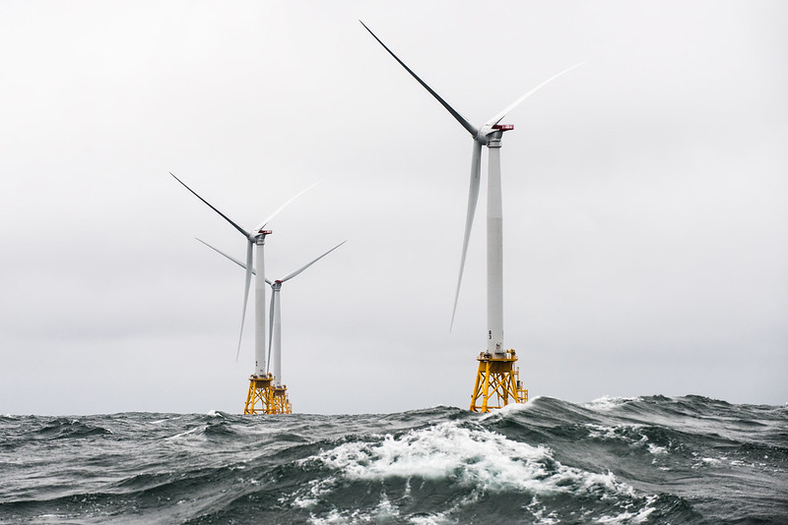
NJ has goal of 7,500 MW from offshore wind by 2035
Notes:
A number of world’s countries have demonstrated they can switch to 100% wind and solar. Read “NJ goal of 3500MW….”In fact, I read those offshore sites have potential for further future expansion by 3 or 4 times the wind power.

Slide 49
World Solar PV Installations
1980 – 2019
Gigawatts (Cumulative)
2019
Data: Earth Policy Institute/BP, Statistical Review of World Energy June 2014 (London: 2014); Bloomberg New Energy Finance
Notes:
ID #3733.G - Can be used in noncommercial online and TV broadcasts of your presentation, but not modified.
This exponential curve is even steeper than the one for wind and rising even faster, …
DESCRIPTION: Graph showing the worldwide growth of solar PV installations in gigawatts, 1980 - 2019
ADDITIONAL TALKING POINTS:
Solar capacity has grown exponentially in the past decade.
Solar technology has been around since the 1970s, but its capacity has grown significantly in recent years, driven by falling costs, continued government support, and technological innovation. There were more renewable solar installations in 2019 than fossil fuel and nuclear power additions combined, which occurred for the fifth year in a row. Solar energy accounted for 57 percent of this new renewable capacity.[1*]
Major greenhouse gas emitters like China, the United States, and India are taking the lead in installing large-scale solar photovoltaics (PV).[1*]
By the end of 2019, at least 39 countries had 1 GW or more of solar capacity, up from 31 in 2018.[1*]
Off-grid solar systems provide rural and off-grid communities with access to electricity. The market for off-grid solar systems grew 13 percent in 2019 – the highest growth of the past five years – with sales totaling 35 million units, up from 31 million units in 2018.[1*]
The cost of solar has dropped significantly in recent decades and the technology has tremendous potential to become even cheaper and more widespread in the future.
Globally, the cost of solar PV has fallen by 99 percent over the last four decades.[2*]
Solar prices have fallen to the point of cost competitiveness with conventional generation technologies (fossil fuels), even without government subsidies.[3*]
In a single hour, the Earth receives more solar energy than humans use in a full year.[4*] It’s just a matter of harnessing what we need.
In 2017, the average solar panel converted 17 percent of all solar energy to usable electricity. Projections show this conversion efficiency could grow to roughly 25 percent by 2027.[5*]
The US continues to ramp up solar investment and installations.
In 2019, solar accounted for nearly 40 percent of all new electricity capacity added in the US – the largest annual share in the industry’s history. The US market installed 13.3 GW of solar PV, which is a 23 percent increase from 2018.[6*]
US solar capacity now exceeds 76 GW, up 7,600 percent from just 1 GW at the end of 2009. Solar capacity is projected to more than double over the next five years, with annual installations reaching 20.4 GW in 2021.[6*]
Solar markets worldwide are blossoming
The Chilean government and the country's four largest electric utility companies reached a voluntary agreement to phase out their coal units by 2040. As solar grows cheaper, coal plants are phased out, and pro-solar government policies continue to be implemented, Chile will accelerate its progress on solar.[7*]
In 2018, Chile’s Installed solar capacity accounted for 9.8 percent of total power generation in 2018, up from only 0.06 percent in 2013.[7*]
Meanwhile, in India, declining costs of solar technologies and government policies that promote foreign investment into Indian markets have driven the rapid adoption of solar PV.[8*]
The pay-as-you-go (PayGo) solar power model allows electricity end-users to pay for their energy consumption and solar technology in small installments – thus avoiding any restrictive up-front investment.[9*]
In 2019, over 1.7 million households were using off-grid PayGo solar products in Sub Saharan Africa and Asia. That number is expected to continue rising rapidly due to its financial accessibility.[10*]
REFERENCES:
[1*] Renewable Energy Policy Network for the 21st Century, “Renewables 2020 Global Status Report,” (2020). https://www.ren21.net/wp-content/uploads/2019/05/gsr_2020_full_report_en.pdf
[2*] David Chandler, “Explaining the plummeting cost of solar power,” MIT News, November 20, 2018. http://news.mit.edu/2018/explaining-dropping-solar-cost-1120
[3*] Lazard, “Lazard's Levelized Cost Of Energy Analysis – Version 13.0,” (November 2019). https://www.lazard.com/media/451086/lazards-levelized-cost-of-energy-version-130-vf.pdf
[4*] Rebecca Harrington, “This incredible fact should get you psyched about solar power,” Business Insider, September 29, 2015. https://www.businessinsider.com/this-is-the-potential-of-solar-power-2015-9
[5*] Ricky Dunbar, “How Efficient Will Solar PV Be In The Future? 10-Year Predictions For The Industry,” Clean Technica, August 15, 2017. https://cleantechnica.com/2017/08/15/efficient-will-solar-pv-future-10-year-predictions-industry/
[6*] Solar Energy Industries Association, “Solar Market Insight Report 2019 Year In Review,” March 17, 2020. https://www.seia.org/research-resources/solar-market-insight-report-2019-year-review
[7*] Mordor Intelligence, “Chile Solar Energy Market – Growth, Trends, And Forecast (2020-2025),” (2019). https://www.mordorintelligence.com/industry-reports/chile-solar-energy-market
[8*] Mordor Intelligence, “India Solar Energy Market – Growth, Trends, And Forecast (2020-2025),” (2019). https://www.mordorintelligence.com/industry-reports/india-solar-energy-market
[9*] Marcus Wiemann and David Lecoque, “The weekend read: A bump in the road for pay-as-you-go solar and self-sustainability,” PV Magazine, October 19, 2019. https://www.pv-magazine.com/2019/10/19/the-weekend-read-a-bump-in-the-road-for-pay-as-you-go-solar-and-self-sustainability/
[10*] Yinka Adegoke, “Africa is facing an electricity crisis – a pay-as-you-go model could solve this problem,” World Economic Forum, July 4, 2019. https://www.weforum.org/agenda/2019/07/pay-as-you-go-africas-solar-energy/
SLIDE SOURCE(S): Bloomberg New Energy Finance

Slide 50
Cost of Crystalline Silicon Solar Cell Modules
1976
$79.40/watt
$ Cost per Watt (Inflation Adjusted)
2020
$0.20/watt
Data: Bloomberg New Energy Finance
Notes:
ID #3212.G - Can be used in noncommercial online and TV broadcasts of your presentation, but not modified.
… because the cost of renewable energy continues to come down dramatically.
DESCRIPTION: Graph showing the decline in cost of crystalline silicon solar cells in US dollars per watt (inflation adjusted), 1976 - 2020
ADDITIONAL TALKING POINTS:
Solar capacity has grown exponentially in the past decade.
Solar technology has been around since the 1970s, but its capacity has grown significantly in recent years, driven by falling costs, continued government support, and technological innovation. There were more renewable solar installations in 2019 than fossil fuel and nuclear power additions combined, which occurred for the fifth year in a row. Solar energy accounted for 57 percent of this new renewable capacity.[1*]
Major greenhouse gas emitters like China, the United States, and India are taking the lead in installing large-scale solar photovoltaics (PV).[1*]
By the end of 2019, at least 39 countries had 1 GW or more of solar capacity, up from 31 in 2018.[1*]
Off-grid solar systems provide rural and off-grid communities with access to electricity. The market for off-grid solar systems grew 13 percent in 2019 – the highest growth of the past five years – with sales totaling 35 million units, up from 31 million units in 2018.[1*]
The cost of solar has dropped significantly in recent decades and the technology has tremendous potential to become even cheaper and more widespread in the future.
Globally, the cost of solar PV has fallen by 99 percent over the last four decades.[2*]
Solar prices have fallen to the point of cost competitiveness with conventional generation technologies (fossil fuels), even without government subsidies.[3*]
In a single hour, the Earth receives more solar energy than humans use in a full year.[4*] It’s just a matter of harnessing what we need.
In 2017, the average solar panel converted 17 percent of all solar energy to usable electricity. Projections show this conversion efficiency could grow to roughly 25 percent by 2027.[5*]
The US continues to ramp up solar investment and installations.
In 2019, solar accounted for nearly 40 percent of all new electricity capacity added in the US – the largest annual share in the industry’s history. The US market installed 13.3 GW of solar PV, which is a 23 percent increase from 2018.[6*]
US solar capacity now exceeds 76 GW, up 7,600 percent from just 1 GW at the end of 2009. Solar capacity is projected to more than double over the next five years, with annual installations reaching 20.4 GW in 2021.[6*]
Solar markets worldwide are blossoming
The Chilean government and the country's four largest electric utility companies reached a voluntary agreement to phase out their coal units by 2040. As solar grows cheaper, coal plants are phased out, and pro-solar government policies continue to be implemented, Chile will accelerate its progress on solar.[7*]
In 2018, Chile’s Installed solar capacity accounted for 9.8 percent of total power generation in 2018, up from only 0.06 percent in 2013.[7*]
Meanwhile, in India, declining costs of solar technologies and government policies that promote foreign investment into Indian markets have driven the rapid adoption of solar PV.[8*]
The pay-as-you-go (PayGo) solar power model allows electricity end-users to pay for their energy consumption and solar technology in small installments – thus avoiding any restrictive up-front investment.[9*]
In 2019, over 1.7 million households were using off-grid PayGo solar products in Sub Saharan Africa and Asia. That number is expected to continue rising rapidly due to its financial accessibility.[10*]
REFERENCES:
[1*] Renewable Energy Policy Network for the 21st Century, “Renewables 2020 Global Status Report,” (2020). https://www.ren21.net/wp-content/uploads/2019/05/gsr_2020_full_report_en.pdf
[2*] David Chandler, “Explaining the plummeting cost of solar power,” MIT News, November 20, 2018. http://news.mit.edu/2018/explaining-dropping-solar-cost-1120
[3*] Lazard, “Lazard's Levelized Cost Of Energy Analysis – Version 13.0,” (November 2019). https://www.lazard.com/media/451086/lazards-levelized-cost-of-energy-version-130-vf.pdf
[4*] Rebecca Harrington, “This incredible fact should get you psyched about solar power,” Business Insider, September 29, 2015. https://www.businessinsider.com/this-is-the-potential-of-solar-power-2015-9
[5*] Ricky Dunbar, “How Efficient Will Solar PV Be In The Future? 10-Year Predictions For The Industry,” Clean Technica, August 15, 2017. https://cleantechnica.com/2017/08/15/efficient-will-solar-pv-future-10-year-predictions-industry/
[6*] Solar Energy Industries Association, “Solar Market Insight Report 2019 Year In Review,” March 17, 2020. https://www.seia.org/research-resources/solar-market-insight-report-2019-year-review
[7*] Mordor Intelligence, “Chile Solar Energy Market – Growth, Trends, And Forecast (2020-2025),” (2019). https://www.mordorintelligence.com/industry-reports/chile-solar-energy-market
[8*] Mordor Intelligence, “India Solar Energy Market – Growth, Trends, And Forecast (2020-2025),” (2019). https://www.mordorintelligence.com/industry-reports/india-solar-energy-market
[9*] Marcus Wiemann and David Lecoque, “The weekend read: A bump in the road for pay-as-you-go solar and self-sustainability,” PV Magazine, October 19, 2019. https://www.pv-magazine.com/2019/10/19/the-weekend-read-a-bump-in-the-road-for-pay-as-you-go-solar-and-self-sustainability/
[10*] Yinka Adegoke, “Africa is facing an electricity crisis – a pay-as-you-go model could solve this problem,” World Economic Forum, July 4, 2019. https://www.weforum.org/agenda/2019/07/pay-as-you-go-africas-solar-energy/
SLIDE SOURCE(S): Bloomberg New Energy Finance

Slide 51
Global Cumulative Storage Capacity
Historical
Gigawatts
Data: Bloomberg New Energy Finance
Notes:
ID #5225 - Can be used in noncommercial online and TV broadcasts of your presentation, but not modified.
It can be enhanced further with storage capacity.
DESCRIPTION: Graph showing the recent growth of global cumulative energy storage capacity (in gigawatts), 2011 - 2016
ADDITIONAL TALKING POINTS:
Energy storage is experiencing sharp cost declines and a surge in deployments.
In 2018, global annual energy storage additions more than doubled, to 9 GWh, and are on pace to surge another 78 percent in 2019.[1*]
The cost of lithium-ion batteries dropped by 85 percent from 2010–2018.[2*]
In the first quarter of 2020, venture capital and corporate investments into battery storage totaled $408 million in USD (compared to $200 million one year earlier).[3*]
In November 2017, Tesla announced that it had fully installed the world’s largest lithium-ion battery in South Australia. In late 2019, the company operating the site announced it would be expanding an additional 50 percent, since the installation has already saved customers more than $34 million in the first year of operation.[4*]
Projections for storage are increasingly positive, with major cost reductions in the coming years.
According to a report by Bloomberg New Energy Finance, the global energy storage market is projected to grow 122-fold between 2018 and 2040, rising to a total of 1,095 GW (2,850 GWh).[5*]
Bloomberg also estimated that installed costs could fall another 52 percent by 2030.[5*]
REFRENCES:
[1*] Garrett Hering, “Amid global battery boom, 2019 marks new era for energy storage,” S&P Global Market Intelligence, January 11, 2019. https://www.spglobal.com/marketintelligence/en/news-insights/trending/9GIYsd7qF8tNpiopwH7KSg2
[2*] Bloomberg New Energy Finance, “Energy Storage Investments Boom As Battery Costs Halve in the Next Decade,” July 31, 2019. https://about.bnef.com/blog/energy-storage-investments-boom-battery-costs-halve-next-decade/
[3*] Mercom Capital Group, “Battery Storage, Smart Grid, and Efficiency Funding and M&A – 2020 First Quarter Report,” (2020). https://mercomcapital.com/wp-content/uploads/2020/04/MercomSmartGridFundingMAQ12020ExecSumm.pdf
[4*] James Thornhill, “Tesla Set to Bulk Up the World’s Largest Lithium-Ion Battery,” Bloomberg, November 19, 2019. https://www.bloomberg.com/news/articles/2019-11-19/tesla-set-to-bulk-up-the-world-s-largest-lithium-ion-battery
[5*] Bloomberg New Energy Finance, “Energy Storage Investments Boom As Battery Costs Halve in the Next Decade,” July 31, 2019. https://about.bnef.com/blog/energy-storage-investments-boom-battery-costs-halve-next-decade/
SLIDE SOURCE(S): https://about.bnef.com/blog/global-storage-market-double-six-times-2030/

Slide 52
Global Cumulative Storage Capacity
Projected to 2040
Energy storage deployments doubled from 2017 to 2018 and are projected to double again in 2019.
Gigawatts
Data:
Bloomberg
New Energy
Finance
Notes:
ID #5226.C - Can be used in noncommercial online and TV broadcasts of your presentation, but not modified.
The projections forward show that this is a new trillion-dollar industry, which is going to make solar and wind even more useful.
DESCRIPTION: Graph showing the recent and projected growth of global cumulative energy storage capacity (in gigawatts) from 2011 - 2040 with text stating that energy storage deployments doubled from 2017 to 2018 and are projected to have doubled again in 2019
ADDITIONAL TALKING POINTS:
Energy storage is experiencing sharp cost declines and a surge in deployments.
In 2018, global annual energy storage additions more than doubled, to 9 GWh, and are on pace to surge another 78 percent in 2019.[1*]
The cost of lithium-ion batteries dropped by 85 percent from 2010–2018.[2*]
In the first quarter of 2020, venture capital and corporate investments into battery storage totaled $408 million in USD (compared to $200 million one year earlier).[3*]
In November 2017, Tesla announced that it had fully installed the world’s largest lithium-ion battery in South Australia. In late 2019, the company operating the site announced it would be expanding an additional 50 percent, since the installation has already saved customers more than $34 million in the first year of operation.[4*]
Projections for storage are increasingly positive, with major cost reductions in the coming years.
According to a report by Bloomberg New Energy Finance, the global energy storage market is projected to grow 122-fold between 2018 and 2040, rising to a total of 1,095 GW (2,850 GWh).[5*]
Bloomberg also estimated that installed costs could fall another 52 percent by 2030.[5*]
REFRENCES:
[1*] Garrett Hering, “Amid global battery boom, 2019 marks new era for energy storage,” S&P Global Market Intelligence, January 11, 2019. https://www.spglobal.com/marketintelligence/en/news-insights/trending/9GIYsd7qF8tNpiopwH7KSg2
[2*] Bloomberg New Energy Finance, “Energy Storage Investments Boom As Battery Costs Halve in the Next Decade,” July 31, 2019. https://about.bnef.com/blog/energy-storage-investments-boom-battery-costs-halve-next-decade/
[3*] Mercom Capital Group, “Battery Storage, Smart Grid, and Efficiency Funding and M&A – 2020 First Quarter Report,” (2020). https://mercomcapital.com/wp-content/uploads/2020/04/MercomSmartGridFundingMAQ12020ExecSumm.pdf
[4*] James Thornhill, “Tesla Set to Bulk Up the World’s Largest Lithium-Ion Battery,” Bloomberg, November 19, 2019. https://www.bloomberg.com/news/articles/2019-11-19/tesla-set-to-bulk-up-the-world-s-largest-lithium-ion-battery
[5*] Bloomberg New Energy Finance, “Energy Storage Investments Boom As Battery Costs Halve in the Next Decade,” July 31, 2019. https://about.bnef.com/blog/energy-storage-investments-boom-battery-costs-halve-next-decade/
SLIDE SOURCE(S): https://about.bnef.com/blog/energy-storage-620-billion-investment-opportunity-2040/

Slide 53
Global Electric Cars on the Road
Cumulative; Battery and Plug-in Hybrid EVs
Electric Car Stock (Millions)
Data: Global EV Outlook © OECD/IEA 2016
Notes:
ID #4075.F - Can be used in noncommercial online and TV broadcasts of your presentation, but not modified.
… which can cut the global warming pollution there. This is another positive sign.
DESCRIPTION: Graph of the global electric car stock, cumulative of battery and plug-in hybrids between 2010 - 2020
ADDITIONAL TALKING POINTS:
The transportation sector is the second-largest source of global greenhouse gas emissions. To slash emissions and avert catastrophic climate change, we need to transition to cleaner transportation alternatives.[1*]
The danger goes beyond climate impacts: air pollution from vehicle emissions increases the risk of cancer and respiratory issues like asthma and bronchitis.[2*]
Communities of color in the Northeast and Mid-Atlantic United States are exposed to approximately 66 percent more air pollution from vehicles than White residents.[3*]
Globally, vehicle emissions have been linked to approximately 385,000 premature deaths in 2015.[4*]
It took five years to sell the first million electric passenger cars, 17 months to sell the second million, and just six months to get from 3 million to 4 million.[5*]
Though the total volume of electric vehicles (EVs) is still low compared to traditional gas-powered vehicles, EV adoption is skyrocketing – with global sales growing by 46 percent in the first half of 2019, compared to the same period in 2018.[6*]
Much of the recent growth, especially in the US, has been due to the mass production of the Tesla Model 3, which was the highest-selling EV globally in 2019 – making up 13 percent of the global plug-in vehicle market.[7*]
Between 2010–2019, the price of lithium-ion batteries fell by 87 percent, contributing to the increasing competitiveness of EVs.[8*]
When the first mass-market EVs were introduced in 2010, the average cost of a battery pack was $1,000 per kWh. Falling costs meant that by 2017, Tesla’s Model 3 battery packs were only $190 per kWh.[8*], [9*]
f the price of battery packs falls between $125 and $150 per kWh, then EVs are forecast to cost the same or less than internal combustion vehicles. Experts project this will happen by the mid-2020s.[9*]
Some forecasts project the price of battery packs to fall to around $73 per kWh by 2030, as manufacturing methods and materials improve.[9*]
Financial incentives have helped to bridge the gap to make EVs cost-competitive.[10*]
Each of the top-10 countries for electric car registrations has some type of financial incentive in place.[10*]
China, the world’s largest market for electric cars, employs regulatory and purchase incentives that, together, led to nearly 800,000 electric vehicle registrations in 2018.[10*]
Germany, the United Kingdom, Italy, and Romania all offer purchase incentives for electric vehicles. Whereas, the US Norway, and the Netherlands offer tax bonuses, and France offers a combination purchase incentive and scrappage bonus for older non-EVs.[10*]
The US federal government offers a $7,500 consumer tax break for the first 200,000 vehicles an automaker sells. As of the beginning of 2020, only Tesla and General Motors hit the cap.[10*]
With the climate crisis deepening and viable alternatives to gas vehicles increasing, a growing number of countries are planning to phase out combustion engines. Many major auto manufacturers are also developing plans to phase out traditional vehicles and transition to entirely electric lineups.[11*]
Countries like China, India, the UK, and France have all announced plans or intentions to begin phasing out fossil fueled vehicles by 2030 or 2040.[11*]
The trend is similar in the auto manufacturer space:
Daimler (owner of Mercedes-Benz) is accelerating its EV program to have 10 new EVs by 2022.[11*]
All Volvo models introduced in 2019 and after will be hybrid or electric.[11*]
BMW will have 12 new battery electric vehicles (BEVs) and 13 new hybrids by 2025.[11*]
Volkswagen announced that it would attempt to bring 30 or more BEVs to the market by 2025.[11*]
The global electric vehicle market is expected to grow exponentially in the coming years.[12*]
The International Energy Agency projects that by 2030, electric vehicle stock could grow by more than 30 times 2019 levels and reach 245 million electric cars, buses, and trucks.[12*]
The US is projected to see 18.7 million EVs on its roads by 2030, up from 1 million at the end of 2018.[13*]
In 2019, electric buses continued to witness dynamic developments, with about half a million vehicles on the road worldwide.[12*]
REFERENCES:
[1*] International Energy Agency, "CO2 Emissions," last accessed July 2020.
https://www.iea.org/data-and-statistics?country=WORLD&fuel=CO2%20emissions&indicator=CO2%20emissions%20by%20sector
[2*] Union of Concerned Scientists, “Vehicles, Air Pollution, and Human Health,” July 18, 2014. https://www.ucsusa.org/clean-vehicles/vehicles-air-pollution-and-human-health
[3*] Union of Concerned Scientists, “Inequitable Exposure to Air Pollution from Vehicles in the Northeast and Mid-Atlantic,” June 21, 2019. https://www.ucsusa.org/resources/inequitable-exposure-air-pollution-vehicles
[4*] Susan Anenberg, et al., "A global snapshot of the air pollution-related health impacts of transportation sector emissions in 2010 and 2015," (The International Council on Clean Transportation, February 2019). https://theicct.org/publications/health-impacts-transport-emissions-2010-2015
[5*] Bloomberg New Energy Finance, "Cumulative Global EV Sales Hit 4 Million," August 30, 2018. https://about.bnef.com/blog/cumulative-global-ev-sales-hit-4-million/
[6*] Edison Electric Institute, "Electric Vehicle Sales: Facts & Figures," (October 2019). https://www.eei.org/issuesandpolicy/electrictransportation/Documents/FINAL_EV_Sales_Update_Oct2019.pdf
[7*] Zachary Shahan, “Tesla Model 3 Sales = ~4× Nissan LEAF Sales, World’s 2nd Best Selling EV Outside Of China — November EV Sales Report,” CleanTechnica, January 4, 2020.
https://cleantechnica.com/2020/01/04/tesla-model-3-sales-4x-nissan-leaf-sales-worlds-2nd-best-selling-ev-outside-of-china-november-ev-sales-report/
[8*] Veronika Henze, "Battery Pack Prices Fall As Market Ramps Up With Market Average At $156/kWh In 2019," Bloomberg New Energy Finance, December 3, 2019. https://about.bnef.com/blog/battery-pack-prices-fall-as-market-ramps-up-with-market-average-at-156-kwh-in-2019
[9*] Union of Concerned Scientists, “Electric Vehicle Batteries: Materials, Cost, Lifespan,” March 9, 2018. https://www.ucsusa.org/clean-vehicles/electric-vehicles/electric-cars-battery-life-materials-cost
[10*] Volkswagen Aktiengesellschaft, “How electric car incentives around the world work,” May 28, 2019. https://www.volkswagenag.com/en/news/stories/2019/05/how-electric-car-incentives-around-the-world-work.html
[11*] David Roberts, “The world’s largest car market just announced an imminent end to gas and diesel cars,” Vox, September 13, 2017. https://www.vox.com/energy-and-environment/2017/9/13/16293258/ev-revolution
[12*] International Energy Agency, “Global EV Outlook 2020,” June 2020. https://www.iea.org/reports/global-ev-outlook-2020
[13*] Adam Cooper and Kellen Schefter, “Electric Vehicle Sales Forecast and the Charging Infrastructure Required Through 2030,” The Edison Foundation Institute for Electric Innovation and the Edison Electric Institute, November 30, 2018. https://www.edisonfoundation.net/-/media/Files/IEI/publications/IEI_EEI-EV-Forecast-Report_Nov2018.ashx
SLIDE SOURCE(S): https://www.iea.org/reports/global-ev-outlook-2019; https://data.bloomberglp.com/promo/sites/12/678001-BNEF_2020-04-22-ExecutiveFactbook.pdf?link=cta-text

Slide 54
Auto Manufacturers Are Moving to Electric Vehicles
Companies with Electric Models in Production
Aixam
Aston Martin
Audi
BAIC
BMW
Bolloré
Buddy Electric
BYD
ChangAn
Chery
Chevy
Citroën
Citydom GmbH
CODA
Daimler
Exagon
Fiat
Fisker
Ford
Geely
GM
Goupil
Honda
Hyundai
JAC
Kandi
Kantanka
Kia
Kyburz
Mahindra
Mercedes-Benz
Mitsubishi
Mullen
NIO
Nissan
Opel
Peugeot
Qiantu
Rayttle
Renault
$mart
Subaru
Tata
Tesla
Toyota
Trumpchi
Venturi
Volkswagen
Zotye
Data: Bloomberg New Energy Finance, EVObsession
Notes:
ID #4842.B - Can be used in noncommercial online and TV broadcasts of your presentation, but not modified.
In transportation, we're seeing the beginnings of a massive shift to electric vehicles, …
DESCRIPTION: Text slide listing auto manufacturers with an electric model in production
ADDITIONAL TALKING POINTS:
The transportation sector is the second-largest source of global greenhouse gas emissions. To slash emissions and avert catastrophic climate change, we need to transition to cleaner transportation alternatives.[1*]
The danger goes beyond climate impacts: air pollution from vehicle emissions increases the risk of cancer and respiratory issues like asthma and bronchitis.[2*]
Communities of color in the Northeast and Mid-Atlantic United States are exposed to approximately 66 percent more air pollution from vehicles than White residents.[3*]
Globally, vehicle emissions have been linked to approximately 385,000 premature deaths in 2015.[4*]
It took five years to sell the first million electric passenger cars, 17 months to sell the second million, and just six months to get from 3 million to 4 million.[5*]
Though the total volume of electric vehicles (EVs) is still low compared to traditional gas-powered vehicles, EV adoption is skyrocketing – with global sales growing by 46 percent in the first half of 2019, compared to the same period in 2018.[6*]
Much of the recent growth, especially in the US, has been due to the mass production of the Tesla Model 3, which was the highest-selling EV globally in 2019 – making up 13 percent of the global plug-in vehicle market.[7*]
Between 2010–2019, the price of lithium-ion batteries fell by 87 percent, contributing to the increasing competitiveness of EVs.[8*]
When the first mass-market EVs were introduced in 2010, the average cost of a battery pack was $1,000 per kWh. Falling costs meant that by 2017, Tesla’s Model 3 battery packs were only $190 per kWh.[8*], [9*]
f the price of battery packs falls between $125 and $150 per kWh, then EVs are forecast to cost the same or less than internal combustion vehicles. Experts project this will happen by the mid-2020s.[9*]
Some forecasts project the price of battery packs to fall to around $73 per kWh by 2030, as manufacturing methods and materials improve.[9*]
Financial incentives have helped to bridge the gap to make EVs cost-competitive.[10*]
Each of the top-10 countries for electric car registrations has some type of financial incentive in place.[10*]
China, the world’s largest market for electric cars, employs regulatory and purchase incentives that, together, led to nearly 800,000 electric vehicle registrations in 2018.[10*]
Germany, the United Kingdom, Italy, and Romania all offer purchase incentives for electric vehicles. Whereas, the US Norway, and the Netherlands offer tax bonuses, and France offers a combination purchase incentive and scrappage bonus for older non-EVs.[10*]
The US federal government offers a $7,500 consumer tax break for the first 200,000 vehicles an automaker sells. As of the beginning of 2020, only Tesla and General Motors hit the cap.[10*]
With the climate crisis deepening and viable alternatives to gas vehicles increasing, a growing number of countries are planning to phase out combustion engines. Many major auto manufacturers are also developing plans to phase out traditional vehicles and transition to entirely electric lineups.[11*]
Countries like China, India, the UK, and France have all announced plans or intentions to begin phasing out fossil fueled vehicles by 2030 or 2040.[11*]
The trend is similar in the auto manufacturer space:
Daimler (owner of Mercedes-Benz) is accelerating its EV program to have 10 new EVs by 2022.[11*]
All Volvo models introduced in 2019 and after will be hybrid or electric.[11*]
BMW will have 12 new battery electric vehicles (BEVs) and 13 new hybrids by 2025.[11*]
Volkswagen announced that it would attempt to bring 30 or more BEVs to the market by 2025.[11*]
The global electric vehicle market is expected to grow exponentially in the coming years.[12*]
The International Energy Agency projects that by 2030, electric vehicle stock could grow by more than 30 times 2019 levels and reach 245 million electric cars, buses, and trucks.[12*]
The US is projected to see 18.7 million EVs on its roads by 2030, up from 1 million at the end of 2018.[13*]
In 2019, electric buses continued to witness dynamic developments, with about half a million vehicles on the road worldwide.[12*]
REFERENCES:
[1*] International Energy Agency, "CO2 Emissions," last accessed July 2020.
https://www.iea.org/data-and-statistics?country=WORLD&fuel=CO2%20emissions&indicator=CO2%20emissions%20by%20sector
[2*] Union of Concerned Scientists, “Vehicles, Air Pollution, and Human Health,” July 18, 2014. https://www.ucsusa.org/clean-vehicles/vehicles-air-pollution-and-human-health
[3*] Union of Concerned Scientists, “Inequitable Exposure to Air Pollution from Vehicles in the Northeast and Mid-Atlantic,” June 21, 2019. https://www.ucsusa.org/resources/inequitable-exposure-air-pollution-vehicles
[4*] Susan Anenberg, et al., "A global snapshot of the air pollution-related health impacts of transportation sector emissions in 2010 and 2015," (The International Council on Clean Transportation, February 2019). https://theicct.org/publications/health-impacts-transport-emissions-2010-2015
[5*] Bloomberg New Energy Finance, "Cumulative Global EV Sales Hit 4 Million," August 30, 2018. https://about.bnef.com/blog/cumulative-global-ev-sales-hit-4-million/
[6*] Edison Electric Institute, "Electric Vehicle Sales: Facts & Figures," (October 2019). https://www.eei.org/issuesandpolicy/electrictransportation/Documents/FINAL_EV_Sales_Update_Oct2019.pdf
[7*] Zachary Shahan, “Tesla Model 3 Sales = ~4× Nissan LEAF Sales, World’s 2nd Best Selling EV Outside Of China — November EV Sales Report,” CleanTechnica, January 4, 2020.
https://cleantechnica.com/2020/01/04/tesla-model-3-sales-4x-nissan-leaf-sales-worlds-2nd-best-selling-ev-outside-of-china-november-ev-sales-report/
[8*] Veronika Henze, "Battery Pack Prices Fall As Market Ramps Up With Market Average At $156/kWh In 2019," Bloomberg New Energy Finance, December 3, 2019. https://about.bnef.com/blog/battery-pack-prices-fall-as-market-ramps-up-with-market-average-at-156-kwh-in-2019
[9*] Union of Concerned Scientists, “Electric Vehicle Batteries: Materials, Cost, Lifespan,” March 9, 2018. https://www.ucsusa.org/clean-vehicles/electric-vehicles/electric-cars-battery-life-materials-cost
[10*] Volkswagen Aktiengesellschaft, “How electric car incentives around the world work,” May 28, 2019. https://www.volkswagenag.com/en/news/stories/2019/05/how-electric-car-incentives-around-the-world-work.html
[11*] David Roberts, “The world’s largest car market just announced an imminent end to gas and diesel cars,” Vox, September 13, 2017. https://www.vox.com/energy-and-environment/2017/9/13/16293258/ev-revolution
[12*] International Energy Agency, “Global EV Outlook 2020,” June 2020. https://www.iea.org/reports/global-ev-outlook-2020
[13*] Adam Cooper and Kellen Schefter, “Electric Vehicle Sales Forecast and the Charging Infrastructure Required Through 2030,” The Edison Foundation Institute for Electric Innovation and the Edison Electric Institute, November 30, 2018. https://www.edisonfoundation.net/-/media/Files/IEI/publications/IEI_EEI-EV-Forecast-Report_Nov2018.ashx
SLIDE SOURCE(S): https://evobsession.com/electric-car-sales/

Slide 55
Creating Clean Energy
Creates Clean Energy Jobs
Solar, Wind, and Energy Efficiency
Are the Fastest Growing Jobs in the US
Notes:
ID #1 - Can be used in noncommercial online and TV broadcasts of your presentation.
…
DESCRIPTION: Blank slide
PRESENTER NOTE: While this slide is almost entirely black, the small leaf in the bottom left corner can be used as an indicator that all your technology is properly connected without alerting the audience.

Slide 56
HOW DO I KNOW WE WILL HAVE A CLEAN ENERGY FUTURE BY 2050?
Because We Must!
We must save the world for our children and grandchildren. Starting Now!
And We Will.

Slide 57
HOW DO I KNOW WE WILL HAVE A CLEAN ENERGY FUTURE BY 2050?
Because the people demand it.
Notes:
.

Slide 58
GLOBAL
YOUTH
CLIMATE
STRIKE
NYC
September 20, 2019
Notes:
And the Youth of the world demanded Climate Action during this Strike, Sept, 2019, by 250K people in NYC (8 million people, in thousands of events during the week before and during the 2019 UN Climate summit in this was the current UN Climate summit in NYC.
Pat and I were down there carrying Climate Crisis signs as we marched and chanted to Battery Park to hear Greta Thunberg, the climate hero of the world’s youth.

Slide 59
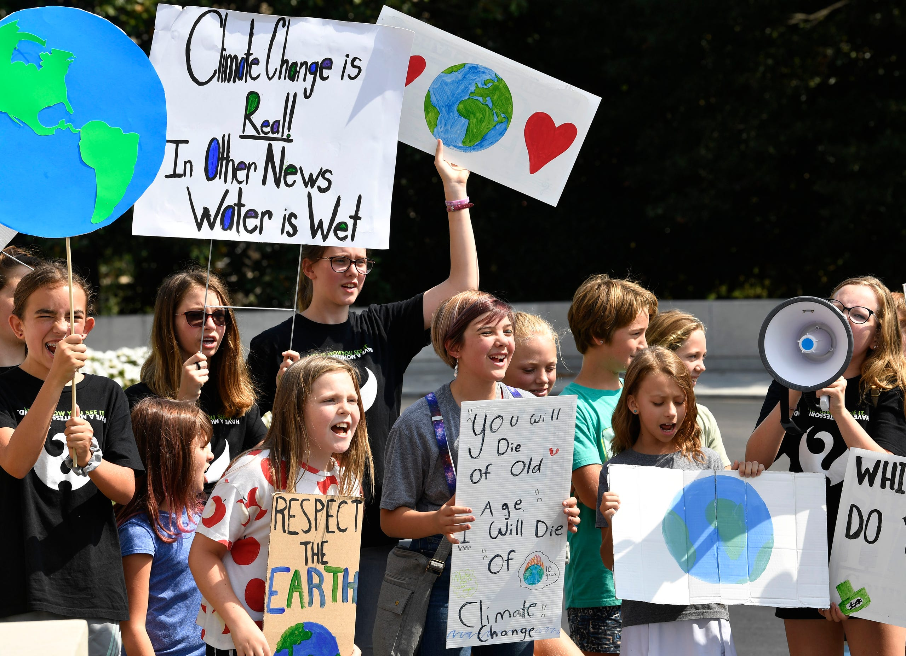
Nashville, Tennessee
September 20, 2019
Photo © 2019 Larry McCormack/The Tennessean
Notes:
ID #6671 - May be live-streamed, broadcast, and presented in-person, but may not be recorded or modified.
And the rising young generation, the Greta generation, they're leading the way. They are demanding a better world as they have a right to do.
DESCRIPTION: Photo of students participating in the Global Climate Strike at the Tennessee state capitol on September 20, 2019
ADDITIONAL TALKING POINTS:
The September 20, 2019 Global Climate Strikes brought out an estimated four million people in over 163 countries on all seven continents to more than 2,500 events. Inspired in part by Greta Thunberg’s school strike for climate, and organized by youth around the world, the September strikes were one of the largest youth-led demonstrations in history, and likely the largest ever demonstration for climate action.[1*][2*]
REFERENCES:
[1*] Eliza Barclay and Brian Resnick, “How big was the global climate strike? 4 million people, activists estimate,” Vox, last updated September 22, 2019. https://www.vox.com/energy-and-environment/2019/9/20/20876143/climate-strike-2019-september-20-crowd-estimate
[2*] Sarah Kaplan,, Lauren Lumpkin, and Brady Dennis, “'We will make them hear us’: Millions of youths around the world strike for action,” The Washington Post, September 20, 2019. https://www.washingtonpost.com/climate-environment/2019/09/20/millions-youth-around-world-are-striking-friday-climate-action/

Slide 60
HOW DO I KNOW WE WILL HAVE A CLEAN ENERGY FUTURE BY 2050?
And the market will drive it.
Notes:
197 countries have signed or acceded to the Paris agreement. Subsequently, the Trump administration announced its intention to withdraw

Slide 61
Conventional Energy Stocks Are the Worst Investments
“Energy has been…the worst performer since the U.S. bull stock market began more than a decade ago.”
– Reuters
S&P 500 Index
S&P 500
S&P 500 Energy Sector Index
Data: MarketWatch
Notes:
ID #6633 - Can be used in noncommercial online and TV broadcasts of your presentation, but not modified.
The market is also changing to help us in this journey. Here is the stock market going up, but here is the energy sector, the fossil fuels sector. They're bad investments now, and that word is getting out, and we're seeing a huge shift of assets toward the sustainability revolution.
DESCRIPTION: Graph comparing the S&P 500 and the S&P 500 Energy Sector Index from 2010 to 2020 with a quote from Reuters stating that, “Energy has been…the worst performer since the U.S. bull stock market began more than a decade ago.”
ADDITIONAL TALKING POINTS:
To meet the goals of the Paris Agreement, approximately half of gas reserves and more than 80 percent of proven coal reserves must stay in the ground.[1*]
The Social Cost of Carbon.[2*]
Mining, drilling, and burning fossil fuels like coal, oil, and natural gas are harming our environment and our health. We see the cost of carbon clearly in devastating impacts from extreme weather events like flooding and deadly storms to fast-spreading diseases to rising seas to ecosystem loss. What we don’t always see are the costs of the lingering aftermath and recovery from these disasters, such as increased health care expenses, destruction of property, increased food prices, and more.
The current estimate of the social cost of carbon is roughly $50 per ton, which many experts argue is far lower than the true cost of carbon pollution.
As the world moves fast to a low-carbon economy, investments in fossil fuels reaching into the trillions will become lost as stranded assets.
According to a 2018 study, up to $4 trillion worth of fossil fuel assets could be wiped off the global economy due to changes in technology, markets, and social habits.[1*]
Furthermore, there is a reputational risk for investors that their investment is not in line with global climate goals, which is a growing concern among many institutional investors around the world.[3*]
The CEO of the Colombian coal giant, Cerrejon, agrees that the coal industry is in terminal decline and prices continue to plunge.[4*]
Global investments in fossil fuels continued to rise in recent years, despite many of the world’s most prominent investors divesting from fossil fuels.
The International Energy Agency’s World Energy Investment 2020 report estimates that clean energy investment has been relatively resilient in the 2020 economic downturn. However, investments in renewables have been stagnant since 2015 and are far from the level needed for emissions reductions.[5*]
The energy return on investment (how much energy a source will produce compared to how much energy it takes to extract or develop the source) for fossil fuels is getting lower and lower, especially as easily accessible fossil fuel resources become exhausted. On the other hand, as renewable infrastructure is built out, the energy return on investment for renewable sources will likely increase, further building the case for increasing investment in renewables.[6*]
As of early 2020, nearly 1,200 institutions across world, representing over $14 trillion in assets under management, have pledged to divest from their investments in coal, oil, and gas companies.[7*]
REFERENCES:
[1*] Joel Makower, “The growing concern over stranded assets,” GreenBiz, September 10, 2019. https://www.greenbiz.com/article/growing-concern-over-stranded-assets
[2*] Environmental Defense Fund, “The true cost of carbon pollution,” last accessed July 7, 2020. https://www.edf.org/true-cost-carbon-pollution
[3*] Bill McKibben, “At last, divestment is hitting the fossil fuel industry where it hurts,” The Guardian, December 16, 2018. https://www.theguardian.com/commentisfree/2018/dec/16/divestment-fossil-fuel-industry-trillions-dollars-investments-carbon
[4*] Matthew Bristow, “One Coal CEO Sees Writing on Wall, Says Make Money While You Can,” Bloomberg, August 9, 2019. https://www.bloomberg.com/news/articles/2019-08-09/one-coal-ceo-sees-writing-on-wall-says-make-money-while-you-can
[5*] International Energy Agency, “World Energy Investment 2020,” May, 2020. https://www.iea.org/reports/world-energy-investment-2020
[6*] University of Leeds, "Fossil fuels increasingly offer a poor return on energy investment," July 11, 2019. https://www.sciencedaily.com/releases/2019/07/190711114846.htm
[7*] Fossil Free Divestment, “1000+ Divestment Commitments,” last accessed July, 2020. https://gofossilfree.org/divestment/commitments/
SLIDE SOURCE(S): https://www.reuters.com/article/us-usa-energy-stocks-analysis/no-ready-spark-seen-for-lagging-u-s-energy-shares-idUSKCN1VF0DU; marketwatch.com/investing/index/spx/charts; https://www.marketwatch.com/investing/index/sp500.10/charts?countrycode=xx

Slide 62
In the 2015 Paris Agreement,
every nation in the world agreed to work together to achieve net zero greenhouse gas emissions by mid-century.
The U.S. cannot legally withdraw until the day after the 2020 Presidential election.
© SevArt/Pond5
Notes:
ID #3782.B - Can be used in noncommercial online and TV broadcasts of your presentation, but not modified.
Well, that's partly up to us, but we've got the Paris Agreement, and don't shortchange the Paris Agreement. Don't be fooled by the fact that the current president of the US wants to withdraw. The US can't withdraw until the day after this November's election. Were there to be a new president, that new president could give 30 days’ notice, and the US is right back in the agreement.
DESCRIPTION: Video of canal boats in the Seine River in Paris and text about the Paris Agreement’s net zero greenhouse gas emissions goal and a statement that the US cannot legally withdraw from the Agreement until the day after the 2020 Presidential election
ADDITIONAL TALKING POINTS:
In 2015, nearly 200 countries committed to work together to slash emissions and solve the climate crisis through the historic Paris Agreement.
The agreement sets ambitious goals that require action from every nation.
The Paris Agreement aims to keep global average temperature rise to well below 2 degrees Celsius, while working to hold it under 1.5 degrees Celsius.
The agreement sets a target of peaking global emissions as soon as possible, then aiming for net-zero greenhouse gas emissions in the second half of this century.
To achieve these goals, each country submits an action plan (known as a “nationally-determined contribution,” or NDC) every five years, progressively strengthening the plan over time.
The accord also establishes new frameworks for measuring, reporting, and verifying emissions reductions, and providing capacity building for less-developed countries.
The result is a global framework for action to solve the climate crisis.[1*]
However, nearly two years after the Paris Agreement was signed, US President Donald Trump announced he would take the United States out of the agreement.
Despite the president’s announcement, the earliest that any country can leave the agreement is November 4, 2020, the day after the 2020 US presidential election.[2*]
In response to President Trump’s decision to withdraw the US from the Paris Agreement, several states joined together to create the United States Climate Alliance. The governors of Washington, New York, and California spearheaded the initiative and 11 other states, as well as Puerto Rico, joined the bipartisan coalition initially.[3*]
As of mid-2020, the member states represent 55 percent of the US population and 60 percent of US GDP. Their goal is to help the US still meet its Paris goal of reducing emissions by at least 26–28 percent below 2005 levels by 2050.[3*]
Fortunately, other nations are stepping up and on track to overachieve their Paris commitments.
China and India are projected to reduce global carbon emissions by roughly 2–3 billion metric tons by 2030, due largely to positive developments in coal restrictions in both countries. [4*]
China’s coal consumption peaked in 2013 at 4.24 billion metric tons, followed by a steady decline between 2014 and 2016. However, coal consumption rose again in 2017 and 2018, despite China remaining optimistic it will reduce coal in its energy mix to under 58 percent.[5*]
India has stated that planned coal-fired power plants may not be needed, and if the country fully implements the policies it has announced, it would see significantly slower growth of CO2 emissions over the next decade.[4*]
As a result, both China and India look set to overachieve their Paris Agreement climate pledges. Five years ago, the idea of either country stopping – or even slowing – coal use was considered highly unlikely. Yet, both are now on the way to achieving this critical goal.[4*]
Over 100 members, comprised of national governments, subnational governments, and businesses and organizations, have joined the Powering Past Coal Alliance, committing to phase out coal use no later than 2050.[6*]
Global climate action needs to be more ambitious.
The current set of global country emissions pledges and targets still falls short of what’s needed to prevent global temperatures from rising more than 2 degrees Celsius. One analysis indicates that current pledges/targets need to be strengthened to prevent an additional 13 to 16 gigatons of carbon dioxide equivalent (GtCO2e) emissions by 2030.[7*]
Analyses also suggest that while many countries’ current climate action commitments are insufficient and not consistent with keeping global temperature rise below 2 degrees Celsius, the commitments are critically insufficient in Russia, Saudi Arabia, Turkey, the US, Ukraine, and Vietnam. The commitments made by these countries could lead to global temperature rise of more than 4 degrees Celsius.[8*]
A growing number of countries are setting targets toward carbon neutrality by mid-century, including Chile, Costa Rica, New Zealand, Denmark, France, and the United Kingdom.[9*]
This year (2020) marks a critical year for raising ambition on climate commitments, as it is the first year that parties to the Paris Agreement will begin submitting new or enhanced climate plans. (This is often referred to as the Paris Agreement’s “ratchet” mechanism.) Although the UN’s COP 26 climate conference to review these plans has been delayed due to COVID-19, more ambitious climate plans are expected this year.[10*] The US election in November and the EU-China summit in September 2020 will likely set the stage for how ambitious other parties to the Agreement will be.
REFERENCES:
[1*] United Nations Framework Convention on Climate Change, “Paris Agreement,” (December 2015). https://unfccc.int/files/meetings/paris_nov_2015/application/pdf/paris_agreement_english_.pdf
[2*] Brad Plumer, “The U.S. Won’t Actually Leave the Paris Climate Deal Anytime Soon,” The New York Times, June 7, 2017. https://www.nytimes.com/2017/06/07/climate/trump-paris-climate-timeline.html
[3*] US Climate Alliance, “Annual Report,” last accessed July, 2020. http://www.usclimatealliance.org/annual-report
[4*] Niklas Höhne et al., “Action by China and India slows emissions growth, President Trump’s policies likely to cause US emissions to flatten,” (Climate Action Tracker, May 2017). https://climateactiontracker.org/documents/51/CAT_2017-05-15_UpdateChinaIndiaUS_CATUpdate.pdf
[5*] Feng Hao and Tom Baxter, “China’s coal consumption on the rise,” ChinaDialogue, March 1, 2019. https://www.chinadialogue.net/article/show/single/en/11107-China-s-coal-consumption-on-the-rise
[6*] Powering Past Coal Alliance, “Members,” last accessed July 2020. https://poweringpastcoal.org/about/Powering_Past_Coal_Alliance_Members
[7*] Climate Action Tracker, “CAT Emissions Gaps,” last updated December 10, 2019. https://climateactiontracker.org/global/cat-emissions-gaps/
[8*] Climate Action Tracker, “Countries,” last updated June 2020. https://climateactiontracker.org/countries/
[9*] Megan Darby, “Which countries have a net zero carbon goal?,” Climate Home News, June 14, 2019. https://www.climatechangenews.com/2019/06/14/countries-net-zero-climate-goal/
[10*] Fernanda de Carvalho, "Climate action cannot be a tradeable priority in 2020," World Wildlife Fund, April 27, 2020. https://wwf.panda.org/our_work/climate_and_energy/?362564/Climate-action-2020
SLIDE SOURCE(S): https://www.nytimes.com/2017/06/07/climate/trump-paris-climate-timeline.html

Slide 63
Twenty-four states representing 55% of the American people have formed the United States Climate Alliance
Founding Members
California
New York
Washington
Additional States
Connecticut
Delaware
Hawaii
Massachusetts
Oregon
Minnesota
Rhode Island
Vermont
Virginia
North Carolina
Colorado
Maryland
New Jersey
Illinois
New Mexico
Michigan
Wisconsin
Maine
Nevada
Pennsylvania
Montana
and Puerto Rico
Notes:
ID #4917.I - Can be used in noncommercial online and TV broadcasts of your presentation, but not modified.
In the US, we're already seeing almost half of our states, with more than half of our people, moving faster than the Paris Agreement requires. We're seeing cities move as well.
DESCRIPTION: Text and table introducing the United States Climate Alliance, founded by three states and joined by 21 others along with Puerto Rico
ADDITIONAL TALKING POINTS:
In 2015, nearly 200 countries committed to work together to slash emissions and solve the climate crisis through the historic Paris Agreement.
The agreement sets ambitious goals that require action from every nation.
The Paris Agreement aims to keep global average temperature rise to well below 2 degrees Celsius, while working to hold it under 1.5 degrees Celsius.
The agreement sets a target of peaking global emissions as soon as possible, then aiming for net-zero greenhouse gas emissions in the second half of this century.
To achieve these goals, each country submits an action plan (known as a “nationally-determined contribution,” or NDC) every five years, progressively strengthening the plan over time.
The accord also establishes new frameworks for measuring, reporting, and verifying emissions reductions, and providing capacity building for less-developed countries.
The result is a global framework for action to solve the climate crisis.[1*]
However, nearly two years after the Paris Agreement was signed, US President Donald Trump announced he would take the United States out of the agreement.
Despite the president’s announcement, the earliest that any country can leave the agreement is November 4, 2020, the day after the 2020 US presidential election.[2*]
In response to President Trump’s decision to withdraw the US from the Paris Agreement, several states joined together to create the United States Climate Alliance. The governors of Washington, New York, and California spearheaded the initiative and 11 other states, as well as Puerto Rico, joined the bipartisan coalition initially.[3*]
As of mid-2020, the member states represent 55 percent of the US population and 60 percent of US GDP. Their goal is to help the US still meet its Paris goal of reducing emissions by at least 26–28 percent below 2005 levels by 2050.[3*]
Fortunately, other nations are stepping up and on track to overachieve their Paris commitments.
China and India are projected to reduce global carbon emissions by roughly 2–3 billion metric tons by 2030, due largely to positive developments in coal restrictions in both countries. [4*]
China’s coal consumption peaked in 2013 at 4.24 billion metric tons, followed by a steady decline between 2014 and 2016. However, coal consumption rose again in 2017 and 2018, despite China remaining optimistic it will reduce coal in its energy mix to under 58 percent.[5*]
India has stated that planned coal-fired power plants may not be needed, and if the country fully implements the policies it has announced, it would see significantly slower growth of CO2 emissions over the next decade.[4*]
As a result, both China and India look set to overachieve their Paris Agreement climate pledges. Five years ago, the idea of either country stopping – or even slowing – coal use was considered highly unlikely. Yet, both are now on the way to achieving this critical goal.[4*]
Over 100 members, comprised of national governments, subnational governments, and businesses and organizations, have joined the Powering Past Coal Alliance, committing to phase out coal use no later than 2050.[6*]
Global climate action needs to be more ambitious.
The current set of global country emissions pledges and targets still falls short of what’s needed to prevent global temperatures from rising more than 2 degrees Celsius. One analysis indicates that current pledges/targets need to be strengthened to prevent an additional 13 to 16 gigatons of carbon dioxide equivalent (GtCO2e) emissions by 2030.[7*]
Analyses also suggest that while many countries’ current climate action commitments are insufficient and not consistent with keeping global temperature rise below 2 degrees Celsius, the commitments are critically insufficient in Russia, Saudi Arabia, Turkey, the US, Ukraine, and Vietnam. The commitments made by these countries could lead to global temperature rise of more than 4 degrees Celsius.[8*]
A growing number of countries are setting targets toward carbon neutrality by mid-century, including Chile, Costa Rica, New Zealand, Denmark, France, and the United Kingdom.[9*]
This year (2020) marks a critical year for raising ambition on climate commitments, as it is the first year that parties to the Paris Agreement will begin submitting new or enhanced climate plans. (This is often referred to as the Paris Agreement’s “ratchet” mechanism.) Although the UN’s COP 26 climate conference to review these plans has been delayed due to COVID-19, more ambitious climate plans are expected this year.[10*] The US election in November and the EU-China summit in September 2020 will likely set the stage for how ambitious other parties to the Agreement will be.
REFERENCES:
[1*] United Nations Framework Convention on Climate Change, “Paris Agreement,” (December 2015). https://unfccc.int/files/meetings/paris_nov_2015/application/pdf/paris_agreement_english_.pdf
[2*] Brad Plumer, “The U.S. Won’t Actually Leave the Paris Climate Deal Anytime Soon,” The New York Times, June 7, 2017. https://www.nytimes.com/2017/06/07/climate/trump-paris-climate-timeline.html
[3*] US Climate Alliance, “Annual Report,” last accessed July, 2020. http://www.usclimatealliance.org/annual-report
[4*] Niklas Höhne et al., “Action by China and India slows emissions growth, President Trump’s policies likely to cause US emissions to flatten,” (Climate Action Tracker, May 2017). https://climateactiontracker.org/documents/51/CAT_2017-05-15_UpdateChinaIndiaUS_CATUpdate.pdf
[5*] Feng Hao and Tom Baxter, “China’s coal consumption on the rise,” ChinaDialogue, March 1, 2019. https://www.chinadialogue.net/article/show/single/en/11107-China-s-coal-consumption-on-the-rise
[6*] Powering Past Coal Alliance, “Members,” last accessed July 2020. https://poweringpastcoal.org/about/Powering_Past_Coal_Alliance_Members
[7*] Climate Action Tracker, “CAT Emissions Gaps,” last updated December 10, 2019. https://climateactiontracker.org/global/cat-emissions-gaps/
[8*] Climate Action Tracker, “Countries,” last updated June 2020. https://climateactiontracker.org/countries/
[9*] Megan Darby, “Which countries have a net zero carbon goal?,” Climate Home News, June 14, 2019. https://www.climatechangenews.com/2019/06/14/countries-net-zero-climate-goal/
[10*] Fernanda de Carvalho, "Climate action cannot be a tradeable priority in 2020," World Wildlife Fund, April 27, 2020. https://wwf.panda.org/our_work/climate_and_energy/?362564/Climate-action-2020
SLIDE SOURCE(S): http://www.usclimatealliance.org/us-climate-alliance-fact-sheet

Slide 64
Over 240 global companies have made a commitment to go 100% renewable
Notes:
ID #5071.K - Can be used in noncommercial online and TV broadcasts of your presentation, but not modified.
And we're seeing businesses move. More than 240 global companies have pledged to go 100 percent renewable, and more companies are adding their names and pledges to this list every single day.
DESCRIPTION: Corporate logos with overlaid text stating that over 240 global companies have made a commitment to go 100-percent renewable
ADDITIONAL TALKING POINTS:
In the absence of climate leadership at the federal level, the United States is still moving forward with clean and renewable energy commitments.
The US made record investments in clean energy in the first three years of the Trump Administration. These increases were largely driven by investments in solar and wind due to their cost-competitiveness and an anticipated rollback of tax credits in 2020.[1*]
As of early 2020, over 150 US cities had made public commitments to transition to 100 percent renewable energy, and 15 states, along with Washington, DC and Puerto Rico, have publicly announced targets to source at least 50 percent of their electricity from clean energy.[2*]
The clean energy commitments of state and local governments, as well as those of businesses and utilities, could put these subnational US actors on track to reduce emissions 25 percent below 2005 levels by 2030.[2*]
Corporations are taking climate action through global sustainability initiatives like RE100 and the Science-Based Targets Initiative.
Corporations release an average of 31 gigatons of greenhouse gases globally each year – equivalent to the emissions from more than 8,000 coal power plants. Private sector engagement in climate change mitigation would make a significant difference in emissions while protecting $4 trillion in assets that will be at risk from climate change by 2030.[3*]
RE100 is a global corporate leadership initiative that brings together companies that have committed to sourcing 100 percent renewable electricity, either through the production or purchasing of renewable electricity.[4*] As of mid-2020, there are over 240 members in RE100.[5*] In 2018, one-in-three members were sourcing over 75 percent renewable electricity, and more than 30 members had already met their 100 percent goals.[4*]
Through the Science-Based Targets initiative, corporations must set clearly defined emissions reductions targets that are in line with the goals of the Paris Agreement. As of mid-2020, over 900 global companies were actively taking science-based climate actions and over 400 have committed to science-based emissions-reduction targets.[6*]
Power purchase agreements are tools corporations use to meet their renewable energy goals.
A power-purchase agreement (PPA) is a legal contract between an electricity generator (seller) and a power purchaser (buyer). PPAs can be used to finance implementation of renewable energy projects. PPAs facilitate the delivery of predictable, low-cost energy without large upfront costs.[7*]
Global corporate clean energy purchases reached a record high of 19.5 GW in 2019, more than triple the activity in 2017.[8*]
In the US, 13.6 GW of new clean energy purchase agreements were signed in 2019, more than all global activity in 2018.[8*]
REFERENCES:
[1*] Bloomberg New Energy Finance, “Late Surge in Offshore Wind Financings Helps 2019 Renewables Investment to Overtake 2018,” January 16, 2020. https://about.bnef.com/blog/late-surge-in-offshore-wind-financings-helps-2019-renewables-investment-to-overtake-2018/
[2*] Lacey Shaver, “Watch these four clean energy trends in U.S. cities” GreenBiz, February 13, 2020. https://www.greenbiz.com/article/watch-these-four-clean-energy-trends-us-cities
[3*] CDP Disclosure Insight Action, “Companies,” last accessed July, 2020. https://www.cdp.net/en/companies
[4*] RE100, “RE100 Progress and Insights Annual Report,” (December 2019).
https://www.theclimategroup.org/sites/default/files/dec_2019_re100_progress_and_insights_annual_report.pdf
[5*] RE100, “Companies,” last accessed July, 2020. http://there100.org/companies
[6*] Science Based Targets, “Companies taking action,” last accessed July, 2020. https://sciencebasedtargets.org/companies-taking-action/
[7*] Jesse Heibel and Jocelyn Durkay, “State Policies for Power Purchase Agreements,” National Conference of State Legislatures, July 10, 2015. http://www.ncsl.org/research/energy/state-policies-for-purchase-agreements.aspx
[8*] Bloomberg New Energy Finance, “Corporate Clean Energy Buying Leapt 44% in 2019, Sets New Record,” January 28, 2020.
https://about.bnef.com/blog/corporate-clean-energy-buying-leapt-44-in-2019-sets-new-record/
SLIDE SOURCE(S): http://there100.org/companies

Slide 65
New Jersey’s Clean Energy Initiatives
Join US Climate Alliance
NJ 2019 Energy Master Plan: 100% Clean Energy by 2050
Rejoin Regional Greenhouse Gas Initiative (RGGI)
Renewable Energy Law
Renewable Energy Standard (graduated to 50% by 2030)
Solar, Offshore Wind, Energy Efficiency, Energy Storage
Energy Aggregation, Community Solar, EVs
Notes:
Gov Murphy Executive Order #28 on 5/23/2018: 50% renewable electricity by 2030 and 100% Clean Energy by 2050 –
rollout is being nailed down by 2019 Energy Master Plan, to be final by end of year.
We will have 3500 MW of Offshore Wind, new solar programs, Energy Storage AND
CLICK
RGGI provides carbon trading across east cost states. NJ is officially back in RGGI as of Jun 2019 and stands to benefit financially from credits that could be used for additional renewable projects.
BAN OFFSHORE DRILLING : we cant actually control drilling in Federal Waters (beyond 3 miles or so). BUT WE CAN and ARE PROHIBITING any use of land-based facilities – no ships, pipelines, etc.
12/18/2018 NJ joined with 9 other regional and mid-atlantic states in the “Transportation and Climate Initiative” (TCI) to within 1 year, define a low-carbon transportation policy

Slide 66
NJ Energy Master Plan (EMP) Strategies
Transportation
Renewable & Distributed Energy
Efficiency & Conservation
Buildings
Environmental Justice Communities
Modernize the Grid Infrastructure
Clean Energy Innovation Economy
Notes:
TONIGHT’s visioning focuses on these 5 strategies, found in the NJ 2019 Energy Master Plan.
We need YOUR visioning of what do you expect in an energy plan to enhance YOUR quality of life??
Following are examples of the 5 (These are also printed in front, above the white poster boards)

Slide 67
Integrated Energy Plan Cost Analysis
Consultant: Rocky Mountain Institute
Conclusion: Least cost scenario for reaching carbon neutral by 2050 would cost only a few % more than business as usual
Assumes cost of renewable stays flat (and does not fall)
Assumes price of fossil fuel stays flat (and does not rise)
Assumes no new technology
Does not count benefits of reduced emissions at all

Slide 68
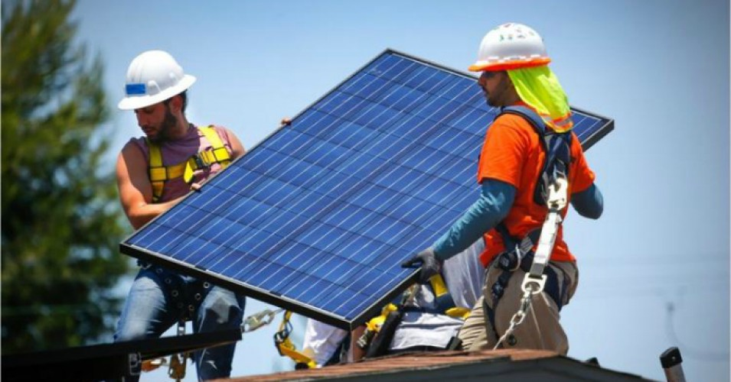
NJ Top 6 Solar States: Solar Panels on 2 Million Homes
Notes:
NJ has dropped a little, but remains #6 in the nation in rooftop solar.

Slide 69
NJ has goal of 7,500 MW from offshore wind by 2035
Notes:
A number of world’s countries have demonstrated they can switch to 100% wind and solar. Read “NJ goal of 3500MW….”In fact, I read those offshore sites have potential for further future expansion by 3 or 4 times the wind power.

Slide 70
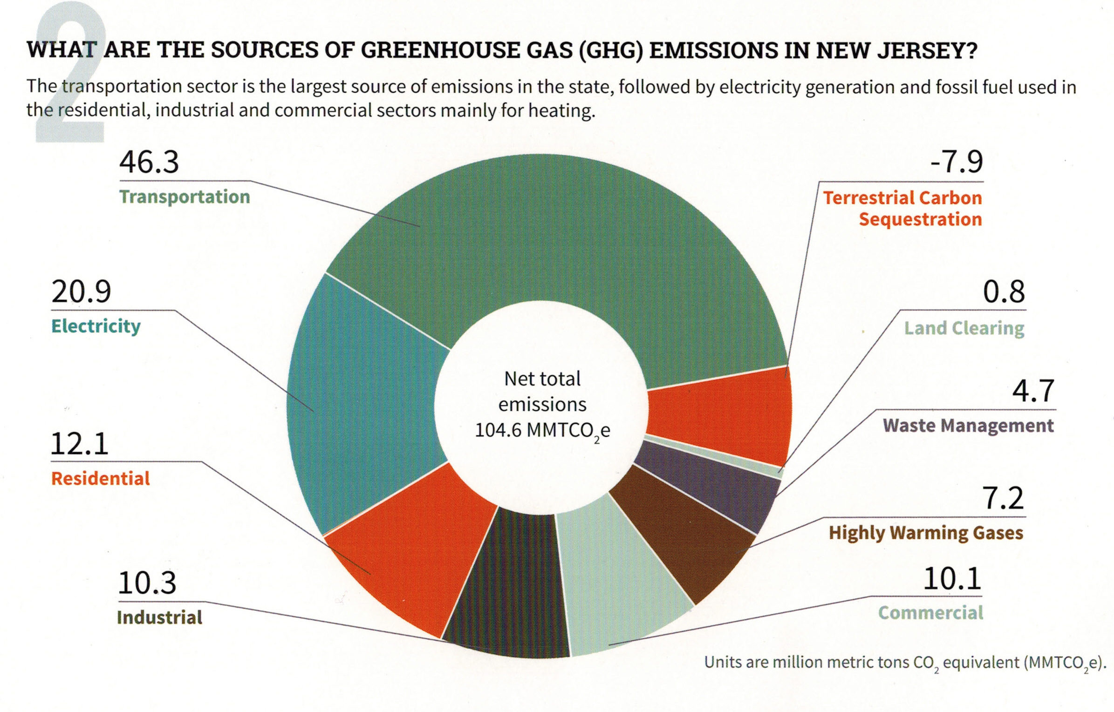
Your (Typical NJ) GHG Emissions EEEmissions
“Reducing NJ Greenhouse Gas Emissions”, Rutgers, Jan 2018
Notes:
This is the NJ “Footprint” of sources of world-heating Greenhouse gases, to show what to tackle first.
Sustainable Jersey states: “the primary goal [of “Gold Star in Energy” is reducing Green House Gases. Responding to this overarching imperative will help achieve all the other [sustainability] goals.”
20% of the GHG is from electricity generation; nearly 50% is from transportation.
Switching electricity to 100% wind/solar, then switching all vehicles to batteries charged by renewable electricity will ELIMINATE almost 70% of our GHG.
VERY IMPORTANT: -8% carbon sequestration by marshes, mudflats, trees, landscaping

Slide 71
Middletown 2020 Energy Plan Goals
Make Middletown 100% clean energy by 2050
As per NJ Global Warming Response Act
As per NJ Energy Master Plan
Achieve Sustainable Jersey Gold Star in Energy
Notes:
Edit to introduce Energy Plan.

Slide 72
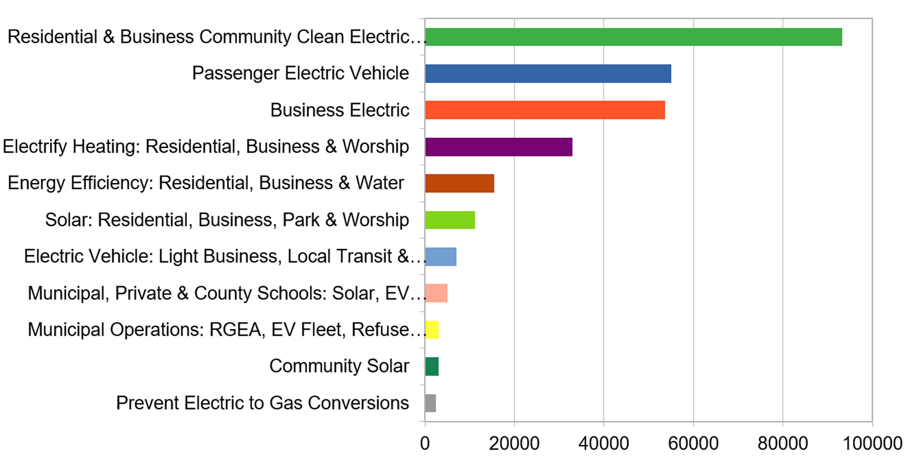
Middletown Energy Plan: GHG emission reductions during year 2030 In 2018, Middletown emissions were 705K Tons (CO2 equiv)- calculated per capita of NJ total
266K Tons TotAl CO2 (equivalent) reduction in year 2030
(38% reduction of 2018 Emissions)
Middletown Energy Plan https://bit.ly/2FZi0ti
Tons CO2 reduction in 2030
Notes:
Start with personal story [show grandkids photo]- I now have 2 grandsons- and want a better life for them. During a 9/15/2020 talk, Joseph Fiordliso, longtime President of the NJ Board of Public Utilities stressed that it is NOW OBVIOUS that our descendants’ lives will be affected by climate change- it will be a different, less friendly life for them.
ASSUMPTIONS on ACCEPTANCE RATES:
Residential (100%) & Business (10%) Community Choice Electric
Passenger Vehicles 25% are electric
Business Electric RPS + 10% for all not otherwise counted
Electrify heating 25%
savings in Energy Efficiency (10%) – consistent with projection from Middletown actual experience
Solar: (10% solar penetration) Residential, Business, park & worship
Delivery trucks ALREADY moving to EV Trucks
Municipal/private/schools: 25% area utilized for solar
Municipal operations: 25% conversations of vehicles to EV & buildings to electric heat

Slide 73
What Am I To Do?
Switch To Clean Electricity
Install rooftop solar
Switch to a 100% clean supplier http://electric.smiller.org
Invest in or subscribe to community solar
Ask your town to supply renewable community choice electrical aggregation
Notes:
You can switch to 100% clean electricity, AND save money, instead of defaulting to 20% clean electric from JCP&L.
Best investment: If you can SOON, pay cash to install rooftop solar.
OR (same GHG reduction): swtich to 100% clean supplier (spend 10 minutes, selecting vendor at URL)
OR – wait a couple of years for investors to build large array “Community Solar” fields – which should prove to be a GREAT investment for you
CLICK

Slide 74
Influence Your Town To Adopt Clean Energy
FLORIDA
Notes:
AND/OR – JOIN WITH OTHERS and push for your town to switch ALL residents to 100% renewable Community Choice Electric aggregation. This saves 5 or 10% on electric bill, and has the BIGGEST GHG reduction!

Slide 75
New Jersey Renewable Government Energy (Electric) Aggregation (R-GEA) for Community
Also called Community Choice Aggregation
Most effective carbon reduction action: accounts for 40% of potential savings of first decade actions
Provides cost savings to residents; low or no cost to Township
Notes:
For last 3 years, I have maintained a price-ranked list of 3rd party suppliers of renewable electricity

Slide 76
Switch To Plug-in Electric Vehicle (EV)
Plug Into Your Clean Electricity
Save On Fuel Costs (~30-70% more efficient)
Save On Car Maintenance
Notes:
MAKE YOUR NEXT CAR A PLUG-IN EV!
Save money, and stop the world from continued heating that will severely degrade your own, and descendants’ quality of life

Slide 77
OTHER CHANGES WE WILL SEE IN 2050
Building standards to require net-zero emissions, net-zero waste, net-zero water, rooftop solar (where practical)
Heating and appliances all electric; no gas furnaces, hot water heaters, stoves, or dryers
Electric grid upgraded for reliability and smart metering
EV charging stations replace gas stations; or exchangeable batteries
Diets will be more local and plant-rich, and less animal-based or factory farmed
Notes:
BY 2050:
Highly energy efficient NETZERO building standards will be the norm.
FOSSIL FUELS are almost totally abandoned.
The world’s electric grids are upgraded for the high electrical loads
GAS STATIONS ARE NON-EXISTENT.
In Maryland, the 1st First US gas station just dumped the pumps & installed EV Chargers
Our plastic mess is gone
We are moving to a plant-based healthy diet.
We MUST make these changes to save lives.
If we wait, the solutions become ever more costly

Slide 78
Speak up, act, and vote
Like your world depends on it
Notes:
ID #6251 - Can be used in noncommercial online and TV broadcasts of your presentation, but not modified.
Become a part of this movement to speak truth to power. Do it like your world depends on it…
DESCRIPTION: Text slide encouraging the audience to speak truth to power - like your world depends on it

Slide 79
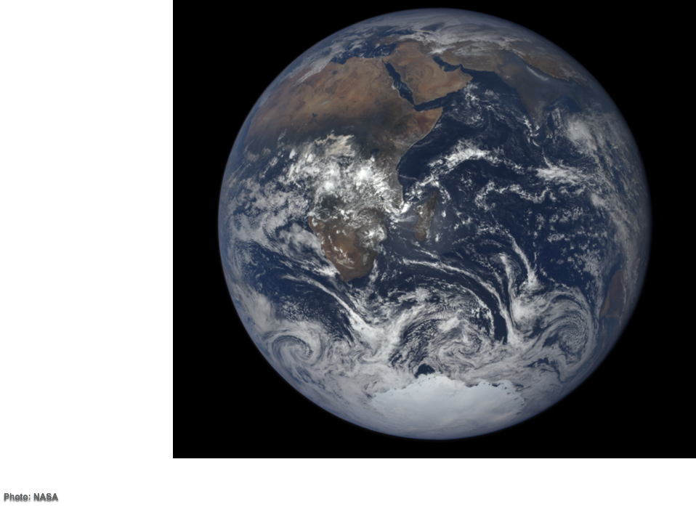
Your world depends on it.
Source: NASA
Notes:
ID #5132 - Can be used in noncommercial online and TV broadcasts of your presentation.
…because, after all, your world does depend on it. Thank you.
DESCRIPTION: Photo of the Earth with text stating that your world depends on it

Slide 80
Take action in the
United States
Secure your voting plan
Pledge to vote, and ask three friends to do the same
Stay tuned for upcoming civic engagement events with Climate Reality
Continue the conversation in your community
Visit 24hoursofreality.org to plant your tree and take these local actions!

