Slide 1
Sierra Club
100% Committed
Oct 10, 2020 “Your City: Path to 100% Clean Energy”
Pat and Steve miller “Middletown for Clean Energy”
Our mission is to leave a legacy of a livable world for our children and grandchildren.
Notes:
Project is supported by Sierra Club “Ready for 100%”, and The Climate Reality Project “100% Committed”

Slide 2
Twenty-four states representing 55% of the American people have formed the United States Climate Alliance
Founding Members
California
New York
Washington
Additional States
Connecticut
Delaware
Hawaii
Massachusetts
Oregon
Minnesota
Rhode Island
Vermont
Virginia
North Carolina
Colorado
Maryland
New Jersey
Illinois
New Mexico
Michigan
Wisconsin
Maine
Nevada
Pennsylvania
Montana
and Puerto Rico
Notes:
ID #4917.I - Can be used in noncommercial online and TV broadcasts of your presentation, but not modified.
In the US, we're already seeing almost half of our states, with more than half of our people, moving faster than the Paris Agreement requires. We're seeing cities move as well.
DESCRIPTION: Text and table introducing the United States Climate Alliance, founded by three states and joined by 21 others along with Puerto Rico
ADDITIONAL TALKING POINTS:
In 2015, nearly 200 countries committed to work together to slash emissions and solve the climate crisis through the historic Paris Agreement.
The agreement sets ambitious goals that require action from every nation.
The Paris Agreement aims to keep global average temperature rise to well below 2 degrees Celsius, while working to hold it under 1.5 degrees Celsius.
The agreement sets a target of peaking global emissions as soon as possible, then aiming for net-zero greenhouse gas emissions in the second half of this century.
To achieve these goals, each country submits an action plan (known as a “nationally-determined contribution,” or NDC) every five years, progressively strengthening the plan over time.
The accord also establishes new frameworks for measuring, reporting, and verifying emissions reductions, and providing capacity building for less-developed countries.
The result is a global framework for action to solve the climate crisis.[1*]
However, nearly two years after the Paris Agreement was signed, US President Donald Trump announced he would take the United States out of the agreement.
Despite the president’s announcement, the earliest that any country can leave the agreement is November 4, 2020, the day after the 2020 US presidential election.[2*]
In response to President Trump’s decision to withdraw the US from the Paris Agreement, several states joined together to create the United States Climate Alliance. The governors of Washington, New York, and California spearheaded the initiative and 11 other states, as well as Puerto Rico, joined the bipartisan coalition initially.[3*]
As of mid-2020, the member states represent 55 percent of the US population and 60 percent of US GDP. Their goal is to help the US still meet its Paris goal of reducing emissions by at least 26–28 percent below 2005 levels by 2050.[3*]
Fortunately, other nations are stepping up and on track to overachieve their Paris commitments.
China and India are projected to reduce global carbon emissions by roughly 2–3 billion metric tons by 2030, due largely to positive developments in coal restrictions in both countries. [4*]
China’s coal consumption peaked in 2013 at 4.24 billion metric tons, followed by a steady decline between 2014 and 2016. However, coal consumption rose again in 2017 and 2018, despite China remaining optimistic it will reduce coal in its energy mix to under 58 percent.[5*]
India has stated that planned coal-fired power plants may not be needed, and if the country fully implements the policies it has announced, it would see significantly slower growth of CO2 emissions over the next decade.[4*]
As a result, both China and India look set to overachieve their Paris Agreement climate pledges. Five years ago, the idea of either country stopping – or even slowing – coal use was considered highly unlikely. Yet, both are now on the way to achieving this critical goal.[4*]
Over 100 members, comprised of national governments, subnational governments, and businesses and organizations, have joined the Powering Past Coal Alliance, committing to phase out coal use no later than 2050.[6*]
Global climate action needs to be more ambitious.
The current set of global country emissions pledges and targets still falls short of what’s needed to prevent global temperatures from rising more than 2 degrees Celsius. One analysis indicates that current pledges/targets need to be strengthened to prevent an additional 13 to 16 gigatons of carbon dioxide equivalent (GtCO2e) emissions by 2030.[7*]
Analyses also suggest that while many countries’ current climate action commitments are insufficient and not consistent with keeping global temperature rise below 2 degrees Celsius, the commitments are critically insufficient in Russia, Saudi Arabia, Turkey, the US, Ukraine, and Vietnam. The commitments made by these countries could lead to global temperature rise of more than 4 degrees Celsius.[8*]
A growing number of countries are setting targets toward carbon neutrality by mid-century, including Chile, Costa Rica, New Zealand, Denmark, France, and the United Kingdom.[9*]
This year (2020) marks a critical year for raising ambition on climate commitments, as it is the first year that parties to the Paris Agreement will begin submitting new or enhanced climate plans. (This is often referred to as the Paris Agreement’s “ratchet” mechanism.) Although the UN’s COP 26 climate conference to review these plans has been delayed due to COVID-19, more ambitious climate plans are expected this year.[10*] The US election in November and the EU-China summit in September 2020 will likely set the stage for how ambitious other parties to the Agreement will be.
REFERENCES:
[1*] United Nations Framework Convention on Climate Change, “Paris Agreement,” (December 2015). https://unfccc.int/files/meetings/paris_nov_2015/application/pdf/paris_agreement_english_.pdf
[2*] Brad Plumer, “The U.S. Won’t Actually Leave the Paris Climate Deal Anytime Soon,” The New York Times, June 7, 2017. https://www.nytimes.com/2017/06/07/climate/trump-paris-climate-timeline.html
[3*] US Climate Alliance, “Annual Report,” last accessed July, 2020. http://www.usclimatealliance.org/annual-report
[4*] Niklas Höhne et al., “Action by China and India slows emissions growth, President Trump’s policies likely to cause US emissions to flatten,” (Climate Action Tracker, May 2017). https://climateactiontracker.org/documents/51/CAT_2017-05-15_UpdateChinaIndiaUS_CATUpdate.pdf
[5*] Feng Hao and Tom Baxter, “China’s coal consumption on the rise,” ChinaDialogue, March 1, 2019. https://www.chinadialogue.net/article/show/single/en/11107-China-s-coal-consumption-on-the-rise
[6*] Powering Past Coal Alliance, “Members,” last accessed July 2020. https://poweringpastcoal.org/about/Powering_Past_Coal_Alliance_Members
[7*] Climate Action Tracker, “CAT Emissions Gaps,” last updated December 10, 2019. https://climateactiontracker.org/global/cat-emissions-gaps/
[8*] Climate Action Tracker, “Countries,” last updated June 2020. https://climateactiontracker.org/countries/
[9*] Megan Darby, “Which countries have a net zero carbon goal?,” Climate Home News, June 14, 2019. https://www.climatechangenews.com/2019/06/14/countries-net-zero-climate-goal/
[10*] Fernanda de Carvalho, "Climate action cannot be a tradeable priority in 2020," World Wildlife Fund, April 27, 2020. https://wwf.panda.org/our_work/climate_and_energy/?362564/Climate-action-2020
SLIDE SOURCE(S): http://www.usclimatealliance.org/us-climate-alliance-fact-sheet

Slide 3
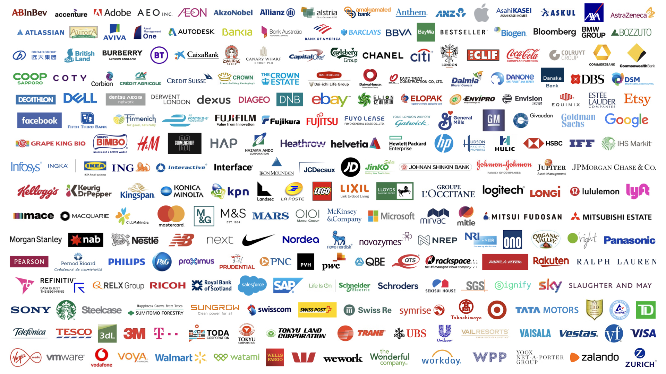
Over 240 global companies have made a commitment to go 100% renewable
Notes:
ID #5071.K - Can be used in noncommercial online and TV broadcasts of your presentation, but not modified.
And we're seeing businesses move. More than 240 global companies have pledged to go 100 percent renewable, and more companies are adding their names and pledges to this list every single day.
DESCRIPTION: Corporate logos with overlaid text stating that over 240 global companies have made a commitment to go 100-percent renewable
ADDITIONAL TALKING POINTS:
In the absence of climate leadership at the federal level, the United States is still moving forward with clean and renewable energy commitments.
The US made record investments in clean energy in the first three years of the Trump Administration. These increases were largely driven by investments in solar and wind due to their cost-competitiveness and an anticipated rollback of tax credits in 2020.[1*]
As of early 2020, over 150 US cities had made public commitments to transition to 100 percent renewable energy, and 15 states, along with Washington, DC and Puerto Rico, have publicly announced targets to source at least 50 percent of their electricity from clean energy.[2*]
The clean energy commitments of state and local governments, as well as those of businesses and utilities, could put these subnational US actors on track to reduce emissions 25 percent below 2005 levels by 2030.[2*]
Corporations are taking climate action through global sustainability initiatives like RE100 and the Science-Based Targets Initiative.
Corporations release an average of 31 gigatons of greenhouse gases globally each year – equivalent to the emissions from more than 8,000 coal power plants. Private sector engagement in climate change mitigation would make a significant difference in emissions while protecting $4 trillion in assets that will be at risk from climate change by 2030.[3*]
RE100 is a global corporate leadership initiative that brings together companies that have committed to sourcing 100 percent renewable electricity, either through the production or purchasing of renewable electricity.[4*] As of mid-2020, there are over 240 members in RE100.[5*] In 2018, one-in-three members were sourcing over 75 percent renewable electricity, and more than 30 members had already met their 100 percent goals.[4*]
Through the Science-Based Targets initiative, corporations must set clearly defined emissions reductions targets that are in line with the goals of the Paris Agreement. As of mid-2020, over 900 global companies were actively taking science-based climate actions and over 400 have committed to science-based emissions-reduction targets.[6*]
Power purchase agreements are tools corporations use to meet their renewable energy goals.
A power-purchase agreement (PPA) is a legal contract between an electricity generator (seller) and a power purchaser (buyer). PPAs can be used to finance implementation of renewable energy projects. PPAs facilitate the delivery of predictable, low-cost energy without large upfront costs.[7*]
Global corporate clean energy purchases reached a record high of 19.5 GW in 2019, more than triple the activity in 2017.[8*]
In the US, 13.6 GW of new clean energy purchase agreements were signed in 2019, more than all global activity in 2018.[8*]
REFERENCES:
[1*] Bloomberg New Energy Finance, “Late Surge in Offshore Wind Financings Helps 2019 Renewables Investment to Overtake 2018,” January 16, 2020. https://about.bnef.com/blog/late-surge-in-offshore-wind-financings-helps-2019-renewables-investment-to-overtake-2018/
[2*] Lacey Shaver, “Watch these four clean energy trends in U.S. cities” GreenBiz, February 13, 2020. https://www.greenbiz.com/article/watch-these-four-clean-energy-trends-us-cities
[3*] CDP Disclosure Insight Action, “Companies,” last accessed July, 2020. https://www.cdp.net/en/companies
[4*] RE100, “RE100 Progress and Insights Annual Report,” (December 2019).
https://www.theclimategroup.org/sites/default/files/dec_2019_re100_progress_and_insights_annual_report.pdf
[5*] RE100, “Companies,” last accessed July, 2020. http://there100.org/companies
[6*] Science Based Targets, “Companies taking action,” last accessed July, 2020. https://sciencebasedtargets.org/companies-taking-action/
[7*] Jesse Heibel and Jocelyn Durkay, “State Policies for Power Purchase Agreements,” National Conference of State Legislatures, July 10, 2015. http://www.ncsl.org/research/energy/state-policies-for-purchase-agreements.aspx
[8*] Bloomberg New Energy Finance, “Corporate Clean Energy Buying Leapt 44% in 2019, Sets New Record,” January 28, 2020.
https://about.bnef.com/blog/corporate-clean-energy-buying-leapt-44-in-2019-sets-new-record/
SLIDE SOURCE(S): http://there100.org/companies

Slide 4
New Jersey’s Clean Energy Initiatives
Join US Climate Alliance
NJ 2019 Energy Master Plan: 100% Clean Energy by 2050
Rejoin Regional Greenhouse Gas Initiative (RGGI)
Renewable Energy Law
Renewable Energy Standard (graduated to 50% by 2030)
Solar, Offshore Wind, Energy Efficiency, Energy Storage
Energy Aggregation, Community Solar, EVs
Notes:
Gov Murphy Executive Order #28 on 5/23/2018: 50% renewable electricity by 2030 and 100% Clean Energy by 2050 –
rollout is being nailed down by 2019 Energy Master Plan, to be final by end of year.
We will have 3500 MW of Offshore Wind, new solar programs, Energy Storage AND
CLICK
RGGI provides carbon trading across east cost states. NJ is officially back in RGGI as of Jun 2019 and stands to benefit financially from credits that could be used for additional renewable projects.
BAN OFFSHORE DRILLING : we cant actually control drilling in Federal Waters (beyond 3 miles or so). BUT WE CAN and ARE PROHIBITING any use of land-based facilities – no ships, pipelines, etc.
12/18/2018 NJ joined with 9 other regional and mid-atlantic states in the “Transportation and Climate Initiative” (TCI) to within 1 year, define a low-carbon transportation policy

Slide 5
NJ Energy Master Plan (EMP) Strategies
Transportation
Renewable & Distributed Energy
Efficiency & Conservation
Buildings
Environmental Justice Communities
Modernize the Grid Infrastructure
Clean Energy Innovation Economy
Notes:
TONIGHT’s visioning focuses on these 5 strategies, found in the NJ 2019 Energy Master Plan.

Slide 6
Integrated Energy Plan Cost Analysis
Consultant: Rocky Mountain Institute
Conclusion: Least cost scenario for reaching carbon neutral by 2050 would cost only a few % more than business as usual
Assumes cost of renewable stays flat (and does not fall)
Assumes price of fossil fuel stays flat (and does not rise)
Assumes no new technology
Does not count benefits of reduced emissions at all

Slide 7
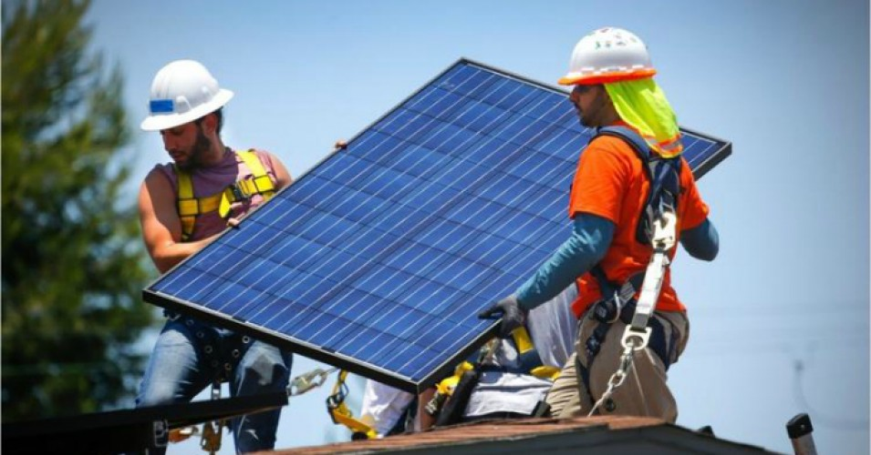
NJ Top 6 Solar States: Solar Panels on 2 Million Homes
Notes:
NJ has dropped a little, but remains #6 in the nation in rooftop solar.

Slide 8
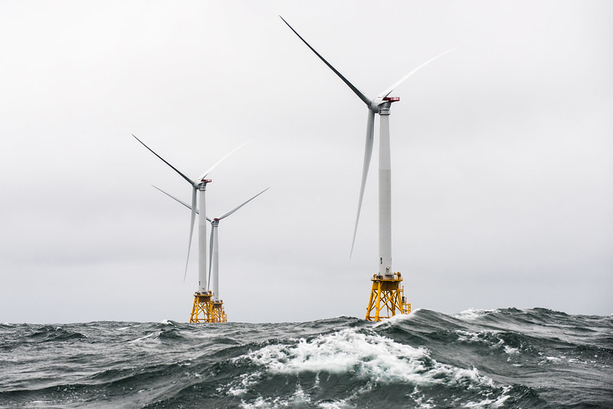
NJ has goal of 7,500 MW from offshore wind by 2035
Notes:
A number of world’s countries have demonstrated they can switch to 100% wind and solar. Read “NJ goal of 7500MW….”In fact, I read those offshore sites have potential for further future expansion by 3 or 4 times the wind power.

Slide 9
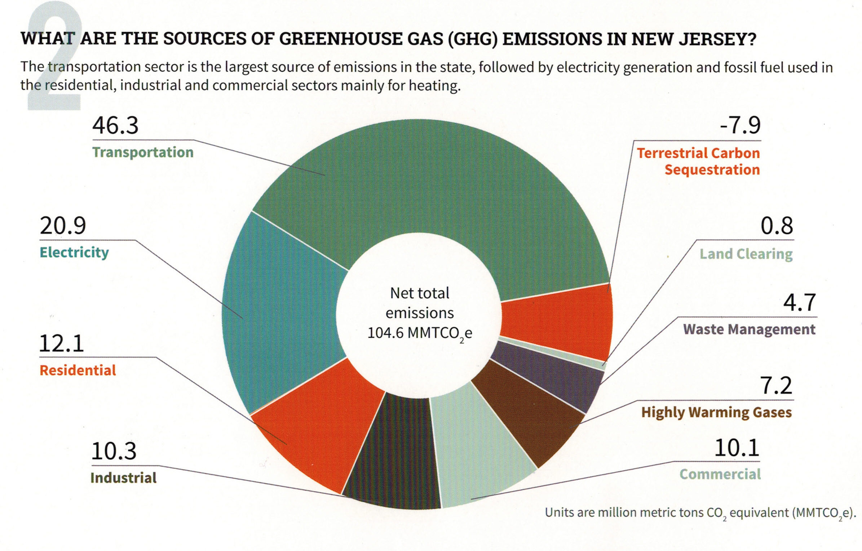
Your (Typical NJ) GHG Emissions EEEmissions
“Reducing NJ Greenhouse Gas Emissions”, Rutgers, Jan 2018
Notes:
This is the NJ “Footprint” of sources of world-heating Greenhouse gases, to show what to tackle first.
Sustainable Jersey states: “the primary goal [of “Gold Star in Energy” is reducing Green House Gases. Responding to this overarching imperative will help achieve all the other [sustainability] goals.”
20% of the GHG is from electricity generation; nearly 50% is from transportation.
Switching electricity to 100% wind/solar, then switching all vehicles to batteries charged by renewable electricity will ELIMINATE almost 70% of our GHG.
VERY IMPORTANT: -8% carbon sequestration by marshes, mudflats, trees, landscaping

Slide 10
Middletown 2020 Energy Plan Goals
Make Middletown 100% clean energy by 2050
As per NJ Global Warming Response Act
As per NJ Energy Master Plan
Achieve Sustainable Jersey Gold Star in Energy
Notes:
Edit to introduce Energy Plan.

Slide 11
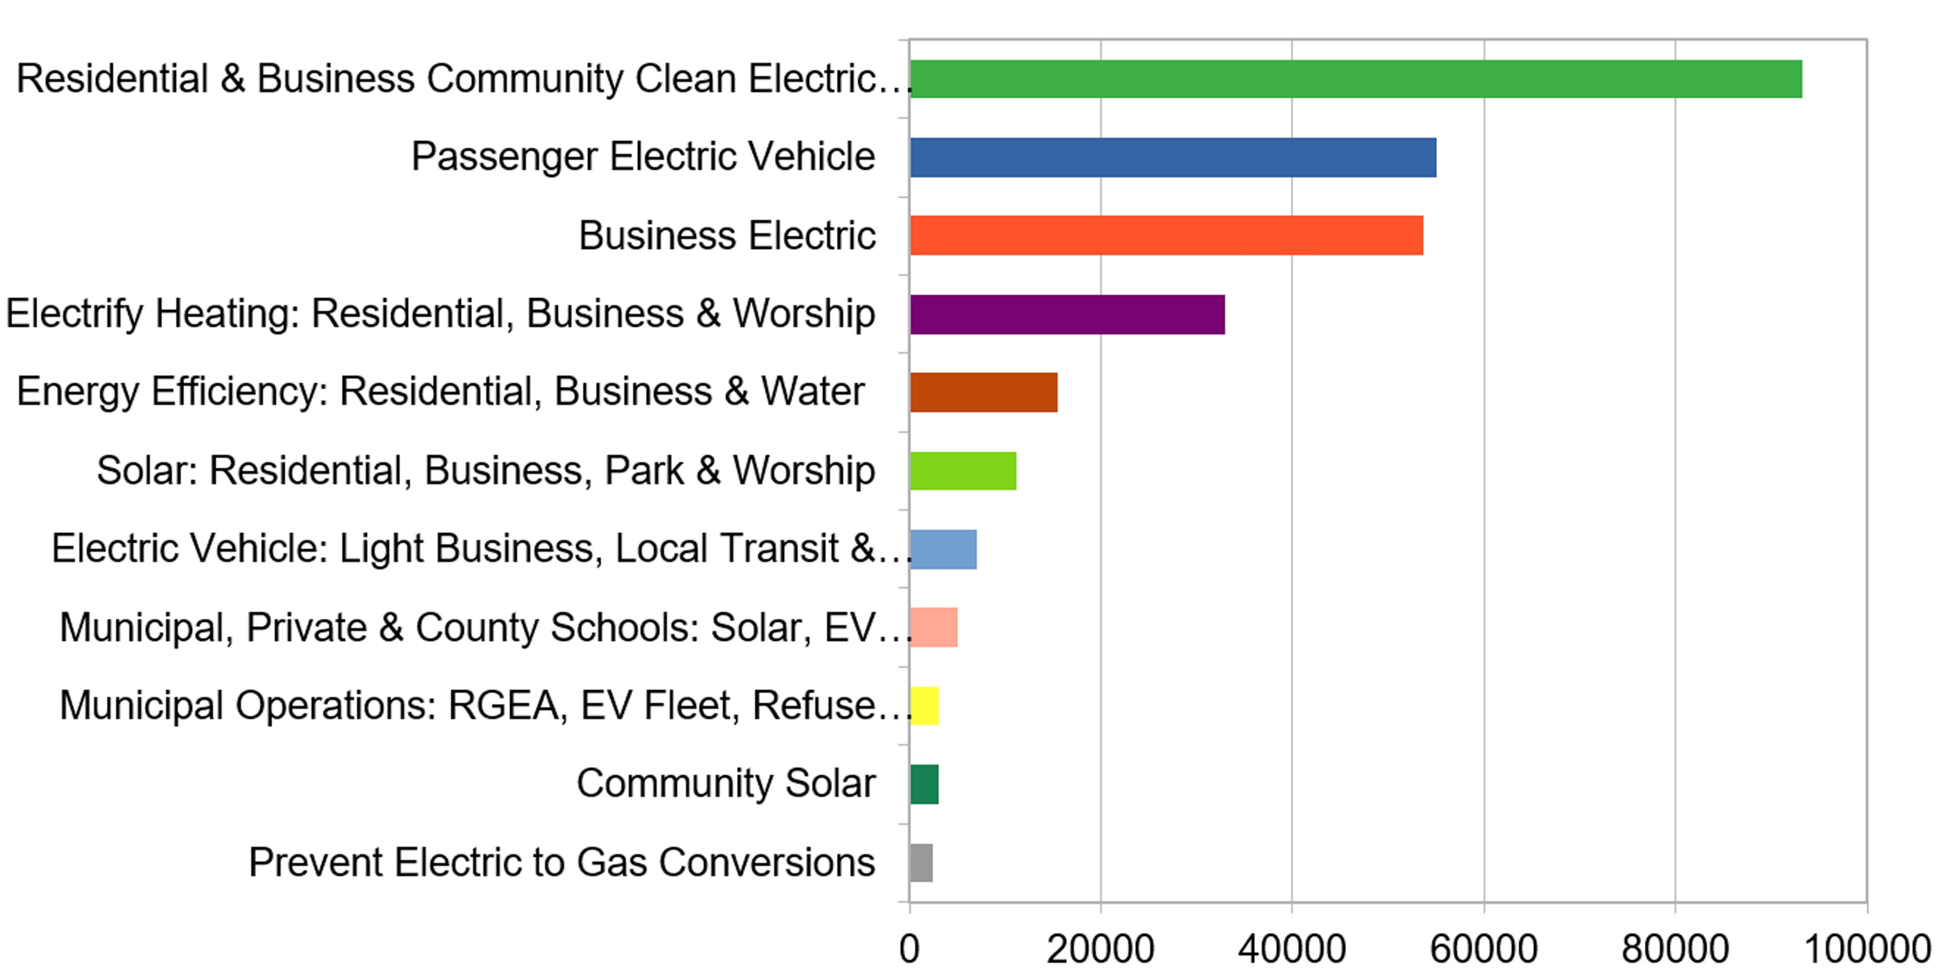
Middletown Energy Plan: GHG emission reductions during year 2030 In 2018, Middletown emissions were 705K Tons (CO2 equiv)- calculated per capita of NJ total
266K Tons TotAl CO2 (equivalent) reduction in year 2030
(38% reduction of 2018 Emissions)
Middletown Energy Plan https://bit.ly/2FZi0ti
Tons CO2 reduction in 2030
Notes:
Start with personal story [show grandkids photo]- I now have 2 grandsons- and want a better life for them. During a 9/15/2020 talk, Joseph Fiordliso, longtime President of the NJ Board of Public Utilities stressed that it is NOW OBVIOUS that our descendants’ lives will be affected by climate change- it will be a different, less friendly life for them.
ASSUMPTIONS on ACCEPTANCE RATES:
Residential (100%) & Business (10%) Community Choice Electric
Passenger Vehicles 25% are electric
Business Electric RPS + 10% for all not otherwise counted
Electrify heating 25%
savings in Energy Efficiency (10%) – consistent with projection from Middletown actual experience
Solar: (10% solar penetration) Residential, Business, park & worship
Delivery trucks ALREADY moving to EV Trucks
Municipal/private/schools: 25% area utilized for solar
Municipal operations: 25% conversations of vehicles to EV & buildings to electric heat

Slide 12
What Am I To Do?
Switch To Clean Electricity
Install rooftop solar
Switch to a 100% clean supplier http://electric.smiller.org
Invest in or subscribe to community solar
Ask your town to supply renewable community choice electrical aggregation
Notes:
You can switch to 100% clean electricity, AND save money, instead of defaulting to 20% clean electric from JCP&L.
Best investment: If you can SOON, pay cash to install rooftop solar.
OR (same GHG reduction): swtich to 100% clean supplier (spend 10 minutes, selecting vendor: For last 3 years, I have maintained a price-ranked list of 3rd party suppliers of renewable electricity at http://electric.smiller.org
OR – wait a couple of years for investors to build large array “Community Solar” fields – which should prove to be a GREAT investment for you
CLICK

Slide 13
Influence Your Town To Adopt Clean Energy
FLORIDA
Notes:
AND/OR – JOIN WITH OTHERS and push for your town to switch ALL residents to 100% renewable Community Choice Electric aggregation. This saves 5 or 10% on electric bill, and has the BIGGEST GHG reduction!

Slide 14
New Jersey Renewable Government Energy (Electric) Aggregation (R-GEA) for Community
Also called Community Choice Aggregation
Most effective carbon reduction action: accounts for 40% of potential savings of first decade actions
Provides cost savings to residents; low or no cost to Township
Notes:
For last 3 years, I have maintained a price-ranked list of 3rd party suppliers of renewable electricity

Slide 15
Switch To Plug-in Electric Vehicle (EV)
Plug Into Your Clean Electricity
Save On Fuel Costs (~30-70% more efficient)
Save On Car Maintenance
Notes:
MAKE YOUR NEXT CAR A PLUG-IN EV!
Save money, and stop the world from continued heating that will severely degrade your own, and descendants’ quality of life

Slide 16
OTHER CHANGES WE WILL SEE IN 2050
Building standards to require net-zero emissions, net-zero waste, net-zero water, rooftop solar (where practical)
Heating and appliances all electric; no gas furnaces, hot water heaters, stoves, or dryers
Electric grid upgraded for reliability and smart metering
EV charging stations replace gas stations; or exchangeable batteries
Diets will be more local and plant-rich, and less animal-based or factory farmed
Notes:
BY 2050:
Highly energy efficient NETZERO building standards will be the norm.
FOSSIL FUELS are almost totally abandoned.
The world’s electric grids are upgraded for the high electrical loads
GAS STATIONS ARE NON-EXISTENT.
In Maryland, the 1st First US gas station just dumped the pumps & installed EV Chargers
Our plastic mess is gone
We are moving to a plant-based healthy diet.
We MUST make these changes to save lives.
If we wait, the solutions become ever more costly

Slide 17
Speak up, act, and vote
Like your world depends on it
Notes:
ID #6251 - Can be used in noncommercial online and TV broadcasts of your presentation, but not modified.
Become a part of this movement to speak truth to power. Do it like your world depends on it…
DESCRIPTION: Text slide encouraging the audience to speak truth to power - like your world depends on it

Slide 18
Your world depends on it.
Source: NASA
Notes:
ID #5132 - Can be used in noncommercial online and TV broadcasts of your presentation.
…because, after all, your world does depend on it. Thank you.
DESCRIPTION: Photo of the Earth with text stating that your world depends on it

Slide 19
Take action in the
United States
Secure your voting plan
Pledge to vote, and ask three friends to do the same
Stay tuned for upcoming civic engagement events with Climate Reality
Continue the conversation in your community
Visit 24hoursofreality.org to plant your tree and take these local actions!

